Slide 1
Heart Failure in Women
Radhika Nandur Bukkapatnam
2/26/2021

Slide 2
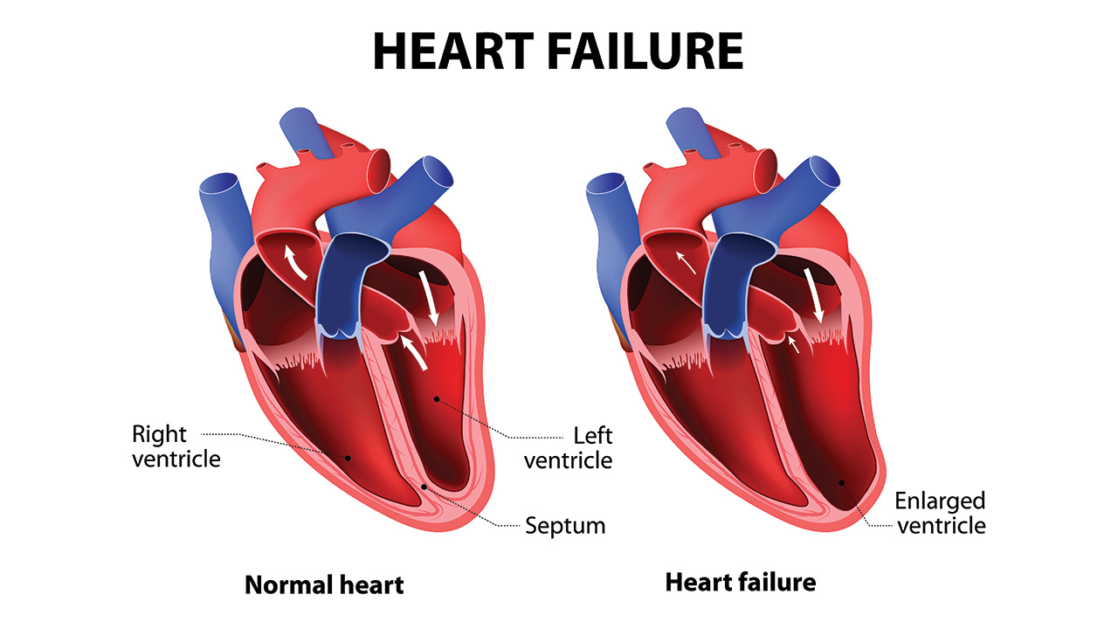

Slide 3
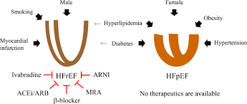
Types of Heart Failure
Reduced EF and Preserved EF

Slide 4
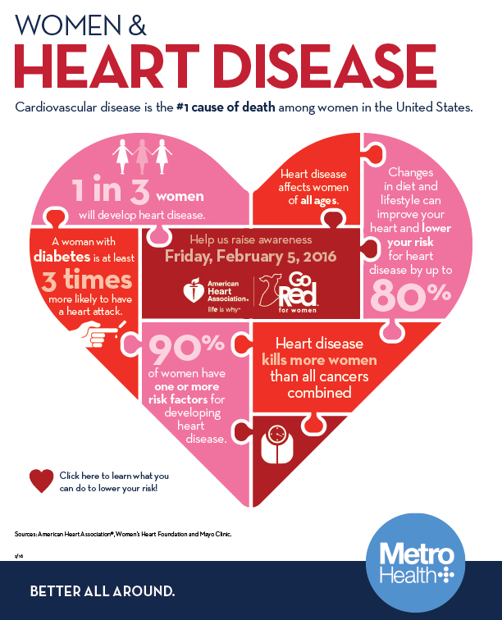

Slide 5
Causes of Congestive Heart Failure
Coronary Artery Disease
Hypertension
Valvular Heart Disease
Infection
Chemotherapy
Pregnancy
Increased heart rate (Tachycardia induced)
Broken heart syndrome
Diabetes

Slide 6
CHF Statistics in Women
About half the CHF occurs in women
Women make up <30% of participants in clinical trials
Magnitude of improvement in CHF survival in women is less pronounced
Women with CHF are older, with more comorbidities and have normal LVEF, and less access to care

Slide 7
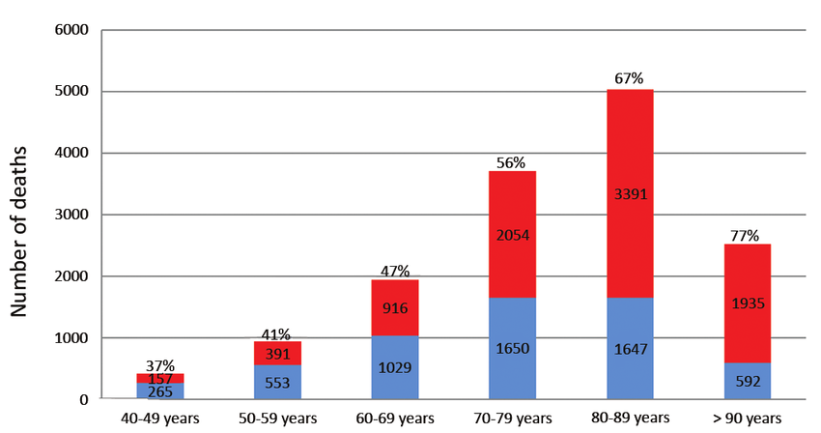
CHF Mortality in Men vs Women

Slide 8
Relative Causes of CHF in Women vs Men

Slide 9
Causes of CHF in women at various ages

Slide 10
Peripartum Cardiomyopathy
Heart muscle weakness during or right after pregnancy
Incidence 1:3000
Most women recover
Recognize with symptoms of CHF, high HR or swelling
RF:
Age
Multiparity
Socioeconomic status
Comorbidities
Multiple pregnancies

Slide 11
Obesity and Risk of Heart Failure in Women vs Men

Slide 12
Hypertension and CHF
50% of patients with hypertension develop CHF
Mostly with preserved HF
Some have heart attacks, causing low LVEF

Slide 13
Diabetes and CHF

Slide 14
Takastubo Cardiomyopathy
>90% cases involve women
Majority are postmenopausal
Average age ~68 years
Neurohormonal mediation
Presenting symptoms are like a heart attack, but there are no blocked arteries
Apical ballooning
Good prognosis

Slide 15
Cancer and Congestive Heart Failure
Cardiovascular disease is the commonest cause of mortality in pts with breast cancer
Some cancer drugs cause temporary heart damage, sometimes permanent
Preventable RF: obesity, inactivity, diabetes
Radiation induced cardiovascular disease

Slide 17
Prognosis of CHF in Men and Women

Slide 18
Conclusion
HF affects ~2.5 million women in the US
Prevalence of HF is 1.8% for white and Mexican American women and 3% in African American women
Many women are misdiagnosed with symptoms of menopause, panic attack or stress
Depression is very common in women with CHF, affecting compliance
~80% of CHF is preventable

Slide 19
Management
Early recognition, education
Standard drug therapy
Self monitoring and diuretic titration
Access and clear communication with Cardiology team

Slide 21
Acknowledgement
Katherine Suggett
Kim Newlin

Slide 22
Thank you

