Slide 1

Lipoprotein and their Role in Atherogenesis
Radhika Nandur Bukkapatnam, MD
Jan 8, 2021

Slide 2
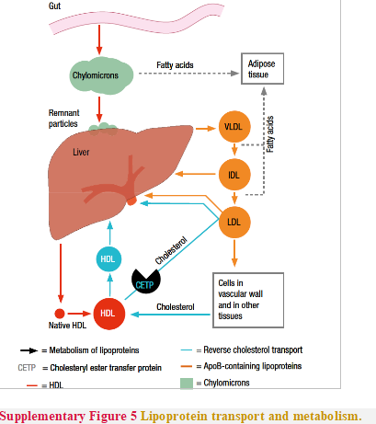
Lipoproteins
There are five different types of lipoprotein particles:
Chylomicrons
Very low density Lipoproteins
Intermediate density Lipoproteins
Low density Lipoproteins
High Density Lipoproteins

Slide 3
What is the Role of Apo B in Atherosclerosis?
ApoB is a large protein that envelops the surface atherogenic as a macromolecular scaffold
The apoB molecule, one single copy per particle, also serves as a ligand for LDL receptor-mediated clearance.
LDL is the most abundant atherogenic lipoprotein and the most prominent driver of circulating cholesterol into the artery wall.
ApoB-containing lipoproteins (up to about 70 nm in diameter), except for fully formed chylomicrons and large VLDL, are capable promoting plaque formation

Slide 4
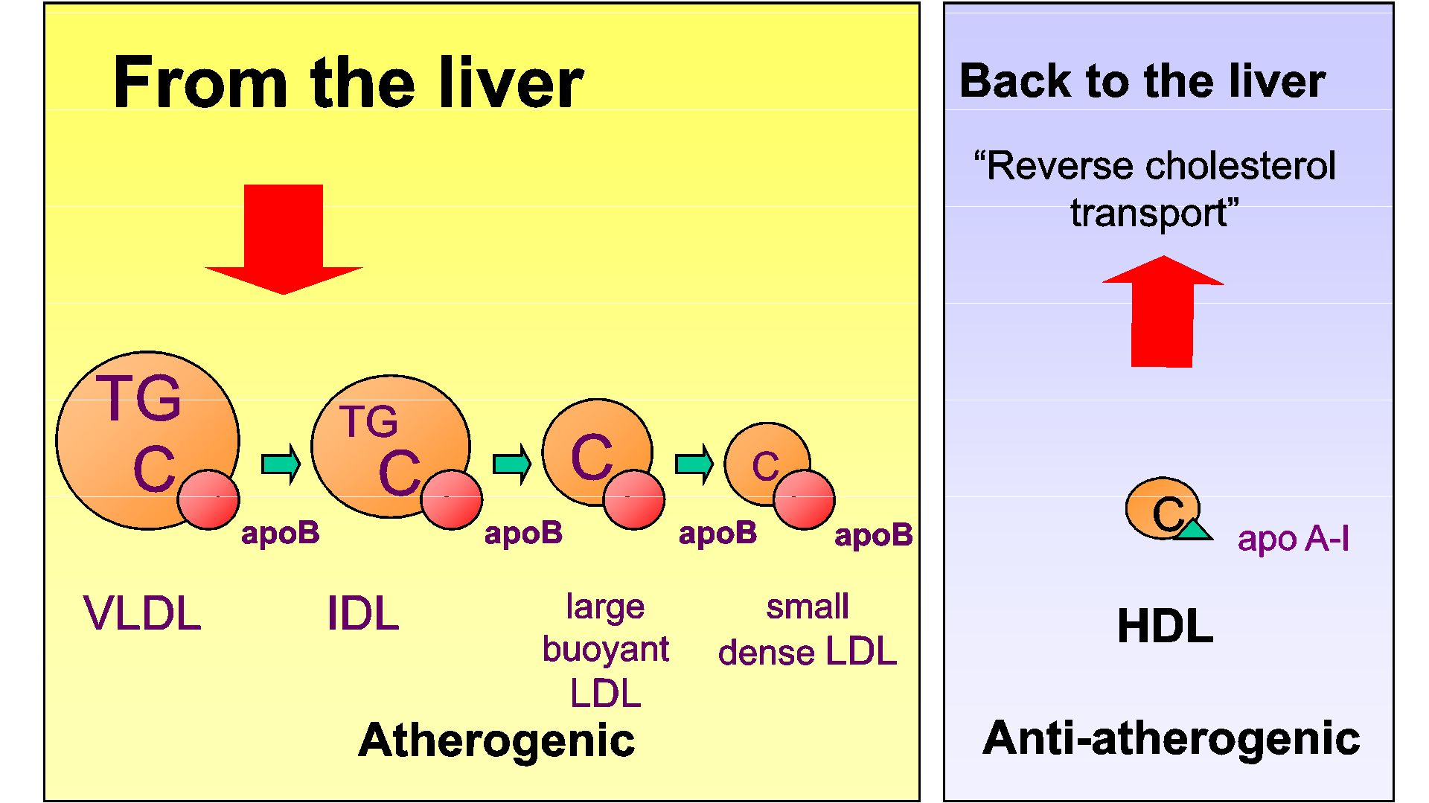

Slide 5
Atherogenic Lipoproteins
Elevated plasma levels increase their likelihood to enter the subendocardium
Particle size <70nm allows them to cross the endothelium
Retention is affected by lipid and protein content of the lipoproteins
Prolonged exposure to apo B containing lipoproteins results in more particles being retained (continuous high fat diets)

Slide 6
LDL-P (Lipoprotein Particle Number) vs LDL-C
LDL-P is a measurement of the number of LDL particles in serum as opposed to LDL-C which is the measurement of the amount of cholesterol inside the LDL particle.
The number of particles influences the number of cholesterol particles entering the vessel wall.
In a large community-based sample, LDL-P was a more sensitive indicator of low CVD risk than either LDL-C or non-HDL-C, suggesting a potential clinical role for LDL-P as a goal of LDL management.

Slide 7
LDL-C
Main source of cholesterol accumulated in the arterial wall.
Plasma levels are a metric of the cholesterol mass carried by LDL particles.
The relationship between LDL-C levels and risk for ASCVD is “J-shaped ”, and seen in metabolic syndrome

Slide 8
Patterns of LDL subpopulations
Pattern A:
  Large buoyant LDL (lbLDL) particles
  Each LDL particle contains one molecule of apoB100
Pattern B:
  Small dense LDL (sdLDL)
  sdLDL is associated with increased triglyceride levels and low HDL-C, which is referred to as the lipid triad, a phenotype common in insulin resistance, metabolic syndrome, obesity, diabetes
  Increased risk of CVD
  Increases LDL particle number

Slide 9
Factors Affecting LDL
Raise LDL
  Dietary fat
  Familial Hypercholesterolemia
  Diabetes
  Thyroid disease
  Renal disease
  Liver disease
  Obesity
Reduce LDL
  Weight loss
  Fat reduction
  Estrogen*
  Niacin
  Fibrates
  Statins
  Resins
  Bile acid Sequestrants

Slide 10
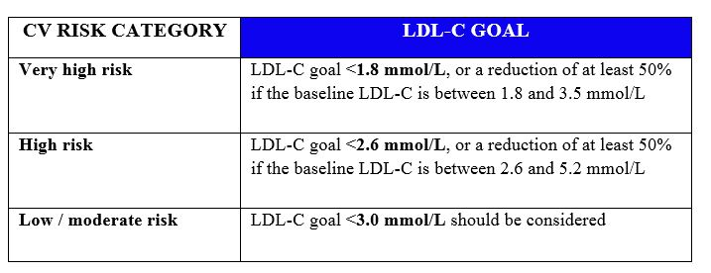
Reduction of LDL based on ASCVD Risk Score

Slide 11
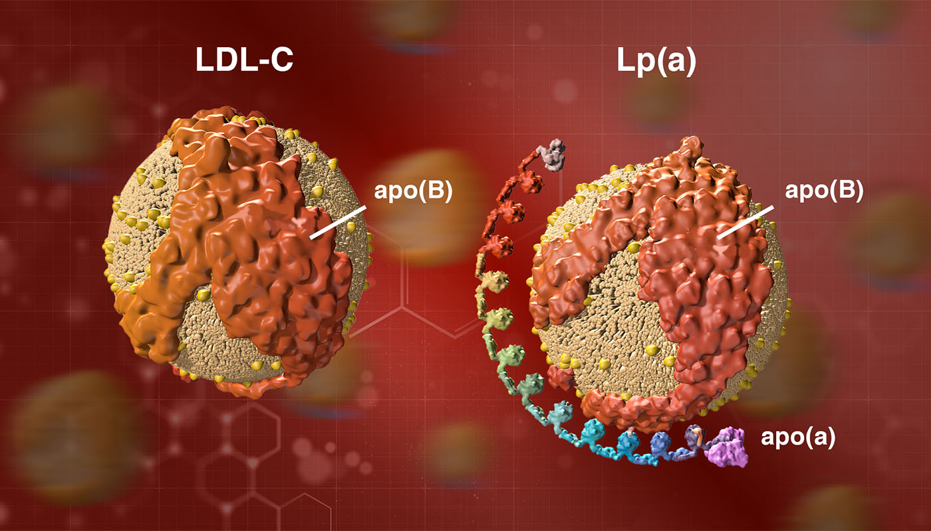
Lipoprotein (a)
Lp (a) consists of an LDL particle in which apo B 100 is linked to apo(a), with repeated Kringle units that are similar to plasminogen

Slide 12
Lipoprotein (a)
The new AHA/ACC guidelines list elevated Lp(a) a one of the risk-enhancing factors for developing ASCVD
Elevated levels of Lp(a) do not respond well to changes in diet or statin therapy
Treatment with niacin reduces Lp(a) by 20-30%, and the European guidelines recommend treating patients with elevated Lp(a) who are at intermediate to high risk of CVD with extended release niacin to obtain levels of Lp(a) < 50 mg/dL
Antisense oligonucleotide therapy is in development to reduce circulating Lp(a)

Slide 13
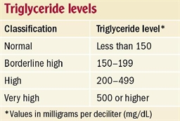
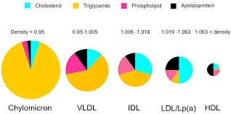
Triglycerides

Slide 14
Triglycerides
Hypertriglyceridemia is generally the result of increases in one or more of the triglyceride-rich lipoproteins; chylomicrons, VLDL, or their remnants
Secondary to diabetes mellitus, hypothyroidism, renal disease, and nephrotic syndrome, diet with high fat or high glycemic index content, excess alcohol and lack of exercise are widely held to be a major contributor to the recent rise in circulating triglyceride levels in developed countries.
Triglyceride rich lipoproteins (VLDL, chylomicron) also contain significant amounts of cholesterol and could promote foam cell formation by contributing cholesterol to the lesion. Remnants of VLDL and chylomicrons are created by partial hydrolysis of their triglycerides through the action of lipoprotein lipase.

Slide 15
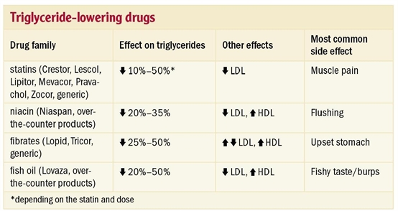
Treatment of Elevated Triglycerides
Low glycemic index diet
Decrease alcohol intake
Fish oil

Slide 16
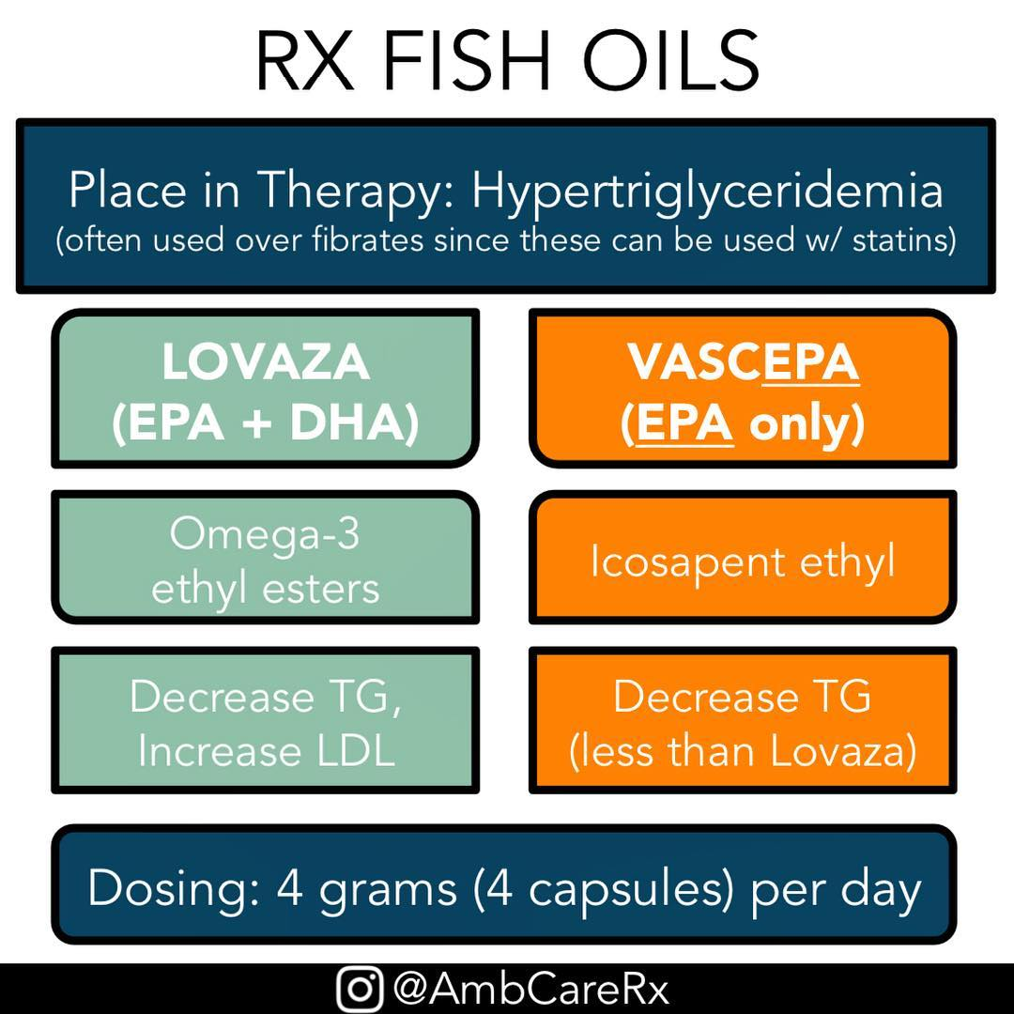
Vascepa (Icosapent ethyl) capsules

Slide 17
HDL-C
Over the years, low HDL-C levels have consistently been reported to be associated with increased risk of ASCVD and events, statin therapy was effective in reducing risk for CVE in subjects with low-HDL-C.
A key purported anti-atherogenic function of HDL is to promote reverse cholesterol transport (RCT) whereby cholesterol is removed from peripheral tissues and delivered to the liver for excretion into bile and feces out of the body.
HDL’s anti-inflammatory properties are conferred by numerous mechanisms in many types of cells

Slide 18
HDL have many beneficial properties, including anti-inflammatory, anti-oxidative, anti-thrombotic, anti-infectious, anti-apoptotic, intercellular communication, and pro-vasodilatory capacities.
HDL dysfunction has been reported in many cardiometabolic diseases, including CAD, T2D, and CKD. Current and future challenges include the need to better define HDL anti-atherogenic properties in health and pro-atherogenic influences in disease to better control HDL function to potentially prevent and treat CVD.

Slide 19
Factors Affecting HDL
Raise HDL
  Exercise
  Weight loss
  Smoking cessation
  Estrogen
  Alcohol
  Niacin
  Fibrates
  Statins
Lower HDL
  Lack of exercise
  High Triglycerides
  Smoking
  Certain drugs
  Progesterone
  Diabetes
  Obesity
  Metabolic syndrome

Slide 20
Very High HDL-C
Two large population-based cohorts in Denmark (52,268 men and 64,240 women) represents the largest study with the most events among those with extremely elevated HDL-C to directly assess the presence or absence of a U-shaped curve with regard to mortality, cardiovascular, and non-cardiovascular events in a sex-specific manner.
Nadir in mortality rates among European Caucasians at HDL-C levels of 73 mg/dL for men and 93 mg/dL for women
All-cause mortality rates increased significantly for men with HDL-C levels above 97 mg/dL and for women above 135 mg/dL,

Slide 21
Possible explanations of high HDL-C include genetic mutations leading to very high HDL-C that also confer adverse CV risk or confounding by factors associated with both mortality and CV risk and high HDL-C levels.
Alternatively, extreme elevations in HDL-C may directly represent dysfunctional HDL in some individuals, which may in turn promote CV risk

Slide 22
In conclusion, the complexity of HDL biology is inadequately reflected by measurement of HDL-C levels.
The future of HDL likely lies in incorporation of deep phenotyping of HDL composition and function for a more sophisticated understanding of cardiovascular risk at an individual and population level.
Therapeutic interventions targeting HDL will likely only be successful at reduction in cardiovascular events if their impact on reverse cholesterol transport and other functions is better understood and thoroughly characterized.

Slide 23
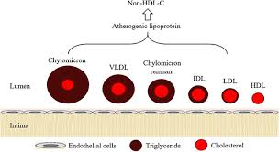
Non-HDL C

Slide 24
Current recommendations set the goal of non-HDL-C as 30 mg/dl higher than the corresponding LDL-C goals.
Non-HDL-C, calculated as the difference between TC and HDL-C, represents the cholesterol mass contained in all atherogenic lipoproteins including LDL-C and VLDL-C

Slide 25
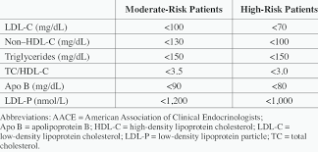
SUMMARY of LIPOPROTEIN FRAGMENTS

Slide 26


Slide 27
Thank You

