Slide 1
Zika Virus: Pandemic Preparedness & Business Continuity
Mary Beth Koza
Director – EHS
mbkoza@ehs.unc.edu
919-843-5915

Slide 2
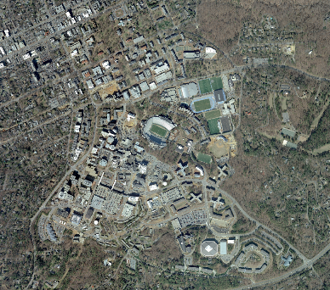
UNC-CH
1st Public University in the Country
29,000 students. 3,778 faculty and 8409 staff
1st public university based on 20 indicators of excellence in Business First's 2016 ranking.
5th best public university in US News & World Report’s 2015 “Best Colleges’ guidebook
796 million dollars in Research Funding
1st (in an 9-way tie) among the nation’s public research universities (Top American Research Universities, 2014)
2- Nobel Laureates
http://uncnews.unc.edu/facts-about-carolina/facts-figures/
http://research.unc.edu/about/

Slide 3
Risk Communications
Contain the problem
Resolve as quickly as possible
Perception is stronger than reality
Emotion is stronger than fact

Slide 4
5 Steps to Success
Solid communication plan
First source of information
Express empathy
Demonstrate competency and expertise
Be honest and open

Slide 5
Crisis Communication Lifecycle
Pre-crisis
Initial crisis
Crisis
Maintenance
Crisis Resolution
Evaluation of
Crisis response

Slide 6
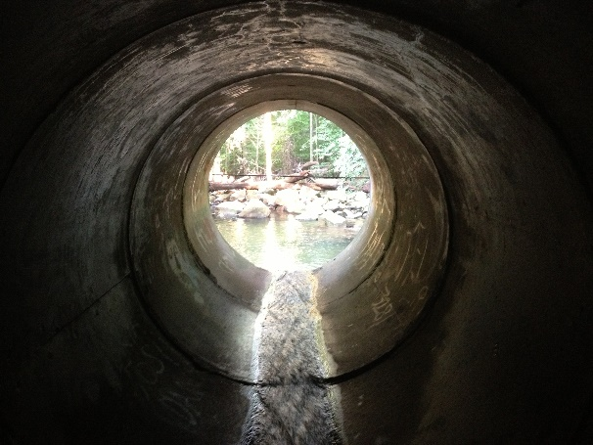
Pre-Crisis
Organizations should identify the types of disasters it may face
Reasonable questions and answers should be developed for each disaster
Initial communications shall be drafted blanks to be filled in later
Alliances and partnerships identified and fostered prior to an event

Slide 7
Initial Phase
People want information
Message must be simple, credible, consistent, timely and verifiable
Acknowledge the event with empathy
Explain the risk in simplest terms
Establish the agency and spokesperson credibility
Provide a process of where to get additional information
Commit to continued communication
Establish your organization as a credible source
Addressing the issue head on quick and accurately

Slide 8
Maintenance Phase
Continue to answer the How could this happen, Has this happened before, How can this be prevented from happening again, What is the long term effect and recovery?
Expect to be criticized in this phase
Stay on top of information flow and maintaining tight coordination

Slide 9
Crisis Resolution
Reduction in public and media interest
Ability to reinforce public health messages
Identify ways to support public policy and resource allocation

Slide 10
Evaluation Phase
Evaluate the initial communications plan
Document lessons learned
Identify specific actions to improve crisis response and plans

Slide 11
Zika Information – The Basics
No symptoms or will only have mild symptoms.
fever, rash, joint pain, or red eyes.
muscle pain and headache.
Can last for several days to a week.
Not sick enough to go to the hospital, and rarely die.
. Once infected with Zika, likely to be protected from future infections.
Spreads Zika via the bite of an infected Aedes species mosquito (Ae. aegypti and Ae. albopictus).
Can also be passed through sex from a person who has Zika.
Can spread from a pregnant woman to her fetus.
http://www.cdc.gov/zika/pdfs/fs-zika-basics.pdf

Slide 12
Definition of Communicable Disease
Infectious disease are a continuing danger with their evolution ability to evolve. Globalization, a growing population and increase frequency of air travel represent a great threat to the health of us all.

Slide 13
Plan Objectives
Minimize the risk of infectious disease to students, faculty and staff
Ensure the operations of the Campus
Proper identification of Communicable Disease Mandatory Emergency Employees (CDME)
Continuity of essential functions of the University and Hospital operations
Implement Social Distancing if needed
Support of UNC-CH students who might remain in Chapel Hill in the event of a campus closure.

Slide 14
Plan Requirements
Department Objectives
Communications
Alert Carolina http://www.alertcarolina.unc.edu/go/doc/1395/1319331/
UNC-CH home page www.unc.edu
UNC Emergency Hot line 919-843-1234
Social Media
Departmental call tree
Emergency Access to Information
Departmental Essential Functions
Department’ Leadership Succession

Slide 15
Plan Requirements continue
Key Internal Dependencies
Energy Services
ITS
Payroll/Purchasing/Finance
Public Safety
Facilities Services
Other
Key External Dependencies
Products
Services
Suppliers
Mitigation Strategies
Recovery

Slide 16
Plan Requirements continue
Special Considerations
Exercising your plan
Additional Resources
Home Emergency Planning
Departmental Coordinator

Slide 17
http://www.alertcarolina.unc.edu

Slide 18
2016 Communicable Disease Response Team
Communicable Disease Response Team
Academics -
UNC Global
Communications &
Public Affairs
Human Resources
Student Affairs/
Campus Health
School of Medicine
Office of University Counsel
Medical Expertise

Slide 19
Members
Elizabeth Ann Barnum
Julie S Byerley
Martha Christine Carlough
Gena Carter
Dr. Mary Margaret Covington
Dan Eisenman
Dr. James Hill
Joe Canady
Jane Calloway
Paul Pogge
Dr. Sylvia Becker-Dreps
Andrew Hunt
Carol Kozel
Harvey Lineberry
Tanya Moore
Judy Culhane Faubert
Dr. Ron Strauss
Dr. David Weber
Christopher Payne
Cathy Brennan
Aravinda M Desilva
Darius Dixon

Slide 20
Actions to date
February 2016
Assemble Team
Create Zika Virus Preparedness informational website http://ehs.unc.edu/emergency/disease/zika/
Partner with Global Travel to assure travel warning are available to all international travelers
http://global.unc.edu/travel-info/state-department-travel- warnings/
Attend the UNC virology seminar on Zika

Slide 21
Actions to date continued
February – May 2016
Support our UNC-CH researchers in development of SOP’s for working safely with Zika
May 2016
Participate in CDC Hosts Zika Action Plan Teleconferences Series
Development of Mosquito Prevention – Report Standing Water form on main Zika informational web page

Slide 22
Actions to date continued:
May – June 2016
Identification of all UNC-CH employees who are outdoor workers and assure their training on self protection.
Updated Q& A on Zika
Link Zika Virus Preparedness informational website to Alert Carolina
Development of informational email to Campus on Zika
June 30th campus event with DHHS

Slide 23
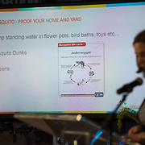
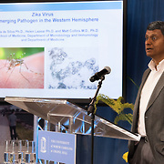
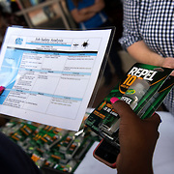
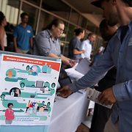
Zika Awareness June 30, 2016

Slide 24
Actions to date continued
August, 2016 Letter to Returning Travelers
Notice to campus and updated websites
Monitor CDC and stay in close contact with Orange County Department of Health

Slide 25
Resources
All students and staff traveling out of country need to register on the UNC Global Travel registry page. http://globalhealth.unc.edu/resources/international-travel-information-and-policies/
This page has the latest warning and restrictions. http://global.unc.edu/travel-info/state-department-travel-warnings/
Campus Health has the International Travel clinic whose goal is the ensure that all UNC travelers are prepared with appropriate health and security information.
https://campushealth.unc.edu/services/international-travel-clinic
Zika Preparedness Website at http://ehs.unc.edu/emergency/disease/zika/
to assist with additional question

