Slide 1
Business Continuity as seen through the eyes of an ISACA Certified IS Auditor (CISA)
By: Heather Groves, MIS, CISA
Date: May 2017

Slide 2
A quick overview of the relationship between COSO and COBIT to set the Stage…
COSO Internal Control Integrated Framework
- Developed by COSO, the Committee of Sponsoring Organizations [of the Treadway Commission]
- Consists of a series of processes and controls for financial reporting, focusing on guidance in the areas of risks and controls to enable good organizational governance and the reduction of fraud.
COBIT (Control Objectives for Information and Related Technologies) Framework
- Developed by ISACA, the Information Systems Audit and Control Association.
- In its current iteration (COBIT 5) is used for the governance and management of enterprise Information Technology.

Slide 3
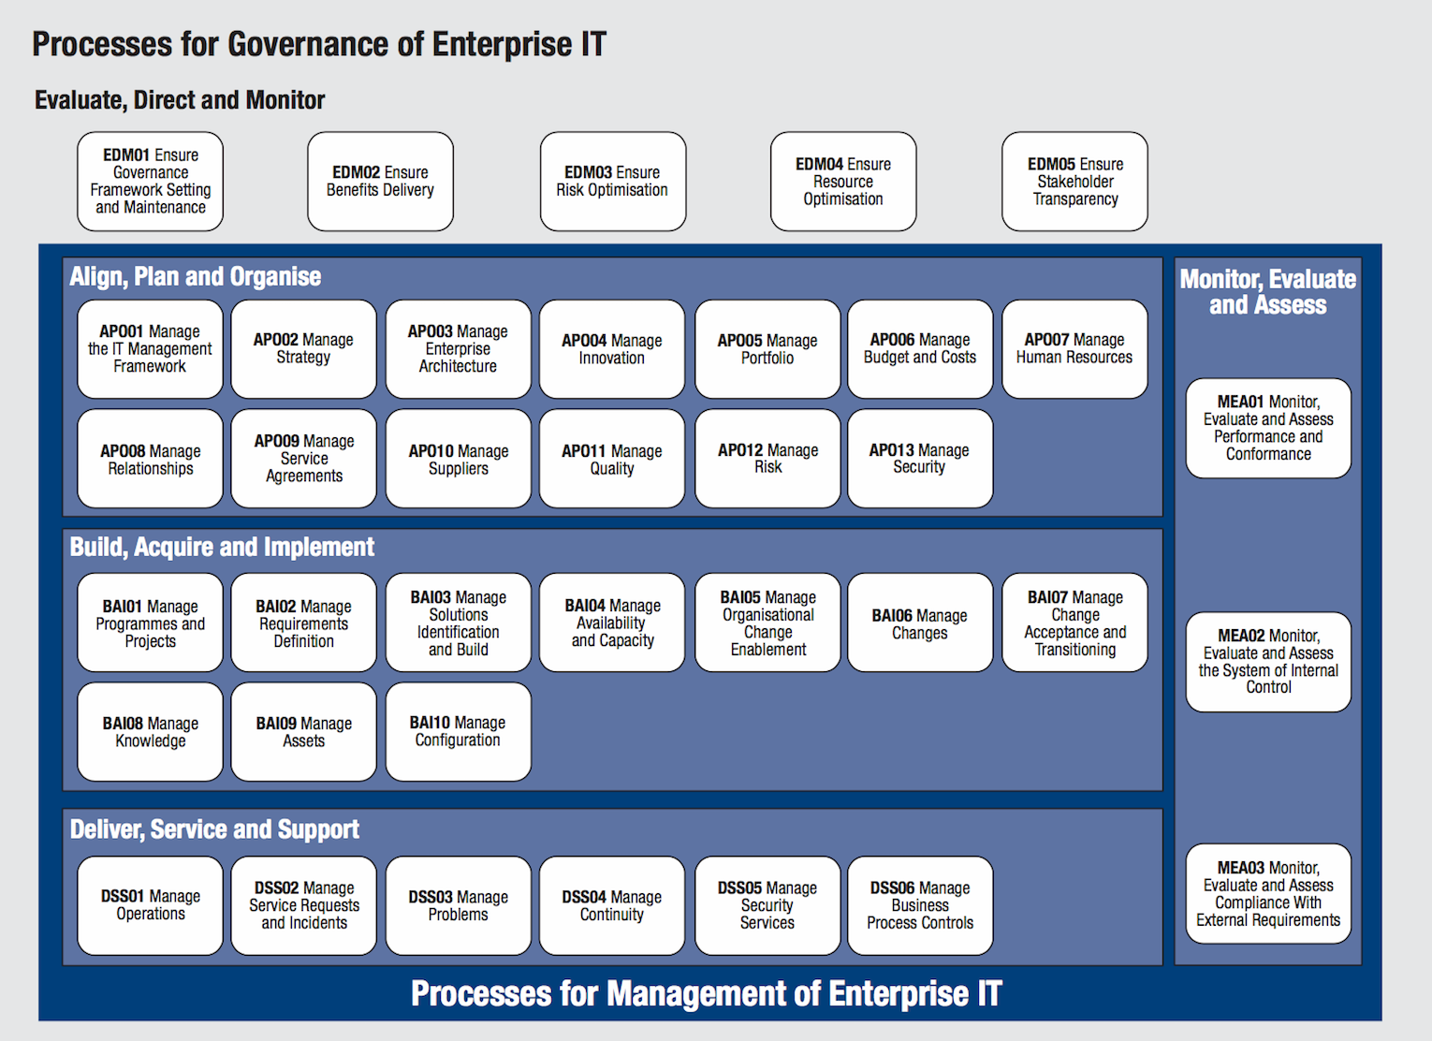

Slide 4
Domain: Deliver, Service and Support
DSS04 – Business Continuity
Process Description:
Establish and maintain a plan to enable the business and IT to respond to incidents and disruptions to continue operation of critical business processes and required IT services and maintain availability of information at a level acceptable to the enterprise.
Process Purpose Statement:
Continue critical business operations and maintain availability of information at a level acceptable to the enterprise in the event of a significant disruption.

Slide 5
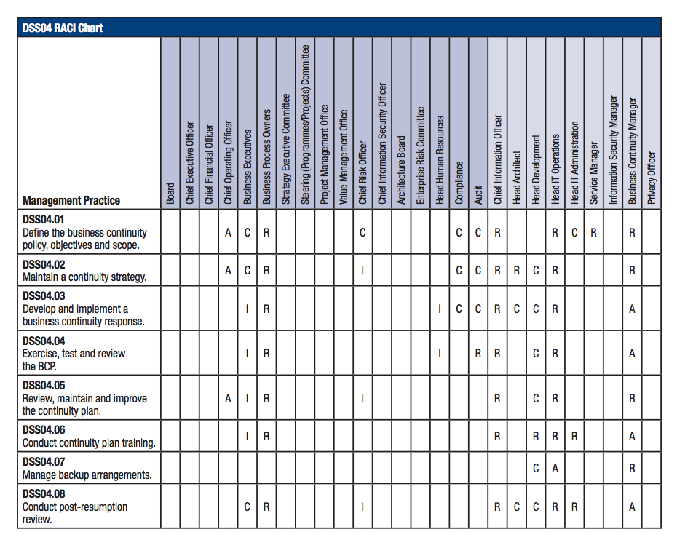

Slide 6
DSS4.01:
Define the Business Continuity Policy, Objectives, and Scope
Intent:
Define the BC Policy and Scope aligned with enterprise and stakeholder objectives.
Inputs to Process:
- Service Level Agreements (SLAs) – Performance and Uptime
Outputs to Process:
- Policy and Objectives for Business Continuity
- Disruptive Incident Scenarios
- Assessment of current continuity capabilities and gaps

Slide 7
DSS4.02:
Maintain a Continuity Strategy
Intent:
Evaluate BC Management options and choose a cost-effective and viable continuity strategy that will ensure enterprise recovery and continuity in the event of a disaster or other major incident or disruption.
Inputs to Process:
- Risk-related root causes
- Risk impact communications
Outputs from Process:
- Business Impact Analyses
- Continuity Requirements
- Approved Strategic Options

Slide 8
DSS4.03:
Develop and Implement a Business Continuity Response
Intent:
Develop a BCP based on the strategy that documents the procedures and information in readiness for use in an incident to enable the enterprise to continue its critical activities.
Inputs to Process:
- Operational Level Agreements (OLAs) - maintenance
Outputs from Process:
- Incident Response Actions and Communications
- Business Continuity Plan

Slide 9
DSS04.04:
Exercise, Test, and Review the BCP
Intent:
Test the continuity arrangements on a regular basis to exercise the recovery plans against predetermined outcomes and to allow innovative solutions to be developed and help to verify over time that the plan will work as anticipated.
Inputs to Process:
- N/A
Outputs from Process:
- Test Objectives
- Test Exercises
- Test Results and Recommendations

Slide 10
DSS04.05:
Review, Maintain, and Improve the Continuity Plan
Intent:
Conduct a Management Review of the continuity capability at regular intervals to ensure its continued suitability, adequacy, and effectiveness. Manage changes to the plan in accordance with the change control process to ensure that the Continuity Plan is kept up to date and continually reflects actual business requirements.
Inputs to Process:
- N/A
Outputs from Process:
- Results of Management Reviews of Plans
- Recommended Changes to Plans

Slide 11
DSS04.06:
Conduct Continuity Plan Training
Intent:
Provide all concerned internal and external parties with regular training sessions regarding the procedures and their roles and responsibilities in case of disruption.
Inputs to Process:
- List of personnel requiring training
Outputs from Process:
- Training Requirements
- Monitoring results of skills and competencies

Slide 12
DSS04.07:
Manage Backup Arrangements
Intent:
Maintain the availability of Business-Critical information.
Inputs to Process:
- N/A
Outputs from Process:
- Test Results of Backup Data

Slide 13
DSS04.08:
Conduct Post-Resumption Review
Intent:
Assess the adequacy of the BCP following the successful resumption of Business Processes and Services after a disruption.
Inputs to Process:
- N/A
Outputs from Process:
- Post-Resumption Review Report
- Approved Changes to the Business Continuity Plans

Slide 14
Related Guidance:
BS 25999:2007 (Business Continuity Standard)
ISO/IEC 20000 (6.3 Service Continuity and Availability Management)
ISO/IEC 27002:2011 (14. Business Continuity Management)
ITIL V3 2011 (Service Design, 4.6 IT Service Continuity Management
COBIT 5: Enabling Processes (ISACA publication)

Slide 15
Questions?
Contact information:
Heather Groves
Email: hgroves@us.ibm.com
Thank you for your time!

