Slide 1
BCM Trends & Careers
Assess Your Marketability & Formulate a Career Path
Cheyene Marling, Hon. MBCI
August 17, 2017

Slide 2
Topics of Presentation
Times have Changed… and WILL Continue to Change
Career Growth Path
Strategize Your Career
Credentials in Demand
Assess Your Career
Increase Your Marketability
Tomorrow’s BC Professional
Your Fair Market Value
Ensure Your Marketability

Slide 3
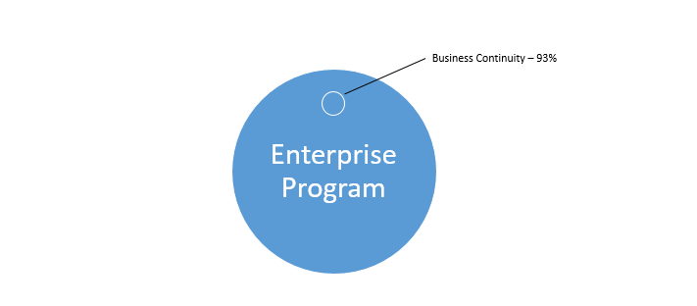
Components of Enterprise Program

Slide 4
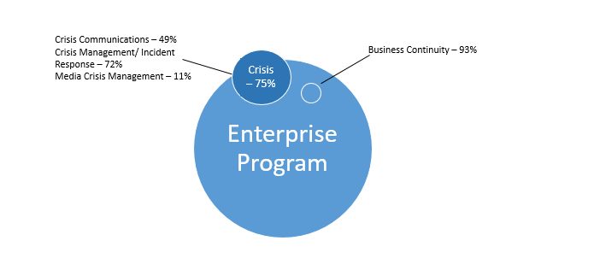
Components of Enterprise Program

Slide 5
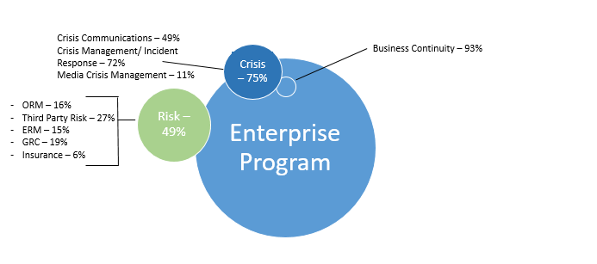
Components of Enterprise Program
ORM – 17%
Third Party Risk – 15%
ERM – 15%
GRC – 14%
Insurance – 4%

Slide 6
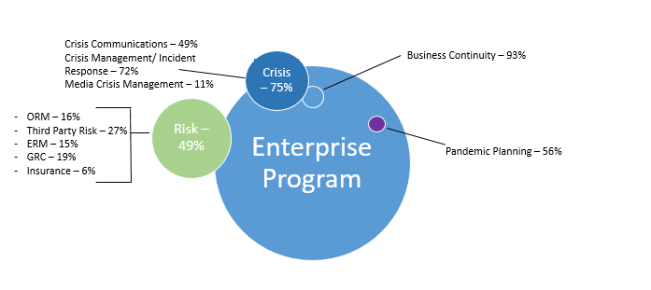
Components of Enterprise Program
Crisis Management/ Incident Response – 71%
Business Continuity – 85%
ORM – 17%
Third Party Risk – 15%
ERM – 15%
GRC – 14%
Insurance – 4%
Pandemic Planning – 57%

Slide 7
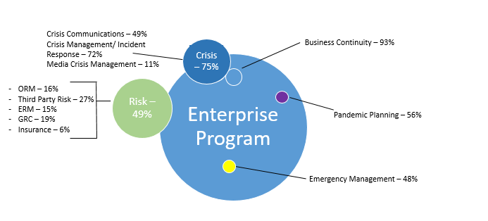
Components of Enterprise Program
Enterprise Program
Risk – 65%
IT – 17%
Crisis Management/ Incident Response – 71%
Business Continuity – 85%
ORM – 17%
Third Party Risk – 15%
ERM – 15%
GRC – 14%
Insurance – 4%
Pandemic Planning – 57%
Emergency Management – 48%

Slide 8
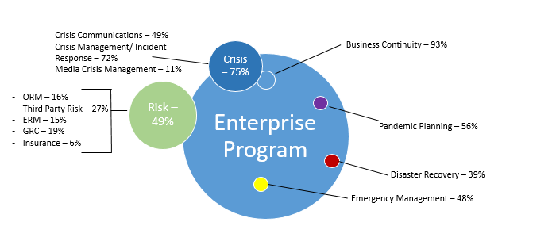
Components of Enterprise Program
Enterprise Program
Risk – 65%
IT – 17%
Crisis Management/ Incident Response – 71%
Business Continuity – 85%
ORM – 17%
Third Party Risk – 15%
ERM – 15%
GRC – 14%
Insurance – 4%
Pandemic Planning – 57%
Disaster Recovery – 47%
Emergency Management – 48%

Slide 9
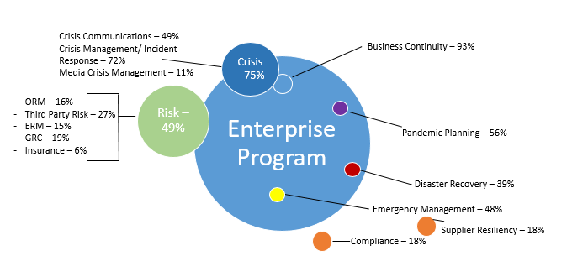
Components of Enterprise Program
Enterprise Program
Risk – 65%
IT – 17%
Crisis Management/ Incident Response – 71%
Business Continuity – 85%
ORM – 17%
Third Party Risk – 15%
ERM – 15%
GRC – 14%
Insurance – 4%
Pandemic Planning – 57%
Disaster Recovery – 47%
Emergency Management – 48%
Compliance – 18%

Slide 10
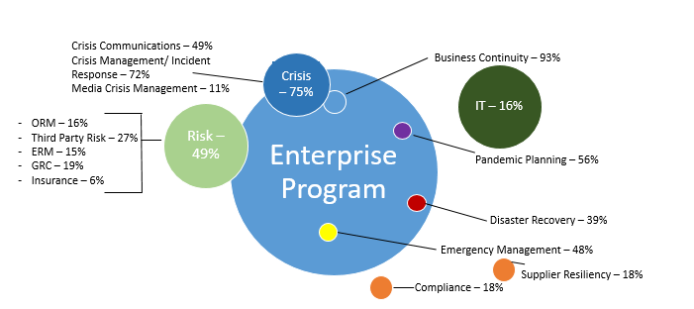
Components of Enterprise Program
Enterprise Program
Risk – 65%
IT – 17%
Crisis Management/ Incident Response – 71%
Business Continuity – 85%
ORM – 17%
Third Party Risk – 15%
ERM – 15%
GRC – 14%
Insurance – 4%
Pandemic Planning – 57%
Disaster Recovery – 47%
Emergency Management – 48%
Compliance – 18%

Slide 11
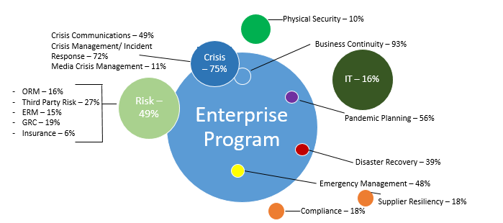
Components of Enterprise Program
Enterprise Program
Risk – 65%
IT – 17%
Crisis Management/ Incident Response – 71%
Business Continuity – 85%
ORM – 17%
Third Party Risk – 15%
ERM – 15%
GRC – 14%
Insurance – 4%
Pandemic Planning – 57%
Disaster Recovery – 47%
Emergency Management – 48%
Compliance – 18%

Slide 12
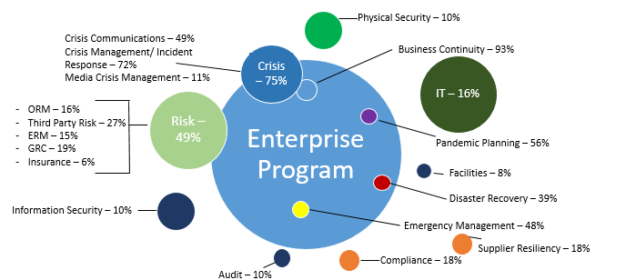
Components of Enterprise Program
Enterprise Program
Risk – 65%
IT – 17%
Crisis Management/ Incident Response – 71%
Business Continuity – 85%
ORM – 17%
Third Party Risk – 15%
ERM – 15%
GRC – 14%
Insurance – 4%
Pandemic Planning – 57%
Facilities – 11%
Disaster Recovery – 47%
Information Security – 11%
Emergency Management – 48%
Compliance – 18%
Audit – 11%

Slide 13

Components of Enterprise Program
Enterprise Program
Risk – 65%
IT – 17%
Crisis Management/ Incident Response – 71%
Business Continuity – 85%
ORM – 17%
Third Party Risk – 15%
ERM – 15%
GRC – 14%
Insurance – 4%
Pandemic Planning – 57%
Facilities – 11%
Disaster Recovery – 47%
Information Security – 11%
Emergency Management – 48%
Compliance – 18%
Audit – 11%

Slide 14
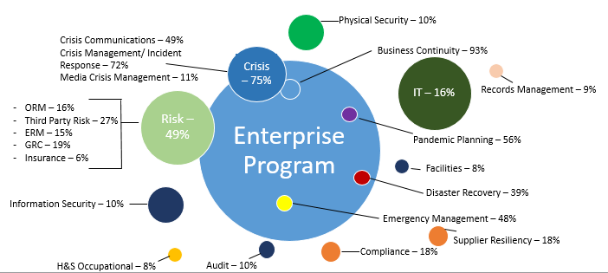
Components of Enterprise Program
Enterprise Program
Risk – 65%
IT – 17%
Crisis Management/ Incident Response – 71%
Business Continuity – 85%
ORM – 17%
Third Party Risk – 15%
ERM – 15%
GRC – 14%
Insurance – 4%
Pandemic Planning – 57%
Facilities – 11%
Disaster Recovery – 47%
Information Security – 11%
Emergency Management – 48%
Compliance – 18%
H&S Occupational – 9%
Audit – 11%

Slide 15
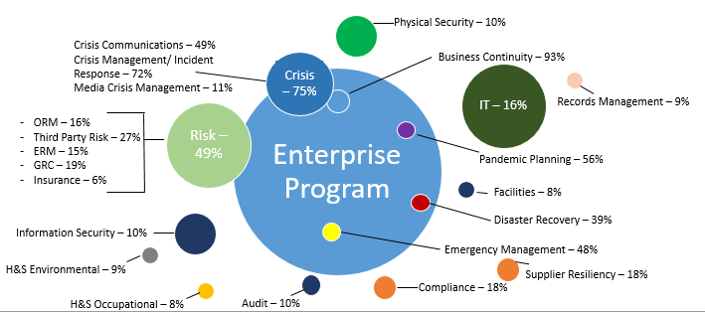
Components of Enterprise Program
Enterprise Program
Risk – 65%
IT – 17%
Crisis Management/ Incident Response – 71%
Business Continuity – 85%
ORM – 17%
Third Party Risk – 15%
ERM – 15%
GRC – 14%
Insurance – 4%
Pandemic Planning – 57%
Facilities – 11%
Disaster Recovery – 47%
Information Security – 11%
Emergency Management – 48%
H&S Environmental – 8%
Compliance – 18%
H&S Occupational – 9%
Audit – 11%

Slide 16
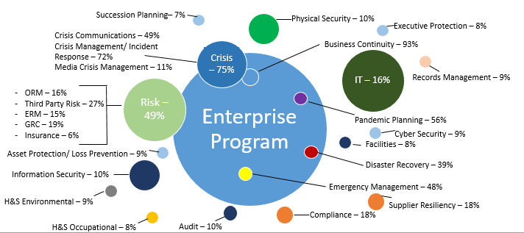
Components of Enterprise Program
Enterprise Program
Risk – 65%
IT – 17%
Crisis Management/ Incident Response – 71%
Business Continuity – 85%
ORM – 17%
Third Party Risk – 15%
ERM – 15%
GRC – 14%
Insurance – 4%
Pandemic Planning – 57%
Facilities – 11%
Disaster Recovery – 47%
Information Security – 11%
Emergency Management – 48%
H&S Environmental – 8%
Other– 4%
Compliance – 18%
H&S Occupational – 9%
Audit – 11%

Slide 17
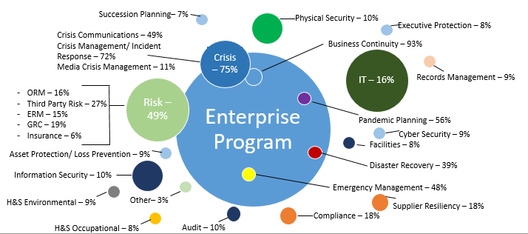
Components of Enterprise Program
Enterprise Program
Risk – 65%
IT – 17%
Crisis Management/ Incident Response – 71%
Business Continuity – 85%
ORM – 17%
Third Party Risk – 15%
ERM – 15%
GRC – 14%
Insurance – 4%
Pandemic Planning – 57%
Facilities – 11%
Disaster Recovery – 47%
Information Security – 11%
Emergency Management – 48%
H&S Environmental – 8%
Other– 4%
Compliance – 18%
H&S Occupational – 9%
Audit – 11%

Slide 18
Components of Enterprise Program
Enterprise Program
Risk – 65%
IT – 17%
Crisis Management/ Incident Response – 71%
Business Continuity – 85%
ORM – 17%
Third Party Risk – 15%
ERM – 15%
GRC – 14%
Insurance – 4%
Pandemic Planning – 57%
Facilities – 11%
Disaster Recovery – 47%
Information Security – 11%
Emergency Management – 48%
H&S Environmental – 8%
Other– 4%
Compliance – 18%
H&S Occupational – 9%
Audit – 11%
4+ Disciplines: 61% (2009), 76% (2011), 66% (2014) and 70% (2016)

Slide 19
2009 to 2014 Trending
44% - 33%
82% - 76%
60% - 67%
70% - 67%
61% - 58%

Slide 20
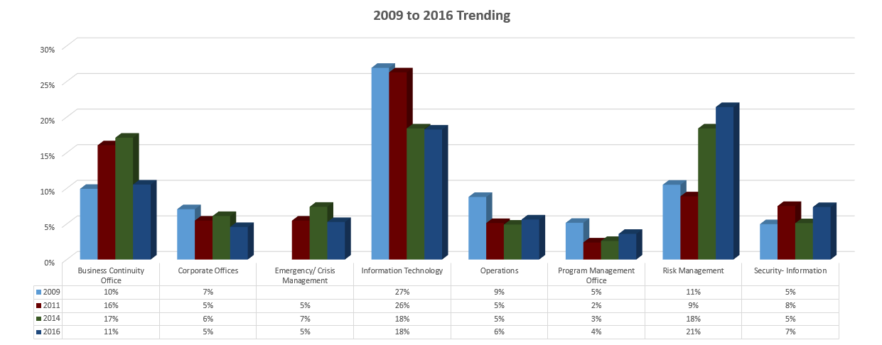
Reporting Structure – department Owner

Slide 21
Previous Career Trending
IT Previous Career Path Decreased from 41% to 44%.

Slide 22
Chief Officer
Global Manager
Vice President/ Director
Manager/ AVP/ Program Manager
Specialist/ Strategist/ Analyst
Entry-level
Use:
Continuity, Assurance,
Enterprise, Readiness, Governance, Risk, Operational, Security, Compliance, Resiliency
Avoid:
Recovery, Disaster, Emergency

Slide 23



Be Opportunistic
Understand the Market
Achieve It
Strategize Your Career

Slide 24

Understand the Market
Skills in Demand?
Where is the Candidate Supply Light?
What Skills Command Top $?
Earning Potential?
Forecast Trends.
Assess Data Metrics……

Slide 25

BC Management’s 2017
Continuity Compensation Data
610 respondents participated in the compensation study.
293 professionals from the USA completed the permanent compensation assessment study.

Slide 26
Average Earnings
Total Compensation includes base, bonus and any commissions earned. Other job related benefits, such as stock options, profit sharing, etc are not included in our study assessment. Data was collected between January – March 2016. Assessment focused on 2014 and 2015 compensations for full-time, permanent employees, unless noted otherwise.
Total Compensation includes base, bonus and any commissions earned. Other job related benefits, such as stock options, profit sharing, etc are not included in our study assessment. Data was collected between January 2016– March 2016. Assessment focused on 2014 and 2015 compensations for full-time, permanent employees, unless noted otherwise.

Slide 27
Factors Impacting Your Compensation
Job Title/ Responsibilities
Total Work Experience
Discipline Experience
Degree
Certification
Geography
Management Experience
Leadership Experience

Slide 29
Total Work Experience
47.6% of respondents indicated 26 – 40 years total working experience.

Slide 30

What Commands
Top Earnings

Slide 31





What Do Companies Want?

Slide 32





What Do You Want?

Slide 33

Tangible Skills in Demand
Certification
Degree
Wide Range of Expertise
Real World Experience
Leadership Skills
Training Experience Across Organization
Global Experience

Slide 34
Certification – Magic Number?

Slide 35
Certifications – Which One?

Slide 36
How Much Education?
83.7% have obtained a Bachelors, Masters or Doctorate degree.

Slide 37
Continuity Degrees?
9.7% obtained a degree specific to business continuity management planning. This is an increase from 5.5% in 2012.

Slide 38
Range of Discipline Expertise

Slide 39
Specific Business Continuity Expertise
54.5% of respondents indicated 7-20 years Business Continuity expertise.

Slide 40





Real World Experience

Slide 41
Program Management Expertise

Slide 42
Program Activation

Slide 43
Program Development

Slide 44
Global Planning

Slide 45
Training Expertise

Slide 46

Intangible Skills in Demand
Ability to Engage All Levels.
Understanding a Culture Fit.
Diplomacy.
Be a Leader.
Delivering Business Cases to Executives.
Think Outside the box.
Consider Your Personal Brand.

Slide 47





Are You A Leader?

Slide 48
Ability to Present?

Slide 49
Do You Publish?

Slide 50
Active Board Member?

Slide 51

Always Better Yourself.
Stay Ahead of the Game.
Be a Champion.
Be Strategic.
Take Initiative.
Evolve.
Always be Networking.
Don’t be Afraid to Ask for
a Promotion.
Be a Top Talent

Slide 52

Achieve Tangible Skills in
Demand.
SWOT.
Evaluate Your Skills.
Career Road Map.
Guard Your Brand.
Always Assess Goals.
Understand When to Seek a
New Employer. Don’t Just Jump!
Achieve It

Slide 53

Questions
Cheyene Marling, Hon. MBCI
BC Management, Inc.
+1 (714) 969-8006
cmarling@bcmanagement.com

