Slide 1
Active Shooter Preparedness and Response
Triangle Area Business Continuity Planners of the Carolina’s
Aug 16, 2018

Slide 2
Agenda
Workplace Violence Table Top Exercise
Overview of an Active Shooter Incident
“Active Shooter – How to Respond” Materials
Hometown Security is Homeland Security
Notes:
Here’s the agenda:
First we’ll briefly discuss an overview an active shooter, who they are…their profile, the characteristics of most active shooters.
Then we’ll discuss how to prepare for an active shooter in your environment, including
how to recognize potential indicators of workplace violence
your Human Resource and Landlord responsibilities in an active shooter situation
and developing an Emergency Action Plan
Finally, we’ll discuss the Department’s many free active shooter resources, including the “Active Shooter – How to Respond” materials (including a guide book, poster, and pocket card), our online training, in-person training, and videos and webinars. At the end of this, you should have some good tools to add to your toolkit.

Slide 3
Insert Video of Parking Lot Confrontation

Slide 4
60 SECONDS
45 SECONDS
30 SECONDS
20 SECONDS
10 SECONDS
SCENARIO END
Notes:
Aurora Movie Theater Shooting-
1:30 minutes response—
70 injured and 12 deceased
Discuss response, responsibility and action

Slide 5
Scenario: (1 of 8)
Pre-Incident Phase
  Several employees arrive at work and pull into the parking garage.
  A disagreement begins between Mark and Sharon after Mark gets upset because Sharon took a parking place he intended to use.
  Mark steps out of the car and a verbal altercation ensues when Brian steps in to try to calm Mark down.
  Mark eventually storms off, parks his car in a separate parking spot, and quickly enters the building.
Should any action be taken by Sharon, Brian, or other coworkers who witnessed this incident take place?
Is there a system in place for reporting signs of potentially aggressive/violent behavior in the workplace?
5
Notes:
5
Should any action be taken by Sharon, Brian, or other coworkers who witnessed this incident take place?
Are plans or procedures available to guide employees in their actions/decisions?
Is there a system in place for reporting signs of potentially aggressive/violent behavior in the workplace?
Are there a clear policy and procedure for employees who report potentially aggressive behaviors?
Employees aware?
Managers aware?
HR aware?
Are you notified about employees who may have domestic violence or restraining orders?
Is there a termination policy for persons who act aggressively?
Is there a policy to document and refer to employees to employee assistance programs?

Slide 6
Scenario: (2 of 8)
Pre-Incident Phase
  Sharon and Brian are in the break room discussing the fact that Mark seems to be disgruntled lately, while going through a divorce.
  Angela (Marks supervisor), walks into the break room and asks Sharon if she is alright, as she heard about the incident in the parking lot by others in the office.
  Angela tells Sharon and Brian that she intends to speak with Mark.
As the supervisor, should Angela have spent more time with Sharon or Brian regarding the incident that took place in the parking lot or should she have asked additional questions about the recent interactions with Mark?
6
Notes:
6
As the supervisor, should Angela have spent more time with Sharon or Brian regarding what took place that morning in the parking lot or should she have asked additional questions about the recent interactions with Mark?
Should Sharon and Brian have volunteered information about Mark’s personal situation?
Is there a policy that governs the reporting or mandates reporting?
If additional questions were asked and answered, could interventions been put into place?

Slide 7
Scenario: (3 of 8)
Pre-Incident Phase
Angela requests a meeting with Mark in her office.
Angela informs Mark that she heard about the parking lot incident and that she has received consistent complaints from other employees regarding his aggressive behavior.
Angela also addresses Mark’s ongoing performance issues and informs him that he will be placed on probation, that his behavior will not be tolerated and that if his work does not improve there could be serious consequences.
Mark abruptly ends the meeting, and is visibly angry and upset when he leaves Angela’s office.
At this point, what actions, if any, should Angela take after the meeting that just took place with Mark in her office?
7
Notes:
7
At this point, what actions, if any, should Angela take after the meeting that just took place with Mark in her office?
What should the Angela have done differently?
What response could have been applied toward reducing disruptive, threatening, or potentially violent behaviors?
Are these behaviors to be expected and accepted?
If the situation escalated, how would Angela been able to ask for assistance?
Is there a messaging application? Or panic button?

Slide 8
Scenario: (4 of 8)
Pre-Incident Phase
Should Mark’s behavior be reported to security?
Did any of the actions taken by Angela potentially increase workplace violence risk factors?
Are there counseling services available to employees who show signs of stress or aggression/violence?
8
Notes:
8
5. Should Mark’s behavior be reported to security?
If so, what policies are in place for this type of situation?
What policies guide security?
Did any of the actions taken by Angela potentially increase workplace violence risk factors?
Are there counseling services available to employees who show signs of stress or aggression/violence?

Slide 9
Scenario: (5 of 8)
Pre-Incident Phase
Mark exits the building and walks out to the parking lot.
Mark goes to his car and retrieves a large, heavy, dark duffel bag out of the trunk, throws it over his shoulder, and walks back toward the building.
Should Mark have been escorted after the heated confrontation with his boss in which he left visibly upset?
Are facility/company policies adequate to deescalate this from proceeding into a violent incident?
Do current procedures consider or ensure safety for employees- given the current circumstances?
9
Notes:
9
Should Mark have been escorted after the heated confrontation with his boss in which he left visibly upset?
If an escort is recommended, who would be sent to accompany Mark?
Are there facility/company policies to deescalate the situation?
Do procedures consider or ensure employee safety- given the current circumstances?

Slide 10
Scenario: (6 of 8)
Incident Phase
Assuming Mark returned to the building and initiated violent action(s) with a firearm;
What actions should employees take?
What actions will management take?
Who is responsible for calling 911?
How is the emergent threat communicated across your campus and to employees who may be off site?

Slide 11
Scenario: (7 of 8)
Post Incident Phase
Assuming some employees opted to “Run,” do the employees know how to exit and where to run to?
Assuming that some employees opted to “Hide,”
  - Have safe places been previously identified?
  - How will employees know its safe to come out of their hiding spot?
Assuming that some employees opt to “Fight,” are there any rules of engagement from a corporate standpoint?
Notes:
12- Run- How do they exit, where do they run to, is it predetermined?
13- When will employees come out of hiding? Is this in your plan?
14- For employees who may need to fight for their life,

Slide 12
Scenario: (7 of 8)
Post Incident - Outcome 1
Mark has shot 2 employees in building A and 6 more are injured.
Mark also shot himself.
What are you next steps?
Notes:
The CIRT members are expected to begin communicating with each other. Try to determine who is where. Begin assigning Command roles starting with personnel that are off premises.
• How do you account for your employees?
• Who is responsible for communicating with news media? – What information will you give them? – Can you control who else the media approaches? If not, what can you do?
• Who initiates business continuity plans?
• What else needs to be considered?
• What about the shot/injured employees? How do you contact families? Get status updates from the hospital etc?
• How is information disseminated to employees? Will employees not involved receive some sort of notification to stay away from the premises?
• Are you able to continue normal business operations using fewer staff?
• How will you accommodate individuals who have been emotionally traumatized by the event? • What resources will you make available to all staff? Ensure mental health professionals are available for employees.
• How will you communicate your company’s resilience to concerned clients/members?
• How will your employees get home? – Will you request access back into the building? Who would go in?

Slide 13
Scenario: (7 of 8)
Post Incident - Outcome 2
Mark has shot 2 employees in building A and 6 more are injured.
Mark has taken an employee hostage and has barricaded himself in a conference room across from the elevator bank in building 100.
What are you next steps?
Notes:
The CIRT members are expected to begin communicating with each other. Try to determine who is where. Begin assigning Command roles starting with personnel that are off premises.
• How do you account for your employees? How do you warn employees to stay away from the building? Where will you as the CIRT team meet?
• Who is responsible for communicating with news media? – What information will you give them? – Can you control who else the media approaches? If not, what can you do?
• Who initiates business continuity plans?
• What else needs to be considered?
• What about the shot/injured employees? How do you contact families? Get status updates from the hospital etc?
• How is information disseminated to employees? Will employees not involved receive some sort of notification to stay away from the premises?
• Are you able to continue normal business operations using fewer staff?
• How will you accommodate individuals who have been emotionally traumatized by the event? • What resources will you make available to all staff? Ensure mental health professionals are available for employees.
• How will you communicate your company’s resilience to concerned clients/members?
• How will your employees get home? – Will you request access back into the building? Who would go in?
How will you work with the police?

Slide 14
Scenario: (7 of 8)
Post Incident - Outcome 3
Mark has shot 2 employees in building A and 6 more are injured.
Mark has left the scene and his whereabouts are unknown.
What are you next steps?
Notes:
12- Run- How do they exit, where do they run to, is it predetermined?
13- When will employees come out of hiding? Is this in your plan?
14- For employees who may need to fight for their life,

Slide 15
Scenario: (8 of 8)
Post Incident Phase
Personnel Accountability
  - How do you account for all employees?
Do you have a communication plan?
  Internal communication plan?
  Media communication plan?
  Is the plan coordinated with local Emergency Response Agencies?
Notes:
How do you account for your personnel- Think about those who exercised the “Run-Hide-Fight”
Do you have a communication plan?
Internally? Respecting an investigation, privacy of employees and rumor control
For the media? Is it coordinated with local Emergency Management Agencies

Slide 16
End of Scenario

Slide 17
After Action

Slide 18
After Action
What went right?
What could be improved?
Are there any gaps that can or should be filled?
Questions/Comments?

Slide 19

Active Shooter Situation Overview
Active shooters can attack workplaces, schools, hospitals, etc.
Although many perpetrators have a history of negative—sometimes violent—behavior, there is still no single, one-size-fits-all profile of an active shooter
Notes:
The workplace or school shooter is concerned about current and very specific problems, i.e. a job termination, mortgage foreclosure, spouse divorce process, school bullying, etc. These persons are Other-centered and think that violence against those offending persons will solve the problem.
With the criminal shooter, Even though there is a personal conflict or issue, as in the Workplace/school shooter, the Criminal shooter is more concerned about self and damage to his/her ego.
Vengeance is desired more as a violent emotional release, rather than only an attack on someone specific.
They experience a Psychological reward through terrorism.
There is a Thrill of guns, bombs ,killing, chaos. We see them often in places like malls and theatres that we call soft targets because they are easy to get into.
Because the criminal shooter’s orientation is more toward achieving psychological reward through chaos, mass murder often happens.
Ideological terrorists.
Population fear – terror driven by an Ideological goal.
Cause oriented not “other” or self-oriented.
Placing a vehicle with a bomb in Times Square is not to damage a specific store or kill specific persons. It is to create terror and advance a cause.
Don’t believe change can occur in peaceful way i.e. voting, protesting, legislating.. Therefore violence is justified.
Includes radical environmentalists like the Discovery Channel shooter, racists like the Holocaust Museum shooter, separatists, extreme political groups, and violent jihadists like Al Quaeda.
Photo: DHS
1. Active Shooter Booklet, http://www.dhs.gov/xlibrary/assets/active_shooter_booklet.pdf

Slide 20
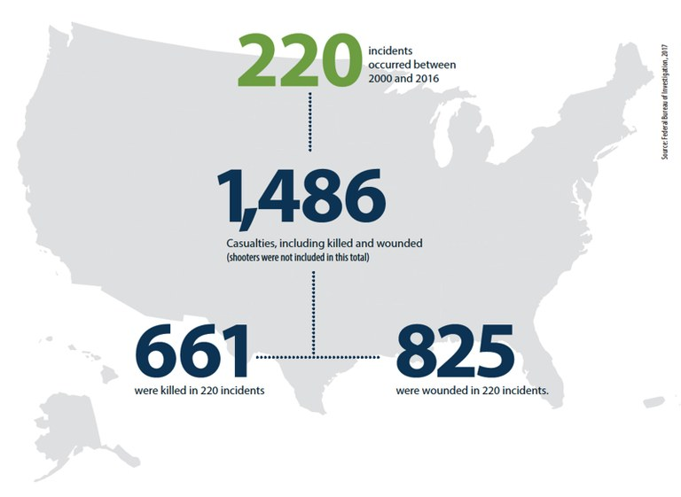
Active Shooter Statistics
Top states:
  CA - 22
  FL - 17
  PA - 13
Top venue types:
  Commerce - 43%
  Education - 22%
  Government - 11%
Female shooter - 3%
Shooter fires at law enforcement - 28%
Shooter suicide - 37%
FBI Law Enforcement Bulletin. Active Shooter Events from 2000 to 2016
Notes:
The FBI and other authoritative public and private organizations have collected a lot of data about active shooter events. The FBI’s 2016 report about active shooter events is an important resource. The graphic above has some key facts and statistics taken from that report that help put the active shooter issue in perspective.
Incident Numbers:
220 incidents, resulting in 661 killed and 825 wounded
The number of annual incidents is trending upward, with an average of 12.9 per year
Incident Locations by State:
Incidents occurred in 43 states and the District of Columbia; CA, FL, and PA were the top three (note, these are states with relatively large populations)
Incident Location by Target Type:
Nearly half of the incidents happened at commercial facilities, namely businesses or malls.
Nearly a quarter happened at schools, including colleges and universities
11 percent took place on government properties.
Shooter Facts:
37% of the time, the shooter committed suicide
The shooter almost always was male (97%)
The shooter poses a threat to law enforcement officers, as well as his/her intended civilian victims
Here are a few more interesting facts:
Unarmed citizens are three times more likely to stop an active shooter than armed citizens (Example: Tucson – shopping mall parking lot – citizen jumped the gunman when he went to reload – shouts of ‘jump him’ when he reloaded… and woman put her figure in the chamber to prevent the round from going off)
18 percent of the attackers went mobile during their attacks; that is, the perpetrator started at one location and then moved to another while still actively attacking. Most frequently, attackers simply walked to another nearby location, but in some cases they used an automobile to move between more distant attack sites.
Source: FBI Law Enforcement Bulletin. Active Shooter Events from 2000 to 2016
Image courtesy of FBI Law Enforcement Bulletin. Active Shooter Events from 2000 to 2016

Slide 21
Active Shooter Incident Characteristics
An active shooter is an individual actively engaged in killing or attempting to kill people in a confined and populated area
In most cases, there is no pattern or method to the selection of victims
Most active shooter situations are unpredictable and evolve quickly
Preparedness and awareness are key to helping protect our employees, our customers, and ourselves
Notes:
The last slide featured active shooters with a variety of motivations – from personal to political to racial to those with psychological issues– and in a variety of locations – schools, commercial facilities, religious facilities, manufacturing plants – but there are some similarities between most active shooter situations. I won’t read the slide, but…
They happen FAST.
They usually end BEFORE police arrive.
Even though the victims are often selected randomly, the attack itself is rarely impulsive. These guys don’t just wake up, grab a gun and start shooting. The shooting has been planned. Some examples:
In February 2007, Sulejman Talović began killed 5 people at the Trolley Square Mall in Salt Lake City, Utah, before being killed by police. In that situation, Talović hung out at that mall all the time, he knew it well, he chose the mall because he was comfortable there, and he began shooting on his way in after getting out of his car.
Most recently, the Aurora shooter booby-trapped his apartment with explosives.
Two days prior to the VA Tech massacre, Seung Hui Cho chained some of the doors of Norris Hall, where he ended his rampage.
Klebold and Harris constructed 99 IEDs in preparation for Columbine
For whatever reason people snap – it could be ideological or just due to a firing or dumping – there’s usually warning signs. Almost every attacker we’ve seen has had some behavioral issues or violence in their past, which is why its so important for employers to conduct background checks for employees.
So again, it could be anyone, anywhere, which is why it is so important for your staff and security guards and volunteers – everyone who works in your building – to be trained on how to react if shooting starts. WE must all be prepared to deal with the situation until law enforcement personnel arrive, and we’ll go into what that means.

Slide 22





Pathway to Violence
Probing and Breaching
Pre-Attack Preparation
Research and Planning
Violent Ideation
Devotes time to gathering materials, forewarning friends
Surveillance, tests plan
Grievance
Conducts research and develops plan
Thoughts replaced by action, declarative writings (manifesto)
Hostile or dark speech, drawings, writings, other expressions
Notes:
Systematic research and extensive case experience by Calhoun and Weston and others has demonstrated the central notion of a targeted “pathway to violence”, and its significance for workplace violence risk assessment. {Is ‘workplace’ analogous to ‘schools’ in the context of a student for him that is a similar environment to what will later be a workplace – does the same pathway apply?}
Perpetrators of targeted violence invariably traverse the pathway to violence, progressing along identifiable steps. Such movement is often revealed to others, as it is not uncommon for the individual contemplating violence to communicate his or her feelings and intentions in some form to third parties, such as co-workers and friends, and less often directly to a target. Preparatory actions – for example procuring and practicing with the firearms or weapons for an attack – may be detected.
Arapaho School Shooting. Insight into Pierson's emotional state by way of his diary entries:
Grievance: Investigators say Pierson described himself in the diary as "a psychopath with a superiority complex" and indicated he was exacting revenge for being teased in elementary school.
Pierson wrote that he planned the attack to start a conversation about elementary school teasing. He wrote "words hurt, can mold a sociopath, and will lead someone a decade later to kill."
A September 2013 entry by Pierson states, "A 10 year subconscious project for me to exact revenge... I will shoot up my school before the year is over.” Source: {From WAVR-21 website December 13, 2013 shooting in which student Karl Pierson, 18, fatally shot Arapahoe High School classmate Claire Davis and himself}.
Violent Ideation can be enhanced and facilitated by VISUAL BRIDGES– e.g. games-videos-even graphic news stories…there is now an Active Shooter ‘game’ that has been developed and positioning to go on-line where as a gamer you can play out being an active shooter creating mass casualties….this is an example of a VISUAL BRIDGE { the owner of video game development engine Unreal Engine 4, issued a statement today to GameSpot on Hatred's use of the technology. "Epic Games isn't involved in this project. Unreal Engine 4 is available to the general public for use 'for any lawful purpose,' and we explicitly don't exert any sort of creative control or censorship over projects. However, the video is using the trademarked Unreal Engine 4 logo without permission from Epic, and we've asked for the removal of our logo from all marketing associated with this product.” A representative for Destructive Creations has responded to GameSpot's request for comment regarding Hatred. The studio confirmed that it does indeed plan to release the game, and would like to launch on Steam or GOG, if they allow it. Information only for the instructor, too much brand name info.
Image Source:
Grievance – Image purchased from Getty Images
Violent Ideation – Image purchased from Getty Images
Research & Planning – Image purchased from Getty Images
Pre-attack preparation – Image purchased from Getty Images
Probing & Breaching - Image courtesy of Wikimedia user pr_ip Primus Inter Pares via https://commons.wikimedia.org/wiki/File:Secondscreen_wettendass_Ipad-app.jpg

Slide 23
Behavioral Indicators
Thoughts
  Talk of previous violent incidents
  Unsolicited focus on dangerous weapons
  Expressions of paranoia or depression
  Overreaction to workplace changes
Feelings
  Depression or withdrawal
  Unstable, emotional responses
  Feeling either arrogant and supreme, or powerless
  Intense anger or hostility
Behaviors
  Increased use of alcohol or drugs
  Violations of company policies
  Increased absenteeism
  Exploiting or blaming others
Notes:
This side includes some of the potential indicators of workplace violence. People need to a) be trained to recognize these indicators, and b) have a mechanism to report it.
Pathway to Violence Handout
Some things that should raise a red flag…
Are people talking a lot about violence?
Flying off the handle, overreacting?
Are some unable to handle changes in the workplace?
Withdrawn or depressed?
Focused on weapons?
Has someone had a complete departure of their normal behavior….

Slide 24
Prevention Tools
Pre-employment background checks and drug tests
Train staff on behavioral signs and impact of workplace violence
Policy for violence and weapons in the workplace
Train staff on HIPAA and FERPA reporting exemptions
Support a culture of caring for all employees
Notes:
These are tools for developing an effective prevention capability. They include:
Conducting pre-employment background checks and drug tests
Training staff on the impact of workplace violence, including the Pathway to Violence and reporting mechanisms
Development of a workplace violence policy, which provides guidance for consistent enforcement: There are currently no specific standards for workplace violence. However, under the General Duty Clause, Section 5(a)(1) of the Occupational Safety and Health Act (OSHA) of 1970, employers are required to provide their employees with a place of employment that "is free from recognizable hazards that are causing or likely to cause death or serious harm to employees.“ Furthermore, the organization should have a written policy that prohibiting all types of workplace violence and threats of violence. All employees should be required to sign the policy.
Train staff and employees on the exceptions for HIPAA and FERPA, which allow sharing of information with law enforcement in exigent circumstances to prevent incidents, and develop a reporting mechanism appropriate for your organization: In many AS incidents, the “dots didn’t get connected” due to concerns that sharing information on a person of concern would violate federal privacy protection legislation. In the case of both HIPAA and FERPA, there are very clear exceptions to the law, which allow for information to be shared in order to protect the health and safety of the individual and others. In the case of HIPAA, the protected health information can be shared with law enforcement official reasonably able to prevent or lessen a serious and imminent threat to the health and safety of the individual or the public. In the case of FERPA, the personally identifiable information can be shared when an articulable and significant threat exists…. In order to protect the health and safety of students or other individuals.
Support a culture of caring for all employees. Your employees are your most important assets.

Slide 25
Protective Measures –
Consider the following when evaluating physical security or other protective measures
  Employees and other personnel
    Who or what are you trying to protect?
    How many people are you protecting?
    What about access and functional needs or visitors?
  Facility characteristics
    How big is the facility? Is it interconnected or a campus?
    Can you use access control to isolate portions of the facility?
Notes:
Employees and Other Personnel: What are you trying to protect, how many are you protecting? You should consider the needs of visitors and those who have functional needs (ADA).
Facility Characteristics: How big is the facility, multi-story, sprawling campus… Can you isolate portions or segments of the facility? Can you communicate across the campus?

Slide 26
Protective Measures –
Consider the following when evaluating physical security or other protective measures
  First responder access
    How many layers of security will they have to traverse?
    Will they have access cards?
    Are they familiar with you facility?
    Have they conducted a “walk-through,” if so, when?
  The shooter’s perspective
    Are there any barriers?
    What items of opportunity may be used against you or used to gain access?
Notes:
First responders: Where and how should first responders access the building? How many layers of security will the first responder navigate? While you and your facility management may know your layout thoroughly, upon arrival first responders are on a timed obstacle course, trying to rapidly reach the shooter and navigate through security protocols. Assist responders with keys or pass cards so they can easily access your facility. Establish pre-plan a location to meet a facility representative
The potential shooter: How would they gain access to your facility if not an employee or other expected person? What barriers are there to reach areas of the facility? What type of weapons might they use?

Slide 27
Protective Measures –
Long-term protective measures should emphasize physical safeguards that present a robust deterrent and provide a more survivable environment. Officials should consider the following measures:
  Install secure locks on all external and internal doors and windows with quick-release capability from within for emergency escape
  Install window and external door protection with quick-release capability for fire escape
  Establish safe areas within the facility for assembly and refuge during crises
  Establish and implement an emergency communications system such as phone trees or text messages for personnel
Notes:
This slide comes from the Joint Intelligence Bulletin released on April 3, 2014 titled Active Shooter Incident at Fort Hood, Texas

Slide 28

Protective Measures –
When considering protective measures;
  Use them consistently
  Know how they work
  Understand roles and responsibilities
  Integrate them with policies and procedures
Notes:
A key challenge is the active shooter often is an “insider” threat. In the active shooter context, the insider typically is an employee or student. This person is expected at your facility and will have access to it. Given this, the security measures that protect against external threats may not be effective against an active shooter. This includes so-called “hard” targets, meaning limited access facilities that typically have multiple layers of security. (An example is the Navy Yard incident where the shooter was a contractor, with approved access to a highly secured site.) Other security measures, may be partially effective. For example, camera systems are generally not a deterrent to active shooters, as these perpetrators are usually not concerned about getting caught. However, camera systems may help responders locate the shooter.
Whatever protective measures you utilize:
Employee them consistently
Know how they work
Understand roles and responsibilities (Example: A large manufacturing facility assumed their armed gate guard force would respond to an active shooter incident within the building. But during an exercise, they discovered the contract called for the security force to maintain security at the gate, and coordinate with responders to assist their access)
And remember that physical security alone will not provide protection; it must be integrated with other policies and procedures meant to defend your organization
Image purchased from Getty Images.

Slide 29
Mitigation Measures –
Notification System
Designate personnel authorized to initiate notifications
Utilize remote communication management systems
Pre-script notification messages
Retain emergency communications channels
Utilize multiple systems and social media
Notes:
Notification is a key risk mitigation action and one that is closely related to incident response. One of the most important mitigation steps is to warn all of the people in your facility of an active shooter incident, so they can take immediate protective actions. Once the notification plan is developed, covering the components outlined above, exercise the notification capabilities.
Designate who can active notification systems – as many as practical.
Consider utilizing mass notification systems to simultaneously active multiple modes of communication, as appropriate to your organization.
Develop pre-scripted messages, as simple as “active shooter in the building (insert location if known), run, hide, fight” which is the signal to activate the active shooter plan.
If the plan includes using designated emergency communications channels, keep these channels reserved for emergency or tests. Using these channels for routine communications causes these messages to be ignored, or delayed in addressing.
Assure your plan includes multiple modes of communications, including appropriate social media channels. Establish social media accounts to use before an event to prevent “spoofing”, by someone pretending to be your organization sending out false messages.
Note that mass notification systems can provide rapid notification on many platforms simultaneously, but can also fail. Do not solely rely on technology solutions. Identify alternative communications methods, to not create a single point of failure.

Slide 30
Mitigation Measures –
Notification System
Immediate
Rapid implementation
Receivable
At or away from work station
Understandable
Clear and concise
Credible
To persons who may not speak English
Delivered from trusted sender
By persons who may have impairments
Notes:
To be most effective, the notification message should be:
IMMEDIATE
Receivable: Employees or other affected personal must be able to hear or otherwise receive the alert, whether at their work stations or elsewhere in the workplace. You need to consider how persons who are deaf, blind, or have other impairments will receive the notification (as well as respond to it).
Understandable: the language should be clear and concise. This holds true for persons who may not speak English or have a limited English language proficiency.
Credible: Recipients need to believe that the notification is coming from appropriate personnel and is not a hoax

Slide 31
Response to an Active Shooter Situation
In an active shooter situation, you should quickly determine the most reasonable way to protect your own life. You should:
  Run: If there is an accessible escape path, attempt to evacuate the premises
  Hide: If evacuation is not possible, find a place to hide where the active shooter is less likely to find you
  Fight: As a last resort, and only when your life is in imminent danger, attempt to disrupt and/or incapacitate the active shooter
It is important to train employees they can react if they are confronted with an active shooter situation
These situations evolve quickly, therefore, quick decisions could mean the difference between life and death
If you are in harm’s way, you will need to quickly decide on the safest course of action based on the scenario unfolding before you
Notes:
Now…there are shots fired. Let’s talk response.
We’ve all heard stop drop and roll. In a shooting, tell people to RUN, HIDE, FIGHT.
These situations happen fast, they evolve quickly, and they can take place in any environment, so the key thing to remember and communicate is EVERYONE WHO WORK FOR YOU SHOULD FEEL EMPOWERED to make the best decision possible to protect themselves. We’re asked all the time: evacuate or hide. Every situation is different, and you don’t want a Washington bureaucrat to make that decision. It is literally a life and death situation, so people need to decide for themselves quickly what is the safest course of action for THEM. Train and empower your people.
Another question we’re asked: should the guard force carry weapons or engage? Again, this is not something a Washington bureaucrat can dictate to you. Every jurisdiction is different regarding this issue, and it’s an internal policy decision that your company should make in concert with their local law enforcement.

Slide 32
Insert the DHS Run-Hide-Fight video
Notes:
Options for Consideration Run-Hide-Fight 8 minute video

Slide 33
Run
If you suspect an active shooter situation, you must quickly determine the most reasonable way to protect your own life; if there is an accessible escape path, attempt to evacuate the premises
Always have an escape route/plan in mind
Leave your belongings behind
Be sure to:
  Warn others not to enter an area where the active shooter may be
  Help others escape, if possible
  Evacuate regardless of whether others agree to follow
  Do not attempt to move wounded people
  Keep your hands visible
  Follow the instructions of any police officers
Notes:
Let’s take it step by step. First, if you can…if you have an accessible escape path…RUN.
Every time you walk in a building, know how to get out.
Know a SECOND way to get out.
Leave your stuff. Stuff is stuff, not important.
Help anyone around.
Keep in mind: It’s human nature: If you’re in a uniform, people are going to follow you. Make sure your people know that so they expect it.
If others are not going to come with you, and you know escape is your best option, stick with your best plan.
Call 911 only when it’s safe and follow the instructions of any police officers.

Slide 34
Hide
If safe evacuation is not possible, find a place to hide where the active shooter is less likely to find you. Your hiding place should:
  Be out of the shooter’s view
  Provide protection if shots are fired in your direction (i.e., an office with a closed and locked door)
  Do not trap or restrict your options for movement
To prevent a shooter from entering your hiding place:
  Lock the door
  Blockade the door with heavy furniture
  Close, cover, and move away from the door
Notes:
If RUNNING is NOT an option…and if hiding is the best course of action, then HIDE.
Train your people about the difference of COVER and CONCEALMENT. Cover is going to provide you with some protection (brick wall) and concealment is just going to conceal you (cubicle wall).
Sometimes the best you can do is concealment, but do whatever you can.
Silence your cell phone so as not to give away your hiding spot. (As soon as your mother sees it on the news, she’s going to call).
Prevent an active shooter from entering your position – lock your door if you can. Blockade it. If your office can’t lock, maybe you want another spot.

Slide 35
Fight
As a last resort, and only when your life is in imminent danger, should you attempt to incapacitate the shooter by acting with physical aggression
  Act as aggressively as possible against him/her
  Throw items and improvise weapons
  Yell
  Commit to your actions
Notes:
Only as a last resort and your life in immediate danger, take action. In another word, FIGHT.
It’s very easy to armchair quarterback, and I certainly don’t want to offend anyone, but one of the key differences between the VA Tech shootings and the Gabby Giffords Tucson shooting is that the kids at VA Tech were not empowered. This is not a judgment. They were kids, they weren’t prepared for this. (And in all fairness, there probably was not time to react.) But in Tucson, the crowd actually tackled Loughner and took him down. They knew their lives were at stake and they took action. EMPOWER YOUR PEOPLE. Let them know if there is no other choice, fight like hell.

Slide 36



Homeland Security Starts with Hometown Security
Security starts here.
connect plan train report

Slide 37


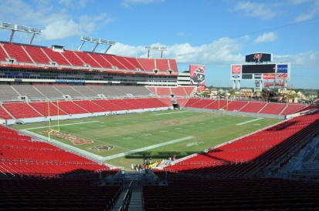
Protective measures for
public gatherings
1
Connect
To establish relationships
Soft targets/public gathering places are attractive targets for our adversaries
Americans congregate daily to work, play, shop, learn, celebrate, worship, and watch sports and entertainment at a variety of locations:
  Concert halls and theatres
  Restaurants and shopping malls
  Parades and fairs
  Houses of worship
  Sports venues
Our adversaries may perceive locations like these as attractive targets
Plan
2
Keep employees & customers safe
3
Train
Staff to deal with potential threats
Report
4
If you see something suspicious
Notes:
Across the United States, Americans congregate daily in public spaces to work, shop, go to school, celebrate, worship, enjoy recreation, or cheer on their favorite sports team.
However, as the terrorist attacks in Paris, France, and San Bernardino, California, revealed, public gatherings are vulnerable.
Adversaries may perceive concert halls, theatres, restaurants, malls, parades, houses of worship, sports venues, and other public locations as attractive targets that may incur mass casualties, have substantial psychological impacts, and draw extensive media coverage.
Photo: IPRS Large Outdoor Public Gatherings

Slide 38
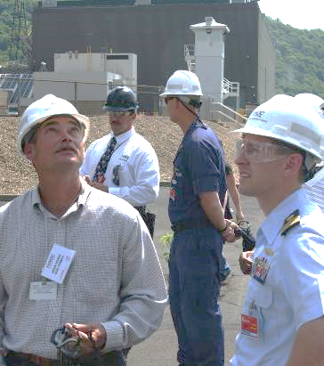

Connect
1
Connect
To establish relationships
1
To establish relationships
Plan
2
Visit dhs.gov/hometownsecurity to learn more about Federal resources like the DHS Protective Security Advisor program. Get to know local law enforcement and EMS.
Keep employees & customers safe
3
Train
Reach Out & Develop Relationships
  Local law enforcement and emergency management officials
  Neighbors and community organizations
  DHS Protective Security Advisor
  FBI and Infragard: https://www.infragard.org/
  Customers and patrons
Staff to deal with potential threats
Report
4
If you see something suspicious
Notes:
Develop relationships with local law enforcement and emergency management in your area. Invite them to tour your business.
Introduce representatives of local law enforcement and community associations
• Contact the local DHS Protective Security Advisor to get expert advice on physical security and assistance with planning, training, and cyber security.
• Connect with the Federal Bureau of Investigation’s Public Private Partnership Program InfraGard.
Their website is www.infragard.net
Introduce local coordinator and chapter president or representatives
The Homeland Security Information Network is the secure web portal DHS uses to share security information with public and private sector partners. Your PSA can help you request access.
• Connect with your customers and let them know about the security measures you’re taking to ensure a positive experience and to maintain good relationships.

Slide 39

Plan
1
Connect
To establish relationships
2
Keep employees & customers safe
Plan
2
Stay aware of potential threats and hazards to your business, including your computer systems.
Visit ready.gov/business to develop plans to ensure safety, security, and business continuity.
Keep employees & customers safe
3
Train
Staff to deal with potential threats
Report
4
If you see something suspicious
Notes:
• Always be aware of current threats related to your geographic region or impacting your business sector.
• Develop generalized plans, including security, emergency response, emergency communications, and business continuity plans, while considering the protection of your employees and customers, access control, closed-circuit television, signage, suspicious activity reporting, and parking security.
• Evaluate your security requirements and design a monitoring, surveillance, and inspection program that is consistent with your business operations.
• Develop evacuation and shelter in place plans, and ensure that multiple evacuation routes are clearly marked with appropriate signage and rallying points are available.
• Develop and implement a security plan for computer and information systems hardware and software.
• Engage local first responders (police, fire, medical) in all of the above efforts to ensure your efforts are in synergy with theirs.
Photo: IPRS Emergency Medical Services

Slide 40
Train
1
Connect
To establish relationships
3
Staff to deal with potential threats
Plan
2
Teach employees to identify and report
suspicious activity.
Keep employees & customers safe
Online Training
“Active Shooter, What You Can Do” (IS-907)
Available through the Federal Emergency Management Agency Emergency Management Institute:
http://training.fema.gov/EMIWeb/IS/IS907.asp
45 minutes
3
Train
Staff to deal with potential threats
Report
4
If you see something suspicious
  www.dhs.gov/ActiveShooter
Notes:
Now, let’s talk about some tools for your toolkits. DHS has produced a simple guide, a break-room poster, and wallet-sized business cards that have the immediate actions to take in the event of an Active Shooter. The Materials have been developed with input from the National Tactical Officers Association, Fairfax County Police, and our private sector partners, namely, the National Retail Federation.
How this product came to be reinforces a great point I’d like to make. It’s not just a great product, but a great example of coordination – it was initiated by our partners (in this case, our Retail partners). They came to us with the gap. There was no program, no stop, drop and roll, for Active Shooter. So every product that the CF SSA produces is in collaboration with our private sector partners - YOU.
The next evolution of these materials was online, interactive training, which you can take at no-cost at the FEMA Emergency Management Institute’s Independent Study Program at the website listed: (IS-907) Active Shooter, What You Can Do . It was released along with another great course (IS-906), Basic Workplace Security Awareness
The IS-907 Active Shooter: What You Can Do course provides guidance on responding to an active shooter situation. Upon course completion, individuals will be able to :
Describe actions to take when confronted by an active shooter,
Recognize potential workplace violence indicators,
Describe actions to prevent and prepare for active shooter incidents, and
Describe how to manage active shooter consequences.
Great course, takes about 45 minutes to complete, and users who finish the course and pass a short “final exam” get a certificate.
There’s also a webinar on the topic on our Homeland Security Information Network (HSIN). If you’re not already registered for HSIN, email me and we can set that up for you. It’s how we share sensitive but UNCLAS info with our partners – lots of great info.

Slide 41



Report
1
Connect
To establish relationships
4
If you see something suspicious
Plan
2
Post details of what to watch for and how to report it. Join the “If You See Something, Say Something™” campaign at dhs.gov/see-something-say-something
Keep employees & customers safe
3
Train
Staff to deal with potential threats
Report
4
If you see something suspicious
Notes:
What to Report
Unattended packages (e.g., backpacks, briefcases, boxes) that might contain explosives
Taking pictures or video of infrequently used access points, security guards, or security equipment (e.g., perimeter fencing, security cameras, etc.)
Wearing unseasonably bulky clothing that might conceal explosives or weapons
Attempting to gain unauthorized entry to restricted areas
Presenting false or misusing insignia, documents, and/or identification
Communicating a threat to a public gathering
How to Report
For emergencies in progress call 9-1-1
Suspicious activity should be reported to
Local law enforcement
Regional fusion center
Local FBI
Factors such as race, ethnicity, national origin, or religious affiliation alone is not suspicious.
For that reason, the public should report only suspicious behavior and situations (e.g., an unattended backpack in a public place or someone trying to break into a restricted area) rather than beliefs, thoughts, ideas, expressions, associations, or speech unrelated to terrorism or other criminal activity.
From DHS “If You See Something, Say Something TM” brief

Slide 42
Resources
Protective Security Advisors proactively engage with government partners and the private sector to protect critical infrastructure. For more information or to contact your local PSA, e-mail NICC@hq.dhs.gov.
The Ready Campaign provides help with planning for businesses at http://www.ready.gov/business.
DHS Active Shooter resources are available at http://www.dhs.gov/active-shooter-preparedness.
“If You See Something, Say Something™” http://www.dhs.gov/see-something-say-something.
Nationwide Suspicious Activity Reporting (SAR) Initiative (NSI) information is available at https://nsi.ncirc.gov/. SAR training for private sector partners is located at https://nsi.ncirc.gov/hsptregistration/private_sector/.
Counter-Improvised Explosive Device information and resources are available at www.dhs.gov/tripwire.
InfraGard is a public-private partnership between the FBI and the private sector that represents individuals from businesses, academic institutions, State and local law enforcement, fire and EMS agencies, as well as other participants dedicated to sharing information, education, and intelligence. Please go to www.infragardmembers.org and https://www.infragard.org.
Information on DHS cybersecurity programs is available at www.dhs.gov/cyber. To find out more about the Cybersecurity Awareness Campaign, go to http://www.dhs.gov/stopthinkconnect. For tips from the U.S. Computer Emergency Response Team, go to https://www.us-cert.gov/ncas/tips.

Slide 43
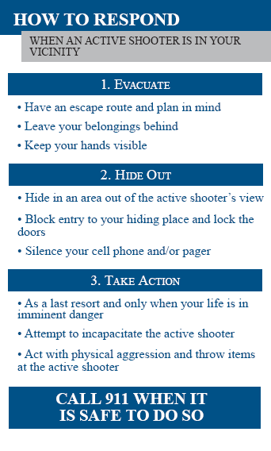
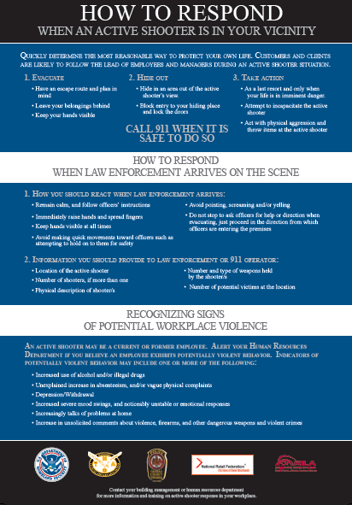
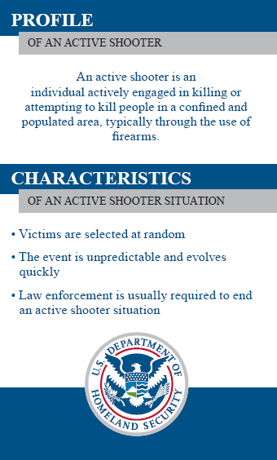
Training and Outreach Materials
DHS materials consist of three products:
  Basic Guide Book
  Pocket Emergency Measures Guide
  Break Room Poster
To download these materials visit:
  www.dhs.gov/activeshooter

Slide 44
Online Training
DHS released “Active Shooter, What You Can Do” (IS-907), an online training course available through the Federal Emergency Management Agency Emergency Management Institute:
  http://training.fema.gov/EMIWeb/IS/IS907.asp
The self-paced course takes approximately 45 minutes to complete.
Upon completion, participants can take a short online "final exam" that is instantly scored. A certificate is provided to participants who finish the course and pass the final exam.
Notes:
The next evolution of these materials was online, interactive training, which you can take at no-cost at the FEMA Emergency Management Institute’s Independent Study Program at the website listed: (IS-907) Active Shooter, What You Can Do . It was released in March, along with another great course (IS-906), Basic Workplace Security Awareness
The IS-907 Active Shooter: What You Can Do course provides guidance on responding to an active shooter situation. Upon course completion, individuals will be able to :
Describe actions to take when confronted by an active shooter,
Recognize potential workplace violence indicators,
Describe actions to prevent and prepare for active shooter incidents, and
Describe how to manage active shooter consequences.
Great course, takes about 45 minutes to complete, and users who finish the course and pass a short “final exam” get a certificate.
There’s also a webinar on the topic on our Homeland Security Information Network (HSIN). If you’re not already registered for HSIN, email me and we can set that up for you. It’s how we share sensitive but UNCLAS info with our partners – lots of great info.

Slide 45
Robert Mielish
Protective Security Advisor
robert.mielish@hq.dhs.gov or 202.809.1827

