Slide 1
Back to basics
Essential and best practices for Business continuity management

Slide 2
Scott R. Price
Senior Business Continuity Analyst
Arch Mortgage Insurance – Greensboro, NC
LinkedIn Profile | sprice02@outlook.com
Background:
34 years of IT and Business Operations experience across Financial Services, Banking and Business Spend Management. Born and raised in Fort Lauderdale, FL. Married 30 years (today), two great kids. I reside in Kernersville, NC.
Education:
BS – UNC, Greensboro
PBC Cybersecurity – UNC, Greensboro
Enrolled MSITM – UNC, Greensboro
Certifications:
DRI – CBCP
ISACA – CoBIT 5 Foundations
DevOps Institute – DevOps Foundations, CASM & CAPO
ITIL – V3 Foundations, Service Strategy, Service Operations
CompTIA – A+ and Server+

Slide 3
Table of contents
Introduction.
Why Back To Basics?
Business Continuity Foundations:
Risk Assessments.
Business Impact Analysis.
Business Continuity Strategies.
Incident Response.
Business Continuity Exercise, Assessment & Maintenance.
Recap.
Questions.

Slide 4
Introduction
Business Continuity Professionals of the Carolinas strives to:
● Provide a forum for the interchange of ideas, topics, and information in the field of business continuity planning.
● Promote increased awareness of business continuity planning.
● Identify common problems and propose resolutions.
● Identify supplier requirements which could facilitate business continuity planning.
● Encourage public and private partnerships to ensure collaboration across the community.
In the spirt of promoting and increasing awareness of business continuity planning this presentation is designed to facilitate conversation around program basics and the importance these elements play in business continuity.

Slide 5
Why back to basics?
“Before the pandemic, it was not unusual for crisis management and business continuity teams to update plans once a year and meet quarterly to review them. However, the most effective response to the pandemic has demanded that teams share data weekly or even daily to continuously monitor an evolving and highly uncertain environment.
COVID-19 showed that many organizations were not maintaining updated and tested pandemic preparedness plans. They are now reconducting business impact analyses to focus on onsite requirements for delivering critical business services and maintaining current service levels during peak periods over the coming weeks and months.”
Owen, D. (2021). Lessons for business resilience planning. Risk Management, 68(1), 16-17. Retrieved from https://login.libproxy.uncg.edu/login?url=https://www.proquest.com/scholarly-journals/lessons-business-resilience-planning/docview/2504871473/se-2?accountid=14604

Slide 6
Why back to basics?
85 percent of maturity Level 1 and 58 percent of maturity Level 2 organizations either don't use a BCM methodology or have their own ad hoc approach.
Only 13 percent of organizations with no BCM framework in place (Level 1) were able to recover all mission-critical processes according to predefined recovery objectives.
A Travelers study found that 48% of small businesses are operating without any type of business continuity plan, yet 95 percent indicated they felt they were prepared.
Last year saw the most active North Atlantic hurricane season ever recorded, reaching 30 named storms. Hurricane Laura was the largest weather-related loss event at an estimated insured loss of $8 billion to $9 billion.
Is Your Business Continuity Plan Giving Your Executives a False Sense of Security? (acronis.com)
Why is Business Continuity Important? | Travelers Insurance
Insured natural catastrophe losses reached $78B in 2020: Report | Business Insurance

Slide 7
Business Continuity foundations
Business Continuity is a complex topic spanning numerous professional practices.
Our group has shared best practices, discussed specific topics including Cloud Computing, Covid Response and Generational Workforce.
Going ‘back to the basics’ is aimed to facilitate conversation around the foundational aspects of business continuity and where possible obtain insights and best practices from one another.
In this presentation we will discuss:
Risk Assessment
Business Impact Analysis
Business Continuity Strategies
Incident Response
Plan maintenance, assessment and exercise

Slide 8
Risk Assessment
What
Why
how
A structured method that allows us to identify risks that can adversely affect our resources or image.
Allows us to assess risks to determine the potential impacts to our business and determine the most effective use of resources (or strategies) to reduce those potential impacts.
Enables a broad evaluation of risk types that include Natural phenomena, Technology, Human Acts, Operating Model.
Helps us determine the frequency, probability, severity and impact caused by a risk.
More clearly identify if establishing early warning indicators are possible.
Provides structure for types of risk (supply chain, cyber, information technology, facility, reputational, customer).
Ensures a final action is taken regarding a risk:
Avoid, Accept, Mitigate, Transfer
Self Assessments
Cause and Effect Relationships
Threat Matrix
DRI BCOE 0200 - Understanding Professional Practice Two: Risk Assessment

Slide 9
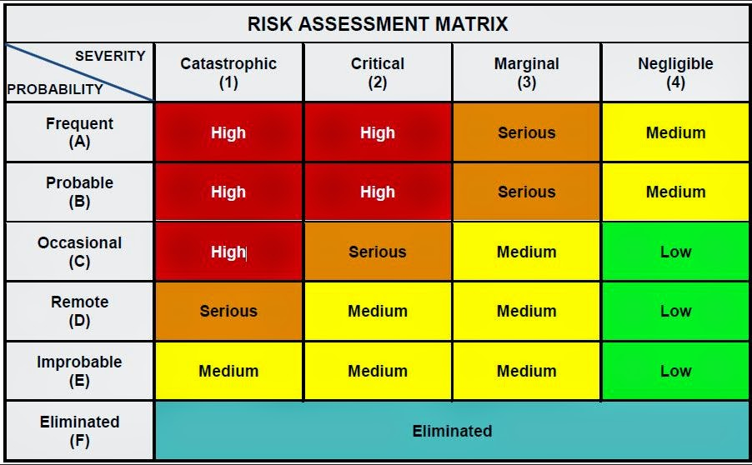
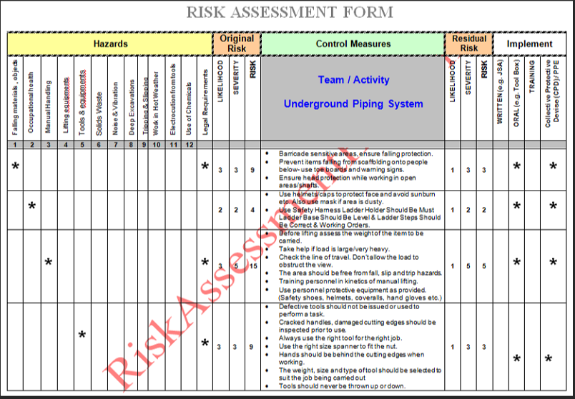
Sample risk matrix
7.6 IMPLEMENTING OPERATIONAL RISK MANAGEMENT
Risk Assessment of Hazard Example

Slide 10
Typical kpi/kri (Performance & Risk) indicators for risk assessment
The aim of this slide is to share perspective and solicit input for ways to measure the performance or risk of a Professional Practice. Audit (or audit methodologies) are not covered. These are techniques I have used and found beneficial.
Performance |  | Risk
Indicator | Reason | Indicator | Reason
Risk register accounts for all reported incident types. | Risks are identified, can be quantified and countermeasures adjusted. | Frequent solicitations for update from plan owners. | Sponsorship of Professional Practice (and Program) are at risk due to lack of support.
Probability, Frequency and Severity of incidents (actual) are aligned to what is listed in the Risk Register. | Risks that occur do not deviate from what we expect them to be. | Not using external sources for validation/verification of risks. | Risks are stale exposing the program to stagnation. (Example: National Risk Index | FEMA.gov)
Key Performance Indicators (KPIs): Used to understand how well Professional Practices are performing against their intended objective.
Key Risk Indicators (KRIs): Used to determine how much risk Professional Practices are exposed to or the sufficiency of the practice to identify risk for the covered stakeholders.

Slide 11
Business impact analysis
What
Why
how
How we identify and prioritize functions and processes within our business and discover which items have the greatest impact if not available.
Provides visibility (gaps) between requirements and our ability to deliver those critical success factors.
Quantify and qualify the critical processes.
Determine Recovery Time Objectives
Obtain alignment/consensus for critical business processes.
Obtain alignment and support for recovering critical business processes within a mutually agreed upon Recovery Time Objective.
Provides a structured outline enabling business decisions.
Quantitative Analysis – Measure/Count
Qualitative Analysis - Descriptive
Impact Assessment (Financial, Legal/Regulatory, Operational, Reputational, Human)
Identification of critical dependencies
GAP Analysis
DRI BCOE 0300 - Understanding Professional Practice Three: Business Impact Analysis

Slide 12
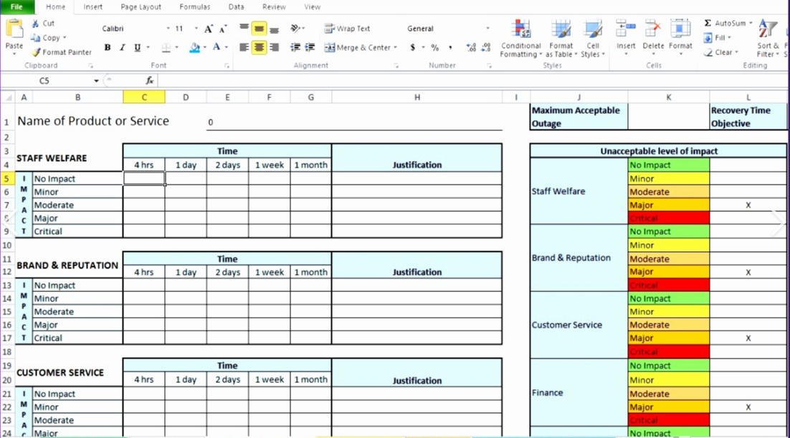
Sample business impact analysis template
business impact analysis

Slide 13
Typical kpi/kri (Performance & Risk) indicators for business impact analysis
The aim of this slide is to share perspective and solicit input for ways to measure the performance or risk of a Professional Practice. Audit (or audit methodologies) are not covered. These are techniques I have used and found beneficial.
Performance |  | Risk
Indicator | Reason | Indicator | Reason
Aggregate BIA’s are 90% aligned (recovery time objectives) for shared technology. | Alignment that federated services (email, phone, collaboration) are aligned across user groups ensuring consistency in support services being provided. | Frequent solicitations for update. | Sponsorship of Professional Practice (and Program) are at risk due to lack of support.
Less than 3% difference between what business reports (technology) and what Technology expects to test during annual DR exercise. | Mutual alignment between Business and Technology around technology usage. | BIA includes all business-critical applications | Business owner does not supply all critical applications reflecting a disconnect between Technology and Business Teams.
Key Performance Indicators (KPIs): Used to understand how well Professional Practices are performing against their intended objective.
Key Risk Indicators (KRIs): Used to determine how much risk Professional Practices are exposed to or the sufficiency of the practice to identify risk for the covered stakeholders.

Slide 14
Business continuity strategies
What
Why
how
Formation and selection of cost-effective strategies based upon our Risk and Business Impact Assessments.
The actions we will take if/should the Risks we identify occur allowing our business to continue to operate.
Strategies and plans we act upon during an event.
Keep people safe.
Maintain operations to the extent possible and within our Recovery Time Objectives.
Minimize financial loss.
Cost Benefit Analysis.
Reciprocal Agreements.
Alternate Work Locations.
Maintain Training Collateral.
Identify and utilize manual work arounds.
DRI BCOE 0400 - Understanding Professional Practice Four: Business Continuity Strategies

Slide 15
Example business continuity strategies
Manufacturing Examples
Financial Service Examples
Shifting production from one facility to another
Increasing manufacturing output at operational facilities
Retooling production from one item to another
Prioritization of production—by profit margin or customer relationship
Maintaining higher raw materials or finished goods inventory
Reallocating existing inventory, repurchase or buyback of inventory
Limiting orders (e.g., maximum order size or unit quantity)
Contracting with third parties
Purchasing business interruption insurance
Reciprocal Agreements – Shift work to other departments
Repurpose Operations – Close one process (lower priority) to support a more critical operation.
Direct Work to Alternate Location
Activate Work From Home
Source through a 3rd party
Business Continuity Plan | Ready.gov

Slide 16
Typical kpi/kri (Performance & Risk) indicators for business continuity strategies
The aim of this slide is to share perspective and solicit input for ways to measure the performance or risk of a Professional Practice. Audit (or audit methodologies) are not covered. These are techniques I have used and found beneficial.
Performance |  | Risk
Indicator | Reason | Indicator | Reason
100% coverage (strategies) for all the risks we Accept, Mitigate or Transfer. | We have a strategy for each item we Accept, Mitigate or Transfer risk. | 3% of strategies accept consequences. | Acceptance of and no plan for a risk (i.e. ice cream shop closes due to inclement weather).
 |  | Tabletops account for 100% of strategy testing. | Risks are stale exposing the program to stagnation.
Key Performance Indicators (KPIs): Used to understand how well Professional Practices are performing against their intended objective.
Key Risk Indicators (KRIs): Used to determine how much risk Professional Practices are exposed to or the sufficiency of the practice to identify risk for the covered stakeholders.

Slide 17
Incident response
What
Why
how
Implementation of an incident management system that ensures coordination of outside organizations in a timely and effective routine.
A structure that ensures individuals inside the building know what to do and external providers can understand what to expect when entering a facility.
Order is maintained.
Succession planning is accounted for.
People remain safe.
Roles, authorities and documented and understood.
Inventory of hazardous materials.
Incident Management Plan
Procedures for treating incidents (spills, releases).
Roles and Responsibilities.
Damage Assessment Procedures.
DRI BCOE 0500 - Understanding Professional Practice Five: Incident Response

Slide 18
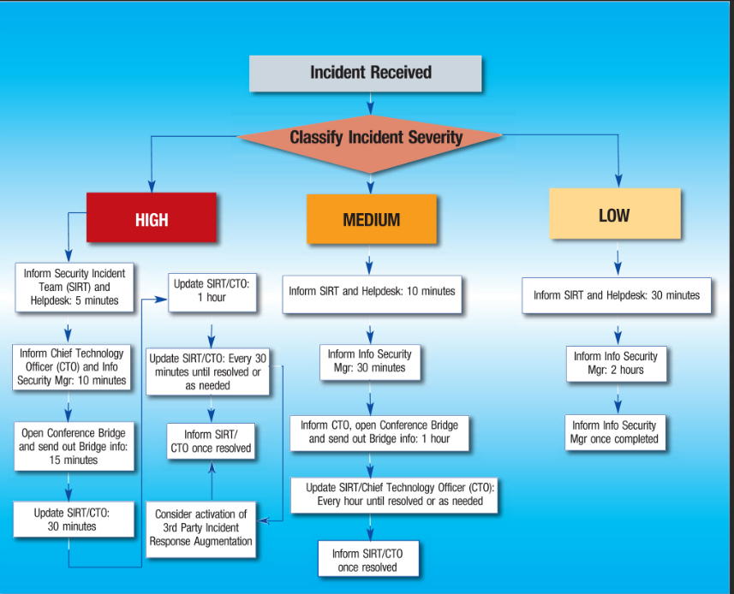
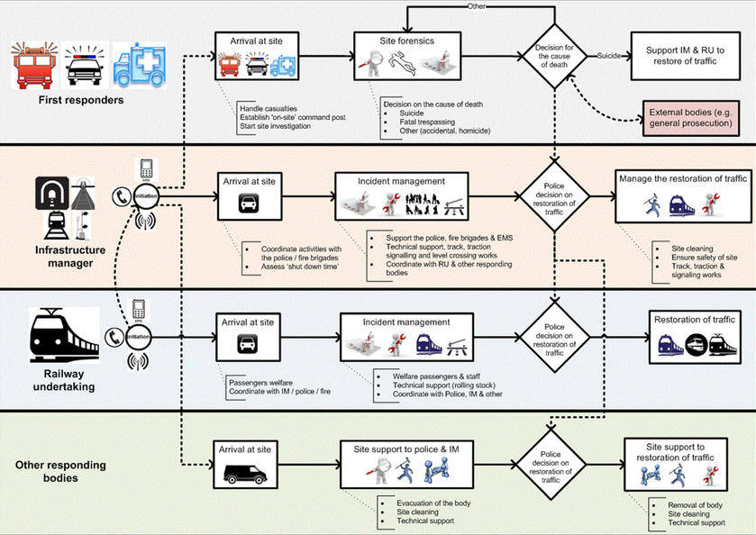
Incident response examples
incident response examples
Incident Response Workflow Plan

Slide 19
Typical kpi/kri (Performance & Risk) indicators for incident response
The aim of this slide is to share perspective and solicit input for ways to measure the performance or risk of a Professional Practice. Audit (or audit methodologies) are not covered. These are techniques I have used and found beneficial.
Performance |  | Risk
Indicator | Reason | Indicator | Reason
Employee contact records update daily (99.9% Attainment) | Employee and Incident System data are 100% in synch ensuring ability to reach employees during crisis. | Frequent solicitations for participation. | Sponsorship of Professional Practice (and Program) are at risk due to lack of support.
Completion of Annual Tests as prescribed by the program. | Measures management support and participation in the program. | Less than 90% response to semi annual incident response tests. | Indicates lack of participation from employees and a key program risk.
Key Performance Indicators (KPIs): Used to understand how well Professional Practices are performing against their intended objective.
Key Risk Indicators (KRIs): Used to determine how much risk Professional Practices are exposed to or the sufficiency of the practice to identify risk for the covered stakeholders.

Slide 20
Business continuity exercise, assessment & maintenance
What
Why
how
A repeatable method to ensure plans are exercised, assessed and maintained.
Ensures data remains current, relevant and up to date.
Enables business outcomes by ensuring people know what to do, how to do it and under which circumstances actions apply.
Remain vigilant.
Situational Readiness.
Resilience.
Preparedness.
Test/exercise program.
Maintenance program.
Audit program.
DRI BCOE 0800 - Understanding Professional Practice Eight: Business Continuity Exercise, Assessment and Maintenance

Slide 21
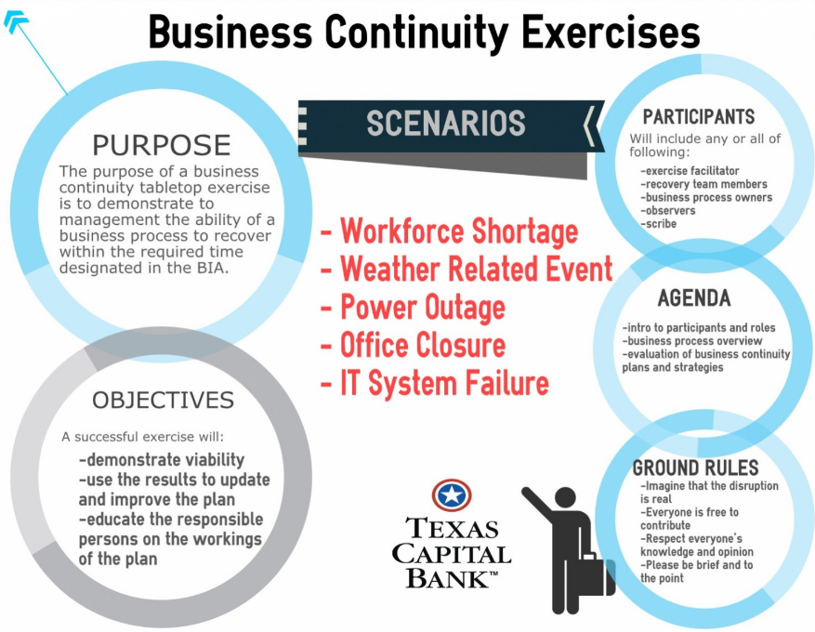
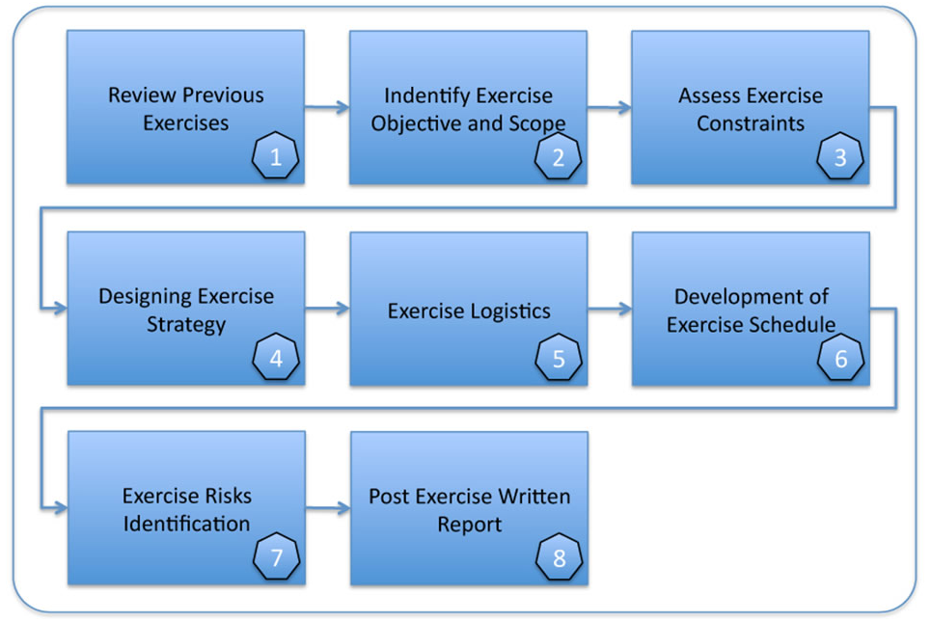
Business continuity exercise examples
business continuity exercise_1
business continuity exercise_2

Slide 22
Typical kpi/kri (Performance & Risk) indicators for bc exercise, assessment and maintenance
The aim of this slide is to share perspective and solicit input for ways to measure the performance or risk of a Professional Practice. Audit (or audit methodologies) are not covered. These are techniques I have used and found beneficial.
Performance |  | Risk
Indicator | Reason | Indicator | Reason
All plans are 100% updated in accordance with the Program Guidelines. | Shows the program is actively managed including specific Professional Practices. | Frequent solicitations for participation. | Sponsorship of Professional Practice (and Program) are at risk due to lack of support.
Two tabletops above and beyond what is required annually. | Shows management commitment and engagement. | 25% reduction in live tests. | Compensated with Tabletops; however, exposes business to less robust exercises potentially dampening resilience and effectiveness.
Key Performance Indicators (KPIs): Used to understand how well Professional Practices are performing against their intended objective.
Key Risk Indicators (KRIs): Used to determine how much risk Professional Practices are exposed to or the sufficiency of the practice to identify risk for the covered stakeholders.

Slide 23
questions

Slide 24
Thank you

