Slide 1
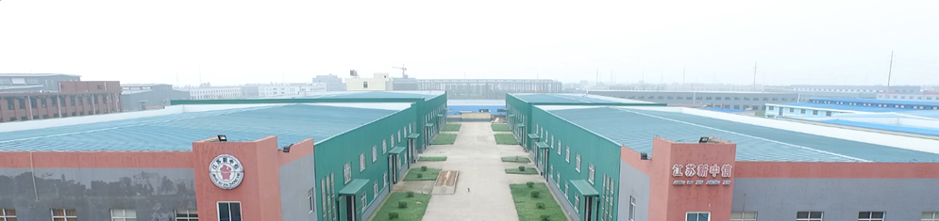

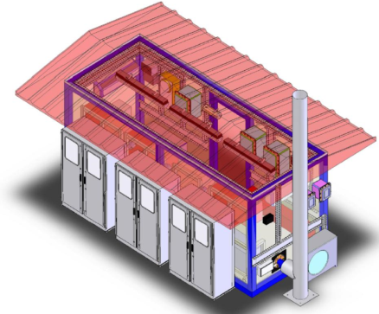
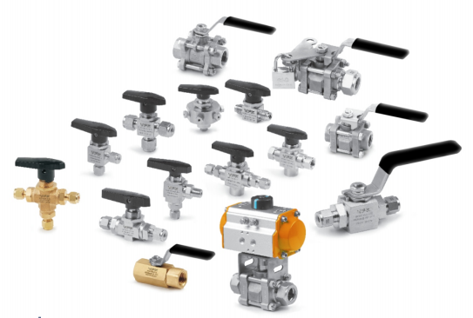
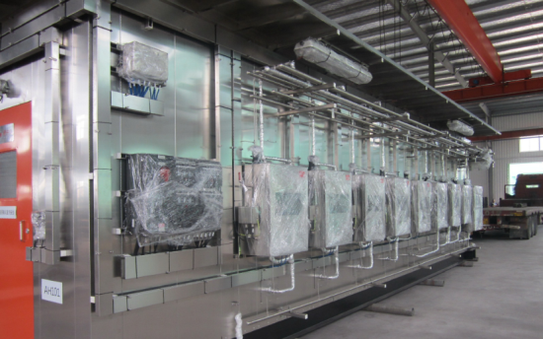
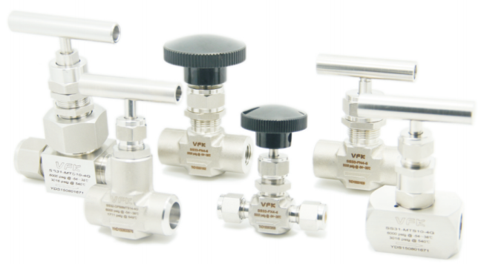
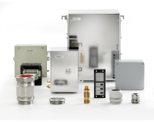
Company Introduction
JIANGSU XINZHONGXIN CO.,LTD.
Advanced Fluid Control
Perfect Partner

Slide 2





企业
概况
Seminar Exhibition
Company Overview
企业
能力
Certificates
Test Report
Main Facilities
实战
练习
结语
Performance
江苏新中信电器设备有限公司
JIANGSU XINZHONGXIN CO.,LTD
【Company Overview】
With 30 years experience in petrochemical industry, we produce instrument valves and fittings, analysis system integration, ex-proof electrical appliances, instrument protection boxes and cable tray. We are the supplier for Sinopec, CNPC, CNOOC and Shenhua Group.
The factory covers an area of 36000 m2, has more than 130 employees, is equipped with more than 100 machine tools and more than 20 testing equipments.
It has ISO 9001/14001/18001, TS, IEC Ex, ExNEPSI, EAC and many other international and domestic certifications, tube fittings, needle valves, ball valves, Y-type globe valves, ex-proof junction boxes, ex-proof glands and other products have passed the national inspection.
It has an experienced design and technical team in the analysis system integration, providing complete sets of analysis system equipment for many major national petrochemical and coal chemical projects.
UKAS
ISO 9001
ISO 14001
OHSAS 18001
Pressure vessel, pressure piping and components
Ex-proof junction case/box, threading box, gland, sealing connector, etc.
Russian/Belarus/Kazakhstan CU TR certificates
Advanced Fluid Control
Perfect Partner

Slide 3
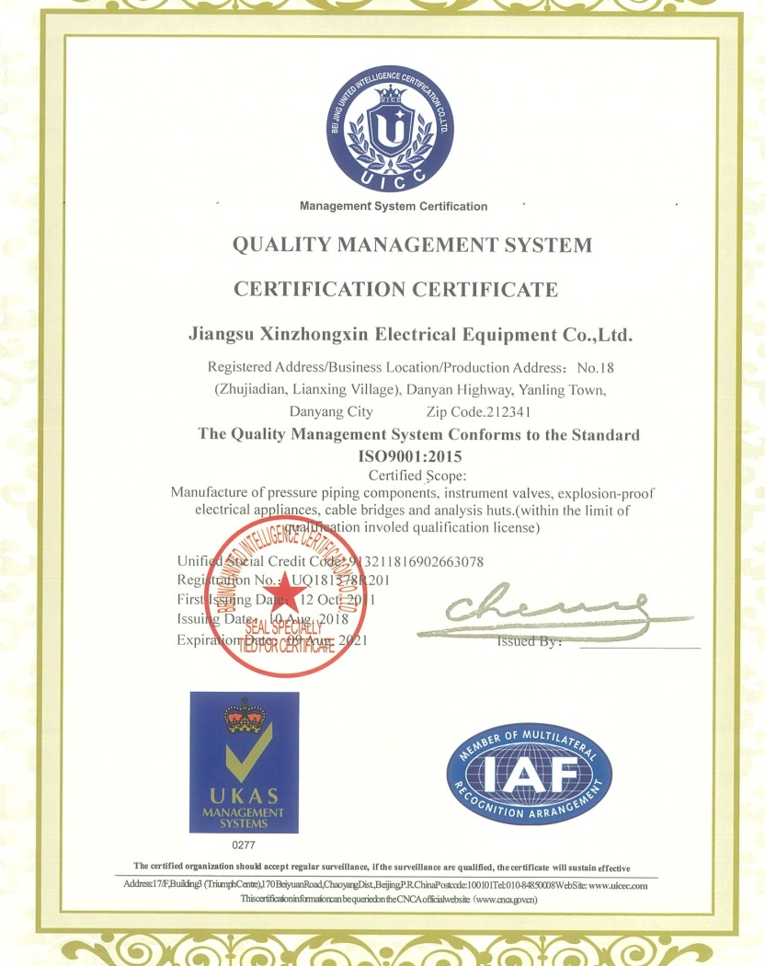
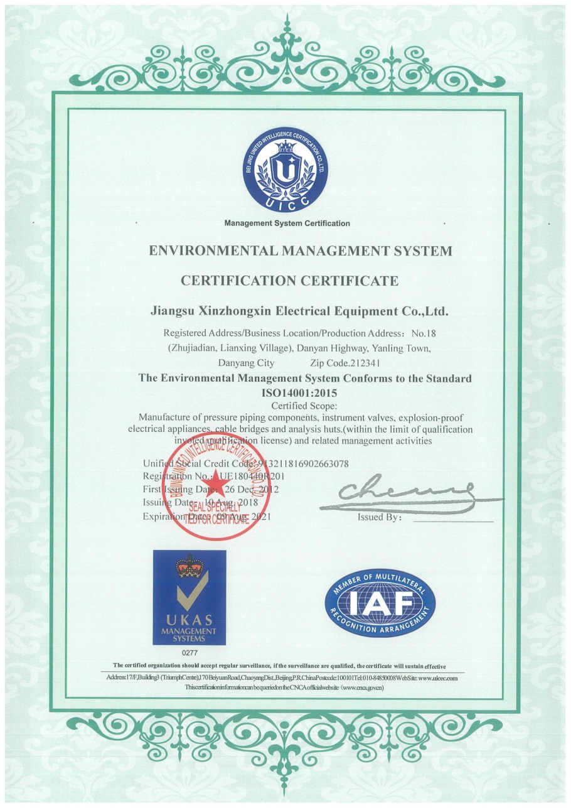
Company Overview
Seminar Exhibition
企业
概况
企业
能力
Certificates
Test Report
Main Facilities
实战
练习
结语
Performance
江苏新中信电器设备有限公司
JIANGSU XINZHONGXIN CO.,LTD
【Certificates】
ISO 9001:2015
OHSAS 18001:2015
ISO 14001:2004
Advanced Fluid Control
Perfect Partner

Slide 4
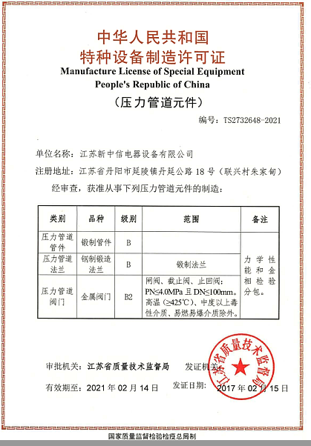
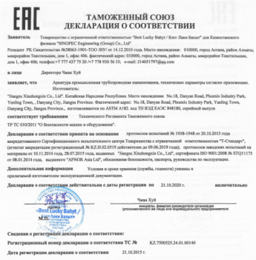
Company Overview
Seminar Exhibition
企业
概况
企业
能力
Certificates
Test Report
Main Facilities
实战
练习
结语
Performance
江苏新中信电器设备有限公司
JIANGSU XINZHONGXIN CO.,LTD
【Certificates】
TS certificate (pressure piping components)
Advanced Fluid Control
Perfect Partner

Slide 5
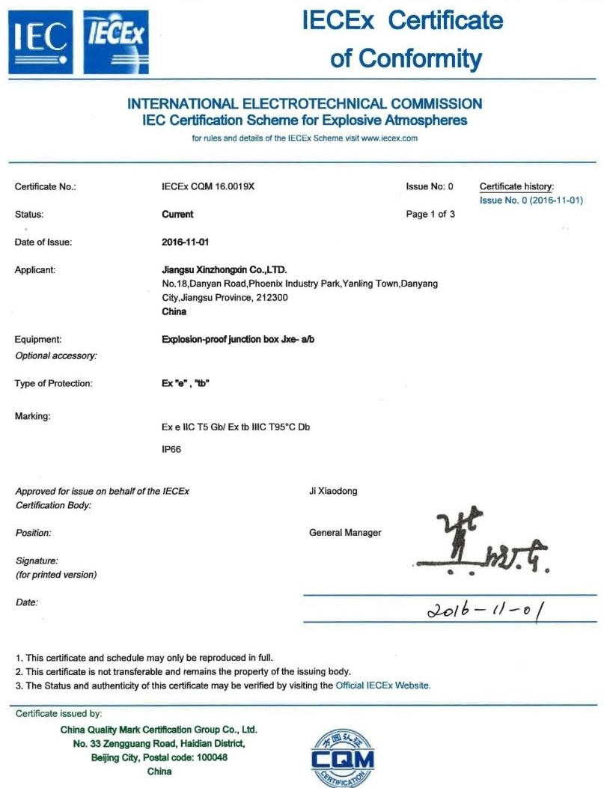
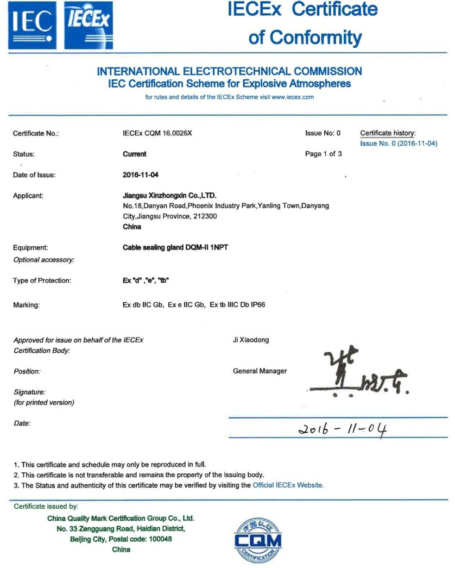
Company Overview
Seminar Exhibition
企业
概况
企业
能力
Certificates
Test Report
Main Facilities
实战
练习
结语
Performance
江苏新中信电器设备有限公司
JIANGSU XINZHONGXIN CO.,LTD
【Certificates】
  Certificate No.：IECEx CQM 16.0026X IECEx CQM 16.0019X
Advanced Fluid Control
Perfect Partner

Slide 6
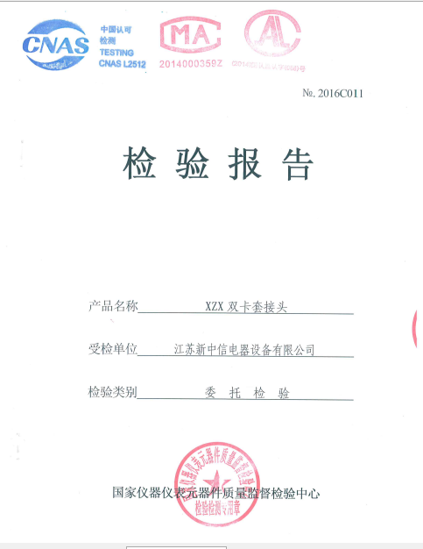
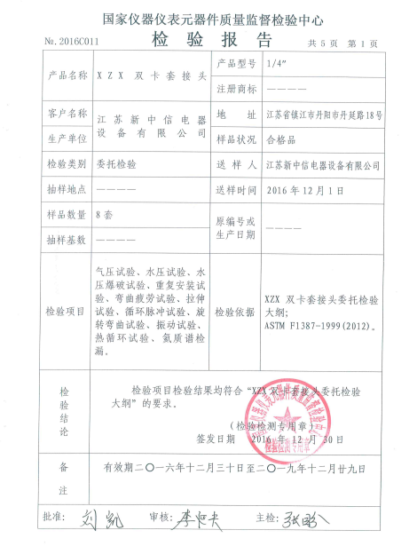
Company Overview
Test Report
Seminar Exhibition
企业
概况
企业
能力
Certificates
Main Facilities
实战
练习
结语
Performance
江苏新中信电器设备有限公司
JIANGSU XINZHONGXIN CO.,LTD
【Test Report】
JIANGSU XINZHONGXIN CO.,LTD. is one of the few manufacturers in China that has passed the Standard Specification for Performance of Piping and Tubing Mechanically Attached Fittings “ASTM F1387-1999 (2012)“ . The instrument valves and fittings we produced can be used as a replacement of imported products.
Test Items
Pneumatic Proof Test | Tensile Test
Hydrostatic Proof Test | Hydrostatic Burst Test
Impulse Test | Repeat Assembly Test
Flexure Fatigue Test | Rotary Flexure Test
Thermal Cycling Test | Shock Test
Stress Corrosion Test | Fire Test
Advanced Fluid Control
Perfect Partner

Slide 7
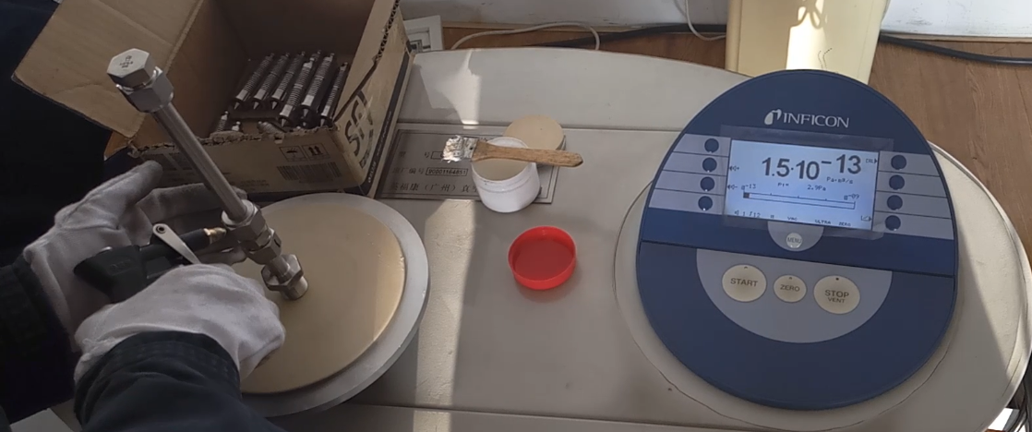
Company Overview
Seminar Exhibition
企业
概况
企业
能力
Certificates
Test Report
Main Facilities
实战
练习
结语
Performance
江苏新中信电器设备有限公司
JIANGSU XINZHONGXIN CO.,LTD
【Test Report】
Under special working conditions like hydrogen environment, leakage rate of fittings produced by JIANGSU XINZHONGXIN CO.,LTD. have reached the level of imported products.
Helium mass spectrometry test can test the leak rate of fittings in hydrogen environment: in an environment with a vacuum of 2.9*10⁻⁶MPa and a pressure of 5 Min, the leak rate of fittings produced by JIANGSU XINZHONGXIN CO.,LTD. is less than 1*10⁻¹⁰ atm·cm³/sec, which is far lower than similar products.
Advanced Fluid Control
Perfect Partner

Slide 8
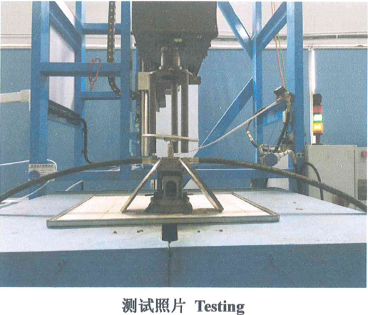
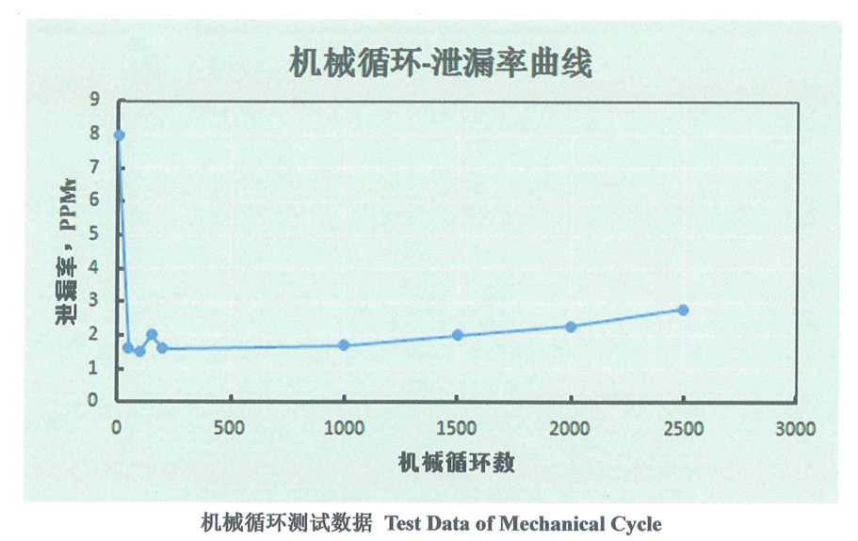
Company Overview
Seminar Exhibition
企业
概况
企业
能力
Certificates
Test Report
Main Facilities
实战
练习
结语
Performance
江苏新中信电器设备有限公司
JIANGSU XINZHONGXIN CO.,LTD
【Test Report】
JIANGSU XINZHONGXIN CO.,LTD. is one of the few manufacturers that have passed the ISO 15848 -1:2015 valve micro-leakage test. Under a pressure of 24.8Mpa, after 2500 mechanical cycles, the valve leak rate is 2ppmv on average, and the bonnet leak rate is 0.
Advanced Fluid Control
Perfect Partner

Slide 9
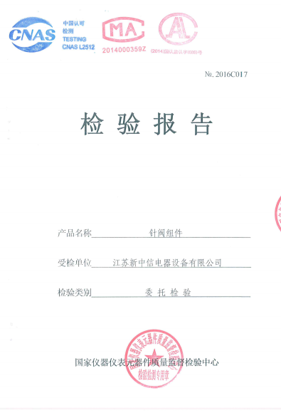
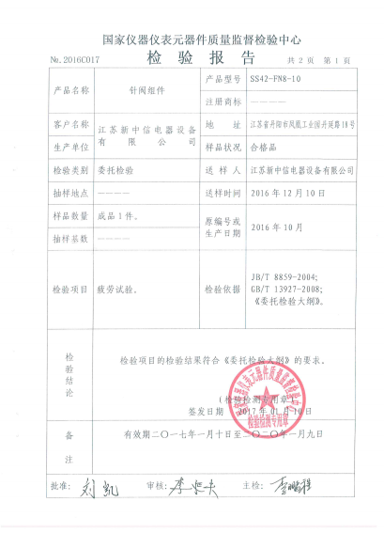
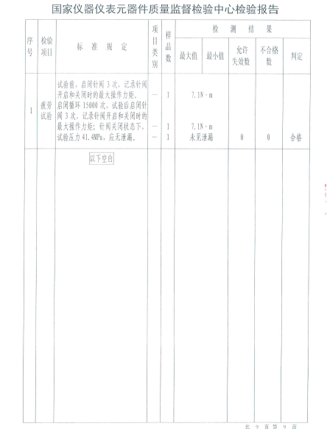
Company Overview
Seminar Exhibition
企业
概况
企业
能力
Certificates
Test Report
Main Facilities
实战
练习
结语
Performance
江苏新中信电器设备有限公司
JIANGSU XINZHONGXIN CO.,LTD
【Test Report】
Needle valve fatigue test: According to JB/T 8859-2004, GB/T 13927-2008, the needle valve is repeatedly opened and closed 15,000 times, and then under a pressure of 6000 psi, the needle valve is opened and closed 3 times, while the valve has no leakage.
Advanced Fluid Control
Perfect Partner

Slide 10
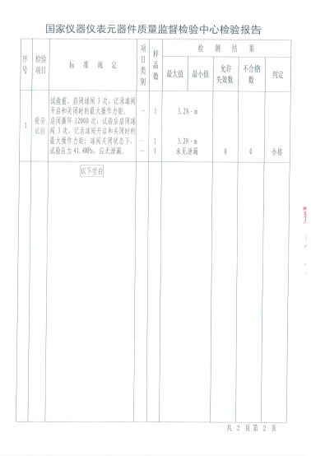
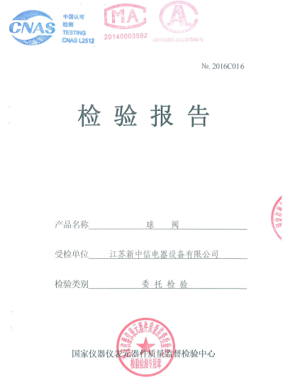
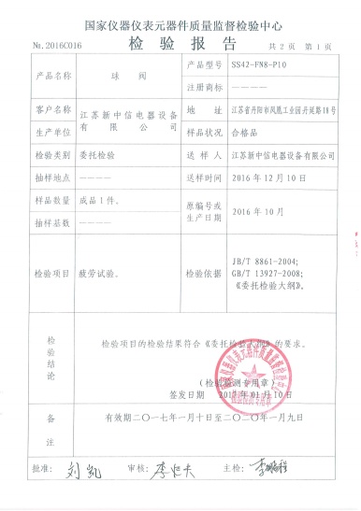
Company Overview
Seminar Exhibition
企业
概况
企业
能力
Certificates
Test Report
Main Facilities
实战
练习
结语
Performance
江苏新中信电器设备有限公司
JIANGSU XINZHONGXIN CO.,LTD
【Test Report】
Ball valve fatigue test: According to JB/T 8859-2004 and GB/T 13927-2008 standards, the ball valve is repeatedly opened and closed 12000 times, and then under a pressure of 6000 psi, the ball valve is opened and closed 3 times, while the valve has no leakage.
Advanced Fluid Control
Perfect Partner

Slide 11
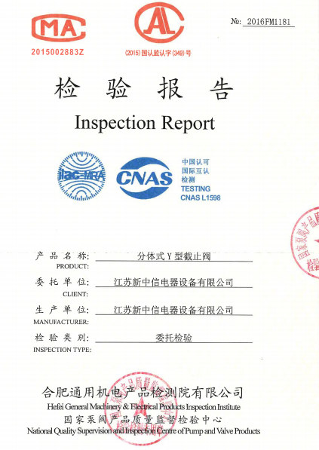
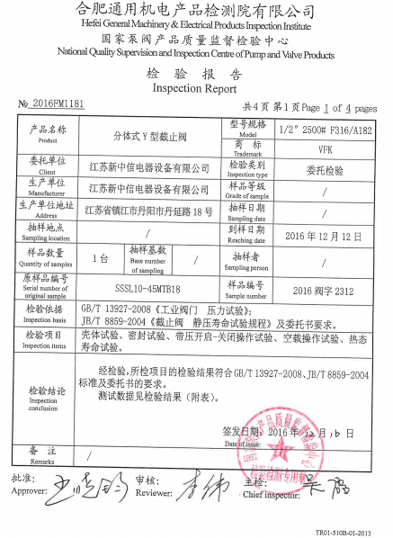
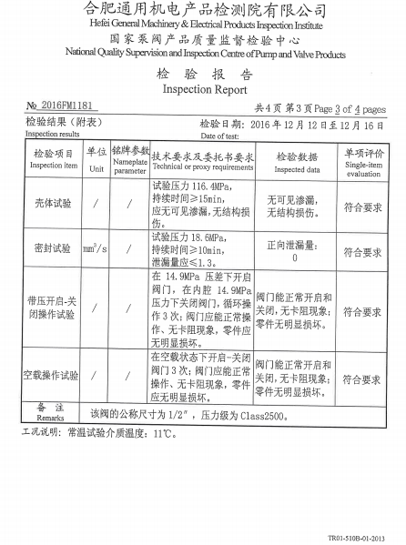
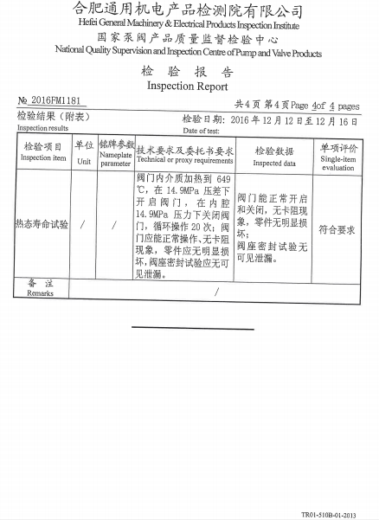
Company Overview
Seminar Exhibition
企业
概况
企业
能力
Certificates
Test Report
Main Facilities
实战
练习
结语
Performance
江苏新中信电器设备有限公司
JIANGSU XINZHONGXIN CO.,LTD
【Test Report】
Y-type globe valve: According to GB/T 13927-2008 and JB/T 8859-2004 standards, carry out shell test, sealing test, open-close test under pressure, no-load operation test, hot life test in Hefei General Machinery Research Institute. Our Y-type globe valve can replace imported products.
Advanced Fluid Control
Perfect Partner

Slide 12
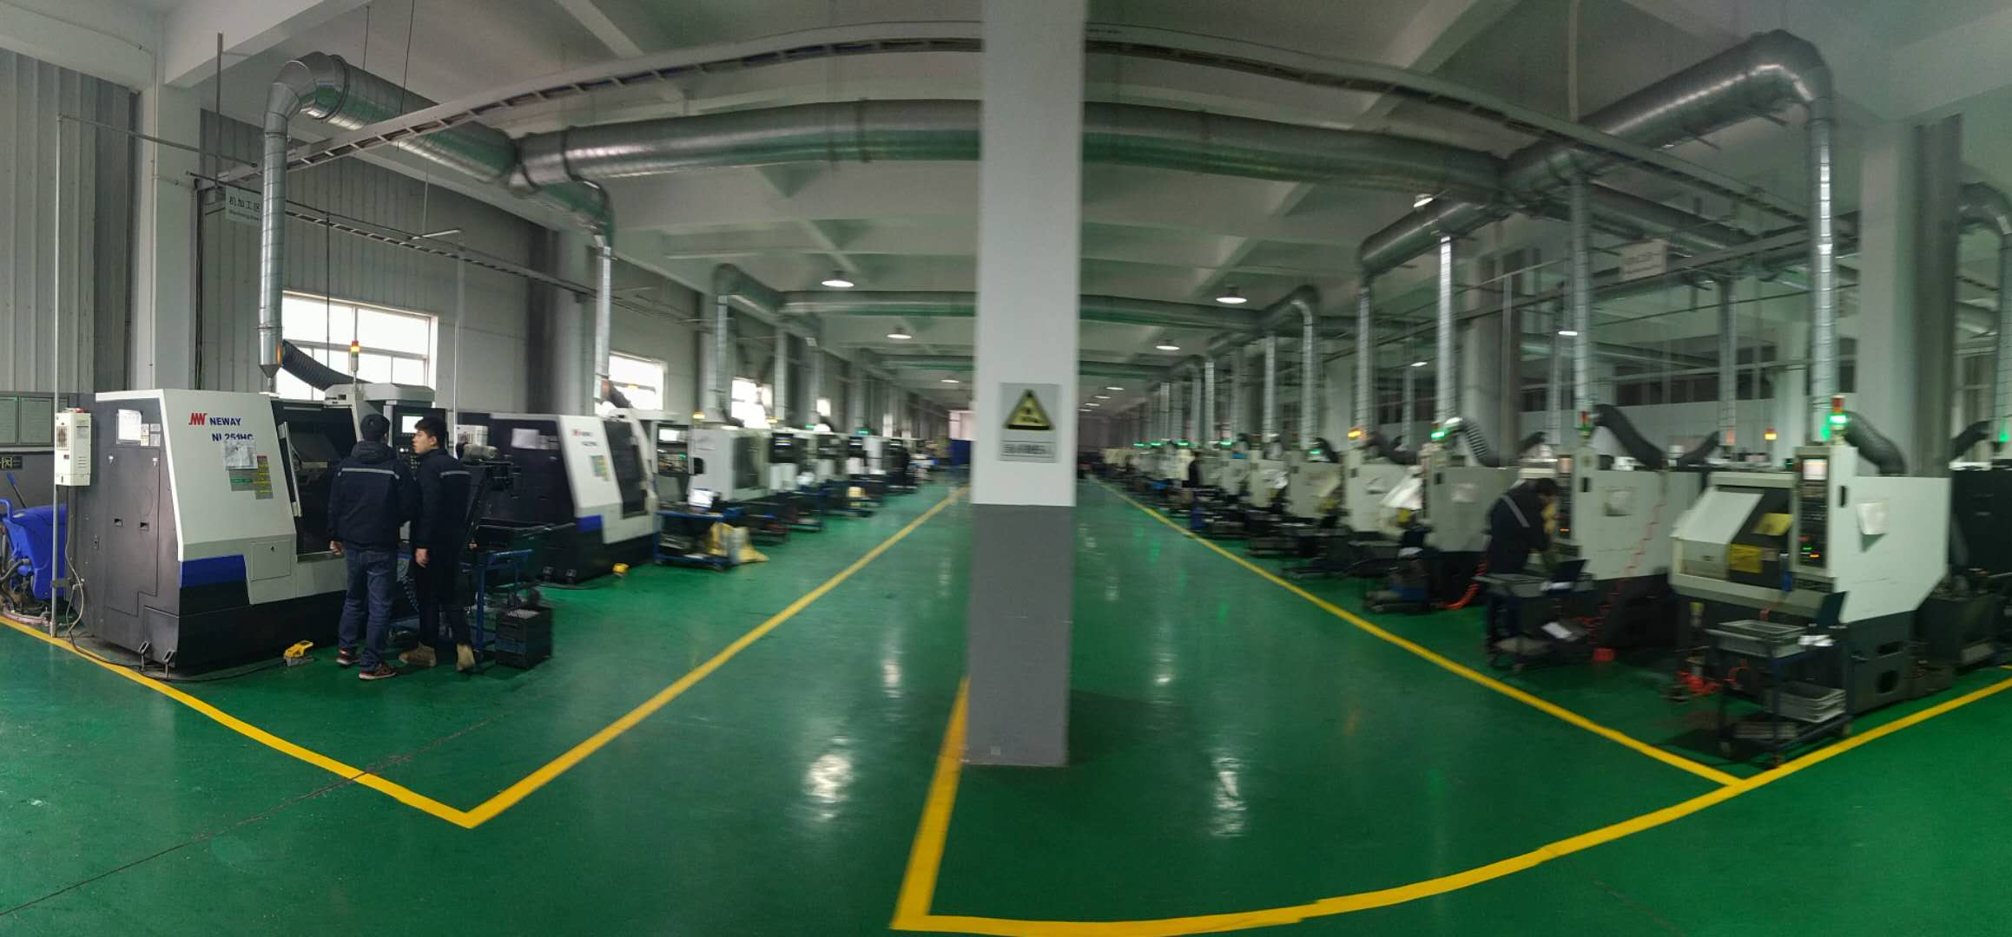
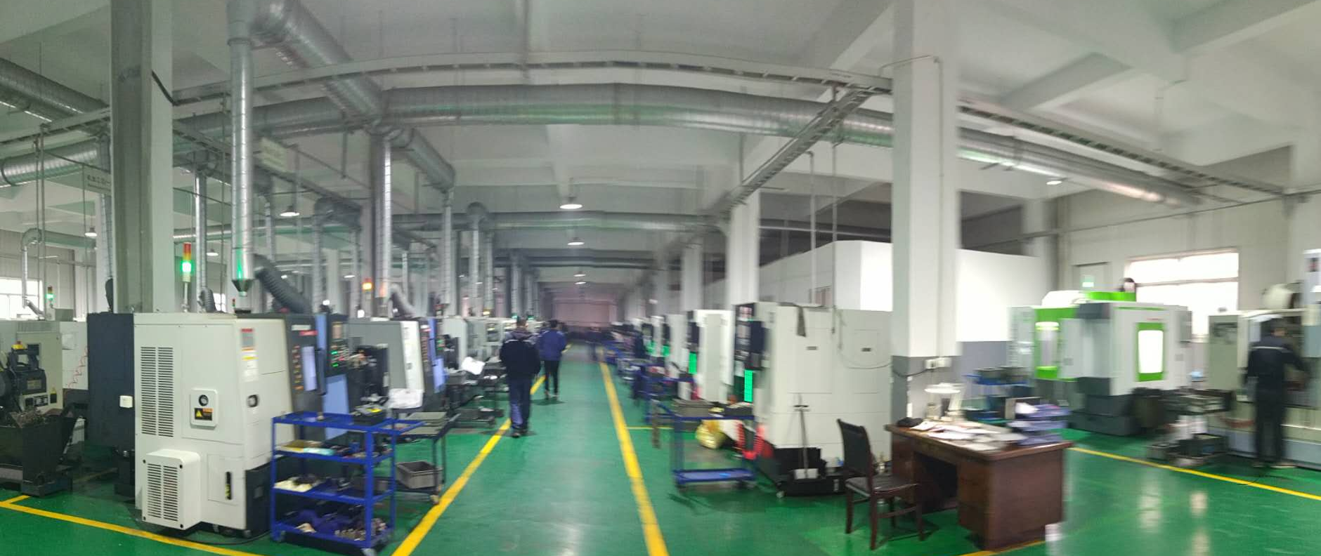
Company Overview
Seminar Exhibition
企业
概况
企业
能力
Certificates
Test Report
Main Facilities
实战
练习
结语
Performance
江苏新中信电器设备有限公司
JIANGSU XINZHONGXIN CO.,LTD
【Main Facilities】
Equipped with more than 100 sets various processing equipment, the main equipment includes:
More than 60 sets CNC machine tools: Doosan Lynx 225, Goodway TLS-150, Shengyang Machine Tool CAK 6385, Nuoxin NXX-46A/B, Lianqiang LK030-SM; Eastern CNC etc.
2 sets CNC machining centers: Twinhorn 850 L3, Priminer V9L；
More than 10 sets milling machines, rolling machines, grinders and wire cutting equipments.
Advanced Fluid Control
Perfect Partner

Slide 13
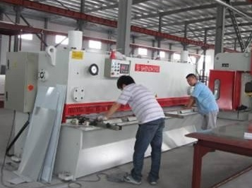
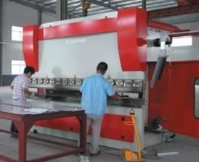
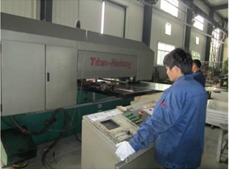
Company Overview
Seminar Exhibition
企业
概况
企业
能力
Certificates
Test Report
Main Facilities
实战
练习
结语
Performance
江苏新中信电器设备有限公司
JIANGSU XINZHONGXIN CO.,LTD
【Main Facilities】
Equipped with more than 100 sets of various processing equipment, the main equipment includes:
3 CNC shearing machines: QC12Y-12*2500, Q11-6*2500A, 3 CNC bending machines: WC67K-100/320, WC67Y-3200; 1 CNC punching and shearing machine: JY92K-2524/1250, CNC laser cutting machine: Yangli BL3015F-ZM
One automatic gas shielded welding machine: OPTIPIUS 380IW; two microcomputer welding machines: YD-500KAIHGE; one butt welding machine: UN-16.
Advanced Fluid Control
Perfect Partner

Slide 14
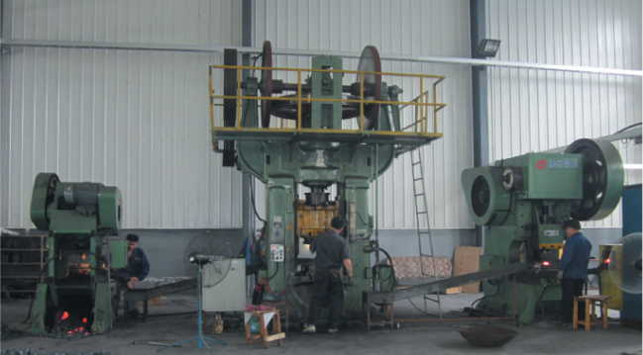
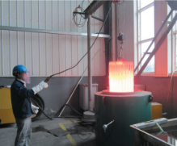
Company Overview
Seminar Exhibition
企业
概况
企业
能力
Certificates
Test Report
Main Facilities
实战
练习
结语
Performance
江苏新中信电器设备有限公司
JIANGSU XINZHONGXIN CO.,LTD
【Main Facilities】
The manufacturer is equipped with one 300-ton, one 100-ton and one 40-ton press machine, which can produce pressure forgings of various specifications. The models of press machines are: J53-300B, J23-40, J21-100.
Advanced Fluid Control
Perfect Partner

Slide 15
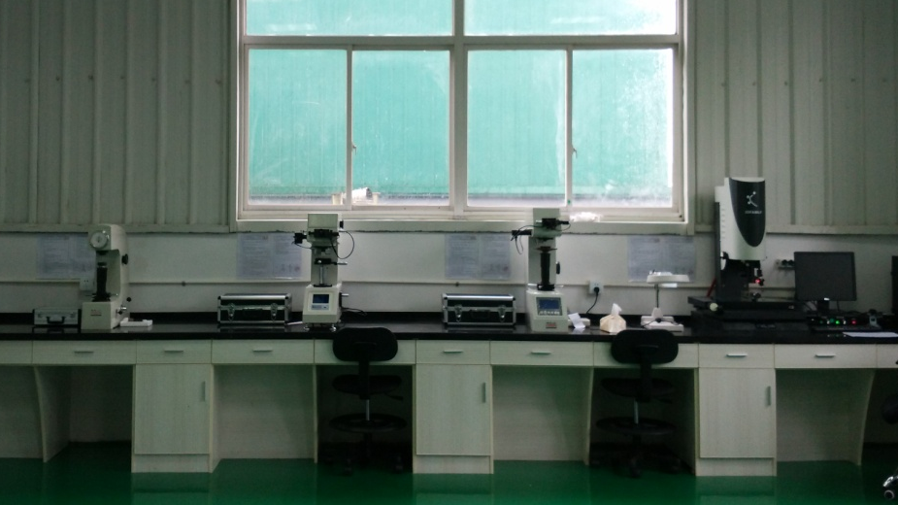
Company Overview
Seminar Exhibition
企业
概况
企业
能力
Certificates
Test Report
Main Facilities
实战
练习
结语
Performance
江苏新中信电器设备有限公司
JIANGSU XINZHONGXIN CO.,LTD
【Main Facilities】
Facilities Name |  | Qty
Size and shape inspection | 2.5 D Video Measuring Machine | 1
 | Surface roughness measuring block | 1
 | Mitutoyo Altimeter | 2
Materials analysis and inspection | Spectroscope & Analyzer | 2
 | Rockwell Hardness Tester | 1
 | Brinell Hardmess Tester | 1
 | Vickers Hardness Tester | 1
 | Shore Hardness Tester | 1
Advanced Fluid Control
Perfect Partner

Slide 16
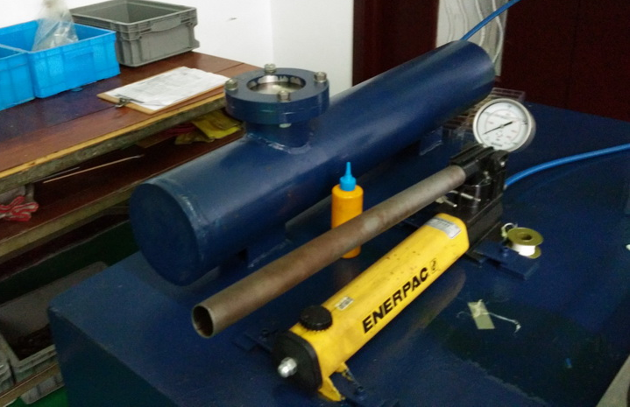
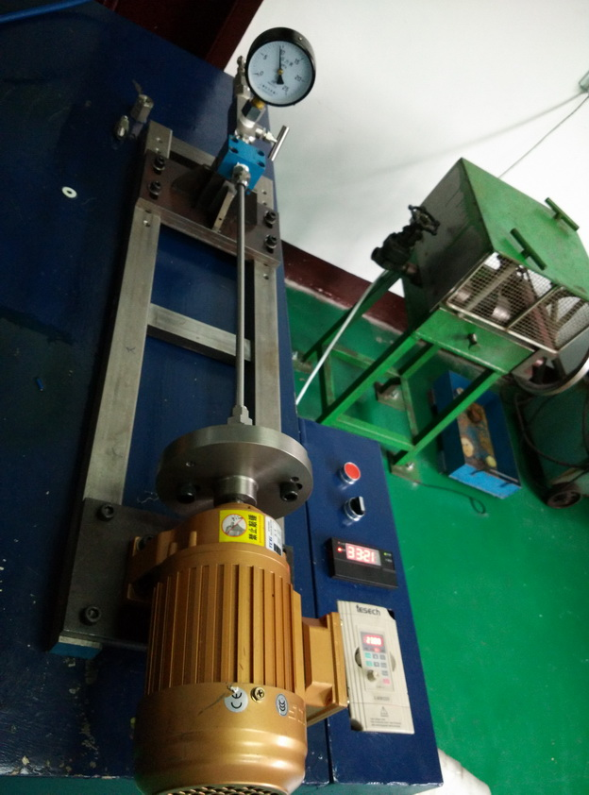
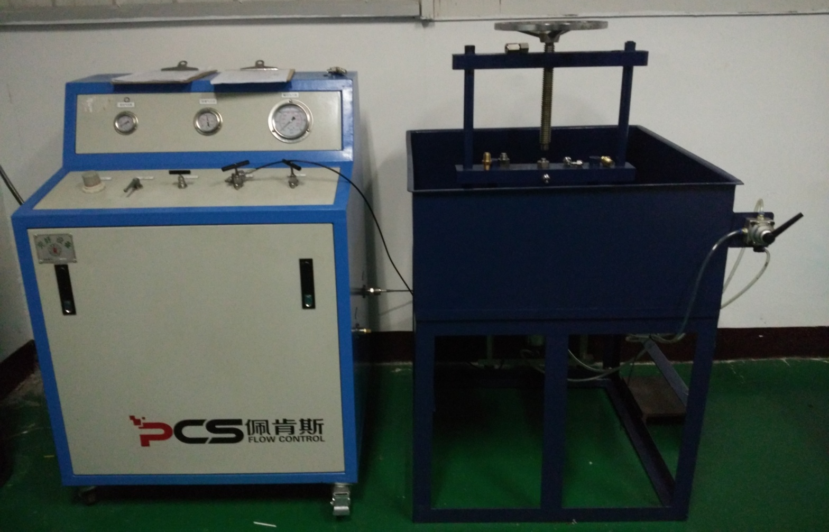
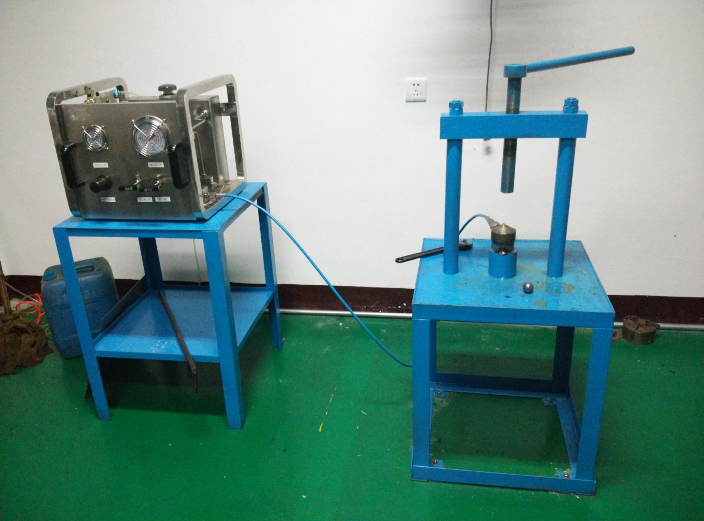
Company Overview
Seminar Exhibition
企业
概况
企业
能力
Certificates
Test Report
Main Facilities
实战
练习
结语
Performance
江苏新中信电器设备有限公司
JIANGSU XINZHONGXIN CO.,LTD
【Main Facilities】
Facilities Name |  | Qty
Pressure Test | Nitrogen test bench– 6000psi | 1
 | Water pressure test bench– 30000psi | 1
 | Water pressure test bench– 100000psi | 1
 | Ferrule vibration test bench | 1
 | Ferrule blasting test bench | 1
 | Salt spray test bench | 1
Advanced Fluid Control
Perfect Partner

Slide 17
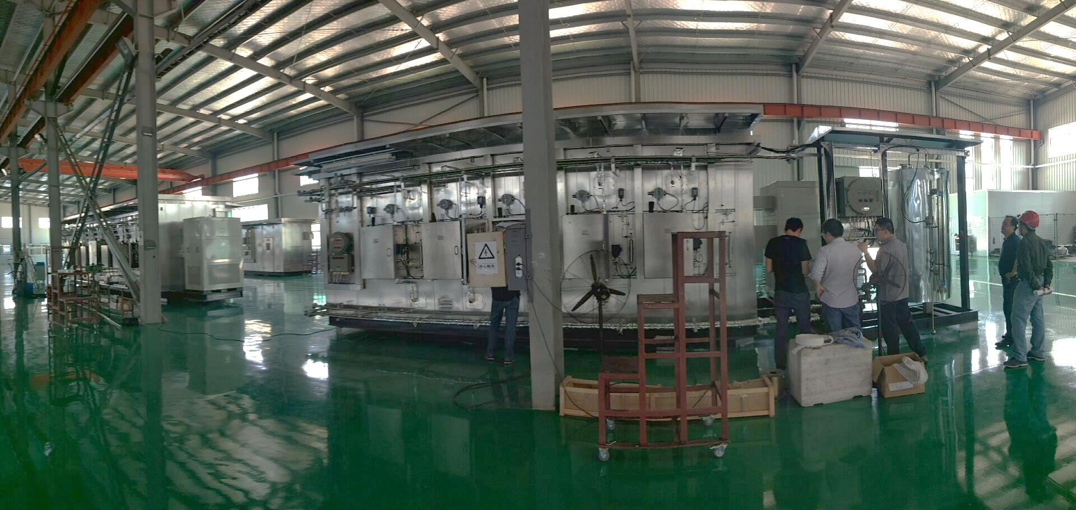
Company Overview
Seminar Exhibition
企业
概况
企业
能力
Certificates
Test Report
Main Facilities
实战
练习
结语
Performance
江苏新中信电器设备有限公司
JIANGSU XINZHONGXIN CO.,LTD
【Main Facilities】
The manufacturer has 6,000 square meters professional analysis houses workshop, special electrical and pneumatic laboratory and debugging center. It has the production, installation, integration and commissioning capabilities of analysis houses and online analysis systems used in large petrochemical plants supporting for 1 million tons/ethylene and 10 million tons/refining projects.
Advanced Fluid Control
Perfect Partner

Slide 18
Company Overview
Seminar Exhibition
企业
概况
企业
能力
Certificates
Test Report
Main Facilities
实战
练习
结语
Performance
江苏新中信电器设备有限公司
JIANGSU XINZHONGXIN CO.,LTD
【Performance】
User | Owner | Project Name | Product Name
SINOPEC Beijing Yanshan Company | SINOPEC Beijing Yanshan Company | 300,000 tons of ethylene expansion project | Fittings and valves, explosion-proof electric appliance, cable tray
SINOPEC Beijing Yanshan Company | SINOPEC Beijing Yanshan Company | Reforming hydrotreating project | Fittings and valves, explosion-proof electric appliance, cable tray
SINOPEC Beijing Yanshan Company | SINOPEC Beijing Yanshan Company | 2 million tons of catalytic project | Fittings and valves, explosion-proof electric appliance, cable tray
SINOPEC Beijing Yanshan Company | SINOPEC Beijing Yanshan Company | 200,000 tons of polypropylene | Fittings and valves, explosion-proof electric appliance, cable tray
SINOPEC Beijing Yanshan Company | SINOPEC Beijing Yanshan Company | 660,000 tons of ethylene expansion project | Fittings and valves, explosion-proof electric appliance, cable tray
SINOPEC Beijing Yanshan Company | SINOPEC Beijing Yanshan Company | 100,000 tons of NBR | Fittings and valves, explosion-proof electric appliance, cable tray
SINOPEC Beijing Yanshan Company | SINOPEC Beijing Yanshan Company | 100,000 tons ethylene cracking furnace | Fittings and valves, explosion-proof electric appliance, cable tray
SINOPEC Beijing Yanshan Company | SINOPEC Beijing Yanshan Company | Styrene renovation | Fittings and valves, explosion-proof electric appliance, cable tray
SINOPEC Beijing Yanshan Company | SINOPEC Beijing Yanshan Company | Glycol renovation | Fittings and valves, explosion-proof electric appliance, cable tray
Beijing Yanhua Construction Engineering Co.Ltd | SECCO | 900,000 tons of ethylene project | Fittings and valves, explosion-proof electric appliance, cable tray
Shandong Qilu Petrochemical Engineering Co. Ltd | Shandong Qilu Petrochemical Engineering Co. Ltd | 720,000 tons ethylene project | Fittings and valves, explosion-proof electric appliance, cable tray
Advanced Fluid Control
Perfect Partner

Slide 19
Company Overview
Seminar Exhibition
企业
概况
企业
能力
Certificates
Test Report
Main Facilities
实战
练习
结语
Performance
江苏新中信电器设备有限公司
JIANGSU XINZHONGXIN CO.,LTD
【Performance】
User | Owner | Project Name | Product Name
Sinopec Yizheng Chemical Fibre Company Limited | Sinopec Yizheng Chemical Fibre Company Limited | 450,000 tons PTA | Fittings and valves, cable tray, ex-proof appliance,
Sinopec Yizheng Chemical Fibre Company Limited | Sinopec Yizheng Chemical Fibre Company Limited | 650,000 tons ethylene ,PTA | Fittings and valves, cable tray, ex-proof appliance,
Sinopec Tianjin Company | Sinopec Tianjin Company | Chemical Fiber Plant Transformation | Fittings and valves
BASF-YPC Company Limited | BASF-YPC Company Limited | Ethylene project, the central tank | Fittings and valves, cable tray, ex-proof appliance,
Sinopec Engineering Corporation | Sinopec Qingdao Refining Corp. Ltd. | 10 million tons of oil refining | Fittings and valves, cable tray
Sinopec Shanghai Engineering Co., Ltd. | Sinopec Qingdao Refining Corp. Ltd. | 10 million tons of oil refining | cable tray, ex-proof appliance,
Sinopec Ningbo Engineering Co.,Ltd. | Sinopec Qingdao Refining Corp. Ltd. | 10 million tons of oil refining | Fittings and valves
Luoyang Petrochemical Engineering Corporation/Sinopec | Sinopec Qingdao Refining Corp. Ltd. | 10 million tons of oil refining | Fittings and valves
Sinopec Shanghai Engineering Co., Ltd. | Sinopec Tianjin Company | 1 million tons of ethylene | Fittings and valves, instrument protective box
Sinopec Shanghai Engineering Co., Ltd. | Zhenhai Refining & Chemical | 1 million tons of ethylene | cable tray
Fujian Refining & Petrochemical Co., Ltd. | Fujian Refining & Petrochemical Co., Ltd. | Refining and ethylene integration | Fittings and valves
Advanced Fluid Control
Perfect Partner

Slide 20
Company Overview
Seminar Exhibition
企业
概况
企业
能力
Certificates
Test Report
Main Facilities
实战
练习
结语
Performance
江苏新中信电器设备有限公司
JIANGSU XINZHONGXIN CO.,LTD
【Performance】
User | Owner | Project Name | Product
Beijing Yanshan Yulong Petrochemical Co. Ltd | Sinopec Tianjin Company | 1 million tons ethylene and supporting project (butadiene / MTBE, gas sweetening, sour water stripper, boiler flue gas desulfurization devices) | Fittings and valves, ex-proof appliance, instrument protective box, cable tray
Sinopec Tianjin Company | Sinopec Tianjin Company | 1 million tons ethylene and supporting project (10 million tons of 1# atmospheric and vacuum distillation, hydrocracking, wax oil hydrotreating, 3.2 million tons of diesel hydrogenation, etc.) | Fittings and valves, ex-proof appliance, instrument protective box, cable tray
Luoyang Petrochemical Engineering Corporation/Sinopec | Sinopec Tianjin Company | 1 million tons / year ethylene and supporting project (reforming, delayed coking and other devices) | Fittings and valves, ex-proof appliance,
Shanghai Zone Petrochemical Engineering Co.Ltd(SZPE AMEC) | Sinopec Tahe Company | Heavy crude oil upgrading project | cable tray
Luoyang Petrochemical Engineering Corporation/Sinopec | Sinopec Tahe Company | Heavy crude oil upgrading project | Fittings and valves, ex-proof appliance,
Luoyang Petrochemical Engineering Corporation/Sinopec | Sinopec Changling Company | Crude oil and oil products of inferior quality upgrading project | Fittings and valves, ex-proof appliance, instrument protective box
Luoyang Petrochemical Engineering Corporation/Sinopec | Sinopec Guangzhou Company | Petrochemical coking unit | Fittings and valves, ex-proof appliance, instrument protective box, cable tray
Advanced Fluid Control
Perfect Partner

Slide 21
Company Overview
Seminar Exhibition
企业
概况
企业
能力
Certificates
Test Report
Main Facilities
实战
练习
结语
Performance
江苏新中信电器设备有限公司
JIANGSU XINZHONGXIN CO.,LTD
【Performance】
User | Owner | Project Name | Product
Luoyang Petrochemical Engineering Corporation/Sinopec | Sinopec Shengli Oilfield Company | Diesel quality upgrading project (Joint sulfur recovery unit) | cable tray
Sinopec Engineering Corporation | Sinopec Shijiazhuang Refining & Chemical Company | Inferior crude oil quality upgrade and transformation project | Fittings and valves
Sinopec Anqing Company | Sinopec Anqing Company | Integration Project of Sinopec Anqing Company | cable tray, instrument fittings and valves, ex-proof appliance,
Sinopec Engineering Corporation | Shanxi Yanchang Petroleum | Jingbian Energy and Chemical integrated utilization industry park project | Fittings and valves
Luoyang Petrochemical Engineering Corporation/Sinopec | Hainan Refinery | 8 million tons of oil refinery | Fittings and valves, ex-proof appliance,
Sinopec Shanghai Engineering Co., Ltd. | Shanghai Sinopec Mitsui Chemical Co., Ltd. | Shanghai Sinopec Mitsui Chemical Co., Ltd. 400,000 tons / year phenol -acetone project | Fittings and valves, ex-proof appliance,
Sinopec Shanghai Engineering Co., Ltd. | China Coal Yuheng | 3.6 million tons coal to methanol and deep processing project | Fittings and valves, instrument protective box
Luoyang Petrochemical Engineering Corporation/Sinopec | Xinjiang Tahe | Heavy crude oil upgrading project | Fittings and valves, ex-proof appliance,
Sinopec Engineering Corporation | Shanghai SECCO | 90,000 tons butadiene | Fittings and valves
Luoyang Petrochemical Engineering Corporation/Sinopec | Shanxi Pucheng | 700,000 tons DMTO project | cable tray, instrument protective box
Luoyang Petrochemical Engineering Corporation/Sinopec | Zhejiang xingxing | 300,000 tons polyethylene, 390,000 tons propylene units | Fittings and valves, instrument protective box
Advanced Fluid Control
Perfect Partner

Slide 22
Company Overview
Seminar Exhibition
企业
概况
企业
能力
Certificates
Test Report
Main Facilities
实战
练习
结语
Performance
江苏新中信电器设备有限公司
JIANGSU XINZHONGXIN CO.,LTD
【Performance】
User | Owner | Project Name | Product
Luoyang Petrochemical Engineering Corporation/Sinopec | Shanxi Yanchang Petroleum (Group) Co., Ltd. | Yulin refinery 1.8 million tons catalytic cracking unit and ancillary facilities technological transformation projects | Cable tray
Sinopec Shanghai Engineering Co., Ltd. | Beihai Petrochemical refinery | China Sinopec Beihai Petrochemical refinery off-site renovation project | Ex-proof appliance,
Sinopec Engineering Corporation | Zhongyuan Petrochemical | Zhongyuan Petrochemical 600,000 tons/year methanol-to-olefin project | Fittings and valves
Sinopec Qingdao Refining Corp. Ltd. | Sinopec Qingdao Refining Corp. Ltd. | Styrene unit, hydrogenation unit, overhaul | Fittings and valves, ex-proof appliance, instrument protective box
Sinopec Baling Company | Sinopec Baling Company | 50,000 tons special epoxy resin and the expansion supporting project, 60,000 tons lithium polymer project | Cable tray
Yanshan Yulong Petrochemical Engineering Co. | Sinopec Wuhan Company | 800,000 tons ethylene project and 130,000 tons butadiene unit | Fittings and valves, ex-proof appliance, instrument protective box
Luoyang Petrochemical Engineering Corporation/Sinopec | Zhanjiang Dongxing Petrochemical Co., Ltd. | 2,000,000 tons diesel hydrogenation unit | Fittings and valves
Sinopec Jinling Company | Sinopec Jinling Company | 3.5 million tons catalytic cracking unit, crude oil distillation unit, hydrotreating unit | Cable tray, Fittings and valves, ex-proof appliance,
Sinopec Wuhan Company | Sinopec Wuhan Company | Wuhan site 800,000 tons ethylene project | Cable tray, ex-proof appliance,
Sinopec Shanghai Engineering Co., Ltd. | China Coal Mengda | PP device | Fittings and valves, ex-proof appliance, ,instrument protective box
Advanced Fluid Control
Perfect Partner

Slide 23
Company Overview
Seminar Exhibition
企业
概况
企业
能力
Certificates
Test Report
Main Facilities
实战
练习
结语
Performance
江苏新中信电器设备有限公司
JIANGSU XINZHONGXIN CO.,LTD
【Performance】
User | Owner | Project Name | Product
Luoyang Petrochemical Engineering Corporation/Sinopec | Shenhua Yulin | MTO downstream processing of methanol | Instrument protective box
Sinopec Engineering Corporation | Dalian West Pacific Petrochemical Co., Ltd. | 1.3 million tons of reforming-extraction | Fittings and valves
Sinopec Engineering Corporation | Zhongtian hechuang | Zhongtian Hechuang Coal Chemical Project | Cable tray
Luoyang Petrochemical Engineering Corporation/Sinopec | Kazakhstan ,Atyrau oil Refinery | Turnkey construction project of oil deep processing unit | Cable tray
Luoyang Petrochemical Engineering Corporation/Sinopec | Kazakhstan ,Atyrau oil Refinery | Turnkey construction project of oil deep processing unit | Ex-proof appliance,
Luoyang Petrochemical Engineering Corporation/Sinopec | Beihai LNG | LNG receiving station project | Cable tray, Fittings and valves, ex-proof appliance,
Luoyang Petrochemical Engineering Corporation/Sinopec | Changzhou Fude | 300,000 tons-MTO, OCU and PP equipment | Fittings and valves, ex-proof appliance,
Luoyang Petrochemical Engineering Corporation/Sinopec | Jiujiang Petrochemical | Sludge drying treatment facility project | Cable tray
Luoyang Petrochemical Engineering Corporation/Sinopec | Kazakhstan ,Atyrau oil Refinery | Turnkey construction project of oil deep processing unit | Explosion-proof junction box
Advanced Fluid Control
Perfect Partner

Slide 24
Company Overview
Seminar Exhibition
企业
概况
企业
能力
Certificates
Test Report
Main Facilities
实战
练习
结语
Performance
江苏新中信电器设备有限公司
JIANGSU XINZHONGXIN CO.,LTD
【Performance】
User | Owner | Project Name | Product
China Huanqiu Contracting & Engineering Co., Ltd. | Tianjin Dagu Project | 30,000 cubic meters of ethylene storage tank project | Fittings and valves
China Huanqiu Contracting & Engineering Co., Ltd. | Shenhua Ningxia Coal | Sewage treatment, torch and other devices | Fittings and valves
China Huanqiu Contracting & Engineering Co., Ltd. | Shenhua Yulin | Polypropylene Project of Methanol Downstream Processing Unit | Ex-proof appliance,
China Huanqiu Contracting & Engineering Co., Ltd. | Shenhua Xinjiang | 600,000 tons/year olefin separation unit | Ex-proof appliance, ,instrument protective box
China Huanqiu Contracting & Engineering Co., Ltd. | Guanghui Energy | LNG Transfer Station in Lusi Port District, Nantong | Fittings and valves
China Huanqiu Contracting & Engineering Co., Ltd. | Venezuela PDVSA | Venezuela’s MPE3 project phase I 165,000 barrels/day expansion project oil transfer station | Fittings and valves
China Huanqiu Contracting & Engineering Co., Ltd. | Egyptian state-owned cotton spinning holding company | 40,000 tons/year polyester staple fiber reconstruction and expansion project | Cable tray, fittings and valves
China Huanqiu Contracting & Engineering Co., Ltd. | Shenhua Yulin | PP device | Analysis houses
Advanced Fluid Control
Perfect Partner

Slide 25
Company Overview
Seminar Exhibition
企业
概况
企业
能力
Certificates
Test Report
Main Facilities
实战
练习
结语
Performance
江苏新中信电器设备有限公司
JIANGSU XINZHONGXIN CO.,LTD
【Performance of analysis houses】
Time | User | Use Device | Equipment Name | Qty
2013 | SINOPEC Beijing Yanshan Company | Ethylene cracking | Sampling processing system | 2
2013 | Sinopec Nanjing Chemical Industries Co.,Ltd. | Synthetic ammonia | Thermal hydrogen and analysis house supporting | 1
2013 | Fujian Refining & Petrochemical Company Limited(FREP) | EOEG | Online analyzer and analysis house supporting | 1
2013 | Fujian Refining & Petrochemical Company Limited(FREP) | EOEG | Newly added magnetic oxygen analyzer and pretreatment | 1
2013 | Ningbo Haiyue | Propane dehydrogenation | Analysis house | 4
2014 | SINOPEC Beijing Yanshan Company | C8 extraction of styrene | Integration of analysis houses | 1
2014 | Fujian Refining & Petrochemical Company Limited(FREP) | Oil refining | Total sulfur analyzer analysis house supporting | 1
2014 | SINOPEC Beijing Yanshan Company | Cracking caustic washing tower CO2 | Chromatograph and pretreatment supporting | 1
Advanced Fluid Control
Perfect Partner

Slide 26
Company Overview
Seminar Exhibition
企业
概况
企业
能力
Certificates
Test Report
Main Facilities
实战
练习
结语
Performance
江苏新中信电器设备有限公司
JIANGSU XINZHONGXIN CO.,LTD
【Performance of analysis houses】
Time | User | Use Device | Equipment Name | Qty
2014 | Sinopec Jiujiang Company | Environmental protection | PH, dissolved oxygen, conductivity and pretreatment kit | 3
2014 | SINOPEC SABIC TianJin Petrochemical Company Limited | EO expansion | Chromatograph and analysis house supporting | 1
2014 | Oxiranchem Yangzhou | EOEG | Analyzer pretreatment system | 5
2014 | Changzhou Fude Energy Investment Holding Co.,Ltd. | Air separation | PH, conductivity and supporting | 1
2014 | Shenhua Yulin | DMTO | Integration of analysis houses | 1
2014 | Shenhua Yulin | PP | Integration of analysis houses | 1
2014 | Taiwan Far Easten Group Yangzhou Company | EO | Analyzer pretreatment system | 8
2014 | Shenhua Yulin | PP | Air transmission system analysis house supporting | 1
Advanced Fluid Control
Perfect Partner

Slide 27
Company Overview
Seminar Exhibition
企业
概况
企业
能力
Certificates
Test Report
Main Facilities
实战
练习
结语
Performance
江苏新中信电器设备有限公司
JIANGSU XINZHONGXIN CO.,LTD
【Performance of analysis houses】
Time | User | Use Device | Equipment Name | Qty
2015 | ZTHC Energy | PP | Chromatograph and analysis house supporting | 3
2015 | Auhui Anqing Shuguang Chemical Group | Butanol | Chromatograph, infrared analyzer and analysis house supporting | 1
2015 | Shenzhen Fude Energy Investment Holding Co.,Ltd.(Changzhou company) | PP | Integration of analysis houses | 3
2015 | Sinopec Qingdao Refining Corp. Ltd. | Hydrocracking/styrene | Integration of analysis houses | 1
2015 | SINOPEC SABIC TianJin Petrochemical Company Limited | Styrene | Integration of analysis houses | 1
2015 | Yun Tian Hua Group | Isooctane | Integration of analysis houses | 1
2016 | Shandong Hai Hua Group Co.,Ltd. | Salinization integration (magnetic oxygen, hydrogen, methane analyzer) | Integration of analysis houses | 4
2016 | Sinopec Yizheng Chemical Fibre Company Limited | Diesel hydrogenation | Integration of analysis houses | 1
2016 | SINOPEC Beijing Yanshan Company | Cracking (PH, conductivity) | Integration of analysis houses | 1
Advanced Fluid Control
Perfect Partner

Slide 28
Company Overview
Seminar Exhibition
企业
概况
企业
能力
Certificates
Test Report
Main Facilities
实战
练习
结语
Performance
江苏新中信电器设备有限公司
JIANGSU XINZHONGXIN CO.,LTD
【Performance of analysis houses】
Time | User | Use Device | Equipment Name | Qty
2016 | Sinopec Jinling Company | PX (environmental protection) | Integration of analysis houses | 1
2016 | SINOPEC Beijing Yanshan Company | S-MTO | Integration of analysis houses | 1
2016 | Air Liquide | Air separation (COD) | Integration of analysis houses | 2
2016 | Yutime Petroleum Company Ltd. | Oil refining | Integration of analysis houses | 1
2016 | Huizhou Refining Ethylene Phase II | OCU | Integration of analysis houses | 2
2016 | Sinopec Jinling Company | PX | Integration of analysis houses | 1
2016 | SINOPEC SABIC TianJin Petrochemical Company Limited | VOC | Integration of analysis houses | 3
2017 | Sinopec Anqing Petrochemical Co.,Ltd. | Total sulfur | Integration of analysis houses | 1
2017 | Huizhou Refining Ethylene Phase II | EO/EG | Integration of analysis houses | 2
2017 | Sinopec Tianjin Company | VOC | Integration of analysis houses | 3
Advanced Fluid Control
Perfect Partner

Slide 29
Company Overview
Seminar Exhibition
企业
概况
企业
能力
Certificates
Test Report
Main Facilities
实战
练习
结语
Performance
江苏新中信电器设备有限公司
JIANGSU XINZHONGXIN CO.,LTD
【Performance of analysis houses】
Time | User | Use Device | Equipment Name | Qty
2017 | Zhong'an United Coal Chemical Co., Ltd. | OCC | Integration of analysis houses | 1
2017 | Zhong'an United Coal Chemical Co., Ltd. | PP | Integration of analysis houses | 1
2017 | Zhong'an United Coal Chemical Co., Ltd. | LLDPE | Integration of analysis houses | 1
2017 | Sinopec Tianjin Company | Alkylation | Integration of analysis houses | 1
2017 | Sinopec Qingdao Refining Corp. Ltd. | COD | Integration of analysis houses | 4
2017 | Shanxi Yanchang Petroleum | Butanol 2PH | Integration of analysis houses | 2
2018 | China-Korea (Wuhan) Petrochemical Co., Ltd. | 2PH | Integration of analysis houses | 1
Advanced Fluid Control
Perfect Partner

Slide 30
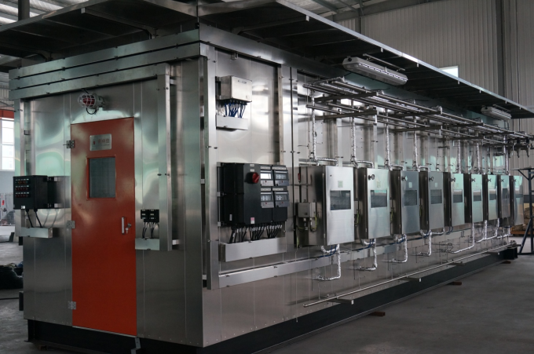
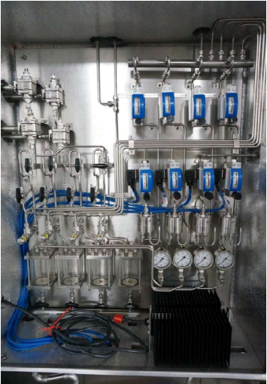
Company Overview
Seminar Exhibition
企业
概况
企业
能力
Certificates
Test Report
Main Facilities
实战
练习
结语
Performance
江苏新中信电器设备有限公司
JIANGSU XINZHONGXIN CO.,LTD
【Performance of analysis houses】
Fujian Refining & Petrochemical Company Limited(FREP) EO/EG
Advanced Fluid Control
Perfect Partner

Slide 31
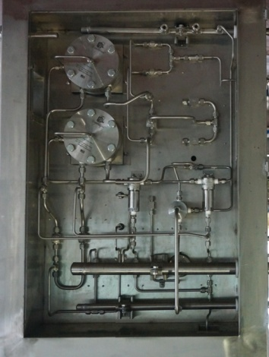
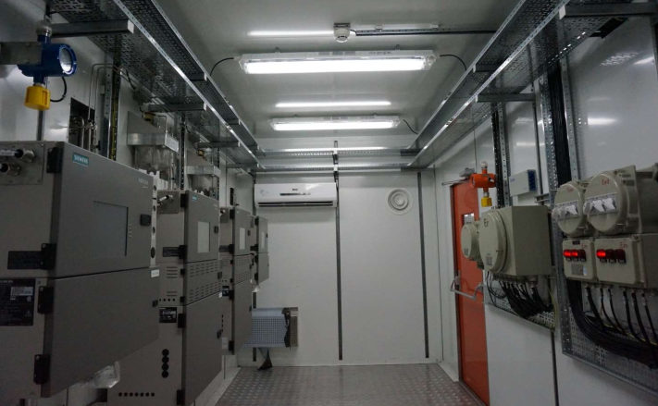
Company Overview
Seminar Exhibition
企业
概况
企业
能力
Certificates
Test Report
Main Facilities
实战
练习
结语
Performance
江苏新中信电器设备有限公司
JIANGSU XINZHONGXIN CO.,LTD
【Performance of analysis houses】
Shenhua Yulin DMTO PP
Advanced Fluid Control
Perfect Partner

Slide 32
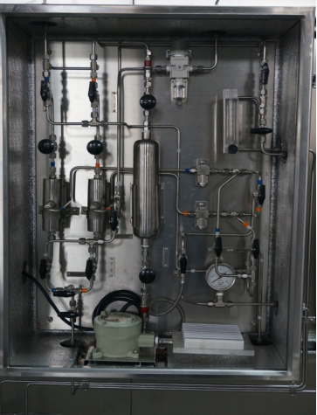
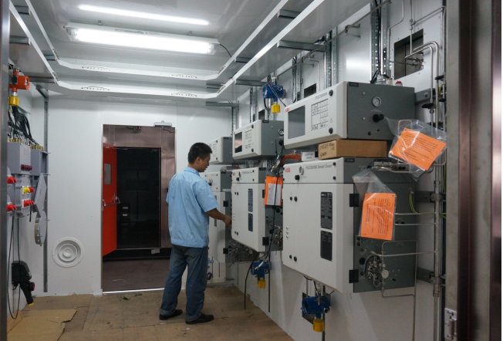
Company Overview
Seminar Exhibition
企业
概况
企业
能力
Certificates
Test Report
Main Facilities
实战
练习
结语
Performance
江苏新中信电器设备有限公司
JIANGSU XINZHONGXIN CO.,LTD
【Performance of analysis houses】
SINOPEC Beijing Yanshan Company C8 extraction of styrene
Advanced Fluid Control
Perfect Partner

Slide 33
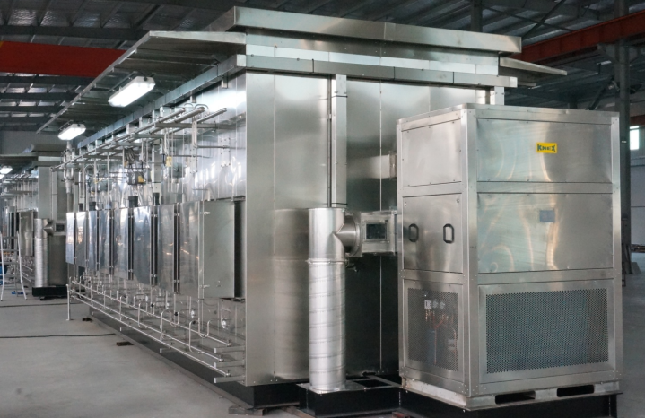
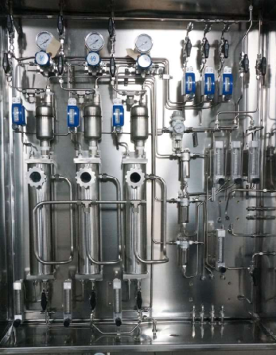
Company Overview
Seminar Exhibition
企业
概况
企业
能力
Certificates
Test Report
Main Facilities
实战
练习
结语
Performance
江苏新中信电器设备有限公司
JIANGSU XINZHONGXIN CO.,LTD
【Performance of analysis houses】
CNOOC Huizhou Refinery OCU
Advanced Fluid Control
Perfect Partner

Slide 34
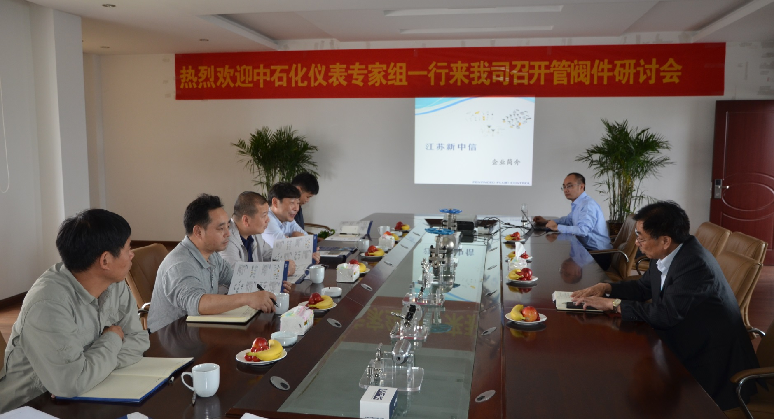
Company Overview
企业
概况
企业
能力
Certificates
Test Report
Main Facilities
实战
练习
结语
Seminar Exhibition
Performance
江苏新中信电器设备有限公司
JIANGSU XINZHONGXIN CO.,LTD
【Seminar Exhibition】
In May 2016, the Sinopec expert team came to our company for a seminar on instrument fittings and valves
Advanced Fluid Control
Perfect Partner

Slide 35
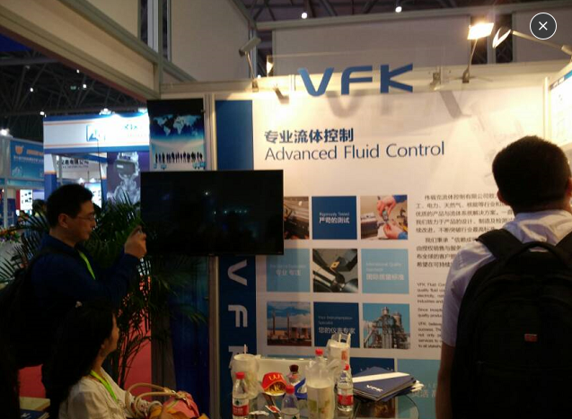



Company Overview
企业
概况
企业
能力
Certificates
Test Report
Main Facilities
实战
练习
结语
Seminar Exhibition
Performance
江苏新中信电器设备有限公司
JIANGSU XINZHONGXIN CO.,LTD
【Seminar Exhibition】
Miconex 2015
Adipec 2015
MIOGE 2016
OTC 2016
Advanced Fluid Control
Perfect Partner

Slide 36


Company Overview
企业
概况
企业
能力
Certificates
Test Report
Main Facilities
实战
练习
结语
Seminar Exhibition
Performance
江苏新中信电器设备有限公司
JIANGSU XINZHONGXIN CO.,LTD
【Seminar Exhibition】
CIOAE 2017
CIOAE 2018
Advanced Fluid Control
Perfect Partner

Slide 37



Company Overview
企业
概况
企业
能力
Certificates
Test Report
Main Facilities
实战
练习
结语
Seminar Exhibition
Performance
江苏新中信电器设备有限公司
JIANGSU XINZHONGXIN CO.,LTD
【Seminar Exhibition】
2019 Abu Dhabi International Petroleum Exhibition & Conference
(Adipec 2019)
Advanced Fluid Control
Perfect Partner

