Slide 1
Ezekiel – Eschatology
  And I saw the dead, great and small,
  standing before the throne, and books were opened.
  Then another book was opened, which is the book of life.
Revelation 20:12a ESV
  Behold, I will open your graves and raise you from your graves, O my people.
  And I will bring you into the land of Israel.
  Ezekiel 37:12b ESV
  My dwelling place shall be with them, and I will be their God,
  and they shall be my people.
  Then the nations will know that I am the LORD who sanctifies Israel,
  when my sanctuary is in their midst forevermore.
Ezekiel 37:27-28 ESV
Son of man, set your face toward Gog, of the land of Magog,
the chief prince of Meshech and Tubal, and prophesy against him …
Ezekiel 38:2 ESV
©2025 Mike Whyte – this document may be used freely for personal study, preaching, and teaching. No part of it may be used under any circumstances for commercial purposes or to attain personal gain or advantage.
Notes:
We have reached the last part of the Book of Ezekiel – eschatology.
The first part of chapter 37 contains the vision of the Valley of Dry Bones
This is implicitly related to the Great White Trone Judgement in Revelation chapter 20
After the vision, Ezekiel returns to familiar theme – New Israel
Then, the actors in the attack of Gog are introduced

Slide 2
What is “Eschatology”?
Eschatology relates to “last things”:
  Eschatology, the doctrine of the last things
    https://www.britannica.com/topic/eschatology
  Eschatology: from Greek ἔσχατος (éskhatos) 'last', and -logy;
  concerns expectations of the end of the present age, human history, or the world itself
    https://en.wikipedia.org/wiki/Eschatology
Beyond that, there is very little agreement on the meaning of the term
From a Biblical perspective, the primary meaning of the term is
the study of the events leading up to the Second Advent,
the Second Advent itself, and events after the Second Advent
Ezekiel chapters 37 through 48 all deal with events after the Second Advent
Without the Book of Revelation, eschatology is very difficult

Slide 3
Ezekiel Chapter 37
The Book of Ezekiel generally follows a chronological order
Since the fall of Jerusalem recorded in chapter 33, Ezekiel has primarily dealt with the establishment of the New Israel
The first half of Chapter 37 skips to the end of millennium,
the Great White Throne Judgement, Revelation 20:11-13
Then the second half of Chapter 37 reverts to the organization of the New Israel in the World Tomorrow
This clearly suggest that when Ezekiel was assembling the book,
he did NOT understand what was the meaning of the first half of Chapter 37
In fact, without Revelation 20:11-13,
it is impossible to understand the Vision of the Valley of Dry Bones

Slide 4
The Great White Throne Judgement
  Revelation 20:11-13 ESV
  Then I saw a great white throne and him who was seated on it.
  From his presence earth and sky fled away, and no place was found for them.
  And I saw the dead, great and small,
  standing before the throne, and books were opened.
  Then another book was opened, which is the book of life.
  And the dead were judged by what was written in the books,
  according to what they had done.
  And the sea gave up the dead who were in it,
  Death and Hades gave up the dead who were in them,
  and they were judged, each one of them, according to what they had done.

Slide 5
The Vision of the Valley of Dry Bones
Ezekiel had already experienced some very “real” visions,
such as the First Temple vision
Ezekiel almost certainly understood the Vision of the Valley of Dry Bones
as a metaphor for the reconstruction of the nation of Israel
From our perspective, the details of the vision clearly indicate that it is NOT strictly a metaphor
The vision starts out much like other visions:
  Ezekiel 37:1-2 ESV
  The hand of the LORD was upon me,
  and he brought me out in the Spirit of the LORD
  and set me down in the middle of the valley; it was full of bones.
  And he led me around among them,
  and behold, there were very many on the surface of the valley,
  and behold, they were very dry.

Slide 6
The Vision of the Valley of Dry Bones
As in other visions, Ezekiel is required to participate in the vision:
  Ezekiel 37:3-6 ESV
  And he said to me, “Son of man, can these bones live?”
  And I answered, “O Lord GOD, you know.”
  Then he said to me,
    “Prophesy over these bones, and say to them,
    O dry bones, hear the word of the LORD.
    Thus says the Lord GOD to these bones:
      Behold, I will cause breath to enter you, and you shall live.
      And I will lay sinews upon you, and will cause flesh to come upon you,
      and cover you with skin, and put breath in you, and you shall live,
      and you shall know that I am the LORD.”
The vision has a familiar objective: “you shall know that I am the LORD”

Slide 7
The Vision of the Valley of Dry Bones
From our perspective, the details of the dead coming back to life,
cannot be just a metaphor:
  Ezekiel 37:7-10 ESV
  So I prophesied as I was commanded.
  And as I prophesied, there was a sound, and behold, a rattling,
  and the bones came together, bone to its bone.
  And I looked, and behold, there were sinews on them,
  and flesh had come upon them, and skin had covered them.
  But there was no breath in them.
  Then he said to me,
    “Prophesy to the breath; prophesy, son of man, and say to the breath,
    Thus says the Lord GOD:
      Come from the four winds, O breath, and breathe on these slain, that they may live.”
  So I prophesied as he commanded me, and the breath came into them,
  and they lived and stood on their feet, an exceedingly great army.

Slide 8
Interpretation of the Vision
Ezekiel is told that what he is seeing is “the house of Israel”:
  Ezekiel 37:11 ESV
  Then he said to me,
    “Son of man, these bones are the whole house of Israel.
    Behold, they say,
      ‘Our bones are dried up, and our hope is lost; we are indeed cut off.’
This is consistent with other material in this section of the Book of Ezekiel
The return to the land and the provision of the Holy Spirit would further Ezekiel’s conviction of a metaphor:
  Ezekiel 37:14 ESV
  And I will put my Spirit within you, and you shall live,
  and I will place you in your own land.
  Then you shall know that I am the LORD; I have spoken, and I will do it, declares the LORD.

Slide 9
Interpretation of the Vision
Again, from our perspective, the details make it clear that,
as described in the Great White Throne Judgement,
a resurrection to physical life is being described:
  Ezekiel 37:12-13 ESV
  Therefore prophesy, and say to them,
    Thus says the Lord GOD:
      Behold, I will open your graves and raise you from your graves, O my people.
      And I will bring you into the land of Israel.
      And you shall know that I am the LORD,
      when I open your graves, and raise you from your graves, O my people.
Indeed, however, the vision is a “metaphor” because it deals only with
“the house of Israel” as a type of all humanity to come up
in the Great White Throne Judgement

Slide 10
A Sign Act: the Two Sticks
Ezekiel now returns to the establishment of the New Israel in the World Tomorrow:
  Ezekiel 37:15-17 ESV
  The word of the LORD came to me:
    “Son of man, take a stick and write on it,
      ‘For Judah, and the people of Israel associated with him’;
    then take another stick and write on it,
      ‘For Joseph (the stick of Ephraim) and all the house of Israel associated with him.’
    And join them one to another into one stick,
    that they may become one in your hand. …”
The “two sticks” represent the historical division of Israel, with the Tribe of Ephraim having pre-eminence in the North and the Tribe of Judah having
pre-eminence in the South
Notes:
Historically there were 8 tribes in the North and 4 tribes in the South
Over the years, large numbers from the northern tribes migrated to the South
The South was a “melting pot” for all twelve tribes
The “political” division remained as long as there were “kings” in the North

Slide 11
Interpretation of the Sign Act
Through the Second Exodus people will be called to the one nation having no schism between North and South:
  Ezekiel 37:18-21 ESV
  And when your people say to you,
    ‘Will you not tell us what you mean by these?’
  say to them, Thus says the Lord GOD:
    Behold, I am about to take the stick of Joseph (that is in the hand of Ephraim)
    and the tribes of Israel associated with him.
    And I will join with it the stick of Judah, and make them one stick,
    that they may be one in my hand.
  When the sticks on which you write are in your hand before their eyes,
  then say to them, Thus says the Lord GOD:
    Behold, I will take the people of Israel from the nations among which they have gone,
    and will gather them from all around, and bring them to their own land.

Slide 12
Interpretation of the Sign Act
There will be unified nation in the Land of Israel; all will be called to repentance;
with resurrected David as King:
  Ezekiel 37:22-25 ESV
  And I will make them one nation in the land, on the mountains of Israel.
  And one king shall be king over them all, and they shall be no longer two nations,
  and no longer divided into two kingdoms.
  They shall not defile themselves anymore with their idols and their detestable things,
  or with any of their transgressions.
  But I will save them from all the backslidings in which they have sinned,
  and will cleanse them; and they shall be my people, and I will be their God.
  My servant David shall be king over them, and they shall all have one shepherd.
  They shall walk in my [mishᵉpatim] and be careful to obey my statutes.
  They shall dwell in the land that I gave to my servant Jacob, where your fathers lived.
  They and their children and their children’s children shall dwell there forever,
  and David my servant shall be their prince forever.
Notes:
mishᵉpatim: RSV has “rules”, KJ has “judgements”; neither are even close to the meaning

Slide 13
Interpretation of the Sign Act
All persons in the New Israel will be called to conversion:
  Ezekiel 37:26-27 ESV
  I will make a covenant of peace with them.
  It shall be an everlasting covenant with them.
  And I will set them in their land and multiply them,
  and will set my sanctuary in their midst forevermore.
  My dwelling place shall be with them,
  and I will be their God, and they shall be my people.
New Israel will fulfill God’s purpose by being an example nation
to teach all the nations of the world:
  Ezekiel 37:28 ESV
  Then the nations will know that I am the LORD who sanctifies Israel,
  when my sanctuary is in their midst forevermore.

Slide 14
The Peoples on the Periphery
The prologue to the attack of Gog identifies the following actors:
  Ezekiel 38:1-6 ESV
  The word of the LORD came to me:
    “Son of man, set your face toward Gog, of the land of Magog,
    the chief prince of Meshech and Tubal, and prophesy against him and say,
    Thus says the Lord GOD:
      Behold, I am against you, O Gog, chief prince of Meshech and Tubal.
      And I will turn you about and put hooks into your jaws, and I will bring you out,
      and all your army, horses and horsemen, all of them clothed in full armor,
      a great host, all of them with buckler and shield, wielding swords.
      Persia, Cush, and Put are with them, all of them with shield and helmet;
      Gomer and all his hordes;
      Beth-togarmah from the uttermost parts of the north with all his hordes
      —many peoples are with you.
Sheba, Dedan, and Tarshish are identified later …
Who are these peoples?
Notes:
Attack of Gog is strictly post-second advent …
But, this introduction is very much rooted in the actual nations around Ezekiel …

Slide 16
Who are These Peoples?
The first rule of Biblical Exegesis is to understand what the original author meant by the words he wrote
The second rule is to understand what the original audience would have understood by the written words
Ezekiel wrote the words we are considering
but they are a direct quotation from God
Ezekiel, and at least some of his listeners/readers, would have been familiar with the eponymous ancestors, but by the time of Ezekiel most of these names applied to well known groups or tribes of people
Ezekiel, himself, references most of these peoples in other places indicating that they were well known to him and to his audience

Slide 17
Who are These Peoples?
Meschech, Tubal, Togarmah, Sheba, Dedan, and Tarshish are all identified
as well known “trading” or “merchant” peoples:
  Ezekiel 27:12-15a, 20, 22-23, 25 ESV
  Tarshish did business with you because of your great wealth of every kind;
  silver, iron, tin, and lead they exchanged for your wares.
  Javan, Tubal, and Meshech traded with you;
  they exchanged human beings and vessels of bronze for your merchandise.
  From Beth-togarmah they exchanged horses, war horses, and mules for your wares.
  The men of Dedan traded with you. Dedan traded with you in saddlecloths for riding.
  The traders of Sheba and Raamah traded with you;
  they exchanged for your wares the best of all kinds of spices and all precious stones and gold. Haran, Canneh, Eden, traders of Sheba, Asshur, and Chilmad traded with you.
  The ships of Tarshish traveled for you with your merchandise.
  So you were filled and heavily laden in the heart of the seas.
Many other scriptures similarly identify these peoples
Notes:
Chapter 27 is Ezekiel’s metaphor of ‘the good ship Tyre”

Slide 18
Who are These Peoples?
Persia, Cush, and Put are identified as “warrior” peoples,
providers of “mercenaries”:
  Ezekiel 27:10, 29:10, 30:4-5 ESV
  Persia and Lud and Put were in your army as your men of war.
  They hung the shield and helmet in you; they gave you splendor.
  … therefore, behold, I am against you and against your streams,
  and I will make the land of Egypt an utter waste and desolation,
  from Migdol to Syene, as far as the border of Cush.
  A sword shall come upon Egypt, and anguish shall be in Cush,
  when the slain fall in Egypt, and her wealth is carried away,
  and her foundations are torn down.
  Cush, and Put, and Lud, and all Arabia, …
  and the people of the land that is in league, shall fall with them by the sword.
Cush is identified as the area south of Egypt

Slide 19
Who are These Peoples?
Conspicuously absent so far are Gog, Magog, and Gomer …
Gog is a personal name – he is the individual leading the attack:
  Ezekiel 38:2a, 39:1
  Gog … the chief (ro´sh) prince … And you, son of man, prophesy against Gog and say,
    Thus says the Lord GOD: Behold, I am against you, O Gog, chief prince (ro´sh) …
The name “Gog” is never used of a people – there is only one other instance:
  1 Chronicles 5:4 ESV
  The sons of Joel: Shemaiah his son, Gog his son, Shimei his son …
Similarly, “Magog” is never used of a people – by the time of Ezekiel, “Magog” designated the general area in which some of the descendants of Javan resided:
  Ezekiel 38:2, 39:6 ESV
  Son of man, set your face toward Gog, of the land of Magog …
  I will send fire on Magog and on those who dwell securely in the coastlands …
“Gomer” occurs only as the umbrella group for “hordes of Togarmah”:
  Ezekiel 38:6 ESV
  Gomer and all his hordes;
  Beth-togarmah from the uttermost parts of the north with all his hordes
Notes:
The noun רֹאשׁ - ro´sh is used over 500 time meaning “head” or “chief”
It is never used as proper noun, i.e., a name
The KJV/NKJV use as a proper noun is based on a bad translation originating in the LXX

Slide 20
Where Did These Peoples Reside?
Tarshish
Dedan
Put
Cush
Sheba

Slide 21
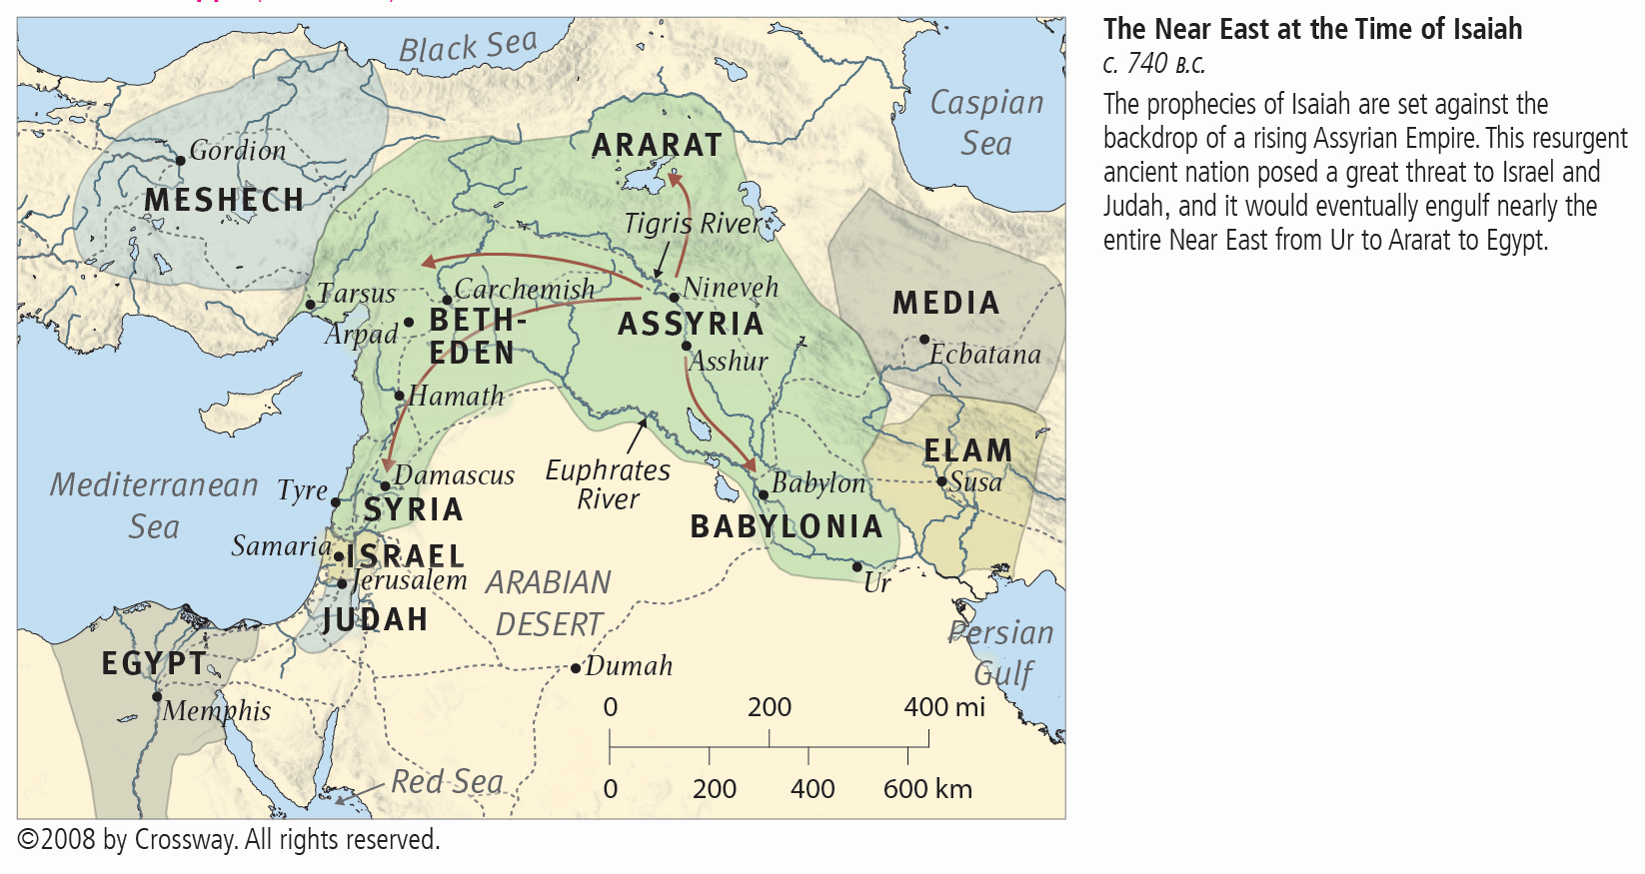
The Mainstream of Civilization

Slide 22
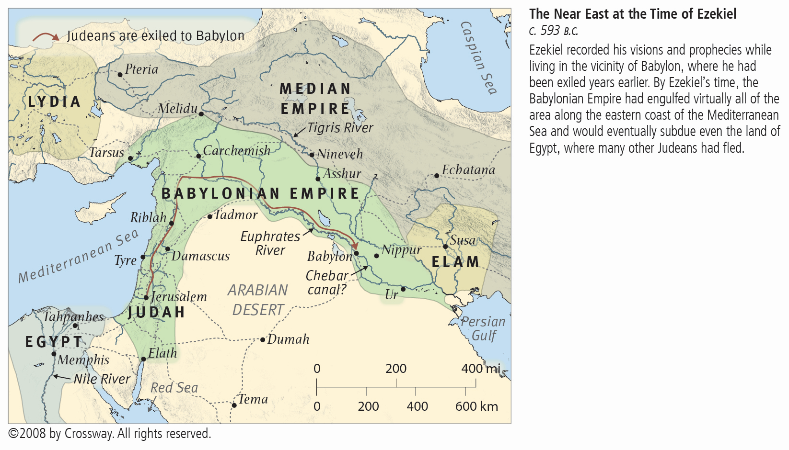
The Mainstream of Civilization

Slide 23
The Peoples on the Periphery
In the time of Ezekiel, the mainstream of civilization comprised Egypt, the land along the East Coast of the Mediterranean Sea, and Assyria-Babylonia
The peoples identified in Ezekiel 38 were all well known,
but they were NOT part of the mainstream of civilization
– the were on the periphery of the mainstream of civilization
That is the point of God’s using these peoples as a type of the peoples to attack Israel in the World Tomorrow
The attack will come from outside of the “mainstream of civilization”
We will continue with that thought next year …

Slide 24
To be continued …

