Slide 1
Isaiah 18:, 19:, and 20: - a Prophetic Trilogy
‘Blessed by Egypt my people, and Assyria the work of my hands, and Israel my inheritance.’ (Isaiah 19:25)
©2018 Mike Whyte – this document may be used freely for personal study, preaching, and teaching. No part of it may be used under any circumstances for commercial purposes or to attain personal gain or advantage.

Slide 3
Purpose of Prophecies about Nations
The purpose of these prophecies is to demonstrate that YHWH is the God of history – he is in control of everything that happens; his plan is unfolding exactly as he intends
The prophecies are NOT generally FOR, or to be presented TO, the nations in question
They are specifically FOR Israel; and, because God has recorded them, they are for US – the Church, especially the end-time Church

Slide 4
God’s Perspective
God inhabits eternity (Is57:15)
We exist in a four dimensional universe, which is simply an ‘object’ to God (Is40:12)
Our existence is linear, sequential, and temporal – these are all irrelevant to God: he declares the end from the beginning (Is46:10, Rv22:13)
We speak of ‘duality’ of prophecy, which is accurate from our perspective; but from God’s perspective, the ‘time’ element is irrelevant: what we see as two similar events separated by a large temporal gap, God sees as two parts of the same event – this is how Isaiah reports the visions and revelations given to him by God

Slide 5
Historical Setting of Isaiah 18:, 19:, and 20:
The general setting of Isaiah 13: through 23: is the beginning of Hezekiah’s sole reign – Hezekiah has commenced his reform; there are ‘parties’ in the court promoting alliance with both Egypt and Babylon in rebellion against Assyria
It is the middle of the reign of Sargon – he is heavily involved in military activities in the east and the north; the west is of less concern to him
By 715, Piankhi and Shabaqo swept away Dynasties 22, 23 and 24 and gained united control over all of Egypt – one of Shabaqo’s first activities is to foment rebellion in western Asia against Assyria
In 714, an alliance led by Ashdod and including Moab, Edom, and Israel considers rebellion
In 711, Sargon sends a force to crush the rebellion: Ashdod is taken, the alliance falls apart
Isaiah has been preaching trust in YHWH – Hezekiah fortunately listens and does not commit to the rebellion and is NOT attacked by Sargon

Slide 6
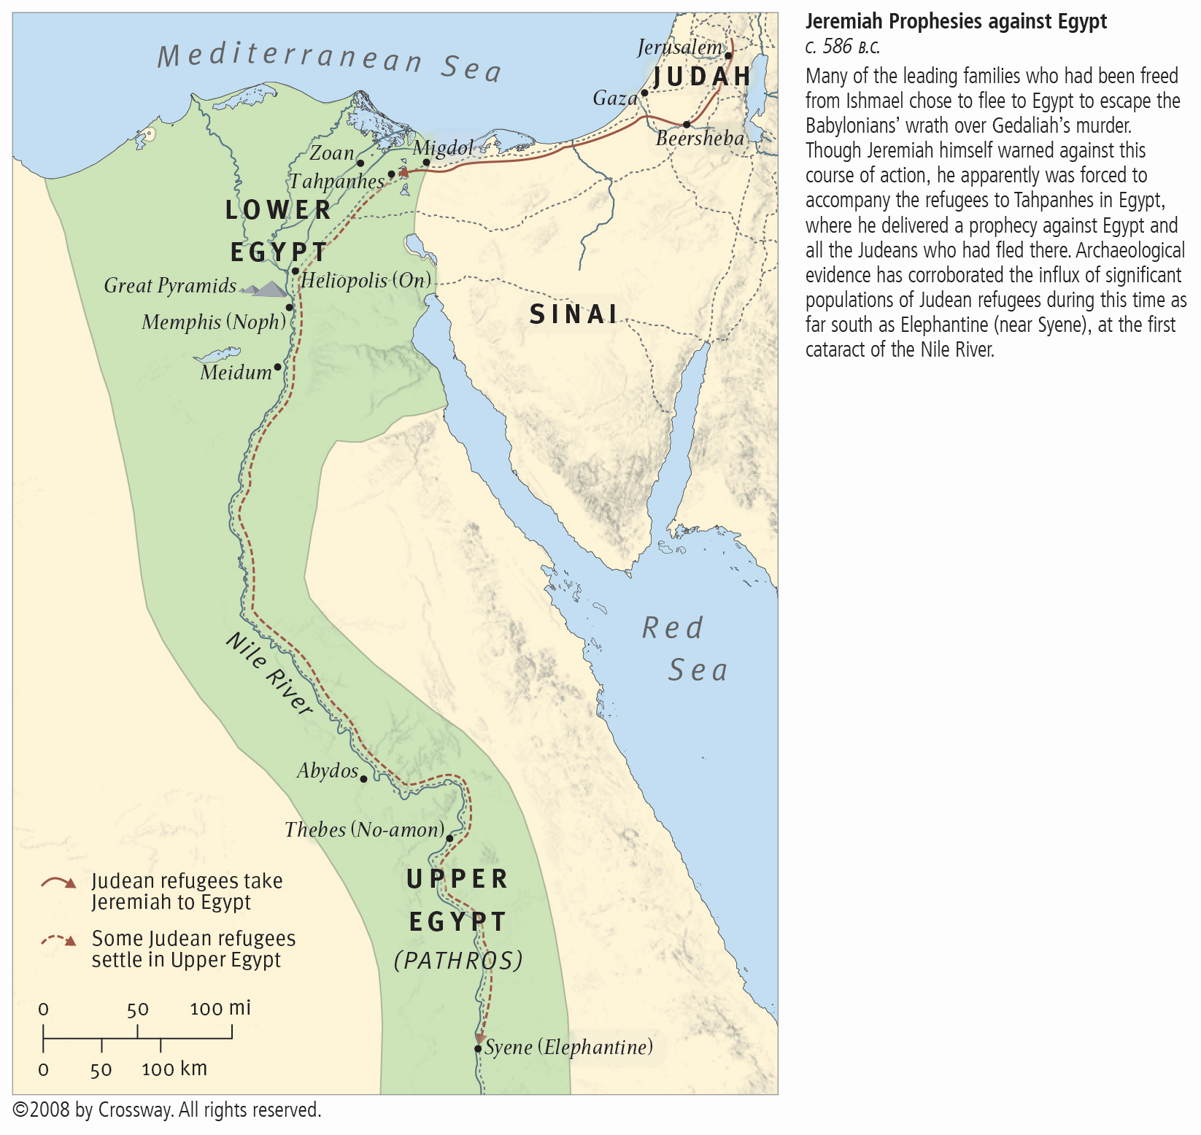
Egypt in the Time of Isaiah

Slide 7
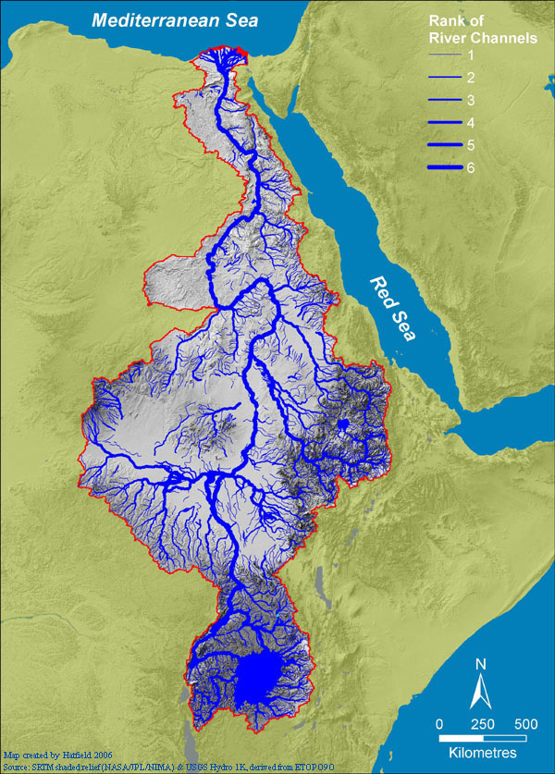
‘…beyond the rivers of Cush’ (Is18:1)
‘… whose land the rivers divide’ (Is18:2)

Slide 8
Isaiah 18: ‘Cush’ – the End of the Earth
18:1 Cush is Nubia (KJV has ‘Ethiopia’, an anachronism), south of upper Egypt, home of Dynasty 25, source of the Nile; ‘whirring wings’ may refer to insects, but more likely ‘wings’ are boat sails – all communication from Nubia with the civilized world (Egypt) was north down the Nile by boat; Isaiah had almost certainly never been to Nubia – it was like the ‘end of the earth’ to him
18:2a ‘ambassadors’ are representatives of Dynasty 25 attempting to foment rebellion against Assyria
182b who are the ‘messengers’? they are NOT the ambassadors – they come from Nubia, the messengers go to Nubia; ‘a nation’ and ‘a people’ are the Nubians, so the messengers have a message for them; what is the message?

Slide 9
God will Act
18:3 Isaiah broadens his scope – he now addresses the inhabitants of the whole earth: telling them to watch for a signal and listen for a trumpet – the final trumpet signifies Christ’s return
18:4 Now YHWH speaks personally to Isaiah; he says that he is waiting patiently for the right time
18:5a the right time is when the harvest is ripe (Mt24:32-33)
18:5b-6 then God will act – the immediate action will be the destruction of Assyria (Ez31:3-7), which is a type of the destruction of ‘world city’ (Rv19:17-18); Assyria is the current representative of the system of this world, ‘world city’, which will pass to the Babylonian empire and ultimately to the last ‘resurrection’ of ‘Roman Empire’ to be destroyed at Christ’s return

Slide 10
Who are the messengers?
18:7 Isaiah now goes to the World Tomorrow – there is no temporal distinction, all these events are at the core of God’s plan, time is irrelevant: the Nubian people will be among those bringing ‘tribute’ to the King of Kings in Mount Zion (Isiah 2:, Micah 4:)
Who are the messengers? The prophets carried God’s message anciently; their message to the world is that God is in charge; his plan is inexorable; he is proceeding with it. The Church has inherited that responsibility. We have the same message – we call it ‘the gospel of the kingdom of God’.

Slide 11
Isaiah 19:1-15 The Burden of Egypt
Isaiah reverts to the current situation: Hezekiah is under pressure to comply with the alliance and side with Egypt in rebellion against Assyria. Isaiah points out the folly in trusting Egypt.
19:1a ‘swift cloud’ a metaphor indicating ‘sovereignty’ and ‘power’ (Dt33:26, Ps18:10, 68:33, 104:3)
19:1b the general affect of God’s power on Egypt (Ex12:12)
19:2 civil war and internal strife were very common under the competing Pharaohs of Dynasties 22, 23, and 24, culminating in military unification of the country under Dynasty 25
19:3-4 God’s plan for Egypt: their glory was gone; the arrogance based on the past cannot be justified; Egypt will suffer under Assyria and Babylon, and finally be ruled by Persians, Greeks, and Romans
19:5-10 the Nile is the economic life blood of Egypt – failure of the annual inundation causes immeasurable suffering
19:11-13 Zoan and Memphis were two of the most important delta cities; God renders the much-heralded wisdom of Egypt to be worthless
19:14-15 Egypt’s glory is gone only decline remains; ‘palm branch and reed’ see Is9:14 for explanation of the metaphor

Slide 12
Isaiah 19:16-25 New Israel and the ‘World’
This is one of the most frequently quoted sections of scripture related to the World Tomorrow; but, it is usually read out of context.
Isaiah has just related God’s judgement on Assyria (18:5b-6) and Egypt (19:1-15); now without any temporal distinction, he rolls into how Assyria, Egypt, and Israel will form a triumvirate of peace, cooperation, and prosperity.
From God’s perspective, the judgements on the nations of this world are simply the prelude to the establishment of the World Tomorrow.
Clearly, the ancient nations are now gone, but in revelation to Isaiah, God uses the ancient nations as symbolic of the world as it will exist in the World Tomorrow.

Slide 13
Salvation to all People in all Nations
19:16-17 the ‘fear’ expressed here at the start of the millennium may be symbolic, or it may be actual – the world has just experienced the holocaust and the Day of YHWH; when God establishes the New Israel, there may well be fear among those people remaining in the nations; on the other hand, the fear may be symbolic of finally eradicating the old ways according to “the purpose that the LORD of hosts has purposed against them”; in any case, the survivors will come to know God as his purpose unfolds
19:18 ‘five cities’ are symbolic of a slow start in the conversion of the nations; ‘City of Destruction’ should be ‘City of Sun’ (Heliopolis) – one letter different in Hebrew
19:19-20 further signs of progress in converting nations; ‘saviour and defender’ resurrected saints – US: this will be our job
19:21-22 conversion of Egypt is symbolic of conversion of people of all nations
19:23-25 ‘highway’ is a symbol of travel, communication, commerce, and interaction; Egypt and Assyria were the classical enemies of Israel – all are gone now, but God will create a New Israel, and it will become the center of an integrated, peaceful, and abundant worldwide society

Slide 14
Isaiah 20:1-6 Back to the Present
Under God’s inspiration, Isaiah comes back to the actual historic situation of 711BC.
20:1 Sargon takes steps to quash the rebellion fomented by Ashdod
20:2-3 Isaiah has performed a symbolic action for three years to emphasize God’s purpose
20:4 God has decreed that Egypt cannot stand against Assyria – trust in Egypt is futile
20:5 ‘they’ is all the participants of the rebellion – especially Israel; Egypt is unable to support the rebellion
20:6 ‘inhabitants of this coastland’ pejorative epithet lumping Israel with the other nations as nothing special, just one of the participants in the rebellion; trust in Egypt is as futile as trust in Assyria, or any ‘human’ power; ‘and we, how shall we escape?’ – the realization God wants to emphasize, the purpose of the whole section: trust in any human power is futile; only God can provide deliverance/salvation

Slide 15
Conclusion
This trilogy provides marvelous insight into God’s plan, his mind, and his dealings with humanity.
Isaiah brilliantly uses the current historical situation to demonstrate to his contemporaries (and recorded for all time) the futility of trusting in any human power.
Isaiah skillfully transitions between God’s inexorable judgement of the nations of Satan’s world and the objective of God in his judgement.
In doing this, he records some of the most powerful descriptive material available about God’s purpose – to establish worldwide peace, prosperity, and salvation.

