Slide 1
Ezekiel – Land, City, & Temple
And I will set my glory among the nations … The house of Israel shall know that I am the LORD their God…
Ezekiel 39:21a, 22a ESV
In visions of God he brought me to the land of Israel, and set me down on a very high mountain, on which was a structure like a city to the south …
Ezekiel 40:2 ESV
Now when he had finished measuring the interior of the temple area, he led me out by the gate that faced east, and measured the temple area all around. It had a wall around it, 500 cubits long and 500 cubits broad, to make a separation between the holy and the common.
Ezekiel 42:15, 20b ESV
Seven days shall they make atonement for the altar and cleanse it, and so consecrate it. …then from the eighth day onward the priests shall offer on the altar your burnt offerings and your peace offerings, and I will accept you, declares the Lord GOD.
Ezekiel 43:26, 27b ESV
©2026 Mike Whyte – this document may be used freely for personal study, preaching, and teaching. No part of it may be used under any circumstances for commercial purposes or to attain personal gain or advantage.
Notes:
The New Temple is all about “Holiness”
God will teach humanity “Holiness” starting with New Israel
Ezekiel was given a vision of the Land of Israel, New City, the New Temple, and the Sacrificial Service.

Slide 2
The Transition
God summarizes his purpose for Israel and for the nations:
Ezekiel 39:21-24 ESV And I will set my glory among the nations, and all the nations shall see my [justness] (mishᵉpat) that I have executed, and my hand that I have laid on them.
The house of Israel shall know that I am the LORD their God, from that day forward.
And the nations shall know that the house of Israel went into captivity for their iniquity, because they dealt so treacherously with me that I hid my face from them and gave them into the hand of their adversaries, and they all fell by the sword.
I dealt with them according to their uncleanness and their transgressions, and hid my face from them.
Notes:
The last paragraphs of chapter 39 relate more to the temple than what is past …

Slide 3
The Purpose of the Temple Vision
Ezekiel 39:25-29 ESV Therefore thus says the Lord GOD: Now I will restore the fortunes of Jacob [even] have mercy on the whole house of Israel, and I will be jealous for my holy name.
They shall forget their shame and all the treachery they have practiced against me, when they dwell securely in their land with none to make them afraid, when I have brought them back from the peoples and gathered them from their enemies’ lands, and through them have vindicated my holiness in the sight of many nations.
Then they shall know that I am the LORD their God, because I sent them into exile among the nations and then assembled them into their own land.
I will leave none of them remaining among the nations anymore. And I will not hide my face anymore from them, when I pour out my Spirit upon the house of Israel, declares the Lord GOD.
Notes:
The focus is post second exodus, New Israel
Relationship to Attack of Gog is undetermined
HANDOUT …

Slide 4
Introduction to the Temple Vision
Ezekiel 40:1-4 ESV In the twenty-fifth year of our exile, at the beginning of the year, on the tenth day of the month, in the fourteenth year after the city was struck down, on that very day, the hand of the LORD was upon me, and he brought me to the city.
In visions of God he brought me to the land of Israel, and set me down on a very high mountain, on which was a structure like a city to the south.
When he brought me there, behold, there was a man whose appearance was like bronze, with a linen cord and a measuring reed in his hand. And he was standing in the gateway. And the man said to me, “Son of man, look with your eyes, and hear with your ears, and set your heart upon all that I shall show you, for you were brought here in order that I might show it to you. Declare all that you see to the house of Israel.”
Ezekiel’s immediate audience remained the exiles …
Notes:
25:1:10, April 573BC
Ezekiel is positioned to the north of the city
Compare “the man” to the First Temple Vision, 8:2-3
The text returns to the immediate audience several times, but …
Clearly this is recorded for all posterity …
Especially us …
HANDOUT …

Slide 5
Ezekiel’s Instructions
Ezekiel’s immediate concern is the Exiles, but the message is eternal:
Ezekiel 43:10-12 ESV As for you, son of man, describe to the house of Israel the temple, that they may be ashamed of their iniquities; and they shall measure the plan.
And if they are ashamed of all that they have done, make known to them the design of the temple, its arrangement, its exits and its entrances, that is, its whole design; and make known to them as well all its statutes and its whole design and all its [torah], and write it down in their sight, so that they may observe all its [design] and all its statutes and carry them out.
This is the [torah] of the temple: the whole territory on the top of the mountain all around shall be most holy. Behold, this is the [torah] of the temple.
Notes:
Like the whole Book of Ezekiel, the message is specifically for the Exiles
The Exiles whom God is calling are to learn repentance and trust in the Plan of God
“design” is צוּרָה - tzurah, on each occasion

Slide 6
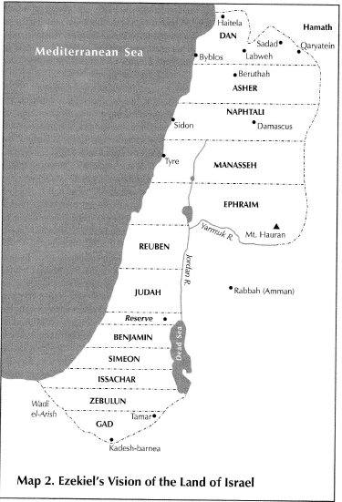
The Allocation of the Land
The allocation of the land is described as follows:
Ezekeil 47:13-23 the boundaries of the land
Ezekiel 48:1-29 the tribal allotments – using the thirteen-tribe paradigm
The tribe of Levi has no allotment
Each tribe is given a strip of land extending from the Mediterranean Coast to the eastern boundary
In the extreme south, Zebulun and Gad have no access to the sea
The northern allotments appear larger
Note the “Reserve” between Judah and Bemjamin
Notes:
I am NOT going to read the details …
Diagrams are much more effective …
All these diagrams are from:
Block, D.I., The Book of Ezekiel Chapters 25-48, (EZ2) New International Commentary on the Old Testament, (NICOT), William B. Eerdmans, Grand Rapids, Michigan, 1998
The diagrams are all included in the handout …

Slide 7
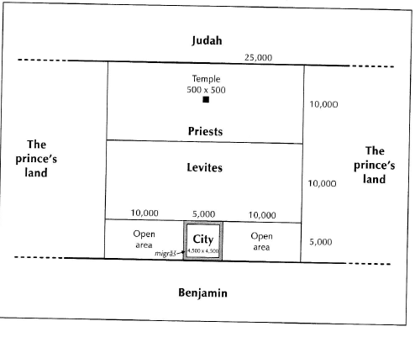
The Reserve
At the center of the “Reserve” is a square of 25,000 cubits on each side – about 8 miles
This area is described in Ezekiel 45:1-6, 48:8-14
The northern 2/5ths are assigned to the “Priests” and contains the Temple
The middle 2/5ths are assigned to the “Levites”
These 4/5ths are called the “Holy District”
The New City is located in the southern 1/5th
Notes:
The long cubit is about 20.5 inches, 1.71 feet

Slide 8
The City and the Prince’s Land
The New City is confined to a square 4,500 cubits on each side - about a mile and a half
Note the “City” is given a new name: “YHWH Shammah” (YHWH is There) see Ezekiel 48:35
There will be three city gates on each side named after the Tribes
The “open area” on each side of the city is to produce food for the city
The city is described in Ezekiel 48:15-19, 30-35
The allotment to the “Prince” is on each side of the “Reserve” and extends to the boarder of the land in each direction
The Prince’s allotment is described in Ezekiel 45:7-8, 48:21-22
The role of the “Prince” will be discussed later

Slide 9
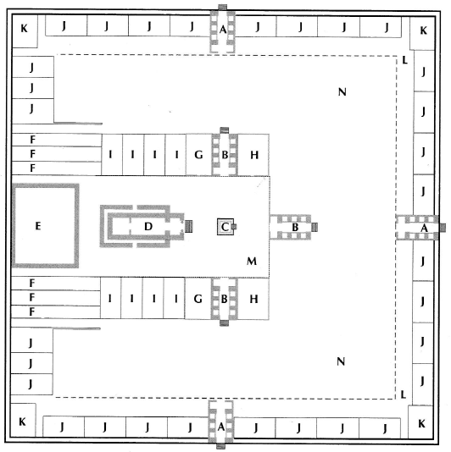
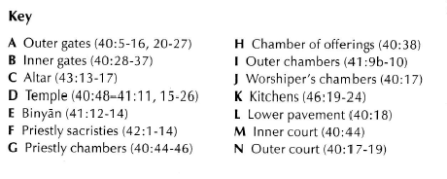
The Temple Area
The Temple Area is described in Ezekiel 40:5-49, and all of chapters 41 and 42
The “key” below points to specific features
General features: outer wall, inner wall, gates, outer court, inner court, temple proper, altar, various rooms and buildings
Notes:
F: 46:19-20 place for Priest to boil: western end of building
K: is only 46:21-24
I: there is no mention of how these chambers are used

Slide 10
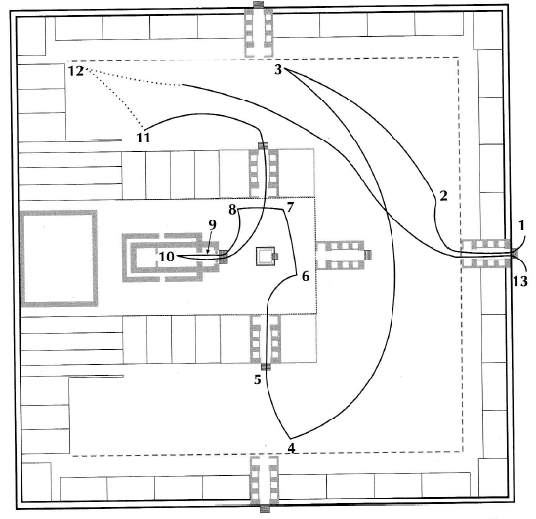
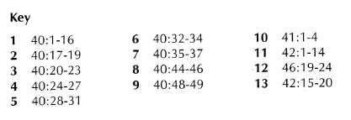
Ezekiel’s Tour
If you read through the text, a large part of it follows the “tour” depicted on this diagram
The “key below” points to the scriptures at each point of the tour
I am NOT generally following the tour
Notes:
Ezekiel is now explicitly involved
When Israel is established, this will occur
The provenance of Gog is explicit- the uttermost north, periphery
“horses” clearly symbolic

Slide 11
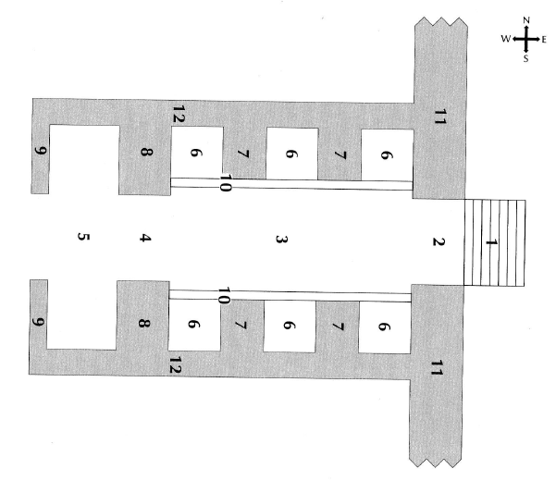
The Temple Gates
There are three gates in the outer wall and three gates to the inner court
All gates are identical, only the outer east gate is described in detail in Ezekiel 40:6-16; other gates are briefly mentioned in Ezekiel 40:20-37
#1 There are seven steps
#2 the width of the Gate is about 17 feet
#11 the outer wall is about 10 feet thick

Slide 12
The Temple Gates
#6 each gate has six small rooms each about 10 feet square
The rooms have small openings to function as windows for air and light
#5 the “vestibule” is a larger room at the inner end of the gate about 14 feet deep and perhaps 36 feet wide
The total length of the gate structure about 86 feet (50 cubits) and the width is about 43 feet (25 cubits)
Notes:
The 2:1 ratio is maintained throughout the temple as are multiples of 5 and 10
The outer wall is 500 cubits square
The Temple Proper is 50 cubit by 100 cubits

Slide 13
The Courts
The Courts are described in Ezekiel 40:17-19, 29-34
The Outer Court is a square of 400 cubits (~685 feet)
Any “clean” person is allowed in the outer court
The Outer Court is 100 cubits broad to the north and south of the Inner Court and 150 cubits on the east
Only officiating Priests are allowed in the inner court
In the Inner Court, the area in front of Temple Proper is 100 cubits square
The altar is in the middle of this area
Notes:
The “rooms” are likely for teaching
There will likely be seating galleries to observe the Temple Service

Slide 14
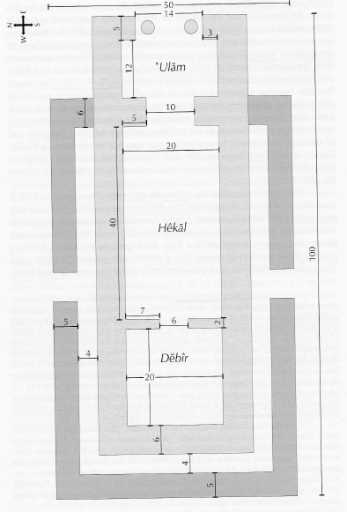
The Temple
The Temple is described in Ezekiel 40:48-49, 41:1-4, 15b-26
The Temple is 50 cubits by 100 cubits
“´ulam” is the vestibule, the entrance, 22 cubits long and 20 cubits wide
“hekal” is the “Holy Place”, 20 cubits by 40 cubits
Officiating Priests go into the “Holy Place”
“debir” is the “Most Holy Place”, 20 by 20 cubits
Only YHWH is in the “Most Holy Place”
The only furniture mentioned is an altar in the “Holy Place” before the entrance to the “Most Holy Place”
The Temple is surrounded by three stories of side rooms

Slide 15
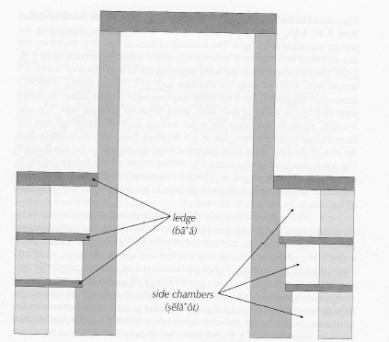
The Side Rooms
The side rooms are described in Ezekiel 41:5-11
There are 30 rooms in each story
Modelled after Solomon’s Temple
Note the “ledges” supporting the floors and roof – these are to prevent the Temple wall from being used as a support
The rooms get wider in each ascending story
Notes:
Probably mostly sleeping and private space for on-duty priests

Slide 16
The West Wall
The buildings along the West Wall are described in Ezekiel 41:12-15a, 42:1-12, 46:19-20
Building E is called the “banᵉyan”, there is no discussion of it use
The building containing rooms F is for use of the officiating Priests
The building appears to have “observation galleries” on its roof
There is no explicit description of the building containing rooms J – probably for the Levites
In each corner of the Temple Area is a “kitchen”, K, where the Levites boil the people’s sacrifice, see Ezekiel 46:21-24

Slide 17
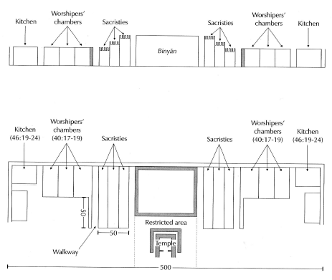
Profile of the West Wall
The use of much of this space remains to be specified

Slide 18
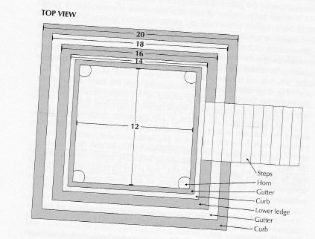
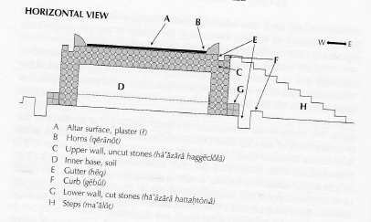
The Altar
The Altar is described in Ezekiel 43:13-17
It is very similar to the Altar of Solomon’s temple
The Altar is the only part of the Temple for which a consecration ceremony is specified
Notes:
Ex20:26 no steps

Slide 19
The Consecration Ceremony
Ezekiel 43:18-21 ESV And he said to me,
“Son of man, thus says the Lord GOD: These are the ordinances for the altar:
On the day when it is erected for offering burnt offerings upon it and for throwing blood against it, you shall give to the Levitical priests of the family of Zadok, who draw near to me to minister to me, declares the Lord GOD, a bull from the herd for a sin offering.
And you shall take some of its blood and put it on the four horns of the altar and on the four corners of the ledge and upon the rim all around.
Thus you shall purify the altar and make atonement for it.
You shall also take the bull of the sin offering, and it shall be burned in the appointed place belonging to the temple, outside the sacred area.
This will occur as the last step in the construction of the Temple
Notes:
Priesthood will be named after Zadok, Solomon’s priest
Isaiah 66:20-21 And they shall bring all your brothers from all the nations as an offering to the LORD, on horses and in chariots and in litters and on mules and on dromedaries, to my holy mountain Jerusalem, says the LORD, just as the Israelites bring their grain offering in a clean vessel to the house of the LORD. And some of them also I will take for priests and for Levites, says the LORD. (ESV)

Slide 20
The Consecration Ceremony
Ezekiel 43:22-27 ESV
And on the second day you shall offer a male goat without blemish for a sin offering; and the altar shall be purified, as it was purified with the bull. When you have finished purifying it, you shall offer a bull from the herd without blemish and a ram from the flock without blemish.
You shall present them before the LORD, and the priests shall sprinkle salt on them and offer them up as a burnt offering to the LORD.
For seven days you shall provide daily a male goat for a sin offering; also, a bull from the herd and a ram from the flock, without blemish, shall be provided. Seven days shall they make atonement for the altar and cleanse it, and so consecrate it.
And when they have completed these days, then from the eighth day onward the priests shall offer on the altar your burnt offerings and your peace offerings, and I will accept you, declares the Lord GOD.
Note that it is the “altar” for which atonement is required
Notes:
The altar was made with human hands, therefore, “atonement” is necessary
It is the “altar” where the “holy” activity will take place so it must be consecrated
The rest of the Temple is Holy by the presence of God

Slide 21
Assessment of the Temple Description
Ezekiel reports what he saw in vision – he is NOT describing a blueprint
The purpose the vision is clear: there will be a physical Temple constructed
There are a lot of similarities to Solomon’s Temple, but also a lot of differences
In many points the details of the Temple are obscure, but there is enough that proper architectural designs can be produced when the time comes
The “Guide” is mostly passive, he doesn’t say much, but just leads Ezekiel around the vision and takes measurements
When there is instruction, mostly it is YHWH speaking
The real purpose of vision is to provide context for the teaching that God gives to Ezekiel regarding the Temple Service

Slide 22
To be continued …

