Slide 1
Ezekiel – Getting Attention
And the hand of the LORD was upon me there. And he said to me …
Go, shut yourself within your house.
… so that you cannot go out among the people.
… you shall be mute and unable to reprove them …
But when I speak with you, I will open your mouth …
And they shall know that I am the LORD …
  Ezekiel 3:22, 24-27, 5:13 ESV
©2022 Mike Whyte – this document may be used freely for personal study, preaching, and teaching. No part of it may be used under any circumstances for commercial purposes or to attain personal gain or advantage.
Notes:
Last time we saw that Ezekiel had been told some of the exiles would listen to him, respond to his preaching and repent
The overriding belief of the people was that God would NOT allow Jerusalem, in particular the Temple, to be destroyed
In the most dramatic theophany given to any prophet, YHWH had revealed himself to Ezekiel and informed him what he was required to do ….
The significance of the theophany must have been understood to some degree by at least some of the exiles …
Ezekiel was dumbfounded for seven days while he figured things out, and probably communicated some of what had happened
Now YHWH tells him how he is going to get the people’s attention …
Ezekiel chapters 4-7 are all about telling the exiles in no uncertain terms that Jerusalem was about to be destroyed

Slide 2
Conditions of Ezekiel’s Service
  Ezekiel 3:22-27 ESV
  And the hand of the LORD was upon me there. And he said to me, “Arise, go out into the valley, and there I will speak with you.” So I arose and went out into the valley, and behold, the glory of the LORD stood there, like the glory that I had seen by the Chebar canal, and I fell on my face. But the Spirit entered into me and set me on my feet, and he spoke with me and said to me, “Go, shut yourself within your house. And you, O son of man, behold, cords will be placed upon you, and you shall be bound with them, so that you cannot go out among the people. And I will make your tongue cling to the roof of your mouth, so that you shall be mute and unable to reprove them, for they are a rebellious house. But when I speak with you, I will open your mouth, and you shall say to them, ‘Thus says the Lord GOD.’
  He who will hear, let him hear; and he who will refuse to hear, let him refuse, for they are a rebellious house.
The constraints were obviously not “full time” – Ezekiel had a wife, most likely he was able to speak with her in private and have a normal private life
The “binding” meant that he was NOT to freely mingle with the people; but only deliver YHWH’s word
Notes:
Chebar - kᵉvar
We finished last time at Ex3:15, skip a bit, then come back …
This is after sitting overwhelmed for seven days
Ezekiel was required to more or less withdraw from the daily life of the exile community
His only contact with the community was to communicate YHWH’s messages
This semi-isolation was to continue until the fall of Jerusalem (about 9 years) …

Slide 3
The Role of the Watchman
This is the first “revelation” from YHWH to Ezekiel:
  Ezekiel 3:16-21 ESV
  And at the end of seven days, the word of the LORD came to me: “Son of man, I have made you a watchman for the house of Israel. Whenever you hear a word from my mouth, you shall give them warning from me.
  “If I say to the wicked, ‘You shall surely die,’ and you give him no warning, nor speak to warn the wicked from his wicked way, in order to save his life, that wicked person shall die for his iniquity, but his blood I will require at your hand.
  “But if you warn the wicked, and he does not turn from his wickedness, or from his wicked way, he shall die for his iniquity, but you will have delivered your [life].
  “Again, if a righteous person turns from his righteousness and commits injustice, and I lay a stumbling block before him, he shall die. Because you have not warned him, he shall die for his sin, and his righteous deeds that he has done shall not be remembered, but his blood I will require at your hand.
  “But if you warn the righteous person not to sin, and he does not sin, he shall surely live, because he took warning, and you will have delivered your [life].”
Notes:
[life] is from nephesh – most English translations use “soul” …
This week’s handout: summary of the presentation and a short discussion of nephesh and psuche
I’ll also put out last week’s handout in case anyone did NOT get the outline
This revelation is extremely important – it tells Ezekiel in no uncertain terms that his responsibility is serious
Presumably this became the basis of his teaching …

Slide 4
Individual Responsibility
The concept was specified in the second commandment: Exodus 20:4-6 ESV
  You shall not make for yourself a carved image, or any likeness of anything that is in heaven above, or that is in the earth beneath, or that is in the water under the earth. You shall not bow down to them or serve them, for I the LORD your God am a jealous God, visiting the iniquity of the fathers on the children to the third and the fourth generation of those who hate me, but showing [ḥesed] to thousands of those who love me and keep my commandments.
Repentance gets individuals out of the cycle of generational sin: otherwise, punishment continues from generation to generation
Individual responsibility is the foundation of “repentance” – each person stands alone before God
In the ancient world, children were frequently killed arbitrarily:
  Herodotus: sons of the Greek general sacrificed by his troops at the outset of war
  Book 1.86 and 7:114 record arbitrary sacrifice of children by Persians
  Josephus: (Antiquities 13:14:2) Alexander Jannaeus crucified 800 Jews and killed their wives and children before their eyes as they were dying
Notes:
I could not find the reference for the first incident in Herodotus …
Alexander Jannaeus was the grandson of Simon ben Mattathias, brother of Judas Maccabeus, third generation Hasmonean king …

Slide 5
The role of the watchman is to warn as required by God – if the warning is NOT presented, God holds the watchman responsible:
  If a “wicked” person dies without warning, he dies in his “wickedness”, and the watchman is held responsible
  If a “wicked” person is warned and refuses to repent, his death is on his own head, but the watchman is absolved
  If the watchman does NOT warn a “righteous” person and the righteous person turns to sin, the watchman is held responsible
  If the watchman warns the “righteous” person and the righteous person heeds the warning, he and the watchman will live
We, the New Testament Church, are similarly assigned the “role of watchman”: our role is equally serious: Malachi 4:4-6 ESV
  Remember the [torah] of my servant Moses, the statutes and [mishᵉpatim] that I commanded him at Horeb for all Israel. “Behold, I will send you Elijah the prophet before the great and awesome day of the LORD comes. And he will turn the hearts of fathers to their children and the hearts of children to their fathers, lest I come and strike the [earth] with a decree of utter destruction.”
Notes:
If we fail, the Plan of God fails: which cannot happen
Our role as “watchman” through eternity is to ensure the evil around us today can never take root again

Slide 6
A Very Important Theme
Ezekiel 3:16-21
  At the beginning of Ezekiel’s ministry
  A personal message from YHWH to Ezekiel
  Role of Watchman is emphasized
Ezekiel 18:1-32
  In the “wisdom” section – an example of Ezekiel’s actual preaching
  Details of prescriptions and proscriptions – what constitutes sin
  Emphasizes “individual responsibility” – no mention of “watchman”
Ezekiel 33:1-20
  Jerusalem has fallen – beginning of people responding
  The “people of the land” appoint the “watchman” – a metaphor
  YHWH reiterates Ezekiel’s responsibility
  “individual responsibility” reiterated with emphasis on “repentance”
Notes:
These are the three major discussions, the theme is also addressed briefly in several other places
We will go over each section as we get to it
This is just to contrast the three main discussions …

Slide 7
The Impending Destruction of Jerusalem
The notion of the inviolability of Jerusalem was the major obstacle that Ezekiel faced in communicating YHWH’s message to the exiles
Ezekiel was required to perform in public four symbolic actions which graphically demonstrated the fate of Jerusalem and the people there
First, a symbolic representation of the upcoming siege:
  Ezekiel 4:1-3 ESV
  And you, son of man, take a brick and lay it before you, and engrave on it a city, even Jerusalem. And put siegeworks against it, and build a siege wall against it, and cast up a mound against it. Set camps also against it, and plant battering rams against it all around.
  And you, take an iron griddle, and place it as an iron wall between you and the city; and set your face toward it, and let it be in a state of siege, and press the siege against it.
  This is a sign for the house of Israel.
The exiles had experienced this in 597BC – see 2 Kings 24:10-16
Notes:
There is no indication what, if anything, Ezekiel said in conjunction with the first action
The largest clay bricks were about a foot square
The siege works, wall, etc. were probably models place around the brick
The significance of the “iron griddle” is not stated – perhaps it was symbolic that YHWH would no longer extend mercy to Jerusalem: the destruction is inevitable

Slide 8
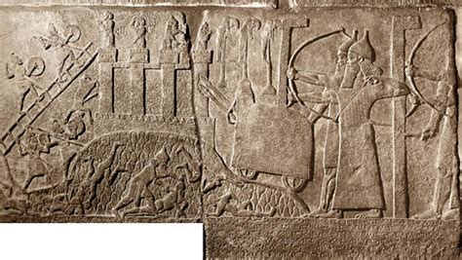
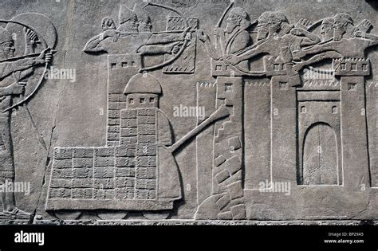
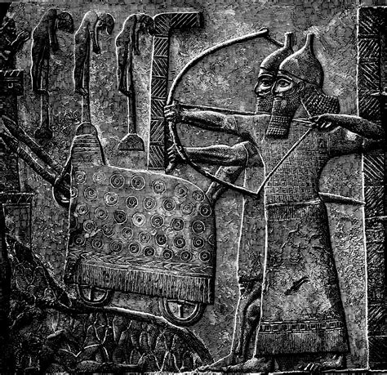
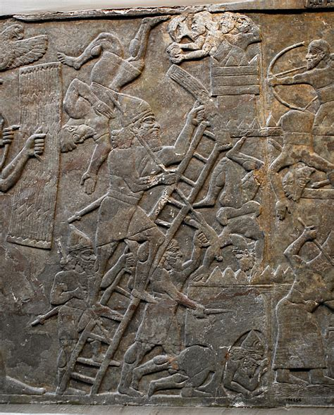
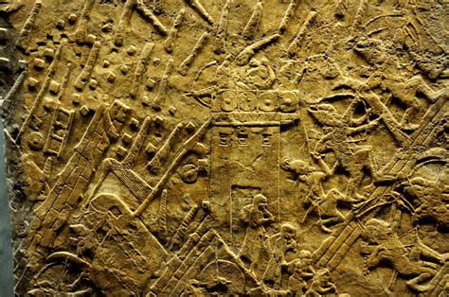
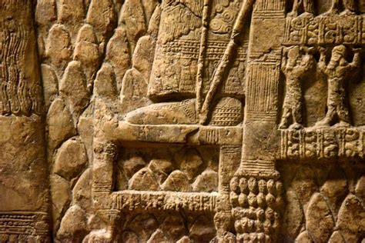
Ancient Siegeworks
Notes:
Bottom left both siege of Lachish by Sennacherib, leftmost possibly sappers

Slide 9
The Iniquity of Israel
The second symbolic action, “bearing iniquity”: Ezekiel 4:4-8 ESV
  “Then lie on your left side, and place the [iniquity] of the house of Israel upon it. For the number of the days that you lie on it, you shall bear their [iniquity]. For I assign to you a number of days, 390 days, equal to the number of the years of their [iniquity]. So long shall you bear the [iniquity] of the house of Israel. And when you have completed these, you shall lie down a second time, but on your right side, and bear the [iniquity] of the house of Judah. Forty days I assign you, a day for each year.
  And you shall set your face toward the siege of Jerusalem, with your arm bared, and you shall prophesy against the city. And behold, I will place cords upon you, so that you cannot turn from one side to the other, till you have completed the days of your siege.
The numbers “390” and “40” are enigmatic – there is no explicit indication of their meaning: “40” became a general metaphor for sin based on the “40” days the spies were in Canaan; “390” has no obvious association
The sum, 430, is the number of years between the call of Abraham and the exodus (Exodus 12:40-41 LXX, Galatians 3:17, Josephus Antiquities 2:15:2), but there is no suggestion in Ezekiel to combine the numbers
Notes:
It is not explicitly stated whether or not the 40 days were concurrent with the 390 days (4:9 suggests concurrent)
Here Ezekiel is told to “prophecy”: the coming destruction was real and imminent
The “binding” probably just meant Ezekiel was “rigid” during the periods he lay on his side
עָוֹן - `awon: ESV text has “punishment” which implies expiation, Christ’s role, Ezekiel is foreshadowing the exile caused by the “iniquity” (ESV footnote)

Slide 10
“Iniquity”
The word translated “iniquity” is עָוֹן - `awon, *Holladay defines it as “activity that is crooked or wrong”, “offense”, “sin”, “guilt”, “punishment”, a wide range of meaning – ESV has “punishment” in the text “iniquity” in footnote
“punishment” implies that Ezekiel is “atoning” for the iniquity, which is the role of the sacrifice – looking to the Messiah; so, “iniquity” is preferable
The role of the priest is to “bear the iniquity” (Exodus 28:38, Numbers 18:1) until it is expiated through sacrifice
So the 390 days look to the period of Israel’s iniquity: this is approximately the number of years the first temple stood (586 + 390 = 976)
When Ezekiel performed this action in 593BC, the date of 586BC for the destruction of the temple had NOT been established
The first temple was constructed during the period 968BC to 961BC
(1 Kings 6:37-38)
*Holladay, W.L., A Concise Hebrew and Aramaic Lexicon of the Old Testament, William B. Eerdmans Publishing Company, Grand Rapids, Michigan, 1971, page 268
Notes:
Ezekiel is told to “bear the iniquity”
This is a symbolic action, there is no suggestion that the numbers are precise or significant, they are symbolic
Ezekiel would take his model each day into a conspicuous location, lay on one side and possibly then lay on the other, a then deliver a message related to the two symbolic actions

Slide 11
Prepare for Exile
The third symbolic action, “food supply”: Ezekiel 4:9-17 ESV
  “And you, take wheat and barley, beans and lentils, millet and emmer, and put them into a single vessel and make your bread from them. During the number of days that you lie on your side, 390 days, you shall eat it. And your food that you eat shall be by weight, twenty shekels a day; from day to day you shall eat it. And water you shall drink by measure, the sixth part of a hin; from day to day you shall drink. And you shall eat it as a barley cake, baking it in their sight on human dung.”
  And the LORD said, “Thus shall the people of Israel eat their bread unclean, among the nations where I will drive them.” Then I said, “Ah, Lord GOD! Behold, I have never defiled myself. From my youth up till now I have never eaten what died of itself or was torn by beasts, nor has tainted meat come into my mouth.” Then he said to me, “See, I assign to you cow’s dung instead of human dung, on which you may prepare your bread.”
  Moreover, he said to me, “Son of man, behold, I will break the supply of bread in Jerusalem. They shall eat bread by weight and with anxiety, and they shall drink water by measure and in dismay. I will do this that they may lack bread and water, and look at one another in dismay, and rot away because of their [iniquity].
Notes:
This is a prophecy of what conditions were to be in Jerusalem, but the message is for the exiles …
The exiles were already living this, although their conditions were not that bad …

Slide 12
Covenant Curses
  Leviticus 26:26, 33, 38-39 ESV
  … I break your supply of bread, ten women shall bake your bread in a single oven and shall dole out your bread again by weight, and you shall eat and not be satisfied.
  … I will scatter you among the nations … your land shall be a desolation, and your cities shall be a waste.
  … you shall perish among the nations, and the land of your enemies shall eat you up. And those of you who are left shall rot away in your enemies’ lands because of their iniquity …
  Deuteronomy 28:17, 48, 52, 65 ESV
  Cursed shall be your basket and your kneading bowl.
  … you shall serve your enemies whom the LORD will send against you, in hunger and thirst, in nakedness, and lacking everything.
  They shall besiege you in all your towns, until your high and fortified walls, in which you trusted, come down throughout all your land.
  … among these nations you shall find no respite …

Slide 13
The Remnant
The fourth symbolic action, “cutting the hair”: Ezekiel 5:1-4 ESV
  And you, O son of man, take a sharp sword. Use it as a barber’s razor and pass it over your head and your beard. Then take balances for weighing and divide the hair. A third part you shall burn in the fire in the midst of the city, when the days of the siege are completed. And a third part you shall take and strike with the sword all around the city. And a third part you shall scatter to the wind, and I will unsheathe the sword after them.
  And you shall take from these a small number and bind them in the skirts of your robe. And of these again you shall take some and cast them into the midst of the fire and burn them in the fire. From there a fire will come out into all the house of Israel.
Of those in exile, i.e., those with Ezekiel, a small number would form the remnant, and even some of them are burned in the fire
Those that remain will prepare for the Messiah, “a fire to Israel”:
  Matthew 10:34 ESV
  Do not think that I have come to bring peace to the earth. I have not come to bring peace, but a sword.
  Luke 12:49 ESV
  I came to cast fire on the earth, and would that it were already kindled!
Notes:
Shaving the beard was an act of great humiliation (2Sm10:4-5)
After the 390 days, Ezekiel was to light a fire over his brick
the hair represented the people in Jerusalem: 1/3 die in the city, 1/3 die around the city; 1/3 are scattered in exile
The final “fire to Israel” was the destructions in 70AD and 135AD, but more generally “the fire” of the gospel

Slide 14
YHWH’s Case Against Israel
This is no doubt representative of Ezekiel’s preaching during the 390 days:
  Ezekiel 5:5-9 ESV
  Thus says the Lord GOD: This is Jerusalem. I have set her in the center of the nations, with countries all around her. And she has rebelled against my [mishᵉpatim] by doing wickedness more than the nations, and against my statutes more than the countries all around her; for they (Israel) have rejected my [mishᵉpatim] and have not walked in my statutes.
  <protasis> Therefore thus says the Lord GOD: Because you are more turbulent than the nations that are all around you, and have not walked in my statutes or [lived by my mishᵉpatim], and have not even acted according to the [mishᵉpatim] of the nations that are all around you,
  <apodosis> therefore thus says the Lord GOD: Behold, I, even I, am against you. And I will [do mishᵉpatim] in your midst in the sight of the nations. And because of all your abominations I will do with you what I have never yet done, and the like of which I will never do again.
Notes:
YHWH was faithful to the terms of the Sinai Covenant, “a treasured possession”, … but Israel was not …
מִשְׁפָּט - mishᵉpat, “justness” as a character attribute of God, “mishᵉpatim” plural, the understanding / wisdom that comes from living by the torah
There is no corresponding English word, “judgements” and “rules” are not even close
There is an element of “decision making” or “doing”, “action”
Many nuances of meaning – very complicated word
“turbulent” הָמֹון - hamon, Holladay, page 81 “agitation”, “bustle turmoil”, “din, uproar”; “turbulent” is good – Israel was constantly in a state of political polarization, much as Western Civilization is today

Slide 15
Reiteration of Covenant Curses
See Leviticus 26:14-39 and Deuteronomy 28:15-68: Ezekiel 5:10-17 ESV
  Therefore fathers shall eat their sons in your midst, and sons shall eat their fathers. And I will [do mishᵉpatim] on you, and any of you who survive I will scatter to all the winds. Therefore, as I live, declares the Lord GOD, surely, because you have defiled my sanctuary with all your detestable things and with all your abominations … My eye will not spare, and I will have no pity. A third part of you shall die of pestilence and be consumed with famine in your midst; a third part shall fall by the sword all around you; and a third part I will scatter to all the winds and will unsheathe the sword after them. Thus shall my anger spend itself, and I will vent my fury upon them and satisfy myself. And they shall know that I am the LORD—that I have spoken in my jealousy—when I spend my fury upon them.
  Moreover, I will make you a desolation and an object of reproach among the nations all around you and in the sight of all who pass by. You shall be a reproach and a taunt, a warning and a horror, to the nations all around you, when I [do mishᵉpatim] on you in anger and fury, and with furious rebukes—I am the LORD; I have spoken—when I send against you the deadly arrows of famine, arrows for destruction, which I will send to destroy you, and when I bring more and more famine upon you and break your supply of bread. I will send famine and wild beasts against you, and they will rob you of your children. Pestilence and blood shall pass through you, and I will bring the sword upon you. I am the LORD; I have spoken.
Notes:
Defiled my sanctuary – allusion to the “390” years of the Temple
I will have no pity – the iron griddle
“third part” allusion to symbolic action, “cutting the hair”
This is the language of the covenant curses – very strong for the exiles

Slide 16
Blessings and Curses
There are two aspects to the Covenant Blessings and the Covenant Curses:
  Leviticus 26:3, 11-12 ESV
  If you walk in my statutes and observe my commandments and do them, then I will give you <the blessings>
  I will make my dwelling among you, and my [being] shall not abhor you. And I will walk among you and will be your God, and you shall be my people.
This indicates the direct and active blessing as a gift from God; similarly, there are “direct and active curses”
But there is also an automatic aspect:
  Deuteronomy 28:2, 15 ESV
  And all these blessings shall come upon you and overtake you, if you obey the voice of the LORD your God.
  But if you will not obey the voice of the LORD your God or be careful to do all his commandments and his statutes that I command you today, then all these curses shall come upon you and overtake you.

Slide 17
Where are We Today?
The roots of Western Civilization go back to the Protestant Reformation of the 15th Century
The reformers earnestly believed they were “true Christians” and were carrying out the will of God
The moral and ethical values of Western Civilization have been based on the “Judeo Christian Ethic”, specifically belief in the Ten Commandments
Any society that lives by the Ten Commandment will receive the automatic blessings
The more of the Ten Commandments that are violated the more automatic curses will accrue
To receive the direct blessings as a gift of God, worship “in truth” is required, especially Sabbath keeping
Since WW2, Western Civilization has move more and more against the Ten Commandments and automatic curses have increased
Today Western Civilization is immoral, unethical, and god-hating – God’s direct curses are being applied as with ancient Israel at the end …

Slide 18
To be continued …
Notes:
Continue with chapter six next time …

