Slide 1
Ezekiel - the Corrupted Temple
And he said to me, “Son of man, do you see what they are doing, the great abominations that the house of Israel are committing here, to drive me far from my sanctuary?
But you will see still greater abominations.”
“Have you seen this, O son of man? Is it too light a thing for the house of Judah to commit the abominations that they commit here, that they should fill the land with violence and provoke me still further to anger?
Then the glory of the LORD went out from the threshold of the house, and stood over the cherubim. And the cherubim lifted up their wings and mounted up from the earth before my eyes as they went out, with the wheels beside them. And they stood at the entrance of the east gate of the house of the LORD, and the glory of the God of Israel was over them.
Ezekiel 8:6, 17, 10:18-19 ESV
©2022 Mike Whyte – this document may be used freely for personal study, preaching, and teaching. No part of it may be used under any circumstances for commercial purposes or to attain personal gain or advantage.
Notes:
Briefly review first seven chapters …
“abominations”: Hebrew תּוֺעֵבָה – to`evah , willful sin, choosing a lifestyle of sin, idolatry and all that stems from it, “the unpardonable sin”
The exit of the presence of YHWH from the Temple is the most important element of the vision.

Slide 2
Corruption at the Highest Levels
Ezekiel is taken in vision from Babylonia to Jerusalem
God shows him a series of abominations, idolatry, in the Temple
The purpose is to identify the source of the nation’s problems: corruption of “thought leaders”
In Israel “thought leaders” were the priests, prophets, and elders
The problem is the same today: “thought leaders” are educators, entertainers, politicians, the super-rich
Satan, then and now, utterly corrupted the “thought leaders” bringing corruption to the people
Notes:
Ezekiel is being shown what is happening in the “spirit” world
In the “physical” world, Jeremiah was labouring with the death throes of the nation

Slide 3
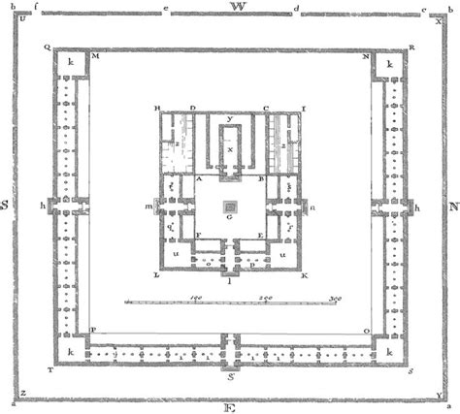
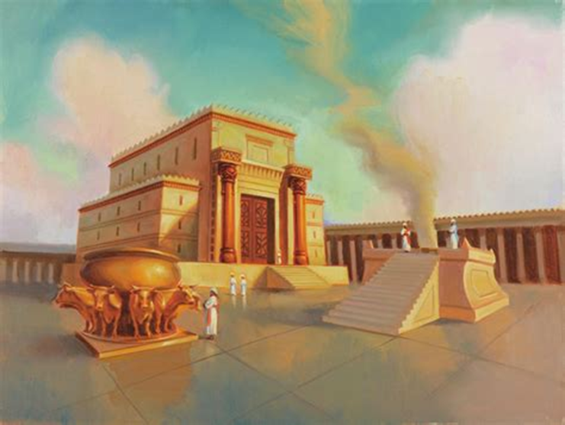
Solomon’s Temple

Slide 4
The Temple Vision
Notes:
The diagram is in the handout
Put handout to chat

Slide 5
Approaching the Temple
  Ezekiel 8:1-4 ESV
  In the sixth year, in the sixth month, on the fifth day of the month, as I sat in my house, with the elders of Judah sitting before me, the hand of the Lord GOD fell upon me there. Then I looked, and behold, a form that had the appearance of a man. Below what appeared to be his waist was fire, and above his waist was something like the appearance of brightness, like gleaming metal. He put out the form of a hand and took me by a lock of my head, and the Spirit lifted me up between earth and heaven and brought me in visions of God to Jerusalem, to the entrance of the gateway of the inner court that faces north, where was the seat of the image of jealousy, which provokes to jealousy. And behold, the glory of the God of Israel was there, like the vision that I saw in the valley.
The month is Elul, late summer 592BC, about 13 months (390 days) has passed, the time of the symbolic actions – Ezekiel was becoming recognized
Ezekiel is taken in Spirit, in a vision, to Jerusalem
“fire”, “gleaming metal” – same as chapter one: this is YHWH

Slide 6
Vision Reality
Paul describes it like this: 2 Corinthians 12:1b-3 ESV
  … I will go on to visions and revelations of the Lord. I know a man in Christ who fourteen years ago was caught up to the third heaven—whether in the body or out of the body I do not know, God knows. And I know that this man was caught up into paradise—whether in the body or out of the body I do not know, God knows …
Isaiah had a similar experience: Isaiah 6:1b-2a, 4-7 ESV
  I saw the Lord sitting upon a throne, high and lifted up; and the train of his robe filled the temple. Above him stood the seraphim. … And the foundations of the thresholds shook at the voice of him who called, and the house was filled with smoke. And I said: “Woe is me! For I am lost; for I am a man of unclean lips, and I dwell in the midst of a people of unclean lips; for my eyes have seen the King, the LORD of hosts!” Then one of the seraphim flew to me, having in his hand a burning coal that he had taken with tongs from the altar. And he touched my mouth and said: “Behold, this has touched your lips; your guilt is taken away, and your sin atoned for.”
Ezekiel had already experienced this with “eating the scroll” in chapter three
Notes:
Eating scroll Ez3:1-3

Slide 7
The Glory of the God of Israel
The word for “glory” is כָּבוֺד – kavod, it indicates the presence of God:
  Exodus 40:34-35 ESV
  Then the cloud covered the tent of meeting, and the [kavod] of the LORD filled the tabernacle. And Moses was not able to enter the tent of meeting because the cloud settled on it, and the [kavod] of the LORD filled the tabernacle.
  1 Kings 8:6, 10-11 ESV
  Then the priests brought the ark of the covenant of the LORD to its place in the inner sanctuary of the house, in the Most Holy Place … And when the priests came out of the Holy Place, a cloud filled the house of the LORD, so that the priests could not stand to minister because of the cloud, for the [kavod] of the LORD filled the house of the LORD.
The kavod was not in the second temple until Jesus came to it:
  Haggai 2:3, 7b, Malachi 3:1b ESV
  Who is left among you who saw this house in its former [kavod]? How do you see it now? Is it not as nothing in your eyes? … I will fill this house with [kavod], says the LORD of hosts. … the Lord whom you seek will suddenly come to his temple …
Notes:
At the dedication of the “second” Temple, Ezra 6:16-18, no mention of kavod

Slide 8
Ezekiel Had Seen the kavod
  Ezekiel 1:26-27, 28bα ESV
  And above the expanse over their heads there was the likeness of a throne, in appearance like sapphire; and seated above the likeness of a throne was a likeness with a human appearance. And upward from what had the appearance of his waist I saw as it were gleaming metal, like the appearance of fire enclosed all around. And downward from what had the appearance of his waist I saw as it were the appearance of fire, and there was brightness around him. … Such was the appearance of the likeness of the [kavod] of the LORD.
But now the Temple was violated by corruption:
  Ezekiel 8:5-6 ESV
  Then he said to me, “Son of man, lift up your eyes now toward the north.” So I lifted up my eyes toward the north, and behold, north of the altar gate, in the entrance, was this image of jealousy. And he said to me, “Son of man, do you see what they are doing, the great abominations that the house of Israel are committing here, to drive me far from my sanctuary? But you will see still greater abominations.
Notes:
The purpose of the vision is YHWH’s exit from the nation
The corruption of the people, the abominations, is the reason
When the time is right, God always acts

Slide 9
The Temple Vision

Slide 10
Corruption of the Elders of Israel
  Ezekiel 8:7-13 ESV
  And he brought me to the entrance of the court, and when I looked, behold, there was a hole in the wall. Then he said to me, “Son of man, dig in the wall.” So I dug in the wall, and behold, there was an entrance. And he said to me, “Go in, and see the vile abominations that they are committing here.” So I went in and saw. And there, engraved on the wall all around, was every form of creeping things and loathsome beasts, and all the idols of the house of Israel.
  And before them stood seventy men of the elders of the house of Israel, with Jaazaniah the son of Shaphan standing among them. Each had his censer in his hand, and the smoke of the cloud of incense went up. Then he said to me, “Son of man, have you seen what the elders of the house of Israel are doing in the dark, each in his room of pictures? For they say, ‘The LORD does not see us, the LORD has forsaken the land.’” He said also to me, “You will see still greater abominations that they commit.”
The worship with “censers” recalls Korah’s rebellion:
  Numbers 16:16a, 17a, 21
  And Moses said to Korah, “… let every one of you take his censer and put incense on it, and every one of you bring before the LORD his censer …” And the LORD spoke … “Separate yourselves from among this congregation, that I may consume them in a moment.”
Notes:
“dig in the wall” – this is a vision, so you can do things like that
“elders”: aristocracy, appointed officials, civic leaders
“form of creeping things and loathsome beasts” – Egyptian deities
“Jaazaniah”: The presence of Jaazaniah the son of Shaphan among the 70 elders may have been a shock. He was probably a member of the clan of Shaphan (2 Kings 22:8–10) which had proved so loyal to the cause of Yahweh in Jeremiah’s ministry (e.g., Jer. 26:24). This identification is not certain, but would explain why Jaazaniah is singled out for mention here. (ESV comment)
“doing in the dark” the corruptions of today’s “thought leaders” are starting to come out into the open …

Slide 11
The Temple Vision

Slide 12
Corruption of the People and Priests
  Ezekiel 8:14-18 ESV
  Then he brought me to the entrance of the north gate of the house of the LORD, and behold, there sat women weeping for Tammuz. Then he said to me, “Have you seen this, O son of man? You will see still greater abominations than these.”
  And he brought me into the inner court of the house of the LORD. And behold, at the entrance of the temple of the LORD, between the porch and the altar, were about twenty-five men, with their backs to the temple of the LORD, and their faces toward the east, worshiping the sun toward the east. Then he said to me, “Have you seen this, O son of man? Is it too light a thing for the house of Judah to commit the abominations that they commit here, that they should fill the land with violence and provoke me still further to anger? Behold, they put the branch to their nose. Therefore I will act in wrath. My eye will not spare, nor will I have pity. And though they cry in my ears with a loud voice, I will not hear them.”
Ezekiel deals with corruption of “prophets” in chapter 13
Notes:
“women weeping for Tammuz” - Moving farther north, Ezekiel sees women weeping for Tammuz (from the Sumerian name, Dumuzi). This ancient Mesopotamian cult celebrated the shepherd-king and god of vegetation, whose association with sacred marriage seems clear, while claims about his status as a dying and rising god remain controversial. (The term “sacred marriage” describes ancient practices of ritual prostitution intended to ensure agricultural fertility.) Mourning rites among women in his cult are well attested outside of the Bible. (ESV comment)
The “twenty-five” had to be “priests” to be in the “inner court” near the alter
“they put the branch to their nose” – the Trudeau salute

Slide 13
I Will Act in Wrath
  Ezekiel 9:1-7 ESV
  Then [YHWH] cried in my ears with a loud voice, saying, “Bring near the executioners of the city, each with his destroying weapon in his hand.” And behold, six men came from the direction of the upper gate, which faces north, each with his weapon for slaughter in his hand, and with them was a man clothed in linen, with a writing case at his waist. And they went in and stood beside the bronze altar.
  (Now the [kavod] of the God of Israel had gone up from the cherub on which it rested to the threshold of the house.)
  And he called to the man clothed in linen, who had the writing case at his waist. And the LORD said to him, “Pass through the city, through Jerusalem, and put a mark on the foreheads of the men who sigh and groan over all the abominations that are committed in it.”
  And to the others he said in my hearing, “Pass through the city after him, and strike. Your eye shall not spare, and you shall show no pity. Kill old men outright, young men and maidens, little children and women, but touch no one on whom is the mark. And begin at my sanctuary.” So they began with the elders who were before the house. Then he said to them, “Defile the house, and fill the courts with the slain. Go out.” So they went out and struck in the city.
Notes:
“the executioners” – angelic beings, still a vision, but reveals what God is planning (see Jr22:7)
Parenthetical: the kavod moves from the “cherub”, (on the Ark of the Covenant), to the “threshold of the house”, the Temple: main theme of the vision
Only those “marked” are to be spared
The listed identify “non-combatants” and “the helpless” (people who might be spared) indicating the extent of corruption
“begin at my sanctuary” - the Priests and Levites had been given the responsibility to teach the people the Way of God, they were most culpable, they would die first
“Defile the house” – prophecy of the destruction to be performed by the Babylonians

Slide 14
The Temple Vision

Slide 15
The Man with the Writing Case
This is a vision: “the man with the writing case” is an angelic being
He is clothed in “linen”, so he is a “priestly” figure: Exodus 39:27-29 ESV
  They also made the coats, woven of fine linen, for Aaron and his sons, and the turban of fine linen, and the caps of fine linen, and the linen undergarments of fine twined linen, and the sash of fine twined linen and of blue and purple and scarlet yarns, embroidered with needlework, as the LORD had commanded Moses.
An ancient “writing case” was worn around the waist and typically contained a “tablet” to write upon, one or more “pens”, and a supply of both “black ink” and “red ink”
His task is to “put a mark on the foreheads of the men who sigh and groan over all the abominations” of Jerusalem: these are people who understand the depths of the depravity and are deeply grieved by it

Slide 16
What is the “Mark”?
The Hebrew is:
מִצְחוֺת עַל־ תָּו וְהִתְוִיתָ
mitzᵉḥoth `al taw wᵉhithᵉwitha
foreheads of on X and you are to put a mark
The verb is very rare; “taw” is the last consonant of the Hebrew alphabet: in Ezekiel’s time it was written like a modern X – Ezekiel does not record that he saw what the mark looked like on anyone (not part of the vision)
Cain was “marked” for identity: Genesis 4:15b ESV
  And the LORD put a mark on Cain, lest any who found him should attack him.
The Hebrew word is אוֺת - ´oth, a more common word for “sign”: it is used for the redemption of firstborn and for the Sabbath: Exodus 13:15bβ-16, 31:13 ESV
  … all the firstborn of my sons I redeem. It shall be as a [´oth] on your hand or frontlets between your eyes, for by a strong hand the LORD brought us out of Egypt.
  Above all you shall keep my Sabbaths, for this is a [´oth] between me and you throughout your generations …
Notes:
There has been much speculation over the “mark”: anything beyond the facts is speculation

Slide 17
In the New Testament, the verb σφραγίζω - sphragizō is used for “sealing” or “marking”; the related feminine noun σφραγίς - sphragis is used for a “mark” or a “sign”: Revelation 7:2-3 ESV
  Then I saw another angel ascending from the rising of the sun, with the [sphragis] of the living God, and he called with a loud voice to the four angels who had been given power to harm earth and sea, saying, “Do not harm the earth or the sea or the trees, until we have [sphragizō] the servants of our God on their foreheads.”
Christians bear a “seal” from God: 2 Timothy 2:15a, 19a ESV
  Do your best to present yourself to God as one approved … God’s firm foundation stands, bearing this [sphragis]: “The Lord knows those who are his …”
The “seal” is the Holy Spirt: 2 Corinthians 1:21-22, Ephesians 1:13-14a ESV
  And it is God who establishes us with you in Christ, and has anointed us, and who also [sphragizō] us and given us his Spirit in our hearts as a guarantee.
  In him you also, when you heard the word of truth, the gospel of your salvation, and believed in him, [sphragizō] with the promised Holy Spirit, [which] is the guarantee of our inheritance
Clearly the “marking” by the “man with the writing case” was to identify either “true worshippers” or those who were being called to be “true worshippers” – but the vision does NOT extend to actually showing anyone as “marked”
Notes:
The point is that when the time comes, God will protect those he chooses to protect

Slide 18
Ezekiel’s Despair
This is one of the brief snippets in which we get a glimpse of Ezekiel’s personality:
  Ezekiel 9:8 ESV
  And while they were striking, and I was left alone, I fell upon my face, and cried, “Ah, Lord GOD! Will you destroy all the remnant of Israel in the outpouring of your wrath on Jerusalem?”
YHWH answers in the affirmative: Ezekiel 9:9-10 ESV
  Then he said to me, “The [iniquity] of the house of Israel and Judah is exceedingly great. The land is full of blood, and the city full of injustice. For they say, ‘The LORD has forsaken the land, and the LORD does not see.’ As for me, my eye will not spare, nor will I have pity; I will bring their deeds upon their heads.”
The “man with the writing case” reports back, but does NOT indicate whether or NOT he was able to “mark” anyone: Ezekiel 9:11 ESV
  And behold, the man clothed in linen, with the writing case at his waist, brought back word, saying, “I have done as you commanded me.”

Slide 19
Destruction by Fire
YHWH commands the “man clothed in linen” to burn the city:
  Ezekiel 10:1-2 ESV
  Then I looked, and behold, on the expanse that was over the heads of the cherubim there appeared above them something like a sapphire, in appearance like a throne. And he said to the man clothed in linen, “Go in among the whirling wheels underneath the cherubim. Fill your hands with burning coals from between the cherubim, and scatter them over the city.”
The “man clothed in linen” complies:
  Ezekiel 10:6-7 ESV
  And when he commanded the man clothed in linen, “Take fire from between the whirling wheels, from between the cherubim,” he went in and stood beside a wheel. And a cherub stretched out his hand from between the cherubim to the fire that was between the cherubim, and took some of it and put it into the hands of the man clothed in linen, who took it and went out.
Notes:
I am skipping details of the “portable throne” – we can return to it later …

Slide 20
The Temple Vision

Slide 21
The Departure of the kavod
The Presence of God is gone from the Temple: Ezekiel 10:3-4, 18-19 ESV
  Now the cherubim were standing on the south side of the house, when the man went in, and a cloud filled the inner court. And the [kavod] of the LORD went up from the cherub to the threshold of the house, and the house was filled with the cloud, and the court was filled with the brightness of the [kavod] of the LORD.
  Then the [kavod] of the LORD went out from the threshold of the house, and stood over the cherubim. And the cherubim lifted up their wings and mounted up from the earth before my eyes as they went out, with the wheels beside them. And they stood at the entrance of the east gate of the house of the LORD, and the [kavod] of the God of Israel was over them.
The Presence of God is gone from Jerusalem: Ezekiel 11:1, 22-23 ESV
  The Spirit lifted me up and brought me to the east gate of the house of the LORD …
  Then the cherubim lifted up their wings, with the wheels beside them, and the [kavod] of the God of Israel was over them. And the [kavod] of the LORD went up from the midst of the city and stood on the mountain that is on the east side of the city.
God is through with the Temple, with Jerusalem, and with Israel
Notes:
This is the “spiritual” reality – soon to be played out in “physical” reality.

Slide 22
To be continued …

Slide 23
Solomon’s Temple

