Slide 1
The Aaronic Priesthood
You are to distinguish between the holy and the common, and between the unclean and the clean, and you are to teach the people of Israel all the statutes that the LORD has spoken to them by Moses.
Leviticus 10:11-12 ESV
Notes:
This quote characterizes the Aaronic Priesthood: to understand and to teach
Last time we talked about God’s requirement of “holiness” of those he calls to be “priests”, which is our calling as Christians
God knew the physical nation of ancient Israel would fail in its calling to be a “nation of priests”
The indwelling of the Holy Spirit is required to attain “holiness” – this was only available with the inception of the New Testament Church
Why, then, does the Bible contain so much detail about the Aaronic Priesthood?

Slide 2
Holiness
The purpose of the Aaronic Priesthood was to teach the people “holiness”:
Exodus 19:5-6 ESV … you shall be my treasured possession among all peoples, for all the earth is mine; and you shall be to me a kingdom of priests and a holy nation.
Only God can make anything “holy”:
- All things that are NOT holy are “common”
- The process of making something “common” into something “holy” is called “sanctification”
- Something “holy” can be reduced again to “common” by being “profaned”
- Things that are “common” are either “clean” or “unclean”
- No “unclean” thing can be “sanctified”
- Some “unclean” things can be “cleansed” and made “clean”
- Any “clean” thing can be “polluted” and made “unclean”
- Animal sacrifice served to take a person from an “unclean” state to a “clean” state, and to “sanctify” a person who is “clean”
- Sin and infirmity profane a person who is “holy” and render a “clean” person “unclean”
- Most importantly, no “unclean” thing can come in contact with something that is “holy”
Notes:
These are axioms about “holiness” …

Slide 3
The following diagrams, taken from Wenham, summarize these concepts:
Wenham, G.J., The Book of Leviticus, New International Commentary on the Old Testament, (NICOT), William B. Eerdmans, Grand Rapids, Michigan, 1979, pages 19 and 26
Notes:
The axioms are taken from these diagrams …
I went over this several years ago, but it bears repeating …

Slide 4
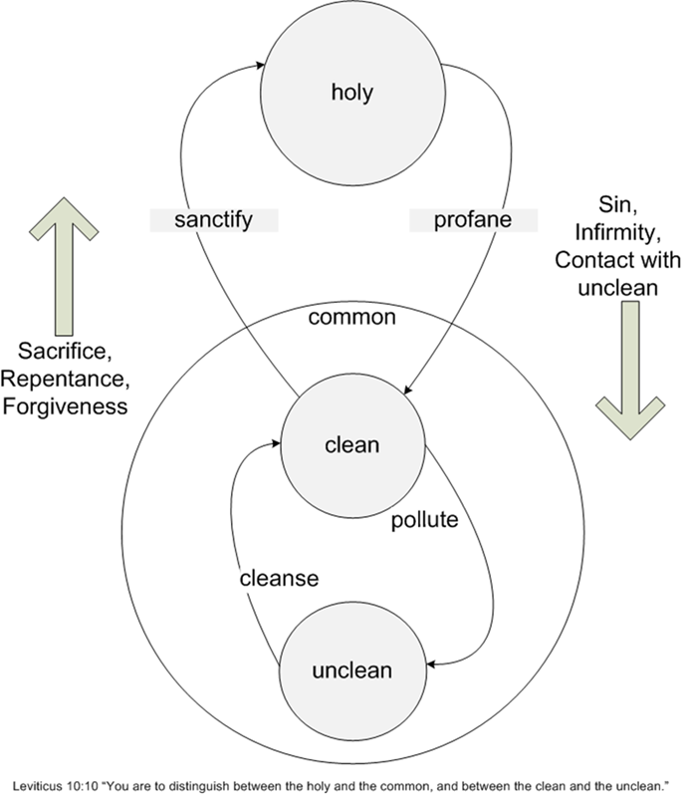
This diagram combines these concepts

Slide 5
Animal Sacrifices
In the ancient world the sacrifice of animals was an assumed normal part of life
From the beginning, animals were used in the worship of God:
God killed animals to clothe Adam and Eve (Genesis 3:21)
Abel offered “the firstborn of his flock” (Genesis 4:4)
Noah “offered a burnt offering” of all clean animals after the flood (Genesis 8:20)
YHWH instructed Abram how to confirm a covenant with slaughtered animals (Genesis 15:9-10)
YHWH provided a ram as a substitute for Isaac (Genesis 22:13)
Jacob offered sacrifices at Beersheba on his way into Egypt (Genesis 46:1)
Animal sacrifices were planned by God from the outset of the instructions given to Moses to build the Tabernacle:
The most important feature of the court of the Tabernacle was the bronze alter upon which the sacrifices were to be performed
The prescribed offering of sacrifices was central to the official worship of YHWH
Notes:
It is hard for us to understand the mind set of ancients to animal sacrifice …

Slide 6
The Tabernacle and the Alter
Notes:
To come near the tabernacle in an “unclean” state could result in death
To go into the court, one had to be in a “holy” state which required a sacrificial animal

Slide 7
The Purpose of Animal Sacrifice
… Israelite sacrifice was concerned with restoring the relationships between God and Israel, and between different members of the nation. The Sinai Covenant had created a fellowship characterized by life and order, harmony between God and man and between man and man. … Anything that disturbed this order … was a potential threat to the whole community, and sacrifice was the principal means for remedying the disruption … In Leviticus sacrifice … is regularly associated with cleansing and sanctification. (Wenham, G.J., op. cit., pages 25-26)
The oft-stated purpose of the sacrifices in Leviticus is ‘to atone’ … This verb may be explained in one of three ways: ‘to cover’ … ‘to wipe away’ … ‘to ransom by a substitute’ … The last seems most in keeping with the theory of sacrifice given in [Leviticus 17:11] ‘the life of the flesh is in the blood … it is the blood that makes atonement for the [life of the offeror] … (R.T. Beckwith, in Douglas, J.D., et al, editors, The New Bible Dictionary, (NBD), William B. Eerdmans, Grand Rapids, Michigan, 1962, page 1120)
A primary function of the Aaronic Priesthood was to perform animal sacrifices
Notes:
There is an enormous literature on animal sacrifice …
Our role is to understand and to teach – there is a lot to learned from what God has given us about the Aaronic Priesthood and animal sacrifices

Slide 8
The Meaning of Sacrifice
To a modern person, the offering of an animal sacrifice is most naturally perceived to be a ceremonial and symbolic action: to an ancient person, it was an integral part of their existence
The relationship of a committed Israelite with God was of utmost importance to the individual, just as it is today for a Christian: an Israelite could not have conceived of maintaining this relationship without animal sacrifice
God is very clear that Israel was to be a “holy nation” and that the people of Israel were individually to be “holy”: the process of “sanctification” could only be accomplished by the “substitutionary” death of an animal in place of the inherently sinful human being
Typologically, all the sacrifices looked forward to the sacrifice of Jesus Christ: his death obviated the need for any physical sacrifice on the part of Christians – Christians are required to offer themselves as “living sacrifices”.
Notes:
As a “living” sacrifice, repentance and forgiveness have replaced animals

Slide 9
Living Sacrifices
Romans 12:1 ESV
I appeal to you therefore, brothers, by the mercies of God, to present your bodies as a living sacrifice, holy and acceptable to God, which is your spiritual worship.
Hebrews 13:12-16 ESV
Jesus also suffered outside the gate in order to sanctify the people through his own blood. Therefore let us go to him outside the camp and bear the reproach he endured. … Through him then let us continually offer up a sacrifice of praise to God, that is, the fruit of lips that acknowledge his name. Do not neglect to do good and to share what you have, for such sacrifices are pleasing to God.
1 Peter 1:15-19 ESV
… but as he who called you is holy, you also be holy in all your conduct, since it is written, “You shall be holy, for I am holy.” And if you call on him as Father who judges impartially according to each one’s deeds, conduct yourselves with fear throughout the time of your exile, knowing that you were ransomed …with the precious blood of Christ …

Slide 10
Intercessory Role of Aaronic Priesthood
As human beings, we are inherently unclean – susceptible to sin
The unclean cannot come in contact with the holy: no human being in this condition can approach to the Holy God
Only through God’s grace can human beings be accounted holy and therefore approach God
God’s grace was extended to the Israelites through the sacrifices offered by the Aaronic Priests: this is the intercessory role of the priest
The official garment of the High Priest, Aaron initially, was specifically designed to represent the fact that the High Priest stood in an intercessory role between God and the people
The garment is described in detail in Exodus chapters 28 and 39
Notes:
Very important to understand the role of an “intercessor”
An “intercessor pleads for favour on behalf of another person”
Only through animal sacrifice could the people be sanctified
The Aaronic Priests performed the sacrifice – the stood between God and the people

Slide 11
The High Priest’s Garment
Gold Plate: Holy to YHWH
Two Onyx stones with the names of Tribes of Israel
Breastpiece of Justice
Twelve stones with the names of Tribes of Israel
Ephod
Notes:
When Aaron went before God, he stood between God and the nation

Slide 12
The Ephod and the Breastpiece
Both of these items were designed to remind Aaron of his responsibility to stand in the place of the people, “bear their names”, before YHWH:
Exodus 28:6-12 ESV
And they shall make the ephod … You shall take two onyx stones, and engrave on them the names of the sons of Israel … And you shall set the two stones on the shoulder pieces of the ephod, as stones of remembrance for the sons of Israel. And Aaron shall bear their names before the LORD on his two shoulders for remembrance.
The “breastpiece” over the heart indicates the relationship of love YHWH desired with Israel:
Exodus 28:15-21, 29 ESV
You shall make a breastpiece of [mishᵉpat] … You shall set in it four rows of stones. … There shall be twelve stones with their names according to the names of the sons of Israel. They shall be like signets, each engraved with its name, for the twelve tribes. … So Aaron shall bear the names of the sons of Israel in the breastpiece of [mishᵉpat] on his heart, when he goes into the Holy Place, to bring them to regular remembrance before the LORD.
Notes:
Remembrance: Aaron was always to be aware of what he was doing, as we must

Slide 13
The Intercessory Role
Aaron’s responsibility was to ensure the people of Israel understood mishᵉpat as an attribute of the nature of God:
Exodus 28:30 ESV
… the breastpiece of [mishᵉpat] … shall be on Aaron’s heart, when he goes in before the LORD. Thus Aaron shall bear the [mishᵉpat] of the people of Israel on his heart before the LORD regularly.
On Aaron’s head was a band of gold with the inscription “Holy to YHWH”:
Exodus 28:36-38 ESV You shall make a plate of pure gold and engrave on it, like the engraving of a signet, ‘Holy to the LORD.’ … It shall be on Aaron’s forehead, and Aaron shall bear any guilt from the holy things that the people of Israel consecrate as their holy gifts.
Aaron carried the sins of the people before YHWH – he took the sins of the people upon himself: in this, he prefigured the sacrifice of Jesus Christ
Aaron had to be in a state of “holiness”, clean and sanctified, whenever he approached YHWH – the people’s offerings became holy through the process of offering
Aaron, representing the entire priesthood, carried the guilt of sin before YHWH so that the people’s offerings could be accepted as holy.
Notes:
The word “guilt” is עַוֺן - `awon, one of the most common words for “sin”
The word for “bear” is נָשָׂא - nasa´, to “bear”, “carry” same as “bear the names”, “bear the mishᵉpat”
Human nature: we are susceptible to sin
The people’s offerings could not be perfect: Aaron took on that sin on behalf of the people

Slide 14
The Message for Christians
Today Jesus Christ is our intercessor to make salvation possible:
Hebrews 10:12, 21-22 ESV
But when Christ had offered for all time a single sacrifice for sins, he sat down at the right hand of God … we have a great priest over the house of God, let us draw near with a true heart in full assurance of faith …
In the World Tomorrow we will be given the role as “intercessors” between the people of the earth and God the Father and Jesus Christ, the King of kings
Each and every person on the planet will be called to the Church, but “calling” requires a response; to respond to God’s calling requires understanding it; to understand God’s calling, people must be taught
Our job today is to prepare to do that teaching
Notes:
The importance of “teaching” cannot be overemphasized.
The world today is characterized by lies.
Many great lies in religion, in science, in history, in social relationships – in fact every aspect of modern living, are accepted the majority of people as truths.

Slide 15
The Covenant with Levi
The last prophetic book of the Old Testament, Malachi, contains the following statement:
Malachi 2:1, 4-7 ESV And now, O priests, this command is for you. … So shall you know that I have sent this command to you, that my covenant with Levi may stand, says the LORD of hosts. My covenant with him was one of life and peace, and I gave them to him. It was a covenant of fear, and he feared me. He stood in awe of my name. True instruction was in his mouth, and no wrong was found on his lips. He walked with me in peace and uprightness, and he turned many from iniquity. For the lips of a priest should guard knowledge, and people should seek instruction from his mouth, for he is the messenger of the LORD of hosts.
This is the other main role of the Aaronic Priesthood: teaching – it is discussed in some detail in the document
Notes:
To “guard knowledge” means to make sure what is taught is “truth” – not available in the world today
We are to be “priests of God” – this role falls to us

Slide 16
Ezekiel’s Prophecy
Ezekiel prophesizes of the day when the Levitical Priesthood will be restored:
Ezekiel 44:15, 23 ESV
But the Levitical priests … who kept the charge of my sanctuary when the people of Israel went astray from me, shall come near to me to minister to me. And they shall stand before me … They shall teach my people the difference between the holy and the common, and show them how to distinguish between the unclean and the clean.
Ezekiel alludes to a very important passage in Leviticus:
Leviticus 10:10-11 ESV
You are to distinguish between the holy and the common, and between the unclean and the clean, and you are to teach the people of Israel all the statutes that the LORD has spoken to them by Moses.
Notes:
Some people believe that the whole of Ezekiel’s second temple vision should be understood allegorically, but we’ll find out when we get there …
The role of teaching is the critical point: this will be our role in the World Tomorrow
Leviticus 10 is the quote from the first slide: we have to learn to distinguish now so that we can teach all people in WT

Slide 17
Moses’ Blessing of the Tribes
Deuteronomy records Moses’ blessing as his last words to the Israelites before his death:
Deuteronomy 33:1 ESV
This is the blessing with which Moses the man of God blessed the people of Israel before his death.
The blessing of Levi is very clear on one point:
Deuteronomy 33:8, 10 ESV
And of Levi he said …
They shall teach Jacob your [mishᵉpat] and Israel your [torah]
The fundamental meaning of mishᵉpat is “justness” as an attribute of God’s divine nature: “to be just” is a character attribute required by God of any person ancient or modern who would consider himself a true worshipper.
The word torah means “teaching”, “instruction“, or “direction”: the torah teaches the way to live – the way to peace, prosperity, and freedom.
Notes:
Moses uses two very important and broad reaching terms with regard to Levi’s teaching responsibilities.
From there, the range of meaning extends all “justice” in personal and community relationships – including the legal administration of justice.
The Ten Commandments are the basis of God’s torah. The Pentateuch and in fact the whole Bible, especially the New Testament, are an elaboration of the Ten Commandments.

Slide 18
God is Inherently Holy
To approach God, a human being must be in a state of “holiness”
The Aaronic Priests had to be in a state of “holiness” to represent the people
The Aaronic Priests had to present animals in a substitutionary manner to bring themselves to a state of “holiness”; then they could, in an intercessory role, present the offerings of the people
The High Priest took upon himself the sins of all the people and carried them before YHWH in a prefiguring of the sacrifice of Jesus Christ
Only the blood of Jesus Christ can through repentance wash away sin
Salvation is made possible by Jesus’ role as High Priest – our intercessor
True “holiness” is only attainable through the blood of Jesus Christ
Christians will be truly “Holy” only at the resurrection, then we will be intercessors for all humanity

