Slide 1
The Covenant of Fidelity
Israel served the LORD all the days of Joshua, and all the days of the elders who outlived Joshua and had known all the work that the LORD did for Israel.
Joshua 24:31 ESV
I remember the devotion of your youth, your love as a bride,
how you followed me in the wilderness, in a land not sown.
Israel was holy to the LORD, the firstfruits of his harvest.
Jeremiah 2:2b-3a ESV
And now I am about to go the way of all the earth,
and you know in your hearts and [minds], all of you,
that not one word has failed of all the good things
that the LORD your God promised concerning you.
All have come to pass for you; not one of them has failed.
Joshua 23:14 ESV
©2022 Mike Whyte – this document may be used freely for personal study, preaching, and teaching. No part of it may be used under any circumstances for commercial purposes or to attain personal gain or advantage.
Notes:
Jsh24:31 is one of the highest accolades given to any OT person
The “Golden Age” of Joshua is the only period of Israelite history during which the people were wholly faithful to YHWH
The Covenant of Fidelity is the epitome of Joshua’s life
It is the climax of the Book of Joshua
The description of the Covenant of Fidelity is quite simple
We need to survey Joshua’s life to appreciate the Covenant of Fidelity

Slide 2
Joshua’s Commission
Joshua was specifically commissioned to lead the people into the Promised Land:
  Numbers 27:18-20
  So the LORD said to Moses, “Take Joshua the son of Nun, a man in whom is the Spirit, and lay your hand on him. Make him stand before Eleazar the priest and all the congregation, and you shall commission him in their sight. You shall invest him with some of your authority, that all the congregation of the people of Israel may obey. …”
  Deuteronomy 31:7-8
  Then Moses summoned Joshua and said to him in the sight of all Israel, “Be strong and courageous, for you shall go with this people into the land that the LORD has sworn to their fathers to give them, and you shall put them in possession of it. It is the LORD who goes before you. He will be with you; he will not leave you or forsake you. Do not fear or be dismayed.”
Joshua had been Moses’ assistant from the beginning, and he was one of the original twelve spies
Notes:
Numbers 27 is in the Plains of Moab just before Moses commences speeches recorded in Deuteronomy
Deuteronomy 31 is at the end of the speeches, just before Moses’ death
Joshua is repeatedly enjoined to “Be strong and courageous” – a lesson for us: we are about to enter the TRUE promised land, but there are a lot of battles first …
The handout contains a timeline of Joshua’s life and the conquest – lots of scriptures

Slide 3
No Apostacy in the Book of Joshua
The Book of Joshua is the only “historic” or “prophetic” book of the Old Testament which does NOT deal with any Israelite apostacy – it is a very positive book, a book of accomplishment, a book of successful service to God
There is only one criticism of Joshua – the Gibeonite deception:
  Joshua 9:14-15 ESV
  So the men took some of their provisions, but did not ask counsel from the LORD. And Joshua made peace with them and made a covenant with them, to let them live, and the leaders of the congregation swore to them.
After the death of Joshua there was some criticism for failure to drive out all the inhabitants of the land, but that was part of the plan: Deuteronomy 7:22 ESV
  The LORD your God will clear away these nations before you little by little. You may not make an end of them at once, lest the wild beasts grow too numerous for you.
The problem was intermixing with the Inhabitants of the land: Judges 2:2 ESV
  … you shall make no covenant with the inhabitants of this land; you shall break down their altars.’ But you have not obeyed my voice. What is this you have done?
Notes:
Joshua ( יְהֹושׁוּעַ - yᵉhoshua`) is the Hebrew equivalent of the Greek (Ἰησοῦς - Iēsous) Jesus
Much can be made of that as a type, but most significant: Joshua gave Israel the “type” of the Kingdom, the “rest” in the promised land, free of apostacy. Jesus gives Christians the “true rest” in the Kingdom of God, in which there can be no apostacy
“intermixing with the Inhabitants of the land” is the problem through the whole Book of Judges

Slide 4
War with the Inhabitants of the Land
Joshua’s first business was war with the inhabitants of the land:
  Joshua 1:3, 5-6, 3:10b, 5:1 ESV
  Every place that the sole of your foot will tread upon I have given to you, just as I promised to Moses. … No man shall be able to stand before you all the days of your life. Just as I was with Moses, so I will be with you. I will not leave you or forsake you. Be strong and courageous, for you shall cause this people to inherit the land that I swore to their fathers to give them.
  … the living God is among you and that he will without fail drive out from before you the Canaanites, the Hittites, the Hivites, the Perizzites, the Girgashites, the Amorites, and the Jebusites.
  As soon as all the kings of the Amorites who were beyond the Jordan to the west, and all the kings of the Canaanites who were by the sea, heard that the LORD had dried up the waters of the Jordan for the people of Israel until they had crossed over, their hearts melted and there was no longer any spirit in them because of the people of Israel.
The war took five to ten years – it is very briefly recounted in Joshua chapters six through eleven
Notes:
See the timeline for chronological perspective
There remains work to do – God will give us the victory

Slide 5
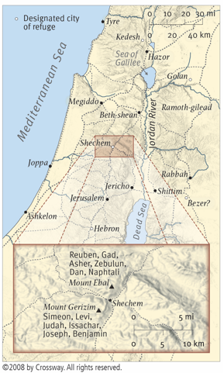
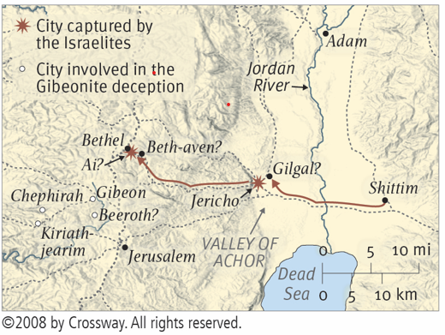
The Ceremony at Mount Ebal
At Mount Ebal the Israelites performed the covenant ratification ceremony prescribed by Moses:
Deuteronomy 27:12-13 ESV
When you have crossed over the Jordan, these shall stand on Mount Gerizim to bless the people: Simeon, Levi, Judah, Issachar, Joseph, and Benjamin. And these shall stand on Mount Ebal for the curse: Reuben, Gad, Asher, Zebulun, Dan, and Naphtali.
After early victories the Israelites were able establish themselves in the central highlands near Shechem:
Notes:
All of Dt27: describes the details of the ceremony

Slide 6
Joshua 8:30-35 ESV
At that time Joshua built an altar to the LORD, the God of Israel, on Mount Ebal, just as Moses the servant of the LORD had commanded the people of Israel, as it is written in the [documentation] of the [torah] of Moses, “an altar of uncut stones, upon which no man has wielded an iron tool.” And they offered on it burnt offerings to the LORD and sacrificed peace offerings.
And there, in the presence of the people of Israel, he wrote on the stones [an extract] of the [torah] of Moses, which he had written.
And all Israel, sojourner as well as native born, with their elders and officers and their judges, stood on opposite sides of the ark before the Levitical priests who carried the ark of the covenant of the LORD, half of them in front of Mount Gerizim and half of them in front of Mount Ebal, just as Moses the servant of the LORD had commanded at the first, to bless the people of Israel.
And afterward he read all the words of the [torah], the blessing and the curse, according to all that is written in the [documentation] of the [torah].
There was not a word of all that Moses commanded that Joshua did not read before all the assembly of Israel, and the women, and the little ones, and the sojourners who lived among them.
Notes:
Joshua would have recorded this in his “daily log” as Moses had done
Joshua was very careful to do what God required as he had been instructed by Moses
Moses instruction for the alter on Mount Ebal: Dt27:4-6, see Ex20:25
This may well have been the occasion of the assembly of Moses speeches into the Book of Deuteronomy
“book”, sepher, is better translated as “documentation” since at this time the writings of Moses required several scrolls, not a single “book”
“an extract”: מִשְׁנֶה - mishᵉneh, “second”, “double”; broad range of meaning, NOT necessarily “exact copy”
“alter of uncut stones” Ex20:25, Dt27:5-6
“words of the [torah], the blessing and the curse” likely alludes to Leviticus 26
“a word of all that Moses commanded” my allude to material we have in Deuteronomy

Slide 7
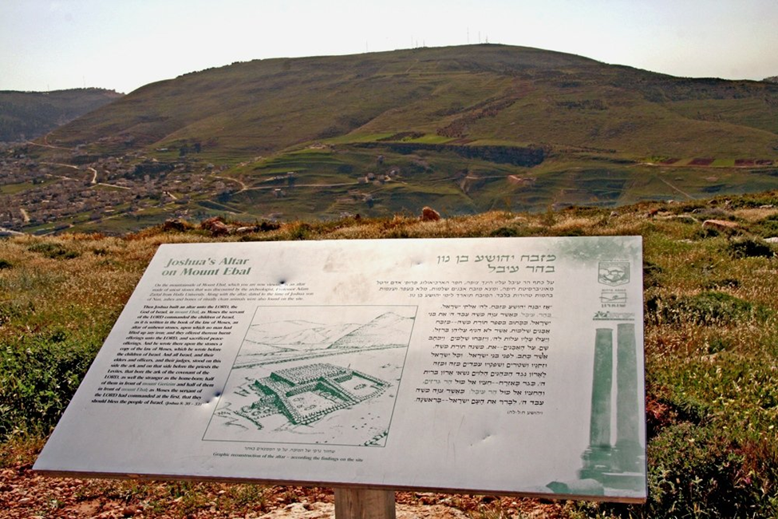
Mount Ebal Today

Slide 8
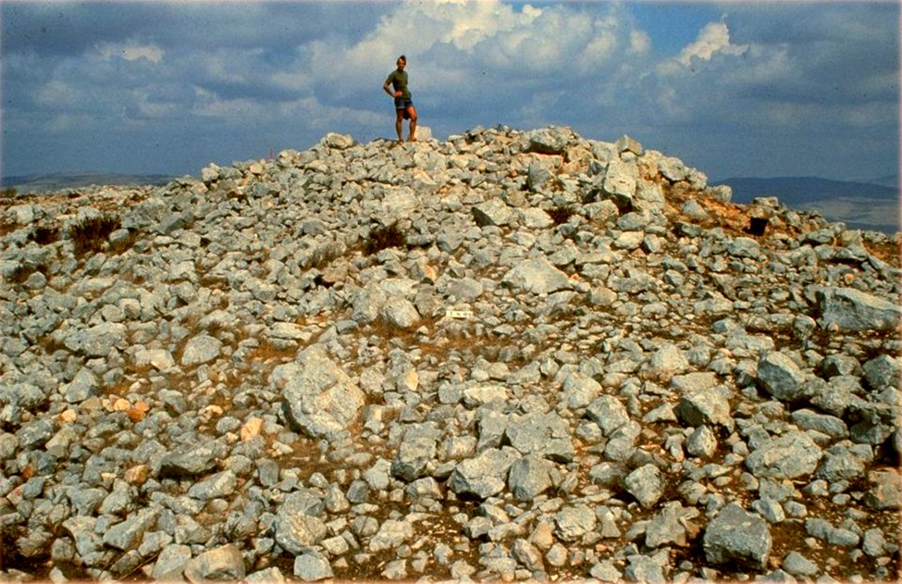
The Archeological Site

Slide 9
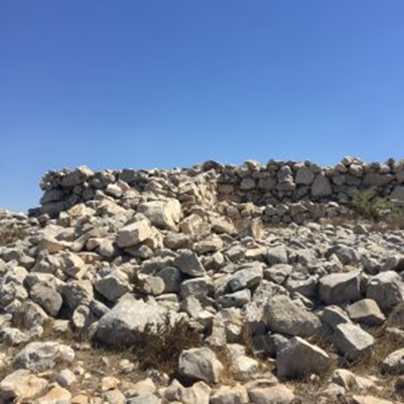
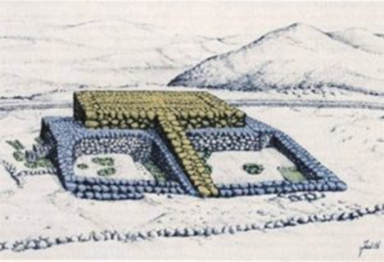
The Site as Excavated
Artist’s Conception of the Alter

Slide 10
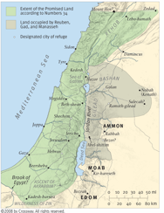
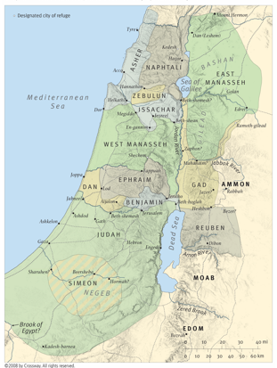
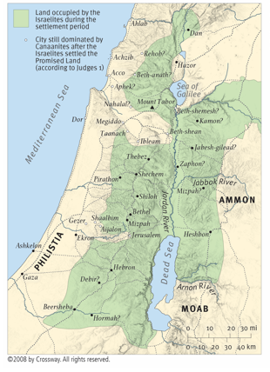
The Division of the Land
Next Joshua spent five to ten years allocating and dividing the land – described in Joshua chapters thirteen through twenty-two:
Boundaries: Numbers 34
Allocation: Joshua 14 through 19
Conquered: Judges 1 and 3

Slide 11
The Golden Age
Although Israel did NOT control all the territory, the remaining inhabitants of the land posed no threat to Israel:
  Joshua 18:1 ESV
  Then the whole congregation of the people of Israel assembled at Shiloh and set up the tent of meeting there. The land lay subdued before them.
Joshua settled into “retirement”:
  Joshua 19:49-50 ESV
  When they had finished distributing the several territories of the land as inheritances, the people of Israel gave an inheritance among them to Joshua the son of Nun. By command of the LORD they gave him the city that he asked, Timnath-serah in the hill country of Ephraim. And he rebuilt the city and settled in it.
These last years of Joshua’s live and the years of the “elders who outlived” him, about forty years, were the “Golden Age” – the only period in the history of Israel were the nation truly served YHWH without apostacy
Notes:
Not clear exactly where Timnath-serah was located, but it was NOT a major center
The timeline lists a bunch of scriptures which refer to the “Golden Age”
That is the background for Joshua’s final speech and the Covenant of Fidelity

Slide 12
Joshua’s Final Speech
When Joshua is approaching death, he makes a final exhortation to the people as did his mentor, Moses:
  Joshua 23:2-5 ESV
  Joshua summoned all Israel, its elders and heads, its judges and officers, and said to them,
  “I am now old and well advanced in years. And you have seen all that the LORD your God has done to all these nations for your sake, for it is the LORD your God who has fought for you. Behold, I have allotted to you as an inheritance for your tribes those nations that remain, along with all the nations that I have already cut off, from the Jordan to the Great Sea in the west. The LORD your God will push them back before you and drive them out of your sight. And you shall possess their land, just as the LORD your God promised you.
Joshua recognizes that the work is NOT complete – there remain inhabitants of the land to be driven out
This speaks to us today: there is work remaining to be done, we cannot rest on our laurels
Notes:
“all Israel” the people were spread out over the whole land, so Joshua had to work with “representatives”
When the World Tomorrow starts, our real work begins: the people that remain, the worldwide survivors of the holocaust must be reached, provided for, and taught: QUICKLY

Slide 13
Joshua is explicit that the remaining inhabitants must be driven out and the consequences of intermixing with them:
  Joshua 23:6-11 ESV
  Therefore, be very strong to keep and to do all that is written in the [documentation] of the [torah] of Moses, turning aside from it neither to the right hand nor to the left, that you may not mix with these nations remaining among you or make mention of the names of their gods or swear by them or serve them or bow down to them, but you shall cling to the LORD your God just as you have done to this day. For the LORD has driven out before you great and strong nations. And as for you, no man has been able to stand before you to this day. One man of you puts to flight a thousand, since it is the LORD your God who fights for you, just as he promised you. Be very careful, therefore, to love the LORD your God.
Again there is a message for us: God will accomplish the work – our job is to resist the “cares of this life”, to “fight” to finish the work, “put to flight a thousand”, and “love the LORD our God”
Notes:
And in the World Tomorrow, we cannot allow any “intermixing” of the old ways of the world

Slide 14
  Joshua 23:12-13 ESV
  For if you turn back and cling to the remnant of these nations remaining among you and make marriages with them, so that you associate with them and they with you, know for certain that the LORD your God will no longer drive out these nations before you, but they shall be a snare and a trap for you, a whip on your sides and thorns in your eyes, until you perish from off this good ground that the LORD your God has given you.
The message for us is clear: Luke 9:62 ESV
  Jesus said to him, “No one who puts his hand to the plow and looks back is fit for the kingdom of God.”
Joshua finishes with a summary: Joshua 23:14-16 ESV
  And now I am about to go the way of all the earth, and you know in your hearts and [minds], all of you, that not one word has failed of all the good things that the LORD your God promised concerning you. All have come to pass for you; not one of them has failed. But just as all the good things that the LORD your God promised concerning you have been fulfilled for you, so the LORD will bring upon you all the evil things, until he has destroyed you from off this good land that the LORD your God has given you, if you transgress the covenant of the LORD your God, which he commanded you, and go and serve other gods and bow down to them. Then the anger of the LORD will be kindled against you, and you shall perish quickly from off the good land that he has given to you.”
Notes:
“if you transgress the covenant” – this is an allusion to the Sinai Covenant

Slide 15
The Covenant of Fidelity
Joshua’s speech serves as a preamble for and a segue into the Covenant of Fidelity: Joshua 23:15b-16a ESV
  … the LORD will bring upon you all the evil things, until he has destroyed you from off this good land that the LORD your God has given you, if you transgress the covenant of the LORD your God …
Israel was committed to the Sinai Covenant; Christians are committed to the Covenant of Baptism …
When Moses committed the people to the Covenant of Life, all Israel was right there in the camp: it was possible to cut the covenant on an individual level – this was no longer possible for Joshua, so the covenant participants are representative: Joshua 24:1 ESV
  Joshua gathered all the tribes of Israel to Shechem and summoned the elders, the heads, the judges, and the officers of Israel. And they presented themselves before God.
But, like the Covenant of Life, the implications of this covenant are very much at an individual level …
Notes:
The Sinai Covenant was the overarching covenant which created the nation of Israel
The Covenant of Baptism is the overarching covenant which makes a Christian a member of God’s Family

Slide 16
Historical Prologue
Joshua expresses a somewhat unique description of Israelite history: he reports a direct speech of YHWH, affirming that the Abrahamic line did not always serve YHWH: Joshua 24:2-4 ESV
  And Joshua said to all the people, “Thus says the LORD, the God of Israel, ‘Long ago, your fathers lived beyond the Euphrates, Terah, the father of Abraham and of Nahor; and they served other gods. Then I took your father Abraham from beyond the River and led him through all the land of Canaan, and made his offspring many. I gave him Isaac. And to Isaac
  I gave Jacob and Esau. And I gave Esau the hill country of Seir to possess, but Jacob and his children went down to Egypt.
The psychological distance of the Israelites from the Exodus is clear by the inclusion of the Exodus Generation as “fathers”: Joshua 24:5-7 ESV
  ‘And I sent Moses and Aaron, and I plagued Egypt with what I did in the midst of it, and afterward I brought you out. Then I brought your fathers out of Egypt, and you came to the sea. And the Egyptians pursued your fathers with chariots and horsemen to [Yam Suph]. And when they cried to the LORD, he put darkness between you and the Egyptians and made the sea come upon them and cover them; and your eyes saw what I did in Egypt. And you lived in the wilderness a long time.
Notes:
This prologue is very important because it speaks to a whole new generation who had grown up in a time of peace and prosperity …

Slide 17
Even the events in the Plains of Moab were a distant memory:
  Joshua 24:8-10 ESV
  ‘Then I brought you to the land of the Amorites, who lived on the other side of the Jordan. They fought with you, and I gave them into your hand, and you took possession of their land, and I destroyed them before you. Then Balak the son of Zippor, king of Moab, arose and fought against Israel. And he sent and invited Balaam the son of Beor to curse you, but I would not listen to Balaam. Indeed, he blessed you. So I delivered you out of his hand.
Finally, the Conquest, which all those born in the Promised Land would NOT remember: Joshua 24:11-13 ESV
  ‘And you went over the Jordan and came to Jericho, and the leaders of Jericho fought against you, and also the Amorites, the Perizzites, the Canaanites, the Hittites, the Girgashites, the Hivites, and the Jebusites. And I gave them into your hand. And I sent the hornet before you, which drove them out before you, the two kings of the Amorites; it was not by your sword or by your bow. I gave you a land on which you had not labored and cities that you had not built, and you dwell in them. You eat the fruit of vineyards and olive orchards that you did not plant.’
Notes:
The war had taken place a generation before this covenant
It would be “history” to all those under 30
This historical prologue is very important because it was addressed to the new generation – these were the people Joshua was trying to reach

Slide 18
Covenant Stipulation: Serve YHWH
There is one simple stipulation to the covenant: Joshua 24:14 ESV
  Now therefore fear the LORD and serve him in sincerity and in faithfulness. Put away the gods that your fathers served beyond the River and in Egypt, and serve the LORD.
The covenant requires “fidelity”, “sincerity and in faithfulness”, to YHWH expressed by avoidance of all idolatry. Joshua rhetorically offers the assembled people the option of choosing other “gods”, but categorically affirms his fidelity to YHWH: Joshua 24:15 ESV
  And if it is evil in your eyes to serve the LORD, choose this day whom you will serve, whether the gods your fathers served in the region beyond the River, or the gods of the Amorites in whose land you dwell. But as for me and my house, we will serve the LORD.
Joshua makes the covenant very personal “as for me and my house, we will serve YHWH”
Notes:
God repeatedly comes back to “idolatry” as the root of all sin
The focus of the covenant is clearly at an individual level

Slide 19
The assembled people emphatically deny any desire to serve other “gods”, and unequivocally affirm fidelity to YHWH: Joshua 24:16-18 ESV
  Then the people answered, “Far be it from us that we should forsake the LORD to serve other gods, for it is the LORD our God who brought us and our fathers up from the land of Egypt, out of the house of slavery, and who did those great signs in our sight and preserved us in all the way that we went, and among all the peoples through whom we passed. And the LORD drove out before us all the peoples, the Amorites who lived in the land. Therefore we also will serve the LORD, for he is our God.”
Next Joshua reminds them of the inevitability of sin and the need for repentance. Again, the assembled people unequivocally affirm fidelity to YHWH. Joshua reminds them of the human disposition to sin:
  Joshua 24:19-21 ESV
  But Joshua said to the people, “You are not able to serve the LORD, for he is a holy [God, he is a jealous God. He will not forgive your transgressions or your sins, if you forsake the LORD and serve foreign gods. Then] he will turn and do you harm and consume you, after having done you good.” And the people said to Joshua, “No, but we will serve the LORD.”
Notes:
Between [ ] is repunctuated from ESV to conform better to the Hebrew
“Forsaking YHWH” implies the choice to “live in sin”, i.e., idolatry – this is the attitude of the “unpardonable sin” which God “will not forgive”
Again, personal nature of the covenant “the LORD our God who brought us …”
“repentance” can only be at a personal level

Slide 20
Covenant Witnesses
Joshua states that the people have witnessed against themselves:
  Joshua 24:22-24 ESV
  Then Joshua said to the people, “You are witnesses against yourselves that you have chosen the LORD, to serve him.” And they said, “We are witnesses.” He said, “Then put away the foreign gods that are among you, and incline your heart to the LORD, the God of Israel.” And the people said to Joshua, “The LORD our God we will serve, and his voice we will obey.”
On this agreement to the terms of the covenant, the covenant is recorded as cut. A “stone” is set up as a formal witness and Joshua records the covenant in the “documentation of the torah of God”:
  Joshua 24:25-27 ESV
  So Joshua [cut] a covenant with the people that day, and put in place [statute and mishᵉpat] for them at Shechem. And Joshua wrote these words in the [documentation] of the [torah] of God. And he took a large stone and set it up there under the terebinth that was by the sanctuary of the LORD. And Joshua said to all the people, “Behold, this stone shall be a witness against us, for it has heard all the words of the LORD that he spoke to us. Therefore it shall be a witness against you, lest you deal falsely with your God.”
Notes:
It is NOT clear if there was an overt problem with “foreign gods” or if Joshua is just speaking rhetorically about the human disposition to “idolatry”
“put away” implies “repent”:
we cannot appreciate overt “idolatry”; but we can appreciate the pulls of the idolatry of the world around us – from which we must constantly “repent”
“statute and mishᵉpat” imply that Joshua did other teaching at that time
“documentation of the torah” clearly the writings of Moses were NOT considered a closed corpus

Slide 21
Conclusion
God’s covenants are a perfect and complete expression of God’s love for human beings: God’s love is most clearly expressed by the grace he holds out to each and every human being: John 3:16 ESV
  For God so loved the world, that he gave his only Son, that whoever believes in him should not perish but have eternal life.
The Covenant of Fidelity was specifically with the Nation of Israel to remind them of the importance of their commitment to the Sinai Covenant: the essence of the covenant is “fidelity”, absolute commitment to serve God – this is the essence of the “covenant” of baptism
A Christian agrees to grow in grace and knowledge – the torah of God: to accomplish that growth absolute commitment to live by the Way of God is required
Because we are human, we are all susceptible to sin, which requires ongoing repentance
Through this process we learn what it means to “serve the LORD for he is our God”

