Slide 1
The Miracles of the Gospel of John
Now Jesus did many other signs in the presence of the disciples, which are not written in this book; but these are written so that you may believe that Jesus is the Christ, the Son of God, and that by believing you may have life in his name. (John 20:30-31)
All Bible quotations are from the ESV
©2022 Mike Whyte – this document may be used freely for personal study, preaching, and teaching. No part of it may be used under any circumstances for commercial purposes or to attain personal gain or advantage.

Slide 2
Framework of the Gospel of John
John structures his Gospel around seven miracles and six feasts
The chronological framework of the feasts is unique to John – without it there would be no chronological data around the ministry of Christ
John’s teaching of the life and message of Jesus is very closely tied to the seven miracles

Slide 4
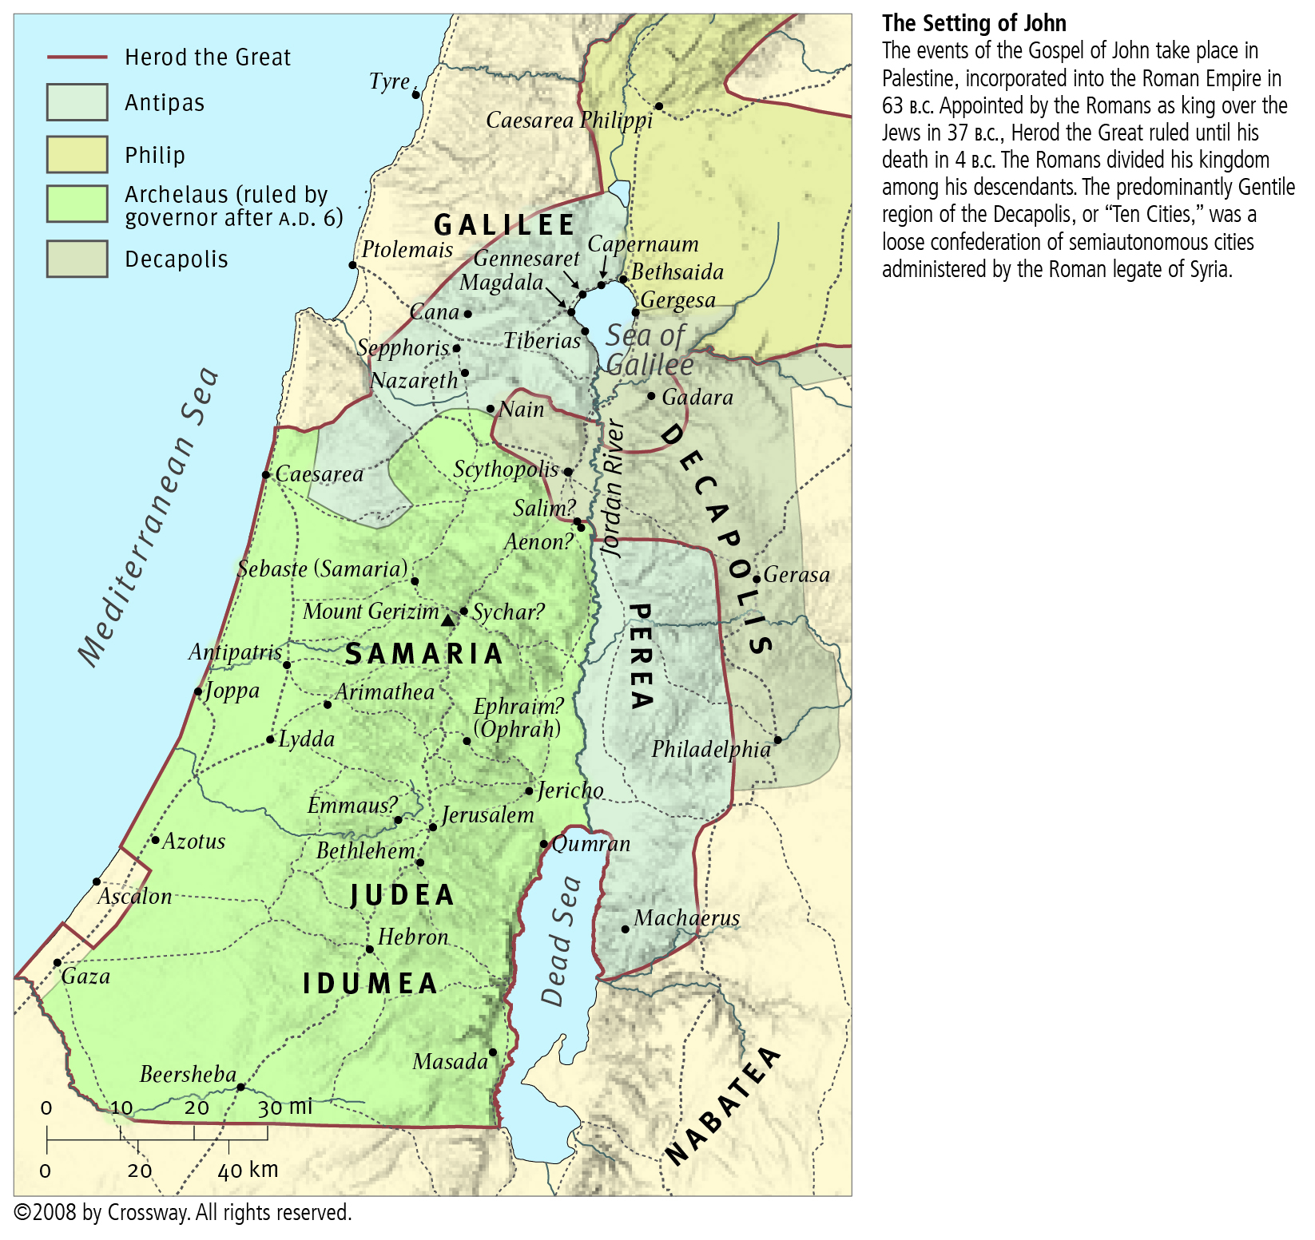
Miracle 1: Water to Wine
John 2:1-11
Note: Cana, Nazareth,
and other locations in Galilee

Slide 5
Miracle 1: Water to Wine
Time: shortly before the First Passover
Theme: ‘What Christ brings is better than everything that came before’
John the Baptist has witnessed to Jesus (John 1:29-34)
Jesus has witnessed to himself (John 1:51)
The ‘good wine’ represents Christ and the Gospel
John 2:9-10

Slide 6
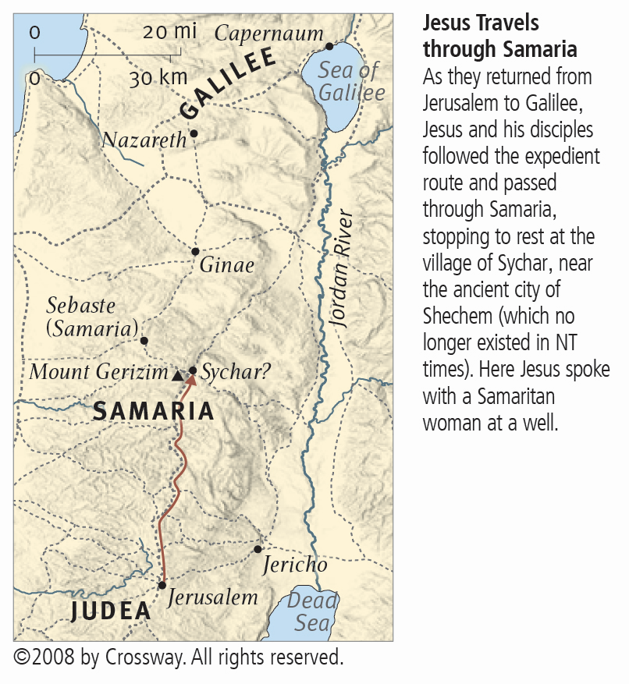
Miracle 2: Healing an Official’s Son
John 4:46-54
Note: Nazareth,
(Cana is just North), and Capernaum
Note: the route that Jesus had taken from Jerusalem through Sychar to Cana

Slide 7
Miracle 2: Healing an Official’s Son
Time: sometime after the First Passover, upon first returning to Galilee
Theme: ‘Unless you see signs and wonders, you will not believe’
Jesus’ teaching in Jerusalem after the first Passover focused on illustrating John 3:16 ‘For God so loved the world, that he gave his only Son, that whoever believes in him should not perish but have eternal life.’
Jesus has taught a believing Jew (Nicodemus), and a Samaritan, and performs his first public miracle for a Gentile, (see Acts 1:8) but his assessment of these representatives of the ‘people of the world’ is “Unless you see signs and wonders you will not believe.” (Jh4:48)

Slide 8
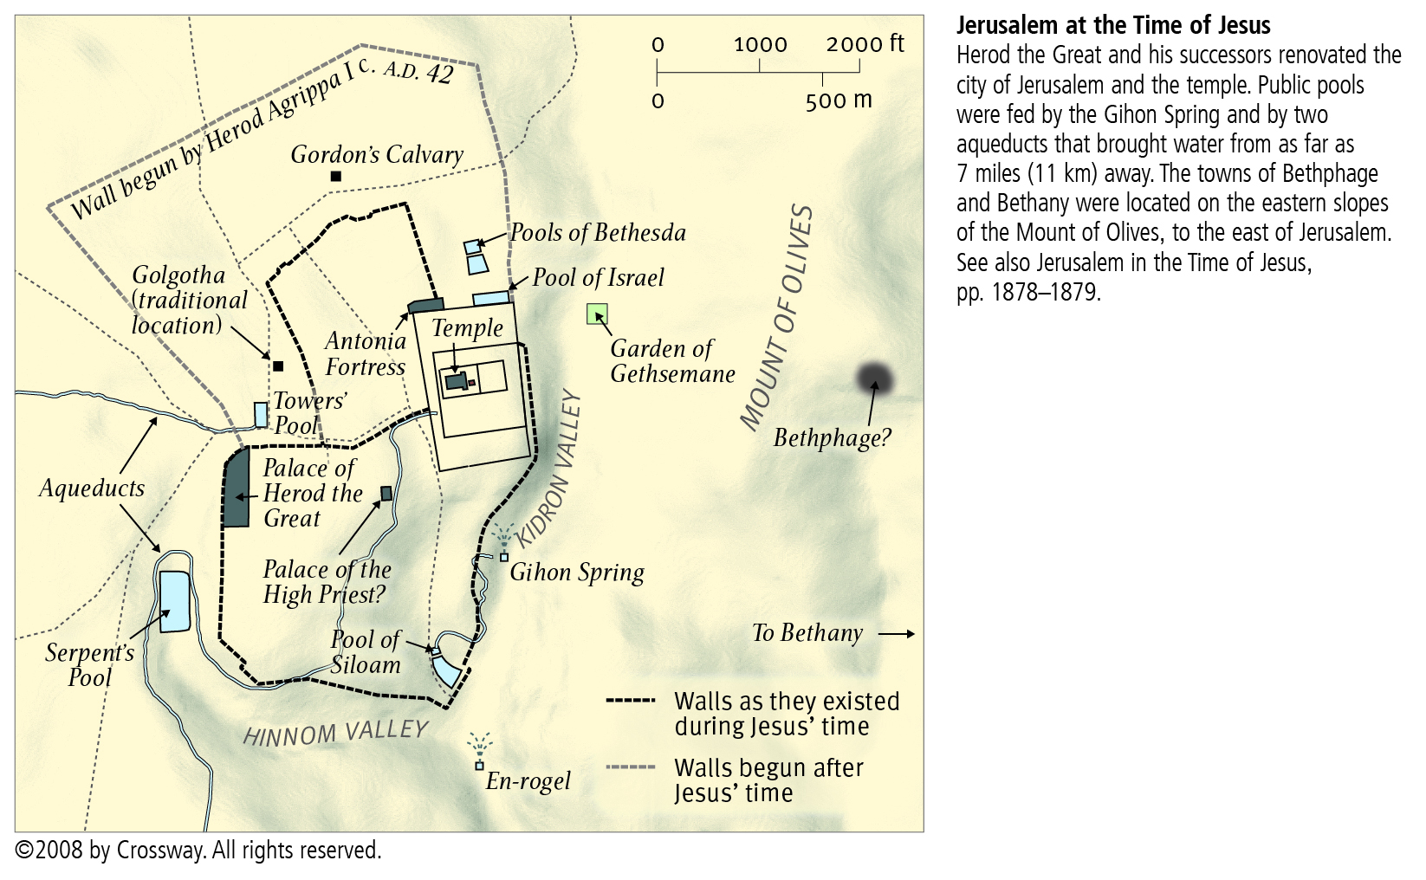
Miracle 3: Healing a Lame Man
John 5:2-9
Note: Pools of Bethesda

Slide 9
Miracle 3: Healing a Lame Man
Time: at the un-named Feast, on the Sabbath
Theme: ‘Do you want to be healed?’
The lame man represents the state of humanity in this world: unless people want to be healed, i.e. are willing to respond to God’s calling, God cannot help them. Christ’s teaching, to the lame man and the Jews in the temple, demonstrates that Christ’s work is to heal the world (physically and spiritually).
“My Father is working until now, and I am working.” (Jh5:17)
“… whoever hears my word and believes him who sent me has eternal life.” (Jh5:24)

Slide 10
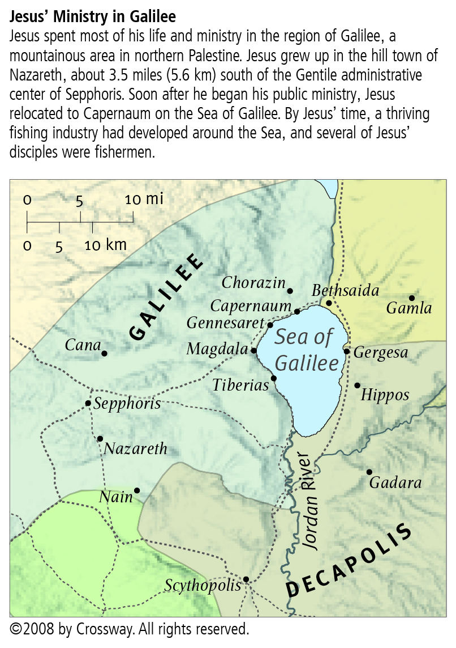
Miracle 4: Feeding 5000
John 6:1-13
Iturea and Traconitis
Note: Decapolis, Tetrarchy of Philip (Iturea and Traconitis)

Slide 11
Miracle 4: Feeding 5000
Time: Just before the Passover in Galilee
Theme: ‘God’s plan provides for all humanity – the crowd’
“… that nothing may be lost.” (Jh6:12) spoken here of food scraps, but the implication is that no people of the world should be lost – God’s desire for humanity (see Jh6:39)
“This is indeed the Prophet …” (Jh6:14) the people recognized this as a work of God
“I am the bread of life …” (Jh6:33-35, 41, 48, 51)
Calling is required for salvation (Jh6:37-40, 44-45)

Slide 12
Miracle 5: Walking on Water
John 6:16-21
Note: Capernaum, crossing Sea of Galilee

Slide 13
Miracle 5: Walking on Water
Time: Immediately after feeding the 5000
Theme: ‘enhance the faith of the disciples’
Only the disciples in the boat witnessed this miracle
(see Jh6:16-17)
“It is I; do not be afraid.” (Jh6:20)
“Jesus, knowing in himself that his disciples were grumbling … there are some of you who do not believe … after this many of his disciples turned back …” (Jh6:61, 64, 66)
“So Jesus said to the twelve, ‘Do you want to go away as well?’ … Lord, to whom shall we go? You have the words of eternal life, and we have believed …” (Jh6:67-69)

Slide 14
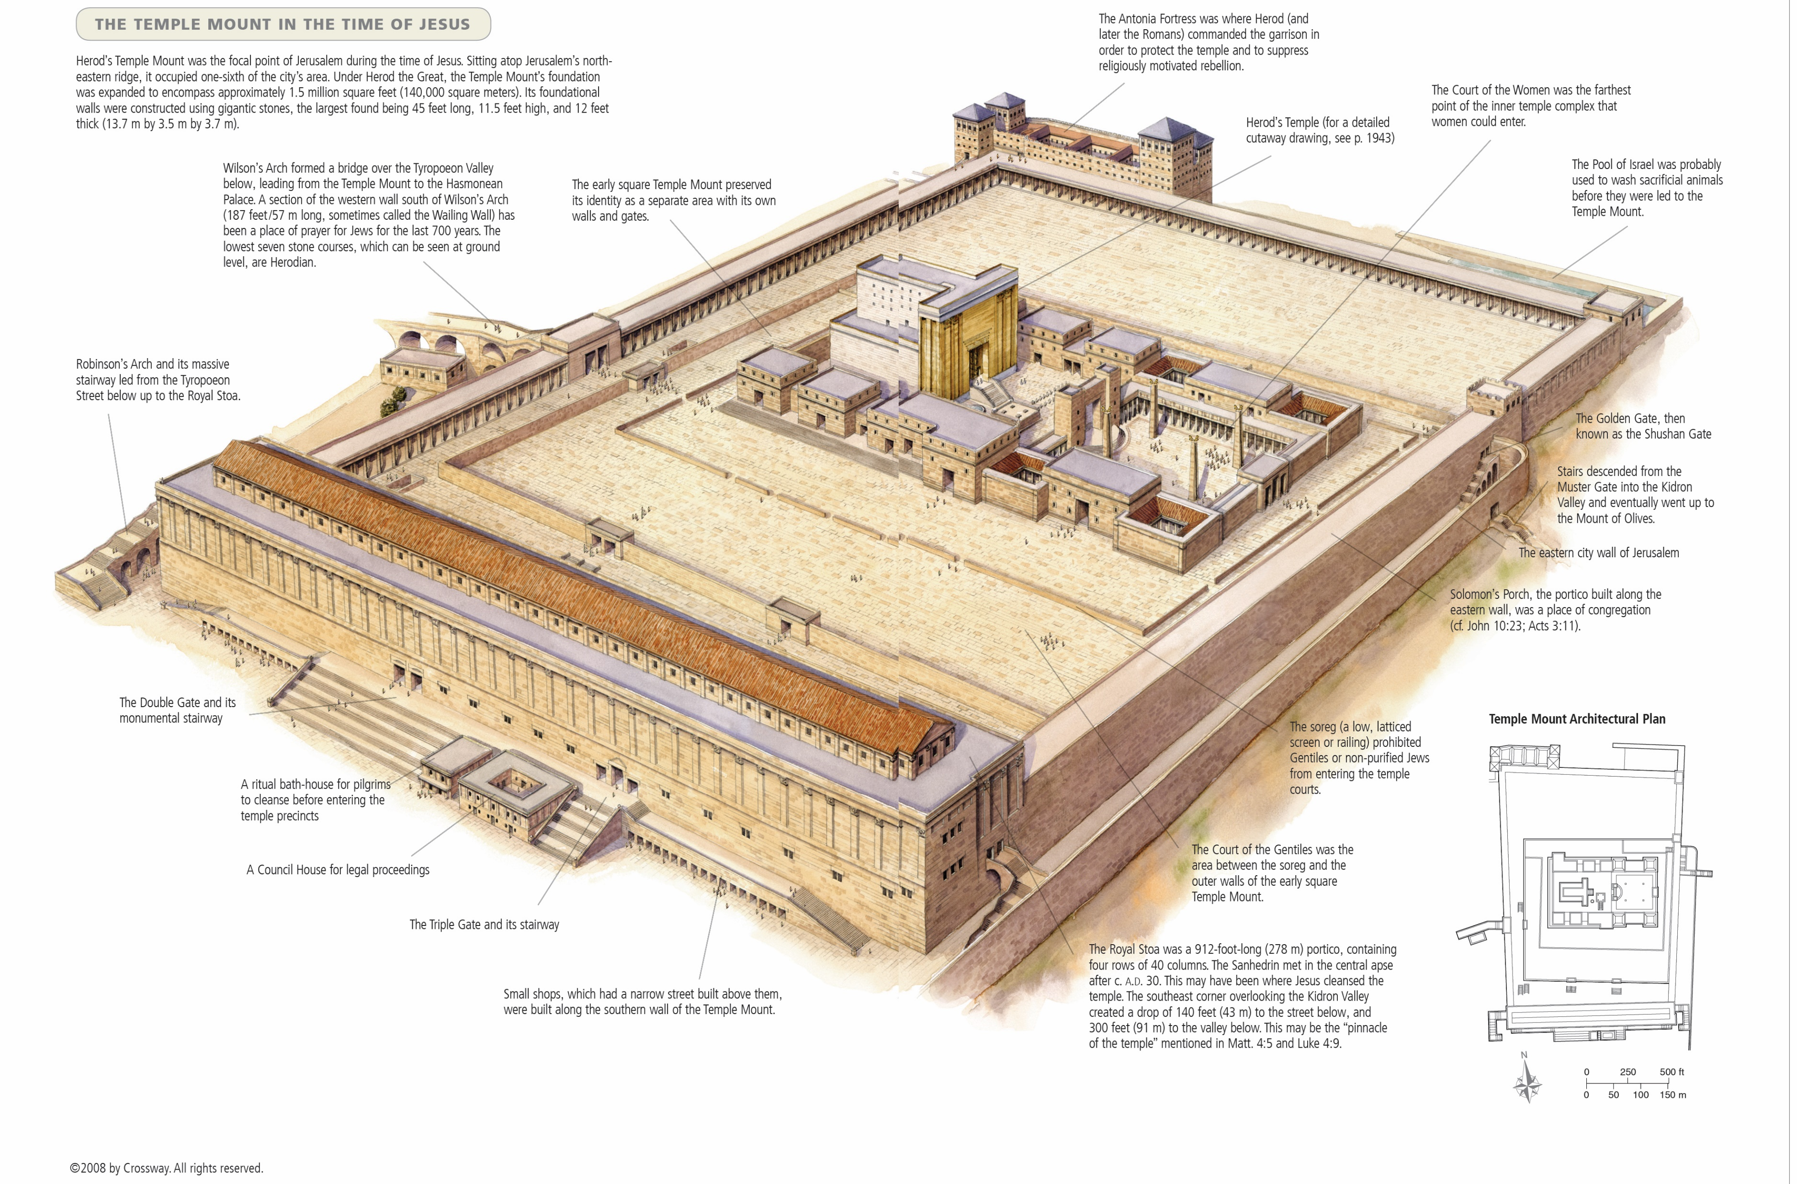
Miracle 6: Healing a Blind Man
John 9:1-14

Slide 15
Miracle 6: Healing a Blind Man
Time: After the Feast of Tabernacles and Last Great Day
Theme: ‘Even the blind of the world (leaders), will be shown the way’
“One thing I do know, that though I was blind, now I see.” (Jh9:25)
“Jesus said, ‘For judgment I came into this world, that those who do not see may see, and those who see may become blind.” (Jh9:39)
“… the Pharisees … said to him, ‘Are we also blind?’” (Jh9:40)
“… Jesus again said to them, ‘Truly, truly, I say to you, I am the door of the sheep. All who came before me are thieves and robbers’ …” (Jh10:7-8)

Slide 16
Miracle 6: Healing a Blind Man
The setting starts with the Feast of Tabernacles and Last Great Day in Jerusalem (Jh7:2, 14, 37)
During the Feast, Jesus had taught openly in the temple: “My teaching is not mine, but his who sent me.” (Jh7:16)
“On the last day of the feast, the great day, Jesus stood up and cried out … whoever believes in me … out of his heart will flow rivers of living water.” (Jh7:37-38)
“I am the light of the world” (Jh8:12, 9:5)
“If you abide in my word, you are truly my disciples, and you will know the truth, and the truth will set you free.” (Jh8:31-32)
Note: Christ taught ‘near the treasury’ (Jh8:20), i.e. inside the court of the women where there would be many high ranking leaders

Slide 17
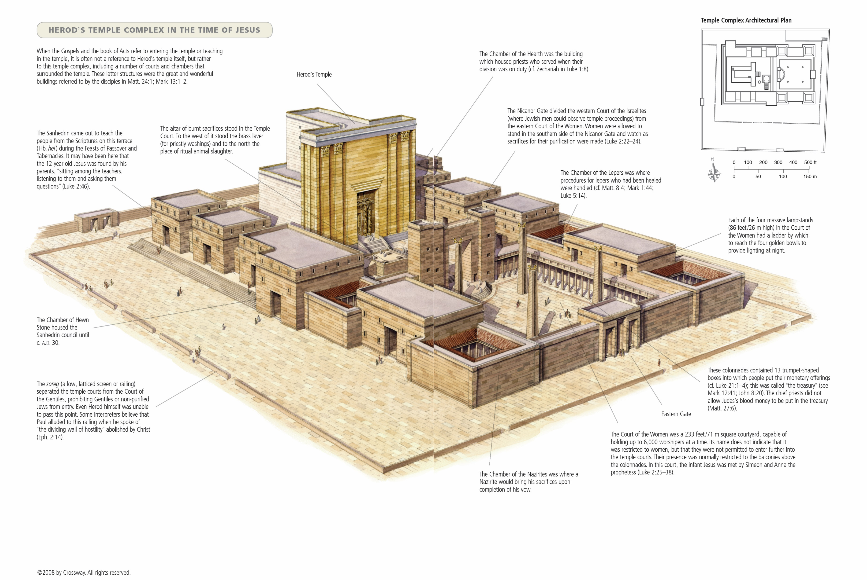
Miracle 6: Healing a Blind Man

Slide 18
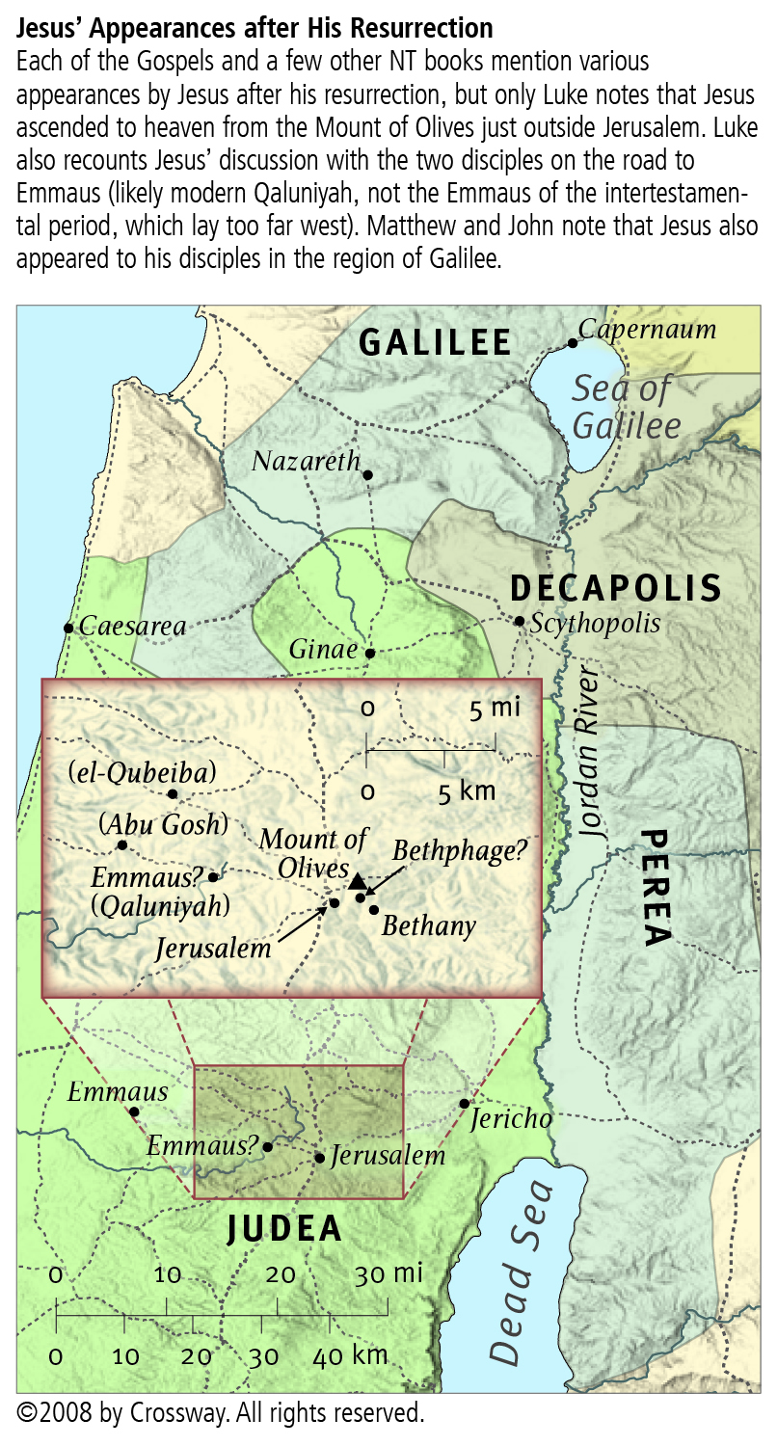
Miracle 7: Raising of Lazarus from the Dead
John
11:11-15,
38-44
Note: Perea, Bethany

Slide 19
Miracle 7: Raising of Lazarus from the Dead
Time: prior to the Last Passover
Theme: ‘only through Christ is the resurrection from the dead possible’
“… for your sake I am glad that I was not there, so that you may believe.” (Jh11:15)
“Jesus said to her, ‘I am the resurrection and the life. Whoever believes in me, though he die, yet shall he live’ …” (Jh11:25)
“… I said this on account of the people standing around, that they may believe that you sent me.” (Jh11:42)
“When he had said these things, he cried out with a loud voice, ‘Lazarus, come out.’” (Jh11:43, see Jh5:28-29)

Slide 20
Conclusion
The apostle John focused his presentation of Christ’s life and teaching around seven miracles:
The first, is private for a small group of disciples and Christ’s immediate family to enhance their faith in his divinity
Miracles two, three, and four are public to demonstrate God’s plan for all humanity
The fifth, is again private for a larger group of disciples to enhance their faith
Miracles six and seven are public to condemn the blind leaders of this world, but also with a very strong messages for the disciples regarding the divinity of Christ and the nature of the resurrection

