Slide 1
The Tabernacle from God’s Perspective
Then Moses went up on the mountain, and the cloud covered the mountain. The glory of the LORD dwelt on Mount Sinai, and the cloud covered it six days. And on the seventh day he called to Moses out of the midst of the cloud. Now the appearance of the glory of the LORD was like a devouring fire on the top of the mountain in the sight of the people of Israel. Moses entered the cloud and went up on the mountain. And Moses was on the mountain forty days and forty nights.
Exodus 24:15-18 ESV
The LORD said to Moses, “Speak to the people of Israel … And let them make me a sanctuary, that I may dwell in their midst. Exactly as I show you concerning the pattern of the tabernacle, and of all its furniture, so you shall make it. …”
Exodus 25:1-2a, 8-9 ESV
Notes:
The instructions for the construction of the Tabernacle: Ex25: - 31: (7 chapters)
The actual construction Ex35: - 39: (5 chapters)
The Tabernacle was very important to God – it was the focal point of his dealing with Israel
But, as we shall see it was just a physical object created for a purpose

Slide 2
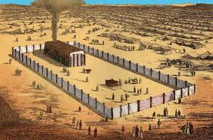
The Tent of Meeting
The entire sanctuary consisted of a “fence” made of cloth partitions hung between posts which surrounded the “tent” which was the Tabernacle. The “fence” was secured by guy ropes on the posts. The tent comprised two rooms: the first room, the “Holy Place”, is frequently referred to as “The Tent of Meeting”.
Exodus 29:42b-46 ESV
… at the entrance of the tent of meeting before the LORD, where I will meet with you, to speak to you there. There I will meet with the people of Israel, and it shall be sanctified by my glory. I will consecrate the tent of meeting and the altar . …
I will dwell among the people of Israel and will be their God. And they shall know that I am the LORD their God, who brought them out of the land of Egypt that I might dwell among them. I am the LORD their God.
Notes:
A lot is not specified: kitchen and eating facilities, sleeping quarters, secondary exit

Slide 3
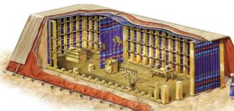
The Most Holy Place
Exodus 26:31-34 ESV
And you shall make a veil of blue and purple and scarlet yarns and fine twined linen. It shall be made with cherubim skillfully worked into it. And you shall hang it on four pillars of acacia overlaid with gold, with hooks of gold, on four bases of silver. And you shall hang the veil from the clasps, and bring the ark of the testimony in there within the veil. And the veil shall separate for you the Holy Place from the Most Holy. You shall put the mercy seat on the ark of the testimony in the Most Holy Place.

Slide 4
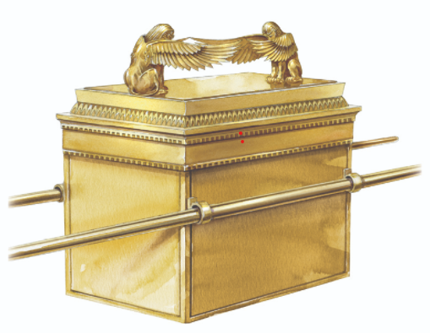
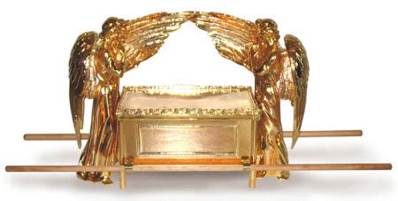
The Ark of the Covenant
Exodus 25:10-16 ESV
… make an ark of acacia wood. Two cubits and a half shall be its length, a cubit and a half its breadth, and a cubit and a half its height. You shall overlay it with pure gold, inside and outside shall you overlay it, and you shall make on it a molding of gold around it. You shall cast four rings of gold for it and put them on its four feet … You shall make poles of acacia wood and overlay them with gold. And you shall put the poles into the rings on the sides of the ark to carry the ark by them. … And you shall put into the ark the testimony that I shall give you.
Notes:
About 4.5’ by 2.25’ by 2.25’
“testimony”, `eduth, the tablets with the ten commandments
Both of these configurations of cherubim are possible
The second show four small legs, “four feet”

Slide 5
The Cherubim
  Exodus 25:17-22 ESV
  You shall make a [kapporeth] of pure gold. … And you shall make two cherubim of gold; of hammered work shall you make them, on the two ends of the [kapporeth]. … The cherubim shall spread out their wings above, overshadowing the [kapporeth] with their wings, their faces one to another; toward the [kapporeth] shall the faces of the cherubim be. And you shall put the [kapporeth] on the top of the ark … There I will meet with you, and from above the [kapporeth], from between the two cherubim …
כַּפֹּרֶת - kapporeth, “place of atonement”, the cover of the ark
כְּרֻבִים - kᵉrubim, “cherubim”, the cognate Accadian verb means “to bless, praise, adore” – “As one of the characteristics of cherubim was adoration of God, this derivation would appear suitable.” (TWOT page 454)
This representation of Cherubim clearly depicts them as having one face; the description in Ezekiel of four-faced creatures is exceptional (Ezekiel 1:10-11).
Note, the depiction in Ezekiel’s temple has two faces (Ezekiel 41:18-20).

Slide 6
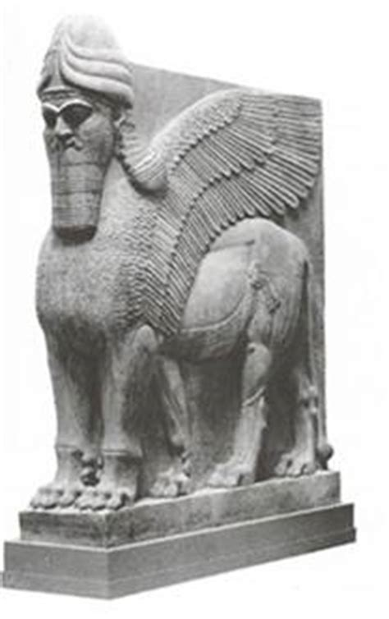
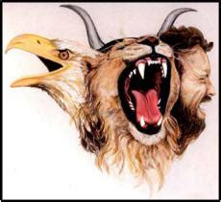
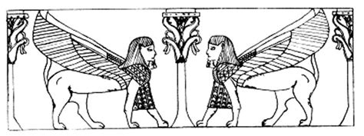
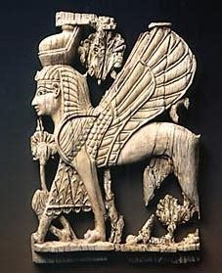
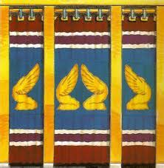
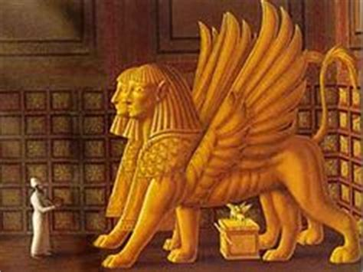
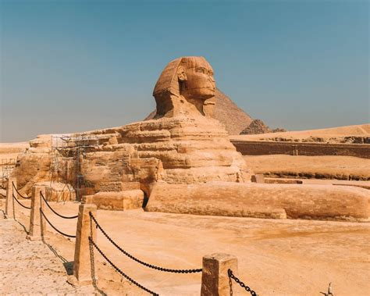
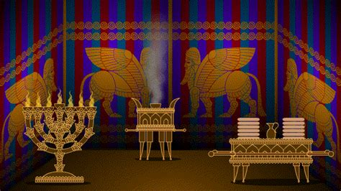
Depictions of Cherubim
Based on Phoenician Ivories
Notes:
There is a class of angelic beings called “cherubim” with various distinct types of beings, i.e. face configurations

Slide 7
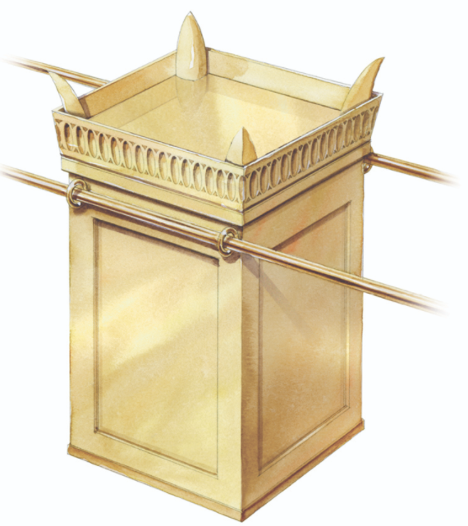
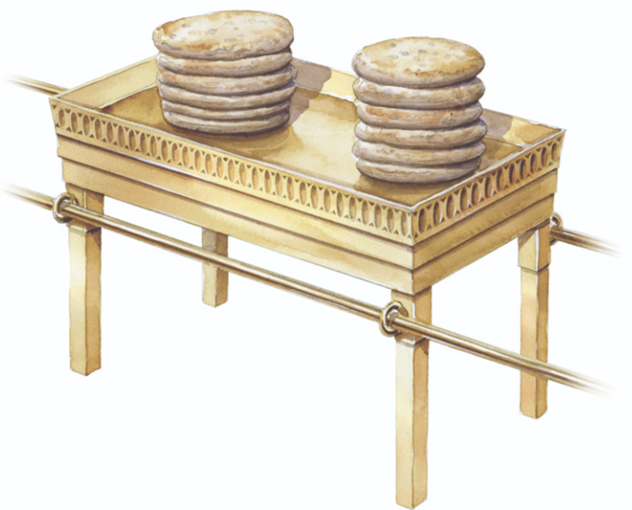
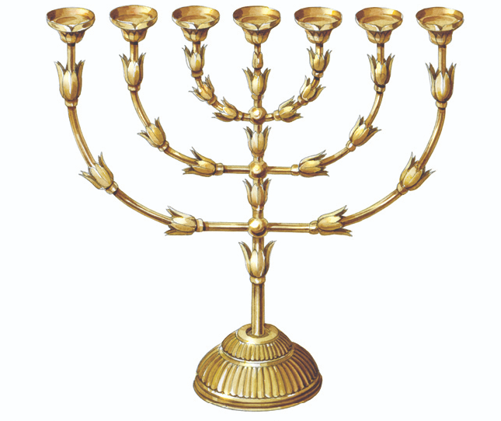
The Other Furniture
The Incense Alter
The Bread Table
The Lampstand
Notes:
There is no specification of the shape of the lampstand – above is based on the Arch of Titus
The Bread of the Prescence was changed each Sabbath Lv24:8
The poles were likely lower

Slide 8
Moving the Tabernacle
First, Aaron and his sons carefully covered the Ark for transit:
  Numbers 4:5-6
  When the camp is to set out, Aaron and his sons shall go in and take down the veil of the screen and cover the ark of the testimony with it. Then they shall put on it a covering of goatskin and spread on top of that a cloth all of blue, and shall put in its poles.
Then all the other furniture was similarly prepared and assigned to the clan of Kohath to carry (Numbers 4:15)
The clan of Gershon carried all the fabric: tents and curtains (Numbers 4:21-28)
The clan of Merari carried all the wood and metal: frames, posts, bindings, and bases (Numbers 4:29-33)
Gershonites and Merarites were assigned wagons to carry materials, but Kohathites had to carry on their shoulders (Numbers 7:1-9)

Slide 9
In the Wilderness
  Exodus 40:36-38 ESV
  Throughout all their journeys, whenever the cloud was taken up from over the tabernacle, the people of Israel would set out. But if the cloud was not taken up, then they did not set out till the day that it was taken up. For the cloud of the LORD was on the tabernacle by day, and fire was in it by night, in the sight of all the house of Israel throughout all their journeys.
The Ark set out first ahead of everyone else (Numbers 10:33)
Then the armed men of the tribes of Judah, Issachar, and Zebulun set out followed by the Gershonites and the Merarites (Numbers 10:14-17)
Then the armed men of the tribes of Reuben, Simeon, and Gad followed by the Kohathites (Numbers 10:18-21)
Then the rest of the armed men by tribe (Numbers 10:22-28)
There is no specification of where non-combatant men, women, children, and animals marched – presumably after all the armed men
The Ark would be at least a full day ahead of the last groups to break camp, which is why they marched night and day
Notes:
The physical components went first so that when a new camp was reached, the tent and the perimeter fence could be erected before the furniture of the Tabernacle arrived

Slide 10
In the Promised Land
The Tabernacle was first set up at Shiloh where it remained for many years:
  Joshua 18:1 ESV
  Then the whole congregation of the people of Israel assembled at Shiloh and set up the tent of meeting there. The land lay subdued before them. (see also Joshua 19:51, 22:19, 29)
  1 Samuel 1:1-3 ESV
  There was a certain man of Ramathaim-zophim of the hill country of Ephraim whose name was Elkanah the son of Jeroham, son of Elihu, son of Tohu, son of Zuph, an Ephrathite. He had two wives. The name of the one was Hannah … Now this man used to go up year by year from his city to worship and to sacrifice to the LORD of hosts at Shiloh, where the two sons of Eli, Hophni and Phinehas, were priests of the LORD.
Apparently, there was a more permanent “Temple” constructed at Shiloh, either in conjunction with the Tabernacle or the Tabernacle was taken down and stored:
  1 Samuel 1:7-9 ESV
  So it went on year by year. As often as she went up to the house of the LORD … Therefore Hannah wept and would not eat. And Elkanah, her husband, said to her, “Hannah, why do you weep? … After they had eaten and drunk in Shiloh, Hannah rose. Now Eli the priest was sitting on the seat beside the doorpost of the temple of the LORD.
Notes:
Some argue that the ”temple”, hekal, is a reference to the Tabernacle, but the tabernacle did not have “doorposts”, and if Eli was sitting by the Tabernacle Tent, Hannah could not have been inside the perimeter unless she was offering a sacrifice
Hannah is the mother of Samuel

Slide 11
Prophets and Kings
Four times in the “appendix section” of the Book of Judges it is stated that there was no king in Israel:
  Judges 21:25 ESV (see also Judges 17:6, 18:1, 19:1)
  In those days there was no king in Israel. Everyone did what was right in his own eyes.
The period of the Judges had been a failure: Israel had not fulfilled YHWH’s requirement to be a Holy Nation
Samuel was the last Judge of Israel and the first official prophet (since Moses)
God was ready to move on to the next phase of his working with Israel, through the institution of Kingship: this implied changes also in the cult – the Tabernacle would be deprecated in favour of a Temple
God was about to remove his presence from the Tabernacle

Slide 12
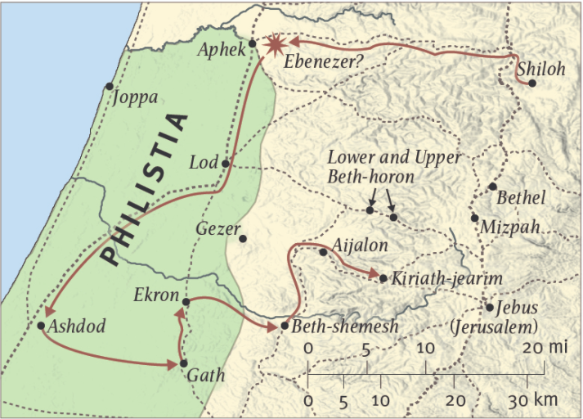
The Battle of Ebenezer
~1050BC
Shiloh is destroyed and the Ark is captured by the Philistines
1 Samuel 4:1-11 ESV
Now Israel went out to battle against the Philistines. They encamped at Ebenezer, and the Philistines encamped at Aphek. The Philistines drew up in line against Israel, and when the battle spread, Israel was defeated before the Philistines … And when the people came to the camp, the elders of Israel said, “Why has the LORD defeated us today before the Philistines? Let us bring the ark of the covenant of the LORD here from Shiloh, that it may come among us and save us from the power of our enemies.” … the Philistines were afraid, for they said, “… Take courage, and be men, O Philistines, lest you become slaves to the Hebrews …” So the Philistines fought, and Israel was defeated … And the ark of God was captured …
Notes:
Use of the Ark in battle is NOT unprecedented
It does not actually mention the destruction of Shiloh or the fate of the Tabernacle
But, clearly Shiloh is destroyed but the Tabernacle is saved
The Ark is never returned to the Tabernacle – God’s presence was never again in the Tabernacle
Ashkelon and Gaza other main Philistine cities

Slide 13
The Destruction of Shiloh
Jeremiah alluded to the temple at Shiloh as foreboding the destruction of the Jerusalem temple:
  Jeremiah 7:12-14 ESV
  Go now to my place that was in Shiloh, where I made my name dwell at first, and see what I did to it because of the evil of my people Israel … therefore I will do to the house that is called by my name …
  as I did to Shiloh.
The Psalmist laments Shiloh:
  Psalm 78:59-60 ESV
  When God heard, he was full of wrath,
  and he utterly rejected Israel.
  He forsook his dwelling at Shiloh,
  the tent where he dwelt among mankind,
  and delivered his power to captivity,
  his glory to the hand of the foe.
Notes:
The fact that ruins remained in the time of Jeremiah also strongly indicates there was a temple structure
God was through with the Tabernacle

Slide 14
Bethel, Nob, and Gibeon
Other possible locations of the Tabernacle:
  Judges 20:26-27 ESV
  Then all the people of Israel, the whole army, went up and came to Bethel … and offered burnt offerings and peace offerings before the LORD. And the people of Israel inquired of the LORD for the ark of the covenant of God was there in those days …
  1 Samuel 21:1-6 ESV
  Then David came to Nob, to Ahimelech the priest … And David said … what do you have on hand? Give me five loaves of bread … ” And the priest answered David, “I have no common bread on hand, but there is holy bread … So the priest gave him the holy bread, for there was no bread there but the bread of the Presence… (see also 1 Samuel 22:11-19)
  2 Chronicles 1:3 ESV
  And Solomon, and all the assembly with him, went to the high place that was at Gibeon, for the tent of meeting of God, which Moses the servant of the LORD had made in the wilderness, was there. (see also 1 Kings 3:4-5, 1 Chronicles 6:31-32, 16:39-40, 21:29)
Notes:
The Bethel incident in Judges 20 appears to be prior to the battle of Ebenezer – suggests the Tabernacle may have moved occasionally
Locate on map …

Slide 15
Final Disposition
The final disposition of the Tabernacle was a storeroom in the Temple built by Solomon:
  1 Kings 8:1-4 ESV (see also 2 Chronicles 5:2-5)
  Then Solomon assembled the elders of Israel and all the heads of the tribes, the leaders of the fathers’ houses of the people of Israel, before King Solomon in Jerusalem, to bring up the ark of the covenant of the LORD out of the city of David, which is Zion. … And all the elders of Israel came, and the priests took up the ark. And they brought up the ark of the LORD, the tent of meeting, and all the holy vessels that were in the tent; the priests and the Levites brought them up.
Over the years, as the Temple was looted on various occasions (see 1 Kings 14:25-26, 2 Kings 12:17-18, 16:17, 18:13-16, 24:10-13), all the precious metals used in the Tabernacle would have been removed. Finally, the wood and fabrics would have been burned in the destruction of the Temple in 586BC.
There is a tradition in 2 Maccabees 2:4-8 that Jeremiah was able to remove whatever was left of the Tabernacle to a cave prior to the destruction of the Temple. While this is possible, it seems unlikely.
Notes:
Jeremiah spent most of the final days of the Temple in incarceration …
It took six wagons to move the cloth and wood …

Slide 16
An Object Lesson for Us
The Tabernacle was extremely important to God – it was his dwelling place among Israel for many years
The Plan of God is inexorable – God will accomplish his purpose: when it was time to move on to the next phase of the Plan, God moved on from the Tabernacle
God does not leave loose ends – the Tabernacle was appropriately stored in its replacement, the Temple, and only final destroyed with the Temple
We cannot cling to physical things: our possessions, our position, or even our lives – we are not called to succeed in this life but to prepare to teach people once we are granted entry in the permanent Dwelling Place of God

