Slide 1
Ezekiel – The Two Mountains
Thus says the Lord GOD: While the whole earth rejoices, I will make you desolate. As you rejoiced over the inheritance of the house of Israel, because it was desolate, so I will deal with you; you shall be desolate, Mount Seir, [even] all Edom, all of it.
Ezekiel 35:14-15a ESV
But you, O mountains of Israel, shall shoot forth your branches and yield your fruit to my people Israel, for they will soon come home. For behold, I am for you, and I will turn to you, and you shall be tilled and sown. And I will multiply people on you, the whole house of Israel, all of it.
Ezekiel 36:8-10a ESV
Then the nations that are left all around you shall know that I am the LORD; I have rebuilt the ruined places and replanted that which was desolate.
I am the LORD; I have spoken, and I will do it.
Ezekiel 36:36 ESV
©2025 Mike Whyte – this document may be used freely for personal study, preaching, and teaching. No part of it may be used under any circumstances for commercial purposes or to attain personal gain or advantage.
Notes:
Chapters 35 and 36 are the last material in Ezekiel dealing wit the situation of the Exiles
God, through Ezekiel, contrast the way of the world, “world city”, Mount Seir, with the Way of God, Mount Zion, the “mountains of Israel”
The actions of Edom at the fall of Jerusalem are used to emphasize that God will accomplish his Plan

Slide 2
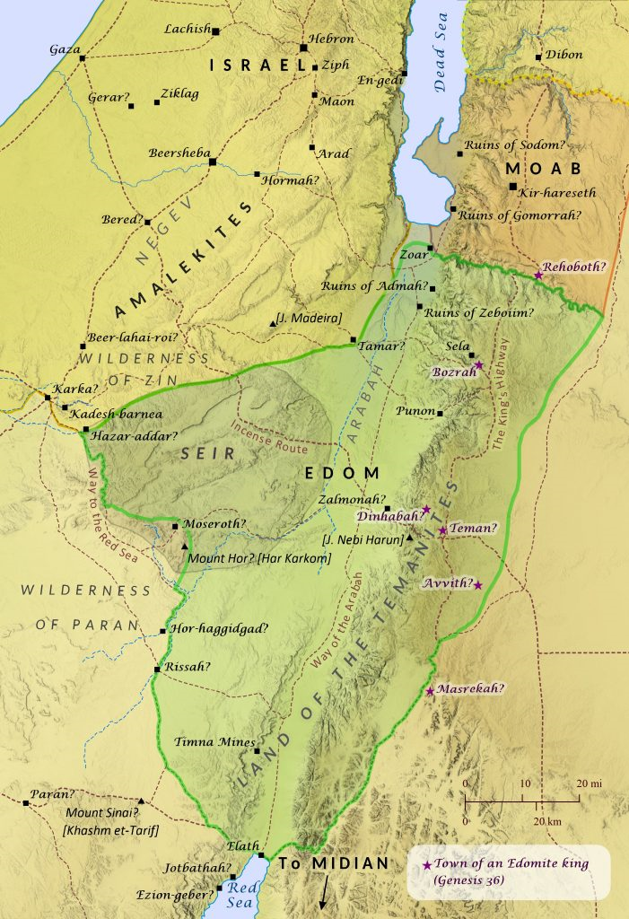
Mount Seir
Mount Seir is the traditional territory of Edom: the area along the Arabah south of the Dead Sea
Notes:
HANDOUT

Slide 3
Mount Seir
Of all the enemies of Israel, Edom is identified for particular punishment:
Ezekiel 35:1-4 ESV
The word of the LORD came to me:
Son of man, set your face against Mount Seir, and prophesy against it, and say to it,
Thus says the Lord GOD:
Behold, I am against you, Mount Seir, and I will stretch out my hand against you, and I will make you a desolation and a waste.
I will lay your cities waste, and you shall become a desolation,
and you shall know that I am the LORD.
God’s objective, as always, is repentance
Perhaps the most often repeated phase in Ezekiel
“you shall know that I am the LORD”
Notes:
HANDOUT

Slide 4
Mount Seir
The final condemnation of Edom is in the Book of Malachi:
Malachi 1:2-4 ESV
“I have loved you,” says the LORD.
But you say, “How have you loved us?”
“Is not Esau Jacob’s brother?” declares the LORD.
“Yet I have loved Jacob but Esau I have hated. I have laid waste his hill country and left his heritage to jackals of the desert.”
If Edom says, “We are shattered but we will rebuild the ruins,”
the LORD of hosts says,
“They may build, but I will tear down, and they will be called ‘the wicked country,’ and ‘the people with whom the LORD is angry forever.’”
About 150 years after Ezekiel, Mount Seir is in a state of ruin …
Notes:
HANDOUT

Slide 5
Mount Seir
God states the reason for the punishment:
Ezekiel 35:5-6 ESV
Because you cherished perpetual enmity and gave over the people of Israel to the power of the sword at the time of their calamity, at the time of their final punishment, therefore, as I live, declares the Lord GOD, I will prepare you for blood, and blood shall pursue you; because you did not hate bloodshed, therefore blood shall pursue you.
The judgement is reiterated:
Ezekiel 35:7-9 ESV
I will make Mount Seir a waste and a desolation, and I will cut off from it all who come and go. And I will fill its mountains with the slain. On your hills and in your valleys and in all your ravines those slain with the sword shall fall. I will make you a perpetual desolation, and your cities shall not be inhabited.
Then you will know that I am the LORD.
Notes:
At the fall of Jerusalem, Edom in some way aided and abetted the Babylonians
For most of the people of Edom, it will be the Great White Throne Judgement before they come to know God

Slide 6
A History of Enmity
Starting with Jacob and Esau, there was a long history of strife between Edom and Israel – it culminated in the fall of Jerusalem in 586BC, where Edomites aided and abetted the Babylonians:
Psalm 137:7 ESV
Remember, O LORD, against the Edomites the day of Jerusalem, how they said,
“Lay it bare, lay it bare, down to its foundations!”
Lamentations 4:21-22 ESV
Rejoice and be glad, O daughter of Edom, you who dwell in the land of Uz; but to you also the cup shall pass; you shall become drunk and strip yourself bare. The punishment of your iniquity, O daughter of Zion, is accomplished; he will keep you in exile no longer; but your iniquity, O daughter of Edom, he will punish; he will uncover your sins.
Notes:
HANDOUT – has a summary of the History of Edom and Israel

Slide 7
Edomites Take the Land
During the exile, Edomites moved into the territory of Israel as far north as Hebron: the area became known as “Idumea”:
Ezekiel 35:10-13 ESV
Because you said,
‘These two nations and these two countries shall be mine, and we will take possession of them’
—although the LORD was there— therefore, as I live, declares the Lord GOD, I will deal with you according to the anger and envy that you showed because of your hatred against them. And I will make myself known among them, when I judge you.
And you shall know that I am the LORD.
I have heard all the revilings that you uttered against the mountains of Israel, saying,
‘They are laid desolate; they are given us to devour.’
And you magnified yourselves against me with your mouth, and multiplied your words against me; I heard it.
Notes:
Edom’s appropriation of Israelite territory, was a personal affront to God
The punishment of Edom is an object lesson for all

Slide 8
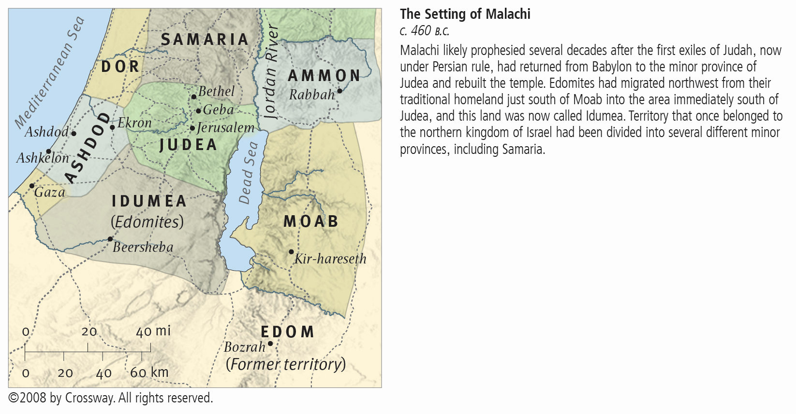
The area was known as Idumea
from Persian times
up until New Testament times.
The traditional territory of Edom
was taken over by the Nabatean Arabs.
In about 120BC, John Hyrcanus forced the Idumeans to accept Judaism – the last remnants of “Edom” were absorbed into the “Jews”.

Slide 9
The Fate of Edom
Jeremiah prophesizes a restoration of the nations of Moab and Ammon:
Jeremiah 48:47a, 49:6 ESV
Yet I will restore the fortunes of Moab in the latter days, declares the LORD.
But afterward I will restore the fortunes of the Ammonites, declares the LORD.
But NOT so for Edom:
Ezekiel 35:14-15 ESV
Thus says the Lord GOD:
While the whole earth rejoices, I will make you desolate. As you rejoiced over the inheritance of the house of Israel, because it was desolate, so I will deal with you; you shall be desolate, Mount Seir, [even] all Edom, all of it.
Then they will know that I am the LORD.
“while the whole earth rejoices” is the World Tomorrow

Slide 10
The Fate of Edom
In many prophecies, Edom is a symbol for “world city”, the nations of the world, under the sway of Satan the Devil, who stand in opposition to God:
Isaiah 34:2, 5 ESV
For the LORD is enraged against all the nations, and furious against all their host; he has devoted them to destruction, has given them over for slaughter.
For my sword has drunk its fill in the heavens; behold, it descends for judgment upon Edom, upon the people I have devoted to destruction.
Amos 9:11-12 ESV
In that day I will raise up the booth of David that is fallen and repair its breaches, and raise up its ruins and rebuild it as in the days of old, that they may possess the remnant of Edom [even] all the nations …
This verse is cited at the Jerusalem conference in 49AD …

Slide 11
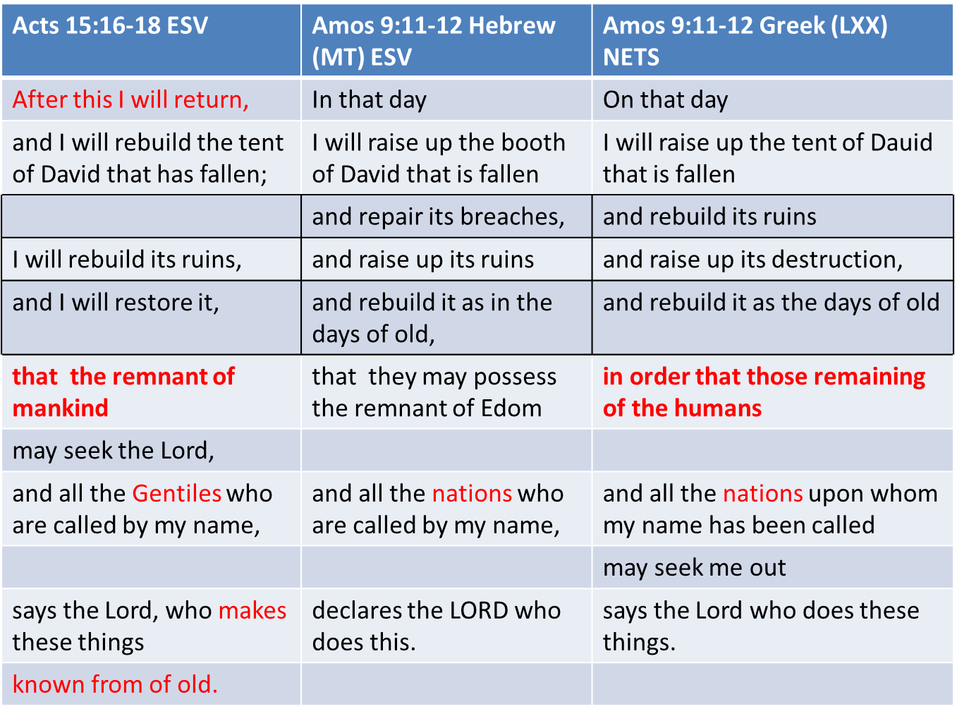
Notes:
The LXX translators made the shift explicit: Edom to “humans”
NT to “mankind”

Slide 12
The Mountain of GOD
Micah 4:1-2 ESV
It shall come to pass in the latter days that the mountain of the house of the LORD shall be established as the highest of the mountains, and it shall be lifted up above the hills; and peoples shall flow to it, and many nations shall come, and say:
Come, let us go up to the mountain of the LORD, to the house of the God of Jacob, that he may teach us his ways and that we may walk in his paths.
For out of Zion shall go forth [torah], [even] the word of the LORD from Jerusalem.
Mount Seir is symbolic of “the world”: the nations of the world under the sway of Satan standing in opposition to God
The Mountain of God is symbolic of the Kingdom of God
In Ezekiel chapter 36, the “mountains of Israel” are initially the physical land, but they come to represent the Kingdom of God

Slide 13
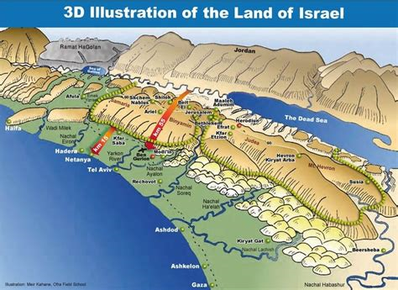
The Mountains of Israel

Slide 14
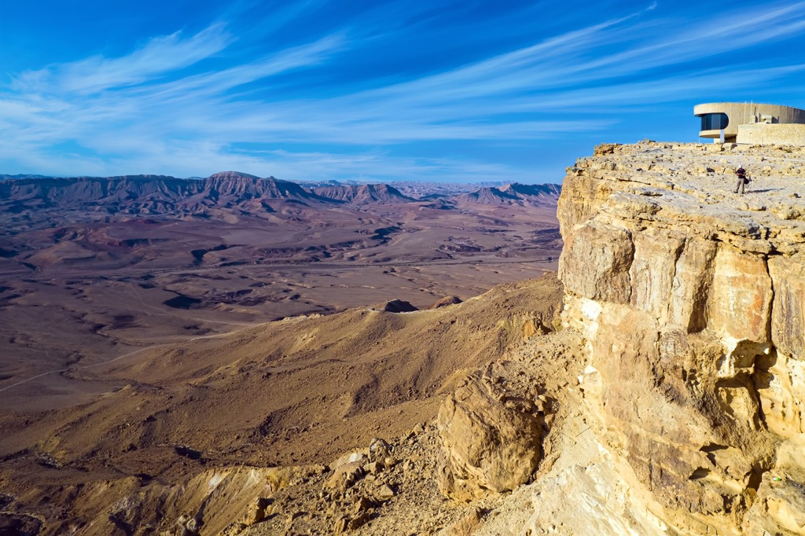
The Mountains of Israel

Slide 15
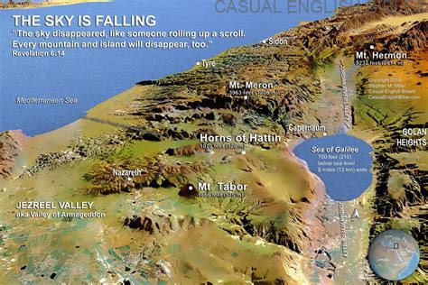
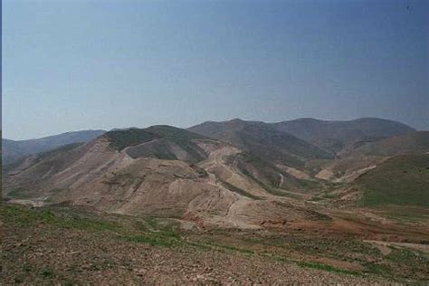
The Mountains of Israel

Slide 16
The Mountains of Israel
God summarizes the state of the “mountains of Israel” in relation to the nations around, primarily Edom, as representative:
Ezekiel 36:1-4 ESV
And you, son of man, prophesy to the mountains of Israel, and say,
O mountains of Israel, hear the word of the LORD. Thus says the Lord GOD:
Because the enemy said of you, ‘Aha!’ and, ‘The ancient heights have become our possession,’ therefore prophesy, and say,
Thus says the Lord GOD:
Precisely because they made you desolate and crushed you from all sides, so that you became the possession of the rest of the nations, and you became the talk and evil gossip of the people, therefore, O mountains of Israel, hear the word of the Lord GOD: Thus says the Lord GOD
to the mountains and the hills, the ravines and the valleys, the desolate wastes and the deserted cities, which have become a prey and derision to the rest of the nations all around …

Slide 17
The Mountains of Israel
Ezekiel 36:5-7 ESV
… therefore thus says the Lord GOD:
Surely I have spoken in my hot jealousy
against the rest of the nations [even] against all Edom, who gave my land to themselves as a possession with wholehearted joy and utter contempt, that they might make its pasturelands a prey.
Therefore prophesy concerning the land of Israel, and say to the mountains and hills, to the ravines and valleys, Thus says the Lord GOD:
Behold, I have spoken in my jealous wrath, because you have suffered the reproach of the nations. Therefore thus says the Lord GOD:
I swear that the nations that are all around you shall themselves suffer reproach.
God’s wrath against “Edom” is typical for all the nations of the world …
The Day of YHWH will bring retributive justice to the whole world …

Slide 18
Second Exodus and New Israel
Ezekiel 36:8-11 ESV
But you, O mountains of Israel, shall shoot forth your branches and yield your fruit to my people Israel, for they will soon come home.
For behold, I am for you, and I will turn to you, and you shall be tilled and sown. And I will multiply people on you, the whole house of Israel, all of it. The cities shall be inhabited and the waste places rebuilt. And I will multiply on you man and beast, and they shall multiply and be fruitful. And I will cause you to be inhabited as in your former times, and will do more good to you than ever before.
Then you will know that I am the LORD.
The “mountains of Israel” will again be central to the New Israel
This is almost a “personification” of the “mountains of Israel”
God addresses them as though they were sentient
Notes:
The exiles would take this as applying to their impending return …
Clearly the focus is the second exodus: there never was a general return of the “whole house of Israel”

Slide 19
Second Exodus and New Israel
Ezekiel 36:12-15 ESV
I will let people walk on you, even my people Israel. And they shall possess you, and you shall be their inheritance, and you shall no longer bereave them of children.
Thus says the Lord GOD:
Because they say to you,
‘You devour people, and you bereave your nation of children,’
therefore you shall no longer devour people and no longer bereave your nation of children, declares the Lord GOD.
And I will not let you hear anymore the reproach of the nations, and you shall no longer bear the disgrace of the peoples and no longer cause your nation to stumble, declares the Lord GOD.
“devour people” is an allusion to former idolatrous worship on the “mountains”

Slide 20
The Plan of God
Ezekiel 36:16-21 ESV
The word of the LORD came to me:
Son of man, when the house of Israel lived in their own land, they defiled it by their ways and their deeds. Their ways before me were like the uncleanness of a woman in her menstrual impurity. So I poured out my wrath upon them for the blood that they had shed in the land, for the idols with which they had defiled it.
I scattered them among the nations, and they were dispersed through the countries. In accordance with their ways and their deeds I judged them. But when they came to the nations, wherever they came, they profaned my holy name, in that people said of them,
‘These are the people of the LORD, and yet they had to go out of his land.’
But I had concern for my holy name, which the house of Israel had profaned among the nations to which they came.
Notes:
God is identified by his Name
God’s name is “profaned”, rendered “common”, not held up as “Holy”, by the sins of Israel
God’s concern for his “Name” is implicit in the working out of his Plan
God has said “I will accomplish my Plan”

Slide 21
The Plan of God
The prescribed punishment for covenant violation was dispersement:
Leviticus 26:33 ESV
And I will scatter you among the nations,
and I will unsheathe the sword after you, and your land shall be a desolation, and your cities shall be a waste.
As require, Israel suffered that fate:
Isaiah 14:24 ESV
The LORD of hosts has sworn:
“As I have planned, so shall it be, and as I have purposed, so shall it stand …”
God works according to his Plan

Slide 22
The New Covenant
Ezekiel 36:22-23a ESV
Therefore say to the house of Israel,
Thus says the Lord GOD:
It is not for your sake, O house of Israel, that I am about to act, but for the sake of my holy name, which you have profaned among the nations to which you came. And I will vindicate the holiness of my great name, which has been profaned among the nations, and which you have profaned among them.
The creation of the New Israel is NOT due to any merit on the part of any person called: God is strictly acting according to his prerogative of “election” to accomplish his Plan
Notes:
“cutting”, karath, creating a new covenant

Slide 23
The New Covenant
Ezekiel 36:23b ESV
And the nations will know that I am the LORD, declares the Lord GOD, when through you I vindicate my holiness before their eyes.
This is a direct reference to the “Covenant of Performance”:
Exodus 34:10 ESV
Behold, I am [cutting] a covenant. Before all your people I will do marvels, such as have not been created in all the earth or in any nation.
And all the people among whom you are shall see the work of the LORD, for it is an awesome thing that I will do with you. …”
God “covenanted” to accomplish his purpose through Israel, and the New Covenant is how it will be accomplished
Notes:
“cutting”, karath, creating a new covenant

Slide 24
The New Covenant
Those called to the New Israel will be called to “conversion”:
Ezekiel 36:24-27 ESV
I will take you from the nations and gather you from all the countries and bring you into your own land. I will sprinkle clean water on you, and you shall be clean from all your uncleannesses, and from all your idols I will cleanse you. And I will give you a new heart, and a new spirit I will put within you. And I will remove the heart of stone from your flesh and give you a heart of flesh. And I will put my Spirit within you, and cause you to walk in my statutes and be careful to [live by my mishᵉpatim].
The “New Covenant” is between God and the New Israel
Jesus began the “New Covenant” with the Apostles at the first Christian Passover
Since then, it has been available only to those called to the New Testament Church
In the World Tomorrow the New Covenant will become available to all
Notes:
This is one of the “seminal scriptures’ on the New Covenant
“mishᵉpatim” is understanding, wisdom, and discernment that come from living by the Way of God

Slide 25
The New Covenant
Those called to the New Israel will be repentant and there will be “physical abundance” in the New Israel:
Ezekiel 36:28-30 ESV
You shall dwell in the land that I gave to your fathers, and you shall be my people, and I will be your God. And I will deliver you from all your uncleannesses.
And I will summon the grain and make it abundant and lay no famine upon you. I will make the fruit of the tree and the increase of the field abundant, that you may never again suffer the disgrace of famine among the nations.
Those called to the New Israel will have survived the Great Tribulation and the Day of YHWH, somewhere on the earth
They will be ready to embrace the Way of God
God will provide for the nation

Slide 26
The New Covenant
There will be “repentance” and “knowledge of God”:
Ezekiel 36:31-32 ESV
Then you will remember your evil ways, and your deeds that were not good,
and you will loathe yourselves for your iniquities and your abominations.
It is not for your sake that I will act, declares the Lord GOD; let that be known to you. Be ashamed and confounded for your ways, O house of Israel.

Slide 27
The Wonderful World Tomorrow
Ezekiel 36:33-36 ESV
Thus says the Lord GOD:
On the day that I cleanse you from all your iniquities, I will cause the cities to be inhabited, and the waste places shall be rebuilt. And the land that was desolate shall be tilled, instead of being the desolation that it was in the sight of all who passed by. And they will say,
‘This land that was desolate has become like the garden of Eden, and the waste and desolate and ruined cities are now fortified and inhabited.’
Then the nations that are left all around you shall know that I am the LORD; I have rebuilt the ruined places and replanted that which was desolate.
I am the LORD; I have spoken, and I will do it.
The New Israel will fulfill God’s purpose of being an example nation to teach all the nations of the world

Slide 28
The Wonderful World Tomorrow
Ezekiel 36:37-38 ESV
Thus says the Lord GOD:
This also I will let the house of Israel ask me to do for them:
to increase their people like a flock.
Like the flock for sacrifices, like the flock at Jerusalem during her appointed [times], so shall the waste cities be filled with flocks of people.
Then they will know that I am the LORD.
All peoples in all nations will come to know “that I am the LORD”

Slide 29
To be continued …

