Slide 1
Ezekiel – The Temple Service
As the glory of the LORD entered the temple by the gate facing east, the Spirit lifted me up and brought me into the inner court; and behold, the glory of the LORD filled the temple.
Ezekiel 43:4-5 ESV
But the Levitical priests, the sons of Zadok, shall come near to me to minister to me. They shall teach my people the difference between the holy and the common, and show them how to distinguish between the unclean and the clean.
Ezekiel 44:15a, 23 ESV
The [Levites] shall be ministers in my sanctuary, having oversight at the gates of the temple and ministering in the temple. They shall slaughter the burnt offering and the sacrifice for the people, and they shall stand before the people, to minister to them.
Ezekiel 44:11 ESV
It shall be the prince’s duty to furnish the burnt offerings, grain offerings, and drink offerings, at the feasts, the new moons, and the Sabbaths …
Ezekiel 45:17a ESV
This is the [torah] of the temple: the whole territory on the top of the mountain all around shall be most holy. Behold, this is the [torah] of the temple.
Ezekiel 43:12 ESV
©2026 Mike Whyte – this document may be used freely for personal study, preaching, and teaching. No part of it may be used under any circumstances for commercial purposes or to attain personal gain or advantage.
Notes:
Last time we discussed physical properties: city, land, and Temple
The physical description is there to provide context for the Temple Service
The New Temple is all about “Holiness”
God will teach humanity “Holiness” starting with New Israel
YHWH extends “Holiness” by his presence
God’s purpose for the Temple Service is to teach
Priests and Levites will perform the Temple Service
The “Prince” has significant responsibilities
The Teaching of the Temple is all about “Holiness”

Slide 2
The Glory of the YHWH Fills the Temple
God’s presence will definitely be in the New Temple:
Ezekiel 43:1-5 ESV Then he led me to the gate, the gate facing east. And behold, the glory of the God of Israel was coming from the east. And the sound of his coming was like the sound of many waters, and the earth shone with his glory.
And the vision I saw was just like the vision that I had seen when he came to destroy the city, and just like the vision that I had seen by the Chebar canal. And I fell on my face.
As the glory of the LORD entered the temple by the gate facing east, the Spirit lifted me up and brought me into the inner court; and behold, the glory of the LORD filled the temple.
Exodus 40:34-35a, 1 Kings 8:11 ESV Then the cloud covered the tent of meeting, and the glory of the LORD filled the tabernacle. And Moses was not able to enter the tent of meeting … … so that the priests could not stand to minister because of the cloud, for the glory of the LORD filled the house of the LORD.
Notes:
Presumably, this will occur right after the consecration of the Altar …
The presence of God makes the Temple Holy
HANDOUT

Slide 3
YHWH Inhabits the Most Holy Place
The New Temple will be YHWH’s permanent home on earth:
Ezekiel 43:6-9 ESV While the man was standing beside me, I heard one speaking to me out of the temple, and he said to me, “Son of man, this is the place of my throne and the place of the soles of my feet, where I will dwell in the midst of the people of Israel forever.
And the house of Israel shall no more defile my holy name, neither they, nor their kings, by their whoring and by the dead bodies of their kings at their high places, by setting their threshold by my threshold and their doorposts beside my doorposts, with only a wall between me and them.
They have defiled my holy name by their abominations that they have committed, so I have consumed them in my anger. Now let them put away their whoring and the dead bodies of their kings far from me, and I will dwell in their midst forever.”
Notes:
The only antecedent I can see for “setting their threshold by my threshold” is Solomon’s Palace
“dead bodies of their kings” is obscure
HANDOUT

Slide 4
The Zadokite Priesthood
The New Priesthood will look to Zadok as its eponymous ancestor:
Ezekiel 44:15-16 ESV But the Levitical priests, the sons of Zadok, who kept the charge of my sanctuary when the people of Israel went astray from me, shall come near to me to minister to me. And they shall stand before me to offer me the fat and the blood, declares the Lord GOD.
They shall enter my sanctuary, and they shall approach my table, to minister to me, and they shall keep my charge.
“kept the charge of my sanctuary when the people of Israel went astray”: may allude to Absalom’s rebellion
Abiathar went with Absalom
Zadok remained with David
Notes:
HANDOUT

Slide 5
The Zadokite Priesthood
The New Priesthood will exemplify “Holiness”:
Ezekiel 44:17-19 ESV When they enter the gates of the inner court, they shall wear linen garments. They shall have nothing of wool on them, while they minister at the gates of the inner court, and within. They shall have linen turbans on their heads, and linen undergarments around their waists. They shall not bind themselves with anything that causes sweat.
And when they go out into the outer court to the people, they shall put off the garments in which they have been ministering and lay them in the holy chambers. And they shall put on other garments, lest they transmit holiness to the people with their garments.
“transmit holiness”: to be in the outer court, people must be “clean”, but they remain “common”
The “common” cannot come in contact with the “Holy”

Slide 6
The Role of the Levites
The Levites are responsible for the whole Temple Area outside the Inner Court:
Ezekiel 44:14, 11, 46:24 ESV Yet I will appoint them to keep charge of the temple, to do all its service and all that is to be done in it.
They shall be ministers in my sanctuary,
having oversight at the gates of the temple
and ministering in the temple.
They shall slaughter the burnt offering and the sacrifice for the people,
and they shall stand before the people, to minister to them.
Then he said to me, “These are the kitchens where those who minister at the temple shall boil the sacrifices of the people.”

Slide 7
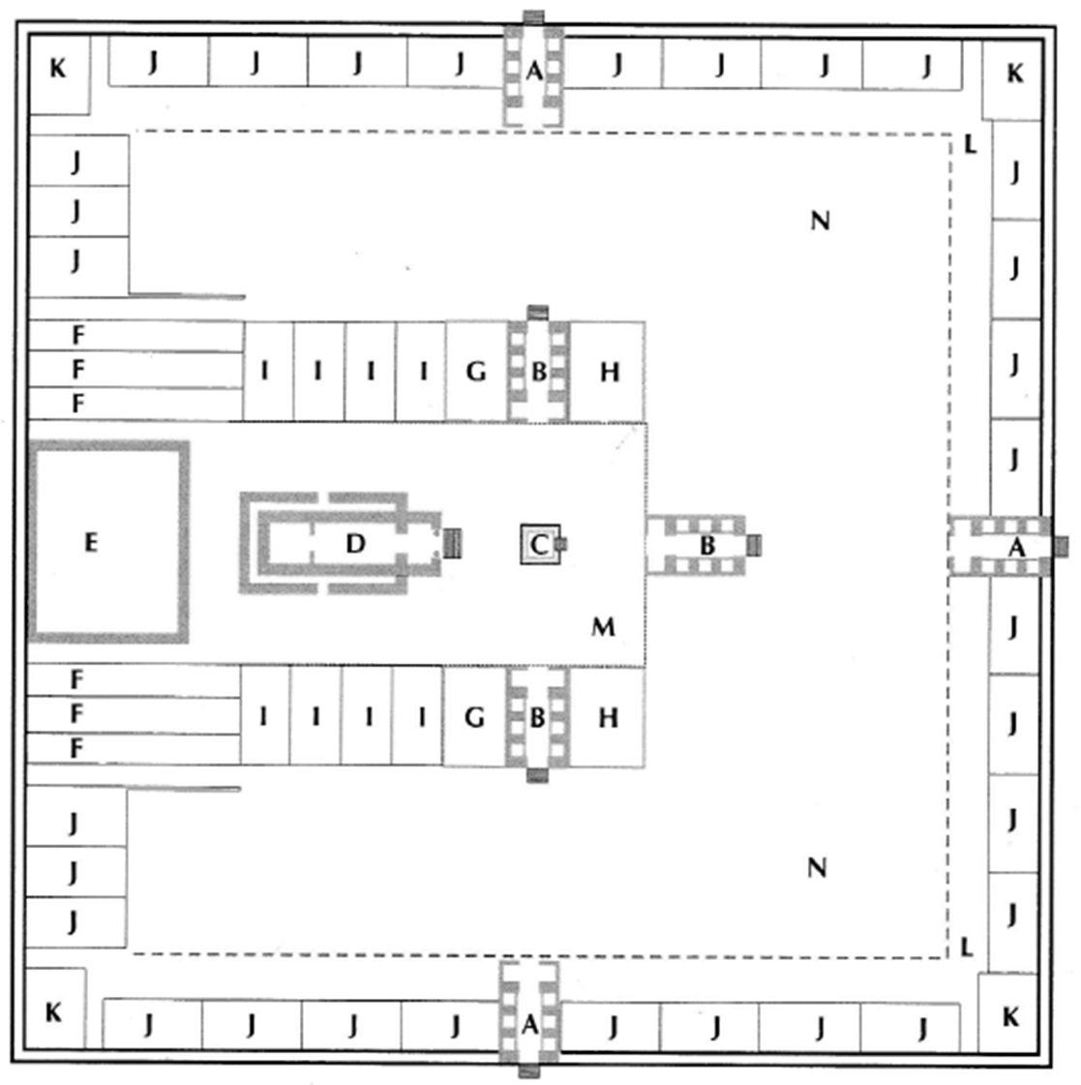
The Role of the Levites
People’s Sacrifices
Only officiating priests are allowed in Inner Court
Levites responsible for everything outside the Inner Court
Chambers marked “J” along the west wall are likely for Levites
Levites kill “people’s sacrifices”
“Kitchens” marked “K” are where Levites boil “people’s sacrifices”
People’s Sacrifices

Slide 8
The Role of the Levites
The Levites are held responsible for historic apostacy:
Ezekiel 44:10, 12-13 ESV But the Levites who went far from me, going astray from me after their idols when Israel went astray, shall bear their punishment.
Because they ministered to them before their idols and became a stumbling block of iniquity to the house of Israel, therefore I have sworn concerning them, declares the Lord GOD, and they shall bear their punishment.
They shall not come near to me, to serve me as priest, nor come near any of my holy things and the things that are most holy, but they shall bear their shame and the abominations that they have committed.
“Levites who went far from me”: no specific incident
Must allude to general corruption of “Priests / Levites / prophets” evident in Jeremiah and Ezekiel

Slide 9
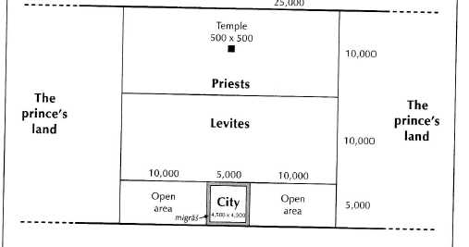
Who is the “Prince”
The word “prince” is from נָשִׂיא - nasi´, it usually connotes a “leader”, a “chief”, a “member of royalty”, but NOT a “king”
In the land allocation, the two large territories on each side of the “sacred reserve” were set aside for the “Prince”
The land allocated to the “Prince” is for agricultural purpose:
Ezekiel 45:17a ESV It shall be the prince’s duty to furnish the burnt offerings, grain offerings, and drink offerings, at the feasts, the new moons, and the Sabbaths …

Slide 10
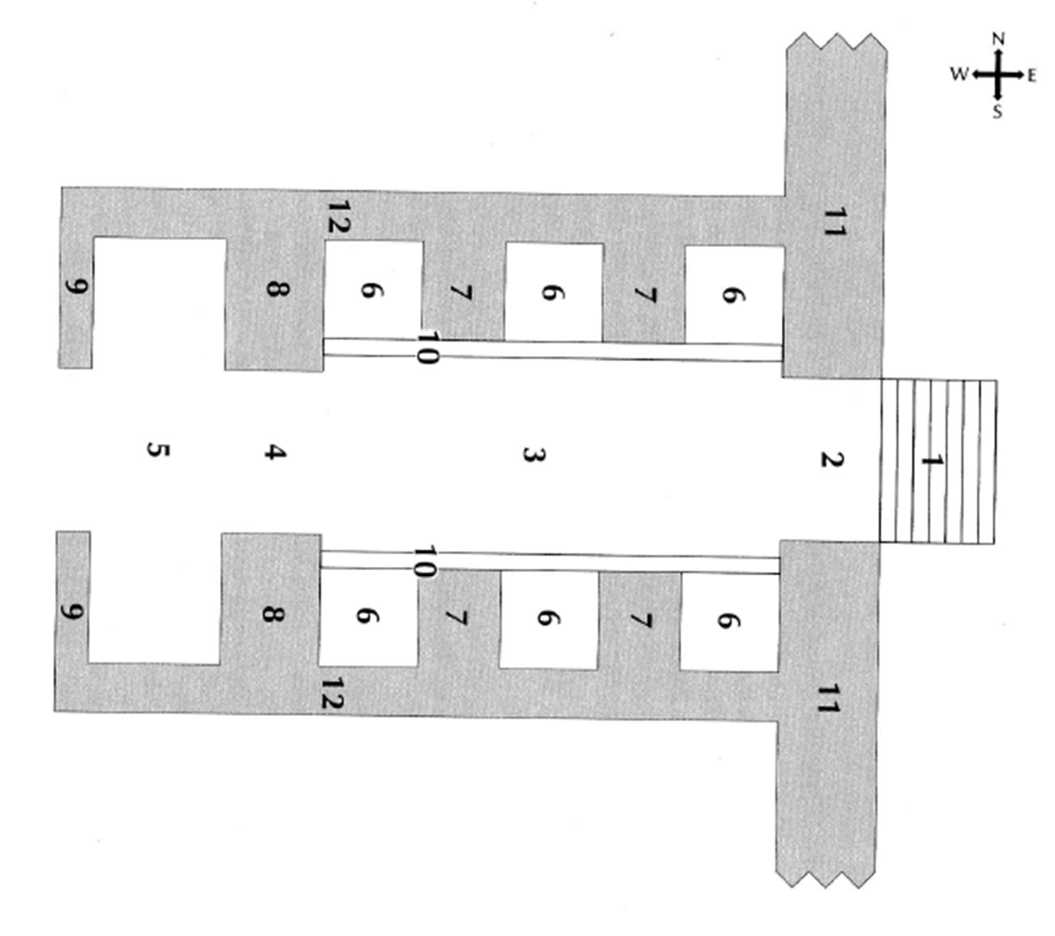
Who is the “Prince”
The “Prince” is an observer of Priestly activities:
Ezekiel 46:1-2 ESV Thus says the Lord GOD: The gate of the inner court that faces east shall be shut on the six working days, but on the Sabbath day it shall be opened, and on the day of the new moon it shall be opened.
The prince shall enter by the vestibule of the gate from outside, and shall take his stand by the post of the gate. The priests shall offer his burnt offering and his peace offerings, and he shall worship at the threshold of the gate.
Then he shall go out, but the gate shall not be shut until evening.
Notes:
Block suggests that the Prince goes no further than just inside the gate
The “vestibule” is the large room at the end of the gate
The point is to NOT enter the Inner Court
In 45:19, the “posts” seem to be at the Inner Court end of the gate

Slide 11
Who is the “Prince”
Only officiating priests are allowed in Inner Court
On Sabbath and New Moon, the east gate is open
The “Prince” enters from the Outer Court and sits in the vestibule of the gate to observe the Priestly activities
The gate remains open all day:
Ezekiel 46:3 ESV The people of the land shall bow down at the entrance of that gate before the LORD on the Sabbaths and on the new moons.

Slide 12
Who is the “Prince”
The “Prince” is one of the common people:
Ezekiel 46:9-10 ESV When the people of the land come before the LORD at the appointed feasts, he who enters by the north gate to worship shall go out by the south gate, and he who enters by the south gate shall go out by the north gate: no one shall return by way of the gate by which he entered, but each shall go out straight ahead.
When they enter, the prince shall enter with them, and when they go out, he shall go out.
The “Prince” has family:
Ezekiel 46:16 ESV (see also verse 17) Thus says the Lord GOD:
If the prince makes a gift to any of his sons as his inheritance, it shall belong to his sons. It is their property by inheritance.
The “Prince” is a human being with special responsibilities
Notes:
Ezekiel 34:24 and 37:25 refer to “David” as “prince”
But David will be a resurrected divine being, a “king”
Jeremiah 30:9 - But they shall serve the LORD their God and David their king, whom I will raise up for them.
Ezekiel 37:24a - “My servant David shall be king over them, and they shall all have one shepherd.
Hosea 3:5 - Afterward the children of Israel shall return and seek the LORD their God, and David their king, and they shall come in fear to the LORD and to his goodness in the latter days.
The Prince may NOT make permanent grants of land:
Ezekiel 46:17 But if he makes a gift out of his inheritance to one of his servants, it shall be his to the year of liberty. Then it shall revert to the prince; surely it is his inheritance—it shall belong to his sons.

Slide 13
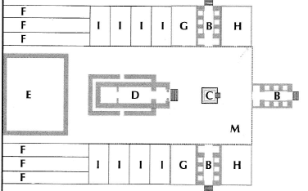
The Sacrificial Service
The heart of the Temple is the altar of sacrifices in the center of the Inner Court
Ezekiel observed where the animals were processed:
Ezekiel 40:35a, 38-39 ESV Then he brought me to the north gate … There was a chamber with its door in the vestibule of the gate, where the burnt offering was to be washed.
And in the vestibule of the gate were two tables on either side, on which the burnt offering and the sin offering and the guilt offering were to be slaughtered.
Further information on the tables: see Ezekiel 40:40-43
processing tables

Slide 14
Chambers for the Priests
The chambers labeled “G” off the Inner Court:
Ezekiel 40:44-46 ESV On the outside of the inner gateway there were two chambers in the inner court, one at the side of the north gate facing south, the other at the side of the south gate facing north. And he said to me, “This chamber that faces south is for the priests who have charge of the temple, and the chamber that faces north is for the priests who have charge of the altar. These are the sons of Zadok, who alone among the sons of Levi may come near to the LORD to minister to him.”
The chambers labelled “F” at the back of the Inner Court:
Ezekiel 42:13-14a ESV (see also 46:19-20) Then he said to me, “The north chambers and the south chambers opposite the yard are the holy chambers, where the priests who approach the LORD shall eat the most holy offerings. There they shall put the most holy offerings …
When the priests enter the Holy Place, they shall not go out of it into the outer court without laying there the garments in which they minister, for these are holy. …”
Notes:
46:19-20 describe boiling the meat

Slide 15
The Daily Sacrifice
There will be a regular morning sacrifice – there is NO mention of an evening sacrifice (Christ died at the time of the evening sacrifice):
Ezekiel 46:13-15 ESV You shall provide a lamb a year old without blemish for a burnt offering to the LORD daily; morning by morning you shall provide it.
And you shall provide a grain offering with it morning by morning, one sixth of an ephah, and one third of a hin of oil to moisten the flour, as a grain offering to the LORD.
This is a perpetual statute. Thus the lamb and the meal offering and the oil shall be provided, morning by morning, for a regular burnt offering.

Slide 16
Annual Sacrifices
There will be a yearly atonement ceremony for the Temple:
Ezekiel 45:18-20 ESV Thus says the Lord GOD: In the first month, on the first day of the month, you shall take a bull from the herd without blemish, and purify the sanctuary.
The priest shall take some of the blood of the sin offering and put it on the doorposts of the temple, the four corners of the ledge of the altar, and the posts of the gate of the inner court.
You shall do the same on the seventh day of the month for anyone who has sinned through error or ignorance; so you shall make atonement for the temple.

Slide 17
Holyday Sacrifices
All the Holydays will have special sacrifices:
Ezekiel 45:21-25, 46:11 ESV In the first month, on the fourteenth day of the month, you shall celebrate the Feast of the Passover, and for seven days unleavened bread shall be eaten.
On that day the prince shall provide for himself and all the people of the land a young bull for a sin offering. And on the seven days of the festival he shall provide as a burnt offering to the LORD seven young bulls and seven rams without blemish, on each of the seven days; and a male goat daily for a sin offering. And he shall provide as a grain offering an ephah for each bull, an ephah for each ram, and a hin of oil to each ephah.
In the seventh month, on the fifteenth day of the month and for the seven days of the feast, he shall make the same provision for sin offerings, burnt offerings, and grain offerings, and for the oil.
At the feasts and the appointed festivals, the grain offering with a young bull shall be an ephah, and with a ram an ephah, and with the lambs as much as one is able to give, together with a hin of oil to an ephah.
Notes:
Note: there is no “lamb” at Passover
Christ was the “Lamb”
The Day of Atonement sacrifices will likely also change a lot

Slide 18
Responsibilities of the Prince
The primary responsibility of the Prince is the provision of animals, grain, and oil for all the ongoing Temple Sacrifices:
Ezekiel 46:4-7, 45:17 ESV The burnt offering that the prince offers to the LORD on the Sabbath day shall be six lambs without blemish and a ram without blemish. And the grain offering with the ram shall be an ephah, and the grain offering with the lambs shall be as much as he is able, together with a hin of oil to each ephah.
On the day of the new moon he shall offer a bull from the herd without blemish, and six lambs and a ram, which shall be without blemish. As a grain offering he shall provide an ephah with the bull and an ephah with the ram, and with the lambs as much as he is able, together with a hin of oil to each ephah.
It shall be the prince’s duty to furnish the burnt offerings, grain offerings, and drink offerings, at the feasts, the new moons, and the Sabbaths, all the appointed feasts of the house of Israel: he shall provide the sin offerings, grain offerings, burnt offerings, and peace offerings, to make atonement on behalf of the house of Israel.

Slide 19
Provisioning of the Prince
The people of Israel are required to provide to the prince animals, grain, and oil for the sacrificial service:
Ezekiel 45:13-16 ESV This is the offering that you shall make: one sixth of an ephah from each homer of wheat, and one sixth of an ephah from each homer of barley, and as the fixed portion of oil, measured in baths, one tenth of a bath from each cor (the cor, like the homer, contains ten baths).
And one sheep from every flock of two hundred, from the watering places of Israel for grain offering, burnt offering, and peace offerings, to make atonement for them, declares the Lord GOD.
All the people of the land shall be obliged to give this offering to the prince in Israel.

Slide 20
An Example Ruler
The Prince is to serve as an example leader for the rest of the world to emulate:
Ezekiel 45:8b, 46:18, 45:9-12 ESV And my princes shall no more oppress my people, but they shall let the house of Israel have the land according to their tribes.
The prince shall not take any of the inheritance of the people, thrusting them out of their property. He shall give his sons their inheritance out of his own property, so that none of my people shall be scattered from his property.
Thus says the Lord GOD: Enough, O princes of Israel! Put away violence and oppression, and execute justice and righteousness. Cease your evictions of my people, declares the Lord GOD.
You shall have just balances, a just ephah, and a just bath. The ephah and the bath shall be of the same measure, the bath containing one tenth of a homer, and the ephah one tenth of a homer; the homer shall be the standard measure. The shekel shall be twenty gerahs; twenty shekels plus twenty-five shekels plus fifteen shekels shall be your mina.

Slide 21
The Role of the Priests
The Zadokite Priesthood will fulfill the charge originally given to Aaron:
Leviticus 10:10-11 ESV You are to distinguish between the holy and the common, and between the unclean and the clean, and you are to teach the people of Israel all the statutes that the LORD has spoken to them by Moses.
The Priests are given no permanent lands:
Ezekiel 44:28-31 ESV This shall be their inheritance: I am their inheritance: and you shall give them no possession in Israel; I am their possession.
They shall eat the grain offering, the sin offering, and the guilt offering, and every devoted thing in Israel shall be theirs. And the first of all the firstfruits of all kinds, and every offering of all kinds from all your offerings, shall belong to the priests.
You shall also give to the priests the first of your dough, that a blessing may rest on your house.
The priests shall not eat of anything, whether bird or beast, that has died of itself or is torn by wild animals.

Slide 22
The Responsibilities of the Priests
The included prescriptions and proscriptions are basically excerpted from the Writings of Moses:
Ezekiel 44:20-25 ESV (see also verses 26-27) They shall not shave their heads or let their locks grow long; they shall surely trim the hair of their heads.
No priest shall drink wine when he enters the inner court.
They shall not marry a widow or a divorced woman, but only virgins of the offspring of the house of Israel, or a widow who is the widow of a priest.
They shall teach my people the difference between the holy and the common, and show them how to distinguish between the unclean and the clean.
In a dispute, they shall act as judges, and they shall judge it according to my judgments.
They shall keep my [torah] and my statutes in all my appointed feasts, and they shall keep my Sabbaths holy.
They shall not defile themselves by going near to a dead person. However, for father or mother, for son or daughter, for brother or unmarried sister they may defile themselves.
Notes:
This sampling shows that the Priests must consider all the Writings of Moses
Any “Priest” becoming unclean will require a “sin offering”:
Ezekiel 44:26–27 ESV After he has become clean, they shall count seven days for him. And on the day that he goes into the Holy Place, into the inner court, to minister in the Holy Place, he shall offer his sin offering, declares the Lord GOD.

Slide 23
An Object Lesson in Holiness
YHWH alludes to obscure historical events to contrast the “Holiness” required:
Ezekiel 44:4-5a, 6-7aα, 7b-8 ESV Then he brought me by way of the north gate to the front of the temple, and I looked, and behold, the glory of the LORD filled the temple of the LORD. And I fell on my face. And the LORD said to me, “Son of man, mark well, see with your eyes, and hear with your ears all that I shall tell you concerning all the statutes of the temple of the LORD and all its [torah].
And say to the rebellious house, to the house of Israel, Thus says the Lord GOD: O house of Israel, enough of all your abominations, in admitting foreigners, uncircumcised in heart and flesh, to be in my sanctuary, profaning my temple … You have broken my covenant, in addition to all your abominations. And you have not kept charge of my holy things, but you have set others to keep my charge for you in my sanctuary.
Notes:
There is no way to identify specifically the historic allusion
Block (pages 622-623) suggests: descendants of the Gibeonites, descendants of Solomon’s Canaanite slaves, foreigners as guards, such as Jehoiada used (“Carites”, 2Kg11:4)
The Temple was defiled several times: the worst being under Ahaz and Manasseh
God adjures us to learn from this

Slide 24
An Object Lesson in Holiness
The whole Temple Area is declared to be “Holy”:
Ezekiel 42:15, 20, 43:12 ESV Now when he had finished measuring the interior of the temple area, he led me out by the gate that faced east, and measured the temple area all around. He measured it on the four sides. It had a wall around it, 500 cubits long and 500 cubits broad, to make a separation between the holy and the common.
This is the [torah] of the temple: the whole territory on the top of the mountain all around shall be most holy. Behold, this is the [torah] of the temple.
Ezekiel 44:1-2 ESV (see also verse 3) Then he brought me back to the outer gate of the sanctuary, which faces east. And it was shut. And the LORD said to me, “This gate shall remain shut; it shall not be opened, and no one shall enter by it, for the LORD, the God of Israel, has entered by it. Therefore it shall remain shut. …”
Notes:
Ezekiel 44:3 ESV Only the prince may sit in it to eat bread before the LORD. He shall enter by way of the vestibule of the gate, and shall go out by the same way.

Slide 25
An Object Lesson in Holiness
The lands allocated to the Levites and Priests remain YHWH’s Holy Possession:
Ezekiel 48:13-14 ESV And alongside the territory of the priests, the Levites shall have an allotment … The whole length shall be 25,000 cubits and the breadth 20,000. They shall not sell or exchange any of it. They shall not alienate this choice portion of the land, for it is holy to the LORD.
Not even the “Prince” can violate the Holiness of the Inner Court:
Ezekiel 46:2a, 8, 12a ESV The prince shall enter by the vestibule of the gate from outside, and shall take his stand by the post of the gate. The priests shall offer his burnt offering and his peace offerings, and he shall worship at the threshold of the gate. When the prince enters, he shall enter by the vestibule of the gate, and he shall go out by the same way. When the prince provides a freewill offering, either a burnt offering or peace offerings as a freewill offering to the LORD, the gate facing east shall be opened for him. And he shall offer his burnt offering or his peace offerings as he does on the Sabbath day.
Notes:
Some contend that the Prince is performing his own sacrifice
The text is clear that the Priest does the sacrifice

Slide 26
People Will Come and Learn
People from all over the world will come to Jerusalem to learn about “Holiness” from the Temple and from the Temple Service:
Micah 4:1-2 ESV It shall come to pass in the latter days that the mountain of the house of the LORD shall be established as the highest of the mountains, and it shall be lifted up above the hills; and peoples shall flow to it, and many nations shall come, and say: “Come, let us go up to the mountain of the LORD, to the house of the God of Jacob, that he may teach us his ways and that we may walk in his paths.” For out of Zion shall go forth [torah], [even] the word of the LORD from Jerusalem.
To enter the Temple area will require conversion:
Ezekiel 44:9 ESV Thus says the Lord GOD: No foreigner, uncircumcised in heart and flesh, of all the foreigners who are among the people of Israel, shall enter my sanctuary.

Slide 27
The River of Life
Ezekiel’s vision ends with the same image as The Apostle John reports:
Revelation 22:1-2 ESV Then the angel showed me the river of the water of life, bright as crystal, flowing from the throne of God and of the Lamb through the middle of the street of the city; also, on either side of the river, the tree of life with its twelve kinds of fruit, yielding its fruit each month. The leaves of the tree were for the healing of the nations.
Ezekiel 47:1, 8-9, 12 ESV Then he brought me back to the door of the temple, and behold, water was issuing from below the threshold of the temple toward the east … The water was flowing down from below the south end of the threshold of the temple …
And he said to me, “This water flows toward the eastern region and goes down into the Arabah, and enters the sea; when the water flows into the sea, the water will become fresh. And wherever the river goes, every living creature that swarms will live … For this water goes there, that the waters of the sea may become fresh; so everything will live where the river goes.
And on the banks, on both sides of the river, there will grow all kinds of trees for food. Their leaves will not wither, nor their fruit fail, but they will bear fresh fruit every month, because the water for them flows from the sanctuary. Their fruit will be for food, and their leaves for healing.”
The whole world will be healed, physically and spiritually, from the New Temple!
Notes:
A new river flows out the south end pf the Dead Sea …

Slide 28
Assessment of the Temple Service
New Israel will be a nation comprised of converted people – people learning to exemplify “holiness”
At the center of the New Israel will be the city of Jerusalem
North of the city of Jerusalem will be the Temple, “the beating heart of the world”: in the daily Temple service there will be depicted “holiness” through sacrifices which look back to the sacrifice of Jesus Christ as a memorial
The Way of God will be taught from the Temple – teaching the whole world “holiness”
The whole new nation of Israel will be a living example of how the nations of the world are to function
The nations will come up and learn the Way of God, and the peace of God will spread to the whole world: Isaiah 9:7a ESV
Of the increase of his government and of peace there will be no end …

Slide 29
The Outcome of Ezekiel’s Work
Daniel prayed, and probably also petitioned Cyrus:
Daniel 9:1-2 ESV In the first year of [Cyrus], who was made king over the realm of the Chaldeans —in the first year of his reign, I, Daniel, perceived in the books the number of years that, according to the word of the LORD to Jeremiah the prophet, must pass before the end of the desolations of Jerusalem, namely, seventy years.
Daniel 9:16a, 17-19 ESV O Lord, according to all your righteous acts, let your anger and your wrath turn away from your city Jerusalem, your holy hill, because for our sins … Now therefore, O our God, listen to the prayer of your servant and to his pleas for mercy, and for your own sake, O Lord, make your face to shine upon your sanctuary …
O my God, incline your ear and hear. Open your eyes and see our desolations, and the city that is called by your name. For we do not present our pleas before you because of our righteousness, but because of your great mercy.
O Lord, hear; O Lord, forgive. O Lord, pay attention and act. Delay not, for your own sake, O my God, because your city and your people are called by your name.
Notes:
Daniel prayed in 539BC
Hegemony of Babylon 609BC-539BC
Daniel was in a position of influence
Daniel appeals to the Plan of God:
Jeremiah had prophesised a return
Ezekiel had prepared a remnant

Slide 30
The Remnant to Prepare for the First Advent
Cyrus decreed a return, and it occurred:
2 Chronicles 36:22-23 ESV Now in the first year of Cyrus king of Persia, that the word of the LORD by the mouth of Jeremiah might be fulfilled, the LORD stirred up the spirit of Cyrus king of Persia, so that he made a proclamation throughout all his kingdom and also put it in writing: “Thus says Cyrus king of Persia, ‘The LORD, the God of heaven, has given me all the kingdoms of the earth, and he has charged me to build him a house at Jerusalem, which is in Judah. Whoever is among you of all his people, may the LORD his God be with him. Let him go up.’”
Ezra 5:14-16a ESV And the gold and silver vessels of the house of God … these Cyrus the king took out of the temple of Babylon, and they were delivered to one whose name was Sheshbazzar, whom he had made governor; and he said to him, “Take these vessels, go and put them in the temple that is in Jerusalem, and let the house of God be rebuilt on its site.”
Then this Sheshbazzar came and laid the foundations of the house of God that is in Jerusalem …
Notes:
Among the returnees were the individuals that God brought to repentance through Ezekiel
The purpose of Ezekiel’s work was to prepare this remnant
He succeeded – he was promised that “some would hear”
The purpose of the remnant community was to prepare for the First Advent
The remnant community was flourishing when the Messiah came to it

Slide 31
The End!

