Slide 1
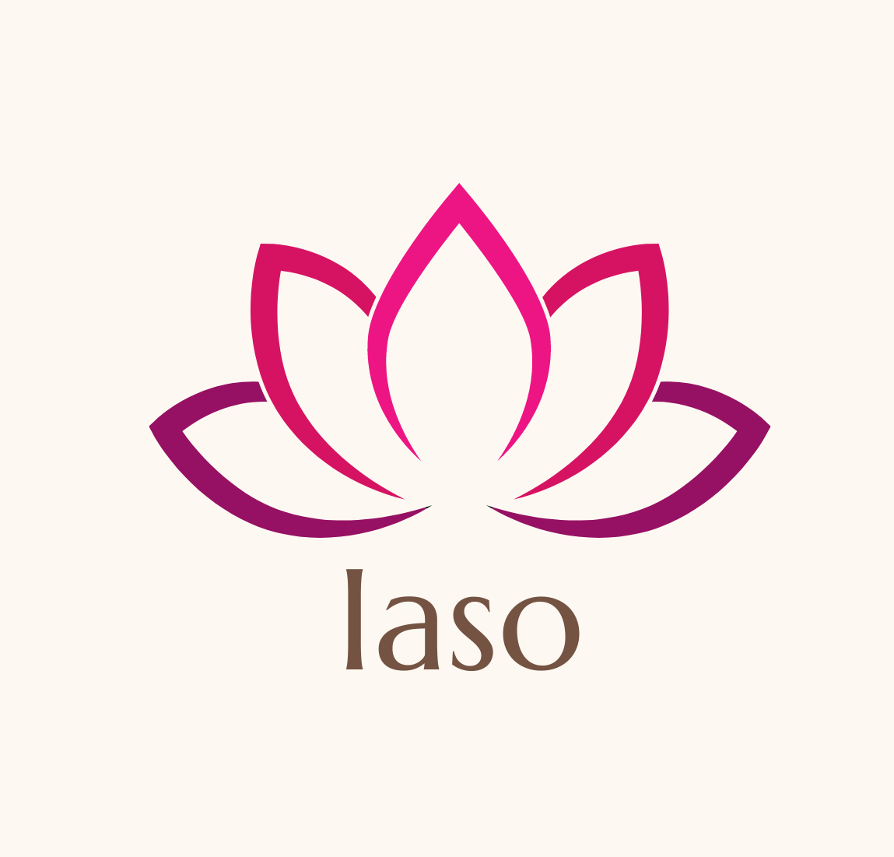
Project Iaso
STOPPING THE OPIOID EPIDEMIC

Slide 2
Brief
Iaso is an automated Naloxone Injector – poised to possibly save over 115,000 lives a year
The Total Available Market for Naloxone currently sitting at $3.36B USD, with ~46.3M users worldwide, both recreational and prescribed.
The three current competitor products all share the same fatal flaw – this is what Iaso solves and this is what could save over 115,000 lives a year

Slide 3
The Problem - Worldwide
According to the World Health Organisation: Worldwide, about 0.5 million deaths are attributable to drug use. More than 70% of these deaths are related to opioids, with more than 30% of those deaths caused by overdose. According to WHO estimates, approximately 115 000 people died of opioid overdose in 2017. Opioid overdoses that do not lead to death are several times more common than fatal overdoses. *
In the United States of America (USA) the number of people dying from opioid overdose increased by 120% between 2010 and 2018, and two-thirds of opioid-related overdose deaths in 2018 in the USA involved synthetic opioids, including fentanyl and its analogues.
In USA, the deaths attributed to opioid overdoses rose from 49,860 in 2019 to 69,710 in 2020. That’s a 40% increase in just one year.

Slide 4
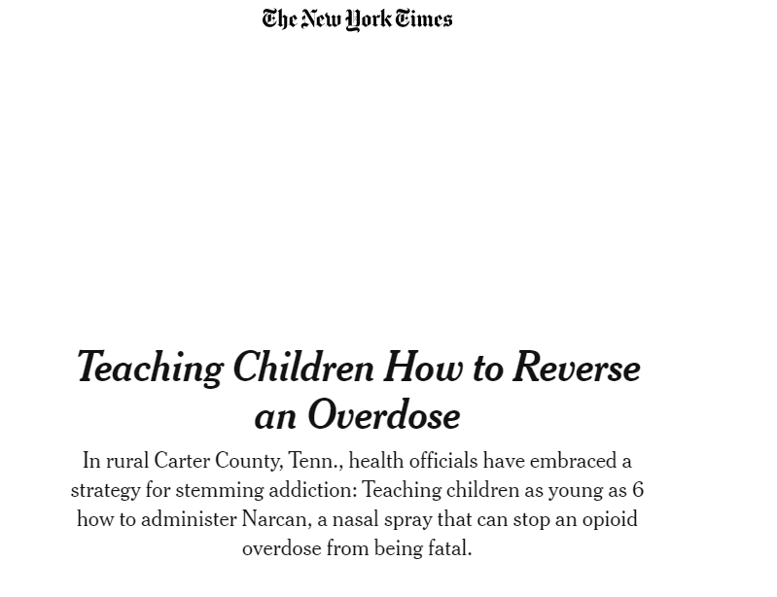
True extent of the problem
To show the extent of the problem, here’s an article from the New York Times, dated early 2020, talking about how one city’s solution to the Opioid Crisis was to teach 6yo kids how to administer Naloxone if they need to.
https://www.nytimes.com/2020/02/23/us/opioids-tennessee-narcan-training.html

Slide 5
The Problem – Existing Products
There are 3 main existing products in the USA market, each have the same flaw that Iaso solves.
Narcan™ - A Nasal spray
Evzio™ - An Epi-Pen styled injector
Generic Naloxone - Generic nasal spray or injector
In America (USD), the price ranges from $30ea for the generic applicators, to $140 for Narcan, to $2,321 for Evzio, they still have one fatal flaw. They need someone to be conscious to administer the applicator. One of the symptoms of an opioid overdose is a loss of consciousness.

Slide 6
The Market
In 2018 Emergent Biosolutions bought Adapt Pharma, the owners of Narcan™ for $735 million USD. Emergent predicted that Narcan can generate revenues of $200 million to $220 million*
The Naloxone spray market is projected to hit $928.1M USD annually by 2026, with a CAGR on 22.8%.*
The Total Available Market for Naloxone (not just spray) currently sits at $3.36B USD, with ~46.3M users worldwide, both recreational and prescribed.

Slide 7
Target Market
While Iaso can work for just as well for 'prescribed' users, the main target market is recreational users of opioids. They are most at risk, face the most stigma and have the least support available to them.
Recreational Use
Prescribed Use
Iaso is specifically developed with recreational users in mind, aiming to keep costs low enough so they don't need to make a choice between their life and another hit.
Prescribed users typically have more of a support network around them, compared to recreational users, so Iaso does not have as much of an advantage for them but we already have a planned iteration to fit this market perfectly.

Slide 8
The Solution
Project Iaso involves using a simple concept to save many of the needless deaths. Automated self-administration of Naloxone. An entirely mechanical device that an opioid user would wear when they are using opioids. They ‘arm’ it when they are taking the opioids and, if they don’t disarm the device before the timer ticks down past the alarm stage to the administering stage, it will automatically administer the Naloxone, reversing the overdose and saving their life.
Iaso will work in every instance that the existing products do and it has the added benefit of not needing someone conscious to administer the Naloxone. This one change is what could save over 115,000 lives a year.

Slide 9
How Iaso can fit in the market
While being competitively priced, the profit potential is very large. The generic competitors being priced at $30USD per unit mean that even if Iaso was priced at $30 to consumers, the other benefits Iaso brings can make a significant impact upon the market and gain a significant market share.
At a bulk rate, the Massachusetts State equivalent of our Pharmac has a current rate of, at absolute cheapest, $20USD per dose. That’s to first responders.
The Opioid Epidemic shows no signs of slowing and the death toll will keep rising, it skyrocketed with 40% more deaths in USA alone from 2019-2020.

Slide 10
How it works
It’s a very simple device. Using a wearable device with a timer around the outer circumference, a user arms the device by turning the timer.
As the timer ticks down slowly, it will hit the ‘alarm’ stage, where a bell will start ringing within the device, alarming the user or others around them.
If the Naloxone is not needed, the user simply disarms the device.
If it is not disarmed when the timer finishes the ‘alarm’ stage, it will engage the injector housed within the device, releasing a dose of Naloxone solution into the wearer’s body, either subcutaneously or intramuscularly.

Slide 11
Validation
We’ve had direct discussions with stakeholders, including the head of Harm Reduction at NZ Needle Exchange, as well as discussions with recreational users as well.
We’ve had discussions with one of the most highly respected Anaesthetists in the Waikato.
We also have a proposal for an in depth market research project to be completed prior to seed funding.

Slide 12
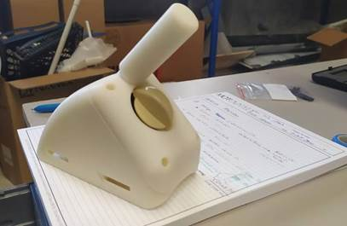
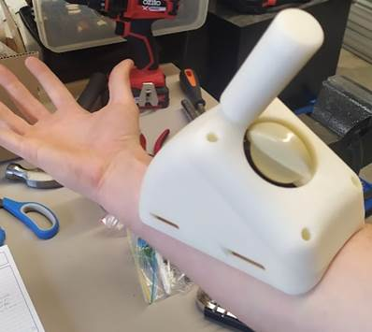
The device
We’ve recently completed the first prototype.
It’s not pretty, it’s much bigger than it will end up, but it does what it should. The ‘nub’ poking out of it was just because of the parts we used to put it together, that won’t be in the end iteration either.
Once we’ve finished, it is aimed to not be much bigger than a deck of cards, strapped on either your forearm or your outer thigh for intramuscular injection.

Slide 13
Birth of the company
Started by Tim Andrews, with initial engineering support by Ben Murton, Iaso is still in the initial stages.
So far, we've gotten an NZ Provisional Patent and have completed the prototype in early August, with support from Callaghan Innovation’s Getting Started Grant.

Slide 14
Next Steps
2021^{est} - PCT Patent Applications, Regulatory Strategy Documents, Mechanical Engineering and Market Research - ending with us poised to commence pre-clinical studies - RSD will shine further light on specific costs, timelines and requirements for regulatory approval
2022^{est} - Patent Applications across jurisdictions, Pre-Clinical trials and any further design iterations - Ending with us poised to start Clinical trials, subject to RSD

Slide 15
Direct Competitors
Future Competitors
Narcan
Naloxowatch - smart watch with Naloxone injector
Evzio
Embedded device - surgical implant
Generic Nasal Spray (Pfizer/Teva)
Sensor based devices

Slide 16
Competitor Approach
Approach 1 - Sprays
Approach 2 - Smart watch
Approach 3 - Sensor based devices
The approach of manual administration of Naloxone works for many prescribed users and for first responders.
While this device will be expensive, it is a 'round the clock' solution that would work well for many users who can afford it.
While these are admittedly very effective, the sensors and computation may price these high enough to make it inaccessible for recreational users.

Slide 17
Advantage 1 - Simplicity
Advantage 2 - Cost
In 2019, the FDA quoted a study showing 10% of users who had not been trained could not use the existing devices correctly - Iaso does not require training
The Massachusetts state (our Pharmac equivalent) pays $20USD per unit of Naloxone device (nasal spray - Narcan). That's in bulk, and for first responders
Advantage 3 - Accessibility
Advantage 4 - Automation
Recreational users do not have much spare money, and what they do will often be spent on more drugs. That's why Iaso is designed to be as accessible as possible, to ensure users can actually access the benefits
One of the symptoms of an opioid overdose is losing consciousness. Because of the stigma, recreational users are frequently alone or with other users when taking opioids. The risk this poses is clear. That's why Iaso is automated.

Slide 18
The Team
Tim Andrews - Founder - Tim had been running his previous company successfully for over two years and has a massive passion for this due to having a close friend pass away due to opioid overdoses.
Rhys Ponton - Advisor & part of the team - Dr Rhys Ponton is an experienced pharmacist with over two decades of work. His PhD, undertaken at the University of Bath in the UK, was entitled 'Evidence-based harm reduction' with his current research noted as both Illicit drug injection in New Zealand Opioid use disorder treatment and opioid misuse.
Dave Andrews - Advisor - Dave has had an extensive career in the corporate world, culminating in a directorship for the top PC company in the world at that time, as well as Vice President for IT for the countries largest hotel group.
Luud Aalsma - Advisor - Luud has been a registered nurse for over 30 years, working in post-operative care as well as rehabilitation. Her experience in this field as a senior RN gives her great practical experience to lend to Iaso.

Slide 19
Summary
While there are 3 main competitors, Iaso offers something none of them do and that one unique selling point is what could possibly save over 115,000 lives a year.
Iaso currently has a provisional patent in New Zealand and a deadline to file overseas patent applications before 24/12/2021.

Slide 20
The Ask
We’re looking to raise $500,000.
This would:
Solidify IP protection
Facilitate Non-Dilutive funding assessment for USA and apply for all applicable grants
These range from $250k USD to $20m USD
Ensure Iaso is poised to engage in Pre-Clinical Trials
Solidify the regulatory strategy
Finalise the product engineering
Complete extensive market research

Slide 21
“Aren’t you encouraging drug abuse?”
This is a common question, while we definitely understand the basis of the question, no. In the same way that the Clean Needle Exchange doesn’t encourage drug abuse, nor does PReP encourage unsafe sex, Iaso doesn’t encourage users to abuse drugs.
As shown by a study* from the Ohio State University, Naloxone access doesn’t make heroin seem less risky. A common worry is that by making Naloxone more accessible, especially in such a “risk free” device as Iaso, that it would be encouraging opioid abuse by taking away the risk. As shown in the linked study, even through there has been a massive increase in access to Naloxone across 47 USA states, the perceived risk of heroin usage has not decreased. This result is still true, even for current opioid users.

Slide 22
Contact Us
+64 21 237 915
Tim@ProjectIaso.com
www.ProjectIaso.com

Slide 23
References
Naloxone Spray Market To Reach USD 928.1 Million By 2026 |
Opioid overdose
Emergent BioSolutions snaps up Narcan maker in $735M deal
Teva wins generic Narcan approval as FDA mulls bolder actions
Intellectual Property Office of New Zealand - 771589
Bulk Purchasing of Naloxone
Naloxone access doesn’t make heroin seem less risky - (the study)

