Slide 1
BSU Topics
Created By – Janai Griffin
Please pay attention to the next upcoming slides and enjoy this music while we wait for everyone to log into the meeting . Thank you
11/4/2020

Slide 2
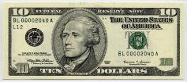
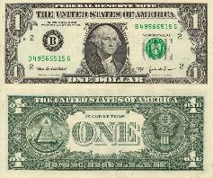
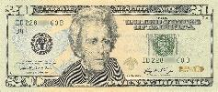
Club Dues
What is a club due ?- A charge or fee for membership, as in a club or organization.
Why are we charging a club due?- The Bsu President and Advisor is now officially charging a club due to purchase your club t-shirts, graduation cords, and future BSU member activities.
Is the club due required for everyone?- Yes Everyone is required to pay a club due.
What happens if I don’t want to purchase a customize BSU shirt do I still have to pay a club due? Okay ! If you decided to not purchase a customize club shirt your club due will be reduced. There is a set price for people who are purchasing shirts and people who are not.
How much is the club due if I purchase a shirt? Club Due will be a $20.00 flat rate fee ( this is a One-Time FEE)
How much is the club due if I don’t purchase a shirt? Club due will be a flat rate fee of $12.00 ( this a One-Time Fee)
For people who are opting in the $20.00 due their shirt will be Included along with their graduation cords and all club events
For people who are opting in the $12.00 due all club sponsored events and graduation cord will be included.
The reason we Suggest the $20.000 due is because you can use your senior shirts for personal senior pictures vs the $12.00 rate you don’t have an official BSU shirt.
Time are tough during this pandemic however I will give a fair amount of time for you to send in your payment . As per Broward County Public Schools rules club organization's dues can be NO MORE than $20.00
This Photo by Unknown Author is licensed under CC BY

Slide 3
Topic 1 Graduation Cords
All the seniors of BSU need to have a graduation cords
price for 6 cords (6 seniors ) are $17.40
Shipping Fee $5.29
Total Price for cords is $22.75
Color of cords is Black/Black/ White
Here is an image of the cord we will be wearing for graduation
The cord color is black and white because that is the colors of Black Student Union.
This color will NOT be changed for personal preference or style.
The president & Advisor Ms. G has agreed with this color because it also match the color of our shirts.

Slide 4
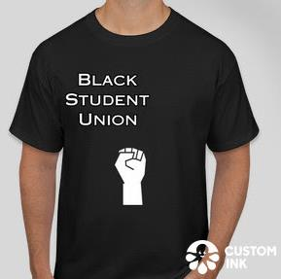
Topic 2 BSU Senior Shirts
Its Optional for bsu members to purchase a BSU customized shirt
Prices for customized shirts are (To be discussed )
For photo shoot purposes members who didn't purchase a customize BSU shirt will be subjected to wear a black or white plain polo shirt
Females it's mandatory to wear a white polo shirt (No Exception )
Males- Its mandatory to wear a black polo shirt (No Exception)
This a professional picture that will be going into the yearbook and I will be uploading them onto the BSU Instagram and website. So that’s why it’s mandatory to wear a polo shirt so we can look professional and united!
No exceptions will be made for the shirts, If you happen to come the session not wearing the proper approve attire you will not be allowed to be in the picture. You will be seated OUT
Here is what the shirt will look like . This is a basic design because we are trying to keep the price fair and reasonable for all our members.

Slide 5
Topic 3 BSU Pants
This is a Professional photo that will be going into the yearbook for the class of 2021
Please No ripped JEANS , this is a professional photo that will be in the yearbook and uploaded into the BSU website. So our goal is to look Professional!
I've sent a poll in the GROUPME at 12:40 pm
The poll will close on (November 6th, 2020) at 8:00 am
Once the poll has been closed Majority vote wins and the bottom with the most votes will be required to wear it on the day of the photoshoot.
If you arrive to the photo session with rip jeans or anything NOT following the approved attire you will be seated out from the photo. No Exception .

Slide 6
Topic 4 Location/ Scenery
Club Pictures will be taken at Plantation High School
Choices of locations (Front of the school, back of the school, Courtyard section )
It's mandatory that pictures are taken on school property
Please have an ID Badge and a Mask when entering school property.
There will be sanitizing involved wherever you all go within the building ( with security in tow)
Social distancing will be an issue if members are not following protocol.
Social distance is required until actual photo is taken
Regarding keeping mask on during photo shoots hasn’t been decided this topic is declared under (To be discussed )
We are waiting to hear what the proper protocol will be to ensure of members safety.

