Slide 1


Vision Plan 2020

Slide 2

Walker Family Trust Vision 2021 Plan via VetVest Group, LLC
Altschul-Carson Ames-Rollerson Nicholas O. and Rosa L. Walker
AR, CO, TX
Time is of Essence

Slide 3
Walker Family Trust – VetVest Group, LLC
Today, and into the future, the Walker Family Trust, has
1/4 shareholder of family-heir owned raw agricultural land in Pine Bluff, ARK @ 20 acres.
Owners of improved and raw land in CO and in TX respectively.
VetVest Group members shall be a funding, development, and management source for funding the ARK and TX projects. Government and private grant private grants and OZ Investors round-out
The Walker Family shall be 100% owner of ALL land and have controlling I interest improvements in CO and TX and own any shares (1/4) promulgated by the ALDG Board o of Directors.
  VetVest is currently registered in CO and (in TX…???) since 2018
  Registered member of the Wichita Falls Chamber of Commerce in January, 2020
  Planning for the AR project is ongoing since 1979 (Heir property)
  Identified and potential construction advisors: Gilmore Construction (Local) and Planning for it first TX project began in in 2019 including our Joint Venture Partners, Mr./ Pastor,
  POTENTIAL: Larry Nelson, CM and Mr. Phillip Townsend, RA, and other CO and TX entities yet to be defined.
VetVest Group, LLC shall share all expenses and income from all investor and JV partners according to the time, talent., or treasury lent to the success of ALL projects NOW, and into the future.
VetVest Group shall be a funding conduit for financing Opportunity Zone projects in ARK and TX. It will secure Opportunity Zone Investors or other grants (via a Fiscal Agency alignment with a 501 c(3) organization) funding from federal, state/local governments, and private sectors granting agencies/entities.

Slide 4
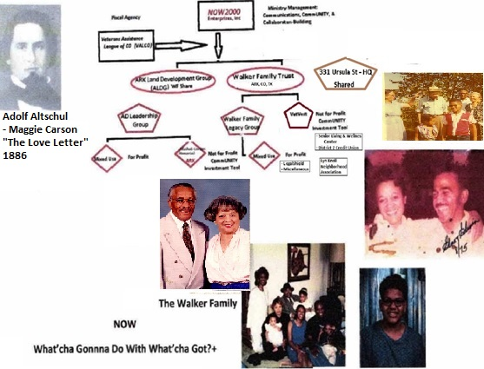
A Family Affair

Slide 5
Project Purposes and Scopes
The Purposes of this multi-state Real Estate Development Venture is driven by Holy mandates, the 1886 Last Will and Testament of Adolf Altschul, who “Illegally Loved and married” his slave-wife, Sarah. This purpose drives this servant to:
Preserve, Protect, and Grow the Walker Family Legacy and continue the legacies given through the Altschul-Carson, Ames, and Rollerson heritages.
Provide the local workforce with living wages (Minimum $15.00 per hour) and benefits such that people have pathways to excel in their individual/family lives.
Provide residents, contractors and, employees with a safe and environmentally sound living and working spaces.
Provide the commUNITY with environmentally friendly assets focused on meeting the living and services requirements of the neighborhood where VetVest Group projects are undertaken.
Provide governing bodies with a stable tax base with which it shall support the governing laws, statutes, and rules promulgated to ensure the safety and well-being of the people it serves.
Together, we provide the Quality of Life demanded by the Wichita Falls citizens and our neighbors.

Slide 6
Project Scope
Fully comply with the stated By-Laws and any authorized projects share-owned (AR) By-Laws (unless noted otherwise), of the VetVest Group, LLC (VetVest).
Align with necessary collaborative LLC/LLP Members/Joint Ventures in order to successfully start and complete all project including follow-on maintenance/management.
Building Standards
ALL Construction/Conversions shall comply with the highest standards of environmental conscious and respect for the people and the resources given by mother earth, air, and water. As such, materials and technologies known today include:
  “Cool” nuclear power plant with back0up generators.
  Fire/Storm resistant roofing with mounted solar capture panels
  Compressed Earth Blocks (CEB) Wall construction materials insulated with high-quality fire/noise reduction materials
  Green and Well Certified Standards Schedule objectives
Here are the overall project objective

Slide 7

Project Stakeholders
As property owners, ALL acquired land and property SHALL remain in the control and ownership of the Walker Family Trust in perpetuity.
In order to successfully develop those properties, it may a requirement that certain stakeholder require a position of ownership or compensation in a lump sum or as in an annuity. These instances of collaboration shall be tied to the development and NOT to the land.
Potential Stakeholders may include:
Subsequent generations as specified in
the Walker Family Trust.
All vested LLC Members and Joint
Venture
Partners and Fiduciary Owner(s)/
Operators
All taxing entities

Slide 8
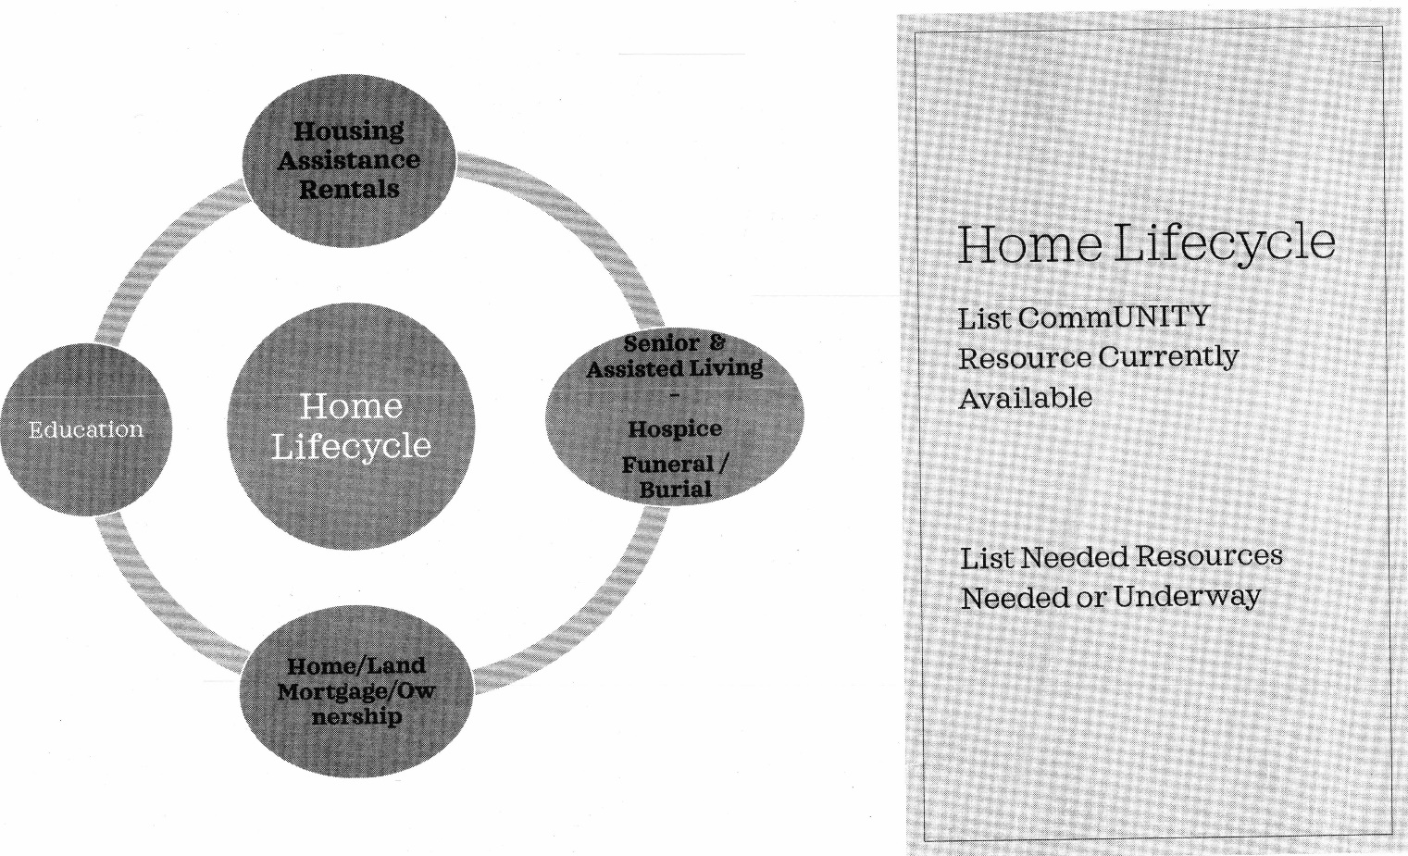
Success Factors
Here are elements that are keys to the success of each project:
Fulfill Walker Family Legacy, Ministry/Mission/ Objectives of this Ames Baby Boomer Generation and, the goals and
objectives of our clients or stakeholders and neighbors.
Provide a full-scale demonstration of environmentally
efficient/friendly development from construction to
occupancy.
Identify and Retain Critical Team Members
  TX Attorney (1st Priority) (Complete)
  Architect (Pending – 9-21)
  City Liaison(s) (Complete)
  Developer (Pending – 9-21; Consider Fiduciary Owner/Operator)
  Construction Manager (Pending – 9-21)
  General Contractor (Pending – 9-21
Complete within budget
Deliver ALL projects on-time and within Budget.

Slide 9
Implementation Plan – An Overview
This is a faith-based initiative. Funding shall be in-place and ready as needed.
After complete Due Diligence work, including all pre-construction legal issues by 2021, begin assembling Wichita Falls project principals, prepare land, assemble all component materials and sources required for building and then, begin construction in, or before, 2022
The future vision is to develop a multi-use CommUNITY consisting of agriculture, light industrial/warehousing, and a tourism site.
Arkansas – Pine Bluff is ongoing
  Survey and Platting ( Clay – Guest Family to Finish )
  Begin structuring/positioning for Regional Marijuana/Hemp Recycling (Begun 8-21 )
  Establish Industry growers, producers, and packagers.
  Not Fully Assessed at this time.
Colorado is ongoing. The latest activity is converting single family space to qualify as a Veterans Group Home.
Wichita Falls, TX is first up for development:
  Land acquisition (completed 8-21)
  Retain Financial and Technical Team (Begun 8-21 )
    Banking – Line of Credit, Bridge Loan, Permanent
    Identify/Commit LLC Members (Maximum 38-TX)/ Partners
    Complete Business Plan with Feasibility and Pro Fora statements

Slide 10

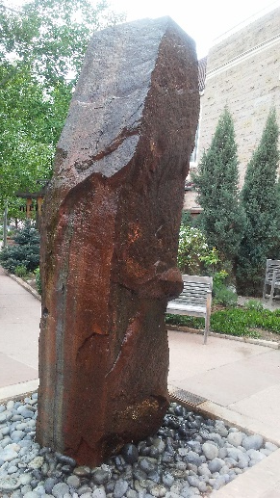
Implementation Plan
Arkansas – 1/4 Ames Family Shareholder (AR Land Development Group, LLP (ALDG)) of the
Altschul-Carson Family Heirship consisting of 20 acres of Agricultural Zoned, raw land.
Currently the land is forestry and ground bush with NO known encroaching utilities-
above or below ground. Area is generally Small Industrial and Commercial. Major Transportation
access points easily adjacent to the property.
Tasks/Activities Required:
  Retain, Schedule, Certified Surveyor and ensure certified results are recorded. Replace wooden flag markers with metal mmarkers as survey is bbeing conducted.
  Set aside % for University of AR at Pine Bluff – Dr. Henry English – On Hold
  Obtain a Forestry Plan – Mr. Joseph Friend
  Land Use Vision Plan submitted to Metro. Planning Org. (MPO) and Zoning for Industrial, Memorial Park, and small footprint Financial Services building (Office or ATM)
  Capture Altschul-Carson legacy information and prepare for Memorial Park and local, and national, designation as a Historical site. JeffCO Public Library – Atlas-Genealogy)
  Identify/Align with major CommUNITY/political leadership. Established and Working with
  city (CoS, Cynthia Anderson; Aldermen Lockett & Mays(- D4)), county, and state officials concerning community/economic development.
  Title Search/Recapture Lost 19 or 20 acres – ( Scheduled for December +, 2021; PB Title)
Timeline: 1886; 1972 to Present

Slide 11
Implementation Plan
Colorado– Two Projects:
Walker Family Trust Controls two residential properties: 331 Ursula St., Aurora and, ½ interest in 3070 Birch St., Denver.
Aurora Property: VetVest Group, LLC is contracted to serves as Chair for the Asset-Baes Community Development Group, Inc.’s Initiative – a Steering Committee researching and developing a Low-Income Community Development Financial Institution (LI-CDFI).
Tasks/Activities Required:
Maintain all residential properties to the highest level of Quality Standards. Aurora Property: Begin improvements to open basement by adding bedroom and common area space in a single-family home converting to a certified Veterans Group Home. Obtain an application for an inspection from AUR Housing Authority according to instructions from Dept. of Veteran Affairs.
Identify/Align with major CommUNITY/political leadership.
Identify/Align with city, county, and state officials concerning community/economic development..

Slide 12
Implementation Plan
Texas – 3 parcels - 100% owner: 107 North Rosewood – THE Creek at ML ; .9 acres/4 Shareholder of the Altschul-Carson Family Heirship consists of 20 acres of Agricultural Zoned raw land. Currently the land is forestry and ground bush with NO known encroaching utilities.- above or below ground.
Tasks/activities Required:
  Planning & Engineering meeting 9-8-21
  Platting required for 107 N. Rosewood. Retain, Schedule, Certified Surveyor and ensure certified results are recorded.
Identify/Align with city, county, and state officials, WF Chamber and others including Small Business Development Centers (SBDC). concerning community/economic development.
Underway

Slide 13
Cost Objectives – Under Construction
AR
  Not Assessed at this time
CO
  New Horizons FCU R & D - $100K Due 12-2022
  New Horizons FCU Opening Assets – Goal: $5M
  Simulated Pro Forma Available with Non-Disclosure
TX
  Land Acquisition – (Complete 8-2021)
  Bids out for Platting, Soil Sampling et. – Released 8-2021

Slide 14
Project Team Roles and Responsibilities
Nicholas O. Walker or Assigns
Oversight
Administrative Assistance
Yet Unnamed
AR Personal Representative
Yet Unnamed
TX Personal Representative
Expansion
Technical / Professional Consultants
Government Liaison – Federal, State, County, Local
CO
New Horizons FCU
Vet. Group Home

Slide 15
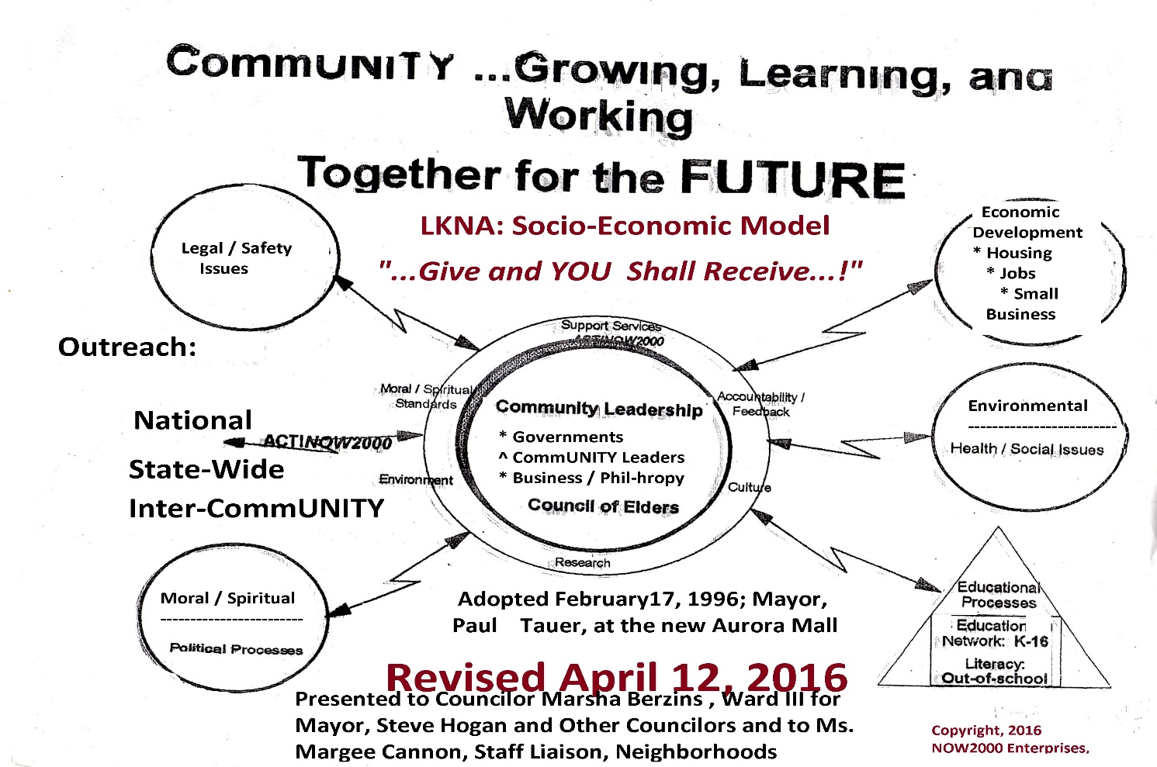
Use the Community Development: A Socio-Economic Development Tool
Communications Strategy

Slide 16

Altschul-Carson Memorial Gardens
Industrial Office Park
Hemp / Marijuana Grow and Recycle Center
UAPB Collaboration (Not NOW for Muscadine Berry; Substitute Forestry Plan – Mr. Joe Friend; PB D4 – Bruce Lockett 6-21)
This is a multi-faceted vision. The Altschul-Carson Family of heirs have introduced several possibilities any of which should be considered as viable. The City of Pine Bluff, however, has published its list of priorities some of which match the ideas of the family members.. Next, the University of AK at Pine Bluff has also expressed an interest. (HOLD 6-21*) Together, ALL ideas can be developed in order to reach the highest and best use of the land passed down through the ages of @140 years.
Following is a table of those ideas as of today.

Slide 17
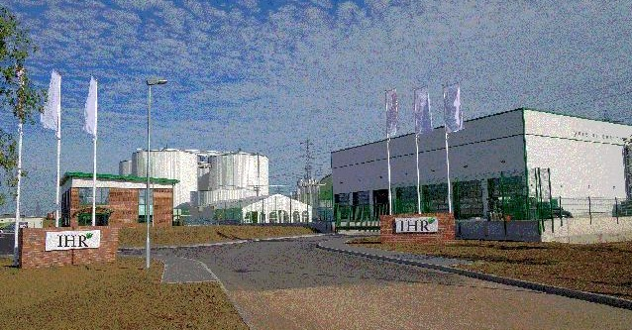
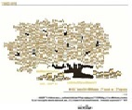

Highest and Best Uses Proposed
City of Pine Bluff and UAPB (HOLD*)
Family Proposal
Historical Memorial Park
Indusial/Warehousing
Agricultural\UAPB*: Catfish and Berry Preserve and Research Extension Facility.
Altschul-Carson Memorial Garden on W Short 3rd corner )gravesite) @ 2 acres
Cell Site Location
Hemp/Marijuana Grow/Recycling Center
Transplant New Horizons PFCU Model to corner of US 539 @ Barraque (2-Lane) County Rd

Slide 18

AURORA, CO
- New Horizons FCU Initiative
- CO Veterans Group Home

Slide 19


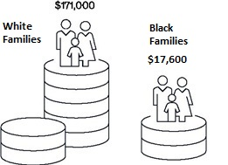
New Horizons Proposed Federal Credit Union (PFCU): A Proposed Low-Income Community Development Financial Institution
The Problem: Wealth Gap and Access to Capital
Proposed Logo
A Core Group is their Given Time, Talent, and Treasury to develop a NCUA Insured Credit Union Model having a Low-Income designation that enables better access to capital to neighborhood residents and businesses at more competitive rates and having community focused products and services.

Slide 20
CO Veterans Group Home (COVetHome)
The City of Aurora permits four (4) unrelated persons to live in a private, single family zoned residents and, the Veterans Administration maintains a program supporting homeless individuals/families and, supporting housing for those requiring access to the nearby Eastern Regional Medical Center. COVetHome is @ One (1) Mile away from the hospital and our Directors will provide supportive counseling services, meals, and transportation while the veteran enjoys a clean and safe living environment with amenities.

Slide 21

Wichita Falls, TX

Slide 22



Slide 23
Wichita Falls Senior Living & Wellness Center
On the eastside of the City of Wichita Falls, the Walker Family proposes to build a high-quality senior retirement complex consisting of:
Elevated L-Shaped building to 2-5 stories where Garden Level is commercial Pharmacy (corner); leading to a small community conference / office center (divisible to class & exercise rooms); leading to Central Facilities Room include air condition/heating powered plant by “Cool Nuclear and solar with backup diesel generation; an ATM outlet; and finally, a small community Laundry/Dryer rom.
Major League Basketball will be proposed to develop a Basketball and other sports lot dedicated for the Boys & Girls Club (across the street on Rosewood) that could supplement parking. Full security and lighting system shall surround all internal an external accesses controlled by a central office monitoring system on the second floor surrounded by residential living spaces.
Finally, project MUST have sufficient overflow, off-street parking with circular drop-off from the Marconi to Rosewood or through the alleyway between Marconi and Juarez.

Slide 24
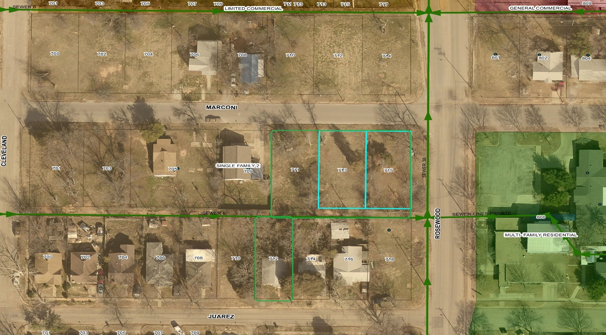
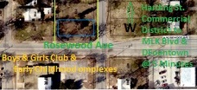
Boy and Girls Club undergoing @ $6.5 M Redevelopment to premier Sports/Community Center – 2021-22

Slide 25
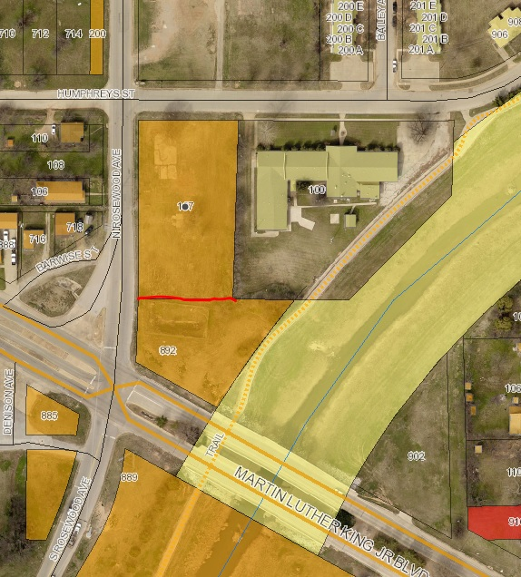
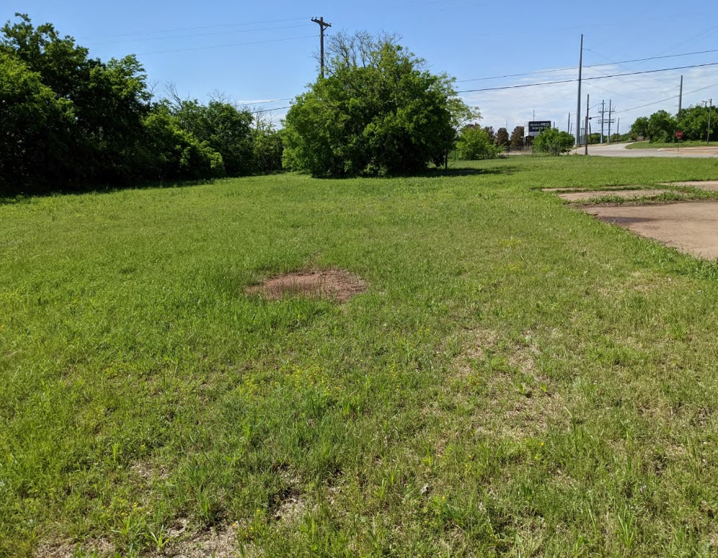
107 N. Rosewood
The latest acquisition at the intersections of MLK Blvd. @ Rosewood and Harding Streets.
Aerial and Frontal Views. Not visible here and to the top left side of the property is a Free-flowing contributory yo the Wichita River called, Holliday Creek. A Biking, Walking, and Running track accompanies that river side.
Holliday Creek/Wichita River
City-owned Deainage Detention Pond

Slide 26
Resources
People – AR
People - TX
Nicholas O. Walker Family
Outside Services – Forming
People - CO
Resources Notes
Other
Government
Notes
Sales
VetVest Group
Resource 2
Resource 3
Resource 4
Notes
Nicholas O. Walker Family
ABCD Core Group
Resource 3
Resource 4
Resource Notes
Developer & Independent Contractors
Resource 3
Resource 4
Architect
Banking
City WF
Federal
HUD (permanent Finance)
DOE (Solar/Nuclear)
SBA
Vet Preference
Mentor / Protege
Resource 2
Resource 3
Resource 4
AR Land Development Group (ALDG) – 4 Ames Families
WFCC / SBDC
GRAnderson Wealth Management Group. Inc.
Michael Johnson, CPA
VetVest Group, LLC Partners
VetVest Group
Outside Services
City of Pine Bluff

Slide 27
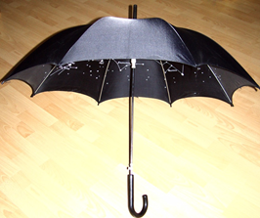
Walker Family Trust –
AR Land Development Group
Dba
VetVest Group, LLC
Thank You for Your Support by the Giving of Your Given Time, Talent, and Treasury !!

Slide 28
Section 2: Business Plan – Under Construction

Slide 29
Cost Analysis

Slide 30
Project Schedule and Milestones
Milestone 1
Milestone 2
Milestone 3
Milestone 4
Date
Date
Date
Date

Slide 31
Risk Management Plan
Risk | Probability | Impact | Owner | Mitigation Plan
Budget cuts may reduce staff, affecting project scope and schedule | Medium | High | Project Manager | See appendix for a phased implementation plan

Slide 32
Quality Management and Performance Measures
Define quality management plans
How will you monitor and control costs?
How will you monitor and control schedule?
Notes:
May require more than one slide

Slide 33
Appendix
Reference supplementary materials and resources

