Slide 1
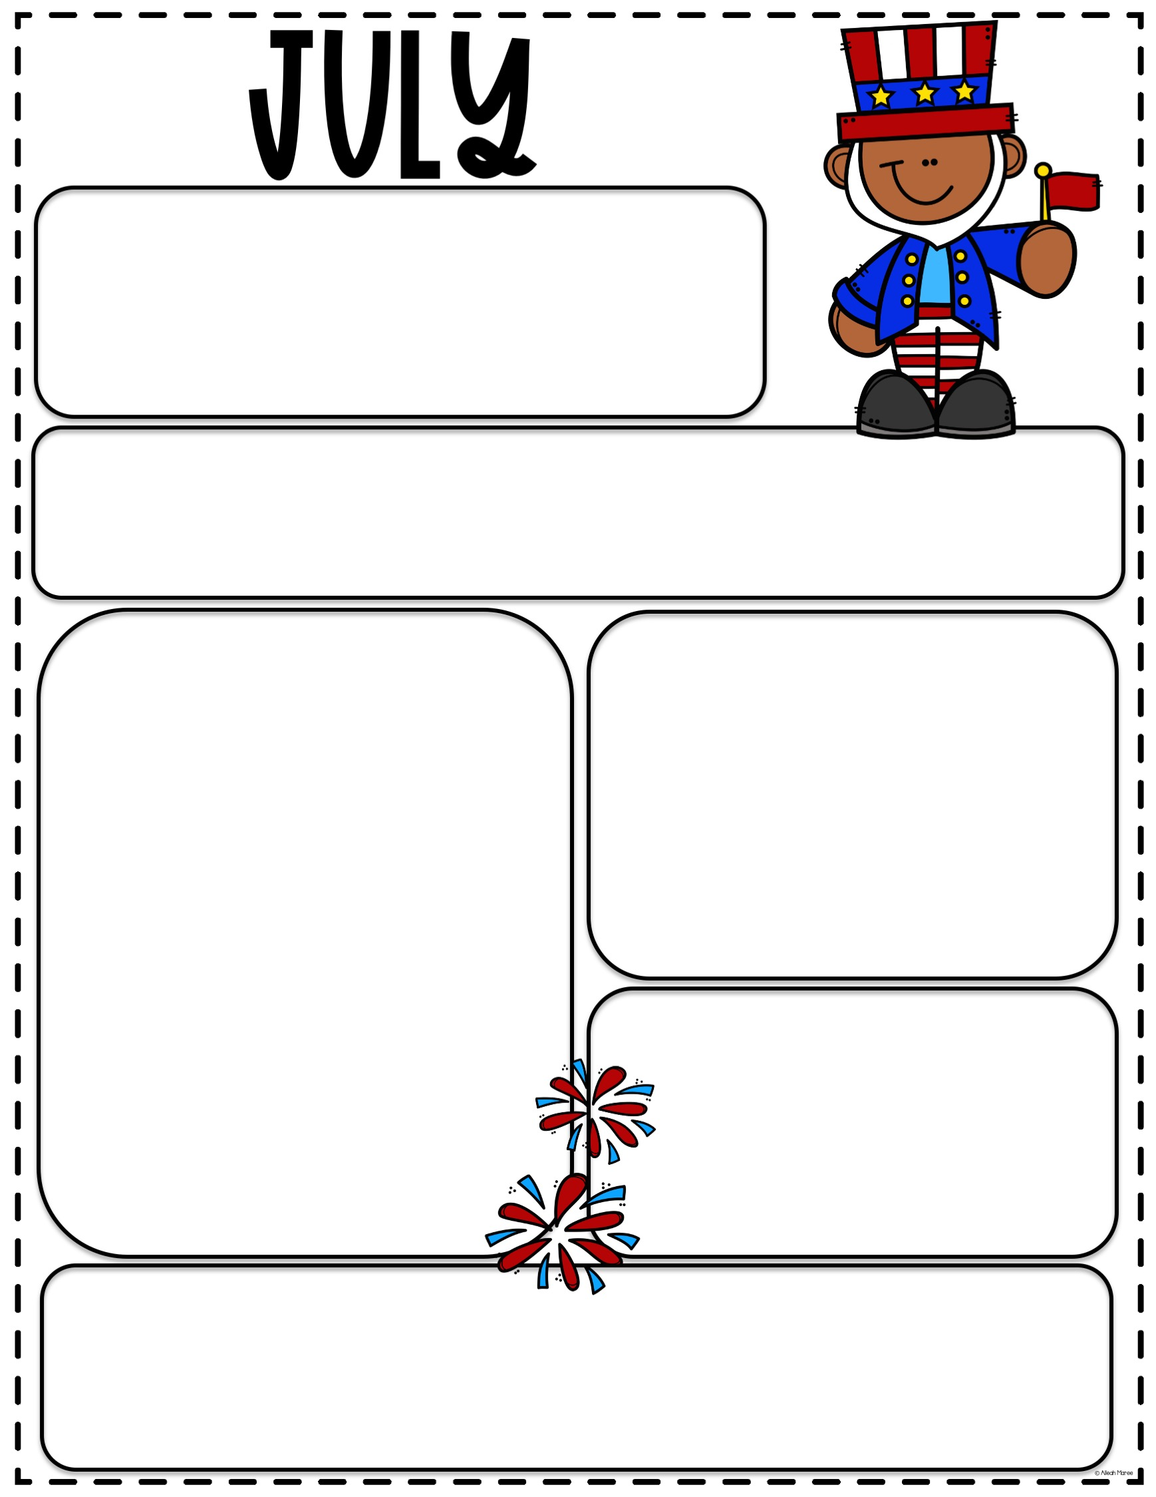
ACEC
Monthly
Newsletter
How To Wash Your Hands
Hand washing is the single most important means of preventing the spread of germs in a child care setting. The Centers for Disease Control estimate that up to 80% of infections are spread by hands. In addition, improper and insufficient hand washing can stand in the way of higher quality ratings.
Reminders
Please remember to sign your child in and out each day!
Please be curtious, if your child is sick (running a fever of 100 or more, throwing up, etc.) please keep your child at home!
Please check your email for important information, updates, and events from Chassidy. If you need to update your email please see Chassidy or Sharon.
Birthdays
Ethan 7.07
Hunter S. 7.10
Gavin 7.10
Braelee 7.11
Jackson D. 7.12
Theo 7.17
Eleanor 7.23
Henry S. 7.24
Caroline M. 7.24
Dates to Remember
7/5 ACEC closed to observe 4th of July
7/9 ACEC Closed for Staff In-service Day
RSV
Respiratory syncytial virus is highly contagious. It spreads through droplets containing the virus when someone coughs or sneezes. It also can live on surfaces (like counters or doorknobs) and on hands and clothing. So people can get it if they touch something that's contaminated.
RSV can spread quickly through schools and childcare centers. Babies often get it when older kids carry the virus home from school and pass it to them. Almost all kids have had RSV at least once by the time they're 2 years old.

