Slide 1
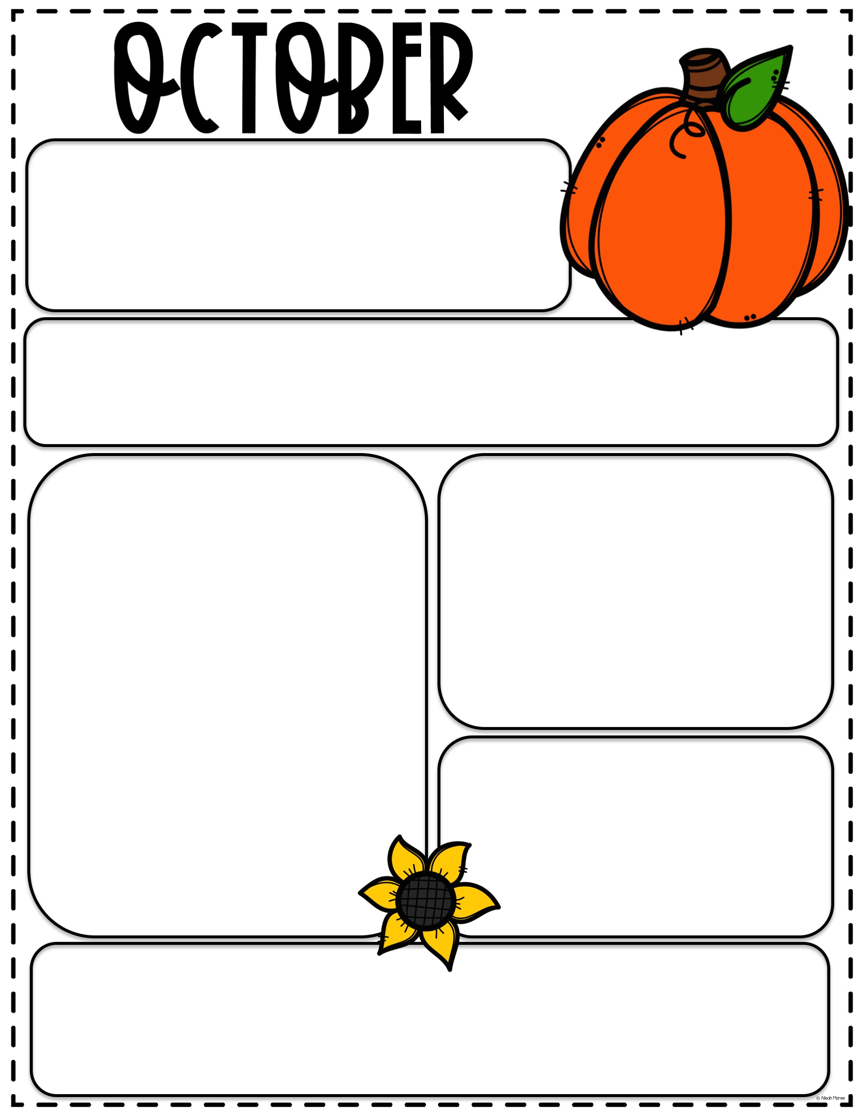
ACEC
MONTHLY
NEWSLETTER
There will be no consignment sale this fall!!
BIRTHDAYS
Neveah 10/3
Wyatt 10/9
Amelia 10/12
Hunter M 10/12
Holden 10/25
5 Fall Things To Do As A Family
Get Active and Explore a Nature Trail
Pumpkin Patch
Go Pick your own apples at an apple orchard
Paint Pumpkins
Go on a hay ride
Upcoming Reminder
November 18: Thanksgiving Feast
Only two people per family
If your child has a fever of 100 or higher, cough, severe runny nose, diarrhea please keep your children at home and take them to the doctor. If anyone in your household is having to quarantine, you will need to keep your child out of daycare. We want to keep our staff and children healthy as possible.

