Slide 1
California Instructors’ Perceptions of the Effect of Course Modality on the Academic Achievement of Dual-Enrolled Students: A Qualitative Exploratory Case Study
Jeannie Karlitz
Notes:
California Instructors’ Perceptions of the Effect of Course Modality on the Academic Achievement of Dual-Enrolled Students: A Qualitative Exploratory Case Study

Slide 2

Introduction and Personal Background
Diverse professional journey
Passion for educational disruption
Dissertation focus
Notes:
Welcome to my dissertation defense. My name is Jeannie Karlitz, and I am presenting from Southern California where my husband and I are living as empty nesters with our goldendoodle.
My professional path has evolved through various sectors, including business development in technology during the first dot-com era and philanthropic fundraising with a focus on juvenile arthritis and educational attainment.
The college admission process captured my attention after navigating it with my eldest, sparking a commitment to educational reform. I pursued a Master's in Higher Education at ACE, aimed at disrupting college admissions. This pursuit led to pro-bono work assisting underrepresented students with college admissions, and subsequently to my Ed.D. in Instructional Technology.
Today, I'm presenting my dissertation titled "California Instructors’ Perceptions of the Effect of Course Modality on the Academic Achievement of Dual-Enrolled Students: A Qualitative Exploratory Case Study." This study is born from my interest in the accessibility and equity of higher education, particularly through the lens of dual enrollment as a strategy to enhance college graduation rates cost-effectively.
The inspiration comes from my youngest son’s high school experience during the Covid-19 pandemic. He proactively completed nine dual enrollment courses through California Community Colleges. These courses were free, online, asynchronous, rigorous, and fully transferable, allowing him to advance into his university as a sophomore, thereby saving a year's tuition. Dual enrollment strengthened Jackson’s college application and secured him a presidential scholarship.
I was intrigued whether the online modality of these dual enrollment courses affected his grades or the rigor of the coursework. My dissertation explores these aspects, seeking to understand the broader effects of course modality on academic achievement. Thank you for joining me in exploring this educational research.

Slide 3
Phenomenon Under Investigation

Slide 4

Problem
The problem is that online dual-enrolled students are less successful than in person dual-enrolled students in the United States (Kim et al., 2021; Liu et al., 2020; Westwick et al., 2018).
Notes:
The problem identified by Kim et al. in 2021, Liu et al. in 2020, and Westwick et al. in 2018 is the lack of success among online dual-enrolled students in comparison to their in-person counterparts in the United States.
The academic achievement of dual-enrolled students is affected by the reduced rigor in online dual enrollment courses, as explored in 2020 by Alsup and Depenhart . Westwick et al. also found that academic achievement of dual-enrolled students in online courses largely depends on the instructor’s teaching level and the course’s rigor.
Liu et al. quantified the issue, noting that dual-enrolled students in online settings have a persistence rate that is 3.7 percent lower than those in traditional in-person courses. Moore and Williams contributed to this discussion by identifying the online learning environment, instructors, and transfer options as factors that further affect lower persistence rates.
The challenges are compounded for low-income and underrepresented students, who, as Kim et al. suggested, might not have access to necessary support at home. This situation has been exacerbated by the COVID-19 pandemic, which, according to Park and Hayman in 2022, has significantly harmed the already vulnerable, isolated, and often food-insecure students, affecting the attendance and academic achievement of particularly Black and Latin-x students.
The research highlights the need for addressing the issues inherent in the online modality of dual enrollment courses to improve the academic achievement for all dual-enrolled students.

Slide 5

Purpose
The purpose was to explore California dual enrollment instructors’ perceptions of the effect of course modality on the academic achievement of dual-enrolled students.
Notes:
The purpose of this study was to understand the perceptions of California dual enrollment instructors on the effect of course modality on the academic achievement of dual-enrolled students. Data from 15 instructors were collected through a qualitative approach that included an open-ended questionnaire and semistructured interviews, aiming to define academic achievement by GPA, course rigor, and withdrawal or graduation rates. This study was driven by the need to understand California dual enrollment instructors’ perspectives regarding the effect of course modality on dual-enrolled students’ academic achievement. Through thematic analysis of the data, as recommended by Olmos-Vega et al. in 2022, the research aimed to expand the knowledge base by offering rich insights and using qualitative methods to explore the complexities of the effect of course modality on the academic achievement of dual-enrolled students.

Slide 6



Research Questions
Research Question 1:
What are the perceptions of California dual enrollment instructors regarding the effect of course modality on the academic achievement of dual-enrolled students as defined by their grade point average?
Research Question 2:
What are the perceptions of California dual enrollment instructors regarding the rigor of dual enrollment course instruction based on course modality?
Research Question 3:
What are the perceptions of California dual enrollment instructors regarding the effect of course modality on the academic achievement of dual-enrolled students as defined by their withdrawal or graduation rate?
Notes:
The first research question is:
What are the perceptions of California dual enrollment instructors regarding the effect of course modality on the academic achievement of dual-enrolled students as defined by their grade point average?
The second research question is:
What are the perceptions of California dual enrollment instructors regarding the rigor of dual enrollment course instruction based on course modality?
The third research question is:
What are the perceptions of California dual enrollment instructors regarding the effect of course modality on the academic achievement of dual-enrolled students as defined by their withdrawal or graduation rate?

Slide 7
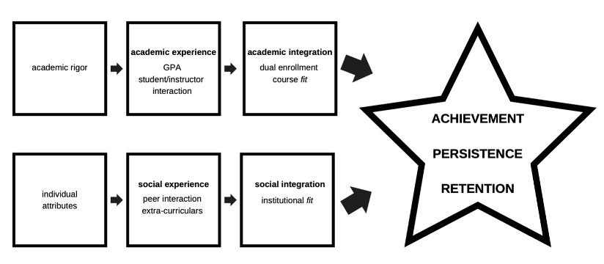
Theoretical Framework
Tinto's Student Integration Model (1975)
Notes:
Tinto’s 1975 Student Integration Model focused on academic and social integration for academic achievement and student success. It is about how students need to feel integrated and belong academically and socially for success. Integration matters for dual-enrolled students to achieve and be successful.
Tinto also focused on student success metrics like GPA, persistence, and retention, which are related to the study.

Slide 8
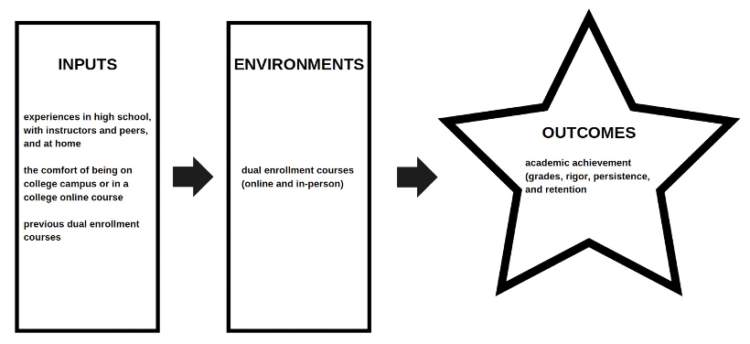
Theoretical Framework (continued)
Astin’s Theory of Student Involvement (1984)
Notes:
Astin’s 1984 theory of Student Involvement examined involvement, achievement, and attrition. Astin believes involvement leads to achievement. If dual-enrolled students are more involved and engage more in their courses, whether online or in-person, then involvement and engagement could affect their grades, rigor, persistence, and retention. Astin noted that involvement is subjective.
Tinto’s model and Astin’s theory agree that student-teacher interactions are significant. Dual enrollment students' relationships with instructors may be affected by the course modality (online or in-person).

Slide 9

Theoretical Framework (continued)
Alignment with Study
Student-instructor interactions.
Tinto's Student Integration Model (1975)
Astin’s Theory of Student Involvement (1984)
Course modalities’ effect
Notes:
Tinto’s model and Astin’s theory align with the study on how students feeling integrated, engaged, and challenged affect dual enrolled students’ academic achievement. Student-instructor interactions are focal points in both theories, highlighting how these relationships also affect academic achievement.
Tinto's model, which evaluates academic achievement with a focus on grades, persistence, and retention, aligns with the study as student integration is used to explore academic achievement.
Similarly, Astin's theory draws a connection between the degree of student involvement and their academic achievement, aligning with the the study.
Tinto’s model and Astin’s theory agree on the effect that student integration and involvement have on academic achievement. Student integration and involvement are factors in exploring if online and in-person course modalities contribute to or detract from students' academic achievement, thereby aligning the theories with the study.

Slide 10

Literature Review
Dual Enrollment in California
Positive Effect on Academic Achievement
Disparity in Affluent Student Advantage
Challenges in Transferability and Equity
Strategic Focus on Underrepresented Students
Vision for Success Alignment
Notes:
Studies by Field in 2021, Villarreal in 2017, and Westwick et al. in 2018 found that dual enrollment courses have a positive effect on students’ academic achievement. Dual enrollment courses, however, have disproportionately benefited affluent students, as pointed out by Spencer and Maldonado in 2021.
While dual enrollment’s popularity has increased, significant challenges remain. Ison et al. in 2022 and Kurlaender et al. in 2021 discussed the persistent issues related to the transferability of credits and equity among dual-enrolled students.
California’s strategic emphasis on dual enrollment since the early 21st century has been directed at enhancing equity and improving access to higher education. This strategy, particularly noted by Ison et al., aims to support low-income students who are traditionally underrepresented in higher education.
The alignment of the California Community College’s Vision for Success with dual enrollment initiatives is crucial. In 2021 Oakley highlighted the vision's focus on providing equitable access and creating expedited pathways for students, underlining the commitment to improving educational outcomes through dual enrollment.

Slide 11

Literature Review (continued)
Effect of Course Modality on Academic Achievement of College Students
Efficacy of Online vs. In-Person Modality
Inconsistency in Findings
Online Modality's Enhanced Effectiveness
Comparable Grade Distribution
Similar Rigor Across Modalities
Lower Failure and Withdrawal Rates Online
Notes:
The question of whether an online modality is as effective as an in-person one has been a subject of investigation by researchers like Broeckelman-Post et al. in 2019, Faulconer et al. in 2018, Gavassa et al. in 2018, and Liu et al. in 2020. This inquiry is the foundation of understanding academic achievement in different course delivery approaches.
Although the findings across studies were inconsistent, literature suggests that the online modality is more effective academic achievement for college students (not dual-dual enrolled students). The online modality was more effective on academic achievement, defined by grades, rigor, persistence, and retention than the in-person modality for all college students, as reported in studies by Broeckelman-Post et al., Faulconer et al., Gavassa et al., and Liu et al..
When examining the grade distribution between online and in-person modalities, Broeckelman-Post et al. found no statistical difference, indicating that college students achieve similar academic grades regardless of the modality.
The rigor experienced by college students in both online and in-person modalities was found to be similar, as discussed by Paul & Jefferson in 2019. This suggests that the level of academic challenge is maintained across online and in-person delivery methods.
Online college students showed lower failure and withdrawal rates, observed in findings by Broeckelman-Post et al. and Faulconer et al. This could indicate the potential benefits of online learning for college students in terms of student persistence and retention.

Slide 12

Literature Review (continued)
Effect of Course Modality on Academic Achievement of Dual-enrolled Students
Efficacy of Online vs. In-Person Modalities
Mixed Findings on Dual Enrollment Outcomes
Challenges in Online Dual Enrollment
Comparative Success in Modalities
Identified Gaps in Literature
Notes:
In 2020 Paulsen & McCormick questioned whether an online modality is as effective as an in-person modality for dual-enrolled students. This comparison is important for understanding the effect of course modality on the academic achievement of dual-enrolled students.
Although literature highlights the problem of the lack of success among online dual-enrolled students in comparison to their in-person counterparts in the United States, there is no consensus on whether the online or in-person modality is superior to the other regarding dual-enrolled students’ academic achievement, defined by grade point average, course rigor, withdrawal rates or graduation rates.
The research yielded inconsistent findings. For instance, Kim et al., Liu et al., and Westwick et al. observed that online dual enrollment courses offered fewer benefits and presented more challenges than in-person courses. The same studies indicated that online dual-enrolled students were less successful and faced more negative outcomes than in-person dual-enrolled students. Alsup & Depenhart also found that online dual enrollment courses seemed less rigorous than in-person courses.
Contrarily, studies by Paul and Jefferson and Westwick et al. reported that dual-enrolled students in online courses excelled more academically and performed better than those in in-person courses, highlighting a dichotomy in the findings.
There is a gap in literature pointing to the need for further research on the effect of course modality on the academic achievement of dual enrolled students, specifically concerning instructors' perceptions on grade distribution, course rigor, withdrawal and graduation rates.

Slide 13
Research Methodology

Slide 14

Research Method and Research Design
Qualitative Exploratory Case Study
Qualitative Method Rationale
Advantages
Exploratory Case Study Design
Notes:
Qualitative Method Rationale
A qualitative research method was used to prioritize depth over breadth, capture real-life insights, and emphasize the study's human element. This approach was supported by Creswell and Denzin & Lincoln in 2017, who advocated for its strength in facilitating an in-depth understanding of complex issues. A qualitative study allows for a more nuanced exploration of phenomena than a quantitative approach typically permits. The work of Cuthbertson et al. in 2020 and Creswell & Clark in 2017 suggested collecting personal experiences and perspectives as they are critical for providing a detailed view of the research problem.
Advantages
I used a qualitative method because it is cost-effective and suitable for my context-specific study, where the need to capture data beyond numbers was important. According to Denzin & Lincoln, this approach requires fewer resources and time than quantitative methods. Creswell emphasized the value of in-depth interviews, questionnaires, and reflective field notes in yielding detailed information that goes beyond quantitative data. The qualitative study was particularly appropriate for the context of the study, exploring effect of course modality on the academic achievement of dual-enrolled students in California and allowing for a detailed understanding of the phenomena.
Exploratory Case Study Design
The exploratory case study design used to lay the groundwork for the study through preliminary data collection, as emphasized by Saunders et al. in 2019. This design allows for idea and insight generation, and it embraces the flexibility needed to capture complex perspectives, which was necessary for exploring instructors’ perceptions of the effect of course modality on dual-enrolled students’ academic achievement. In 2014 Yin supported the use of an exploratory case study design for its adaptability and depth. The design was appropriate for my study as it is an in-depth exploration of the nuances of the effect of course modality on academic achievement, considering GPAs, rigor, withdrawal, and graduation rates among dual-enrolled students in California. Creswell and Poth and Yin suggested that such a detailed exploration is critical to understanding the phenomena under study.

Slide 15

Assumptions
Assumptions Based on Creswell and Poth's (2018) Framework
Ontological Assumptions
Epistemological Assumptions
Axiological Assumptions
Methodological Assumptions
Notes:
The first assumption of the study is the ontological assumption.
The study adopted the belief that reality is subjective and that there are multiple perspectives on the effects of course modality on the academic achievements of dual-enrolled students in California. Creswell & Poth and Saunders et al. highlighted the importance of recognizing these diverse perspectives. The study also assumed that instructors have experience teaching both online and in-person modalities for at least one year.
The second assumption is the epistemological assumption.
Aligning with the views of Creswell and Poth and Shah, the study is rooted in the idea that knowledge is constructed through experience. In the study, instructors’ perceptions were explored, some of which were shaped by their unique experiences during the COVID-19 pandemic.
The third assumption is the axiological assumption
Following Creswell & Poth's framework, the research was conducted with an objective approach, aiming for transparency to minimize potential biases, as also suggested by Saunders et al. This commitment to objectivity ensures the credibility and reliability of findings.
The fourth assumption is the methodological assumptions
The study used an inductive approach, as recommended by Alharahsheh & Pius in 2020, allowing the validity of interpretations to emerge from the data. In layman's terms, this means I built my understanding from the ground up by using the data to guide conclusions rather than forcing the data to fit pre-conceived ideas.

Slide 16

Limitations
Small Sample Size
Qualitative Generalizability
Virtual Interview Limitations
Bias Mitigation Strategies
Trustworthiness Measures
Ethical Considerations
Notes:
The fist limitation of the study is the small sample size
The study incorporated 15 participants, which may only partially represent California’s larger population of dual enrollment instructors. Recognizing this, I interpreted the findings within the context of this sample size, as the exact number of dual enrollment instructors statewide in California has not been established.
The fist limitation is qualitative generalizability
While the qualitative approach allowed for rich, in-depth data collection, it also acknowledged the limitation in the generalizability of the study’s findings. This approach excels in detailed exploration but may not be as easily applicable to broader settings or different populations.
The third limitation is the virtual interview
Conducting research online via platforms like Zoom is convenient but may miss some of the subtleties available through in-person interactions. This was factored into the study analysis, considering the potential limitations of virtual communication.
Acknowledging that researchers have implicit biases, I had a bias mitigation strategy.
To address biases inherent in nonprobability, purposeful sampling, and self-reporting, the study employed techniques of open-ended questionnaires and semistructured interviews. The questionnaires and interview protocol were designed to elicit comprehensive responses and reduce the risk of skewed data.
Subject matter experts and triangulation were also used in the study, as recommended by Hayashi et al. in 2019 and Al Halbusi et al. in 2021, to increase the trustworthiness of the findings.
Throughout the study, I remained committed to ethical practices, following guidelines that ensure the study’s integrity and ethical conduct, in line with Simon’s 2011 recommendations.

Slide 17

Scope and Delimitations
Study Scope
Focus on Instructor Perceptions
Research Delimitations
Recruitment and Data Collection
Notes:
The study’s scope was clearly defined by parameters and limitations that framed the study’s goals, expectations, methodology, and potential biases. This structure, aligned with the 2022 guidelines from the University of Mount Olive, ensured a focused approach to exploring the perceptions of California instructors on the effect of course modality on dual-enrolled students’ academic achievement.
The exploration of California dual enrolment instructors' perceptions was central to the study. By exploring their experiences and viewpoints, I tried to understand how the online and in-person modalities affected dual enrolled students' academic achievement.
The research delimitations and boundaries were intentionally set based on specific factors including objectives, research questions, chosen population, and theoretical frameworks as guided by Simon’s 2011 work. These delimitations helped to narrow the focus of the research.
Recruitment and data collection strategies involved Facebook and snowballing techniques, avoiding physical sites or facilities. The participant pool was limited to 15-20 instructors with recent experience teaching dual enrollment courses online and in-person in California. Each participant engaged in a semi-structured interview lasting approximately 45 minutes and completed a 20-minute open-ended questionnaire, allowing me to gather comprehensive qualitative data.

Slide 18


Target Population and Sample
Population
Sample Size
Sampling Techniques
Recruitment Methods
Notes:
The population of the study was certified dual enrollment instructors in California who have previously taught dual enrollment students in both online and in-person modalities for at least a year prior to this study. These instructors have the necessary experience and vested interest in the success of dual-enrollment students.
The sample of 15 participants, from more than three institutions, was based on recommendations from Creswell & Clark. Though the sample is small, it's strategically chosen to ensure a breadth of perspectives while allowing for diverse data.
The study’s techniques and approach to sampling was twofold, incorporating nonprobability purposeful sampling and snowball sampling techniques. Nonprobability purposeful sampling was used to recruit participants who could offer detailed perceptions, while snowball sampling, as discussed by Palinkas et al. in 2015 and Geana in 2020, expanded the reach through participant referrals.
Recruitment was facilitated through approved Facebook sites, as identified by Darko et al. in 2022. This method is both cost-effective and efficient, tapping into a pool of instructors who are active and accessible via social media platforms.

Slide 19

Instruments
Open-ended Questionnaire
Semi-structured Interviews
Reflexive Field Notes
Notes:
Open-ended Questionnaire
The purpose of the open-ended questionnaire was to collect nuanced perceptions from California dual enrollment instructors. Distributed electronically, these questionnaires featured open-ended questions to draw deep insights, a technique supported by Stoneman et al. in their 2013 research and Tenny et al.’s 2022 research. The data collection method was carefully designed to minimize bias, allowing instructors to provide detailed responses, as noted by Malhotra in 2006 and Stone in1993. The questionnaire was validated with SME feedback using a Validation Rubric for Expert Panel and aligned with the study.
Semistructured Interviews
The semistructured interviews aimed to gather rich, qualitative data on instructors’ perceptions, a method detailed by Creswell & Poth and Merriam & Tisdell in 2016. Conducted virtually via Zoom for about 45 minutes, this format was chosen for its flexibility, allowing for specific responses while adapting to the flow of conversation, as per McNamara in 2005 and Husband in 2020. I ensured credibility and reliability through the validation processes, including SME feedback, and published rubric, and all participants' informed consent.
Reflexive Field Notes
Using reflexive field notes, I documented experiences and perspectives throughout the study, helping to acknowledge biases and assumptions, as Smith’s 1999 research and Lincoln & Guba’s 1985 research highlighted. The reflexive field notes ensured the study's quality and rigor and facilitated triangulation of data, which Stake suggested in 1995 is key for qualitative research. Reflexive field notes also helped the trustworthiness of the data by ensuring that I was self-aware throughout the research process.

Slide 20

Reliability and Validity
Criteria for Trustworthiness
Establishing Credibility
Ensuring Dependability
Achieving Transferability
Maintaining Conformability and Trustworthiness
Notes:
Five criteria were used to evaluate the trustworthiness of the study: Credibility, Dependability, Transferability, Conformability, and Trustworthiness. The criteria were adopted from Denzin & Lincoln and Lincoln & Guba to evaluate the quality and integrity of the research.
Credibility is about the believability of the study's findings. To establish credibility, data triangulation and member checking were employed, as mentioned by Creswell and Lincoln and Guba. I used qualitative instruments such as open-ended questions, semi-structured interviews, and reflexive field notes, with member checking serving as a critical component for ensuring the credibility of the data and interpretations.
Dependability questions if the study's findings would be consistent in repeated applications. By using triangulation, observations, and reflexivity, as recommended by Creswell and Creswell & Poth, I aimed to ensure that the results are dependable and reproducible over time.
Transferability pertains to the applicability of the study's findings to other contexts. Providing a thorough description of the study's context, limitations, and sampling methods, as suggested by Creswell, allows future researchers to potentially apply these findings to other settings.
Conformability assesses if the research was conducted ethically and without bias, while trustworthiness encompasses all the criteria, reflecting the overall integrity of the study. Ethical standards including member checking, bracketing biases, and reflexivity were integrated into the study to enhance its trustworthiness, which is in line with Lincoln and Guba.

Slide 21

Ethical Procedures
Adherence to Belmont Report
Informed Consent Process
Confidentiality Measures
Institutional Oversight
Notes:
The study's ethical approach was aligned with the 1979 Belmont Report, which advocates for respect for persons, beneficence, and justice as outlined by the Office for Human Research Protections. These principles guided my treatment of human participants.
Informed consent was obtained from all participants, clearly outlining the purpose of the research and potential risks. This process, as detailed by Creswell, also included the participants' right to withdraw from the study at any time, thereby respecting their autonomy and providing them with control over their involvement.
To maintain confidentiality, I used numerical aliases for all participants and ensured that all relevant data were reported, adhering to the guidelines by Denzin & Lincoln. This practice not only protected the identity of the study participants but also contributed to the integrity of the data collected.
The American College of Education's Institutional Review Board (IRB) provided institutional oversight, assessing the risks and benefits associated with the study. As per Creswell , this oversight ensured that the study maintained respect for individuals, acted beneficently, and was just, by carefully weighing the risks and benefits involved. Purposeful snowball sampling was employed to ensure an equitable participant sample without exploiting vulnerable groups.

Slide 22
IRB Approval
Recruitment Strategies
Consent and Questionnaire Distribution
Participant Compensation
Interviews Conducted
Data Security
Data Collection
Timeline
Notes:
The study began with IRB approval, as stipulated by Creswell, ensuring that all research activities adhered to the necessary ethical standards and protocols before the recruitment of participants began.
Recruitment was conducted through social media Facebook sites and snowball sampling methods, a strategy suggested by Lincoln & Guba. These approaches were instrumental in identifying and enrolling eligible participants for the study.
In the first two weeks, informed consent was collected, and an open-ended questionnaire was distributed, as detailed by Creswell & Báez in 2020. This phase was important for obtaining the necessary permissions from the participants.
Discussed by Creswell & Báez, participants of the study received financial compensation upon completing the questionnaire. The compensation, suggested by California human research departments in UC Berkeley and UCLA, was for participants’ time and contribution to the research and aligned with their hourly wage as a dual enrollment instructor in California.
Approximately 45-minute semi-structured Zoom interviews were conducted over weeks 2-6 following a set protocol, in line with the methodology described by Creswell & Poth.
Collected data was stored securely on encrypted devices to protect the confidentiality and integrity of the information, a security measure underlined by Yang in 2020. This step was critical in maintaining the trust of participants and upholding data privacy.

Slide 23

Data Preparation and Storage
Data Organization
Anonymization Process
Data Exploration and Coding
Data Analysis Tools
Data Storage and Retention
Notes:
The data from interview transcripts, questionnaires, and reflexive field notes were systematically organized to facilitate ease of access and analysis, following the procedures outlined by Creswell & Poth 2018.
To ensure the confidentiality of participants, all identifiers were removed, and unique participant numbers were assigned, as per the 2022 guidelines by Khan & MacEachen. This step was critical for maintaining participant privacy, anonymization, and ethical research practice.
Data was manually explored for familiarization, which was an essential step in the coding process, as described by Creswell. This hands-on approach provided a deep understanding of the data's nuances, which is crucial for accurate and comprehensive analysis.
Notion and Dedoose software were used to organize codes and themes. These tools facilitated an efficient and structured analysis process, allowing for the systematic, not automated, categorization of data into coherent patterns and themes.
Digital data was securely stored on an external drive, adhering to data protection standards. The retention plan is to store the data for 3 years and then securely erase it to protect participant information in the long term, following the protocol set by Khan & MacEachen in 2022.

Slide 24

Data Analysis Model
Employing Creswell and Poth’s (2018) Data Analysis Spiral
Thematic Analysis Process
Iterative Framework
Notes:
In analyzing the data, I used Creswell and Poth 2018 Data Analysis Spiral, which includes data preparation, memoing ideas, coding themes, interpreting, and visualizing. I began this with the management and organization of data, ensuring a structured approach to analysis.
Thematic analysis was used to identifying patterns and themes within the data. This involved an immersion into the data through transcription, ensuring thoroughness by reexamining data and seeking novel ideas to create comprehensive codes
Creswell and Poth’s framework allows for the flexibility to revisit steps as needed. I read and memoed to find patterns, classified codes into themes and developed and assessed interpretations by analyzing data to understand participant perceptions. I also represented and visualized the data through tables and figures. This iterative process ensured validity and reliability in the study analysis.

Slide 25
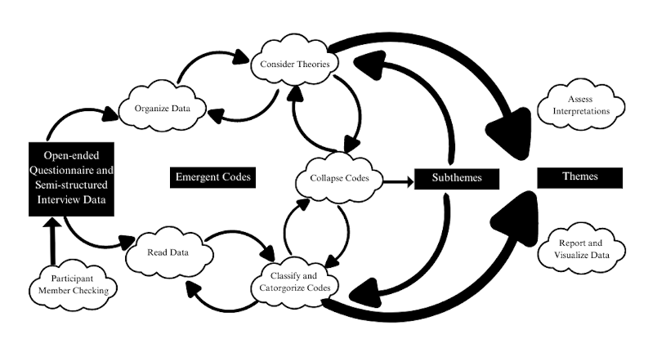
Data Analysis Process
Notes:
In the initial step of the analysis process, I prepared and organized transcripts from questionnaires, interviews, and reflexive field notes.
Following this organization step, I immersed myself in the data, conducting iterative readings where I detected patterns. Multiple readings ensured I understood the data before proceeding to the subsequent analysis steps.
With the patterns identified, I then used Notion and Dedoose for coding the data. Notion served as a database to organize the information, while Dedoose was used to group codes to develop coherent sub-themes and themes.
Once the themes were generated, I analyzed them with consideration of the study’s theories.
I visualized the findings using tables to present complex data in an accessible and understandable way.
Adhering to Creswell and Poth’s spiral approach to data analysis, I was able to revisit any stage of the data analysis process. This non-linear approach acknowledged the evolving nature of qualitative analysis, permitting me to refine codes and themes.
Lastly, I manually organized, coded, and analyzed the material using Dedoose software and a Notion database, identifying 80 distinct occurrence codes. These codes determined the themes within the data, guiding the research findings’ narrative.

Slide 26
Findings and Results

Slide 27

Themes
Engagement
Teaching Effectiveness and Adaptation
Socialization
Barriers
Notes:
The study’s four main themes emerged from the thematic analysis were Engagement, Teaching Effectiveness and Adaptation, Socialization, and Barriers.
Each of these themes provided insights into California instructors’ perceptions of the effect of course modality on the academic achievement of dual-enrolled students.
All four themes were featured in questionnaires and interviews. All four themes also answered all three research questions.

Slide 28

Research Question 1 Results
What are the perceptions of California dual enrollment instructors regarding the effect of course modality on the academic achievement of dual-enrolled students as defined by their grade point average?
Themes
Engagement
Teaching Effectiveness & Adaptation
Socialization
Barriers
Subthemes
Student Involvement & Integration
Institutional Support
Content Delivery
Social Involvement & Integration
Extracurricular Involvement
Access & Equity
Motivation
Technology
Notes:
Research Question 1 was What are the perceptions of California dual enrollment instructors regarding the effect of course modality on the academic achievement of dual-enrolled students as defined by their grade point average?
The research question was aligned with four themes and eight subthemes.
The four themes were engagement, teaching effectiveness and adaptation, socialization, and barriers
which were supported by the following subthemes: student involvement and integration, institutional support, content delivery, social involvement and integration, extracurricular involvement, access and equity, motivation, and technology.

Slide 29
RQ1 Engagement
Theme
Engagement
Subtheme
Student Involvement and Integration
Notes:
In exploring research question 1, the theme of "Engagement" was generated. Engagement was a theme regarding the depth and breadth of dual-enrolled student engagement in online and in-person course modalities. A consensus emerged among participants indicating that engagement had a positive effect on dual-enrolled students' GPAs in in-person courses.
The student involvement and integration subtheme showed the relationship between dual-enrolled student interaction and involvement in online or in-person courses and the dual-enrolled students’ GPAs. All participants agreed regarding the positive effect of student involvement and integration on dual-enrolled students’ GPAs in in-person courses.
The participants’ observations were supported by the reflexive field notes, which strengthened the claim that dual-enrolled students in in-person courses had higher GPAs due to engagement, serving as a form of triangulation that validated the overall findings.
The chart on this slide and the following three slides depicts the number of times the theme and subthemes were mentioned by participants.

Slide 30
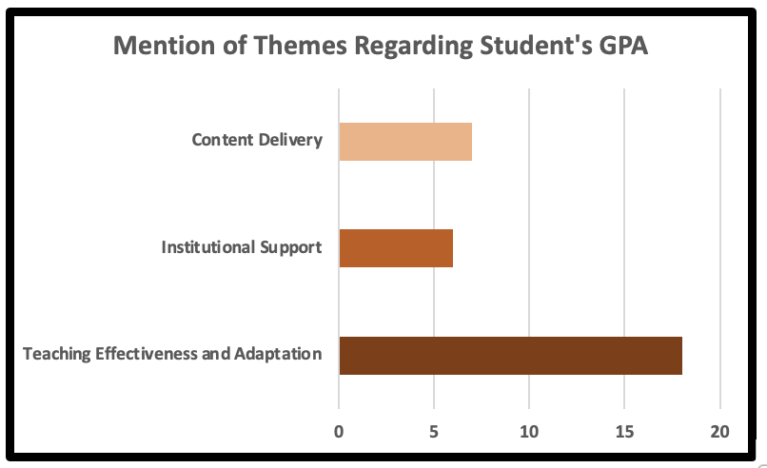
RQ1 Teaching Effectiveness and Adaptation
Theme
Teaching Effectiveness and Adaptation
Subthemes
Institutional Support
Content Delivery
Notes:
The theme of "Teaching Effectiveness" was generated in exploring research question 1. Teaching effectiveness and adaptation was a theme about the efficacy and adaptability of instructional approaches across both online and in-person modalities and the relationship between teaching strategies or adaptations and dual-enrolled students’ GPAs.
Although participants agreed that institutional support had a positive effect on dual-enrolled students GPAs regardless of course modality, there was a diversity of experience among participants about the content delivery in online and in-person courses and the effect on dual-enrolled students’ GPAs.
The reflexive field notes reinforced the idea that strong institutional support promoted more effective teaching adaptations, which positively impacted the GPAs of dual-enrolled students. The reflexive field notes also corresponded to the participants’ varying experiences with content delivery, reinforcing the notion that modality and quality of content delivery affected dual-enrolled students’ GPAs.

Slide 31
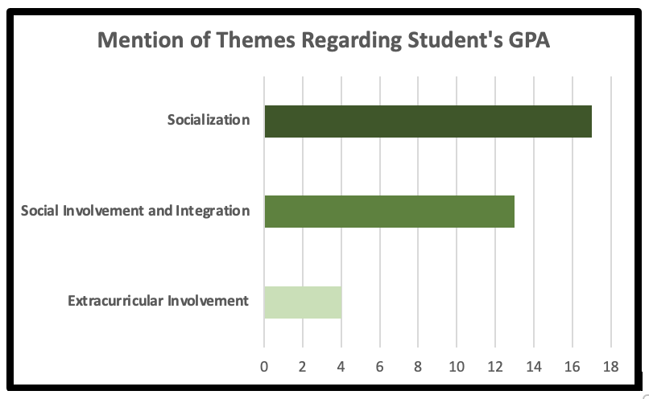
RQ1 Socialization
Theme
Socialization
Subthemes
Social Involvement and Integration
Extracurricular Involvement
Notes:
The theme of "Sociialization" was generated in exploring research question 1. Socialization was a theme about the relationship between social integration, participation in social activities, and dual-enrolled students’ GPAs in the online and in-person modalities.
Participants had a diversity of experiences regarding socialization’s effect on course modality and dual-enrolled students’ GPAs.
Participants’ responses, and reflexive field notes, indicated that if instructors or peers are socially involved with the dual-enrolled students, that may boost GPAs. However, participants shared varied and opposing experiences, on extracurricular involvement and the relationship between dual-enrolled students’ extracurricular activities and academic achievement as defined by GPA.

Slide 32
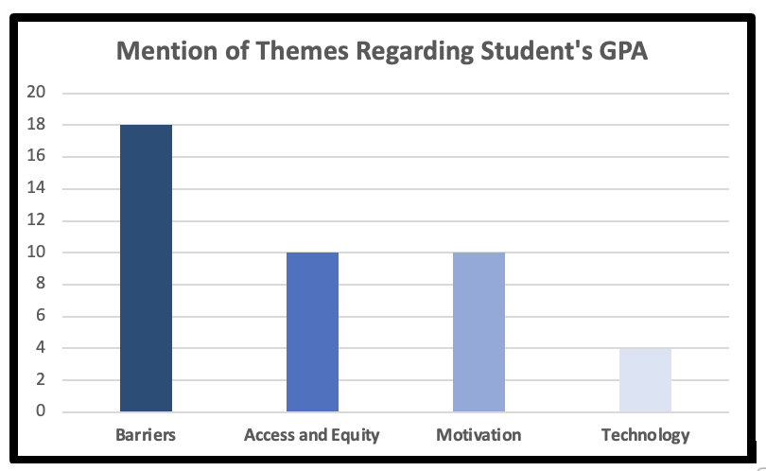
RQ1 Barriers
Theme
Barriers
Subthemes
Access and Equity
Motivation
Technology
Notes:
The theme of "Barriers" was generated in exploring research question 1. Barriers was a theme about the relationship between challenges and academic achievement as defined by GPA of dual-enrolled students in online and in-person modalities. Experiences varied among participants regarding barriers’ effect on course modality and dual-enrolled students’ GPAs.
Although participants were unanimous in their perception that access and equity of online and in-person dual enrollment courses affected students’ GPAs, they shared various experiences regarding motivation and the effect of technology on dual enrolled students’GPA.

Slide 33

Research Question 2 Results
What are the perceptions of California dual enrollment instructors regarding the rigor of dual enrollment course instruction based on course modality?
Themes
Engagement
Teaching Effectiveness & Adaptation
Socialization
Barriers
Subthemes
Student Involvement & Integration
Institutional Support
Content Delivery
Social Involvement & Integration
Extracurricular Involvement
Access & Equity
Motivation
Technology
Notes:
Research Question 2 was, What are the perceptions of California dual enrollment instructors regarding the rigor of dual enrollment course instruction based on course modality?
The research question was aligned with four themes and eight subthemes.
The four themes were engagement, teaching effectiveness and adaptation, socialization, and barriers,
which were supported by the following subthemes:
student involvement and integration, institutional support, content delivery, social involvement and integration, extracurricular involvement, access and equity, motivation, and technology.

Slide 34

RQ2 Engagement
Theme
Engagement
Subtheme
Student Involvement & Integration
CONTRASTING FINDINGS
Notes:
The theme of "Engagement" was generated in exploring research question 2. The engagement theme represented a pattern of engagement in both modalities and its relationship with course rigor. Participants shared varied experiences on the effect of engagement in online and in-person courses on rigor of dual enrollment courses.
Participants also shared varied experiences on the relationship between dual-enrolled student interaction and involvement in online or in-person dual enrollment courses and the rigor of the courses.
Some participants indicated that students in online dual enrollment courses seemed more isolated and disconnected from peers, potentially contributing to perceptions that online dual enrollment courses lacked rigor compared to in-person dual enrollment courses. Other participants and reflexive field notes suggested that online dual enrollment course rigor was not lower than in-person course rigor.

Slide 35

RQ2 Teaching Effectiveness and Adaptation
Theme
Teaching Effectiveness & Adaptation
Subtheme
Institutional Support
Content Delivery
Assessments
VARIED FINDINGS
Notes:
The theme of "Teaching Effectiveness and Adaptation " was generated in exploring research question 2. Teaching effectiveness and adaptation was a theme about the efficacy and adaptability of instructional approaches across both online and in-person modalities and the relationship between teaching strategies or adaptations and the rigor of dual enrollment courses.
Participants shared varied experiences on the effect of teaching effectiveness and adaptation and rigor on academic achievement in online and in-person dual enrollment courses.
A consensus emerged among participants and reflexive field notes that, in both online and in-person modalities, that institutional support for dual-enrolled students positively affected the rigor of online and in-person dual enrollment courses.
Participants shared varied experiences with content delivery and the effect on rigor and academic achievement in online and in-person dual enrollment courses. Participants said the online modality allowed them to increasing rigor, while several participants said that rigor for online tends to be a bit less, and others said rigor in online and in-person is the same.
Participants and reflexive field notes indicated that assessment and rigor, if not aligned, may affect the academic achievement of dual-enrolled students. Although participants agreed that assessments for online and in-person modalities were the same, online assessments became an open-book exam which is an example of where rigor can affect academic achievement.

Slide 36

RQ2 Socialization
Theme
Socialization
Subtheme
Social Involvement & Integration
A CONSENSUS IN FINDINGS
Notes:
The theme of " Socialization" was generated in exploring research question 2. Socialization was a theme about the relationship between social integration, participation in social activities, and the rigor of online and in-person dual enrollment courses. Participants’ experiences suggested the positive effect of socialization on dual enrollment course rigor in online and in-person modalities.
The social involvement and integration subtheme is about participation in discussions and activities, instructor–student and student–student relationships, and course rigor in online and in-person dual enrollment courses.
Participants’ responses indicated that in-person dual enrollment courses were more rigorous than online dual enrollment courses due to the social involvement and integration in person. One participant said they lower the course rigor online, and another discussed the importance of seeing students’ faces to maintain course rigor.

Slide 37

RQ2 Barriers
Theme
Barriers
Subtheme
Access & Equity
Motivation
Technology
VARIED FINDINGS
Notes:
The theme of " Barriers " was generated in exploring research question 2. Barriers was a theme about the challenges, difficulties, and rigor of dual-enrolled courses in the online and in-person modalities. Participants had a diversity of experiences regarding the barriers to rigor in online and in-person dual enrollment courses.
Access and equity was a subtheme about equal opportunities, available resources for online versus in-person dual enrollment courses, and course rigor. Participants shared varied experiences. Some participants discussed that although students may not have equitable access to online dual enrollment courses, the standards of rigor remain the same, regardless of challenges at home. Some participants perceived online courses to be less rigorous because instructors reduced the difficulty of the courses due to dual-enrolled students’ challenges outside the course environment.
Motivation was a subtheme about the relationship between dual-enrolled students’ desire to put forth effort and the rigor of online and in-person dual enrollment courses. Participants’ experiences suggested in-person dual-enrolled students are more motivated than online dual-enrolled students, and in-person dual enrollment courses are more rigorous than online dual enrollment courses.
Technology was a subtheme about the relationship between technology and rigor in online and in-person courses. Participants shared varied experiences with technology’s effect on course rigor. Several participants felt that even with technology problems at home, the standard of rigor does not change. Other participants disagreed and explained that online labs are less rigorous than in-person labs.

Slide 38

Research Question 3 Results
What are the perceptions of California dual enrollment instructors regarding the effect of course modality on the academic achievement of dual-enrolled students as defined by their withdrawal or graduation rate?
Themes
Engagement
Teaching Effectiveness & Adaptation
Socialization
Barriers
Subthemes
Student Involvement & Integration
Institutional Support
Content Delivery
Social Involvement & Integration
Extracurricular Involvement
Access & Equity
Notes:
Research Question 3 was What are the perceptions of California dual enrollment instructors regarding the effect of course modality on the academic achievement of dual-enrolled students as defined by their withdrawal or graduation rate?
The research question was aligned with four themes and six subthemes.
The four themes were engagement, teaching effectiveness and adaptation, socialization, and barriers,
which were supported by the following subthemes: student integration and involvement, institutional support, content delivery, social involvement and integration, extracurricular involvement, and access and equity.

Slide 39

RQ3 Engagement
Theme
Engagement
Subthemes
Student Integration & Involvement
“The online classes have higher dropout rates due to the lack of social interactions.”
“So, when we’re talking about, like, students dropping out or graduating, I’ve got to say, most of my students really stick with it. They stay engaged, whether it’s online or in person, and they graduate, and not just that, but with good GPAs, too.”
Notes:
The theme of "Engagement" was generated in exploring research question 3. Engagement was a theme about how online and in-person modalities relate to dual-enrolled students’ engagement and persistence. Participants shared varied experiences on the effect of engagement in online and in-person courses on the withdrawal and graduation rates of dual-enrolled students.
The student involvement and integration subtheme is about the relationship between online and in-person dual-enrolled students’ involvement, integration, withdrawal, and graduation rates. Participants shared varied experiences and reflexive field notes supported this sentiment.
Regarding student involvement and integration and the relationship between withdrawal and graduation rates, participants perceived online dual enrollment courses to have lower persistence rates than in-person dual enrollment courses. On the contrary, some participants said that involved students, online and in person, graduate with good GPAs.

Slide 40

RQ3 Teaching Effectiveness and Adaptation
Theme
Teaching Effectiveness & Adaptation
Subthemes
Institutional Support
Content Delivery
"Online has a slightly better retention rate.”
“Online classes have higher dropout rates due to the lack of . . . institutional support.”
Notes:
The theme of " Teaching Effectiveness and Adaptation " was generated in exploring research question 3. Teaching effectiveness and adaptation was a theme about teaching methods in online and in-person modalities and the relationship between teaching strategies or adaptations and dual-enrolled students’ withdrawal and graduation rates. Participants shared varied experiences on the effect of teaching effectiveness and course modality on dual-enrolled students’ withdrawal rates.
Participants’ experiences and reflexive field notes were also varied on institutional support and the relationship between school administrators’ support of dual-enrolled students and instructional adaptation in online and in-person dual enrollment courses. Some participants suggested that online dual-enrolled students have a better retention rates than in-person dual enrolled students. Some participants said that online dual enrollment courses have higher dropout rates due to lack of institutional support.
Participants recounted a range of experiences pertaining to the relationship between content delivery, comprehensiveness, and persistence in online and in-person dual enrollment courses. Some participants indicated that when delivering content cohesively and thoroughly, dual-enrolled students’ dropout and graduation rates were the same for both modalities. However, one participant said that content delivery was not the main concern, but rather the lack of student’s maturity.

Slide 41


RQ3 Socialization
Theme
Socialization
Subtheme
Social Involvement & Integration
“The online classes have higher dropout rates [compared to in-person classes] due to the lack of social interactions.”
Notes:
The theme of " Socialization" was generated in exploring research question 3. Socialization was a theme about the relationship between social integration, participation in social activities, and dual-enrolled students’ withdrawal and graduation rates in online and in-person courses. Participants’ experiences suggested lack of socialization had a negative effect on online and in-person dual-enrolled students’ withdrawal and graduation rates.
The social involvement and integration subtheme is about participation in discussions and activities, instructor–student and student–student relationships, and persistence. Participants indicated the lack of social involvement and integration negatively affected withdrawal rates for online dual-enrolled students.

Slide 42


RQ3 Barriers
“I worry that online students don’t get as much access to resources. This could contribute to more dropouts.”
Theme
Barriers
Subtheme
Access and Equity
Notes:
The theme of " Barriers " was generated in exploring research question 3. Barriers was a theme about the relationship between challenges, withdrawal, and graduation rates of dual-enrolled students in both online and in-person modalities.
Access and equity was a subtheme about the availability of resources and opportunities in online and in-person dual enrollment courses and their relationship with dual-enrolled students’ withdrawal and graduation rates. Participants’ experiences suggested that online students may have been disadvantaged as they may have had limited access to resources, which could have led to higher withdrawal rates.

Slide 43
Discussions and Conclusions
Notes:
The theme of " Barriers " was generated in exploring research question 3. Barriers was a theme about the relationship between challenges, withdrawal, and graduation rates of dual-enrolled students in both online and in-person modalities.
Access and equity was a subtheme about
the availability of resources and opportunities in online and in-person dual enrollment courses and their relationship with dual-enrolled students’ withdrawal and graduation rates. Participants’ experiences suggested that online students may have been disadvantaged as they may have had limited access to resources, which could have led to higher withdrawal rates.

Slide 44
Connections to Previous Literature
Confirm
The in-person modality is more effective for dual enrolled students’ GPAs due to greater engagement (Liu et al., 2020; Paul & Jefferson, 2019).
In-person dual enrollment courses are more rigorous than online dual enrollment courses (Alsup & Depenhart, 2020).
The in-person modality increases withdrawal and graduation rates of dual enrolled students due to engagement (Alsup & Depenhart, 2020; Moore & Williams, 2022).
Differ
The online modality is more effective for dual enrolled students’ GPA.
Online dual enrollment courses are more rigorous than in-person dual enrollment courses.
The online modality increases dual-enrolled students’ retention and persistence.
Extend
The importance of engagement, teaching effectiveness, socialization, and barriers affecting dual enrolled students’ GPAs in online and in-person modalities.
Dual enrollment course rigor is dependent on engagement, teaching effectiveness, adaptations, socialization, and overcoming barriers
The importance of engagement, teaching effectiveness, socialization, and barriers in effecting withdrawal and graduation of dual-enrolled students in online and in-person modalities.
Notes:
Existing research on dual enrollment has underexplored course modality’s effect on academic achievement, prompting this qualitative study.
Previous research confirms the study's finding in understanding the effect of course modality on the academic achievement of dual-enrolled students. This qualitative study confirms Liu and Paul and Jefferson’s previous research that suggested the in-person modality is more effective for dual enrolled students’ GPAs due to greater engagement. Additionally, dual enrollment courses are more rigorous than online dual enrollment courses as noted by Alsup and Depenhart, and the in-person modality increases withdrawal and graduation rates of dual enrolled students due to engagement as reported by Alsup and Depenhart and Moore and Williams. .
In contrast to some findings, other studies differ from the study’s findings as they suggested that the online modality is more effective for dual-enrolled students’ GPAs. Previous literature found online dual enrollment courses are more rigorous than in-person dual enrollment courses, which also differs from the study’s findings. Finally, previous researchers discovered that the online modality increases dual-enrolled students’ retention and persistence, contrary to the study’s findings.
The study extends the findings in the literature by highlighting the importance of how engagement, teaching effectiveness, socialization, and barriers affect dual enrolled students’ GPAs in online and in-person modalities. It also emphasizes that dual enrollment course rigor is dependent on engagement, teaching effectiveness, adaptations, socialization, and overcoming barriers. Additionally, the study underscores the importance of engagement, teaching effectiveness, socialization, and barriers in effecting withdrawal and graduation of dual-enrolled students in online and in-person modalities.

Slide 45
Implications for Leadership
Theoretical Implication
Customized student engagement strategies
Address knowledge gaps
Practical Implication
Targeted instructor training and resources
Policy Implication
Coordinated policies for equitable access.
Social Implication
Engagement to close diverse achievement gaps.
Notes:
The findings suggest a theoretical implication for leadership. There is a need for customized engagement strategies that consider the course modality—whether online or in-person—for dual-enrolled students. There is also a need for different approaches to integration and involvement for dual-enrolled students, which is consistent with the theories established by Tinto and Astin.
Further research is needed to fill the existing knowledge gaps in how to involve students who are dual-enrolled to understand what strategies are most effective.
As a practical implication for leadership, is important for leaders to provide specialized training and resources to instructors on both online and in-person modalities for dual enrollment courses. This will empower instructors to better engage students in dual enrollment courses, enhancing the learning experience and outcomes.
The findings suggest a policy implication for leadership. Policies and practices must be in sync to have equitable access and engagement for dual-enrolled students. Synchronization is key to ensuring all dual-enrolled students have the same opportunities for success.
As a social implication for leadership, achievement gaps can be closed by building engagement among dual-enrolled students. Engagement is a step towards educational equity and improving the overall academic achievement of dual-enrolled students, whether online or in-person.

Slide 46

Recommendations for Future Research
Practitioners
Professional development
Tailored training for instructors
Virtual communities for dual-enrolled students
Integration and involvement strategies
Notes:
Recommendations for future practitioners are the following:
Practitioners should provide professional development on relationship-building, teaching methods, and content delivery suitable for online and in-person dual enrollment courses.
They should train instructors in pedagogical strategies tailored to online and in-person to improve engagement, integration, involvement, and achievement of dual-enrolled students.
Practitioners should establish virtual communities to increase connections and participation for online dual-enrolled students.
Finally, they should implement integration and involvement strategies like virtual office hours, discussions, multimedia content online, hands-on learning, and rapport-building in person.

Slide 47

Recommendations for Future Research (Continued)
Researchers
Mixed-methods designs
Modality-specific strategies
Learning management systems (LMS)
Notes:
Recommendations for future researchers are the following:
Future researchers should use mixed methods designs with larger, diverse, multi-site samples and quantitative data on GPAs, withdrawal, and graduation rates to understand the effect of course modality on academic achievement of dual-enrolled students.
They should explore involvement and integration strategies specific to each modality in dual enrollment courses.
Future researchers should also study how optimized learning management systems could support engagement and effective teaching in dual enrollment courses.

Slide 48

Recommendations for Future Research (Continued)
Policymakers
Equal opportunities in policy
Transparent data and resource allocation
Research-driven reforms
Notes:
Recommendations for future policymakers are the following:
Policies should support equal opportunities for academic achievement across diverse dual-enrolled students.
Policymakers should require transparent outcome data and equitable resource allocation to ensure academic achievement for all dual-enrolled students.
Ongoing research can guide reforms that provide academic achievement for online and in-person dual-enrolled students through socialization and extracurricular opportunities.

Slide 49

Growth as a Leader
Personal and Professional Reflection
Developed research skills including literature review, data collection and analysis.
Gained expertise in online learning, dual enrollment, and college access.
Built project management and perseverance skills.
Expanded scholarly writing and APA capabilities.
Deepened critical thinking, curiosity, and humility.
Integrated ethical research practices.
Strengthened time management and work-life balance.
Notes:
In reflecting personally and professionally, I developed vital research skills, including writing a literature review and collecting and analyzing data.
Throughout my journey, I have gained expertise in online learning, dual enrollment, and college access.
Despite challenges, I built project management and perseverance skills, which have been instrumental in completing my research study.
My scholarly writing and APA capabilities have expanded significantly, enhancing the quality of my dissertation.
My critical thinking has deepened, along with curiosity and humility.
Ethical research practices were integrated into all aspects of my study, ensuring integrity and respect for the research process.
Finally, I strengthened my time management and work-life balance.

Slide 51
References
Al Halbusi, H., Williams, K. A., Ramayah, T., Aldieri, L., & Vinci, C. P. (2021). Linking ethical leadership and ethical climate to employees’ ethical behavior: the moderating role of person–organization fit. Personnel Review, (50)1, 159–185. https://doi.org/10.1108/PR-09-2019-0522
Alharahsheh, H. H., & Pius, A. (2020). A review of key paradigms: Positivism vs. interpretivism. Global Academic Journal of Humanities and Social Sciences, 2(3), 39–43. https://doi.org/10.36348/gajhss.2020.v02i03.001
Alsup, P., & Depenhart, J. (2020). College persistence of dual-enrolled high school students when considering modality of dual-enrollment course delivery. Journal of College Student Retention: Research, Theory & Practice, 152102512097395. https://doi.org/10.1177/1521025120973955

Slide 52
References (continued)
An, B. P., & Taylor, J. L. (2019). A review of empirical studies on dual enrollment: Assessing educational outcomes. Higher Education: Handbook of Theory and Research, 99–151. https://doi.org/10.1007/978-3-030-03457-3_3
Astin, A. W. (1984). Student involvement: A developmental theory for higher education. Journal of college student personnel, 25(4), 297–308.
Broeckelman-Post, M., Hawkins, K. H., Arciero, A., & Malterud, A. (2019). Online versus face-to-face public speaking outcomes: A comprehensive assessment. Basic Communication Course Annual, 31(1).
Bryman, A., & Bell, E. (2015). Business research methods (4 th ed.). Oxford University Press.
Creswell, J. W. (2014). Research design: Qualitative, quantitative, and mixed methods approaches. Sage Publications.

Slide 53
References (continued)
Creswell, J. W., & Báez, J. C. (2020). 30 essential skills for the qualitative researcher. Sage Publications.
Creswell, J. W., & Clark, V. L. P. (2017). Designing and conducting mixed methods research. Sage Publications.
Creswell, J. W., & Poth, C. N. (2018). Qualitative inquiry & research design: Choosing among five approaches (4 th ed.). Sage Publications.
Cuthbertson, L. M., Robb, Y. A., & Blair, S. (2020). Theory and application of research principles and philosophical underpinning for a study utilising interpretative phenomenological analysis. Radiography, 26(2), e94–e102. https://doi.org/10.1016/j.radi.2019.11.092
Darko, E. M., Kleib, M., & Olson, J. (2022). Social media use for research participant recruitment: Integrative literature review. Journal of Medical Internet Research, 24(8), e38015. http//doi.org/10.2196/38015:10.2196/38015

Slide 54
References (continued)
Denzin, N., & Lincoln, Y. (2017). The Sage handbook of qualitative research (5 th ed.). Sage Publications.
Faulconer, E. K., Griffith, J. C., Wood, B., & Roberts, D. (2018). A comparison of online, video synchronous, and traditional learning modes for an introductory undergraduate physics course. Journal of Science Education and Technology, 27(5). https://doi.org/10.1007/s10956-018-9732-6
Field, K. (2021). The rise of dual credit: More and more students take college classes while still in high school. Education Next, 21(1), 57.
Gavassa, S., Benabentos, R., Kravec, M., Collins, T., & Eddy, S. (2018). Closing the achievement gap in a large introductory course by balancing reduced in person contact with increased course structure. CBE - Life Sciences Education, 18(1), 8. https://doi.org/10.1187/cbe.18-08-0153

Slide 55
References (continued)
Geana, M. V. (2020). Kansans in the middle of the pandemic: Risk perception, knowledge, compliance with preventive measures, and primary sources of information about COVID-19. Kansas Journal of Medicine, 13, 160. https://doi.org/10.17161/kjm.v13i.13821
Guba, E. G., & Lincoln, Y. S. (1982). Epistemological and methodological bases of naturalistic inquiry. Educational Researcher, 11(8), 8-14. http://dx.doi.org/10.1007/BF02765185
Hayashi, P., Abib, G., & Hoppen, N. (2019). Validity in qualitative research: A processual approach. The Qualitative Report, 24(1), 98–112. https://doi.org/10.46743/2160-3715/2019.3443
Husband, G. (2020). Ethical data collection and recognizing the impact of semi-structured interviews on research respondents. Education Sciences, 10(8), 206. https://doi.org/10.3390/educsci10080206

Slide 56
References (continued)
Ison, M. P., Cicchetti, E., Tolle, M., & Hernandez, T. (2022). One college program, seventy different campuses: Dual enrollment, community colleges, and the unique challenges faced during the COVID-19 pandemic, Community College Journal of Research and Practice, 46(1-2), 85–92. https://doi.org/10.1080/10668926.2021.1974604
Khan, T. H., & MacEachen, E. (2022). An alternative method of interviewing: Critical reflections on videoconference interviews for qualitative data collection. International Journal of Qualitative Methods, 21, 16094069221090063. https://doi.org/10.1177/16094069221090063
Kim, E., Buckley, F., Parham, K., & Wohlstetter, P. (2021). Equity in secondary career and technical education in the United States: A theoretical framework and systematic literature review. Review of Educational Research, (91)2, 56–396. https://doi.org/10.3102/0034654321995243

Slide 57
References (continued)
Kurlaender, M., Reed, S., Grosz, M., Mathias, J., & Hughes, K. (2021). A foot in the door growth in participation and equity in dual enrollment in California. UC Davis Wheelhouse Center for Community College Leadership and Research Brief, (6)7. https://tinyurl.com/26sts4u4Lakens, D. (2022). Sample size justification. Collabra: Psychology, 8(1), 33267. https://doi.org/10.1525/collabra.33267
Lincoln, Y. S., & Guba, E. G. (1985). Naturalistic inquiry. Sage Publications.
Liu, V., Minaya, V., Zhang, Q., & Xu, D. (2020). High school enrollment in Florida: Effects of college outcomes by race/ethnicity and course modality. Community College Research Center Teachers College, Columbia University. https://doi.org/10.7916/d8-thz2-rv77
Longhurst, R. (2003). Semi-structured interviews and focus groups. Key Methods in Geography, 3(2), 143–156. Sage Publications.

Slide 58
References (continued)
Malhotra, N. K. (2006). Questionnaire design and scale development. Sage Publications. https://doi.org/10.4135/9781412973380
Mason, A. J., & Carr, C. T. (2021). Toward a theoretical framework of relational maintenance in computer-mediated communication. Communication Theory. https://doi.org/10.1093/ct/qtaa035
McNamara, C. (2005). Field guide to consulting and organizational development: A collaborative and systems approach to performance, change and learning. Authenticity Consulting Publications.
Merriam, S. B., & Tisdell, E. J. (2016). Qualitative research: A guide to design and implementation (4 th ed.). John Wiley & Sons.

Slide 59
References (continued)
Oakley, E. O. (2021). 2021 Report: College and Career Access Pathways Legislative Report. California Community Colleges Chancellor’s Office. https://tinyurl.com/fknw54tn
Office for Human Research Protections of U.S. Department of Health & Human Services. (n.d.). The Belmont Report.
https://www.hhs.gov/ohrp/regulations-and-policy/belmont-report/index.html
Olwell, R. (2021). A guide to early college and dual enrollment programs: Designing and implementing programs for student achievement. Routledge.
Palinkas, L. A., Horwitz, S. M., & Green, C. A. (2015). Purposeful Sampling for Qualitative Data Collection and Analysis in Mixed Method Implementation Research. Adm Policy Ment Health, (42), 533–544. https://doi.org/10.1007/s10488-013-0528-y

Slide 60
References (continued)
Paul, J., & Jefferson, F. (2019). A comparative analysis of student performance in an online vs. face-to-face environmental science course from 2009 to 2016. Frontiers in Computer Science, (1)7. https://doi.org/10.3389/fcomp.2019.00007
Paulsen, J., & McCormick, A. C. (2020). Reassessing disparities in online learner student engagement in higher education. Educational Researcher, 49(1), 20–29. https://doi.org/10.3102/0013189X19898690
Pretlow, J., Henderson, M., & Caves, L. (2022). Dual enrollment: An institutional view. Community College Journal of Research and Practice, (46)10, 763–767. https://doi.org/10.1080/10668926.2021.1991858
Rodriguez, O., & Gao, N. (2021). Dual enrollment in California: Promoting equitable student access and success. Public Policy Institute of California. https://www.ppic.org/publication/dual-enrollment-in-california/

Slide 61
References (continued)
Saunders, M., Lewis, P., & Thornhill, A. (2019). Research methods for business students (8 th ed.). Pearson
Shah, R. K. (2019). Effective constructivist teaching learning in the classroom. Shanlax International Journal of Education, 7(4), 1–3. https://doi.org/10.34293/education.v7i4.600
Simon, M. K. (2011). Dissertation and scholarly research: Recipes for success, 2011 Ed. Dissertation Success, LLC.
Smith, B. (1999). Ethical and methodologic benefits of using a reflexive journal in hermeneutic-phenomenologic research. Image Journal of Nursing Scholarship, 31(4),359–63.
Spencer, G., & Maldonado, M. (2021). Determinants of dual enrollment access: A national examination of institutional context and state policies. Sage Journals. https://doi.org/10.1177/23328584211041628

Slide 62
References (continued)
Stake, R. E. (1995). The art of case study research. Sage Publications.
Stone, D. H. (1993). Design a questionnaire. British Medical Journal, 307(6914), 1264–1266. https://doi.org/10.1136/bmj.307.6914.1264
Stoneman, P., Sturgis, P., & Allum, N. (2013). Exploring public discourses about emerging technologies through statistical clustering of open-ended survey questions. Public Understanding of Science, 22(7), 850–868. https://doi.org/10.1177/0963662512441569
Tenny, S., Brannan, J. M., & Brannan, G. D. (2022). Qualitative study. Stat Pearls Publishing.
Tinto, V. (1975). Dropout from higher education: A theoretical synthesis of recent research. Review of Educational Research, 45(1), 89–125.

Slide 63
References (continued)
University of Mount Olive. (2022). Defining the scope of your project. https://moc.libguides.com/c.php?g=914117&p=6592685
Villarreal, M. U. (2017). Policy brief: The effects of dual-credit on postsecondary student outcomes. Education Research Center.
West, M. (2022). The impact of COVID-19 on college student perceptions of learning and class grades. Community College Journal of Research and Practice, (46)11, 769–777. https://doi.org/10.1080/10668926.2022.2079024
Westwick, J. N., Hunter, K. M., & and Chromey, K. J. (2018). Assessing markers of student development for dually and non-dually enrolled students in an online basic public speaking course. Basic Communication Course Annual, (30)7, 76–108.

Slide 64
References (continued)
Yang, J. (2020). American students’ cultural adjustment in China. Journal of International Students, 10(1), 106–123. https://doi.org/10.32674/jis.v10i1.764
Yin, R. K. (2014). Case study research: Design and methods (5 th ed.). Sage Publications.

