Slide 1

Restoring Function and Resilience in Functional Neurological Disorder
Jarhed Peña, PhD, LPC, CRC
Cameron Paxton, MA, LLP
Recovery and Balance

Slide 2
Who we are
Jarhed Peña, PhD, LPC, CRC
Psychotherapist
Cameron Paxton, MA, LLP
Psychotherapist
1

Slide 3
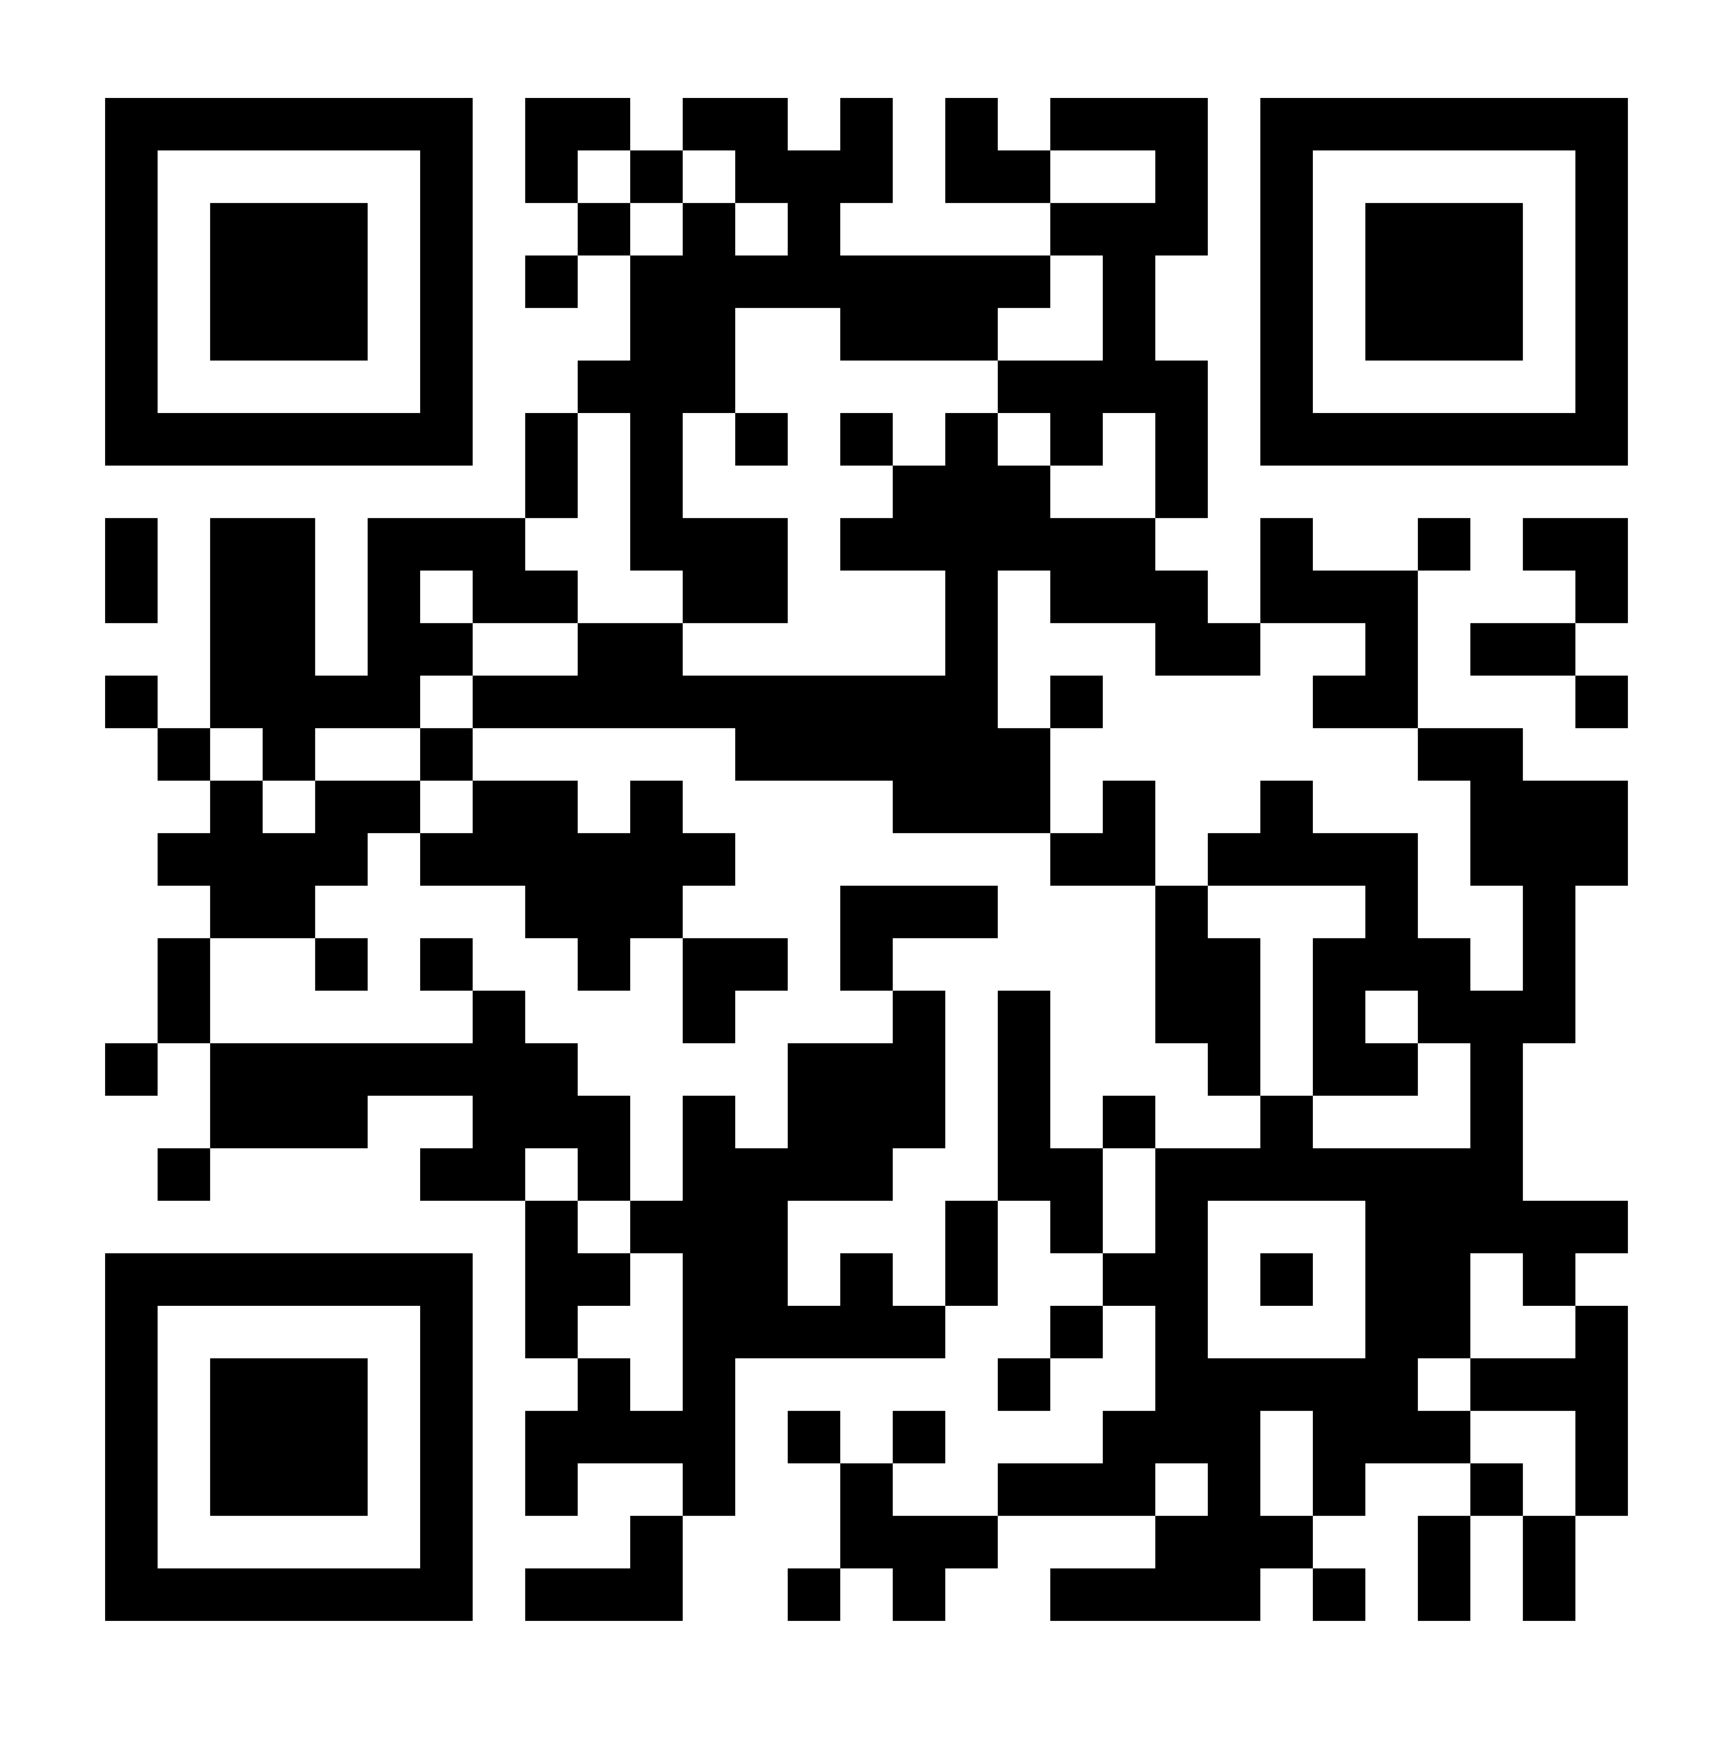
Download this document
2

Slide 4
Agenda
What is Functional Neurological Disorder (FND)?
Why is it that we can’t improve clinical outcomes using the biomedical model alone?
How should the treatment be provided?
7 Strategies to build the patient’s resilience in treatment
3

Slide 5
What is Resilience?
The nervous system’s capacity to flexibly adapt, regulate, and recover in response to internal and external contexts.
4

Slide 6

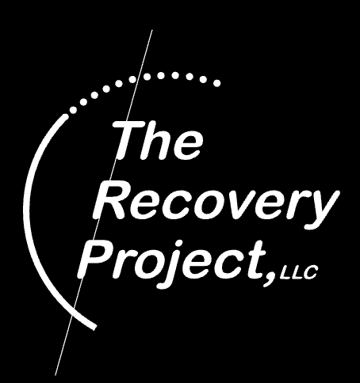
Collab
5

Slide 7
Videos
[put vids here]
6

Slide 8
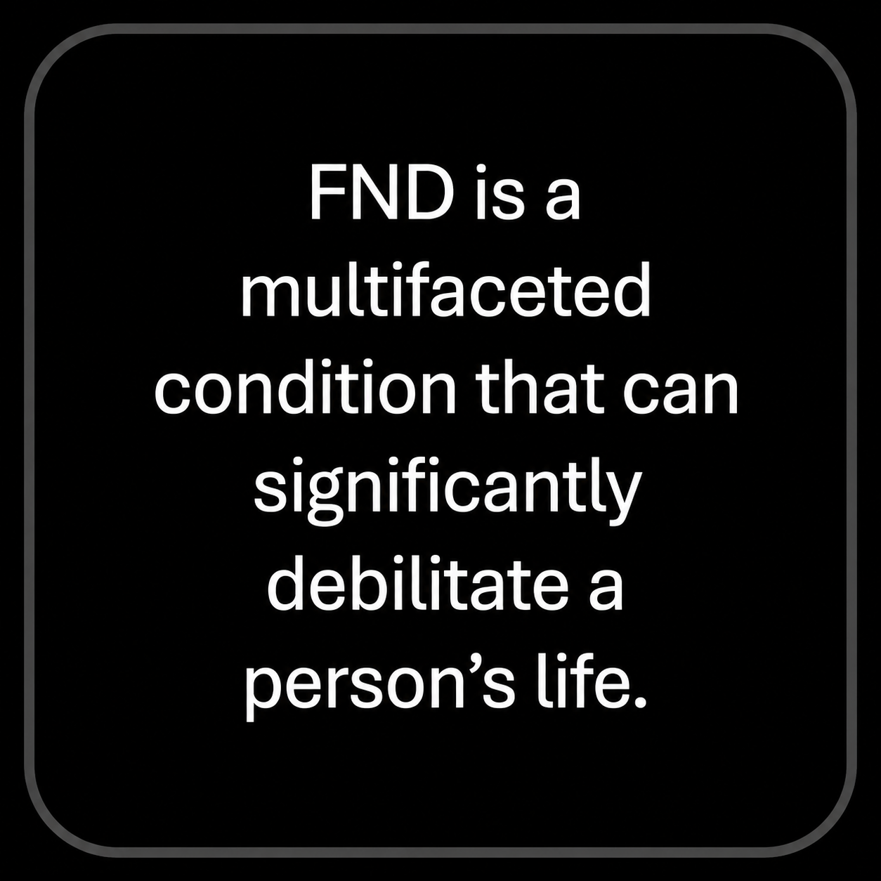
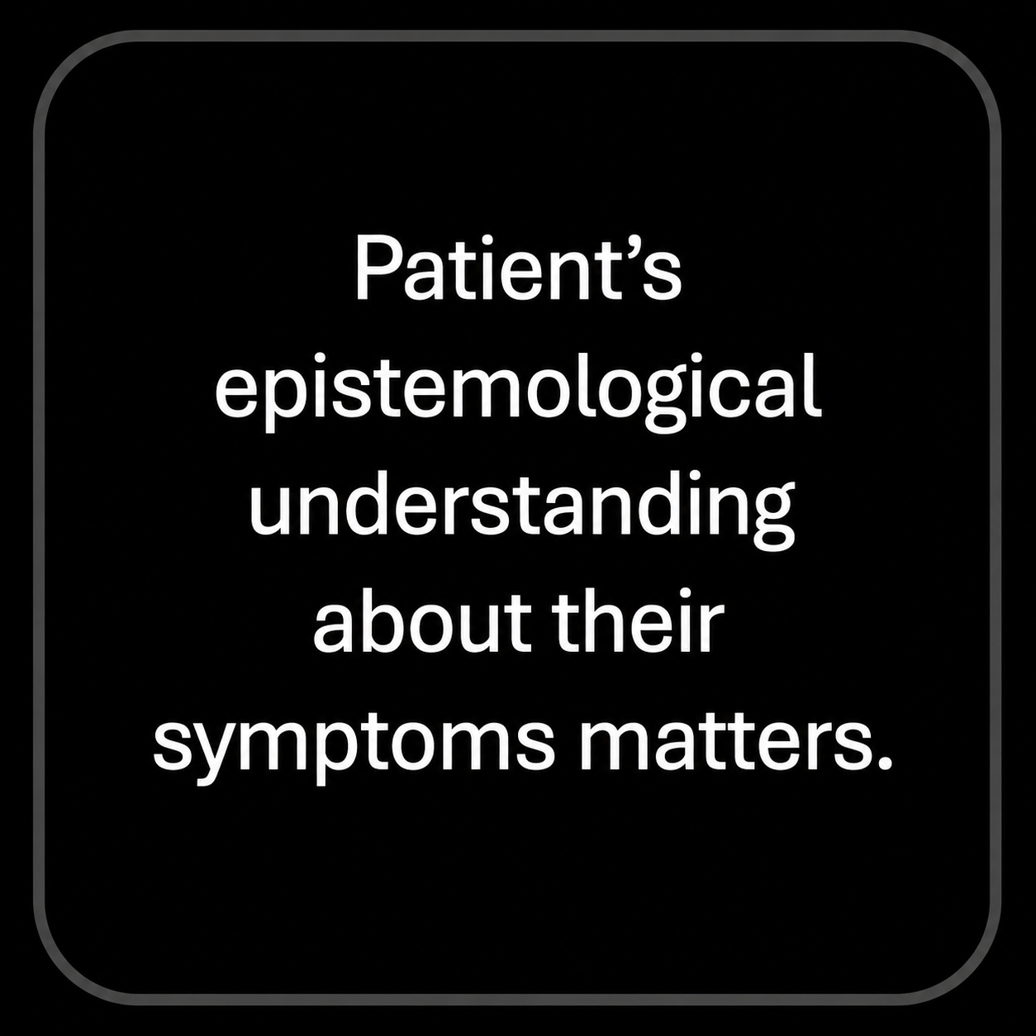
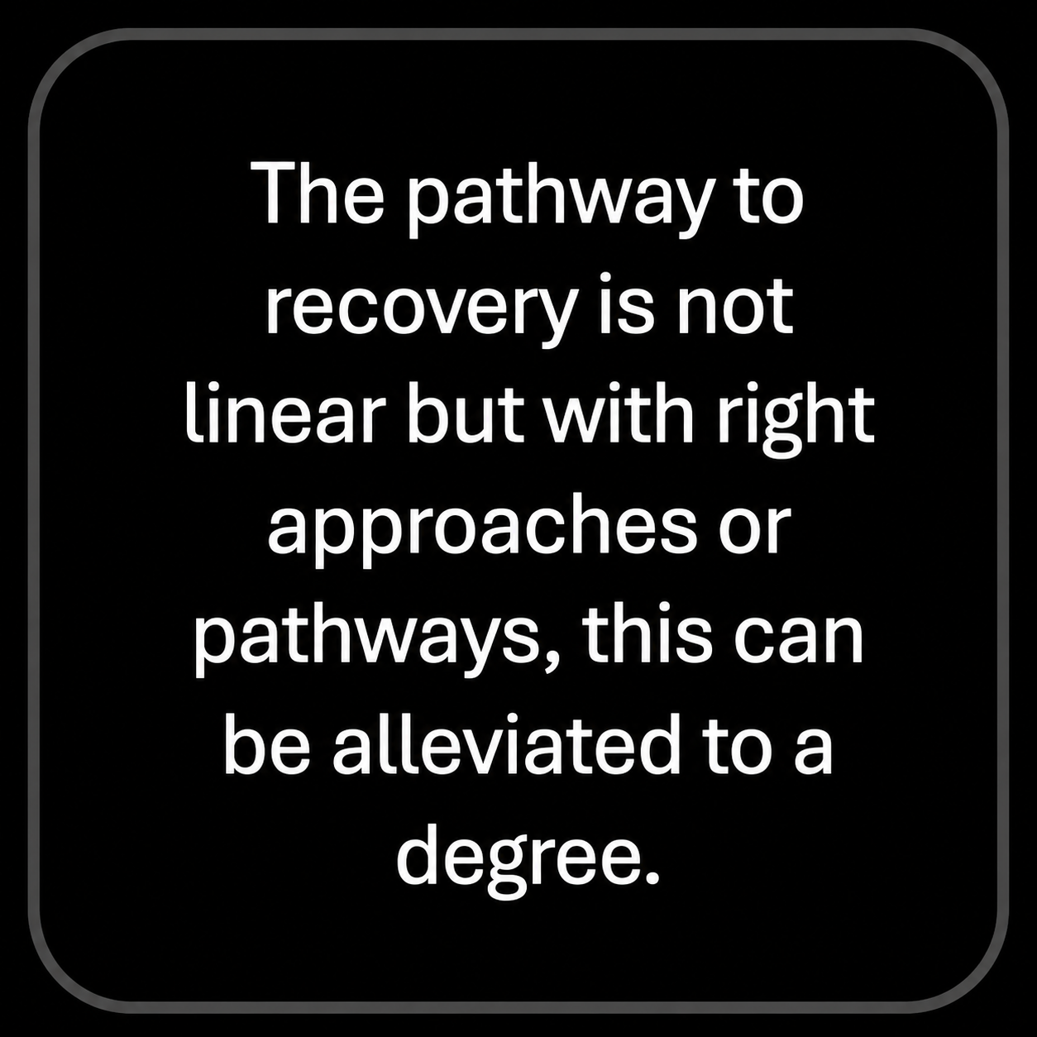
What have we learned?
7

Slide 9

Question #1
What is Functional Neurological Disorder (FND)?
8

Slide 10
History
It was previously called Conversion Disorder and historically referred to as hysteria.
Earlier theories linked FND closely to psychological distress and trauma.
FND has historically been understudied because it falls between neurology and psychiatry.
FND accounts for about 5–15% of neurology presentations.
9

Slide 11
History
Terminology can be convoluted:
Psychogenic Nonepileptic Seizures (PNES)
Functional Seizures
Dissociative Nonepileptic Seizures
Pseudoseizures
10

Slide 12
DSM – IV Criteria
One or more symptoms affecting voluntary motor or sensory functioning.
Symptoms are inconsistent with recognized neurological or medical conditions.
Symptoms are not better explained by another medical or psychiatric disorder.
Symptoms cause significant distress, impairment, or require medical evaluation.
11

Slide 13
DSM – IV Criteria (cont.)
Common Symptom Types
Weakness or paralysis
Abnormal movements
Swallowing symptoms
Speech symptoms
Seizures or attacks
Sensory loss or numbness
Visual, hearing, or smell disturbances
12

Slide 14
DSM – IV Criteria (cont.)
Specifiers
Acute (< 6 months) or persistent (> 6 months)
With or without psychological stressor
13

Slide 15
Rule-In vs Rule-Out
FND is considered a “rule-in” diagnosis, not simply a diagnosis of exclusion.
Diagnosis is based on positive clinical signs that indicate functional symptoms.
14

Slide 16
Rule-In vs Rule-Out
Common Clinical Indicators
Functional tremors may decrease or change with distraction.
A patient may be unable to move a limb in one task but use the same muscles normally in another movement.
Hoover’s sign: hip weakness improves when the opposite leg is activated against resistance.
15

Slide 17
Rule-In vs Rule-Out
PNES indicators may include:
Eyes remaining closed during episodes/resist attempts at opening
Non-synchronous limb movements
Bilateral movements with preserved awareness
Vocalizations during attack
Longer duration
Rapid recovery/lack of confusion upon recovery
Specific behaviors on recovery: blinking/shaking head, looking around, question of "what happened?"
16

Slide 18
Etiology
FND is understood as involving biological, psychological, and social factors.
These factors may affect emotional processing, attention, body awareness (interoception), sense of control (agency), and predictive processing.
Bayesian / Active Inference Model
One major theory suggests FND results from inaccurate brain predictions about bodily sensations and movement.
The brain constantly predicts sensory input based on past experiences and updates those predictions using new sensory information.
In FND, this predictive process becomes disrupted, leading to a mismatch between sensory input and the brain’s expectations.
Emotional dysregulation may increase FND symptoms because emotional signals overly influence these predictions.
Neuroimaging studies have linked FND to altered limbic and salience network functioning.
17

Slide 19
Etiology
I often describe this to patients as a language mismatch:
Brain: “Marche tout droite, corps” (“Walk straight ahead, body”)
Body: translating imperfectly, hears “right,” turns right, and loses balance.
Brain: “Pourquoi on a tourne a droite?!” (“Why did you turn right?!”)
Body: “Because you said ‘right’!”
18

Slide 20
Complicating Factors
Trauma or stressful life events may contribute to FND, but are not required for diagnosis.
Chronic stress and increased allostatic load may play a role.
Symptoms are often variable and may change over time.
Anxiety, depression, PTSD, and suicidality are more common.
Cluster B personality traits may be present.
Physical conditions (e.g., insomnia, IBS) are commonly comorbid.
Neurological conditions may co-occur (e.g., epilepsy and PNES).
19

Slide 21
Complicating Factors
FND can occur across the lifespan:
PNES commonly begins ages 20–29
Motor symptoms commonly begin ages 30–39
FND is more common in women.
Prognosis
Better outcomes are linked to shorter symptom duration and acceptance of the diagnosis.
Poorer outcomes are associated with maladaptive personality traits, medical comorbidities, and disability status.
Disability benefits do not necessarily indicate malingering.
Younger children may have better outcomes than adolescents or adults.
20

Slide 22
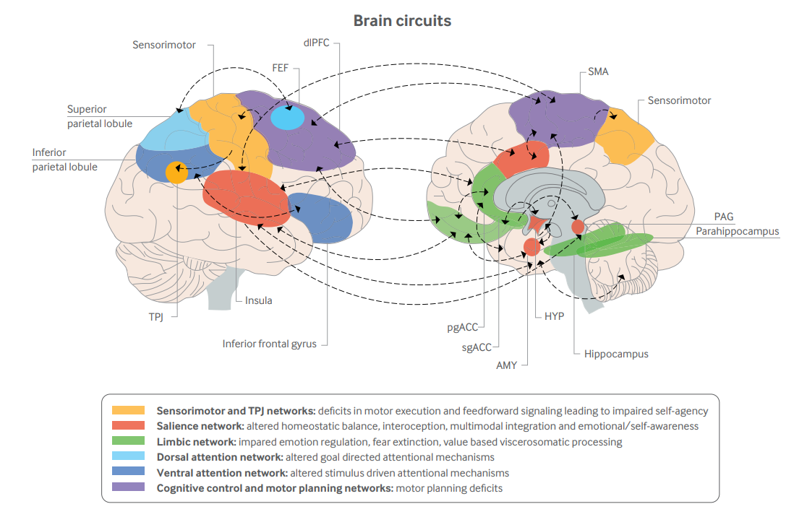
The Brain
21
Aybek& Perez (2023)

Slide 23
Brain Networks Affected
FND is considered a multi-network brain disorder affecting movement, attention, emotion, body awareness, and sense of control (agency).
These brain systems overlap and do not function independently.
Major Networks Associated with FND
Sensorimotor / TPJ Networks
Linked to movement control and sense of agency.
Salience Network
Involved in interoception, emotional awareness, and detecting important bodily signals.
Limbic Network
Associated with emotional regulation, fear processing, and stress responses.
Dorsal Attention Network
Supports goal-directed attention.
Ventral Attention Network
Responds to unexpected or external stimuli.
Cognitive Control / Motor Planning Network
Involved in motor planning and executive control.
22

Slide 24
Recent Scientific Findings
Integrated, multidisciplinary treatment is important for recovery (e.g., physiotherapy, psychotherapy, speech therapy, psychiatric support, and medical care).
FND patients report high levels of stigma, including self-stigma and fear of judgment.
About one-third report believing the condition is their fault.
Stigma increases when others view FND as “purely psychological.”
Work-related stigma is reported most strongly.
Research shows altered interoceptive processing in FND, suggesting disrupted integration of bodily signals and attention.
Symptom explanation is important and may influence outcomes.
Patients may not identify with anxiety or depression labels but may relate to difficulties processing emotions.
23

Slide 25
Question #2
Why is it that we can’t improve clinical outcomes using the biomedical model alone?
24

Slide 26
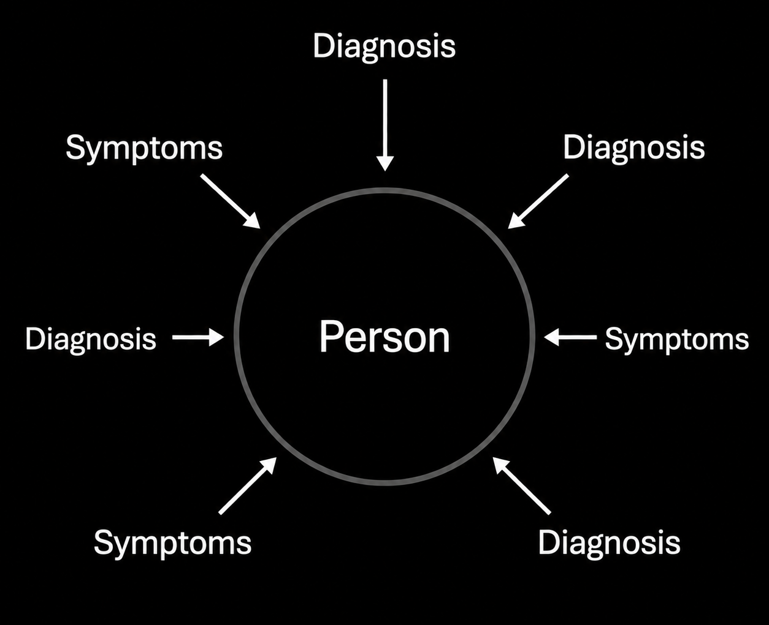
Biomedical Model
25

Slide 27
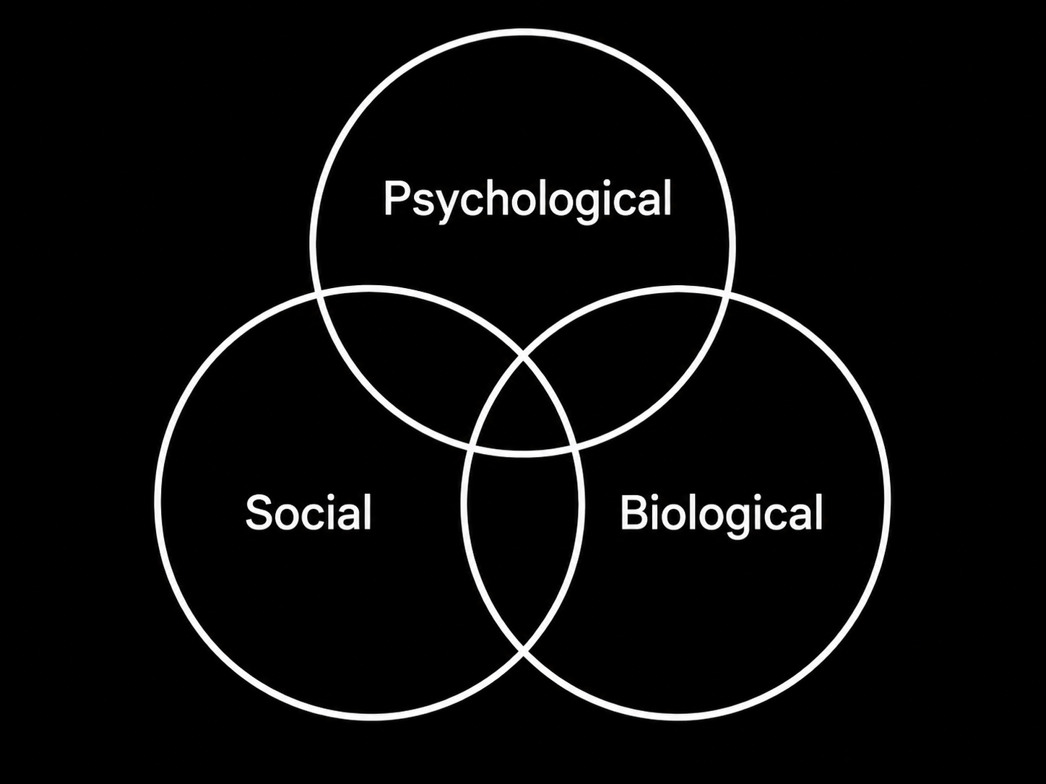
Biopsychosocial Model
(Engel, 1977)
26

Slide 28
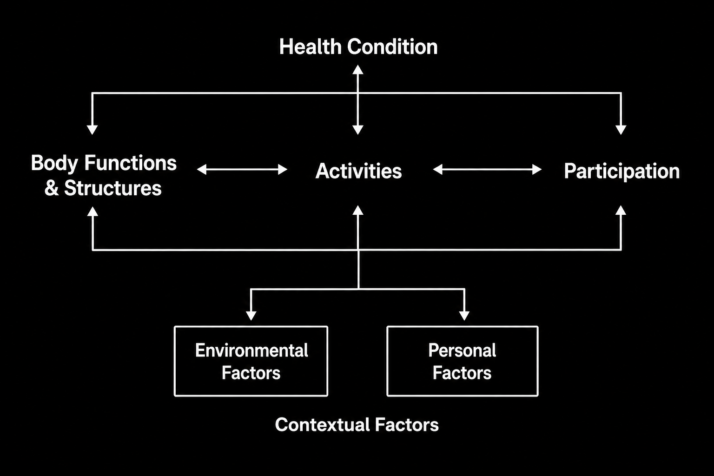
International Classification of Functioning, Disability, and Health
(WHO, 2001)
27

Slide 29
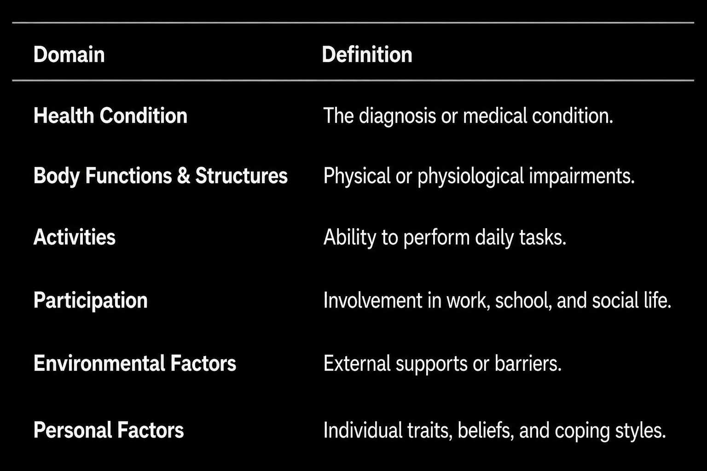
International Classification of Functioning, Disability, and Health
(WHO, 2001)
28

Slide 30
ICF Disability Model
Disability results from interaction between a health condition and environmental, personal, and societal barriers affecting functioning and participation (WHO, 2001).
29

Slide 31
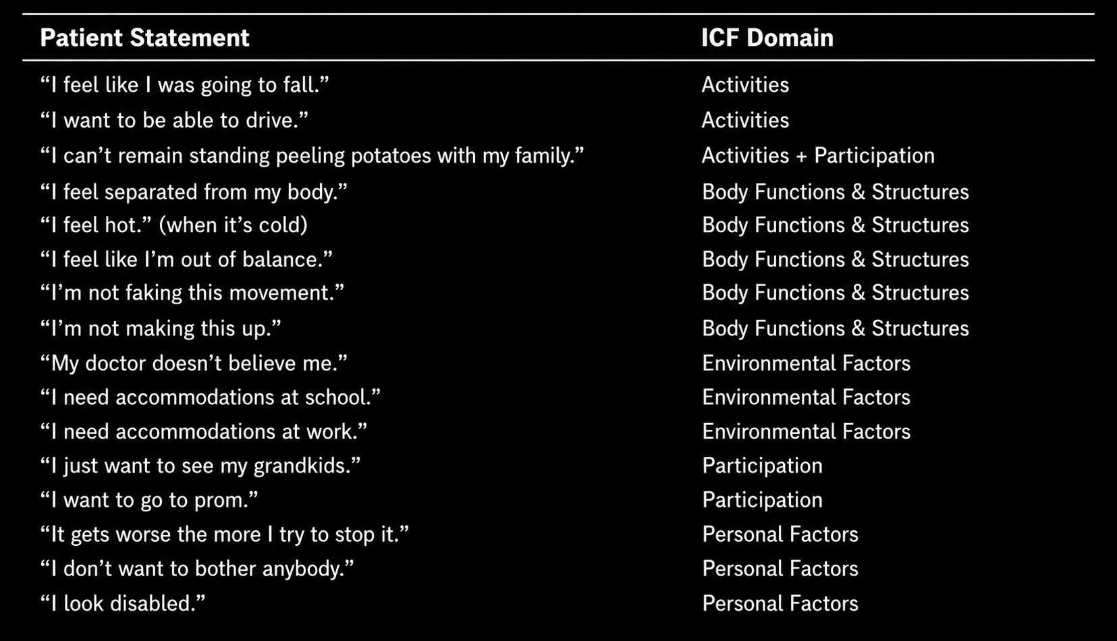
30

Slide 32
Question #3
How should the treatment be provided?
31

Slide 33
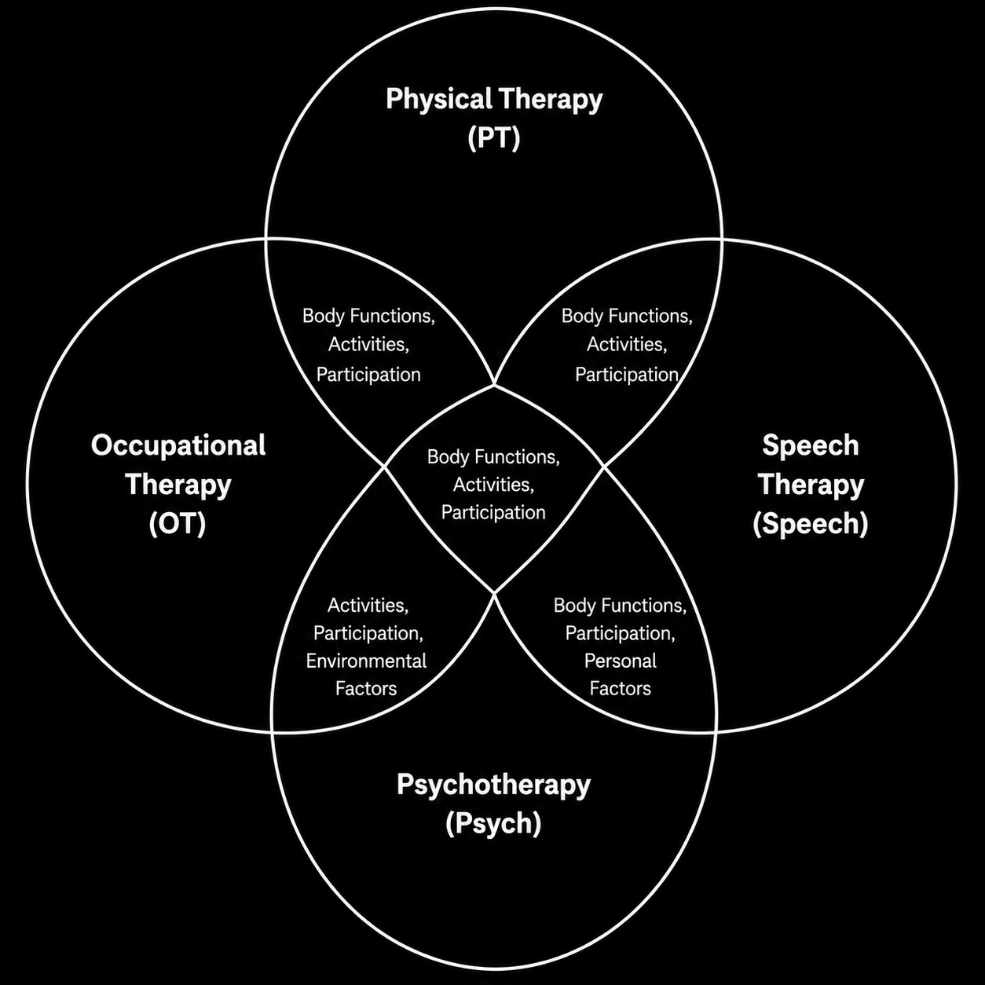
32

Slide 34
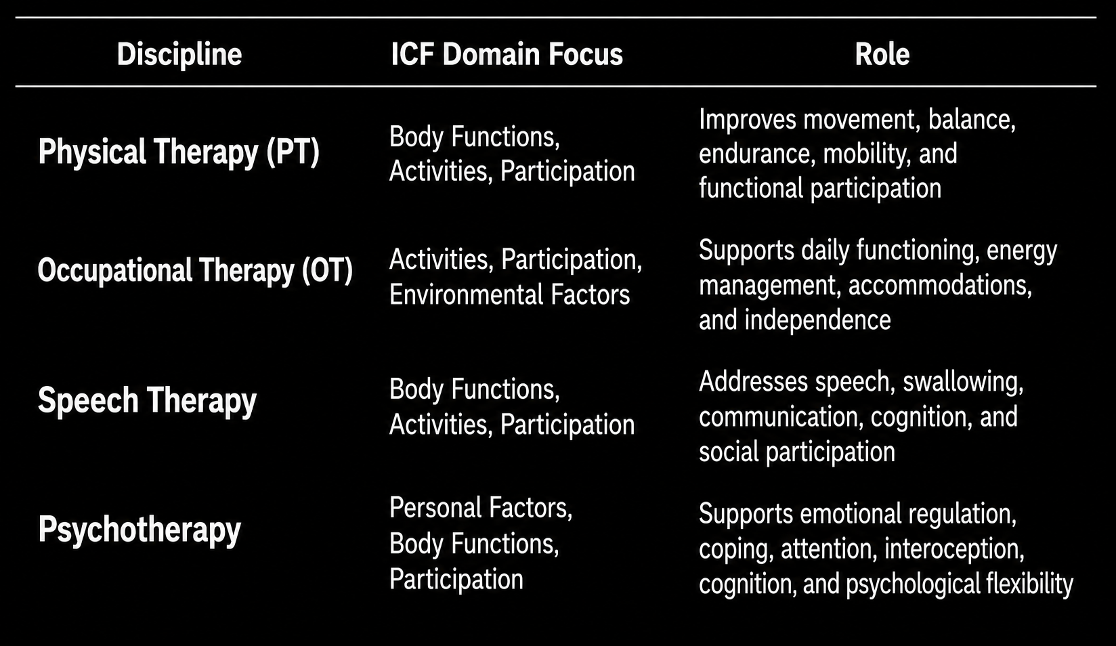
Strategy #1
33

Slide 35
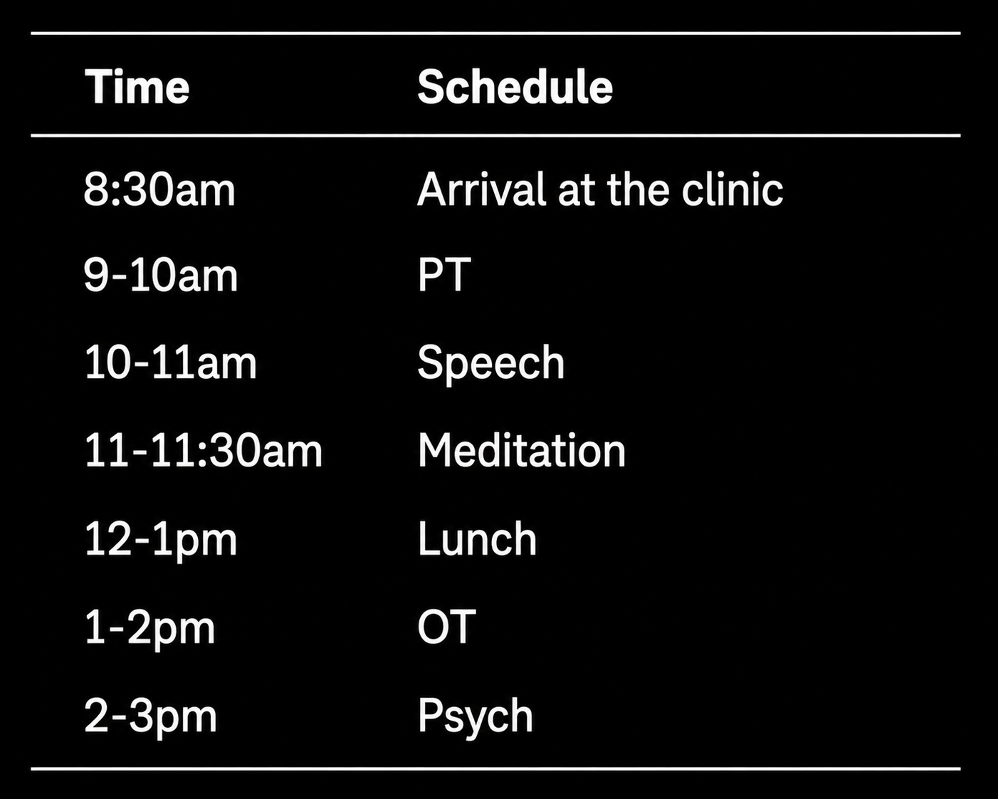
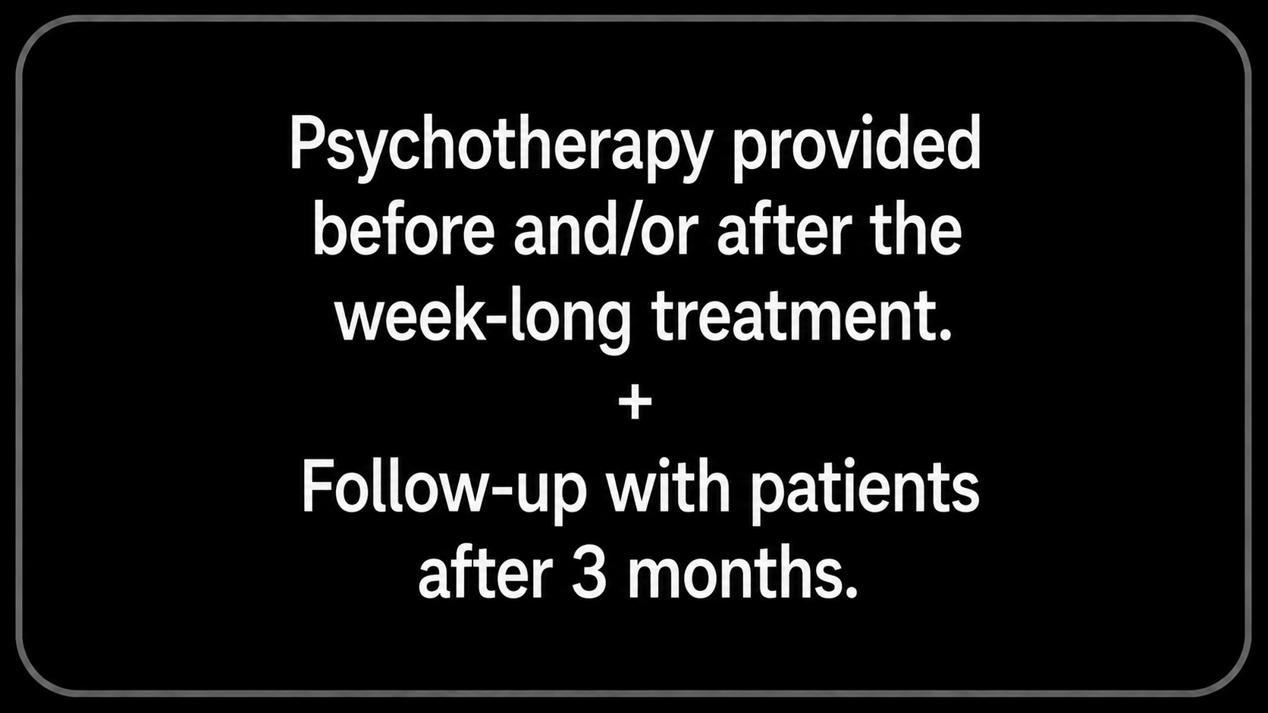
Strategy #2
+
34

Slide 36
Strategy #3
Interoception-focused activities
Mindful Breathing (slow breathing, 8.5-10 bpm)
Purpose:
Enhance interoception
Enhance autonomic flexibility and attention regulation
Teach as a grounding tool
Progressive Muscle Relaxation, Body Scan, and Autogenic Training
Purpose:
Enhance interoception
Enhance volitional control despite of symptoms
35

Slide 37
Strategy #4
Focus on mindfulness during psychotherapy (mainly) but conversations occurring from rehabilitation disciplines also focus on this principle.
Includes: Mindful Breathing and Mindful Movement Exercises
Purpose: teach patients not to be overly attentive (which enhances dysregulation).
36

Slide 38
Strategy #5
Focus on curiosity and play during PT, OT, Speech and encouraged especially during psychotherapy.
Includes: rapport building, tone of voice, encouragement
Purpose: indirectly teach patients not to catastrophize
37

Slide 39
Strategy #6
Help patients make sense of their experience rather than always telling them what is going on
Includes: bridging the patients’ explanation of their experience and disorder symptomatology
Purpose: promotes a person-centered approach
38

Slide 40
Strategy #7
Practical strategies that we’ve seen work
Learning triggers and body sensations
Teach that the process more important than outcome
Mindfulness meditation
Yoga and meditation relaxation
Blowing bubbles for practice extending exhale in breathing
Balloon volley
SoloStep walking
Sensory integration activities (vibration plate, squish mat, shaving cream, sensory bin)
Multi-matrix (game/dual tasking and fine motor control)
Resisted walking/heavy work/weighting/compression
Bal-vis-x (dual tasking bilateral coordination task with auditory cue)
Recognize app (graded motor imagery activity)
Simulated patient selected activities (grocery shopping, cooking, eating, cleaning, sport activities)
Clock yourself app (multidirectional stepping to targets)
Blaze pods (externally focused targets, can be used in a variety of ways)
Outdoor activities to improve community mobility
Social participation with techs or other staff in clinic to improve social interactions
39

Slide 41
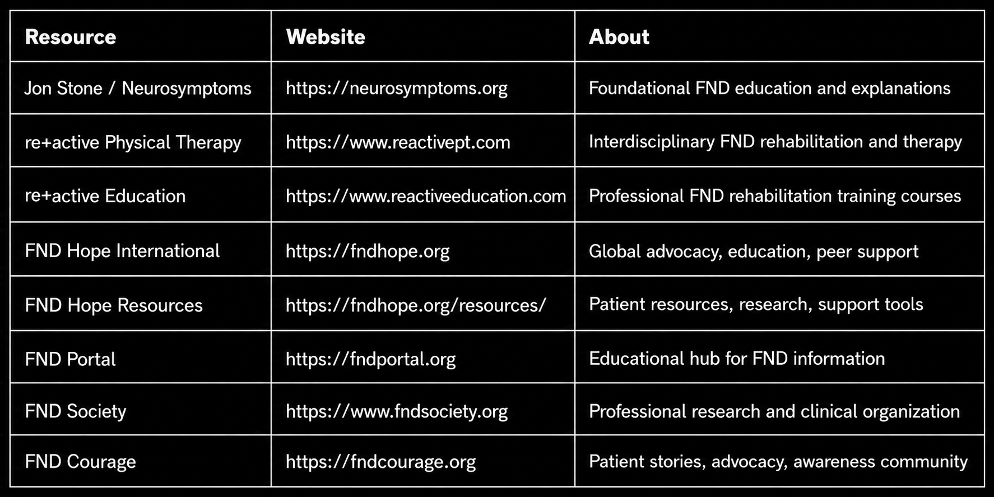
Resources for Patients and Clinicians
40

Slide 42
Download this document
41

Slide 43
References
American Psychiatric Association. (2022). Diagnostic and statistical manual of mental disorders (5th ed., text rev.). https://doi.org/10.1176/appi.books.9780890425787
Americans with Disabilities Act of 1990, 42 U.S.C. § 12101 (2008). https://www.ada.gov/
Aybek, S., & Perez, D. L. (2022). Diagnosis and management of functional neurological disorder. BMJ, 376, o64. http://dx.doi.org/10.1136/bmj.o64
Bennett, K., Diamond, C., Hoeritzauer, I., Gardiner, P., McWhirter, L., Carson, A., & Stone, J. (2021). A practical review of functional neurological disorder (FND) for the general physician. Clinical Medicine, 21(1), 28–36. https://doi.org/10.7861/clinmed.2020-0987
Drane, D. L., Fani, N., Hallett, M., Khalsa, S. S., Perez, D. L., & Roberts, N. A. (2021). A framework for understanding the pathophysiology of functional neurological disorder. CNS Spectrums, 26(6), 555–561. https://doi.org/10.1017/S1092852920001789
Finkelstein, S. A., Diamond, C., Carson, A., & Stone, J. (2025). Incidence and prevalence of functional neurological disorder: A systematic review. Journal of Neurology, Neurosurgery & Psychiatry, 96(4), 383–395. https://doi.org/10.1136/jnnp-2024-334767
Gkintoni, E., Vassilopoulos, S. P., & Nikolaou, G. (2025). Mindfulness-based cognitive therapy in clinical practice: A systematic review of neurocognitive outcomes and applications for mental health and well-being. Journal of Clinical Medicine, 14(5), 1703. https://doi.org/10.3390/jcm14051703
Hallett, M., Aybek, S., Dworetzky, B. A., McWhirter, L., Staab, J. P., & Stone, J. (2022). Functional neurological disorder: New subtypes and shared mechanisms. The Lancet Neurology, 21(6), 537–550. https://doi.org/10.1016/S1474-4422(22)00130-9
Individuals with Disabilities Education Act, 20 U.S.C. § 1400 (2004). https://sites.ed.gov/idea/
Mavroudis, I., Kazis, D., Kamal, F. Z., Gurzu, I. L., Ciobica, A., Pădurariu, M., Novac, B., & Iordache, A. (2024). Understanding functional neurological disorder: Recent insights and diagnostic challenges. International Journal of Molecular Sciences, 25(8), 4470. https://doi.org/10.3390/ijms25084470
42

Slide 44
References
McLoughlin, C., Ramsay, N., Tak, L., Carson, A., & Stone, J. (2026). Stigma in functional neurological disorder: A longitudinal study. Journal of Psychosomatic Research, 203, Article 112550. https://doi.org/10.1016/j.jpsychores.2026.112550
Perez, D. L., Edwards, M. J., Nielsen, G., et al. (2021). Decade of progress in motor functional neurological disorder: Continuing the momentum. Journal of Neurology, Neurosurgery & Psychiatry, 92, 668–677. https://doi.org/10.1136/jnnp-2020-325536
Phillips, W. (2025). Pathophysiology of functional neurological disorder for the general neurologist. BMJ Neurology Open, 7(2), e001309. https://doi.org/10.1136/bmjno-2025-001309
Raynor, G., & Baslet, G. (2021). A historical review of functional neurological disorder and comparison to contemporary models. Epilepsy & Behavior Reports, 16, 100489. https://doi.org/10.1016/j.ebr.2021.100489
Social Security Administration. (n.d.-a). Disability benefits. https://www.ssa.gov/benefits/disability/
Social Security Administration. (n.d.-b). Supplemental Security Income (SSI) benefits. https://www.ssa.gov/ssi/
Stone, J., Coebergh, J., Khoja, L., Butler, M., Nicholson, T. R., & Dodick, D. W. (2025). Migraine and functional neurological disorder (FND): A review of comorbidity and potential overlap. Brain Communications, 7(4), fcaf288. https://doi.org/10.1093/braincomms/fcaf288
Stoffel, N., Mouthon, M., Yang, H., von der Weid, L., Concetti, C., Blanke, O., & Aybek, S. (2026). Attenuated heartbeat-evoked potentials in functional neurological disorder. Brain Communications, 8(1), fcaf503. https://doi.org/10.1093/braincomms/fcaf503
Sverre, K. T., Nissen, E. R., Færver-Vestergaard, I., Johannsen, M., & Zachariae, R. (2023). Comparing the efficacy of mindfulness-based therapy and cognitive-behavioral therapy for depression in head-to-head randomized controlled trials: A systematic review and meta-analysis of equivalence. Clinical Psychology Review, 100, 102234. https://doi.org/10.1016/j.cpr.2022.102234
43

Slide 45
Q&A
44

