Slide 1
Developing Trends in Vaping
Adam Birkenstock, LCSW
Director of Programming
Long Island Council on Alcoholism and Drug Dependence
What parents need to know

Slide 2
The Teen Brain
The parts of the brain that control physical coordination, emotion and motivation develop first.
The part responsible for reasoning and impulse control develops LAST.
What is the average age for people in the US to begin using drugs?
?
?
?
Notes:
Realistic understanding of where their child is at developmentally, to better teach and approach situations. They are fully capable of learning from anyone.

Slide 3
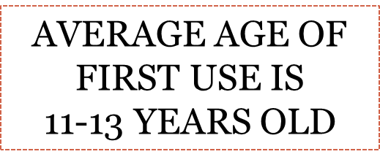
Understanding the Progression
Brief intervention:
Schools, courts, pediatric clinics, emergency rooms, mental health clinics
Brief Interventions
as supplemental
therapy
Intensive Treatment
Dependence
Abuse
Early abuse
Infrequent use
Drug Involvement
Abstinence
Research shows that teens who start drinking before the age of 15 are 4 times more likely to meet the criteria for alcohol dependence at some point in their lives. – NIH, 2017
Adapted from Broadening the Base of Alcohol Treatment (IOM)
Notes:
Treatment options and drug problems are not uni-dimensional concepts. The reality is that there is a range of treatment or intervention options in response to a range of client problems. Specialized or intensive treatment is usually assigned to those individuals at the severe end of a drug involvement spectrum, that is, typically to those who are dependent or addicted to drugs. Brief intervention is most logically indicated when an individual is showing a more mild or moderate version of drug involvement. This is labeled along the drug involvement continuum as early abuse and abuse. Brief intervention techniques can also be used as supplemental therapy within specialized or intensive treatment.
How often or how much would you say these might mean?
Infrequent?
Early use?
Abuse?
Dependence?

Slide 4
Surgeon General’s Latest Advisory: E-Cigarette Use Among Youth – Dec. 18th 2018
https://e-cigarettes.surgeongeneral.gov/documents/surgeon-generals-advisory-on-e-cigarette-use-among-youth-2018.pdf

Slide 5
https://e-cigarettes.surgeongeneral.gov/

Slide 6
https://e-cigarettes.surgeongeneral.gov/

Slide 7
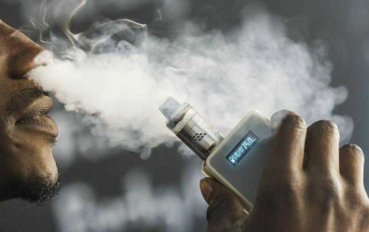
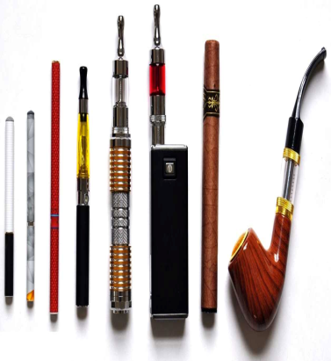
VAPING

Slide 8
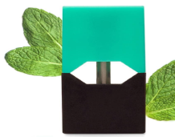
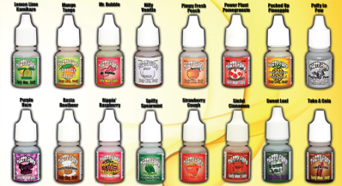
Vaping involves the ingestion of chemicals that are released through the heating of a liquid or plant material via a battery-powered device.
Health Risks Associated with Vaping:
lung Inflammation
respiratory infections
Addiction
Nicotine poisoning
What to look for:
“pods”
Mods: device
Vape Juices
Effects on Sports Performance:
Shortness of breath
Decreased stamina
Difficulty with work outs
Asthma

Slide 9
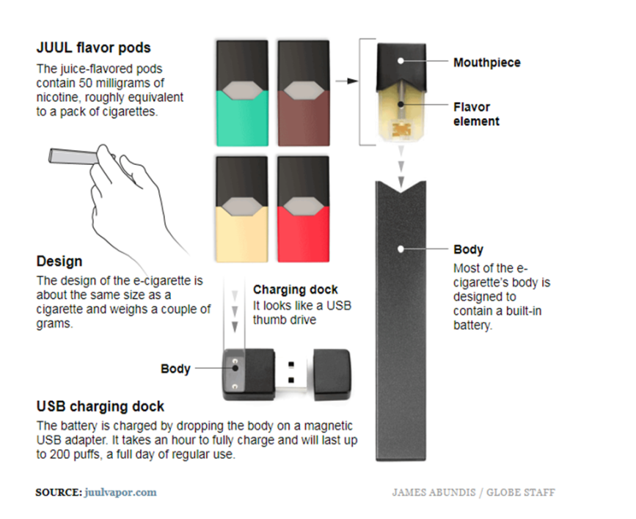
A Juul “starter” kit costs $49.99 if you buy it online from the company. It includes a re-chargeable Juul device, a USB charger, a warranty, and a four-pack of the flavored Juul pods. On its website, the company promises a “powerful vapor experience”.

Slide 10
=

Slide 11
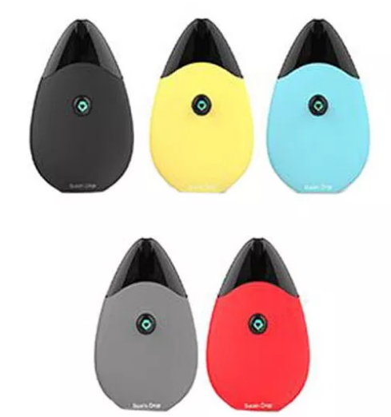

Slide 12
Regulation of E-cigarettes
The U.S. Food and Drug Administration (FDA) announced in 2016 that the FDA will now regulate the sales of e-cigarettes, hookah tobacco, and cigars. Therefore: It is now illegal to sell e-cigarettes, hookah tobacco, or cigars in person or online to anyone under age 18.
Buyers have to show their photo ID to purchase e-cigarettes, hookah tobacco, or cigars, verifying that they are 18 years or older.
FDA regulation also means that the Federal government will now have a lot more information about what is in e-cigarettes, the safety or harms of the ingredients, how they are made, and what risks need to be communicated to the public.

Slide 13
Regulation of E-cigarettes
In Nassau County, Vaping products must now be kept behind the counter in stores where they are sold.
The bill, passed July 9, 2018, also bans advertising vape products at the counter or nearby any candy or toys in stores.
The legal age for purchasing vaping products is 21 in Nassau County.

Slide 14
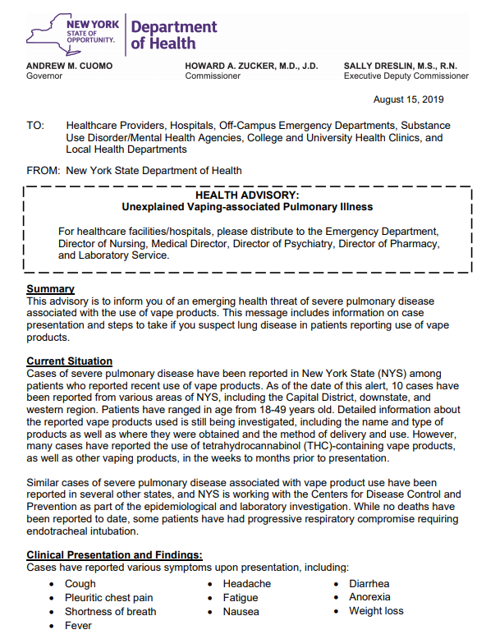

Slide 15
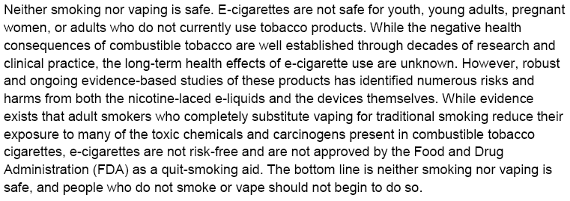
Updated 9/20

Slide 16
Marijuana
Can lead to long-term impairment of memory and learning
Today’s pot is 300% as potent as the pot of the 70’s – oil and dabs are even more potent
THC use, especially at high potency, can lead to psychotic episodes, significant motor impairment, and other MH issues
As of 8/26/19, marijuana is decriminalized in NYS
AKA bud, grass, oil, hash, pot, weed, and more
Use before age 18 is 4 to 7 times more likely to result in problem use – which 30% of users develop
THC (Tetrahydrocannabinol) is the active agent in the high
Impacts mood, reaction time, motor functions, thinking, problem solving and memory

Slide 17
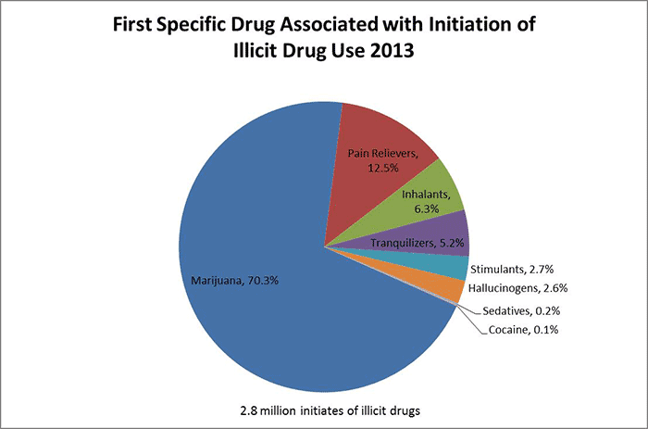
National Institute on Drug Abuse, 2015

Slide 19
NIH Monitoring the Future Study, 2017
1/3 of high school seniors report using some kind of vaping device in the past year
“We are especially concerned because the survey shows that some of the teens using these devices are first-time nicotine users,” Nora D. Volkow, MD, Director of the National Institute on Drug Abuse
“Recent research suggests that some of them could move on to regular cigarette smoking, so it is critical that we intervene with evidence-based efforts to prevent youth from using these products.”
Marijuana use among high school seniors increased from 35.6 percent in 2016 to 37.1 percent in 2017, according to U.S. News & World Report.
The survey also found a decrease in high school seniors’ perceptions of the risk of using marijuana.

Slide 20
Why do people vape?
Curiosity
Pleasure
Avoidance
Experimentation
Traumatic Events
Feelings of isolation
Feelings of despair
Feeling hopeless
Feeling disconnected
Physical pain
Fear
Feelings of grief
Stress
Difficulty coping
Low self-esteem
Depression
Anxiety

Slide 21
1
2
3
WHAT is ADDICTION?

Slide 22
1
2
3
WHAT is ADDICTION?

Slide 23
What do we do?
Feelings of grief
Stress
Difficulty coping
Low self-esteem
Depression
Anxiety
Traumatic Events
Feelings of isolation
Feelings of despair
Feeling hopeless
Feeling disconnected
Physical pain
Fear
Recall the reasons why people may use:
These are the things we must address in our families,
communities and children. Sometimes it is not the
actual presence of a problem, but feelings of grief,
despair or pain that may present as a problem.
For example, when our loved one says,
“You don’t love me,” that doesn’t make it true, but they may feel unlovable.

Slide 24
life gets harder
brains need time to learn school subjects, but also:
how to deal with feelings
how to focus
how to work on problems
how to create
how to plan
Vaping, like any substance, takes our brain’s energy away from learning these things, which is a problem…

Slide 25
Your child’s brain
(or life)

Slide 26
foundation

Slide 28
Where to get help
Syosset Schools Social Work & Guidance
Treatment can be a support for individuals to find sobriety and to address underlying reasons for using.
Community counseling and private counselors can offer assessments and brief counseling to help understand a student’s level of risk.
Support of other people in recovery can foster good coping skills and community, and can build good health habits.
Building connections to their communities in neighborhoods, communities of faith, and families, sometimes with the help of treatment, can be a huge help in managing stresses and pursuing wellness.
516.626.1971
Huntington
888.200.6106
Hicksville
516.935.6858

Slide 29
LICADD SERVICES
You can reach a LICADD clinician 24/7
516-747-2606 Westbury
631-979-1700 Hauppauge
www.licadd.org
Individual and family counseling
Family support and education
Anger Management/Emotional Regulation Counseling
Relapse Prevention Counseling
Connection to Treatment
School-Based Prevention Education
Staff Training
Naloxone Training
Continuing Education for Social Workers and Mental Health Professionals
Community Outreach
Advocacy and Community Partnerships
24-hotline Availability

