Slide 1

34th Annual Vista Bonita Recreation Association Meeting
May 20, 2026

Slide 2
Agenda
Board Member Introductions - All
Presidents Report - Shelah
How to mark email as “okay to receive” - Alexei
Treasurer’s Report - Nicole
Water Report - Larry/Shelah
Lake Ecology Report - Trevor and Nicole
Baker Lake Park Report - Steve
Camino Real Monument - Nicole
Community Events & Needs - Alexei
Questions & Wrap Up - Shelah

Slide 3
Board Member Introductions
Shelah Fred - President
Eileen Van Tilburg - Vice President
Nicole Hoem - Treasurer
Kara Seeber - Secretary (Needed Position)
Alexei Kischuk - Website Admin
Larry Dick - Water Fill Manager
Trevor Dysert - Ecology Committee Chair
Steve Bangs - Park Curator
Communications Director (Needed Position)

Slide 4
President’s Report 2026
We did not have an increase in Dues this year.
However, we will continue to watch inflation and make minimal increases when necessary.
Thankfully, the Association continues to maintain a positive balance sheet which Nicole will share with us later in the meeting.
This year will see 2 main large expenditures for water quality/clarity and insurance premiums.
We provide most of our information via email throughout the year. If you are not receiving emails from us, please talk to a board member to confirm we have your contact information.

Slide 5
President’s Report 2026 (cont.)
Accomplishments in 2025 – 2026
• Maintained adequate water levels in the lake
• Stocked the lake with baitfish, sunfish and bluegills
• Installed new goose fencing and a goose gate on the dock
• Held a successful 2025 Carp Fishing Derby, 4th of July Brunch and Parade, and first Craft Fair
• Completed successful applications for improving lake clarity/quality
• Explored options for Replogle Lake
• Created new, more solid information signs for posting information about upcoming events at the two entrances

Slide 6
President’s Report 2026 (cont.)
Last year, we told you the board would be looking into possibly selling Replogle Reservoir due to changes in how we can utilize the asset to put water in Baker Lake. We are continuing those efforts; however, from what we have learned so far, we may not be able to sell Replogle as it provides us with a required outlet for water per Colorado water law.
Through this process, we are also looking at other ways to make Replogle a financial benefit to us if we are unable to sell it.
Either way, there are things that will need to be done no matter which way the association can go; therefore, we ask you to watch for information via email when we are looking for assistance in things like posting signs and repairing cracks in the dam. We are at the point of needing maintenance on this resource and will need the help of members to complete the tasks.

Slide 7
President’s Report 2026 (cont.)
What Vista Bonita Recreation Association is and is not
Vista Bonita Recreation Association is a recognized association with a legally filed set of by-laws and directives that specifically state what the association is responsible for along with guidelines of securing a board of directors tasked with implementing the by-laws and managing the assets owned by the Association.
Those assets include Baker Lake, Replogle Reservoir, Baker Lake Park, and rights to water via the Poudre River and Windsor Reservoir.
The Vista Bonita Recreation Association is not responsible for Vista Bonita neighborhood, the roads, or the neighborhood entrances. We, the association and board of directors thereof, do not have jurisdiction or responsibility for these areas or anything relating to these areas.

Slide 8
President’s Report 2026 (cont.)
What Vista Bonita Recreation Association is and is not (cont.)
A couple of items may have caused some confusion over our jurisdiction. First, we are responsible for Baker Lake Park and the electricity provided at the pavilion. The electricity is tied into the power at the entrances; thus, VBRA pays the electric bill as the individual usages cannot be separated by the power company.
Second, when maintenance was needed to the entrance monuments, a past board offered to be a monetary financial holder only. Nicole will go into more detail later in the meeting, but for now, that work has been completed and the board will be removing ourselves from that offer once all payment is settled. While that past board had the best of intentions, per our Association by-laws, they probably should not have made the offer. The VBRA board does not have jurisdiction over the entrances and will not be completing any future maintenance financial or otherwise.

Slide 9
President’s Report 2026 (cont.)
What Vista Bonita Recreation Association is and is not (cont.)
The Vista Bonita Recreation Association is not responsible for, nor do we have any jurisdiction over, the roads in our neighborhood. Recently, the board has received questions about a postcard sent by the Larimer County Engineering Department regarding future maintenance/repairs to the neighborhood roads. The VBRA board of directors does not have any additional information about this postcard, what it means, or any future work/costs associated with maintaining the neighborhood roads. Any questions you have should be directed to the individuals and/or departments listed on the postcard. Also, the VBRA board will not be involved in any future work or financial dealings related to maintaining neighborhood roads as this is outside our scope as directed by our association by-laws.

Slide 10
Looking Forward in 2026 – 2027
We will continue critical actions for the community through:
• Keeping Baker Lake as full as possible
• Monitoring water clarity/quality
• Installing a more permanent goose fence for boat ramp
• Completing repairs to our weir
• Addressing Replogle needs
• Improving the boarder around the swing set at the park
• Community events
• Park maintenance

Slide 11



Never Miss a Message!
To receive news about Baker Lake and community updates, please add our email to your Safe List:
This ensures our emails go to your Inbox and not the "Spam" folder.
MAY 20, 2026

Slide 12






3 Simple Steps on Your Computer
1. Open Email
2. Move Mouse
3. Click Icon
Open any email sent to you from VBRA.
Put your mouse over the VBRA email address at the top of the email.
Click the Add to Contacts button in the box that pops up.
That's it! You are all set.
MAY 20, 2026

Slide 13
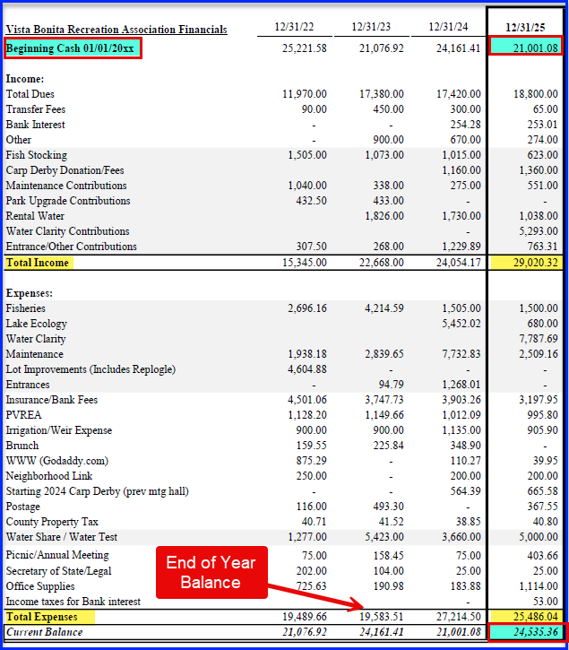
Treasurer’s Report for End of Year 12/31/2025
End of Year Bank Account Balance 12/31/2025:
$24,535.36

Slide 14

Breakdown - Treasurer’s Report
Income for 2025
Normal Dues including Irrigation | $ 18,800
Miscellaneous - Transfer Fees, etc. | 668
Donations | 9,902
 | __________
Total Income | $ 29,370
Miscellaneous included: Irrigation company refunds, Transfer Fees and Bank Interest
Donations increased: Carp Derby - $1,360, Art/Craft Fair - $274, entrance settlement, and generous member contributions!
Overall increase of $1,380 (or 7.9%)

Slide 15
Breakdown - Treasurer’s Report
Spending for 2025
Park and Maintenance & Improvements | $ 2,509
Insurance and Bank Fees | 3,198
Water “rental" (25 days) | 5,000
Fish stocking | 1,500
Water clarity products | 7,788
Lake ecology sample testing (5 months) | 680
Office Supplies, Email/Website, Postage | 1,521
Utilities | 996
Irrigation Fees | 906
Carp Derby prizes and expenses | 564
All Other Administrative and Legal fees | 722
Total Expenses | $ 25,381

Slide 16
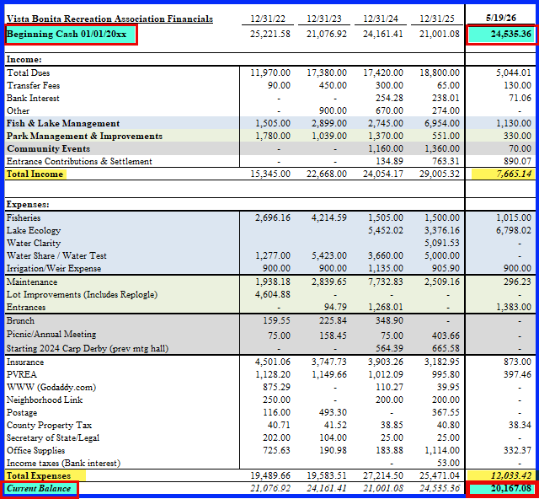
Treasurer’s Report:-
As of 5/19/2026
Current Balance:
$20,167
Income:
Entrance Settlement
Dues Donations
Expenses:
Fisheries
Lake Ecology
Water Delivery
Park Cleanup
Insurance

Slide 17
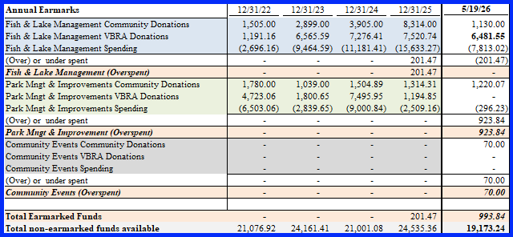
Treasurer’s Report - As of 5/19/2026
Projected Earmarks
2026 Desired Projects & Goals:
Lake Management - treatments for low water levels
Replace timbers around swing set/sandbox

Slide 18
Treasurer’s Report – 2026 New Donation Categories
Fish & Lake Management
Park Management & Improvement
Community Events
This simplifies accounting and fund management.

Slide 19
Summary Treasurer’s Report
2025 VBRA Financials at 5/19/2026
 |  | YTD |  |  | Earmark Balances |  | YTD
Beginning Cash 1/1/2026 |  | $ 24,535.36 |  |  | Fish/Lake Mngt |  | $ 0
 |  |  |  |  | Park Mngt/Impr |  | 924
Income: |  |  |  |  | Community Events |  | 70
 | Normal Dues including Irrigation | 5,044 |  |  | ______________
 | Miscellaneous - Transfer Fees, etc. | 201 |  |  | Total Earmarks $ 994 _______________
 | Donations & Entrance Settlement | 2,420 |  |  | Available Balance $ 19,173
 |  | _______________
Total Income |  | $ 7,665
Expenses:
 | Fisheries (minnows) | 1,015
 | Lake Ecology Product | 6,798
 | Irrigation Company | 900
 | Park Maintenance/Entrances | 1,679
 | Insurance | 873
 | PVREA Taxes | 397
 | Office Supplies/Property | 370
Total Expenses |  | $ 12,033
 |  | _______________
Ending Cash 5/19/2026 |  | $ 20,167

Slide 20
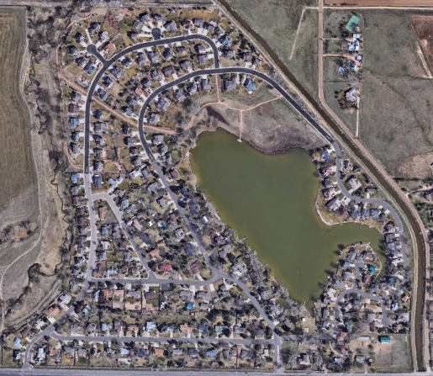
Water Report
Baker Lake
Larry Dick

Slide 21
Water Report (cont.)
Recap: How we get fill water for Baker Lake
1. We own 1 River share and 1 Windsor Reservoir share
2. The River share gives us 2 a/f per day as long as the river runs
a. Seasonal runs averages around 30 days and fills the lake
b. Typically starts in mid to late May
3. The Reservoir share gives us 2 a/f per day for a set number of days
a. LWIC “declares” a set number each year based on conditions
b. It takes 2 shares for a full right so our days are cut in half
c. It has ranged from 10 – 13 days
4. Water comes through the head gate & weir on the NE side of the lake from the canal that runs along the NE side of the development
5. Water Manager contacts the LWIC office and orders water
6. The Ditch Rider manages the head gate flow based on what’s ordered

Slide 22
Water Report (cont.)
Historical data: Baker Lake fills
Year | River Date | Start Level | River Add | Reservoir Add | Season Total | Ending Level
2023 | June 15th | -16.75” | 21.25” | 21.25” | 42.5” | 3.12’
2024 | May 15th | -16.5” | 20.81”* | 32.78” | 53.58” | 3.5’
2025 | May 28th | -19” | 22.62” | 25.38” | 48” | 5’
*Used 11.5” of Replogle water as “swap” water in 2024

Slide 23
Water Report (cont.)
Historical data: (cont)
1. The average amount of water added over the last six years is 49”
2. We typically need and plan for 50” of water yearly
3. We rely on reservoir Rental Water to keep Baker Lake full
4. Reservoir water starts in July
5. Added water 7 times in 2025 including the spring fill
6. We’ve managed to get a late season fill in Oct. for the last three years
7. The 2025 season had 18” of rain, hot weather impacted evaporation
8. Did not swap water with Replogle in ‘25

Slide 24
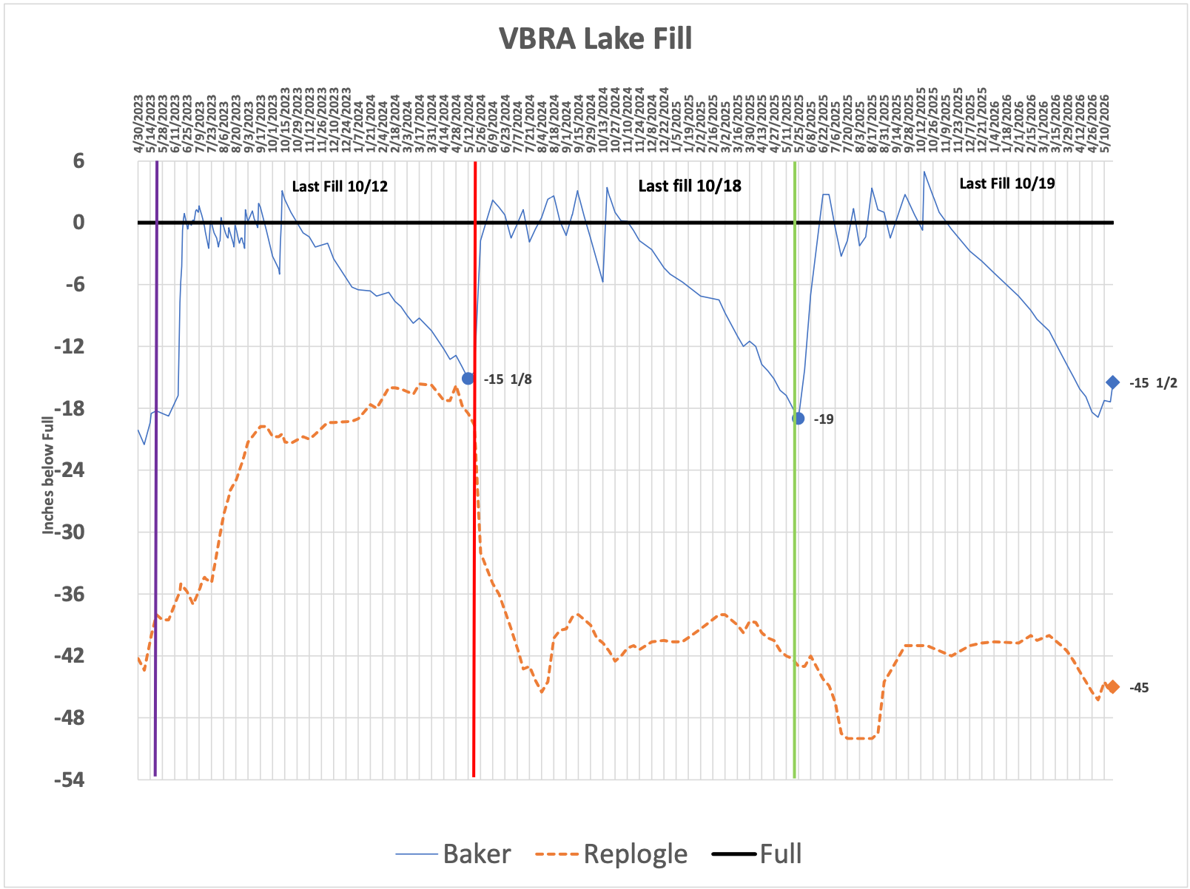
Water Report (cont.)
History of Water Levels- Baker Lake & Replogle Reservoir: Michael Warring

Slide 25
Water Report (cont.)
2025 LWIC Declarations and Purchases
1. The River Run season lasted 33 days, (average length of time)
2. 2025 reservoir water declaration: started at 10 days, ended at 13 days
a. 2 shares = 1 right, 1 right is 2 a/f of water / 24 hours
3. There was no LWIC reservoir rental water available, instead RPW
4. Bought 25 a/f of water from Northern Water @ $200 bid/ a/f ($5000)
5. Received 20 a/f after shrinkage deduction by LWIC (CBT water)
6. Used the entire 20 a/f by last fill
7. Enjoyed a “full” lake for the full season
8. Estimate that local irrigation uses about 10”- 12” of lake water

Slide 26
Water Report (cont.)
Looking forward for 2026
1. The outlook for the lake water this year is BLEAK!
2. May be the worst year since 2002 for water levels
3. LWIC says snowpack is 14%-22% of normal for the ’25-’26 winter
4. Lake level may drop by 48” or more if no natural precipitation
5. VBRA Board will adjust how to manage the lake water usage – which may change on a weekly basis.

Slide 27
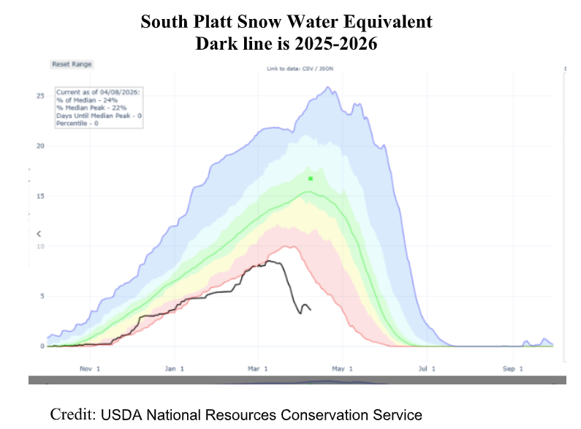
Water Report (cont.)

Slide 28
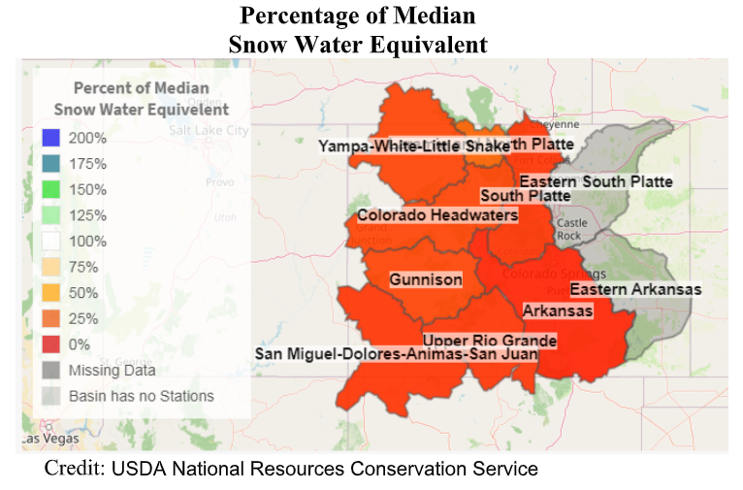
Water Report (cont.)

Slide 29
Water Report (cont.)
Looking forward for 2026 (cont)
1. Minimal River water this year ~ 1.5” total, started 4/12
2. Reservoir share will yield about 6” of water total
3. No Rental water available at this time
4. Water seniority rights may be in effect
5. Irrigation management for Baker Lake residents
6. Possible Replogle water swap, 3:1 ratio
7. Now, about 12” of water depth at the dock in the park
8. 2027 impact could be even more severe than 2026

Slide 30
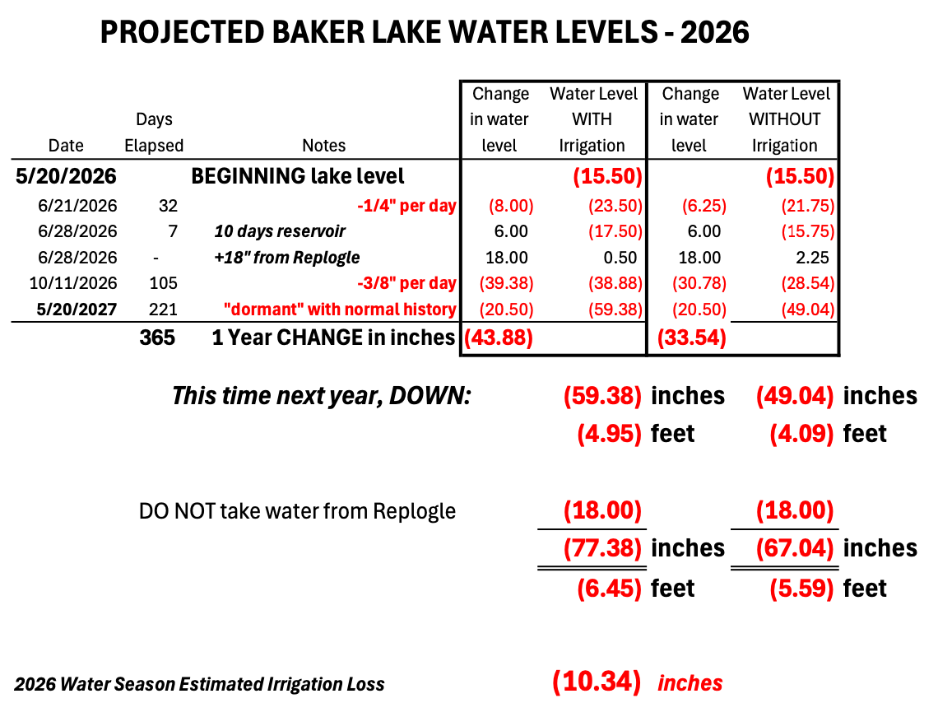
Water Report (cont.)

Slide 31
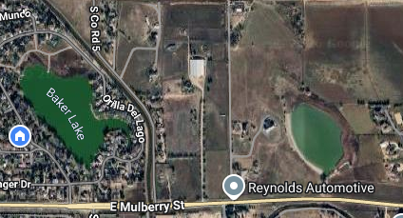
Water Report (cont)
Replogle Reservoir Location

Slide 32
Water Report (cont.)
Looking forward for 2026 (cont)
Replogle Reservoir
1. Replogle has not recovered from water used in ‘24
2. Water level is down about 46”
3. May need to use Replogle water to “swap” with LWIC
4. Usage will be a 3:1 loss/gain ratio
5. Stagnant water is a concern already in late summer
6. Lower water level may allow us to repair the large crack in dam
7. Crack is suspected of leaking water at higher levels

Slide 33
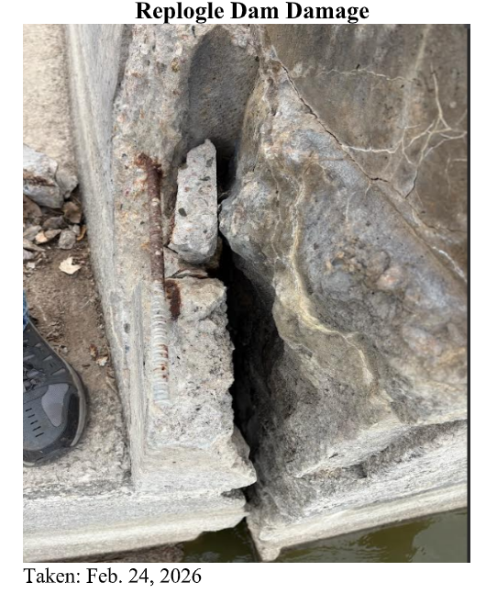
Water Report (cont.)

Slide 34
Water Report (cont.)
So what does all this mean?
Baker Lake may get very low this summer. The board will work diligently and daily to watch water levels and make adjustments as we are able. Our main goal is to keep enough water to maintain the health of the lake. None of us want a stinky lake full of dead fish.
We all need to follow prudent dry weather/drought watering practices.

Slide 35
Water Report (cont.)
Per the Colorado State University Extension Office, please adhere to the following grass watering practices:
Check your sprinkler system and make any needed repairs to sprinkler heads and lines.
Water deeply and infrequently.
Water at night between 9:00 pm and 9:00 am.
Avoid irrigating in windy conditions and during rainfall.
Irrigate when footprints or mower wheel tracks in turf don’t disappear within 30 minutes.
Set your lawn mower on its highest setting and mow frequently enough to only remove 1/3rd of the grass blade length - ensuring the grass stays between 2 and 3.5 inches tall.
Water trees using a hose with a small trickle of water.

Slide 36
Water Report (cont.)
Useful Resource for Lawn Watering:
The CSU Extension Office website contains a lot more information on watering/lawn maintenance techniques, sprinkler systems, rain barrels, landscaping, fertilization, aeration, etc. Please take the time to review additional best practices and information as it relates to your personal situation.

Slide 37
Water Report (cont.)
VBRA Recommendations for Lawn Mgmt.
For homeowners who irrigate from the lake.
Please:
Follow all dry weather/drought watering practices as listed on the previous slide.
Limit watering grass to once per week for now.
Please do NOT water if it rains.
Monitor your email closely
We may need to change restrictions often as we receive updates from LWIC almost daily.
Review information from the CSU Extension Office to be prepared for irrigation to be shut down completely.

Slide 38
Water Report (cont.)
Conclusion
As a Team, the VBRA Board will do all that we can to access water sources and manage the water quality during this highly abnormal year. But be prepared to see Baker Lake as you may have never seen it before. And, watch your email for updates and changes as we get them.

Slide 39
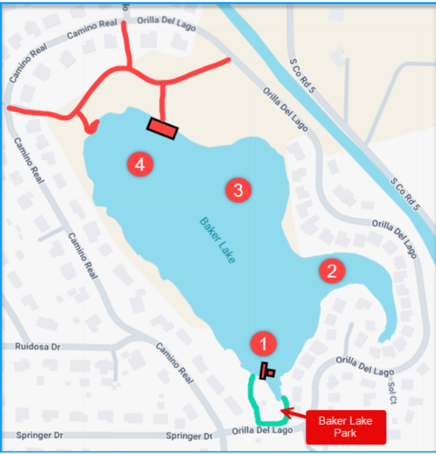
Water Quality and Ecology
Test Locations:

Slide 40
Water Quality and Ecology Cont.
Testing from June - Oct. 2025
Items Tested:
Coliform - Well within acceptable limits
E.Coli - Well within acceptable limits
Muck Depth - overall reduction (June-Sept.)
Water Clarity - explained
*Data/Spreadsheets will be made available online

Slide 41
2025 Lake Treatment
Multiple treatments of:
Muck Pellets
EcoBoost
Pond Clear

Slide 42
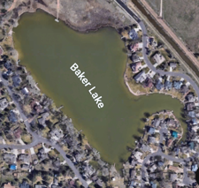
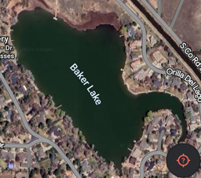
Pond Clear + EcoBoost
Before
After

Slide 43
Fish Stocking
Minnows stocked (50lbs) ($1000)
Reduced fish stocking by $500 in anticipation of other lake needs

Slide 44
2026 Lake Ecology (the bad)
Low water + high temps =
Algae blooms
Low dissolved oxygen
Large fish kills possible
Possible unsafe water conditions
Will be testing regularly

Slide 45
2026 Lake Ecology (treatment)
Pond Dye w/Pond Clear (applied in March)
Helps prevent light penetration (algae & weed growth)
Pond Clear (will apply June-Sept):
Beneficial bacteria and enzymes eliminate nutrient pollution
consuming suspended organic waste in the water column
Maintenance dose of EcoBoost

Slide 46
Other Possible Options
Getting bids for:
Aeration installation
Dredging boat ramp/park area

Slide 47
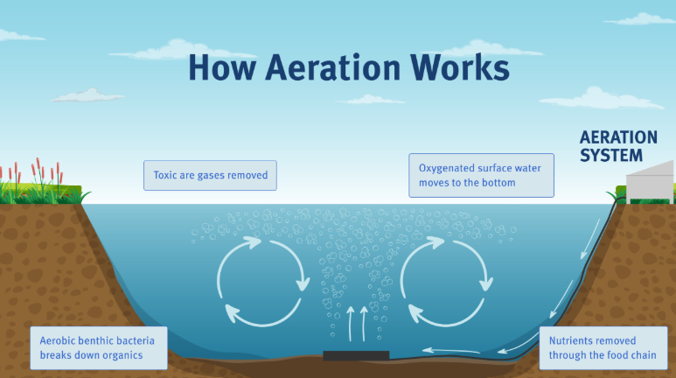
What you can do to help
Minimize water usage from the lake
The lower it gets the worse it gets
Apply Muck Pellets around your shoreline (in water/submerged)
Use weed razor to remove noxious water weeds (see Trevor Dysert for more details)
Add aeration

Slide 48
Baker Lake Park Overview
Thanks all the people who volunteered on a crisp Saturday morning to help clean-up the park and attend to needed maintenance.
Raked leaves, fallen branches, and removed rubbish
Repaired a washed out area at Repogle weir (kudos to Jeff and Larry)
Removed rocks from the lake
Put in a new fence along the lake to discourage geese from coming into the park
Future Projects
Move the large red rocks around the entrance sign.
Cable laced through the new fence
Replace wood around the sandbox area and redo with something else.

Slide 49
Park Policy for 4th of July
The Board asks residents to remember for the 4th of July:
The Park pavilion will not be available for reservation.
Launching fireworks is not allowed from any of the Park property.
Damage, debris, and liability drive this decision. (if there are violations, residents can call the Larimer County Sheriff’s non-emergency line to report it.)

Slide 50
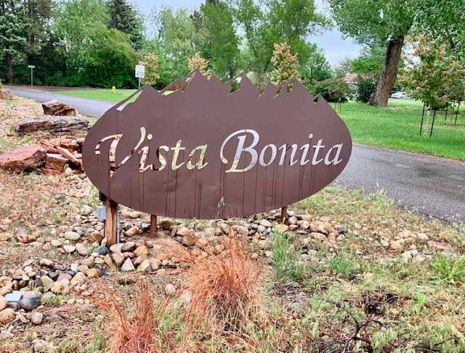
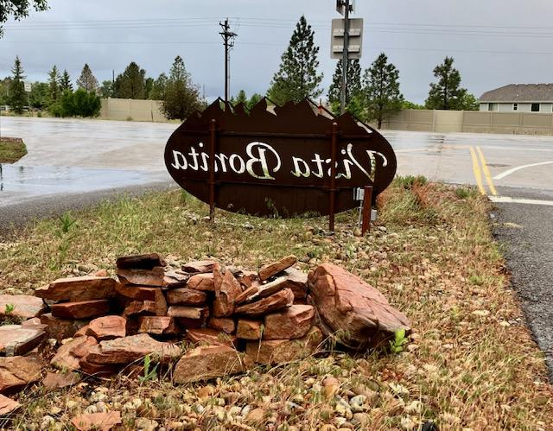
Camino Real East Entrance
It is finally done!
Larimer County Engineering final design approval to reinstall our Vista Bonita sign

Slide 51
Camino Real East Entrance
Thank you to our volunteers for making this happen!
Emily Defoor for leading sign restoration and repair
Mark Browning for updating and installing all new electrical components
Larry Dick and his grand-daughters for resizing and painting posts
Nicole Hoem for managing county permit process and obtaining professional sign company to complete installation
Note: Defendant responsible for accident continues to send VBRA monthly payments through court system to cover all repair costs

Slide 52
Community Events / Needs
Communications
Please check your email settings to make sure you are set up to receive emails from contact@vistabonitarecreationassociation.com
Please ask neighbors not here to do the same
Upcoming Events
Fishing Derby - Suspended this year due to water levels
4th of July Brunch and Parade
We are looking for volunteers to help with the event. Please contact Shelah Fred at shelah.fred@yahoo.com
Neighborhood Night Out - August 4, 2026
Watch your email for more details
Arts and Crafts Fair - Date TBD (this fall)
Need member to be a lead person for planning
Email contact@vistabonitarecreationassociation.com if you are interested

Slide 53
Wrap-up and General Questions

