Slide 1

33rd Annual Vista Bonita Recreation Association Meeting
May 28, 2025

Slide 2
Agenda
Board Member Introductions- All
Presidents Report- Shelah
Treasurer’s Report- Michael
5 Year Spending Plan - Michael
Replogle Recap- Eileen
Lake Ecology Report- Trevor and Nicole
Water Report- Larry
Baker Lake Park Report- Steve
Camino Real Monument- Nicole
Community Events & Needs- Ann Marie
Board of Directors Help Needed- Shelah
Questions & Wrap Up- Shelah

Slide 3
Board Member Introductions
Shelah Fred- President
Eileen Van Tilburg- Vice President
Michael Warring- Treasurer
Kara Seeber- Secretary
Ann Marie- Communications Director/ Webmaster
Larry Dick- Water Advisor
Trevor Dysert- Ecology Committee Chair
Steve Bangs- Park Curator
Nicole Hoem- Project Advisor

Slide 4
President’s Report 2025
Michael’s service to this board and dedication to our neighborhood has touched 4 decades! It is with this meeting that he is announcing his much deserved retirement from the VBRA Board of Directors. While we will miss him greatly, we are so thankful for the hours of effort and work that Michael has unselfishly devoted to us and to making this neighborhood such a wonderful place to live.
Please join me in thanking Michael for his tireless dedication!

Slide 5
President’s Report 2025 (cont.)
We did not have an increase in Dues last year; however, with continued inflation and our goal of keeping up with inflation to prevent large increases, we have made a small increase to the dues this year of $65 for off-lake, $130 for on lake members, and $215 for irrigation.
Like last year, we will need to purchase water to keep Baker Lake full, and we are hopeful that the extra funds will provide enough money to cover part of the rental water costs.
Thankfully, the Association continues to maintain a positive balance sheet which Michael will share with us later in the meeting.
Also, this year will see 3 main large expenditures that include purchasing water, continued maintenance of water quality and clarity, and insurance premiums.

Slide 6
Accomplishments in 2024 – 2025
• Maintained adequate water levels in the lake
• Stocked the lake with baitfish, sunfish and bluegills
• Continued the Neighborhood Links program
• Installed an artificial fish habitat in the lake
• Held the 2024 Carp Fishing Derby
• Completed a successful 4 week test for improving lake clarity/quality
• Installed a goose gate for the boat ramp
• Explored options for Replogle Lake

Slide 7
Looking Forward in 2025 – 2026
We will continue critical actions for the community through:
• Keeping Baker Lake full
• Fish stocking and fish maintenance
• Monitoring and improving water clarity/quality along with muck reduction
• Installing a more permanent goose fence for boat ramp and possible goose gate for the dock
• Completing repairs to our weir
• Address Replogle
• Improving the boarder around the swing set at the park
• Community events
• Park maintenance

Slide 8
President’s Report 2025 (cont.)
A resident of Kelly Farms subdivision (neighboring properties to Replogle Lake) reached out to the board in 2024 about the possibility of renting water or buying water from Replogle.
Through this process, the board has voted to look into the sale of Replogle to either members of the Kelly Farms community or potentially a single individual or multiple individuals within the Kelly Farms community.
At this point, we are only looking into the possibility of selling Replogle and the benefits of this sale. Later in the meeting, Eileen will go into more details about our current research so far. And, while I’m sure you will have many questions, at this point, we do not have a lot of answers. We will record any questions you do have and look into those answers over the next year while we work to address Replogle.
For now ... let’s quickly look at how we have used Replogle in the past and why it is not working for us now.

Slide 9

Treasurer’s Report as of 12/31/2024 – Income
Normal Dues including Irrigation | $ 17,420
Miscellaneous - Transfer Fees, etc. | 1,224
Donations | 5,410
 | __________
Total Income | $ 24,054
Miscellaneous income included irrigation company refunds, Transfer fees and bank interest. Donations were up because of Trevor resurrecting the Carp derby - $1,160 was donated/collected. Overall – UP $1,386 or 6%.

Slide 10
Treasurer’s Report as of 12/31/2024 - Spending
Park and Entrance Maintenance & Improvements | $ 7,733
Insurance | 3,903
Water “rental" and resale of unusable days | 3,895
Muck Mitigation | 2,696
Fathead minnows stocking | 1,505
Water clarity products – 1 application | 1,421
Other lake ecology and testing | 1,335
Entrance- repair metal sign | 1,268
Utilities | 1,012
Irrigation Fees | 900
Carp Derby prizes and expenses | 564
All other | 983
 | $ 27,215

Slide 11
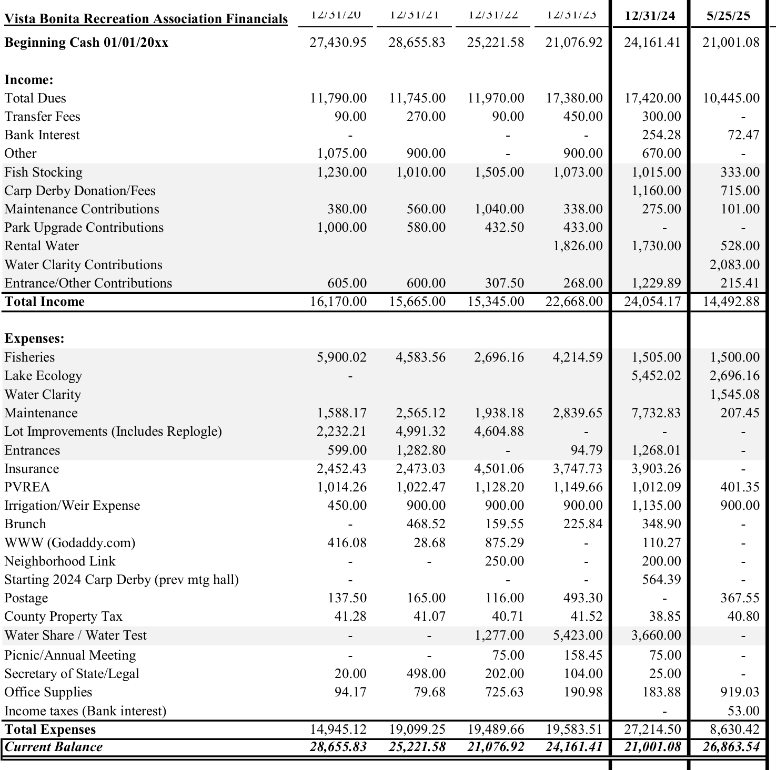
Treasurer’s Report – Current Year + Last 5 Years Income & Expense

Slide 12
Treasurer’s Report as of May 28, 2025
2025 VBRA Financials at 5/28/2025 |  |  |  |  | Earmark Balances
 |  | YTD |  |  |  |  | YTD
Beginning Cash 1/1/2025 |  | $ 21,001 |  |  | Lake Ecology Fund |  | $ 0
 |  |  |  |  | Maintenance Fund |  | 0
Income: |  |  |  |  | Park Upgrade Fund |  | 433
 | Normal Dues including Irrigation | 10,445 | 104 paid |  | Rental Water Fund |  | 528
 | Miscellaneous - Transfer Fees, etc. | 288 |  |  | Water Clarity Fund |  | 538
 | Donations | 3,760 |  |  | Entrances Fund |  | 3,125
 |  | _______________ |  |  | Total Earmarks |  | $ 4,624
Total Income |  | $ 14,493
Expenses: |  |  |  |  | Available Balance |  | $ 22,240
 | Muck Away Prod. (season) | 2,696
 | Water Clarity Prod. (1 time) | 1,545
 | Irrigation Company | 900
 | PVREA | 401
 | Fisheries | 1,500
 | Office Supplies and postage | 1,297 | Preprinted envelopes (10 years), 2 years stamps
 | All other | 291
Total Expenses |  | $ 8,630
Ending Cash 5/28/2025 |  | $ 26,864

Slide 13
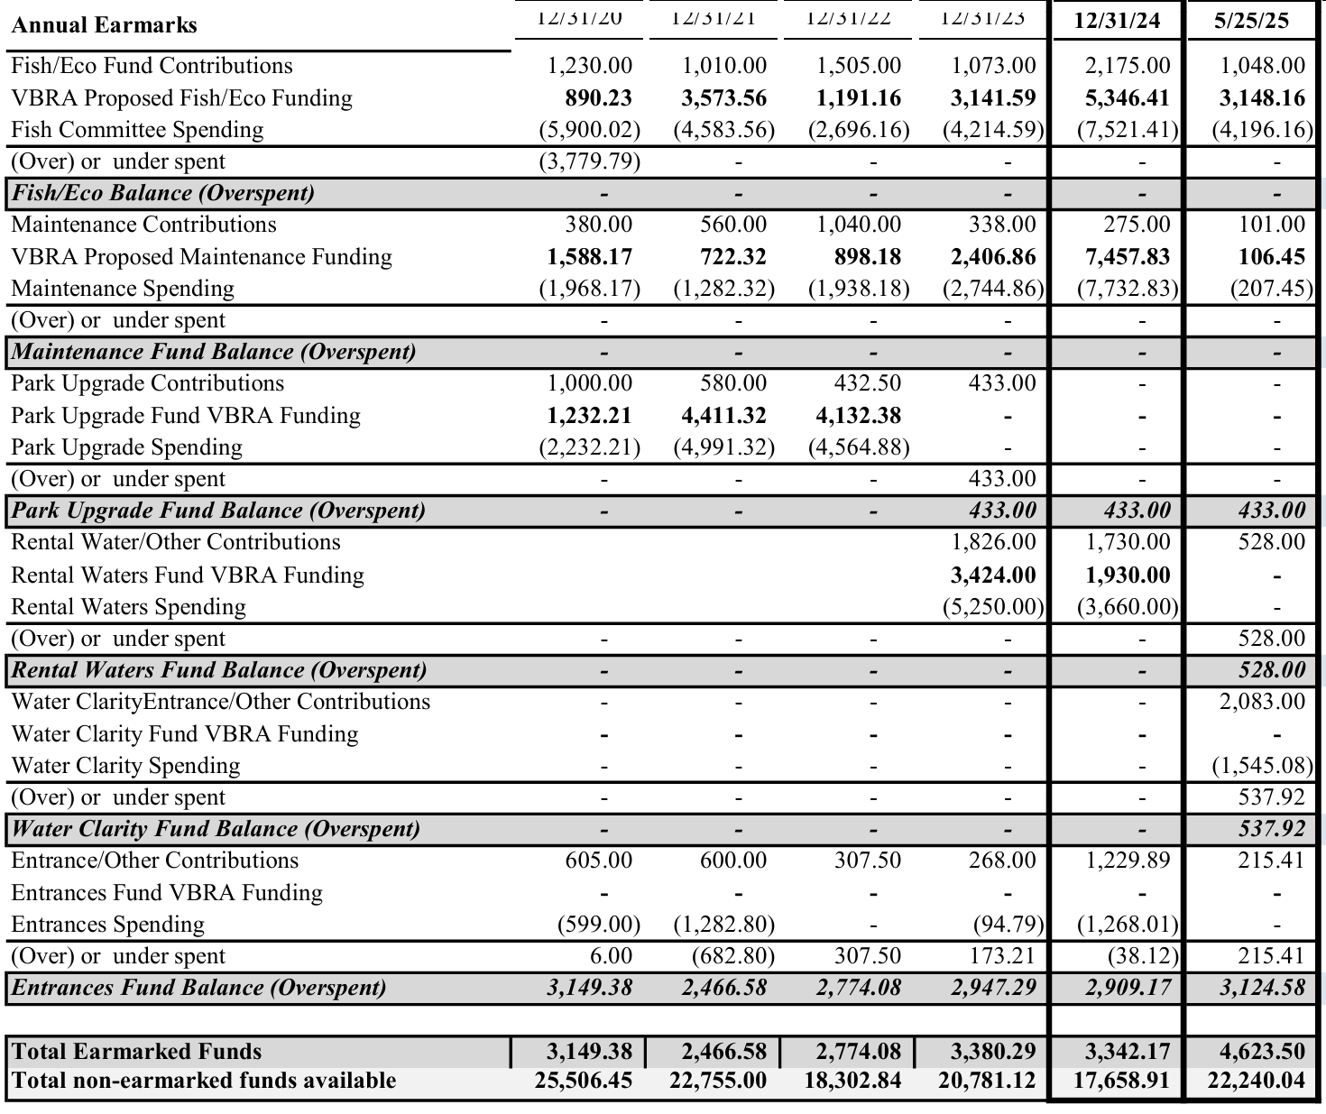
Treasurer’s Report – Current Year + Last Five Years Earmarks

Slide 14
Vista Bonita Recreation Association – 5 Year Spending Plan
 |  | 12/31/24 | 2025 |  | 2026 |  | 2027 |  | 2028 | 2029
Beginning Cash Balance |  | $ 24,161 | $ 21,001 |  | $ 19,221 |  | $ 18,871 |  | $19,151 | $ 18,861
 | Dues (1) | 17,420 | 18,620 |  | 18,620 |  | 19,820 |  | 19,820 | 21,020
 | Earmark - RENTAL WATER | 1,730 | 1,700 |  | 1,030 |  | 1,060 |  | 1,090 | 1,120
 | Earmark - Stocking | 1,015 | 1,000 |  | 1,030 |  | 1,060 |  | 1,090 | 1,120
 | Earmark - Lake Ecology | 1,160 | 1,200 |  | 1,240 |  | 1,280 |  | 1,320 | 1,360
 | Earmark - Water Clarity | ---- | 2,500 |  | 2,580 |  | 2,660 |  | 2,740 | 2,820
 | Earmark - Maintenance | 275 | 300 |  | 310 |  | 320 |  | 330 | 340
 | Earmark - Entrances/Other | 1,230 | 300 |  | 310 |  | 320 |  | 330 | 340
 | Transfer fees/Web Ads/Misc. | 1,224 | 1,000 |  | 1,030 |  | 1,060 |  | 1,090 | 1,120
Revenue |  | 24,054 | 25,920 |  | 26,150 |  | 27,580 |  | 27,810 | 29,240
 |  |  | 7.8% |  | 0.9% |  | 5.5% |  | 0.8% | 5.1%
 | Non-earmark expenses (2) | (7,635) | (7,700) |  | (7,900) |  | (8,100) |  | (8,300) | (8,500)
 | RENTAL WATER | (3,660) | (5,000) |  | (6,200) |  | (6,400) |  | (6,600) | (6,800)
 | Non-project earmark spending (2) | (9,690) | (12,000) |  | (12,400) |  | (12,800) |  | (13,200) | (13,600)
Normal Expenses |  | (20,985) | (24,700) |  | (26,500) |  | (27,300) |  | (28,100) | (28,900)
 |  |  | 17.7% |  | 7.3% |  | 3.0% |  | 2.9% | 2.8%
Unspent Earmarks |  | (3,342)
Available after expenses and earmarks |  | $ 23,889 | $ 22,221 |  | $ 18,871 |  | $ 19,151 |  | $ 18,861 | $ 19,201
Capital Project Spending
 | Dredge Park Cove | $(5,000)
 | Entrance repairs & maintenance | (1,230) | $ (2,000)
 | Park Improvements & Repairs (trees) |  | (1,000)
 | Remove diseased cottonwoods, trim
Total Capital Spending |  | $ (6,230) | $ (3,000) |  | $ - |  | $ - |  | $ - | $ -
Available Cash Balance |  | $ 17,659 | $ 19,221 |  | $ 18,871 |  | $ 19,151 |  | $ 18,861 | $ 19,201
 | Desired Reserve: | $ 6,000 | okay |  | okay |  | okay |  | okay | okay
1 | Increase due to inflation captured once a multiple of $5.00 is reached
2 | 3% annual cost increase beginning in 2025

Slide 15
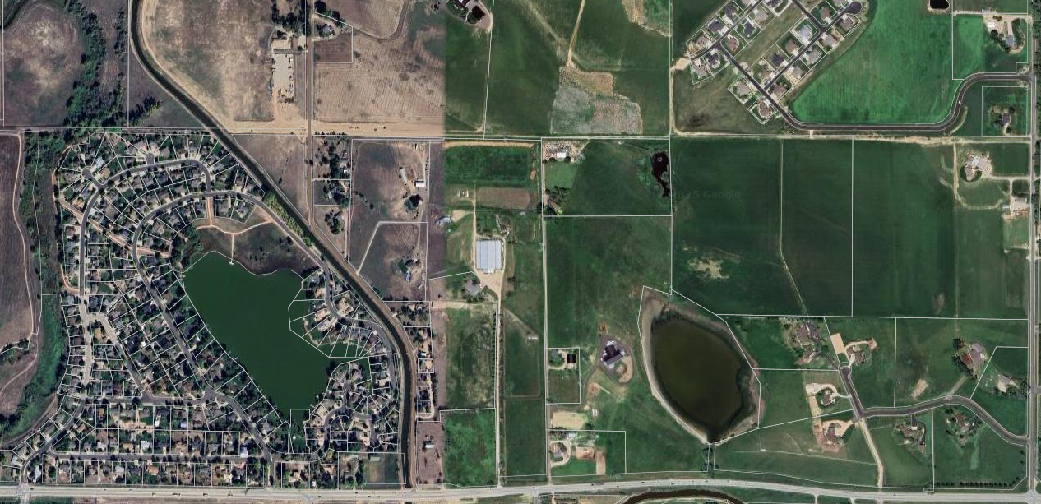
Replogle Lake History
Long-term asset of VBRA
Served as a backup storage lake for water swaps with ditch companies
Historically replenished by runoff of nearby farm.

Slide 16
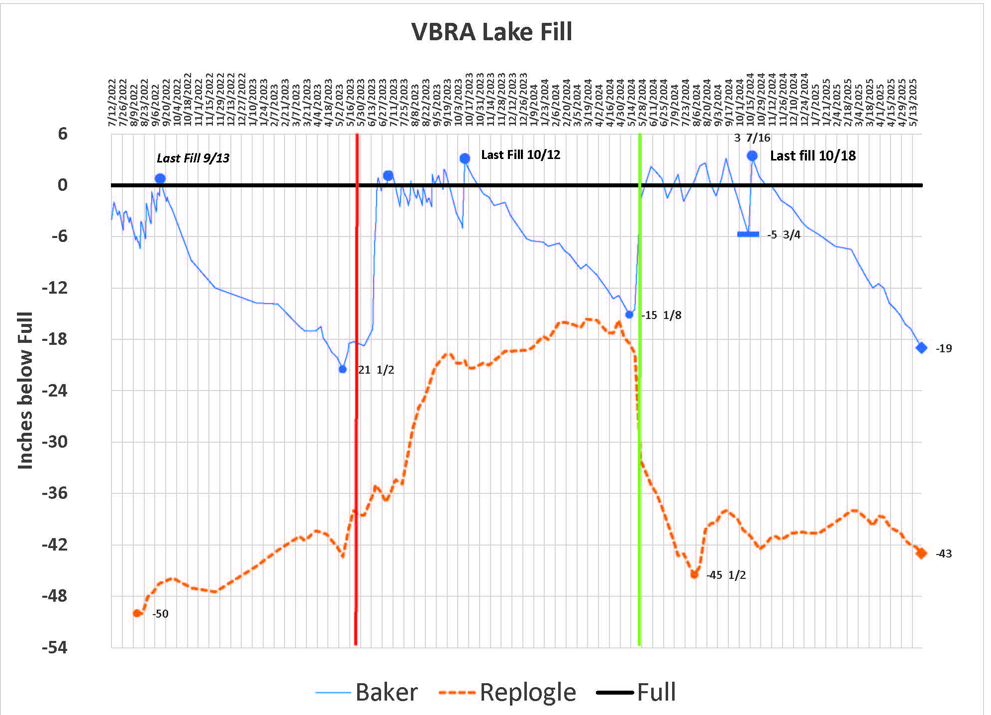
Replogle Lake Now
Primary fill: Limited runoff from Kelly Farms & rainfall
Highly dependent on weather and neighboring property water use
Still recovering from last water draw
Cannot fully recover after swaps with Baker Lake

Slide 17
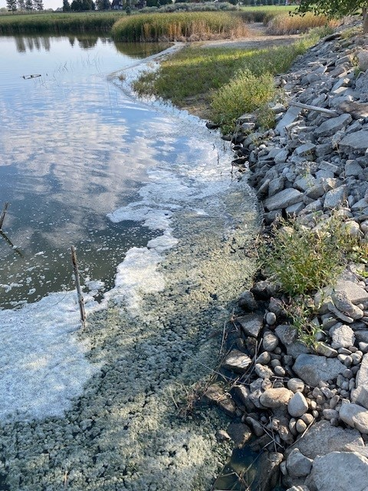
Replogle Lake Maintenance
Water quality issues: Foam, odor, poor ecology
Historical capacity: 114 acre-feet in early 1900s; reduced due to muck buildup
  Never dredged; current capacity hard to estimate
Baker Lake healthier due to better water movement, less stagnation
Replogle is not accessible for us to use in any way other than storing water.

Slide 18
A Look Forward
Baker Lake: Primary focus for VBRA’s attention and funds
Need to acquire water rights to maintain Baker’s water levels
Selling Replogle Lake:
  Funds for river shares to keep Baker full, improve Baker Lake ecology
  Removes liability from VBRA
Member vote upcoming; stay tuned for updates

Slide 19
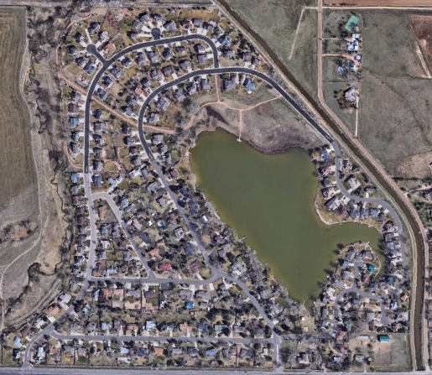
Water Report
Baker Lake

Slide 20
Water Report (cont.)
Overview of the Water Added to Baker Lake by Year
Year | Start of Season* | Amount Added
2024 | -17” | 54”
2023 | -14” | 43”
2022 | -28” | 52”
2021 | -17” | 46”
2020 | -19” | 53”
*Measured at the dock in the park
Average amount of water added per year: 50”
We’ve managed to end each water fill season with the lake being full or within 1”, usually benefiting from a late season run in October.

Slide 21
Water Report (cont.)
Rental Water Order Process
January we communicate to Larimer Weld Irrigation Co (LWIC) our need for water
Our name goes on their list buyers
No guarantee of water being available and first come/first served
May/June notifications sent to buyers
Must pay immediately at the LWIC office in Eaton
New offering this year from Northern Water of Regional Pool water

Slide 22
Water Report (cont.)
Cost of Rental Water
Water is priced per day and one day equals one acre foot of water
One acre foot adds .6” of water before evaporation and irrigation
The price has varied from $150 to $200 per day
2024 bought 30 days for $200/day
2023 bought 30 days for $150/day
2022 bought 5 days for $200/day

Slide 23
Water Report (cont.)
Annual Declaration
LWIC declares the amount of water a “share” will get
Varies by year depending on snowpack and users
A River share allows continuous flow for as long as the river water is available
A Reservoir share is a fixed amount for a fixed duration

Slide 24
Water Report (cont.)
The 2024 River Run Season
Began May 15th and ended June 22nd
Swapped with Replogle for 4 days
Full when the run ended
Added 21” of water
Negative impact to Replogle
$235 in delivery fees from the Ditch Co.

Slide 25
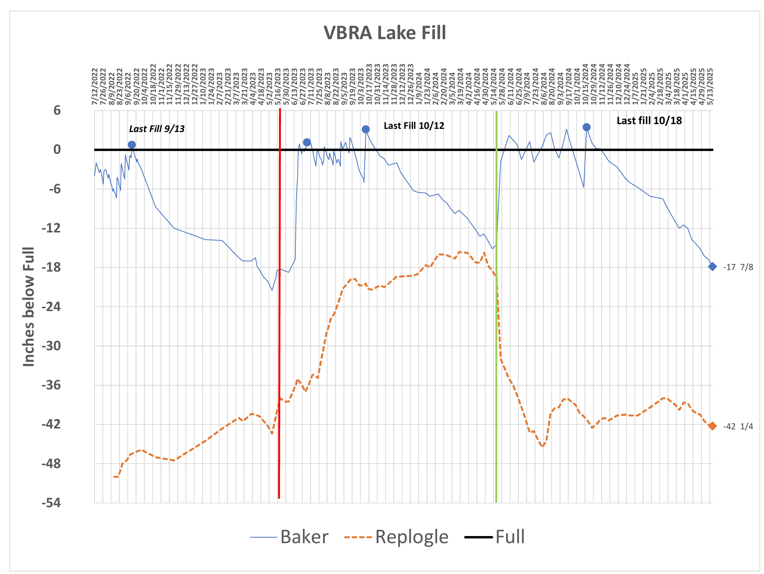
Water Report (cont.)
Water Level History of Baker Lake and Replogle Reservoir

Slide 26
Water Report (cont.)
The 2024 Reservoir Run Season
Began July 2nd and end October 14th
Filled the lake 9 times
43 total days available
August rains, no days used
Sold days to two local farmers
Recovered $2,600
Paid $260 in fees
Net expenditure for ’24 was $3140
Zero days remaining at the end of the year

Slide 27
Water Report (cont.)
Looking Forward
Snow pack peaked at 110% in Dec. ’24 with a median of 73%
There is less water in the entire system this year
Shorter River Run season predicted
Baker Lake will start down 16” to 18”, typical range
Will purchase Rental water again from various sources if available
Enough days to ensure a full lake
Negative effect of too low going into winter

Slide 28
Water Report (cont.)
Long Term
Final comment: Vista Bonita Recreation Association needs to purchase another River share to assure Baker Lake fills in the spring. This gives us the greatest duration of having a full lake during the year to support a healthy Ecology of the lake. River rental water is typically not available like reservoir water is.

Slide 29
Water Report (cont.)
Replogle Reservoir Long Term
And most importantly, starting now Replogle does not have enough water to supplement Baker Lake in the future and will not be used.

Slide 30
Water Report (cont.)
Support Needed
Backup person needed now
Long term, someone willing to take over the job
Do not need to be a VBRA Board member
Contact one of us if interested

Slide 31
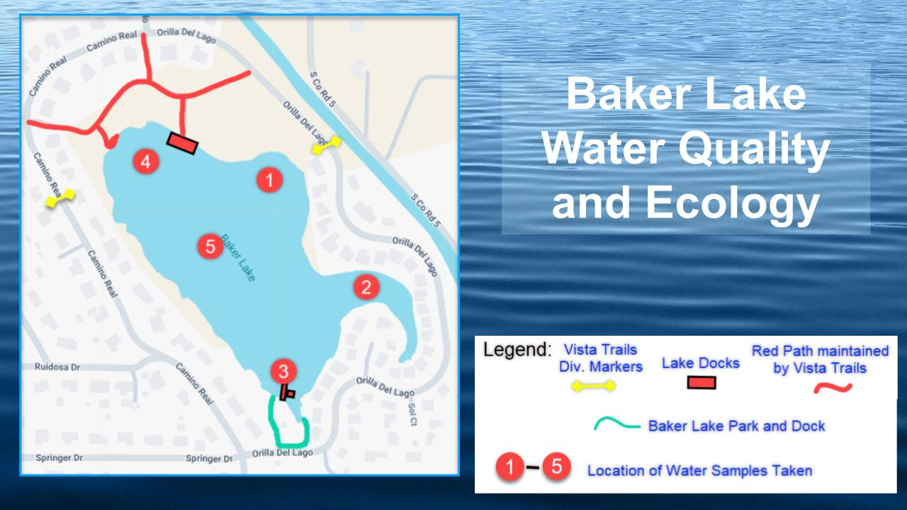
Water Quality and Ecology
Support Needed
Backup person needed now
Long term, someone willing to take over the job
Do not need to be a VBRA Board member
Contact one of us if interested

Slide 32
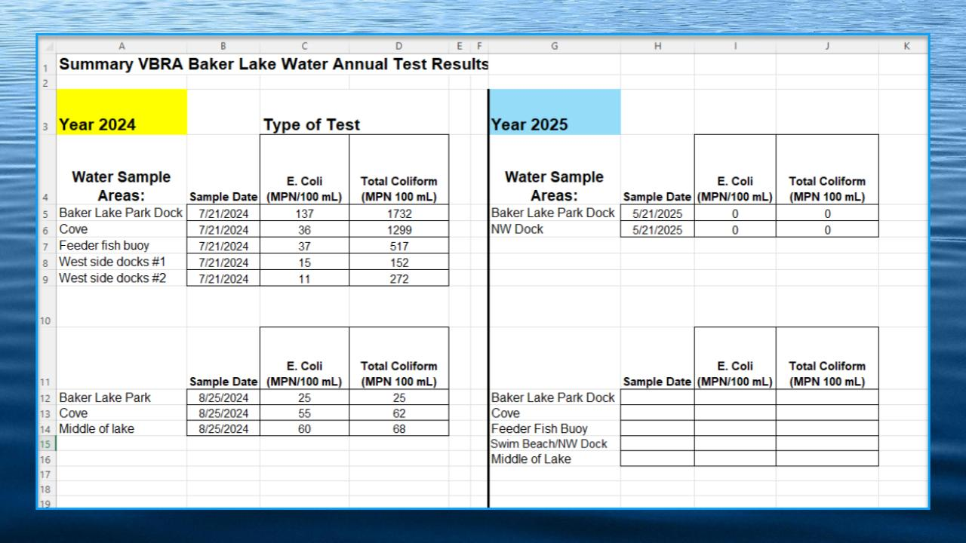
Water Quality and Ecology Cont.
Support Needed
Backup person needed now
Long term, someone willing to take over the job
Do not need to be a VBRA Board member
Contact one of us if interested

Slide 33
Baker Lake Park Overview
I’d like to thank all the folks who once again volunteered on a chilly Saturday to help clean-up the park and do some maintenance.
THANK YOU!
Raked and removed rubbish
Fixed the west fence posts
Repaired a washed out area of the boat ramp
Removed rocks from the lake
Weeded the dandelions
Dug-out and placed mulch around the two new trees
Anchored the tether ball pole

Slide 34
Baker Lake Park Overview (cont.)
There are two important policy rules that the Board will continue to ask residents to abide by for the 4th of July:
The Park pavilion will not be available for reservation.
  Too many residents have been asked to leave the park in the past by someone reserving the pavilion so we are discontinuing this practice.
Fireworks are not allowed to be launched from any of the Park property.
  Damage, debris and liability drive this decision. The Board will not “police” this, but if there are violations, residents can call the Larimer County Sheriff’s non-emergency line to report it.

Slide 35
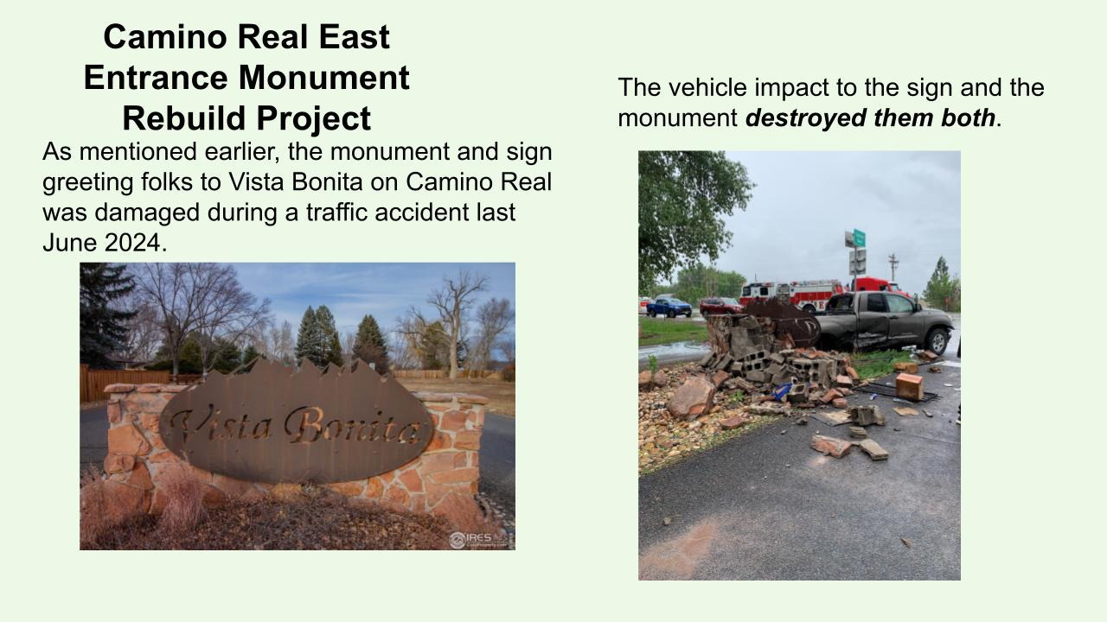
As mentioned earlier, the monument and sign greeting folks to Vista Bonita on Camino Real was damaged during a traffic accident last June. The impact of the vehicle hitting the sign and the monument destroyed both.
A group of volunteers later removed and disposed of the rocks and cement blocks.
The person responsible for causing the accident was uninsured, and the insurance carried by VBRA does not cover the entrances.
In a recent court proceeding, the person causing the accident was ordered to pay over $10,000 to have the repairs/replacement done. It is unlikely we will receive any money. IF we do receive compensation, the Board agreed to only accept the amount required to repair the damage.
The sign was recently returned from restoration and an effort led by Emily Defoor and Board members are researching a suitable replacement design for the monument and sign.

Slide 36
Camino Real East Entrance Monument Rebuild Project Cont.
VB volunteers removed and disposed of the cement blocks, while saving some of the red flagstone type rocks that match the side entrances.
The person responsible for the accident was uninsured.
The VBRA insurance carrier does not cover the subdivision entrances.
The result of the court proceeding - the person whom caused the accident is ordered to pay over $10,000 to have the repairs/replacement done.
  VBRA has received ~$12/month, which will take years for it to be repaid.
The sign was recently returned from restoration and an effort led by Emily Defoor.
VBRA BOD Nicole Hoem has been researching a suitable replacement design for the monument and sign per County Requirements.

Slide 37
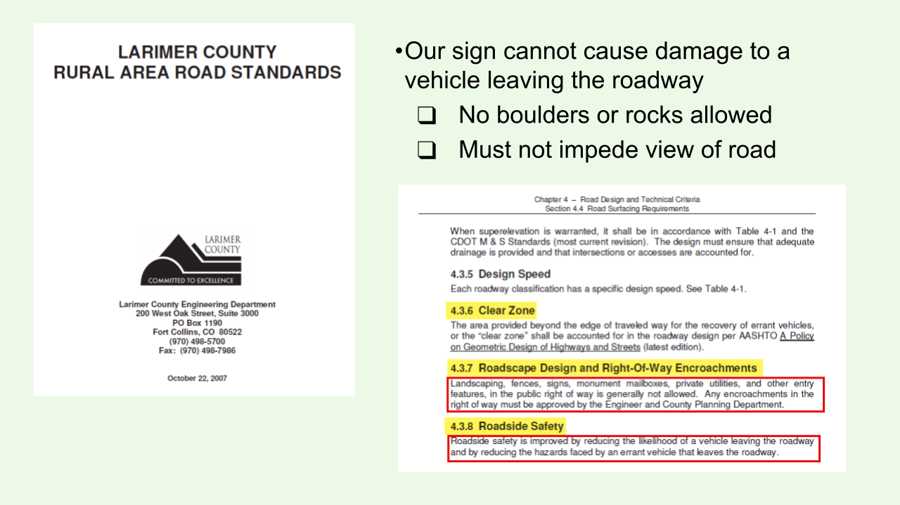
Camino Real East Entrance Monument Rebuild Project Cont.

Slide 38
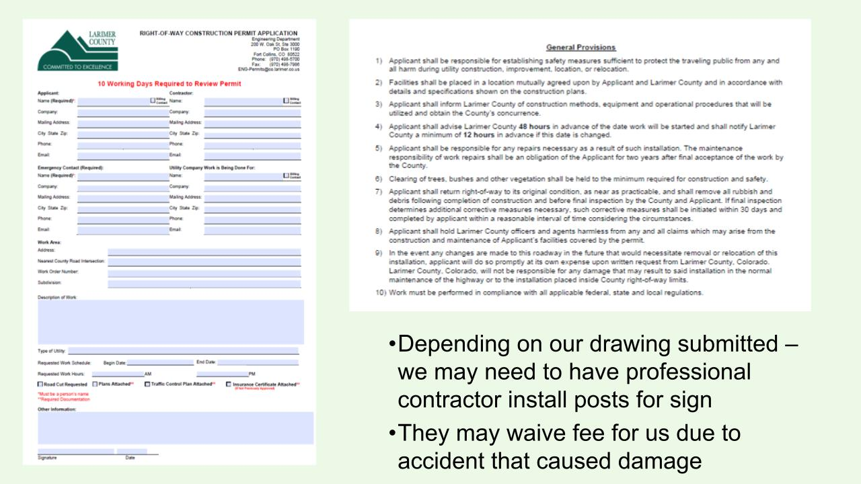
Camino Real East Entrance Monument Rebuild Project Cont.

Slide 39
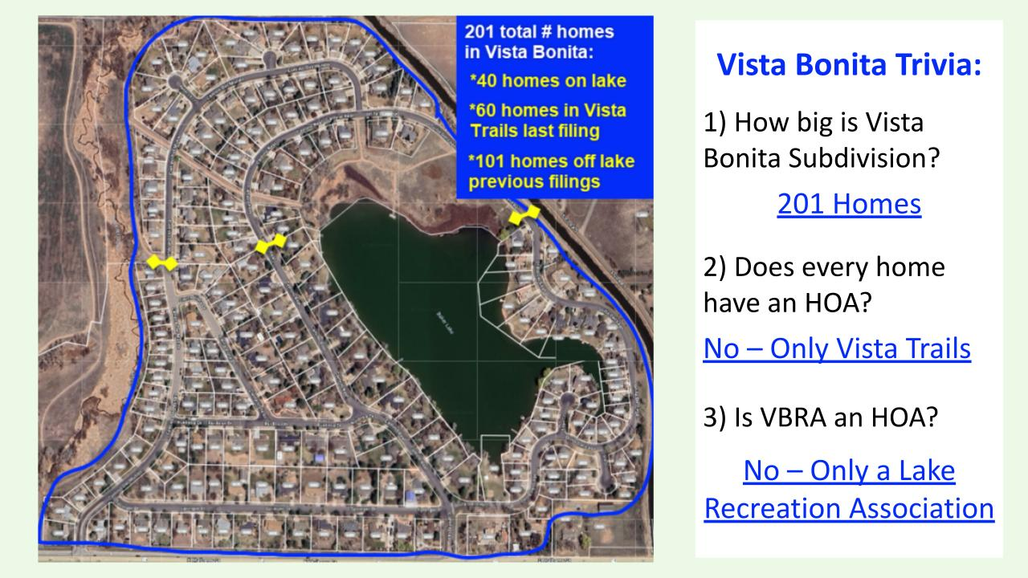
Trivia Time

Slide 40
Community Events / Needs
Communications
Please check your email settings to make sure you are set up to receive emails from contact@vistabonitarecreationassociation.com
Please ask neighbors not here to do the same
Up Coming Events
Fishing Derby - June 7th
  Big Thank You to our sponsors
  Please register if you have not already done so
  We need volunteers - please contact Trevor Dysert at 970-631-4667
4th of July Brunch and Parade
  We are looking for volunteers to help with the event. Please contact Shelah Fred at 970-817-2220
4th Annual Cars and Coffee Social

Slide 41
Board of Directors
The Board has the following positions/duties:
President
Vice President
Treasurer
Secretary
Communication Director
Lake Ecology Director
Lake Water Procurement Manager
Insurance and Contracts Advisor
Park Maintenance Curator
Website Manager
Neighborhood Links
Historian

Slide 42
Wrap-up and General Questions

