Slide 1
Baker Lake Ecology
Trevor Dysert & Nicole Hoem

Slide 2
Topics
Water Quality & Testing
Lake Treatment
Fish
Carp Derby
Future of Baker Lake

Slide 3
Water Quality & Testing
Water Quality testing results - 2024
Water Quality testing to be performed in 2025
  Geese impact
  Incoming water quality
  Clarity Treatments (discussed later)

Slide 4
What you can do to help water quality

Slide 5
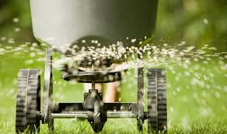
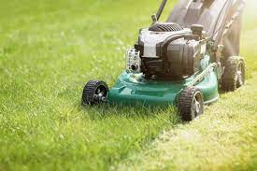
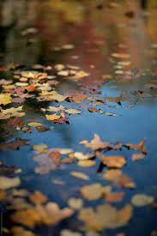
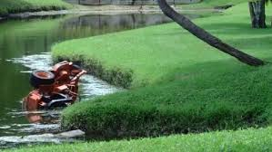
Try and keep fertilizers, grass clippings, leaves and other yard debris out of the lake

Slide 6
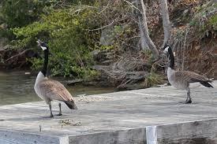
Deter Geese from hanging out on your property year round
Geese can significantly impact water quality by contributing to nutrient loading through their feces
Also causes issues with community areas such as docks, the park, & the beach.

Slide 7
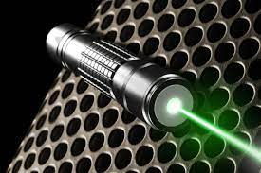
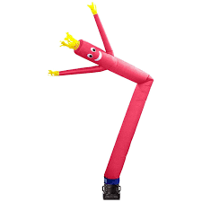
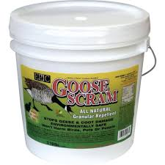
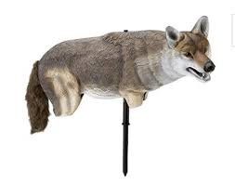
Goose Deterrents

Slide 8
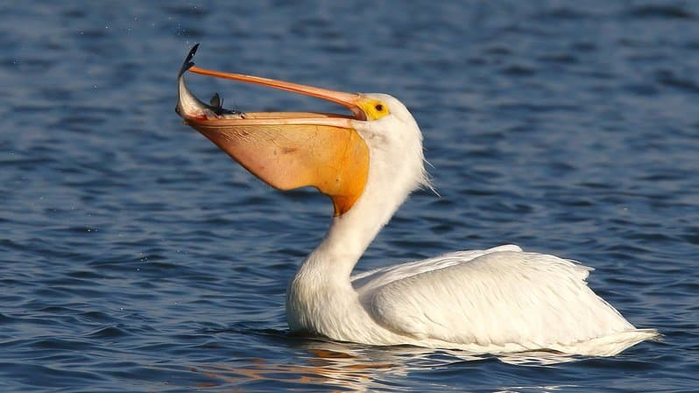
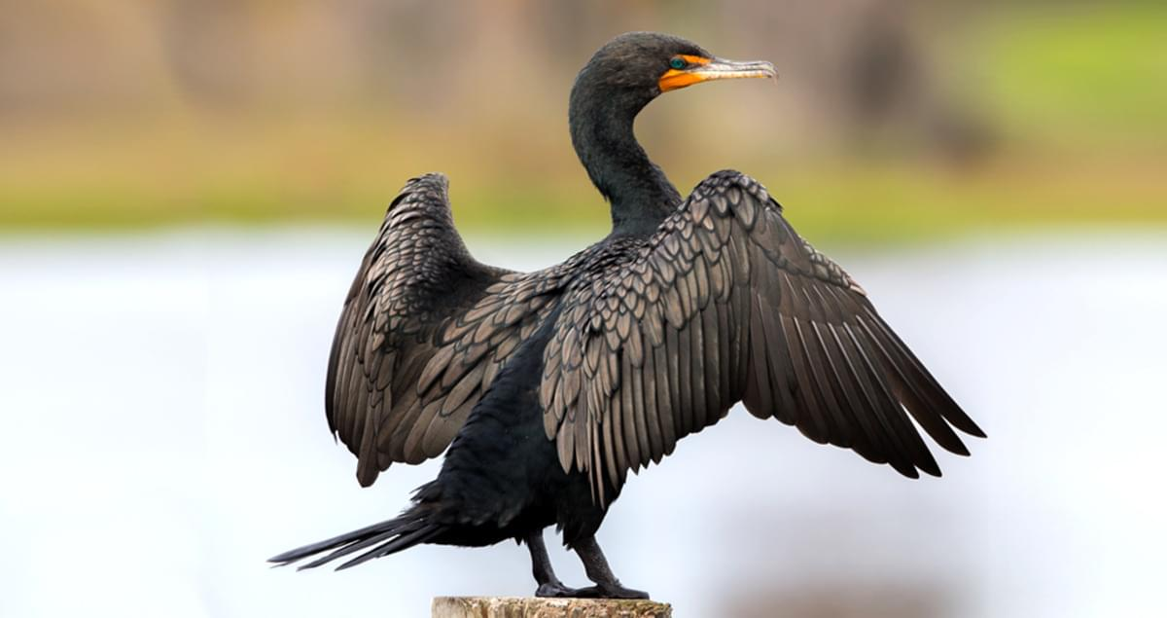
Deter these birds from eating our fish…
Pelicans
Cormorant

Slide 9
Lake Treatment

Slide 10
Lake Treatment Goals
Reduce sediment & muck buildup
Improve water quality & clarity

Slide 11
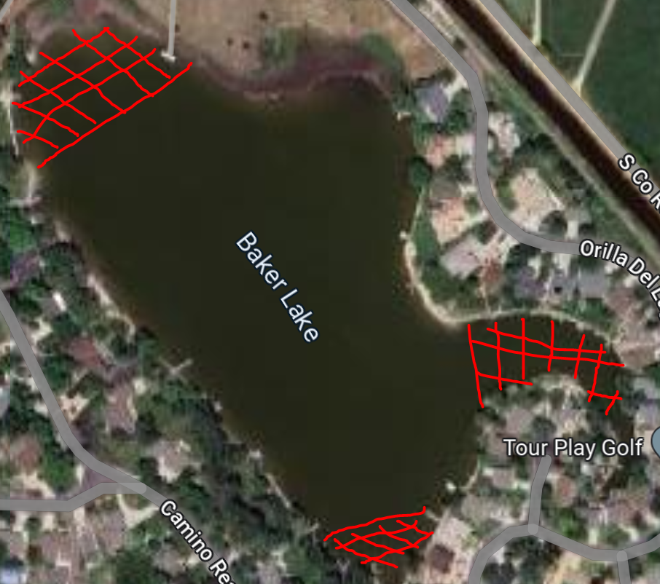
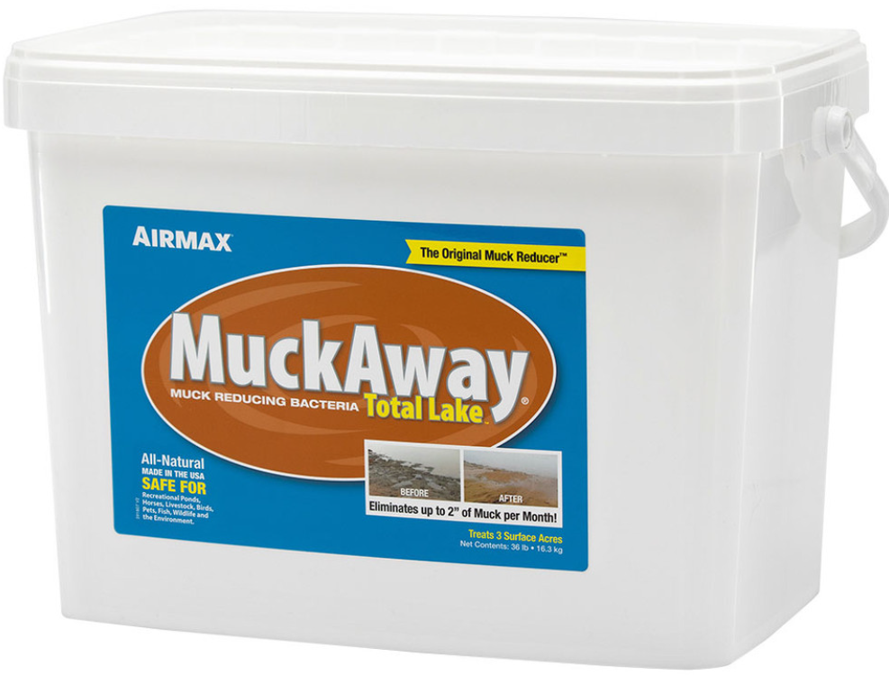
Muck Pellet application
2024 Results: 2”-5” muck reduction in some areas

Slide 12
Shoreline Treatment
Lake residents can treat their shoreline with Muck Away as well
  Follow recommended application information

Slide 13
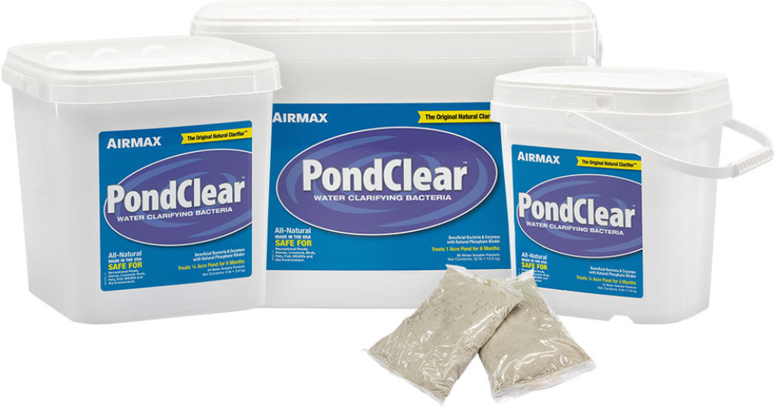
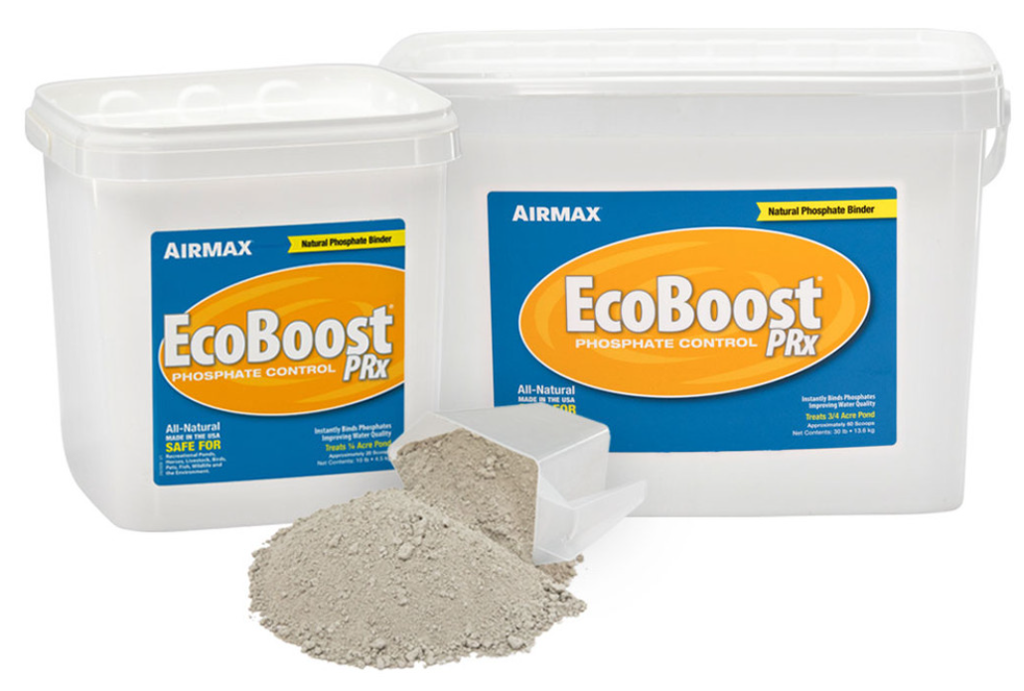
Water Clarity Treatments

Slide 14
EcoBoost PRx
All−Natural Phosphate Binder
Clarifies water without impacting pH
Eliminates the need for heavy metal treatments
Permanently binds phosphates improving water quality & clarity
Safe for recreational ponds, horses, livestock, birds, pets, fish, wildlife, and the environment

Slide 15
Pond Clear
Consumes suspended organics
Removes excess nutrients & noxious odors
Binds phosphates for long−lasting water clarity
Billions of beneficial bacteria improves water quality
Safe for recreational ponds, horses, livestock, birds, pets, fish, wildlife, and the environment

Slide 16
2024 Water Clarity Treatment
2024: 3 week treatment resulted in >2.5” water clarity improvement

Slide 17
2025 Water Clarity Treatment
Board approval for another 3 week treatment (~$1,600))
Looking for donations for a full 3 month treatment (~$4,400)

Slide 18
2025 Fish Stocking
Fish Stocking 2025
  50lbs of fathead minnows, 75 bluegill & 100 sunfish added ($1500)
  Baitfish establishing a breeding population.

Slide 19
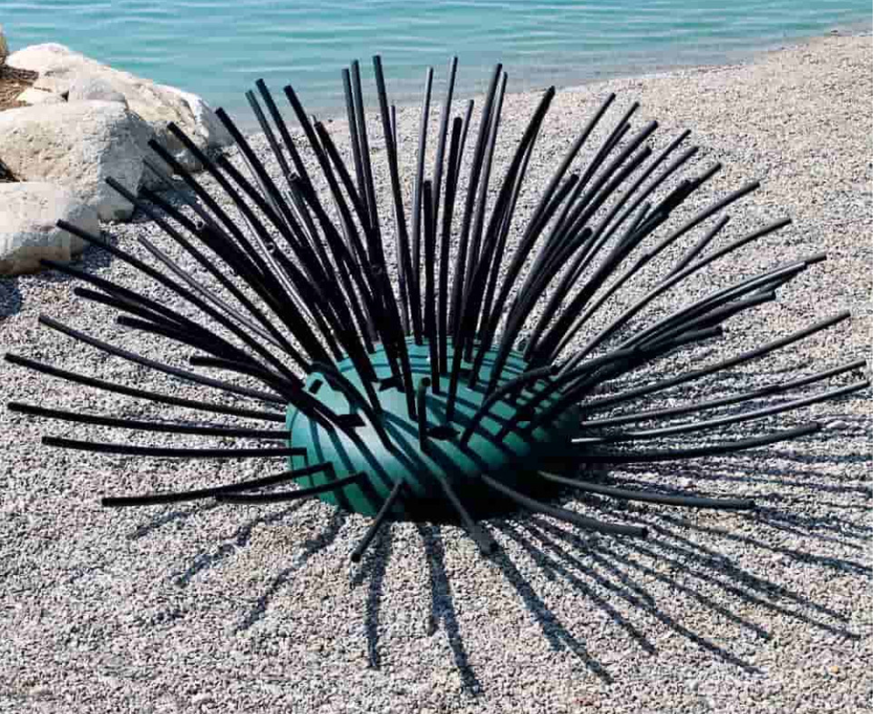
Fish Habitats
Why?
  Creates a sanctuary for baitfish to hide and reproduce
  Reduce future dependence on fish stocking

Slide 20
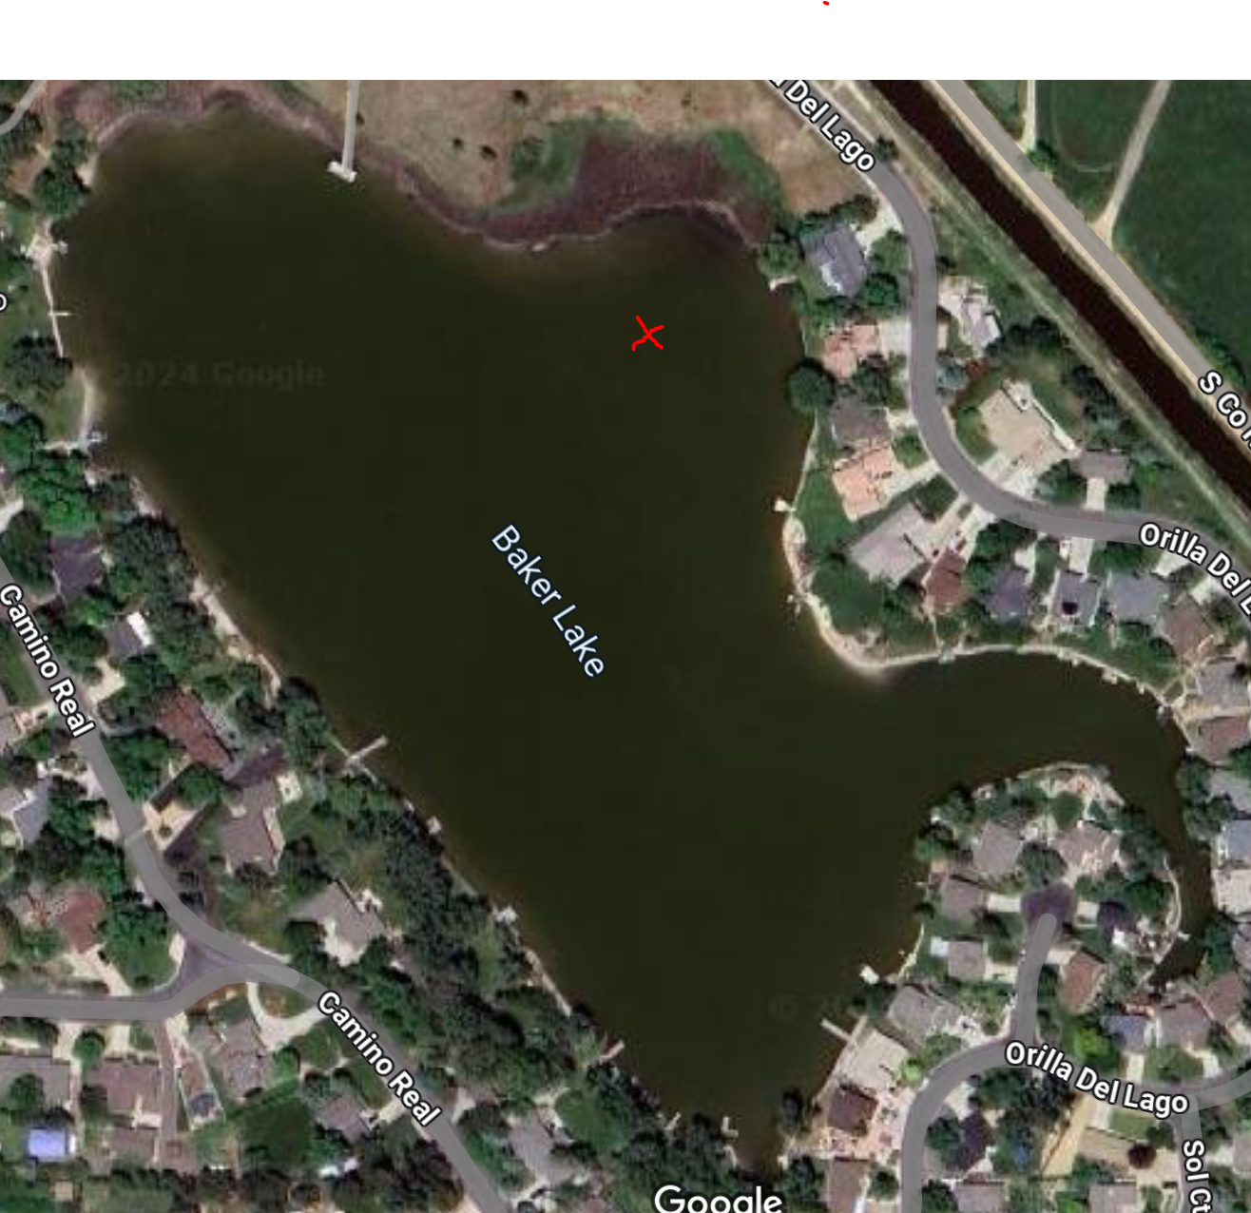
Fish Habitats
Marker buoy indicates location of habitats
Situated deeper (~3-5ft) for good year round habitat

Slide 21
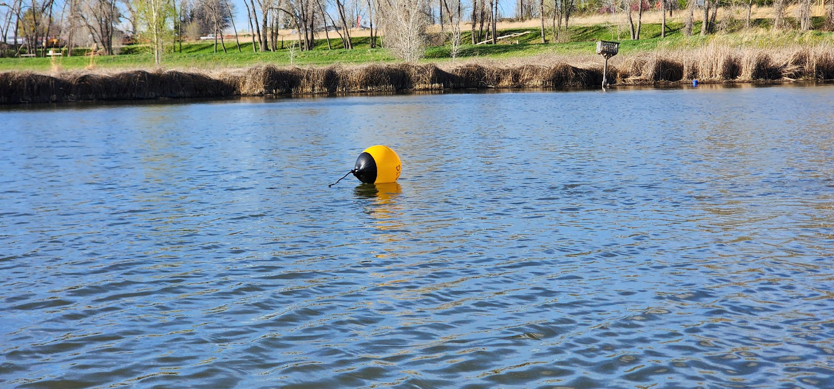

Slide 22
Carp Fishing Derby
June 7st, 2025 (see email with details & signup info)
Remove invasive common carp
Over $800 in prizes
Fun for the whole community

Slide 23
Carp Fishing Derby Sponsors
Mount Vista Greens - Deryl & Carol O’Dell
Fossil Creek Tile – Steve Bangs
Windsor Mill Tavern – Tim Downey
Tiho’s Tequila Bar & Restaurant – Tim Downey
239 Old Town North - Frank Heine & Lindsey Santillanes
Total Automotive Complete Car Care + Fort Collins 4x4 - Ross Houk
Dr T Pottery - Tanner Gerstberger
NoCo Home Loans - Jessica Foster
Find Colorado Real Estate - Davis & Eileen Van TilBerg
Generous neighbor (anonymous)
A-OK Chem-Dry – Mike & Sara Elder
Scheels

Slide 24
Big Thanks to our Ecology Sub-Committee
Nicole Hoem
Steve Bangs
Mike Brunkhardt
Bob Starling
Frank Heine
Jean Lehman

