Slide 1

“It’s happening around the time when HW & other assignments are due …. “ said someone with familiar with the matter….
#JROnews

Slide 2

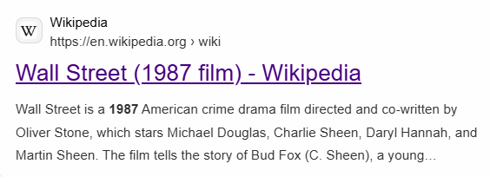


Message from the CEO
Michael Douglas from the movie; “Walstreet”

Slide 3

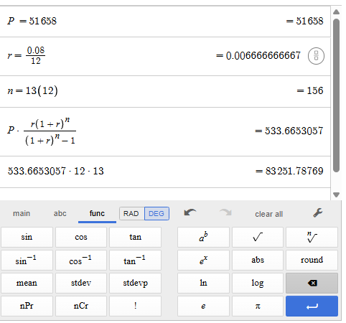

Question 12 (1 point)
Solve.
Determine the total payment over the term of a student loan of $51,658 at a fixed APR of 8% for 13 years.
A) \$83,330.37
B) \$83,283.23
C) \$83,229.32
D) \$83,251.79

Slide 4
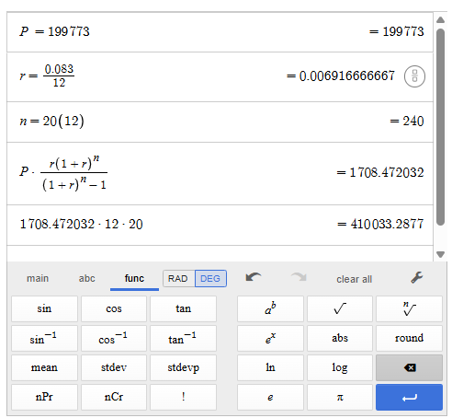
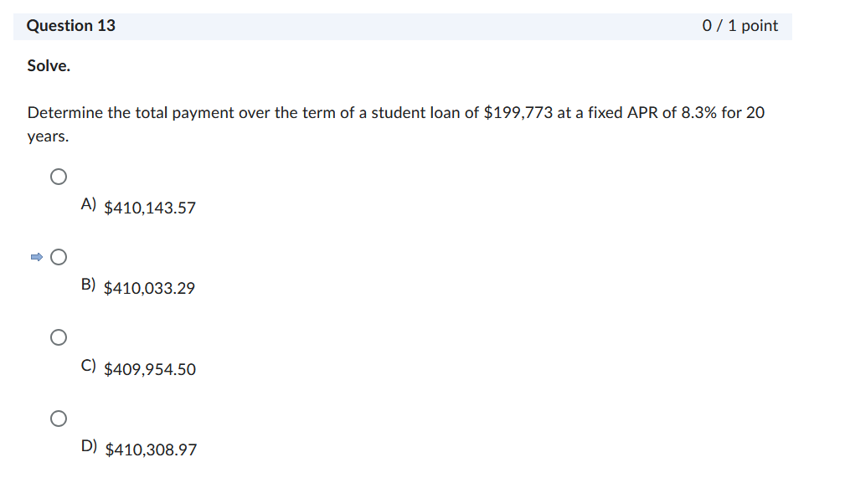
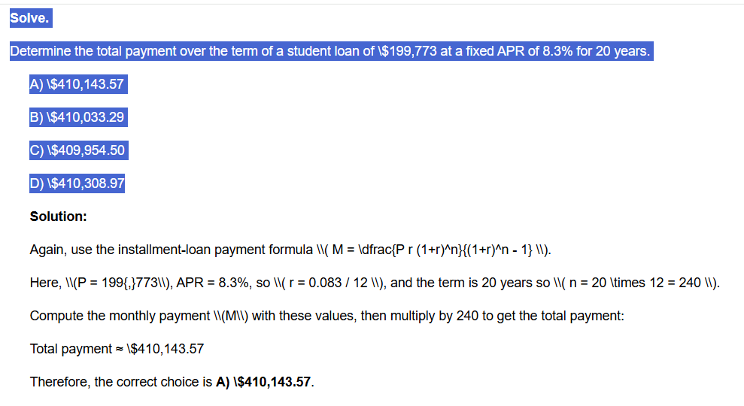

Question 13 (1 point)
Solve.
Determine the total payment over the term of a student loan of $199,773 at a fixed APR of 8.3% for 20 years.
A) \$410,143.57
B) \$410,033.29
C) \$409,954.50
D) \$410,308.97
Note: AI was WRONG !!!!

Slide 5
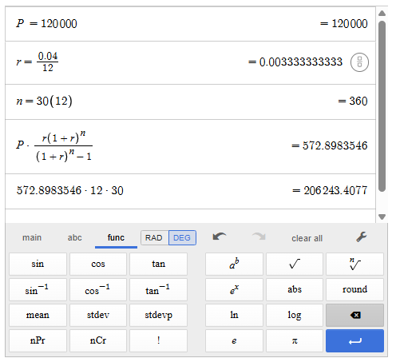


Question 14 (1 point)
Determine the total payment over the term of a home mortgage of $120,000 with a fixed APR of 4% for 30 years.
○ A) $210,352.85
○ 😎 $205,623.11
○ C) $206,243.41
○ D) $141,509.43

Slide 6
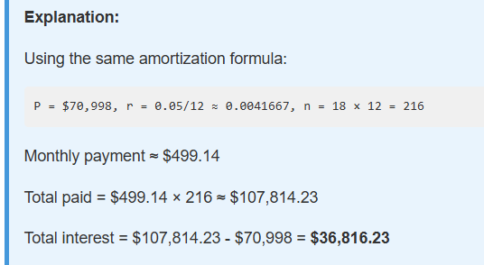
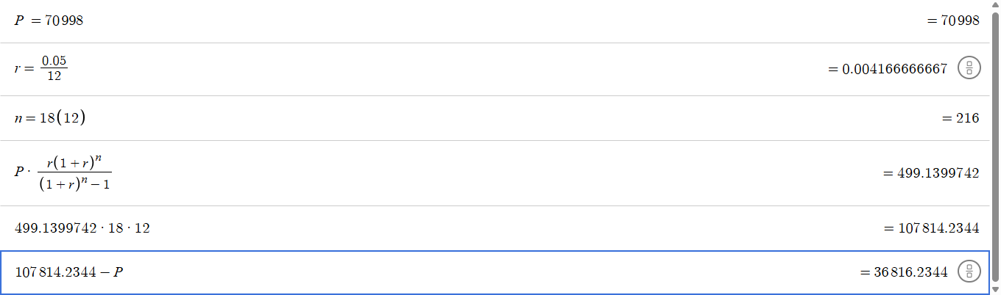
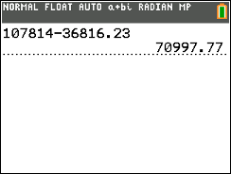






Question 15 (1 point)
Determine how much of the total loan payment applies toward principal and how much applies toward interest for a student loan of $70,998 at a fixed APR of 5% for 18 years.
○ A) $70,998 pays off the principal and $36,796.49 represents interest payments.
○ 😎 $70,998 pays off the principal and $36,885.30 represents interest payments.
○ C) $70,998 pays off the principal and $36,843.86 represents interest payments.
○ D) $70,998 pays off the principal and $36,816.23 represents interest payments.

Slide 7
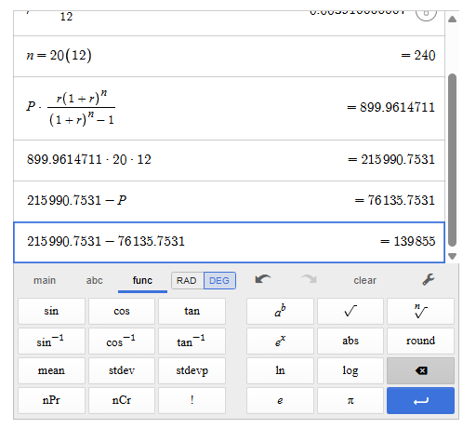
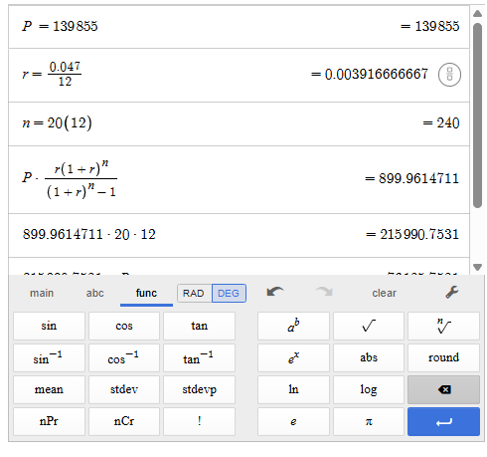






Question 16 (1 point)
Determine how much of the total loan payment applies toward principal and how much applies toward interest for a home mortgage of $139,855 with a fixed APR of 4.7% for 20 years.
A) $139,855 pays off the principal and $76,099.42 represents interest payments.
B) $139,855 pays off the principal and $76,186.61 represents interest payments.
C) $139,855 pays off the principal and $76,262.88 represents interest payments.
D) $139,855 pays off the principal and $76,135.75 represents interest payments.

Slide 8
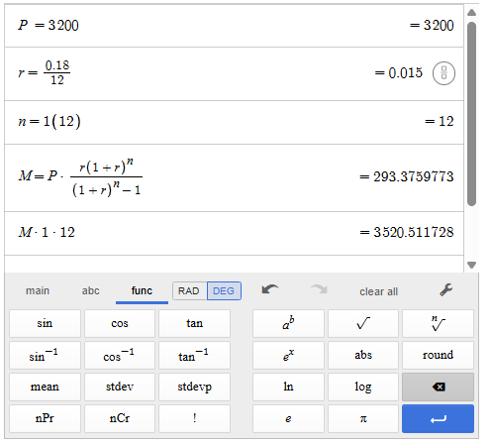







Question 17 (1 point)
Assume you have a balance of $3,200 on your credit card that you want to pay off. Calculate your monthly payment and total payment under the given conditions. Assume you make no additional charges to the card.
The credit card APR is 18% and you want to pay off the balance in 1 year.
A) $352.53; $4,230.33
B) $441.55; $5,298.61
C) $251.22; $3,014.66
D) $293.38; $3,520.51

Slide 9
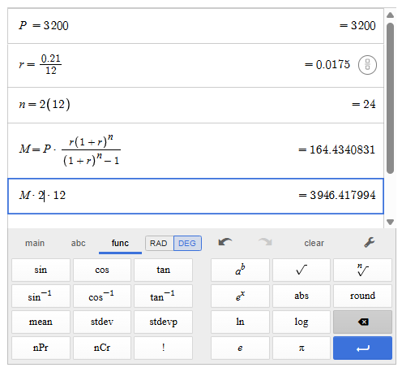
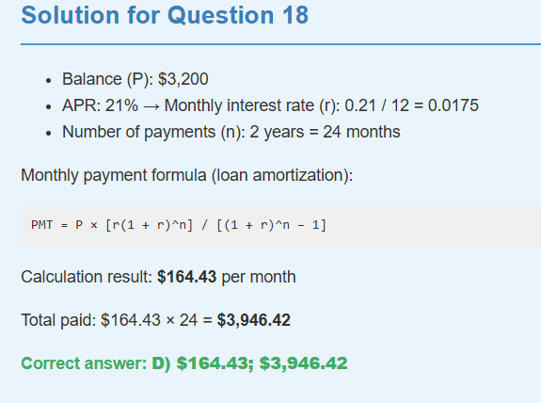







Question 18 (1 point)
Assume you have a balance of $3200 on your credit card that you want to pay off. Calculate your monthly payment and total payment under the given conditions. Assume you make no additional charges to the card.
The credit card APR is 21% and you want to pay off the balance in 2 years.
○ A) $197.60; $4,277.35
○ 😎 $247.51; $5,940.18
○ C) $140.80; $3,051.17
○ D) $164.43; $3,946.42

Slide 10
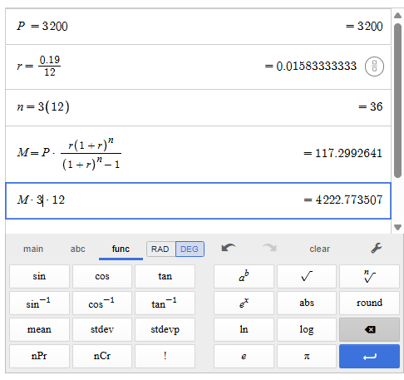
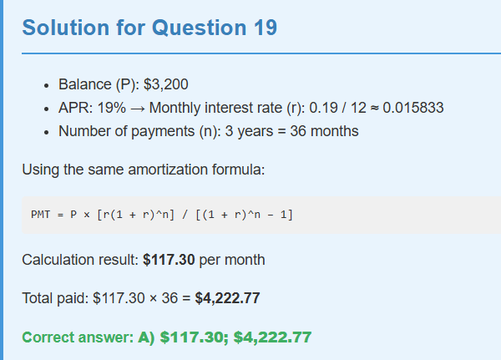





Question 19 (1 point)
Assume you have a balance of $3200 on your credit card that you want to pay off. Calculate your monthly payment and total payment under the given conditions. Assume you make no additional charges to the card.
The credit card APR is 19% and you want to pay off the balance in 3 years.
○ A) $117.30; $4,222.77
○ 😎 $100.46; $3,616.51
○ C) $140.92; $5,073.22
○ D) $176.46; $6,352.54

Slide 11
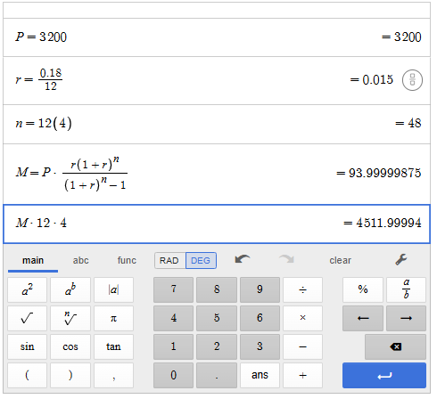




Question 20 (1 point)
Assume you have a balance of $3200 on your credit card that you want to pay off. Calculate your monthly payment and total payment under the given conditions. Assume you make no additional charges to the card.
The credit card APR is 18% and you want to pay off the balance in 4 years.
○ A) $112.91; $5,419.89
○ 😎 $80.51; $3,864.62
○ C) $94.00; $4,512.00
○ D) $130.64; $6,270.75

Slide 12
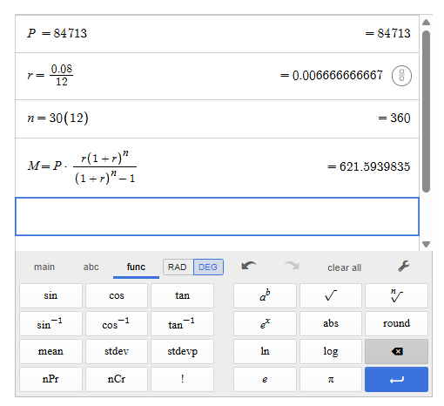
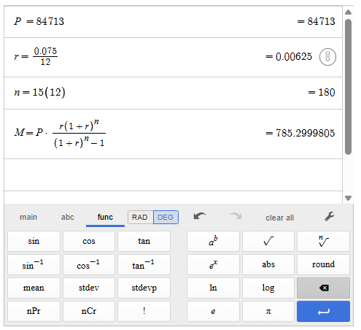

Question 21 (1 point)
Solve the problem.
You need a $84,713 loan. Compute the monthly payment for each of the loan options listed below. Assume that the loans are fixed rate.
Option 1: a 30-year-loan at an APR of 8%
Option 2: a 15-year loan at 7.5%
○ A) Option 1: $630.61 Option 2: $810.48
○ 😎 Option 1: $613.91 Option 2: $763.03
○ C) Option 1: $621.59 Option 2: $785.30
○ D) Option 1: $633.11 Option 2: $818.68
Option 1
Option 2

Slide 13
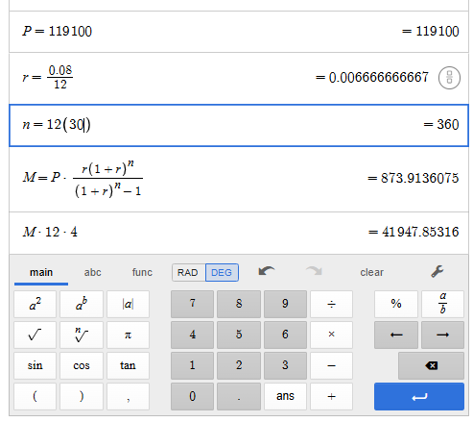
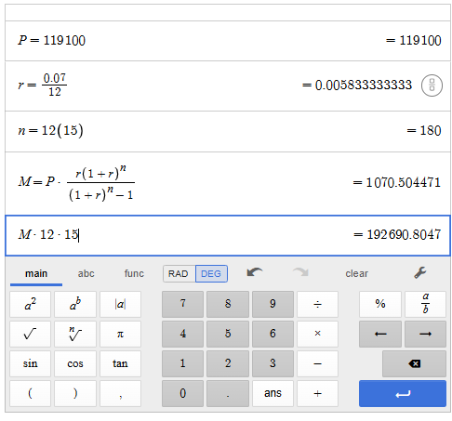




Option 1
Q22: You need a $119,100 loan. Compute the monthly payment for each of the loan options listed below. Assume that the loans are fixed rate.
?
Option 1: a 30 year-loan at an APR of 8%
op1
Option 2: a 15-year loan at 7%
op2
Option 2
Go code ? op1 or op2 ?????

Slide 14
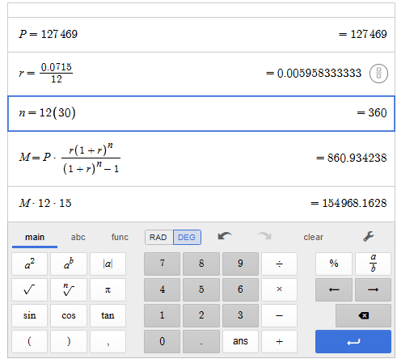
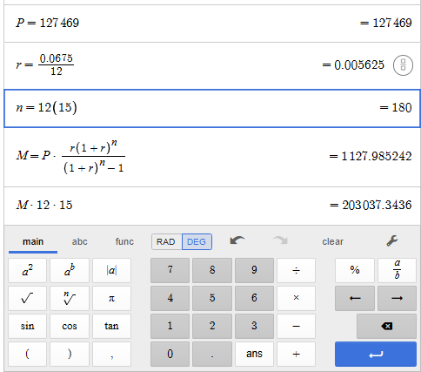




Option 1
Q23: You need a $127,469 loan. Compute the monthly payment for each of the loan options listed below. Assume that the loans are fixed rate.
?
Option 1: a 30 year-loan at an APR of 7.15%
op1
Option 2: a 15-year loan at 6.75%
op2
Option 2
Go code ? op1 or op2 ?????

Slide 15

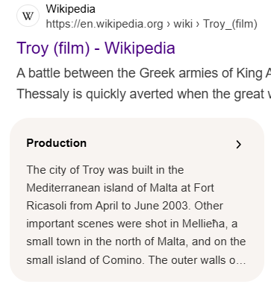
Message from the CFO
Brad Pitt from the movie “Troy”

