Slide 2
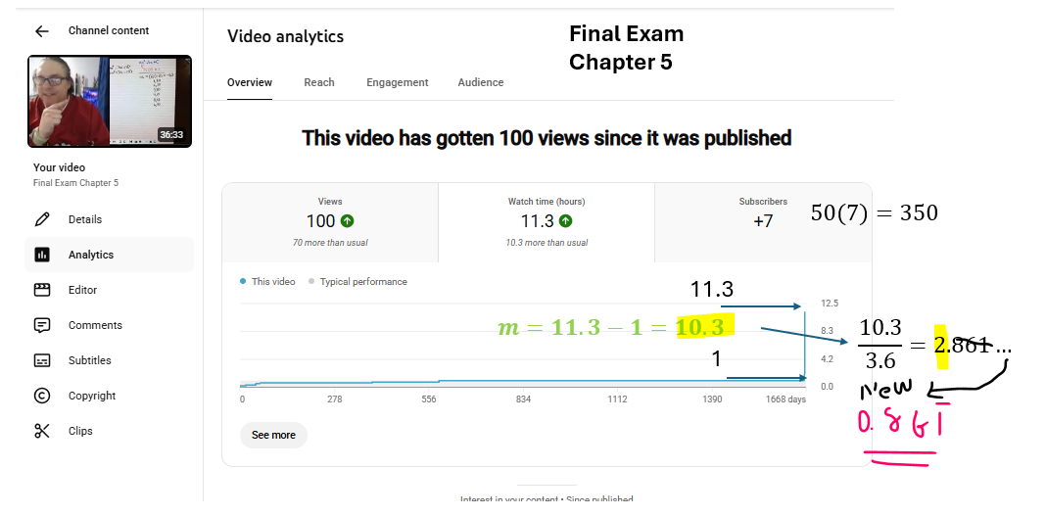

Task for scavengers
Example URL https://www.facebook.com/share/p/14XUsMU4WNL/
Find your watching the watchers, jerry receipt
Do not send 1 DM to Prof to get through the next task of the hunt
I repeat… do not DM Prof with questions about the receipt…. A single DM to prof about this could signal a TOTAL STOP to the scavenger hunt
Example appeared
Use this Fomr fore your Qs
https://docs.google.com/forms/d/e/1FAIpQLScM0vIwEflqZUKyyUlMFs8cyF-3ESdqNe53v-B_22tKX_pRcQ/viewform?usp=publish-editor

