Slide 1
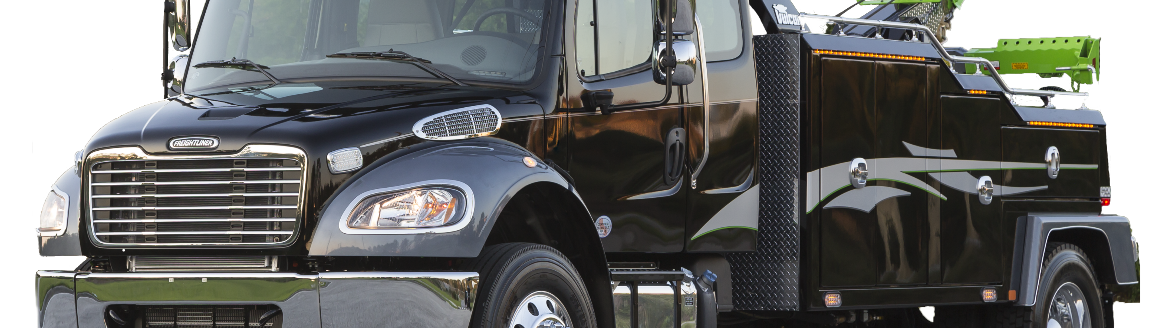
M2-106
Vehicle Overview
This presentation does not replace the Drivers Manual. The Drivers Manual and Maintenance manual provided with each vehicle should be read and followed.

Slide 2


Thank You For Your Purchase
This is a brief overview to some of the features of the vehicle.
Refer to the Drivers Manual and Maintenance Manual for a complete listing.

Slide 3
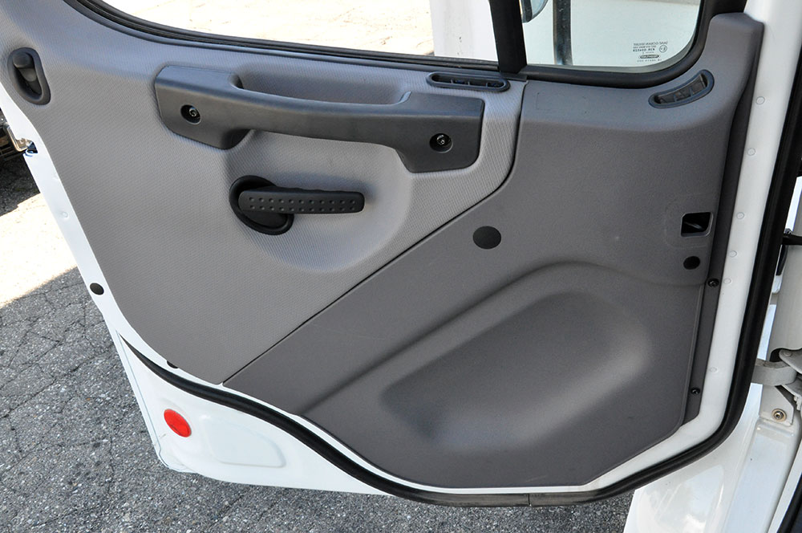
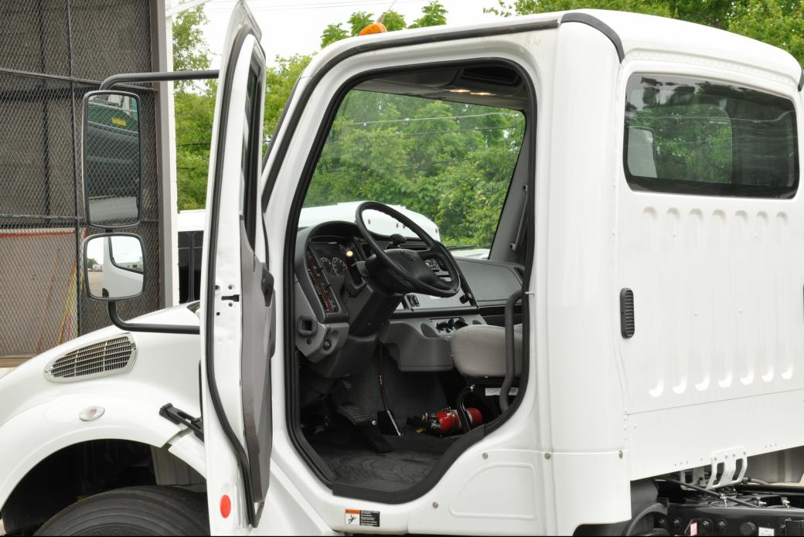
Vehicle Access
Cab Door Locks and Handles – Cab Entry and Exit ( Driver side )
1
2
4
3
1
5
2
3
To open the door from the inside, lift up on the door lever (arrow).
1 Lock Button
2 Armrest/Handle
3 Door Lever
4 Window Crank / Electric window
5 Inner Door Grab Handle (optional)
Driver Side
1. Steering Wheel
2. B-Pillar Grab Handle
3. Inner Door Grab Handle (optional)

Slide 4
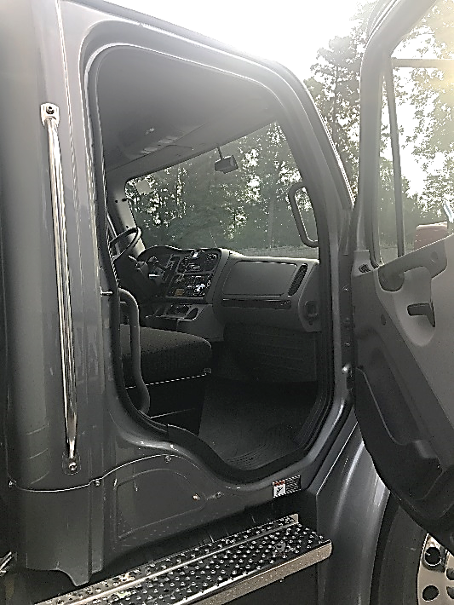
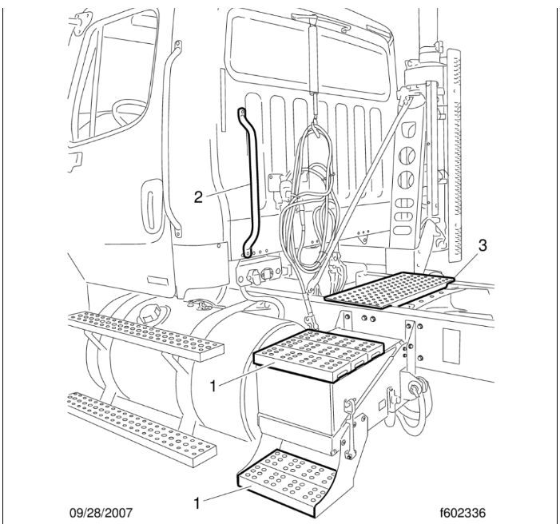
Vehicle Access
Cab Entry and Exit ( Passenger side side ) – Back of Cab Access
4
3
2
1
Cab access system Passenger’s Side
1 Step
2 B-Pillar Grab Handle
3 Sidewall Grab Handle (optional)
4 A-Pillar Cover Grab Handle
Back of Cab Access (typical)
1 Steps
2 Grab Handle
3 Deck Plate

Slide 5
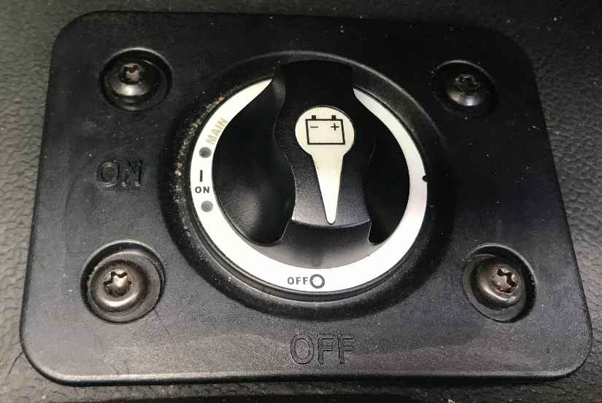
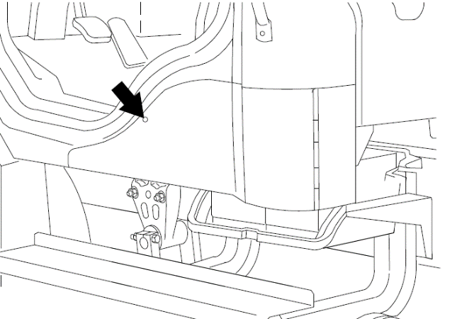
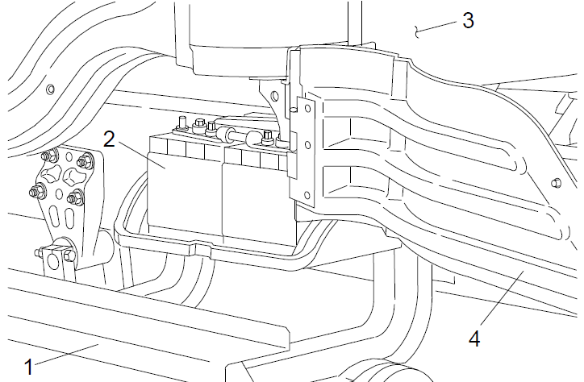
Vehicle Access
Battery Compartment
The battery compartment is located in the lower part of the cab beneath and to the rear of the driver's door. It is fastened by a quarter-turn fastener. To open the battery access door, turn the quarter-turn fastener with a small screwdriver.
1. Top Step
2. Battery
3. Cab
4. Battery Access Door
Cab (Battery) Isolation Switch
The cab isolation switch is located on the cab floor at the left of the driver’s seat, or inside the battery box. The battery isolation switch reduces the power to the cab and engine power wiring. Use it whenever the vehicle is to be put out of service for extended periods.
IMPORTANT: The battery disconnect switch does not completely isolate the batteries from the electrical system. For service operations that require that the batteries be disconnected, always shut down the engine and remove the negative battery cables.
NOTE: Whenever battery power is disconnected, clocks and electronically tuned radios must be reset.

Slide 6
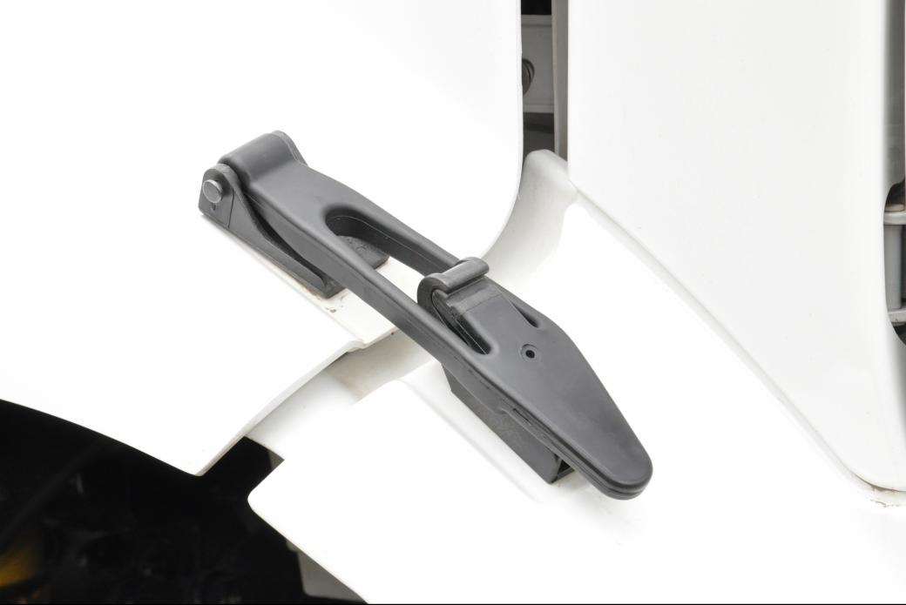
Vehicle Access
Hood Opening and closing
The hood can be raised to a full-open position. A torsion bar helps you to raise the hood, and to lower it to the operating position. Hood restraint cables prevent the hood from over travel. A hood damper limits the closing speed. In the operating position, the hood is secured to the cab-mounted half-fenders by a hold-down latch on each side of the hood.
To Open the Hood
1.Apply the parking brakes.
2.Release both hood hold-down latches by pulling the ends outward.
3.Standing in front of the hood, raise the rear of the hood upward until it reaches the over-center position (45 degrees from vertical). Then slowly bring it to a stop
To Close the Hood
1.Push the hood over center.
2.As the hood goes over center, the damper automatically slows its rate of descent. If needed, you can also slow its rate of descent with your hand.
3.Make sure the hood is flush with the cowl, then secure the hood by engaging both hood hold-down latches.
IMPORTANT: Make sure that both hold-down latches are fully engaged before operating the vehicle.
IMPORTANT: Make sure that both hold-down latches are fully engaged before operating the vehicle.
2
1
3
4
1. Fender
2. Latch Hook
3. Latch Handle
4. Half-Fender
CAUTION
Do not let the hood free-fall to the full-open position. To do so could cause damage to the hood or hood straps.
!

Slide 7
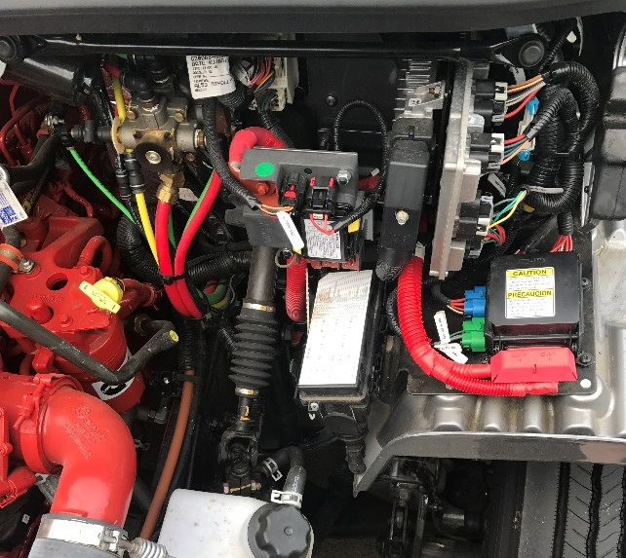
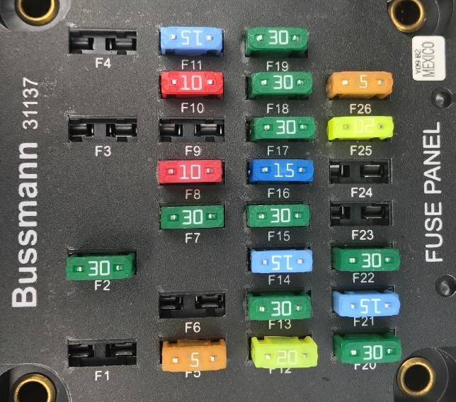
Fuse Identification
Main Fuse Box/PDM
Fuse Identification, Main Fuse Box
Pos. No. | Description | Fuse Color | Rating
F1 | VCU (MBE900 only) | Red | 10 Amp
F2 | Blower Motor | Green | 30 Amp
F3 | Engine ECU | Yellow | 20 Amp
F4 | Transmission Control Unit | Green | 30 Amp
F5 | Ignition Switch | Tan | 5 Amp
F6 | Spare | — | —
F7 | Bulkhead Module | Green | 30 Amp
F8 | ICU | Red | 10 Amp
F9 | Transmission Control Unit | Yellow | 20 Amp
F10 | Door Locks (optional) | Red | 10 Amp
F11 | Mirrors (optional) | Blue | 15 Amp
F12 | Radio/Diagnostics | Yellow | 20 Amp
F13 | Chassis Module | Green | 30 Amp
F14 | L/H Power Windows (optional) | Blue | 15 Amp
F15 | Bulkhead Module | Green | 30 Amp
F16 | ABS ECU | Blue | 15 Amp
F17 | Chassis Module | Green | 30 Amp
F18 | Bulkhead Module | Green | 30 Amp
F19 | Chassis Module | Green | 30 Amp
F20 | Bulkhead Module | Green | 30 Amp
F21 | R/H Power Windows (optional) | Blue | 15 Amp
F22 | Bulkhead Module | Green | 30 Amp
F23 | Spare | — | —
F24 | Spare | — | —
F25 | Spare | — | —
F26 | Spare | — | —
M1 | Battery Power | — | 125 Amp
M2 | Battery Power | — | 125 Amp
M3 | Battery Power | — | 150 Amp
The main fuse box, also known as the power distribution module, or PDM, is located under the hood on the left front fender just forward of the bulkhead module. Below picture. To open the fuse box, pull down on the wire clips holding the lid on the fuse box.
A sticker inside the lid of the fuse box shows the locations of the fuses and describes the circuit(s) that each fuse protects .
The table shows descriptions of a typical set of fuses. The fuses in the main fuse box are mini blade-type fuses. Battery power fuses, located near the batteries, are bolt-in mega fuses.
1
2
1. Bulkhead Module
2. Main Fuse Box

Slide 8
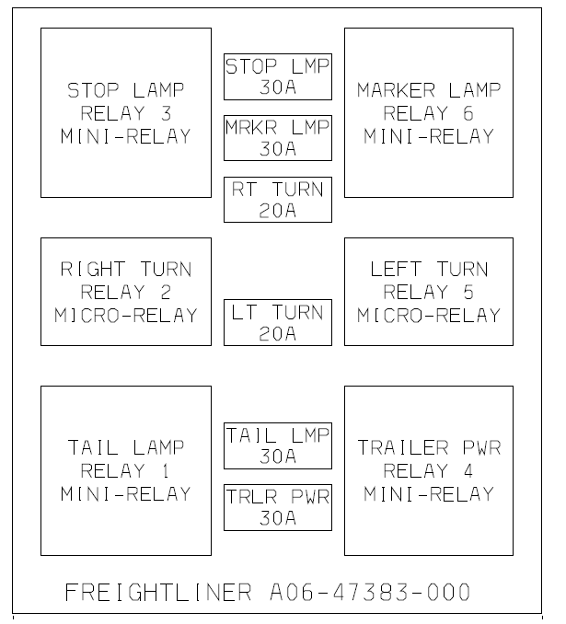
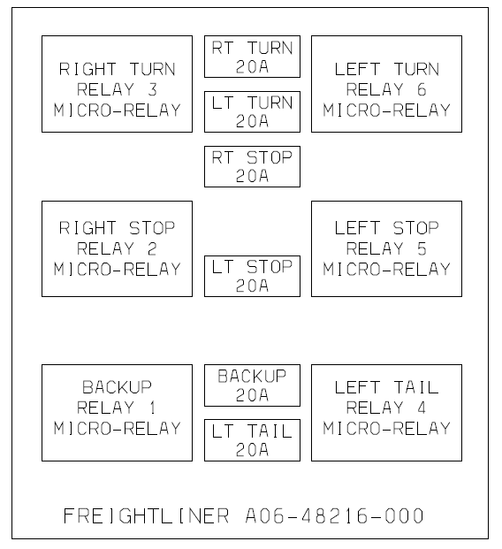
Fuse Identification
Trailer and Taillight Fuse Boxes
The trailer fuse box and the taillight fuse box, on vehicles so equipped, are mounted on a bracket with the chassis module on the left-hand frame rail aft of the cab, or on a cross member at the end of the frame rail. These may be referred to as the chassis fuse box or chassis PDM. See left picture for trailer fuse and relay information, and right picture for taillight fuse and relay information.
These fuse boxes contain mini blade-type fuses, 12-volt mini relays, and 12-volt micro relays.

Slide 9
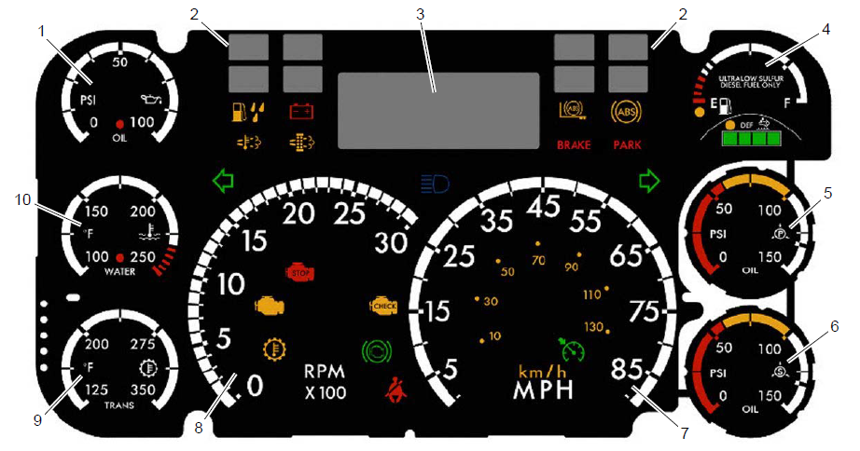
Instruments
Instrument Control Unit
1. Engine Oil Pressure Gauge
2. Optional Telltales
3. Driver Message Center
4. Fuel/DEF Level Gauge
5. Primary Air Pressure Gauge
6. Secondary Air Pressure Gauge
7. Speedometer (U.S. version)
8. Tachometer
9. Transmission Temperature Gauge
10. Coolant Temperature Gauge

Slide 10
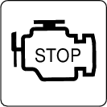

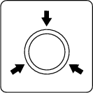




Instruments
Instrument Control Unit – Lamps Descriptions
Indicates a serious fault that requires engine shutdown immediately. The engine protection system will reduce the maximum engine torque and speed, and, if the condition does not improve, will shut down the engine within 30 to 60 seconds.
Safely bring the vehicle to a stop on the side of the road and shut down the engine as soon as the red light is seen. If the engine shuts down while the vehicle is in a hazardous location, turn the key to the OFF position for a few seconds, then restart the engine and move the vehicle to a safer location.
STOP Engine
High Coolant Temperature
Indicates the coolant temperature is above the maximum allowable temperature.
Low Air Pressure (EPA07)
Indicates air pressure in the primary or secondary reservoir has dropped below approximately 70 psi (483 kPa).
Low Air Pressure
(EPA10 and Newer)
Indicates air pressure in the primary or secondary reservoir has dropped below approximately 70 psi (483 kPa).
Indicates the engine oil pressure is below the minimum allowable pressure.
Low Engine Oil Pressure
Parking Brake (EPA07)
Indicates the parking brake is engaged, or hydraulic brake fluid level is low. An audible alert activates when the vehicle is moving over 2 mph (3 km/h) with the parking brake set.
Parking Brake
(EPA10 and Newer)
Indicates the parking brake is engaged.
Lamp Color

Slide 11
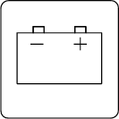


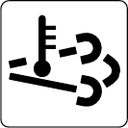

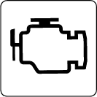

Instruments
Instrument Control Unit – Lamps Descriptions
Low Battery Voltage
Indicates that battery voltage is 11.9 volts or less.
Activates with an audible alert when the system detects that the parking brake is off and the driver seat belt is not fastened on some vehicles. On other vehicles, this lamp illuminates for 15 seconds when the ignition is first turned on.
Unfastened Seat Belt
Indicates an engine condition (low oil pressure, low coolant level, high coolant temperature, high DPF soot level, or uncontrolled DPF regeneration) that requires correction. Correct the condition as soon as possible. If the condition worsens, the STOP engine lamp will illuminate.
CHECK Engine*
Slow (10-second) flashing indicates a regeneration (regen) is in progress.
IMPORTANT: When the HEST lamp is illuminated, do not park the vehicle near flammable material.
Solid illumination indicates high exhaust temperatures at the outlet of the tail pipe when speed is below 5 mph (8 km/h).
High Exhaust System
Temperature (HEST)8*
Diesel Particulate Filter
(DPF) Status
Solid illumination indicates a regen is required. Change to a more challenging duty cycle (such as highway driving ) to raise exhaust temperatures for at least twenty minutes, or perform a parked regen.
Blinking indicates that a parked regen is required immediately. An engine derate and shutdown will occur.
Malfunction
Indicator Lamp (MIL)
Indicates an emissions-related fault. See the engine operation manual for details.
Vehicle ABS
Momentary illumination indicates the vehicle ABS is engaged.
Solid illumination indicates a problem with the vehicle ABS. Repair the ABS immediately to ensure full braking capability.
Lamp Color

Slide 12




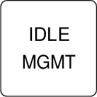


Instruments
Instrument Control Unit – Lamps Descriptions
Trailer ABS
Momentary illumination indicates the trailer ABS is engaged.
Solid illumination indicates a problem with the trailer ABS. Repair the ABS immediately to ensure full braking capability.
No Charge
Indicates the alternator is not properly powering the electrical system.
Water in Fuel
Indicates the fuel may contain water. Drain any water collected in the fuel/water separators.
Fuel Filter Restriction
Indicates the fuel filter is clogged and requires service.
Optimized Idle
Indicates optimized idle is enabled.
Check Transmission
Indicates an undesirable transmission condition.
Transmission Overheat
Indicates high transmission temperature.
Lamp Color

Slide 13





Instruments
Instrument Control Unit – Lamps Descriptions
Wait To Start
(EPA07/EPA10)
EPA10 Detroit engines: Indicates that the system is preventing the starter from cranking. This can occur when the ignition switch is turned to START before the gauge sweep has completed, or if the starter has overheated.
Cummins/Mercedes-Benz engines: Indicates that the intake warmer is active.
Turn the ignition switch back to ON, wait for the lamp to go out, then turn the ignition switch to START again.
Start Blocked
(GHG14 Detroit
engines only)
Indicates that the system is preventing the starter from cranking. This can occur when the ignition switch is turned to START before the gauge sweep has completed, or if the starter has overheated.
NOTE: Illumination of the Start Blocked lamp does not indicate a problem with the starter.
Turn the ignition switch back to ON, wait for the lamp to go out, then turn the ignition switch to START again.
Wheel Spin
Flashing indicates the ATC system is active, or the ATC button has been pressed to allow wheel slip.
Solid illumination indicates a problem with the ATC system. Repair the ATC system immediately to ensure full braking capability
Roll Stability
Momentary illumination indicates that a stability event has occurred.
On vehicles that are also equipped with ATC, flashing indicates the ATC button has been pressed to allow wheel slip.
Hill Start Aid
(HSA) Override
Indicates the HSA switch has been pressed to override the hill start assist feature.
Lamp Color

Slide 14





Instruments
Instrument Control Unit – Lamps Descriptions
Engine Brake†
Indicates the engine brake is enabled.
Left-Turn Signal
Flashing indicates the outside left-turn signal lights are activated.
Right-Turn Signal
Flashing indicates the outside right-turn signal lights are activated.
Cruise Control†
Indicates the cruise control is enabled.
NOTE: The ICU3S does not have a green cruise control telltale.
High-Beam
Headlights
Indicates the high-beam headlights are on.
† On vehicles equipped with the ICU3S, this information is displayed on the driver message center.
Lamp Color

Slide 15
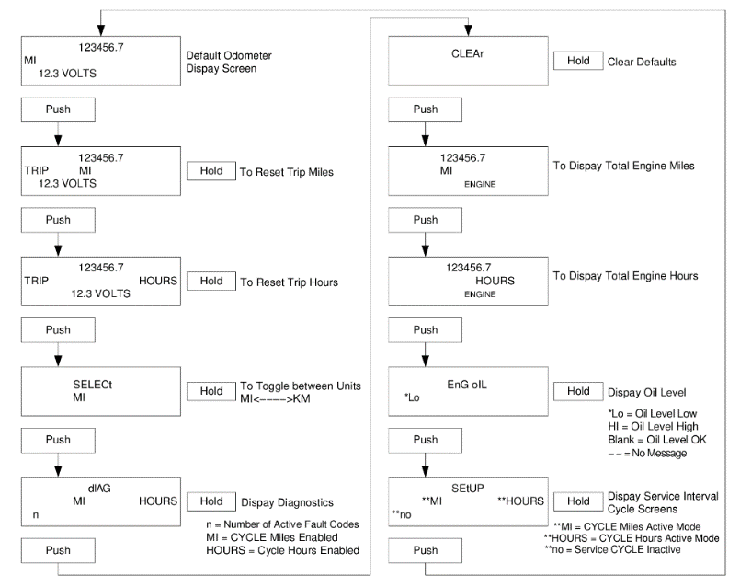
Instruments
Driver Message Center
The driver message center is controlled using the mode/reset switch, located on the right side of the ICU. See below pic. Tap the mode/reset switch to advance one screen; press and hold the switch to select a menu choice or reset the display. When the display resets, an audible chirp sounds.

Slide 16
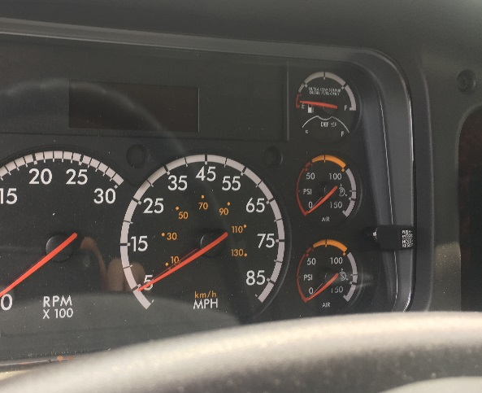
Instruments
Driver Message Center
The following screens are available when the parking brake is off (when the vehicle is mobile) and no active fault codes are found. Use the mode/reset switch to scroll through the screens. To reset any values, press and hold the mode/reset switch. The driving screens appear in the following order:
Odometer
Trip distance
Trip hours
Outside temperature
The cruise control and engine brake indicators are displayed on the driver message center.
Parked Screens/Menus
The parked screens and menus are available when the parking brake is on and no active fault codes are found. Use the mode/reset switch to scroll through the parked screens. To reset any values, press and hold the mode/reset switch. The parked screens appear in the following order:
Odometer
Trip distance
Trip hours
Outside temperature
Select units
Temperature alert
Diagnostics
Engine miles
Engine hours
Setup

Slide 17
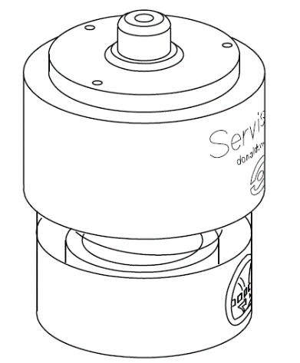
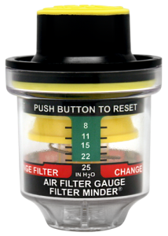
Instruments
Air Intake Restriction Gauge
The air intake restriction gauge indicates the vacuum on the engine side of the air cleaner. On standard installations, it is mounted on the air intake duct in the engine compartment. See below picture. As an option for easier viewing, the air intake restriction indicator can be mounted on the dash, usually on the right-hand control panel.
Air Intake Maximum Restriction Values (inH₂O)
Engine Make | Pre-EPA07 Engines | EPA07 and EPA10 Engines | GHG14 and GHG17 Engines
Detroit | 20 | 22 | 18
Cummins | 25 | 25 | 25
Air intake restriction vacuum is measured in inches of water (inH₂O). For vehicles equipped with a graduated indicator or a restriction gauge on the dash, check the gauge with the engine off. If the yellow signal stays locked in the red zone once the engine is shut down, or is at or above the values shown in above table, the air cleaner element needs to be replaced.
Vehicles may be equipped with a go/no-go restriction indicator without graduations (see right picture) instead of a graduated indicator.
NOTE: Rain or snow can wet the filter and cause a temporary high reading.

Slide 18
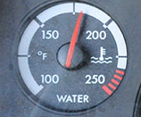
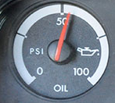
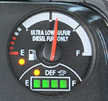
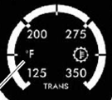
Instruments
Coolant Temperature Gauge/Engine Oil Pressure Gauge/Fuel-DEF Gauge/Transmission Fluid Temperature Gauge
Maximum Coolant Temperature
Engine Make | Temperature: °F (°C)
Cummins | 225 (107)
Detroit | 215 (101)
Minimum Oil Pressure*
Engine Model | At Idle Speed psi (kPa) | At Rated psi (kPa)
Cummins | 15 (103) | 35 (241)
Detroit | 14 (97) | 55 (350)
4
1. Diesel Fuel Level Indicator
2. DEF Level Indicator
3. Low DEF Warning Lamp (amber below 10% DEF)
4. Low Fuel Warning Lamp (amber at 1/8 tank of fuel)
The transmission fluid temperature gauge, measures the transmission lubricant operating temperature. Temperatures vary by application, but the transmission fluid temperature gauge reading should not exceed 250°F (121°C).
1
2
3

Slide 19
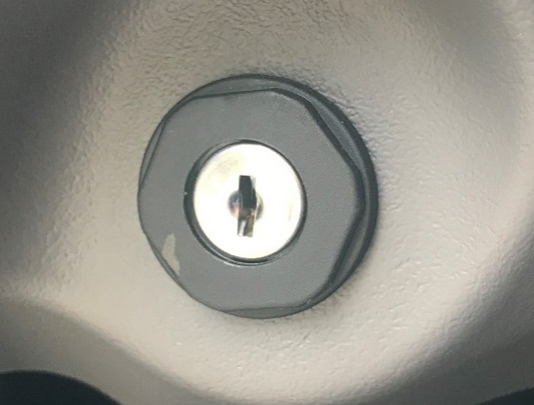
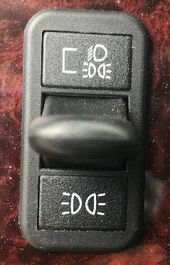
Controls
Ignition/Lights
In the OFF position, the key slot is vertical; the key can be inserted and removed only in this position. The following can be operated in the off position (regardless of whether the key is inserted): The low-beam headlights, taillights, brake lights, road lights, dome lights, clearance lights, turn signals, hazard warning lights, horn, CB radio, power windows, cigarette lighter, clock, and electric oil pan heater.
In the ACCESSORY position, the key is turned counterclockwise. The radio, stereo system, mirror heat, air dryer, backup lights, and all of the electrical systems that are operable in the off position are operable in the accessory position.
In the ON position, the key is turned clockwise and all electrical systems are operable. The low air pressure and low oil pressure warning lights (or messages) and buzzer operate until the engine is started and pressure is built up.
Exterior Light Controls
Headlight/Parking Light Switch
The headlight/parking light switch is a paddle switch located on the left-hand control panel above the cruise control switches. When the paddle is lowered, the parking lights illuminate (the front turn signals, the cab marker and identification lights, and the taillights). When the paddle is raised, the low-beam headlights illuminate, along with all the parking lights. To turn off all lights, return the paddle to the center position.
Raise the paddle to illuminate the headlights, low beam.
Lower the paddle to illuminate the parking lights.

Slide 20
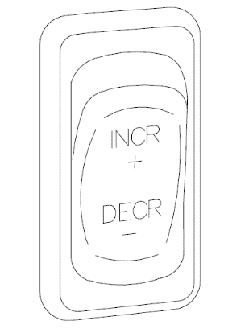
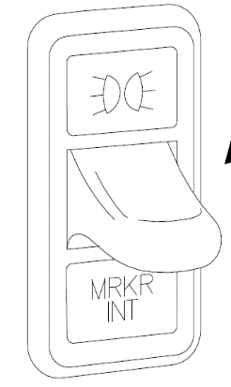
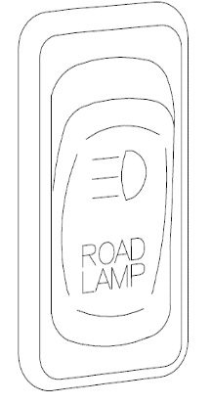
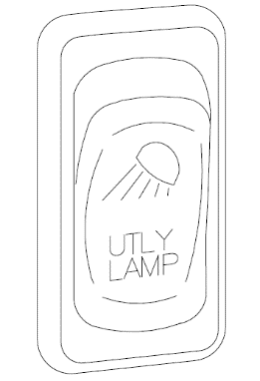
Controls
Lights
Panel Light Increase/Decrease Switch
When the panel lights are on, they can be either brightened or dimmed by using the INCR/DECR rocker switch just below the headlight switch. To brighten the panel lights, press on the upper part of the rocker (at the INCR legend). To dim the panel lights, press on the lower part of the rocker (at the DECR legend).
Marker Light Interrupt Switch
The marker light interrupt (MRKR INT) paddle switch temporarily flashes the marker lights and taillights. With the vehicle lights on, raise the paddle to briefly turn off the marker lights and taillights. With the vehicle lights off, raise the paddle to briefly turn on the marker lights and taillights.
Road Light Switch, Optional
The road light (ROAD LAMP) rocker switch operates the optional road lights, which are recessed into the front bumper or mounted on the lower edge of a cutout in the center of the front bumper.
The low beam headlights must be turned on before the road lights can be turned on. The road lights will not illuminate if the high beam headlights are already on, and switching from low beams to high beams will switch off the road lights.
Utility Light Switch, Optional
The utility light switch operates one of the following lights or sets of lights:
A single round utility light swivel-mounted in the center of the cab roof;
Two round utility lights mounted in fixed positions on each side of the cab roof;
Two flush-mounted utility lights mounted on the back of the cab, one on each side

Slide 21
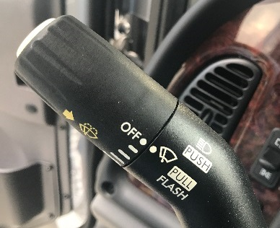
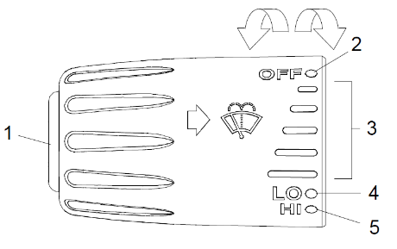
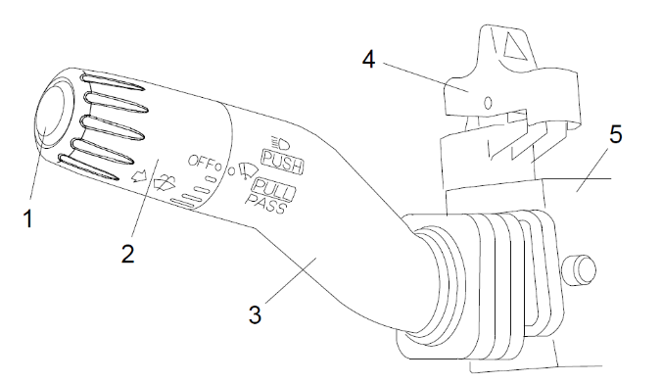
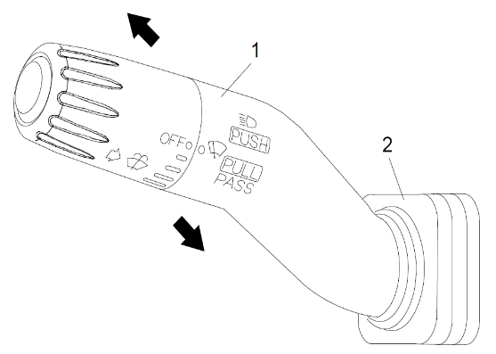
Controls
Multi Turn Signal Switch
The multifunction turn signal switch is attached to the steering column, just below the steering wheel, on the left-hand side. This switch has the following functions:
The turn signals
The windshield wipers and washers
The headlight high beams
The hazard warning flasher
Rotate the control dial away from you to turn the wipers on, or speed them up.
Rotate the control dial towards you to slow the wipers down, or turn them off.
1. Washer Button
2. OFF Position
3. Delay Positions
4. Wipers On, Low Speed
5. Wipers On, High Speed
Move the lever down to turn on the left turn signals.
Move the lever up to turn on the right turn signals.
1. Washer Button
2. Wiper Control Dial
3. Turn Signal Lever
4. Hazard Flasher (red rocker switch)
5. Multifunction Switch Module
Move the lever away from you to turn on the high beams. Move the lever back to its original position to turn them off.
Move the lever towards you to flash the high beams momentarily.
1. Turn Signal Lever
2. Boot

Slide 22
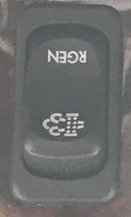
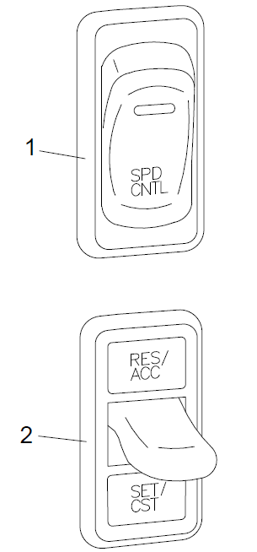
Controls
After-Treatment System (ATS) Request/Inhibit Regen Switch
Cruise Control Switches
To turn cruise control on, press the upper half of the On/Off (rocker) switch. To turn cruise control off, press the lower half of the On/Off (rocker) switch.
1. Cruise Control On/Off (rocker) Switch
2. Cruise Control Set/Resume (paddle) Switch
A parked regen of the ATS can be initiated with the request/inhibit regen switch. It may also be used to inhibit the vehicle from performing an automatic regen. The style and function of switch will vary with the engine make and model. See the engine operation manual for operation details.
!
CAUTION
Do not attempt to shift gears without using the clutch pedal when the cruise control is engaged. Failure to follow this precaution will result in a temporarily uncontrolled increase in engine speed; transmission damage and gear stripping could result.

Slide 23
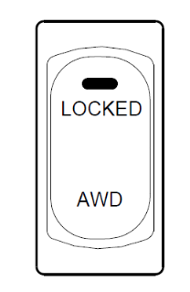
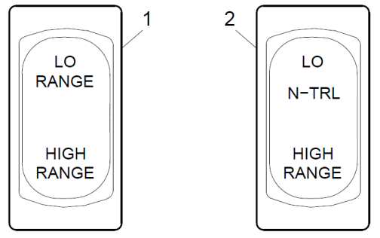
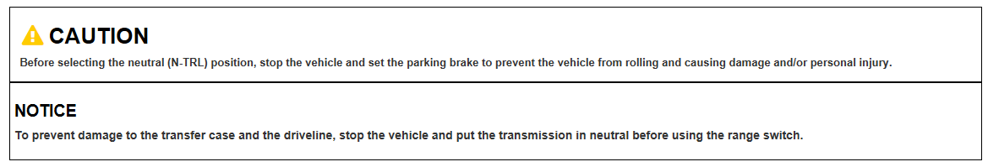
Controls
AWD Range Switch
The AWD switch allows the driver to direct power to the steer axle. For more information about transfer cases and driven steer axles
There are two transfer case range switches: a two-position rocker switch with LO and HIGH RANGE, and a three-position switch that has a neutral (N-TRL) position in the middle for vehicles with a power take-off (PTO) unit. For operating guidelines for Meritor MTC transfer cases.
1. Two-Position Switch
2. Three-Position Switch

Slide 24
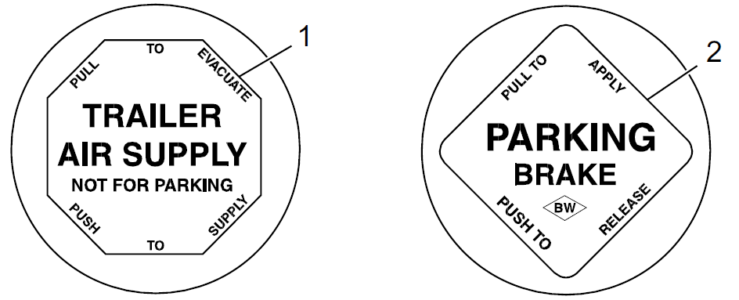
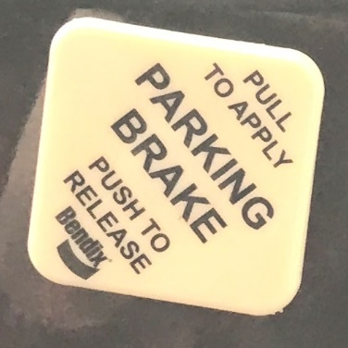
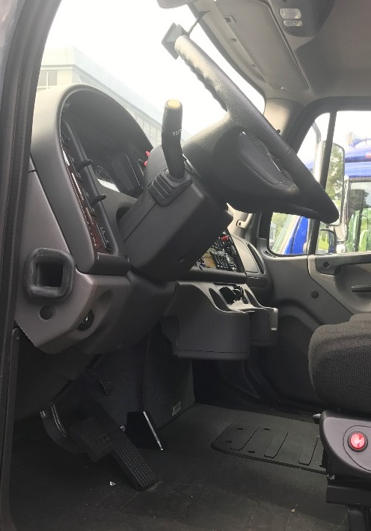
Controls
Parking Brake Control Valve/Adjustable Steering Column
The yellow diamond-shaped knob on the auxiliary dash panel operates the parking brake control valve (park brake switch). Pulling the yellow knob applies the tractor parking brakes (spring brakes). Pushing in the knob releases the tractor parking brakes. Before the parking brakes can be released, the air pressure in either air brake system must be at least 65 psi (448 kPa).
1
1. Multifunction Turn Signal Switch
2. Headlight Switch
3. Ignition Switch
4. Adjustable Steering Column foot Pedal
5. Steering Wheel
5
2
To tilt the steering column, press down on the foot pedal located below the steering column. Tilt the steering column up or down to the desired position. Release the foot pedal to lock the steering column in place.
To telescope the steering column, press down on the foot pedal located below the steering column. Pull the steering wheel closer to you or push the steering wheel farther away from you. Release the foot pedal to lock the steering column in place.
3
4

Slide 25
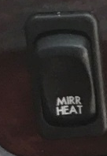
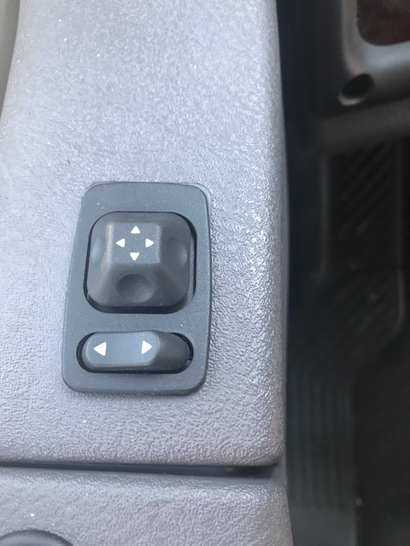
Mirrors
Mirror Heat Switch, Optional
Power Mirrors, Optional
2
One or both outside door mirrors can be heated to keep them clear of fog, frost, and ice.
To heat the mirrors, press the upper part of the mirror heat switch (MIRR HEAT) on the dash. When the mirror heat switch is on, an amber indicator light illuminates inside the switch
1
1. Mirror Select Switch
2. Keypad
The main outside mirrors, if heated, can be equipped with an electrical remote control located on the driver's door. To select the mirrors on the left-hand side, press the left side of the mirror select switch. To select the mirrors on the right-hand side, press the right side of the mirror select switch.
The keypad has four arrow keys, pointing up, down, left, and right. To adjust the mirror position, press the keypad in the direction you want the mirror to move.

Slide 26
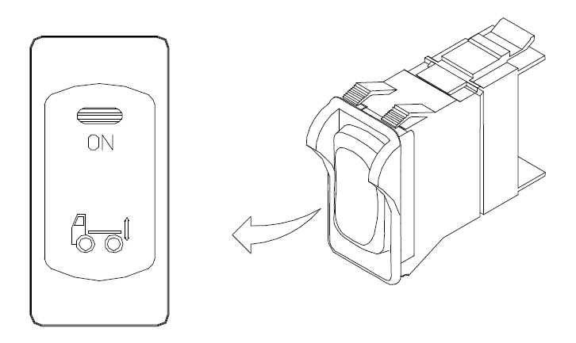
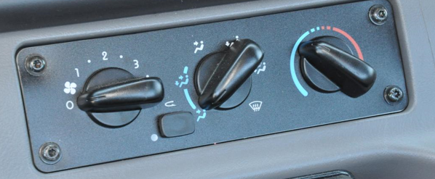
Controls
Suspension Dump Switch/Heater/Air Conditioner Control Panel
The suspension dump switch is a two-position guarded rocker switch. It allows the air in the vehicle air suspension to be quickly exhausted, lowering the rear of the vehicle. This makes it easier to connect to, or disconnect from, a trailer.
To lower the rear of the vehicle quickly, press the upper half of the rocker momentarily (at the LED). To raise the suspension to its normal height, press the upper half of the rocker again.
When the panel lights are on, the tractor icon is backlit in green.
IMPORTANT:
The suspension dump switch is guarded to prevent unintentional switch activation. This switch does not have a diagnostic blink function when inactive.
Standard controls for the heating, ventilation, and air-conditioning system (HVAC) consist of an eight-speed fan switch, an air selection switch, and a temperature control switch. On vehicles with air conditioning, the panel also contains a telltale LED and an air recirculation button.
2
1. Fan Switch
2. Air Selection Switch
3. Temperature Control Switch
3
1

Slide 27





Cab Features
Seats (Seat operation will vary depending on seat option purchased)
A. Seat Slide (fore-and-aft) Adjustment
B. Isolator Feature
A. Lumbar Support
B. Headrest Adjustment
A. Backrest Tilt
B. Seat Cushion Tilt
A. Ride Height

Slide 28





Cab Features
Seat Belt Operation
A. Disengaged
B. Engaged
Sliding Komfort Latch
Fastening the Three-Point Belt
Adjusting Shoulder Harness Clearance, Comfort Clip
Locking the Comfort Clip

Slide 29



Engines
Regeneration/Regen Switches
Regeneration
The harder an engine works, the better it disposes of soot. If the exhaust temperature is high enough, a process called passive regeneration (regen) occurs as the vehicle is driven normally. However, if the engine isn't running hot enough, the electronic controls may initiate an active regen , whereby extra fuel is injected into the exhaust stream to superheat and reduce the soot trapped in the DPF to ash. Active regen happens only when the vehicle is moving above a certain speed, determined by the engine manufacturer. See your engine operation manual for complete details. Both active and passive regen happen automatically, without driver input.
Regen Switches
The regen request switch, located on the dash, is used to initiate a parked regen. The function of the switch varies by the engine make and model in the vehicle. See the engine operation manual for switch operation details.
Some vehicles may be equipped with a regen request/inhibit switch. o stop a regen in progress or prevent the start of a regen, press the lower half of the switch. Regen is then delayed until the switch is no longer active.
NOTE: The regen switch can initiate a parked regen only when the DPF lamp is illuminated.

Slide 30

ATS Warning Lamps
There are three warning lamps that alert the driver of high exhaust temperature, the need to perform a parked regen or service the DPF, or of an engine fault that affects emissions. A decal attached to the driver's sun visor explains the ATS warning lamps
Warning Lamp Decal, Sun Visor

Slide 31

ATS Warning Lamps
Actions required to avoid engine protection sequences

Slide 32




ATS Warning Lamps
Actions required to avoid engine protection sequences
Malfunction Indicator Lamp (MIL)
DPF Status Lamp
HEST Lamp
If the DPF status lamp blinks while the CHECK engine lamp is illuminated, initiate a parked regen immediately in order to prevent an engine derate.
If the red STOP engine lamp illuminates with the blinking DPF lamp and the CHECK engine lamp, begin a parked regen in order to prevent an engine shutdown. Park the vehicle and perform a parked regen
High Exhaust System Temperature (HEST) Lamp
Slow (10-second) flashing of the high exhaust system temperature (HEST) lamp indicates that a parked regen is in progress, and the engine's high idle speed is being controlled by the engine software, not the vehicle driver.
Steady illumination of the HEST lamp alerts the driver of high exhaust temperature during the regen process if the vehicle speed is below 5 mph (8 km/h), or during a parked regen
Maintenance
Authorized service facilities must perform any DPF service. For warranty purposes, maintain a record that includes:
date of cleaning or replacement;
vehicle mileage;
particulate filter part number and serial number.
1. Batteries
2. DEF Tank

Slide 33


Fuel/DEF Gauge
The diesel fuel and DEF levels are measured in a dual-purpose gauge.
Fuel level is indicated at the top of the gauge. Below the fuel level, a low fuel warning lamp illuminates amber when the fuel level drops below 1/8th of the capacity.
A. Green bars—DEF level indicators
B. One bar illuminated amber—DEF very low, refill DEF
C. One bar flashing red—DEF empty, refill DEF
1. Low Fuel Warning Lamp
2. DEF Warning Lamp
A. DEF Warning Lamp (flashing)
B. DEF Light bar (one bar flashing red)x

Slide 34


Drivertrain
Allison MD Series/SmartShift Shift Control
1. SmartShift Control Lever
2. Slide Switch
3. MAN Mode (of slide switch)
4. AUTO Mode (of slide switch)
5. Upshift Direction
6. Reverse Position (of selector switch)
7. Selector Switch
8. Neutral Lock Button
9. Neutral Position (of selector switch)
10. Drive Position (of selector switch)
11. Low Position (of selector switch)
12. Downshift Direction
1. Digital Display
2. Mode Identification Label
3. Mode Indicator LED
4. Mode Button

Slide 35


Maintenance
Complete daily inspection and maintenance procedures to ensure that vehicle components are in good working condition before each trip. A driver who is familiar with the vehicle and drives it regularly can perform the daily inspections, then add the weekly and monthly post-trip inspections as scheduled.
IMPORTANT: For pre- and post-trip checklists, inspections, and maintenance procedures, Refer to M2 Driver’s Manual, Maintenance Manual and other component and body manufacturers' instructions for specific inspection and maintenance instructions, as well as local, state, and federal guidelines.
Below are inspection areas locations.
Oil check- Driver Side
Coolant Check / Fill - Passenger Side

Slide 36



Maintenance
Washer Check / Fill - Passenger side
Power Steering Check / Fill - Passenger side
Air Cleaner- Passenger side

Slide 37


Maintenance
Air Filter Restriction Gauge

Slide 38

Thank You

