Slide 1

Speakers’ Bureau Briefing
Ensuring trusted elections and civics for Georgians

Slide 2
Contents
  Introduction (p. 3)
      Your role as speaker
      Content guidelines
  About speaking engagements (p. 4)
      What qualifies as a speaking engagement
      How to ask for speaking time on an agenda
  Creating your presentation (p. 5)
      Style, format recommendations
      Content recommendations, links and downloads
      Complete customizable sample presentation
  Additional resources and links (p. 6)
  Appendix (p. 8-13)

Slide 3
Introduction
  Thank you for being part of our Speakers’ Bureau. As a representative of the Georgia Democracy Task Force, you will be supporting the ABA Task Force’s strategic communications plan by informing and educating your audience on:
      The importance of American democracy
      The centrality of elections to the successful exercise of democracy principles
      The imperative of the rule of law in a democracy
      The corrosive effects of extreme rhetoric and misinformation on political discourse
  We will provide resources, tools, and templates to guide your presentation, and we encourage you to make your presentation unique and relevant to your audience.

Slide 4
About Speaking Engagements
  Size, scope, location, and frequency of speaking engagements will vary by speaker and by region of the state. Determining factors will include each speaker’s personal and professional networks along with areas of expertise or particular interest.
  Speaking engagements can be events that the speaker was invited to participate in, or that the speaker requested to participate in. Other important information about speaking engagements:
      Everything counts. If you speak to 5 neighbors or to an audience of 5,000. If the message is delivered, you have completed an engagement.
      Look for opportunities to speak at events you attend regularly. For example, Rotary, Kiwanis or like clubs; professional association meetings, social clubs and groups, religious gatherings, etc.
      Ask for time on the agendas of meetings and events that you attend.
      Monitor community calendars for unique speaking opportunities.
      Need to cold contact an event host? Use or modify our pitch template to introduce yourself.
      Look for hyper-local opportunities to speak with small, engaged groups.

Slide 5
Creating your Presentation
  The style and format of your presentation should be based on what best suits your audience.
  Content should focus on how the key topics, as identified by the ABA, apply to Georgia. Links and downloads for each item below are available on our website. Feel free to use these and any other materials you deem appropriate for your event. As a starting point, you are welcome to use this document for your presentation or create your own with key concepts below in mind.
      The importance of American democracy
          How you can get involved in Georgia
      The centrality of elections to the successful exercise of democracy principles
          How elections are structured in Georgia
          Challenges to the election administration process
          Attacks on elections officials
      The imperative of the rule of law in a democracy
          Your role as a legal professional
          Specifics to Georgia
      The corrosive effects of extreme rhetoric and misinformation on political discourse
          Identifying and combating mis/disinformation
          Disagreeing better
          Utilizing ABA Working Papers
          Lost not Stolen – Georgia section

Slide 6
Additional Resources and Links
Visit our website regularly for additional:
  Updates to this deck
  Links to in depth materials
  Links to multi-media aids
  Links to documents/reports
  Links to partner organizations
Notes:
GA Secretary of State website - proposed election amendments:
https://sos.ga.gov/page/proposed-elections-division-rules-and-rule-amendments
Protect Democracy working paper on proposed legislative changes:
https://docs.google.com/document/d/1gtpGcv06KxhsoNANfgHe-4cVjyOeRygc/edit?usp=sharing&ouid=102091946719996189444&rtpof=true&sd=true

Slide 7
Appendix
Slides 8-13 are optional templates for your presentation. The supporting articles and documents are linked directly on each slide and are available for download on our website. Feel free to adjust them to fit your presentation.
Notes:
GA Secretary of State website - proposed election amendments:
https://sos.ga.gov/page/proposed-elections-division-rules-and-rule-amendments
Protect Democracy working paper on proposed legislative changes:
https://docs.google.com/document/d/1gtpGcv06KxhsoNANfgHe-4cVjyOeRygc/edit?usp=sharing&ouid=102091946719996189444&rtpof=true&sd=true

Slide 8

How elections work in Georgia
  Secretary of State’s Office
  State Board of Elections
  Local Board Structure and Elections Administration
  Georgia Election Code

Slide 9
Your role as a legal professional
  Defending Democracy and Upholding the Rule of Law
  Ensuring Fair Elections and Systems
  Strengthening Public Understanding
  Lawyer as Public Citizen
  Disagreeing Better – Lawyers should lead by example

Slide 10
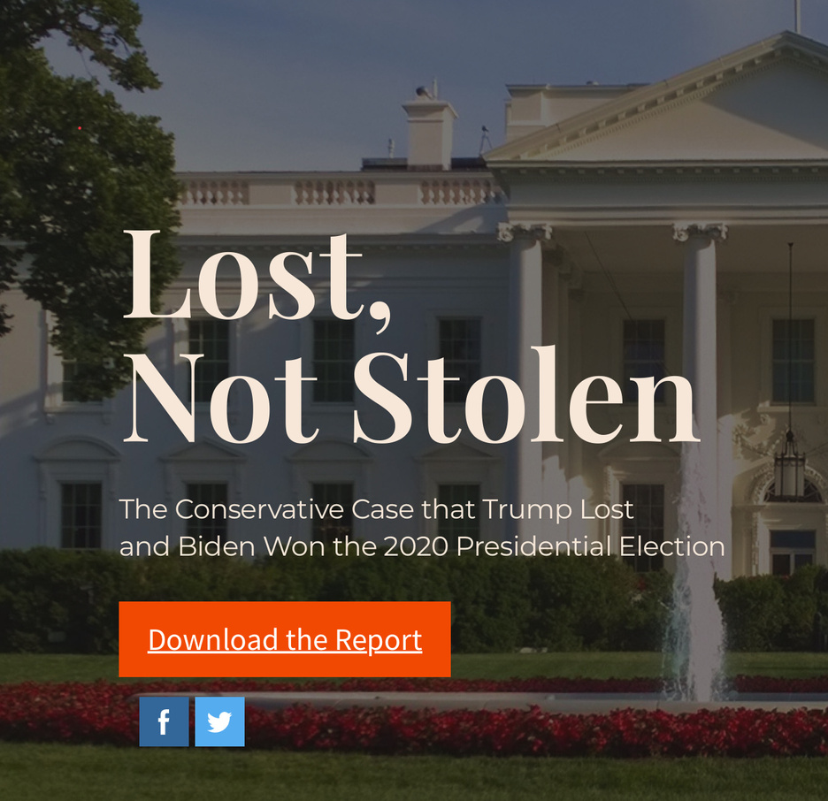
Lost, Not Stolen
  The Lost, Not Stolen Report was researched and published by respected political conservatives.
  Examines 64 cases containing 187 counts of fraud, etc. that unsuccessfully challenged 2020 election results in key states
  There is no principle of our Republic more fundamental than the right of the People to elect our leaders and for their votes to be counted accurately.
  Efforts to thwart the People’s choice are deeply undemocratic and unpatriotic.

Slide 11
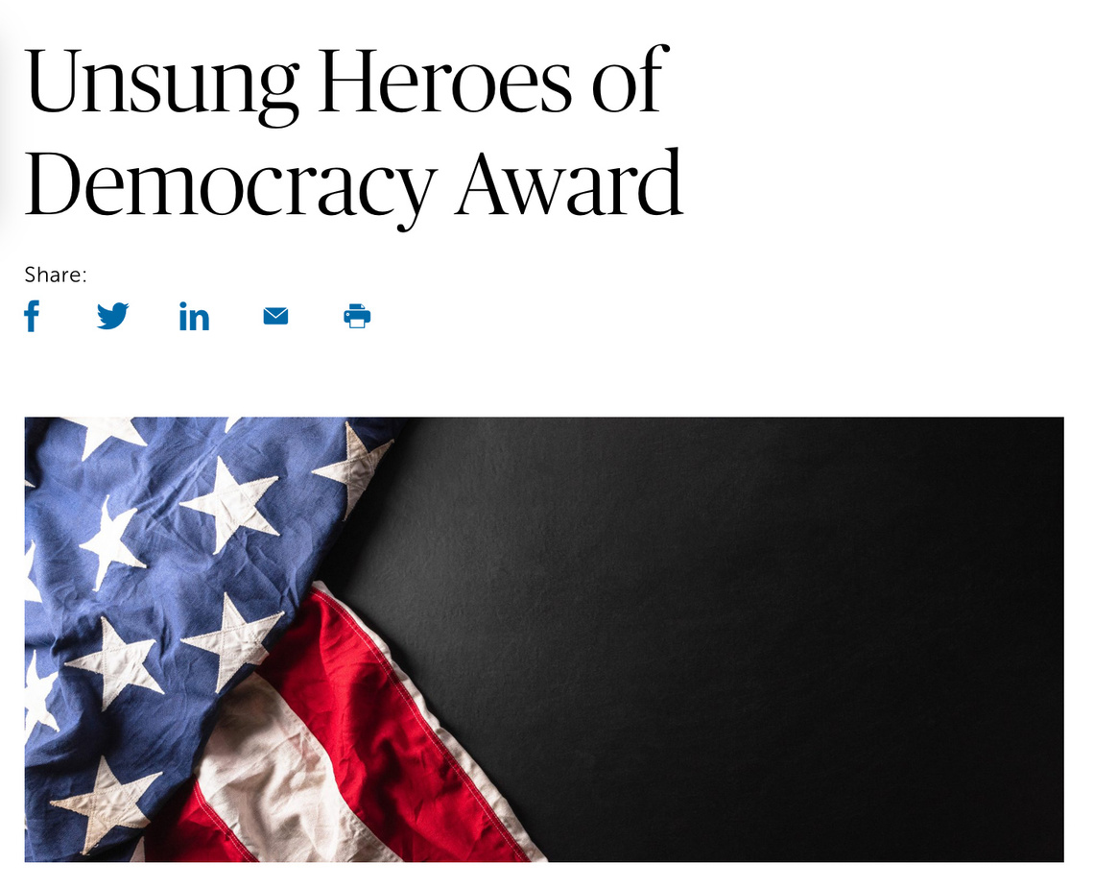
Unsung Heroes of Democracy Award
  Nominate someone for this important award. Eligible candidates include lawyers, election workers, everyday citizens and non-profit organizations that stand up for democracy and the rule of law.
More information at www.americanbar.org

Slide 12
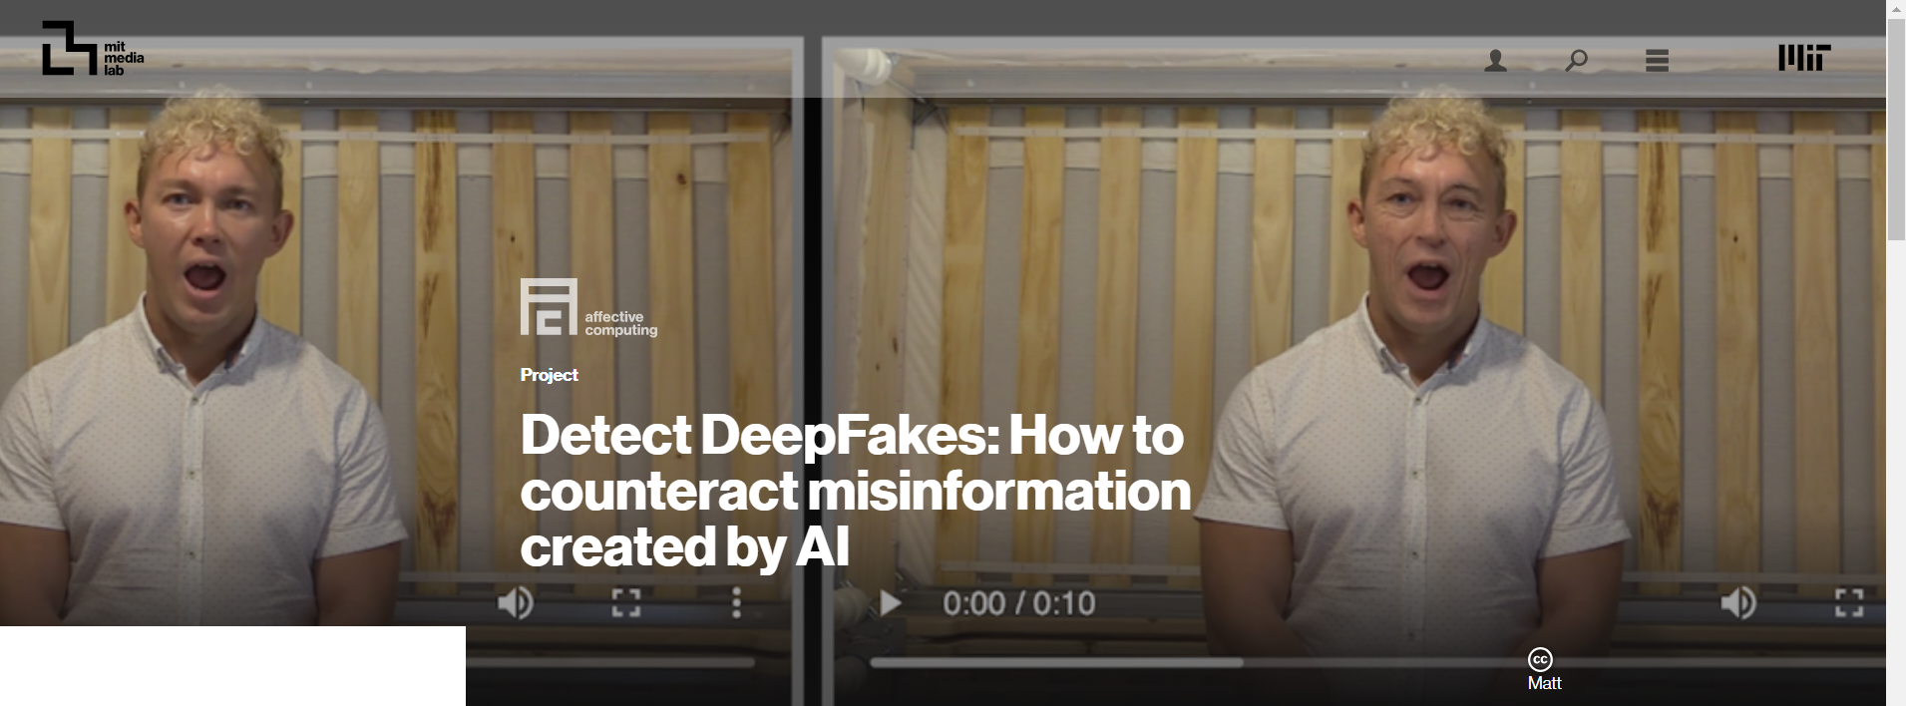
Combatting Mis and Disinformation
Help stop the spread of mis and disinformation by learning to detect deepfakes. Visit the MIT Media Lab’s Website, read and share the ABA’s working paper on Deepfakes and American Elections.

Slide 13
Specific Examples - Speaker Guides
Speaker’s Guide
Speaker’s Guide
What Can Lawyers Do?
Rule of Law

