Slide 1
BIRD’S EYE VIEW OF THE WORLD
DEVAJIT BHUYAN
AUTHOR, CAREER GURU & MENTOR
www.devajitbhuyan.com

Slide 2
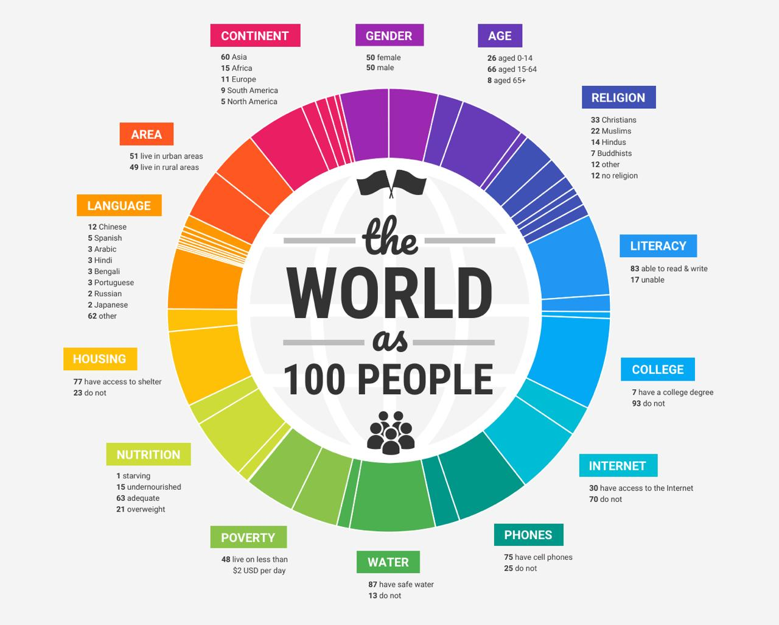

Slide 3
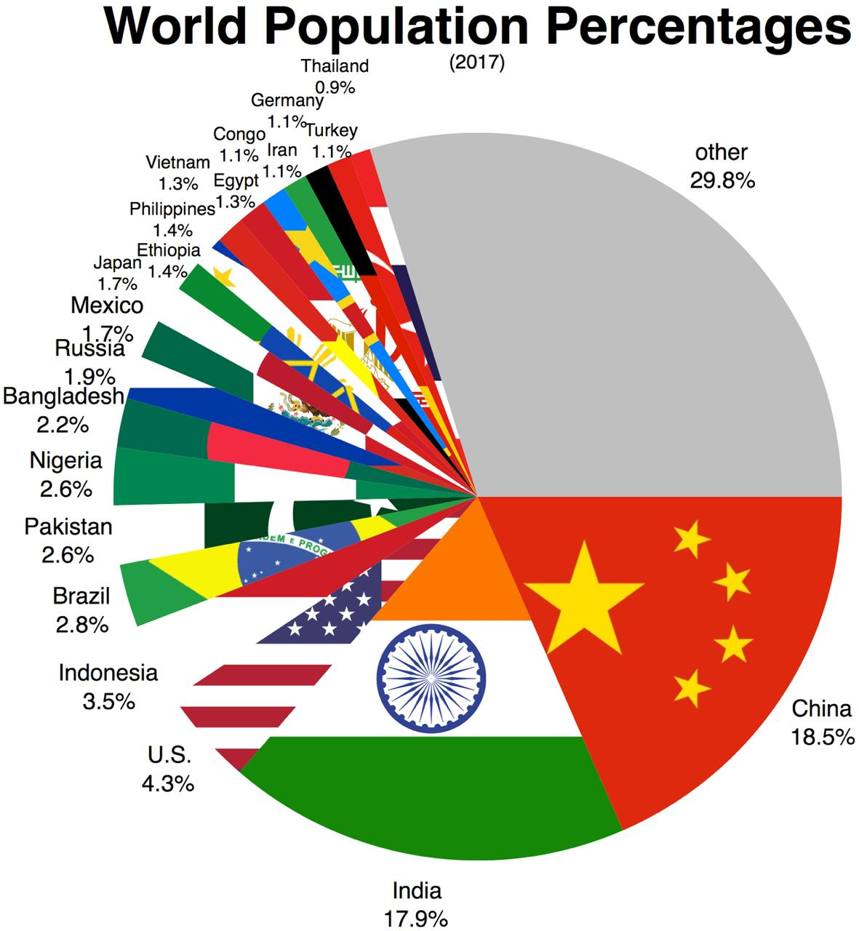

Slide 4
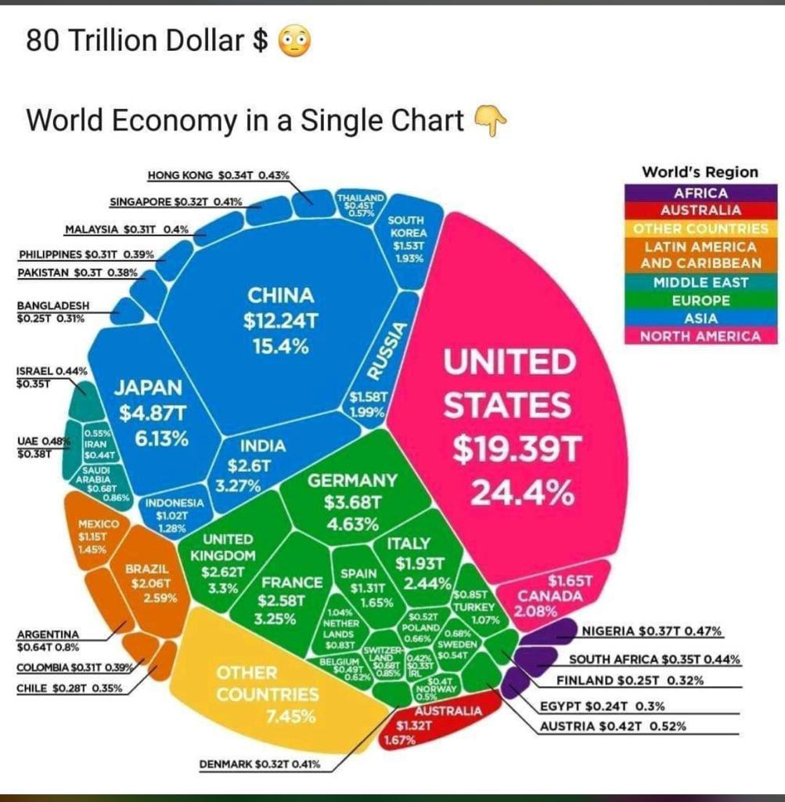

Slide 5
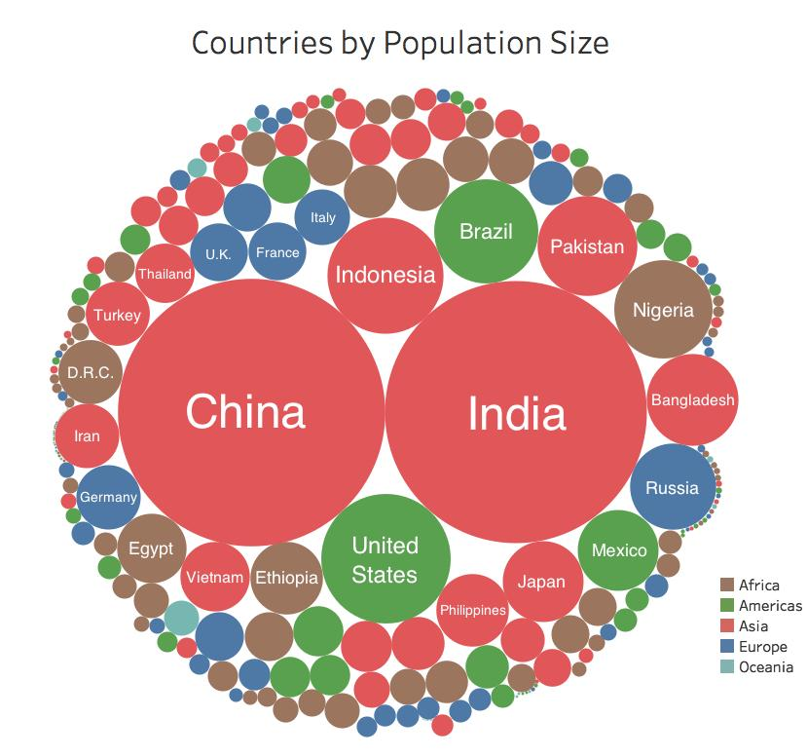

Slide 6
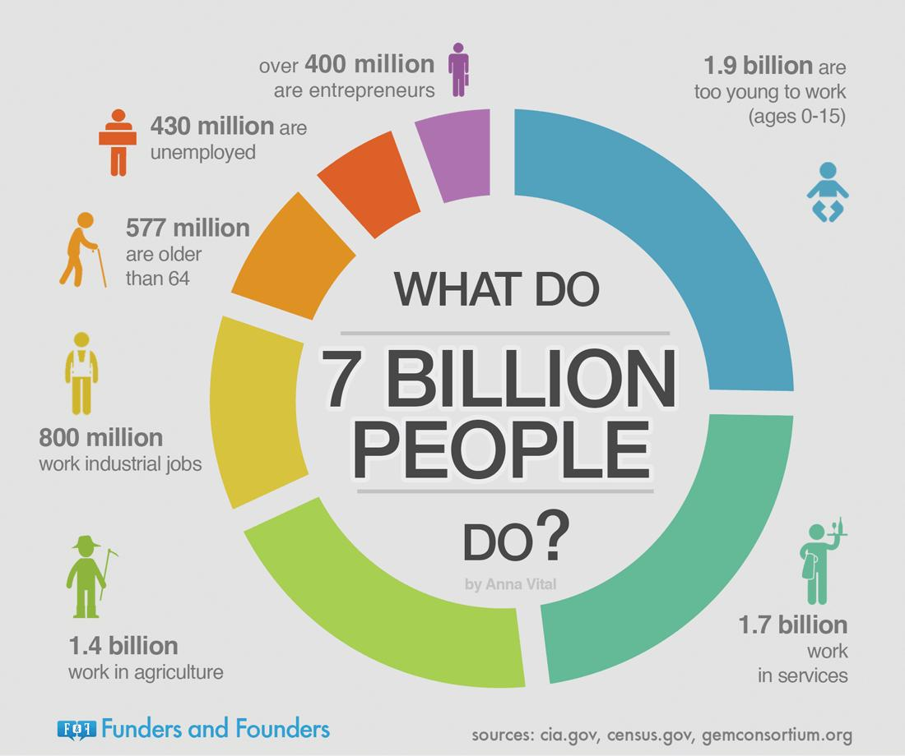

Slide 7


