Slide 1
Two Developmental Theorists to Examine
Martin CJ Mongiello
School of Psychology and Social Sciences, National University
PSY-7120 v2: Overview of the Psychological Concepts (9187202574)
Doctor Amanda Gibson, Ph.D.
August 9, 2025
Notes:
Begin slide show easily.

Slide 2
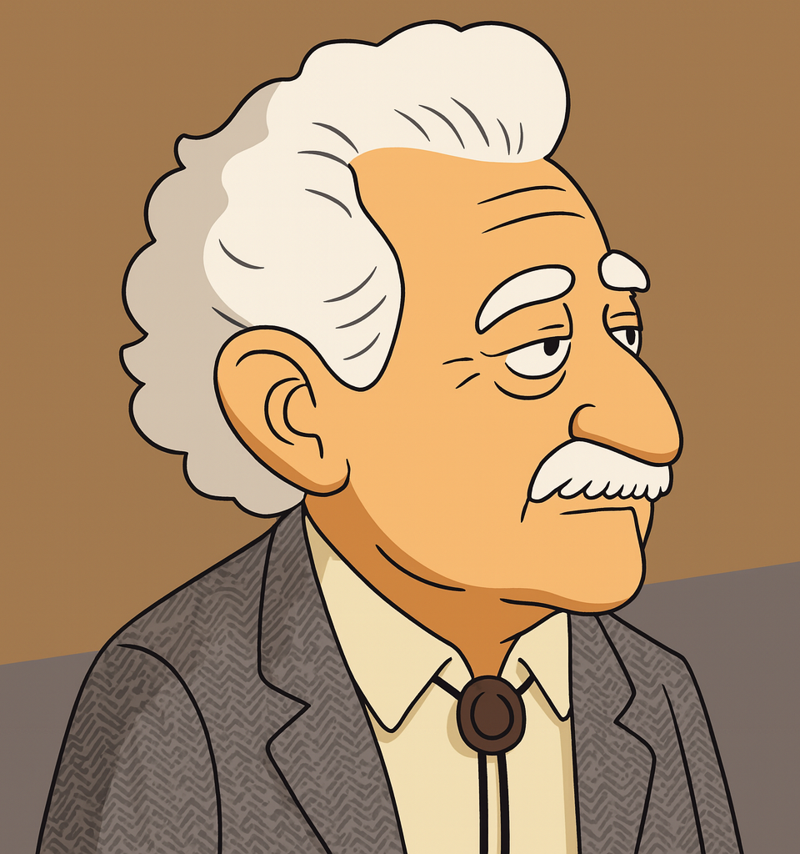
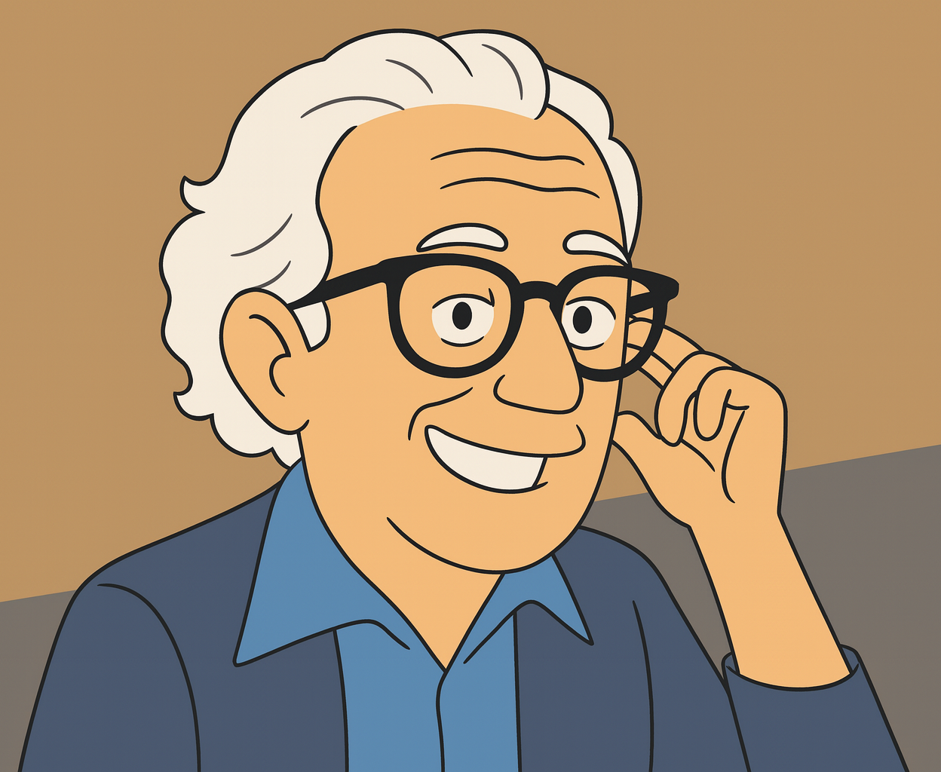
Comparing
Erik Erikson &
Dr. Albert Ellis
An Introductory Psychology Perspective including an unlicensed psychotherapeutic practitioner with no degree and a practitioner who received MA and Ph.D. degrees from Columbia University and was licensed to practice by the noted American Board of Professional Psychology (ABPP).
Photo credits: Martin CJ Mongiello
original cartoon design, August 9, 2025
Notes:
Be ready for bristling in the audience over Erikson being unlicensed and having no degree.

Slide 3

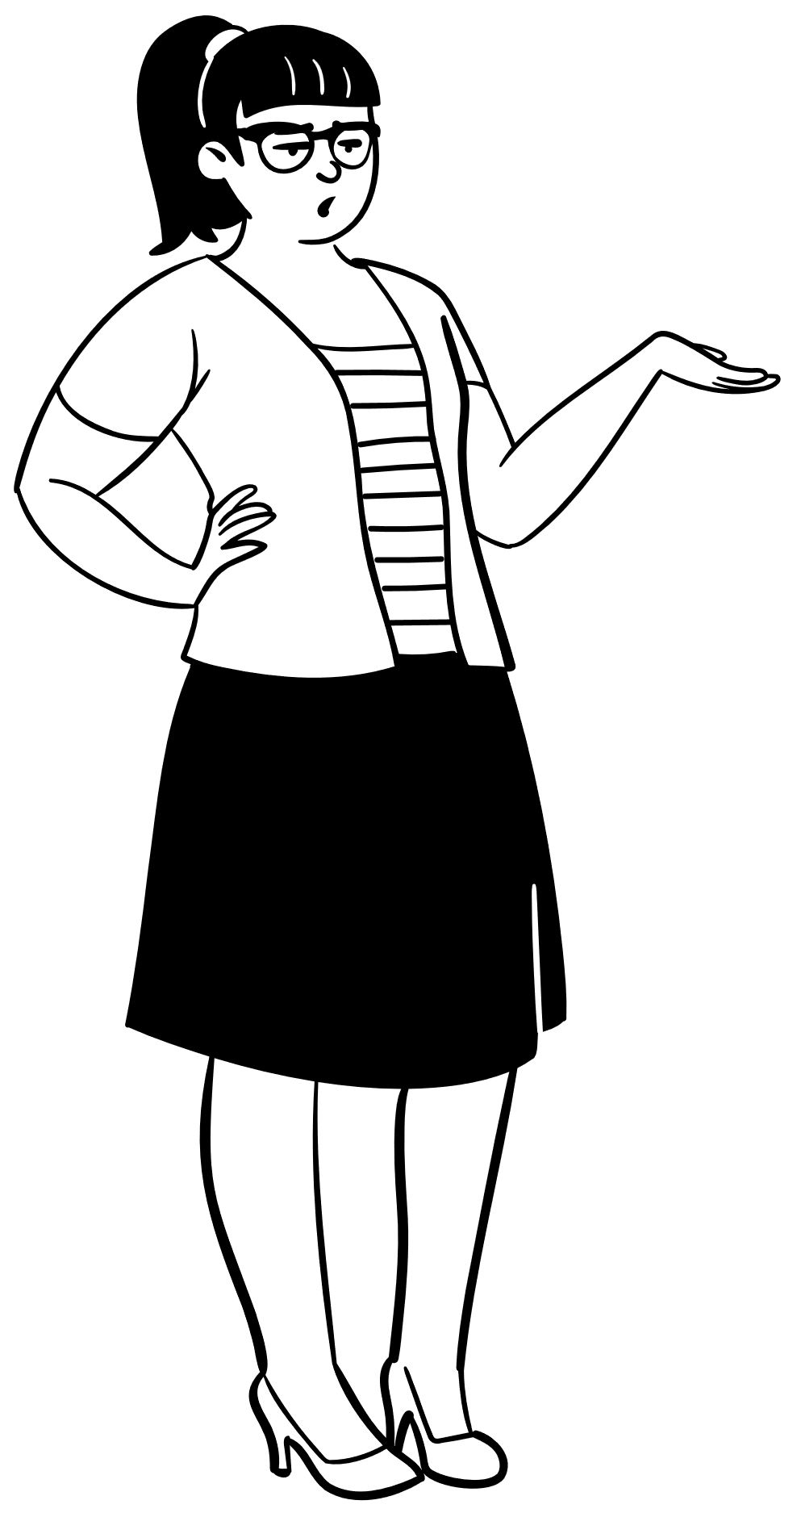
Overview
Erik Erikson: Developmental psychoanalyst, psychosocial stages.
Albert Ellis: Founder of Rational Emotive Behavior Therapy (REBT).
Different foundations, similar aim: improving well-being.
(Dredze, 2020)
(Erikson, 1967)
Photo credits: Microsoft Free Online Library
of Graphics in PowerPoint, August 9, 2025
Notes:
This presentation compares Erik Erikson, known for his eight stages of psychosocial development, and Albert Ellis, creator of REBT. Erikson expanded Freud’s theories to cover the entire lifespan, emphasizing the role of social and cultural influences. Ellis broke from psychoanalysis, advocating for rational thinking to replace harmful beliefs. While their approaches differ—Erikson’s being stage-based and developmental, Ellis’s being immediate and cognitive—they share a goal of fostering mental health through personal growth.

Slide 4
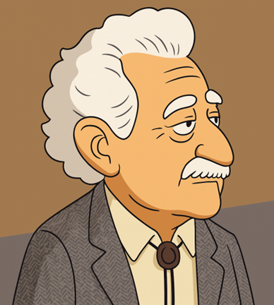
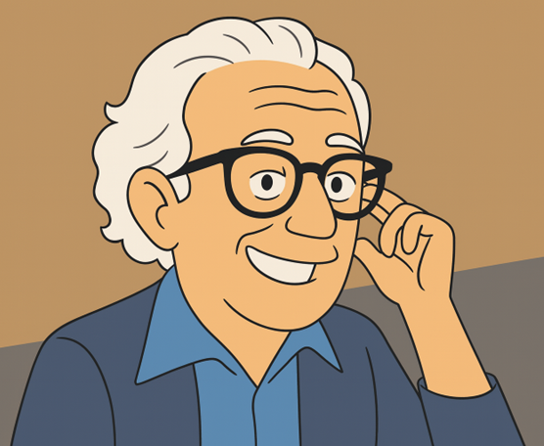

Background
Erikson: German-American, trained in psychoanalysis, lifespan focus.
Ellis: American psychologist, cognitive-behavioral pioneer.
(Dredze, 2020)
(Gredler, 2003)
Notes:
Erikson, trained under Anna Freud, integrated cultural and social aspects into psychoanalytic theory. His eight-stage model provided a framework for understanding development from infancy to late adulthood. Ellis, frustrated by the slow pace of psychoanalysis, developed Rational Emotive Behavior Therapy (REBT) in the 1950s to directly target irrational beliefs. His approach influenced modern Cognitive Behavior Therapy (CBT) methods. Both became key figures in moving psychology toward practical, results-driven applications—Erikson in education and counseling, Ellis in psychotherapy and self-help.

Slide 5
Theories & Contributions
Erikson: Eight Stages of Psychosocial Development.
Ellis: Activating Event – Belief – Consequence (ABC) Model in Rational Emotive Behavior Therapy (REBT).
(حمزه باقری حیدری, 2024)
(Rovira, 2016)
Notes:
Erikson’s eight stages outline life’s psychological conflicts—trust vs. mistrust in infancy to integrity vs. despair in old age. Each stage’s resolution influences later growth. Ellis’s ABC model describes how an activating event (A) leads to beliefs (B), which cause consequences (C). Challenging irrational beliefs changes emotional outcomes. Erikson provided a developmental roadmap; Ellis offered a hands-on tool for emotional change. Together, they represent developmental and cognitive-behavioral approaches in psychology.

Slide 6





Foundational Theories
Erikson: Expanded Freud’s work beyond childhood.
Ellis: Departed from psychoanalysis for direct cognitive restructuring.
(Dredze, 2020)
(Lieberman, 1999)
Notes:
Erikson’s roots were in psychoanalysis, but he emphasized social context and lifelong identity formation, diverging from Freud’s focus on childhood and sexual drives. Ellis rejected the passive analyst role, preferring active dialogue. Drawing from Stoic philosophy, Ellis taught that emotional control comes from altering thought patterns. Both recognized human capacity for change, but Erikson’s model focused on long-term development, whereas Ellis focused on immediate cognitive restructuring.

Slide 7
Ethical Practices
F
A grade of F has been assigned with university violation of code of conduct and ethics policies. Illegal and immoral references have been used. The student has achieved academic suspension.
Erikson: Respect for autonomy, cultural sensitivity. Violated now modern standards of licensure and this presentation may be viewed as inappropriate and unethical, by many, for including him as he had no degree.
Ellis: Direct but empathetic belief-challenging. Obtained a license and had a doctorate degree. He was well known for cursing, and many considered him to be disrespectful to the world and uneducated despite publishing almost 100 books. The student presenter, Martin CJ Mongiello may be considered uncultured, wrong, inappropriate, and uneducated for including Dr. Ellis in any research – or The Ellis Institute of New York may be viewed as horrific, disgusting, revolting, and filthy in the world of psychology.
(Baird, 2019)
(Evans, 2007)
(Watson & Dodd, 1990)
Notes:
Erikson emphasized dignity, cultural respect, and framing life crises as growth opportunities. Ellis valued honesty, often using blunt language, but stressed empathy and informed consent. Both align with APA ethics: beneficence, non-maleficence, and respect for rights. Ellis’s approach was more confrontational, potentially challenging for sensitive clients, whereas Erikson’s was more reflective and exploratory. Both maintained ethical commitments to client welfare and professional integrity. Fellow students using these practitioners in their work could run the risk of receiving failing grades or be disciplined in some universities for referencing them. Please be safe and check in your university and country before doing so.

Slide 8
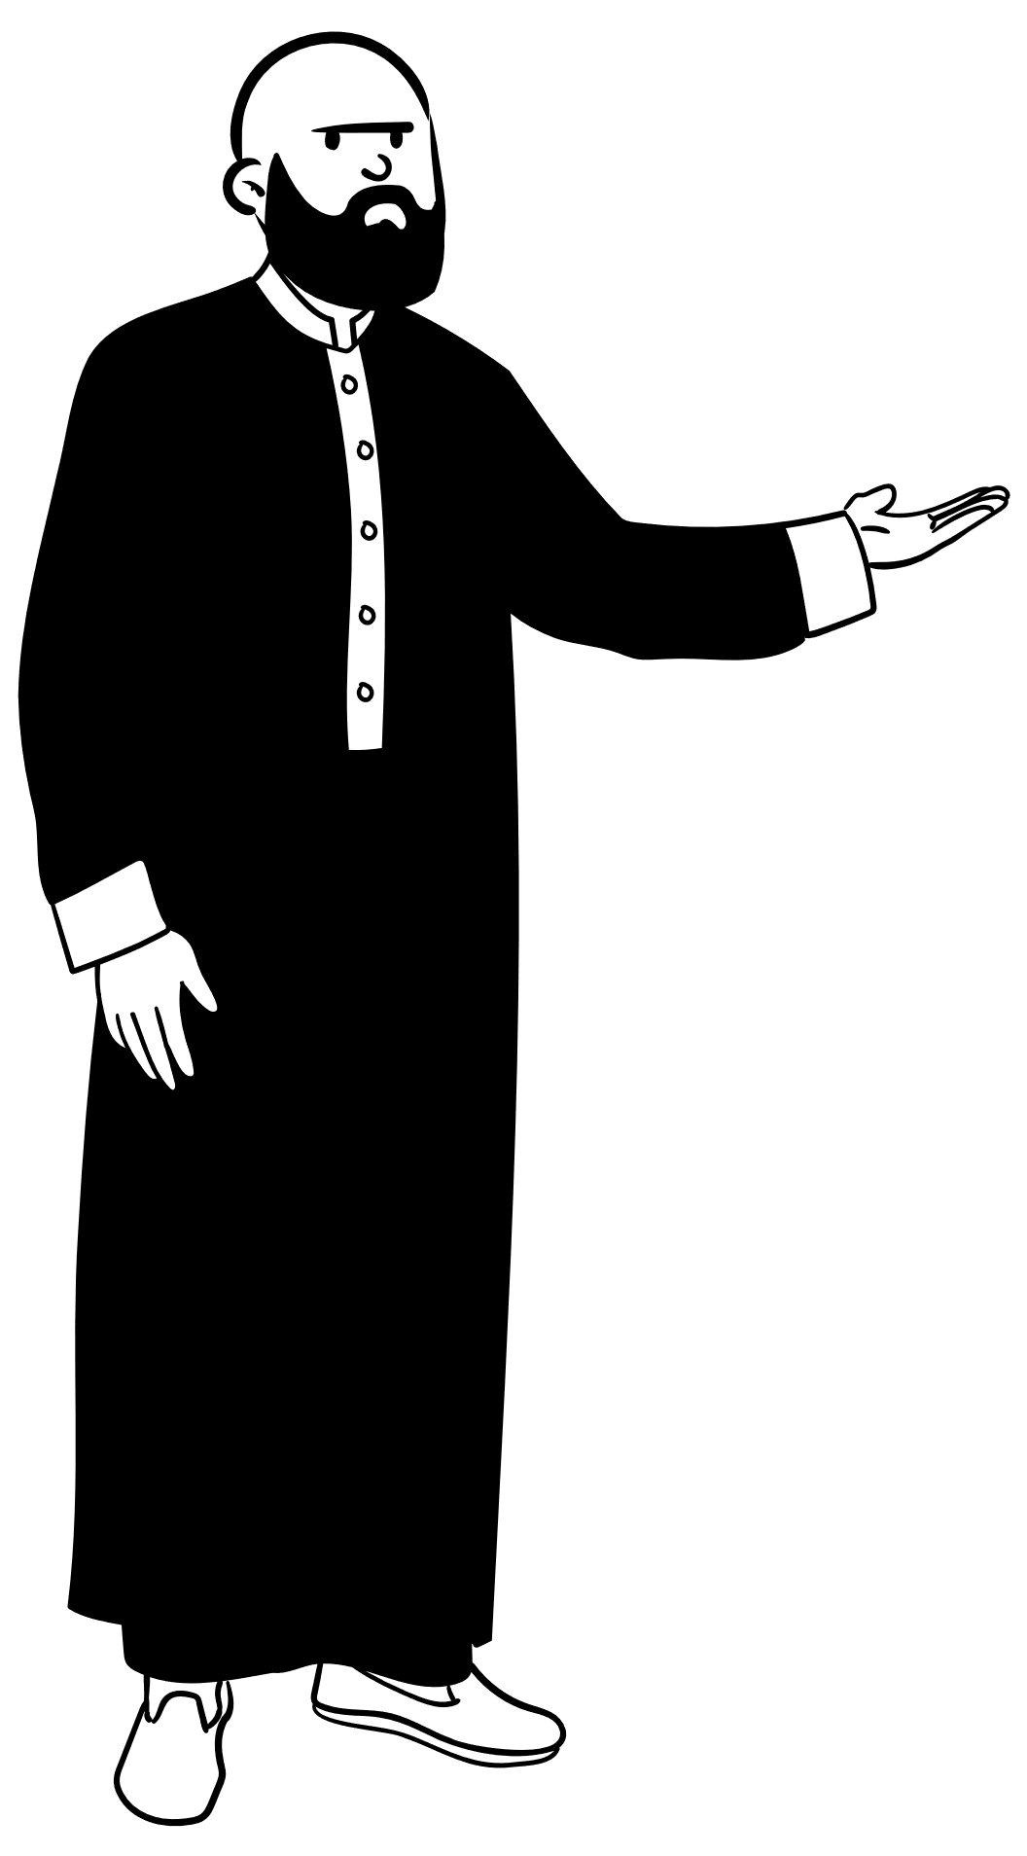
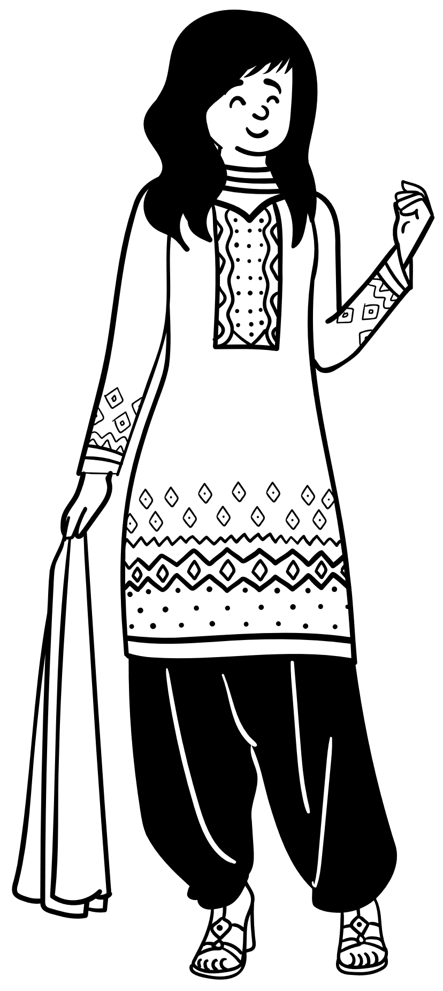


Diversity Considerations
Erikson: Integrated cultural and societal influences
Ellis: Adapted REBT to diverse populations
(Dredze, 2020)
(Maier, 1969)
(Martin-Joy, 2025)
Notes:
Erikson recognized that identity formation is shaped by cultural norms and societal expectations, influencing cross-cultural psychology and multicultural counseling. Ellis designed REBT as universally applicable but encouraged adaptation to clients’ cultural, religious, and personal values. Both theorists acknowledged that effective psychological practice requires sensitivity to diversity, ensuring theories and interventions are relevant and respectful across cultures.

Slide 9
Comparison
Erikson: Developmental stages, identity focus, life-span theory.
Ellis: Cognitive restructuring, present-focused, irrational belief change.
(Stanford, 1993)
(Stevens, 1976)
(Watson & Dodd, 1990)
Notes:
This comparison highlights their contrasts: Erikson provides a life-stage narrative for understanding personal growth, while Ellis gives tools for immediate thought and behavior change. Erikson’s work is foundational in education and counseling; Ellis’s is essential in psychotherapy and self-help. Together, they bridge historical and contemporary approaches to improving mental health.

Slide 10
Integration in Modern Psychology
Erikson’s theory used in education, life coaching.
Ellis’s REBT foundational to CBT and modern therapy.
(P. R. et al., 2024)
(Watson & Dodd, 1990)
(White, 1951)
Notes:
Modern psychology integrates both Erikson’s and Ellis’s ideas, on some continents and in some countries and universities. Educators and counselors rely on Erikson to understand developmental needs, while therapists use CBT approaches rooted in Ellis’s REBT for treating disorders like depression and anxiety. Combining developmental insight with cognitive tools allows for a comprehensive approach—addressing both the origins of issues and their current manifestations.

Slide 11
Summary
Different paths, shared goal: human flourishing.
Legacies endure in theory and practice.
As a student, I am continuing to add to the body of study in advocacy of Dr. Ellis as more curse words are used in film, stage, television than ever before. Modern practitioners moving from 2025 into 2100 must become cognizant of the shift – not a practitioner, but understanding and empathic.
(Rovira, 2016)
(Taha et al., 2024)
(Wazir et al., 2020)
Notes:
Erikson and Ellis represent two distinct but complementary approaches: one developmental, one cognitive-behavioral. Their differences in theory and technique provide psychology with a rich set of tools. Both remain influential in academic study and applied practice, shaping the way we think about identity, change, and mental health.

Slide 12
References
Baird, A. (2019). Psychosocial theory. In Always developing. eCampusOntario Pressbooks. https://ecampusontario.pressbooks.pub/alwaysdeveloping/chapter/psychosocial-theory/
Dredze, J. M. (2020). Albert Ellis and Mindfulness-Based Therapy: Revisiting the Master’s Words a Decade Later. Journal of Rational-Emotive & Cognitive-Behavior Therapy, 38(3), 319–329. https://doi.org/10.1007/s10942-019-00328-0
Erikson, E. H. (1967). Childhood and society. Rev. ed. reprint.
Evans, J. (2007, July 31). Albert Ellis. Prospect Magazine. Retrieved from https://www.prospectmagazine.co.uk/essays/51968/albert-ellis
Gredler, M. (2003). Erik H. Erikson. Gale.
حمزه باقری حیدری, اسماعیل نجار, & روژان باقری حیدر. (2024). بحران هویت و تاثیرگذاری مولفه جامعه در زمانهای بازمانده روز و هرگز ترکم مکن بر اساس آراء اریک اریکسون. Research in Contemporary World Literature, 29(1), 21–43. https://doi.org/10.22059/jor.2023.337926.2319
Notes:
These references combine original works by Erikson and Ellis with scholarly sources analyzing their contributions. They meet APA guidelines for sourcing in academic presentations and provide a strong foundation for understanding both theorists’ impact on psychology. They represent strong peer-reviewed references within five years time.

Slide 13
Lieberman, J. E. (1999, June 15). Identity’s Architect: A Biography of Erik H. Erikson. Library Journal, 124(11), 96.
Maier, H. W. (1969). Three theories of child development : the contributions of Erik H. Erikson, Jean Piaget, and Robert R. Sears, and their applications. Rev. ed.
Martin-Joy, J. (2025). Race and prejudice in Erik Erikson’s Childhood and Society. American Imago, 82(1), 93–127.
P. R., S., Sujatha, K., N., K., S. K., S. K., K., K. K., & S., R. (2024). Circumstances Shaping Man’s Virtues - a Cross-Sectional Study Based on Erik Erikson’s Stages of Psychosocial Development among College Students in Tamil Nadu. Journal of Cardiovascular Disease Research (Journal of Cardiovascular Disease Research), 15(4), 69–81.
Rovira, M. (2016). The Albert Ellis Institute: Past, Present and Future: Interview with Dr. Kristene Doyle: Director of the Albert Ellis Institute, New York. Journal of Rational-Emotive & Cognitive-Behavior Therapy, 34(2), 125–134. https://doi.org/10.1007/s10942-015-0232-9
Stanford, B. H. (1993). Erik H. Erikson: A Life’s Work. Childhood Education, 70(1), 57.
Stevens, R. (1976). Integration and the concept of self. 1. publ.
Taha, M., Febriningsih, F., Asfar, D. A., Zalmansyah, A., Muzammil, A. R., Ajam, A., Lestari, S. A. B., Zar’in, F., Rauf, R., & Gritantin, L. A. L. (2024). Sula Malay’s Hate Speech in the Sanana Jurisdiction: A Pragmatic Study. Journal of Language Teaching & Research, 15(6), 1941–1950. https://doi.org/10.17507/jltr.1506.19

Slide 14
Theories of childhood; an introduction to Dewey, Montessori, Erikson, Piaget, and Vygotsky, 2d ed. (2013, April 1). Reference & Research Book News, 28(2). White, R. W. (1951). Childhood and Society. Journal of Abnormal Psychology, 46(3), 447– 448.
Watson, A. K., & Dodd, C. H. (1990). Communication apprehension and rational emotive therapy: An interview with Dr. Albert Ellis. Journal of Social Behavior & Personality, 5(2), 203–210.
Wazir, A. S. B., Karim, H. A., Abdullah, M. H. L., Mansor, S., AlDahoul, N., Fauzi, M. F. A., & See, J. (2020). Spectrogram-Based Classification Of Spoken Foul Language Using Deep CNN. 2020 IEEE 22nd International Workshop on Multimedia Signal Processing (MMSP), Multimedia Signal Processing (MMSP),Multimedia Signal Processing (MMSP), 1–6. https://doi.org/10.1109/MMSP48831.2020.9287133

