Slide 1
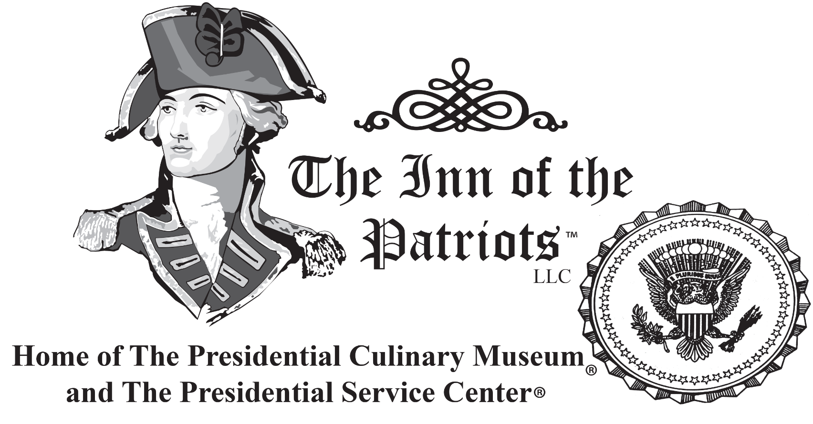
The Inn of the Patriots, LLC

Slide 2
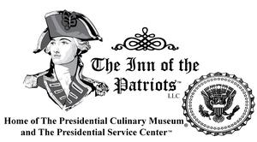
The Inn of the Patriots expansion (12 years) with The United States Presidential Culinary Museum is by White House alumni in Washington, DC. We are evaluating several potential properties and partners.
The Inn of the Patriots, LLC

Slide 3
Problems worth solving
Unique museum astounds guests
Television series highly entertaining
Featured to almost three billion via TV
Showcased in 160+ newspapers worldwide
Enjoy staying a Night at the Museum!
The Inn of the Patriots, LLC

Slide 4
Our solution
Our expansion in DC will grow us into a property featuring The Hail to the Chef Restaurant with All the Presidents’ Menu’s, a slightly larger museum, our TV series, an amazing kitchenware store (like Williams & Sonoma), and Culinary Institute with 5315 alumni members.
The Inn of the Patriots, LLC

Slide 5

Target market
22M
2019 DC tourists
Prospects
Market size
$8B
The Inn of the Patriots, LLC

Slide 6
Competitive landscape
Competitors | How our solution is better
No culinary museum | We will have a full-sized museum
Hail to the Chef | Restaurant w/ All the Presidents' Menu's
Culinary Institute | 5074 graduates and growing
Public appeal | We are disabled, injured, crippled vets
Food IS the draw | We will promote our food/chefs across TV
The Inn of the Patriots, LLC

Slide 7
Funding needed
$91M
Our business operating plan is $26M (available on our site). It takes $91M, on one of our proposed buildings, to buy & rehab on Pennsylvania Avenue. We return a minimum of $264M – and up to $490M. We are open to considering any building, ROI, or portfolio balance - but would like to be near Capitol Hill and the White House – or in between to facilitate our heavy PAC clientele.
The Inn of the Patriots, LLC

Slide 8
Sales channels
Groupon #1 world sales record
LivingSocial, two #1 world sales records
21,000 room nights offered - can't take
Seen on CNN, FOX, CBS, NBC, ABC & PBS.
In PEOPLE in 2021 on on the TODAY Show
Golden Data Unicorn on staff
The Inn of the Patriots, LLC

Slide 9
Marketing activities
Our marketing strategy triangulates FOOD, HISTORY and our PRESIDENTIAL MUSEUMS. These provide countless levers to bring our brands to hundreds of newspapers, radio, magazines, and television. We've monetized fame and publicity.
The Inn of the Patriots, LLC

Slide 10
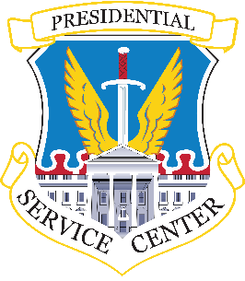




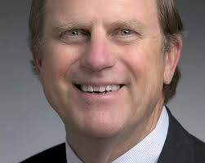


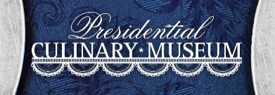



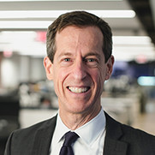
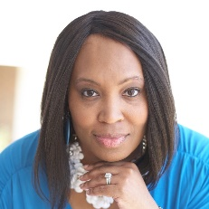




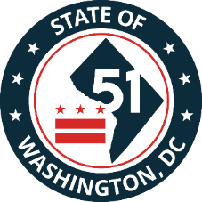
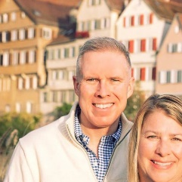

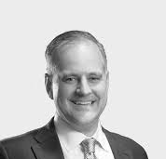
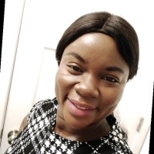
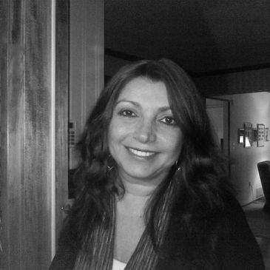


Team & Key Roles
Stormy L. Mongiello, BA, PHR, SHRM-CP
John Kerr
Toni Ann
Marcolini, Esq.
Dr. Hazel
Herrington
Chuck Gorum,
PE
CBRE Senior VP
General Counsel
PRESIDENTIAL
Magazine Editor
Investors Project
Manager
CHRO & co-CEO
Antwain
Thomas
Martin CJ Mongiello,
MBA, MA, MCFE
Bill Kline. AIA,
ACHA, EDAC,
LEED AP
Dr. Joynicole
Martinez
Orlando Herrera,
Jr. MSA, CPS, PRC
CDO
Senior VP
Co-CEO & CMO
Managing Principal
William Collins, Esquire
Terrence
Caufield
Paul Wesley Bridges, AIA, NCARB
Maria Plinio, Esquire
Dr. Thelma
Frimpong
Mensah FPMP, DBA, MBA, BA

Slide 11








Partners and Resources
Presidential Service Center
The Presidential Culinary Museum
AMVETS Post 12 onsite
NAVOBA featured member
IAVA alumni member
Heroes Vodka Bar
White House Knives
Alumni Wounded Warrior Project
The Inn of the Patriots, LLC

