Slide 1
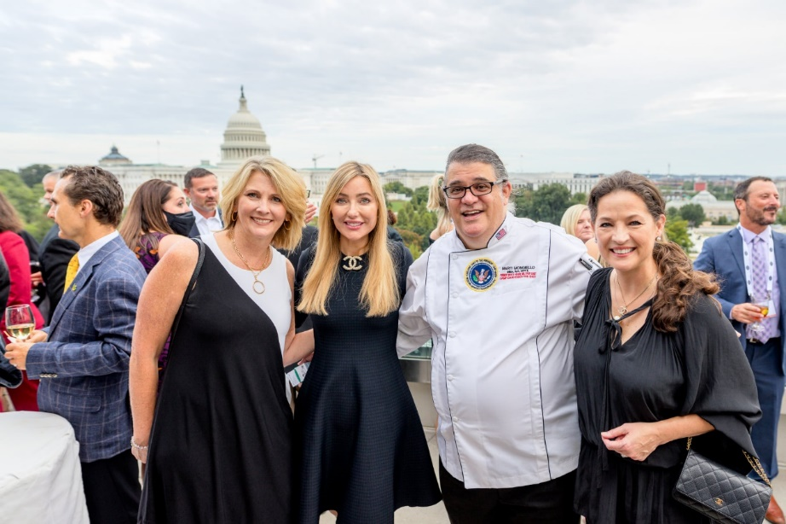
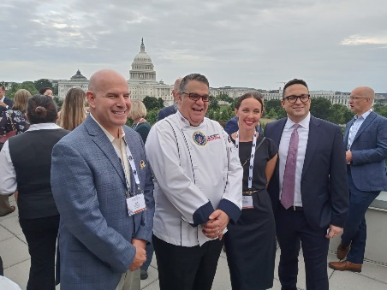

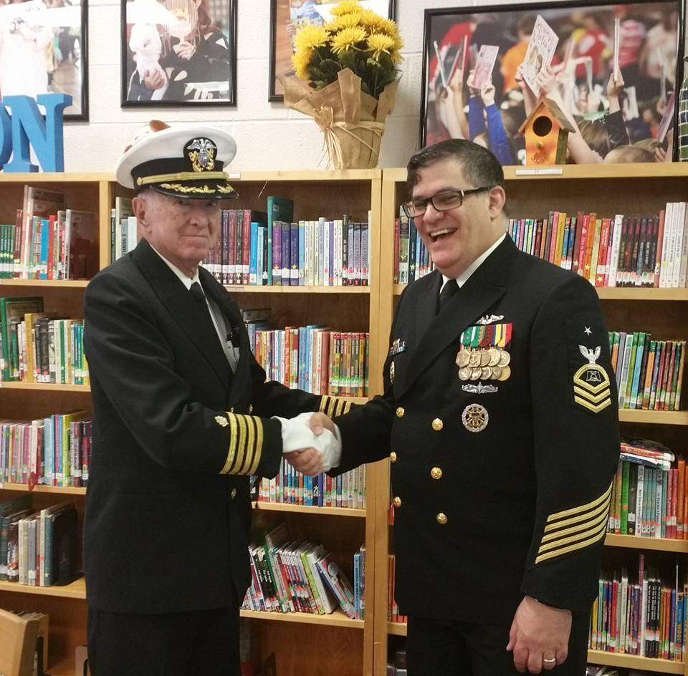
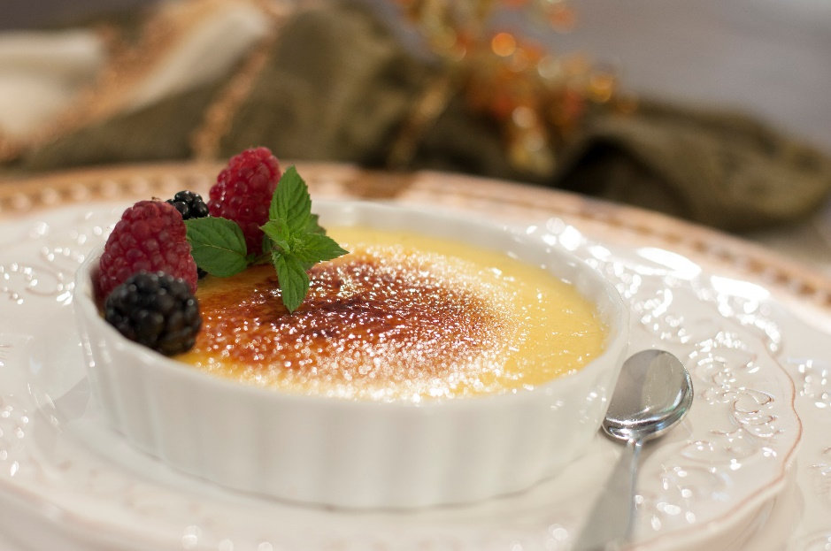
Welcome to Chef Marti Mongiello
Martin CJ Mongiello, MBA, MA, MCFE
CSCS (SS/SW), USN, Ret.
1

Slide 2

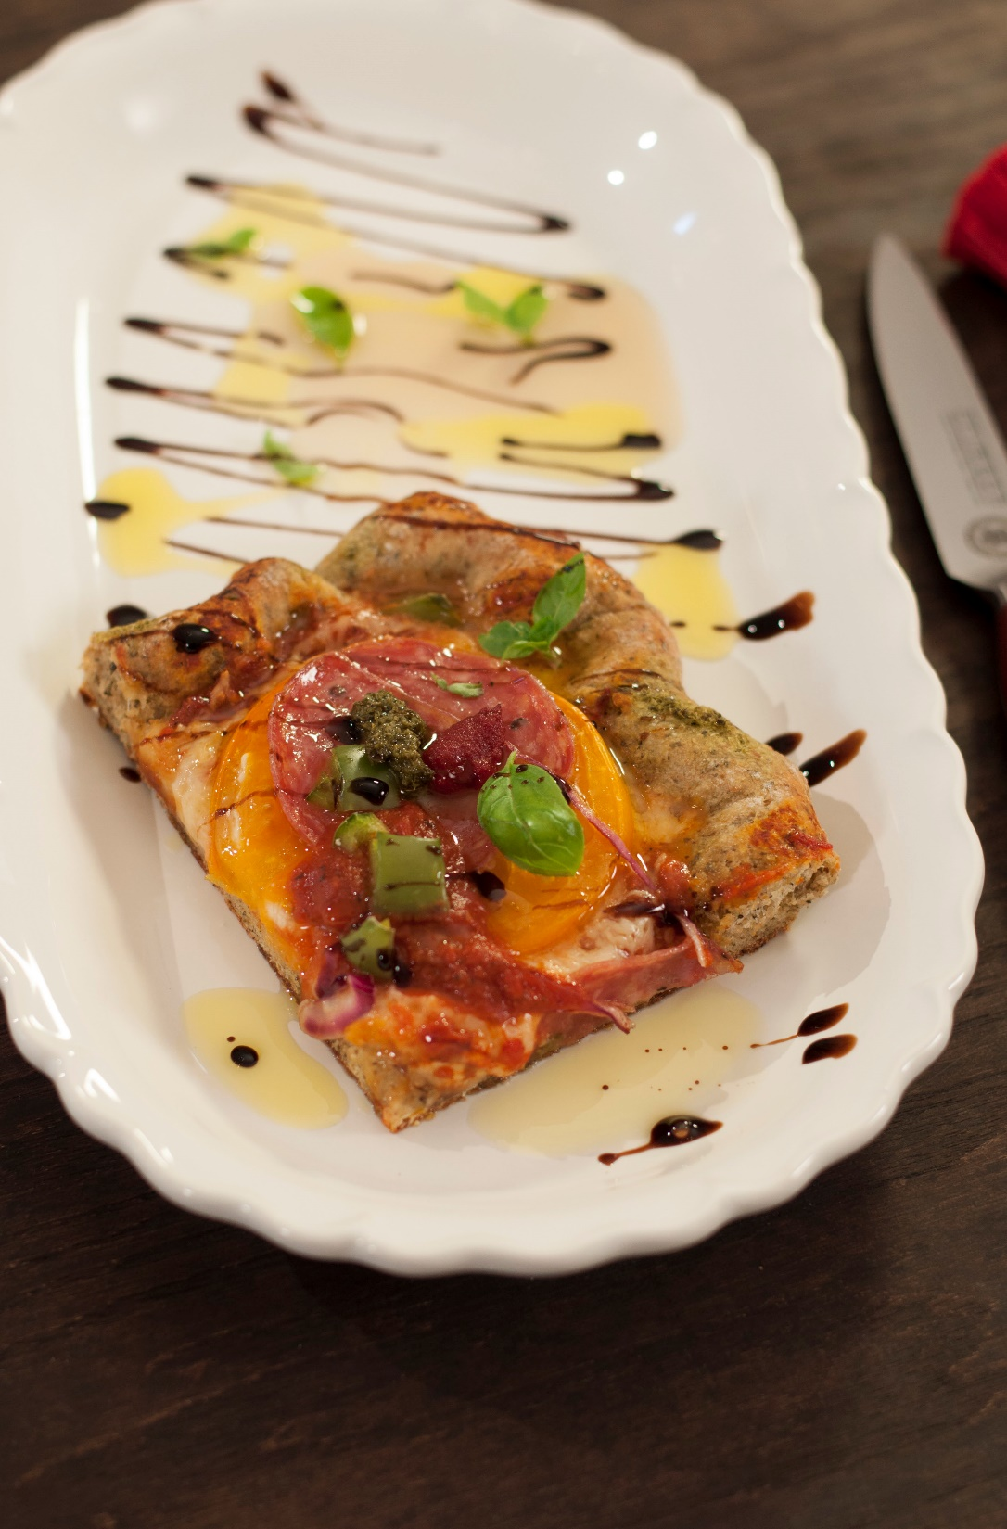
2

Slide 3
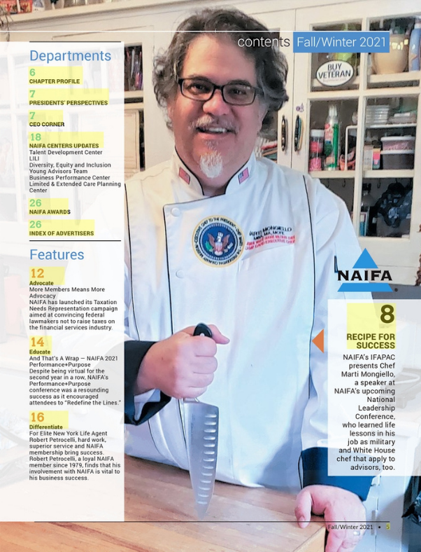
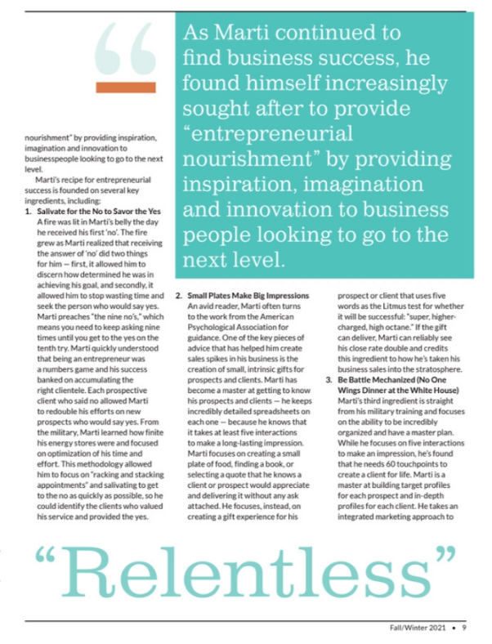
3

Slide 4

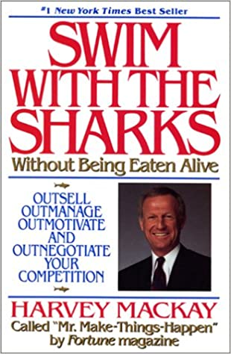
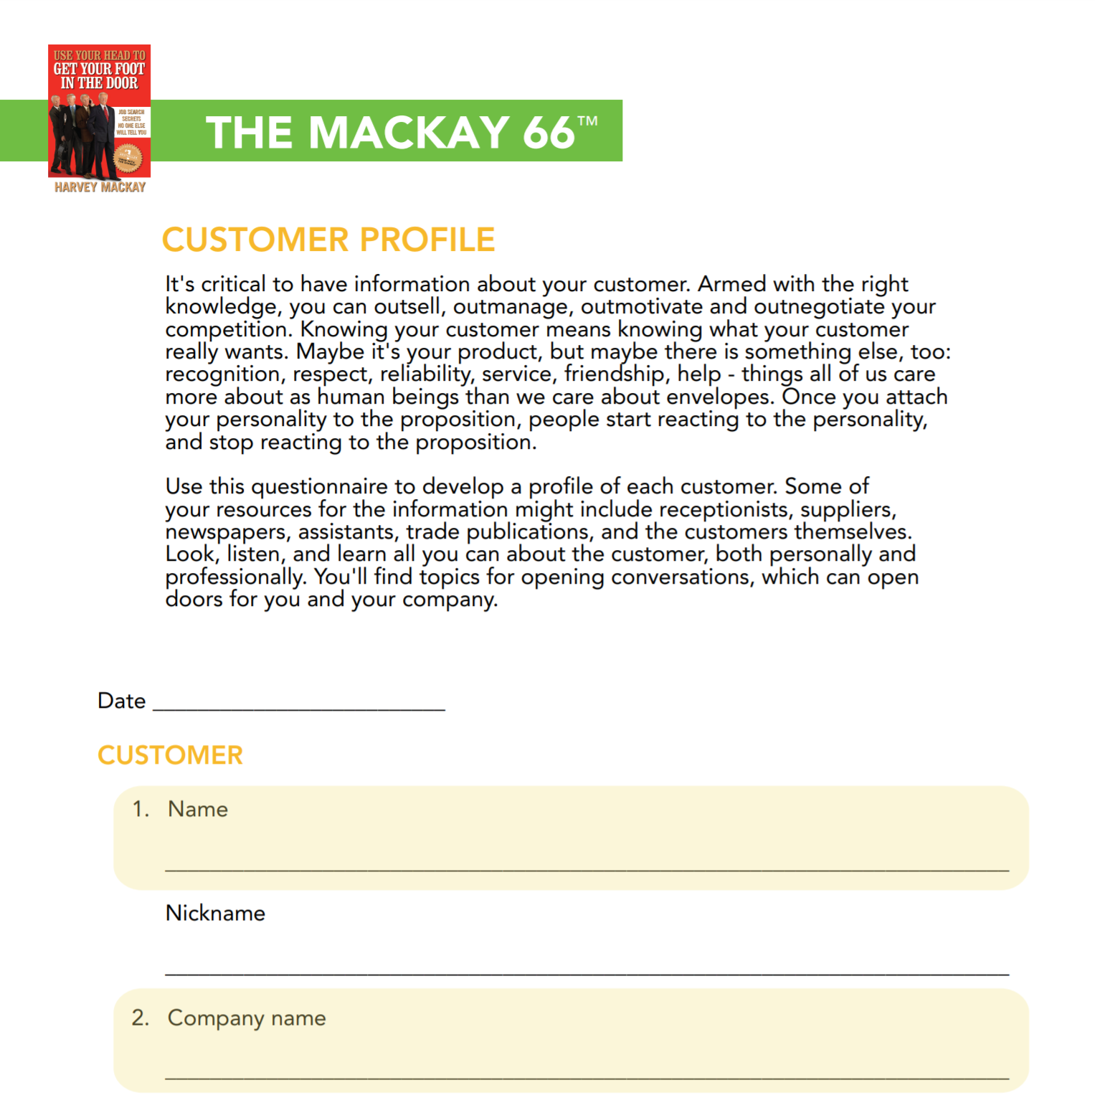
“3”
Let's dissect number three a bit more:
AVON teaches its agents that it takes five interactions or catalogs to solidify a relationship and link that client for perpetual sales.
Name | Address | Email | Phones | Typed letter on one piece of paper signed in blue ink | Blue ballpoint pen letter on loose leaf | Greeting card | Phone call | Email | Small gift sent
Postcard, grocery store flowers in dollar store vase, greeting card, fax, phone call, email, caricature, case of water, plant.
4

Slide 5


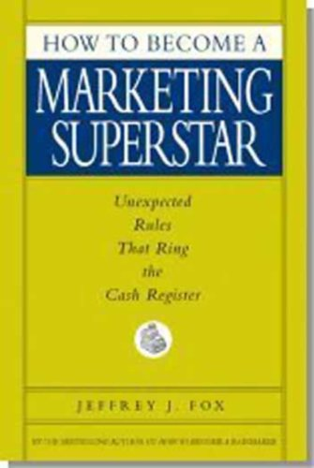

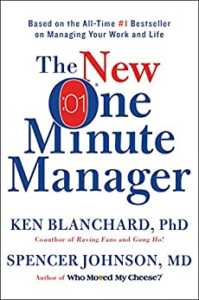
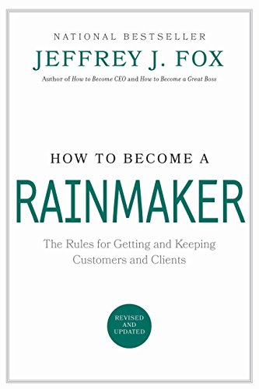

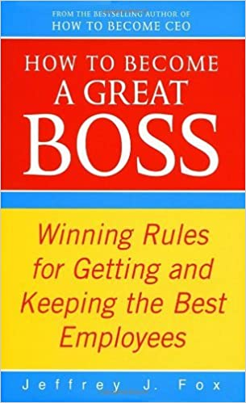
5

Slide 6
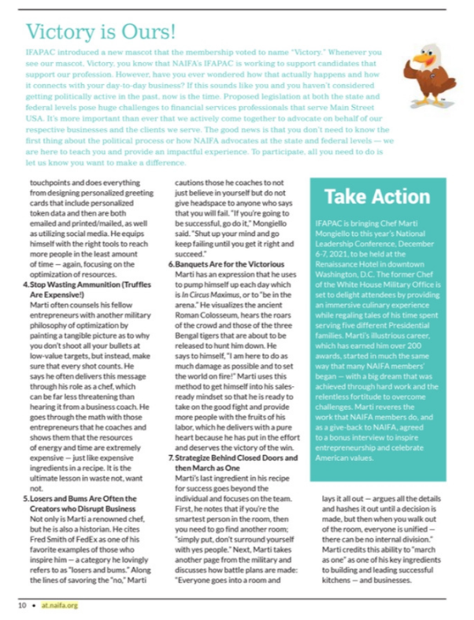




3. Personalized Greeting Cards:
SendOutCards.com/u/35513
4. Stop wasting truffles = every shot counts. The shotgun v.s. the rifle.
5. About losers disrupting business.
6. Circus Maximus, rage, fury, negativity and the lies they peddle and teach you.
7. Encouraging subordinates to tell you your idea is dumb and harmful to your company during board meetings.
6

Slide 7
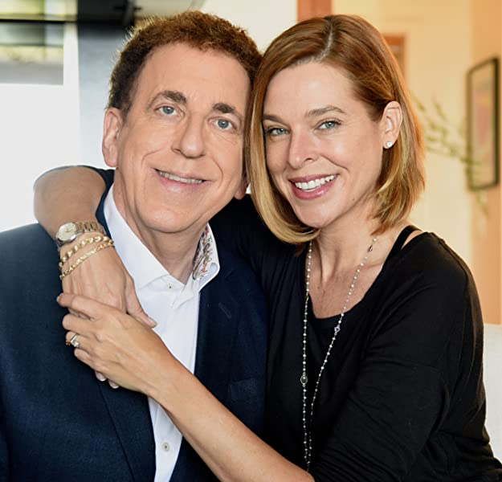


Nutrition and computational brain power with Doctor Dean & Anne Ornish.
1. Green Tea
2. Blueberries
3. Dark Cacao
Chocolate 85% or
higher cacao
About failure and failing. FAIL = FORTUNATE ATTEMPT IN LEARNING = You always win.
7

Slide 8
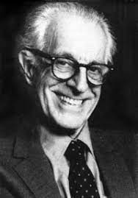
Doctor Albert Ellis
Based on a professional survey of US and Canadian psychologists, he was considered the second most influential psychotherapist in history (Carl Rogers ranked first in the survey; Sigmund Freud was ranked third). Psychology Today magazine noted that, "No individual—not even Freud himself—has had a greater impact on modern psychotherapy.”
https://albertellis.org/
8

Slide 9
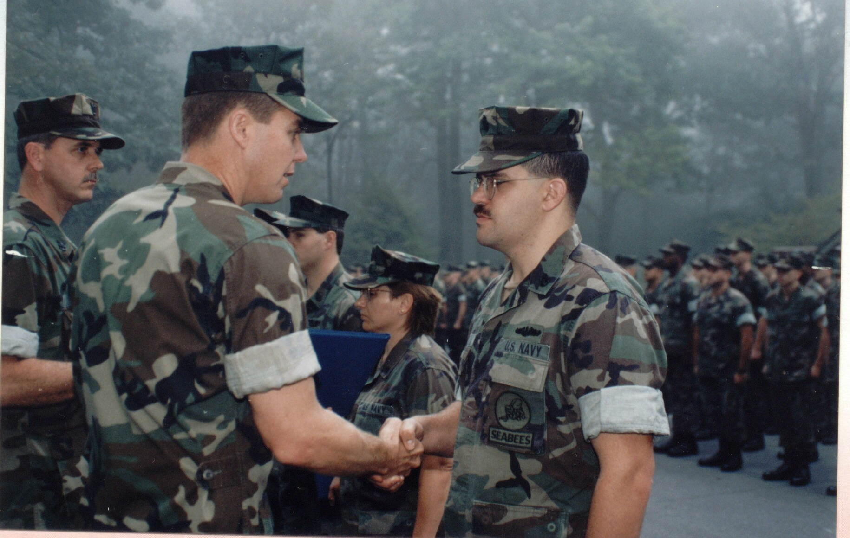
9

Slide 10
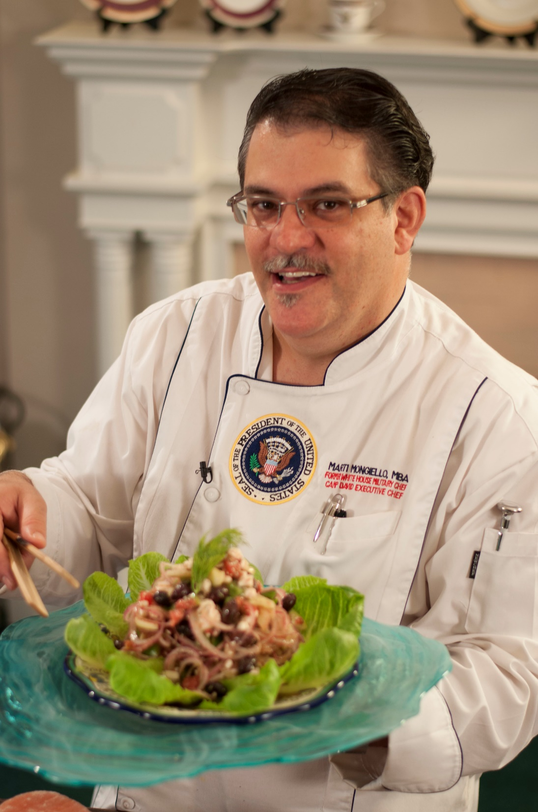
Thank you for having me and supporting disabled and injured veterans in business, like myself. We truly appreciate it.

