Slide 1

Mongiello Associates Strategic Marketing™
a DBA of Mongiello Holdings™, LLC
Presents
Chefs Marti and Stormy Mongiello with
“The Commander and Chief of All Cooking Shows™”
Inside the Presidents’ Cabinet™©
& Extended Profile of
Team Staff Capabilities
www.insidethepresidentscabinet.com www.theinnofthepatriots.com www.thepresidentialculinarymuseum.org
Writers Guild of America East Registration Number: I237867, Library of Congress registered,
Mongiello Associates, 704-490-3947, www.mongielloassociates.com

Slide 2

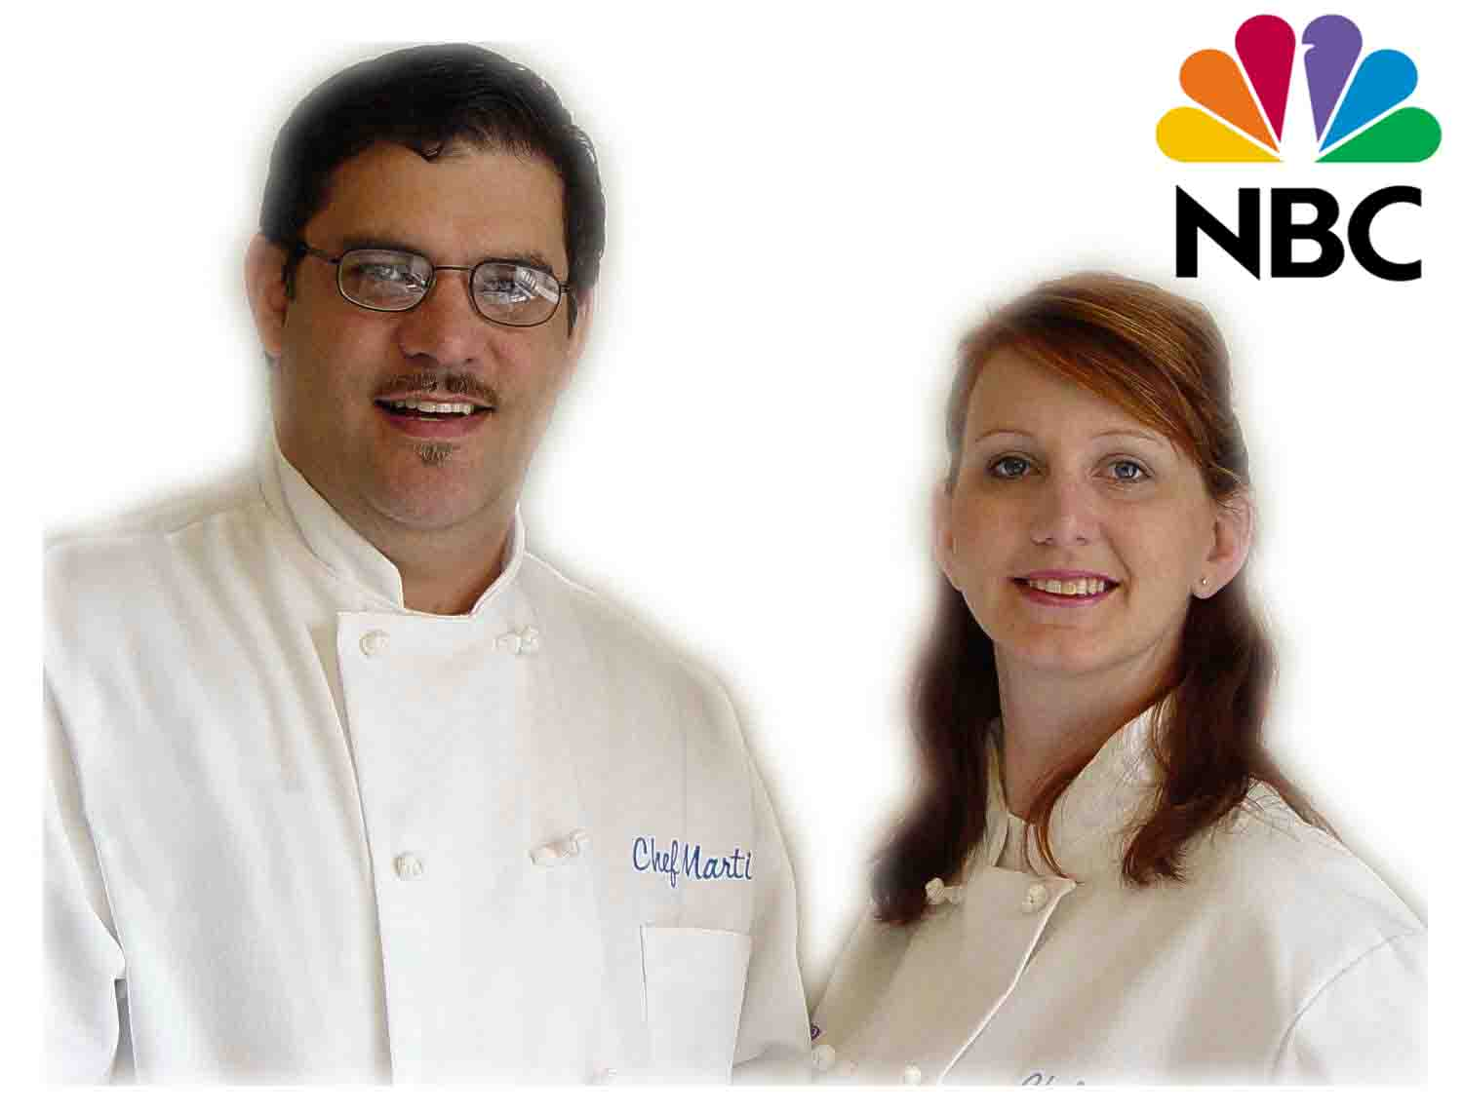


Slide 3


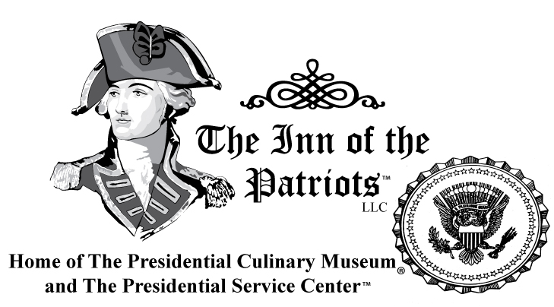

Slide 4


Slide 5
The presentation, ideas and programs enclosed are the intellectual property of Mongiello Associates
– a DBA of Mongiello Holdings, LLC and Martin CJ Mongiello.
The reader acknowledges that the information provided by Martin CJ Mongiello in this marketing plan is confidential; therefore, reader agrees not to disclose it without the express written permission of Martin CJ Mongiello. This document contains proprietary information relating to Martin CJ Mongiello. It is submitted solely for the purpose of allowing interested parties to review the company's marketing communications proposal. This document may not be reproduced in whole or in part without the express written consent of Martin CJ Mongiello. The disclosure of information contained herein does not constitute any license of authorization to use the information, ideas or concepts presented or to secondarily disclose any information. By accepted delivery of this document, the recipient agrees to return this document to company upon request or within five days. It is acknowledged by reader that information to be furnished in this marketing plan is in all respects confidential in nature, other than information which is in the public domain through other means and that any disclosure or use of same by reader, may cause serious business harm or damage. This is a marketing idea and plan, it does not imply an offering of securities.
Copy 1: Sent via email/mail to recipient for review, Copy 2: Mongiello Associates, Martin CJ Mongiello
Copy 3: Mongiello Associates, Michael C Mongiello, Copy 4: Mongiello & Mongiello, Michael Mongiello
Copy 5: Galli Associates, Anthony P. Galli, Copy 6: Cooking with Chef Marti, Andrew M. King
After review of proposal please return copy within five days.

Slide 6
SOME of our current sponsors

Slide 7










Slide 8

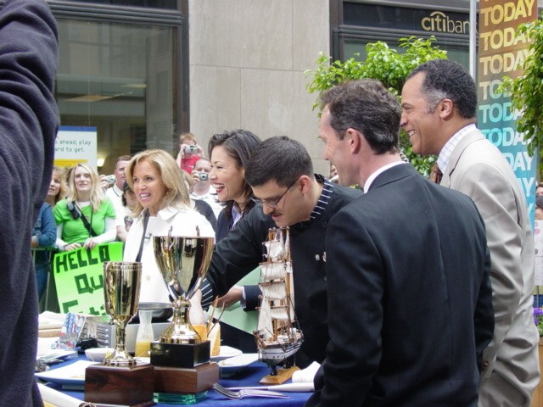
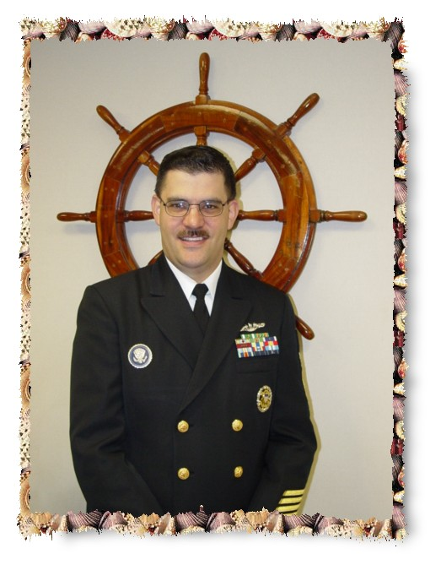


Slide 9
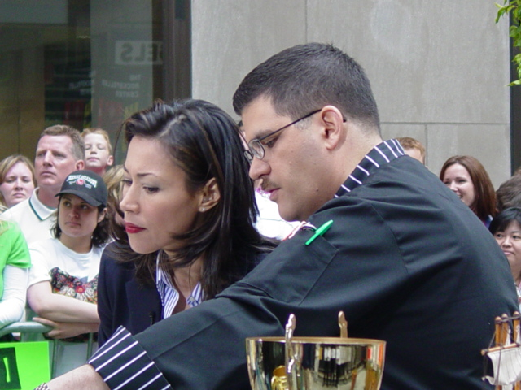
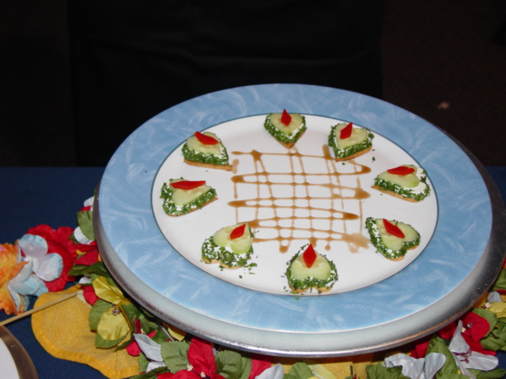

Slide 10
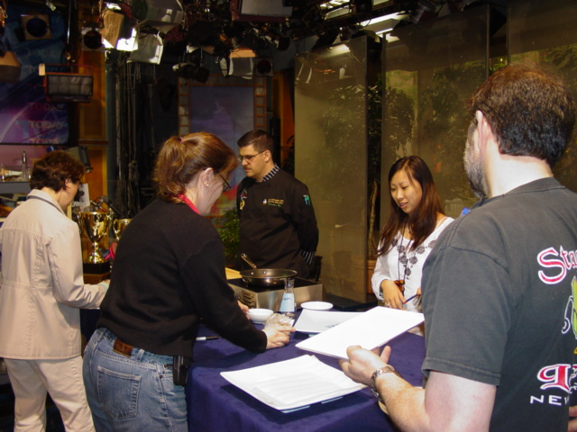
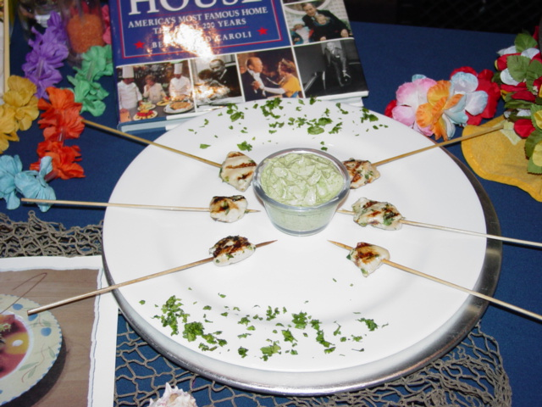

Slide 11
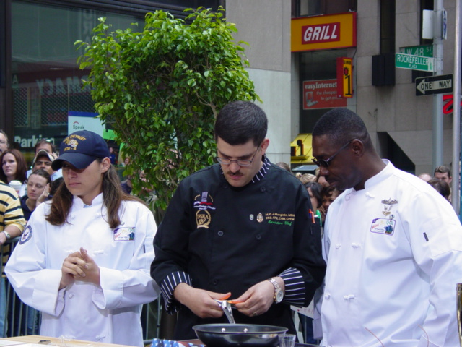
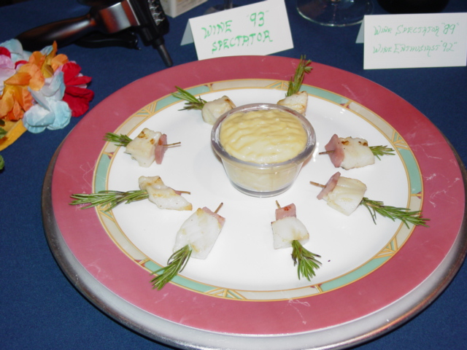

Slide 12
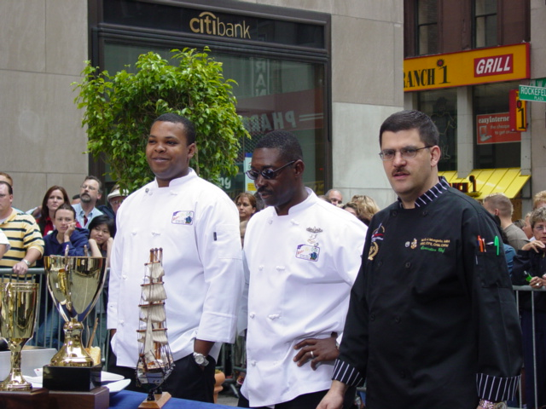
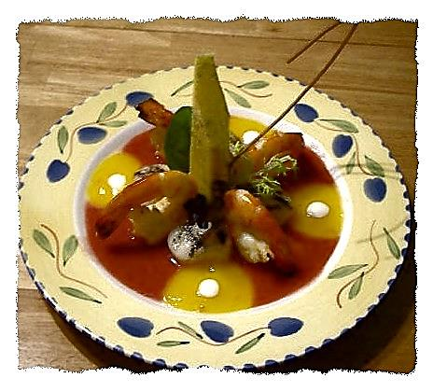
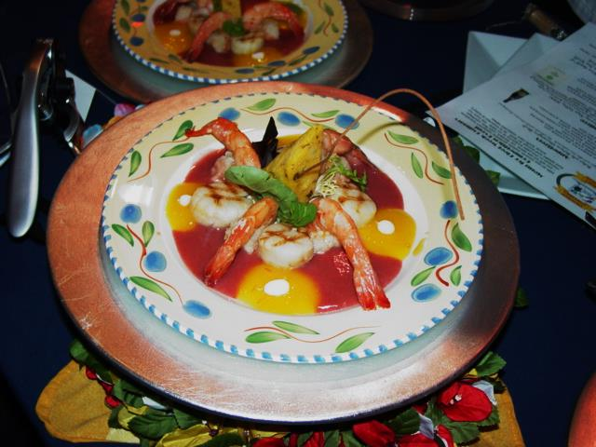
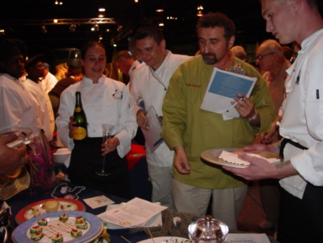
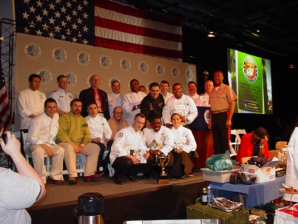
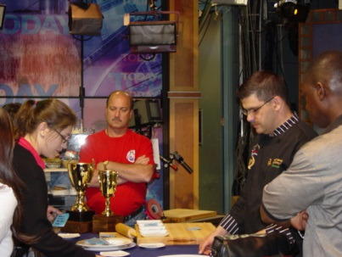

Slide 13
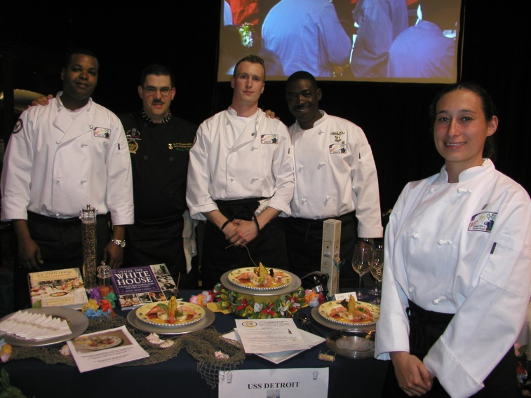
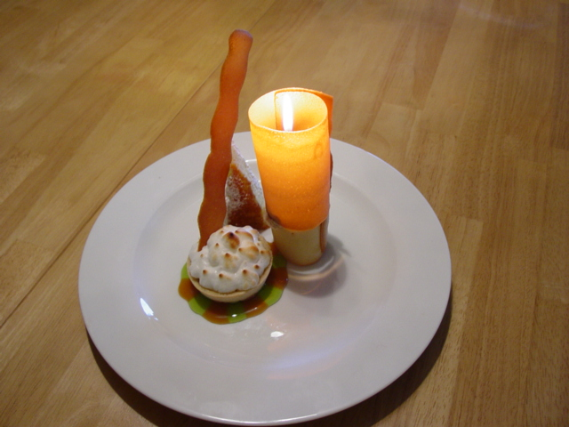

Slide 14
Our Offerings
White House Dinners and Dishes
First Families Favorites from Camp David, the White House and Air Force One supported by the Presidential Culinary Museum
featuring historical reproductions and artifacts of White House China Sets and more on display in our mobile museum.
Cooking Stage Battles
Iron Chef-like battles pitting local cooks & chefs against each other with the Presidents Chef as host. A local panel of experts sits as Judges. Can also be used for Corporate fun and crazy team building!
Fun and Frolic Dinners
Creatively themed meals where Chef Marti entertains and explains before each course served – sometimes with a few stories

Slide 15

Manufacturers That We Assist
Marketing & Branding Ideas that Work!
We develop recipes, promotions, publicity or complete
stage shows to market and sell your product.
We’ve Worked With These Companies and Brands:

Slide 16
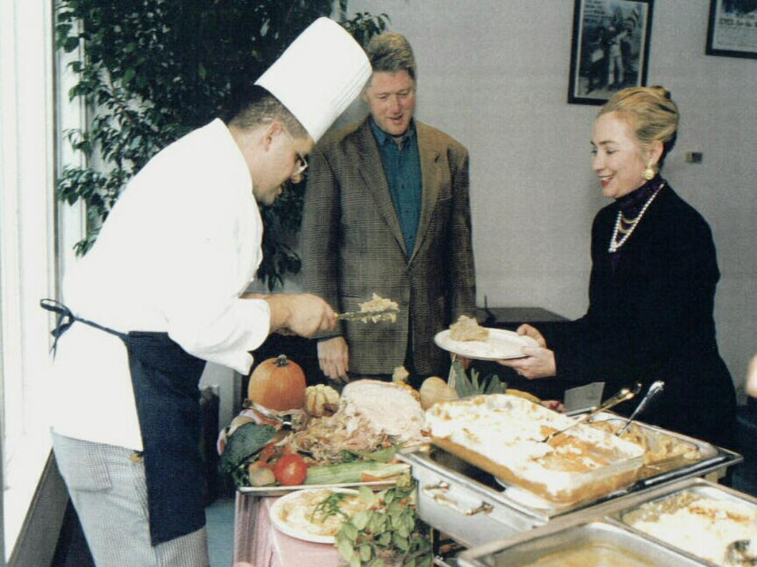

Slide 17
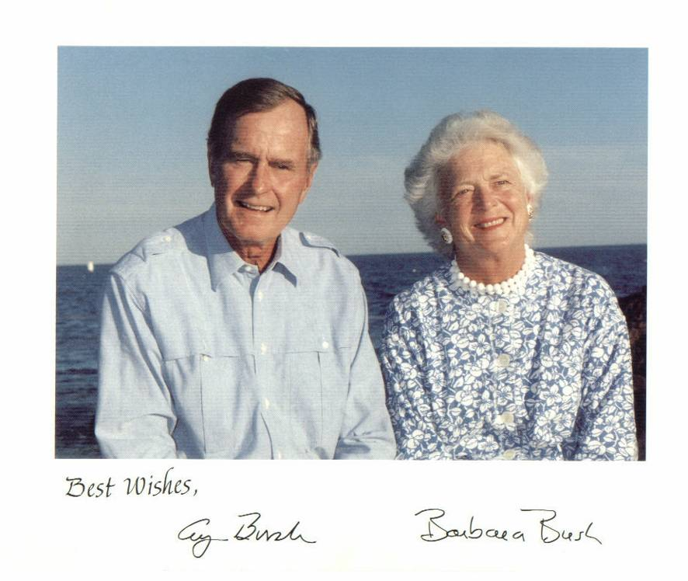

Slide 18
Presidential Tasting Event
A celebration of American Regional cuisine and the many good food items that come from, “Cooking American,” will be shared.
Chef Marti Mongiello, former Executive Chef at Camp David and a White House Chef with Chef Stormy Mongiello, Chef de Cuisine and Curator of the Presidential Culinary Museum will take, the stage. They’ll whip up favorite recipes of the First Families. The gala celebration event will also include a sneak peak at Americas only Presidential Culinary Museum and personal tales of cooking for the famous First Families. The LIVE show and talk will mesmerize or have taste buds be - tantalized - with a tidbit of every item cooked. Your guest's have a chance to examine select items from the White House China Collection that will be on Display as Part of the Presidential Culinary Museum that Chef Marti is the Curator and Executive Director of in the USA. Please ask for more details.
Food Preparation is done by your staff or caterer – simple recipes.

Slide 19
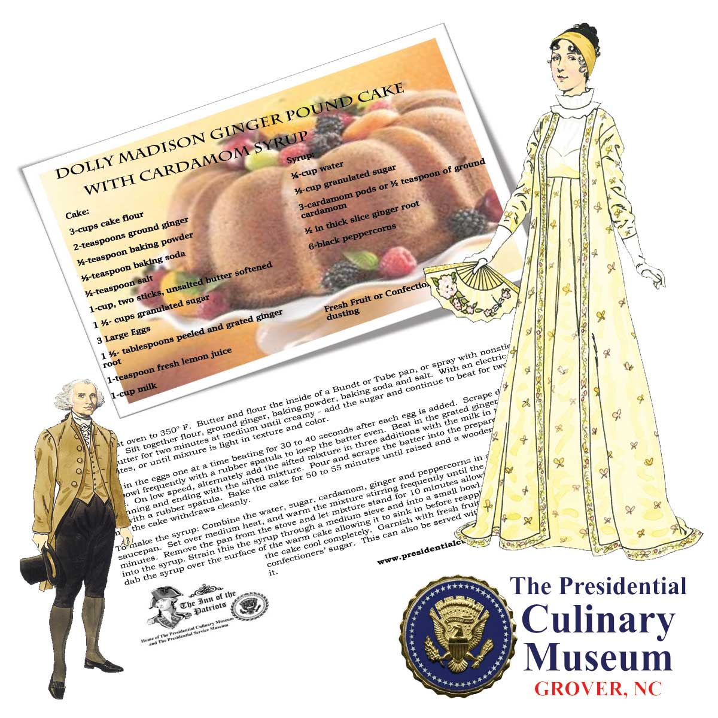
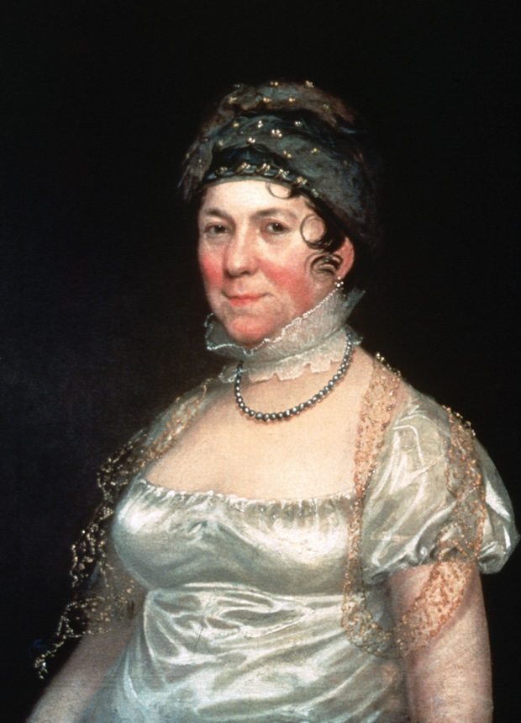
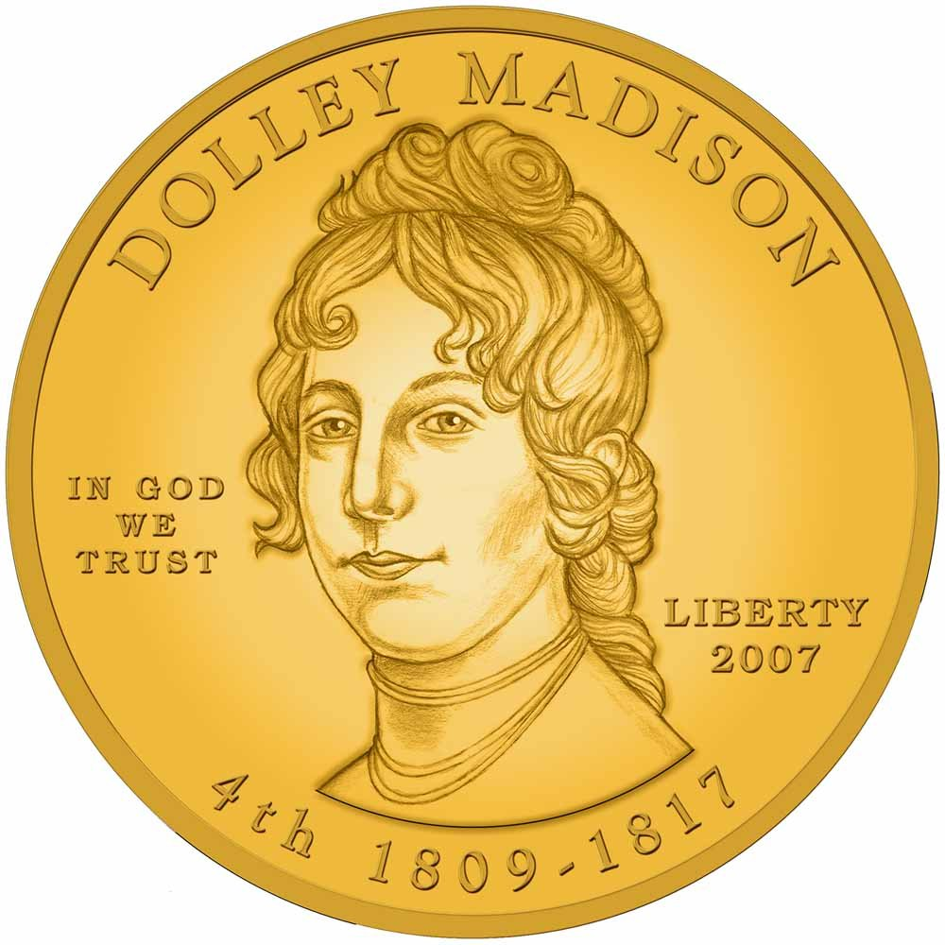
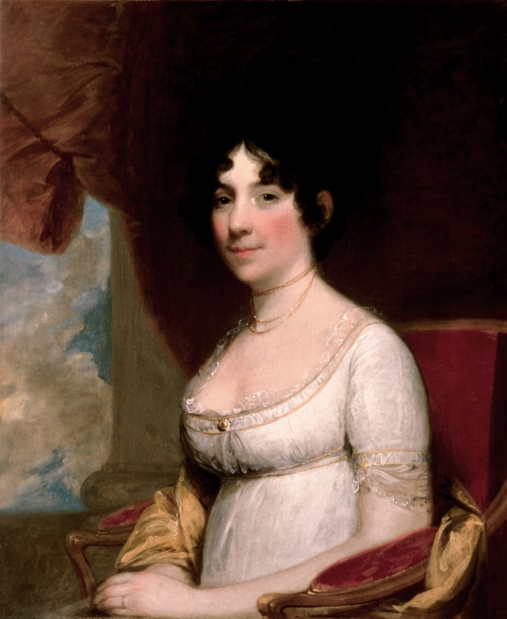

Slide 20
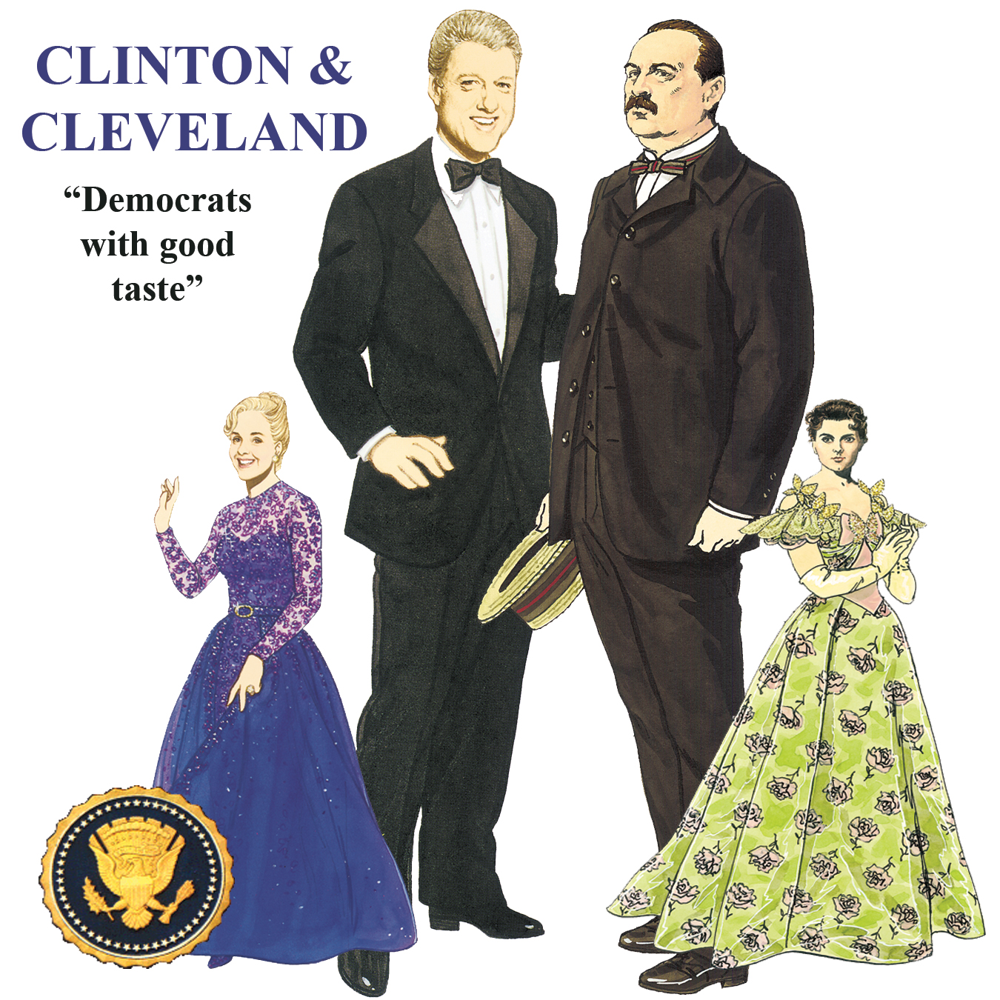

Slide 21
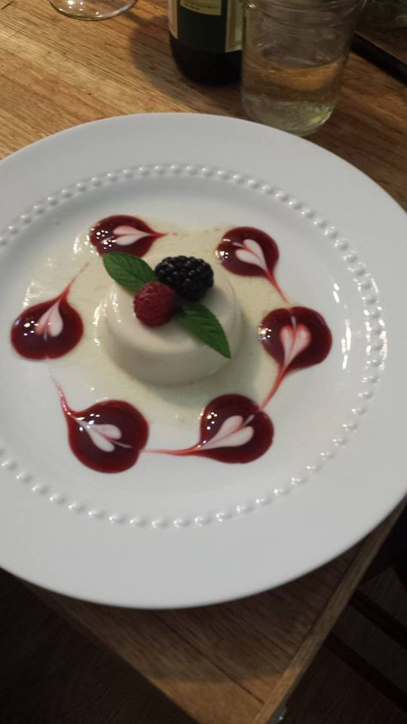
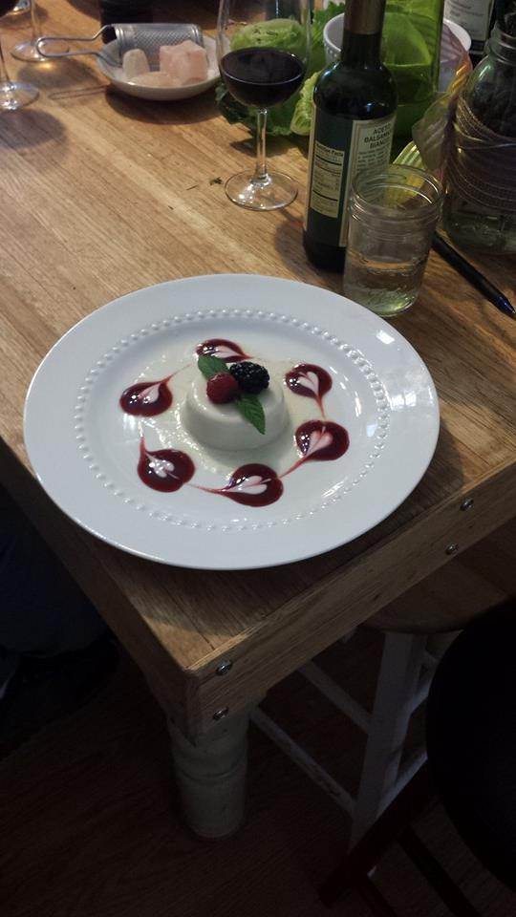

Slide 22
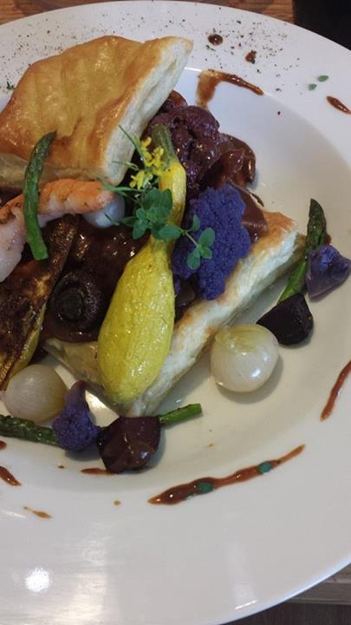
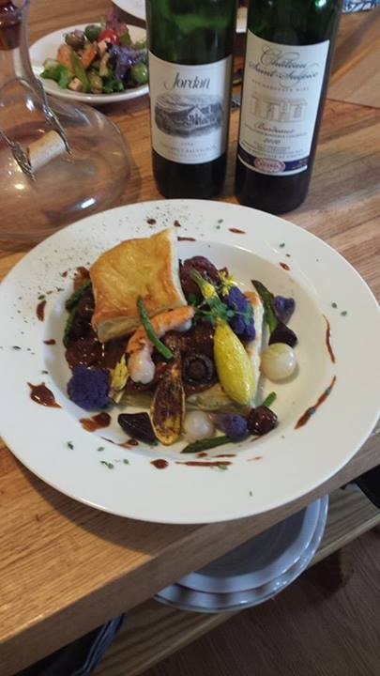

Slide 23
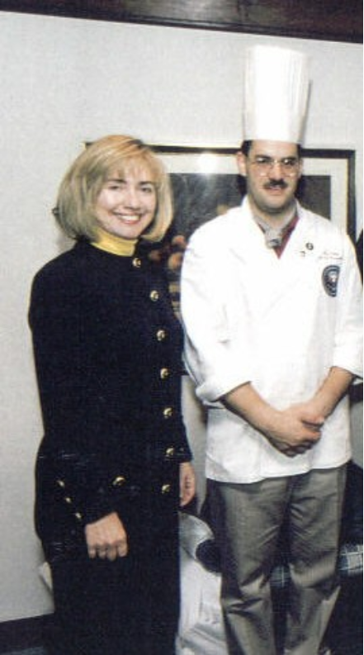
Example Tasting Menu
Royal Hashemite Kingdom Hummus
with Grilled Pita, Zaatar and Baked Pita Chips
(from the King & Queen of Jordan)
Famed White House Roof Garden Salad
With Homemade Italian Focaccia
Thai Spiced Sweet Potato Soup with Grilled Shrimp
Flamed New York Strip Steak over gathered Field
Greens, Spicy Pecans, Stilton Blue Cheese Crumbles,
Grape Tomatoes and Carmelized Onions
Lemon & Madagascar Pure Vanilla Crème Brulee
with fresh Raspberries, Blackberries and Mint
Tidbit Polynesian Coconut Pineapple
Macadamia White Chocolate Chip Cookies

Slide 24
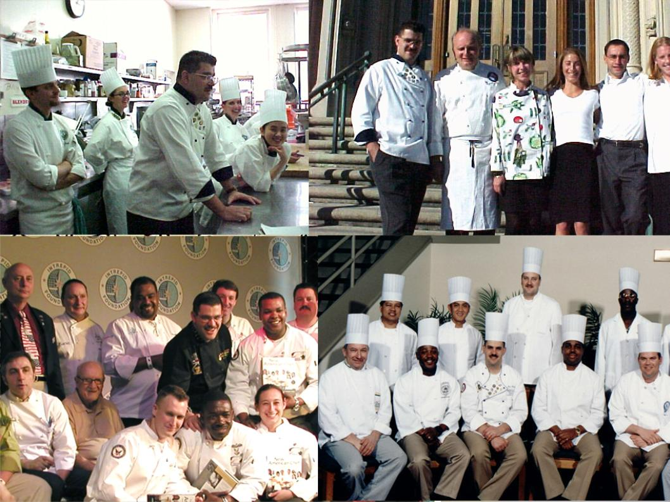


Le Cordon Bleu Institute
University of San Francisco
Culinary Institute of America

Slide 25


COOKING STAGE BATTLES
21 Years in the US Navy and living on three continents has given Chef Marti a unique ability to develop teams that work together, no matter how diverse or off the wall. This is a great way to bring departments or rival offices together (NOT just for foodie or food professionals to engage in)
Our Program Includes :
2 Hour Sit Down Talk
Creating Teams
Make a Recipe
Practical Lessons Learned
Award for the best dishes
Special Menu For Dinner
All Day Event

Slide 26
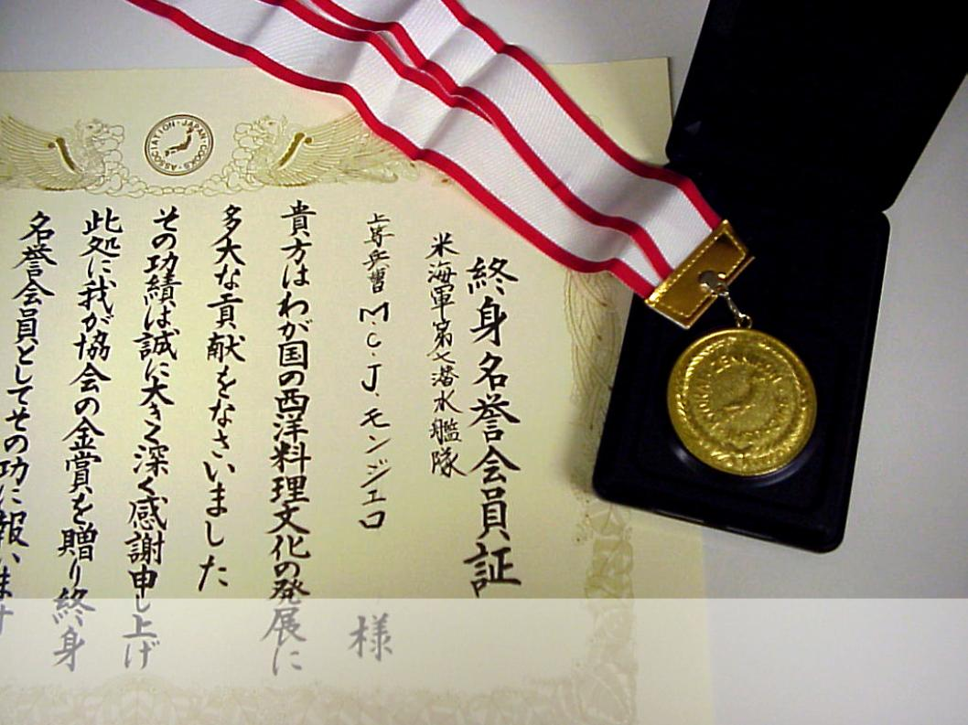
Chef Marti Lived in Japan and Belgium – he Travels the World Extensively – A Spokesman You Can Trust to Speak the Language of Food In Your Country

Slide 27
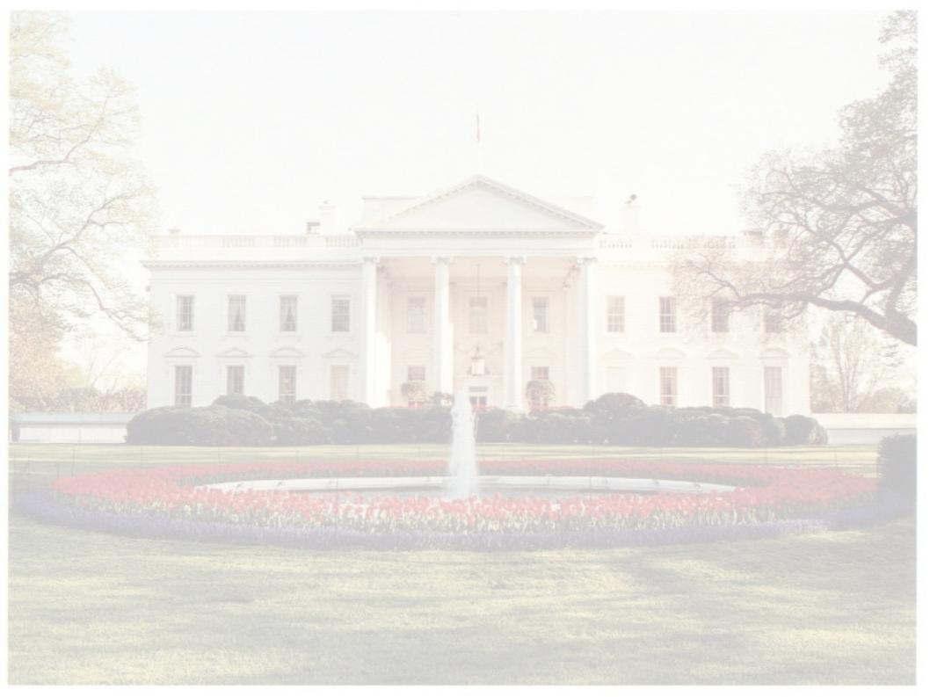
Head Of State Dinner
Coordinated with your venue and staff we will reproduce an unforgettable occasion! Our event planning team will reproduce the look and feel and most importantly the TASTE of a private dinner party at the White House.
We recommend this sort of an event for fund raising or for a select group of executives.

Slide 28




Slide 29
Brand Promotion
  Multi Location Roadshows at the largest events held in America and the world – iconic landmarks
  Recipes Developed With Your Product
  Excellent Track Record With Proctor & Gamble
  Large Events for Casino's & Trade Shows
  Experience and a Name with Professional Executive Chef's Credentials

Slide 30
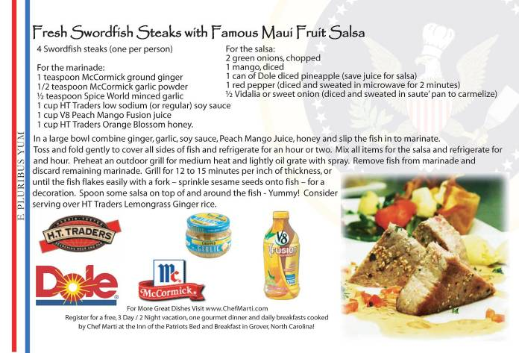
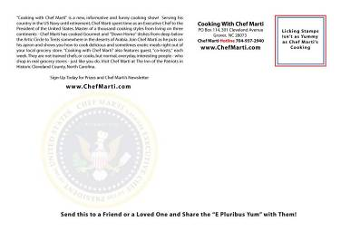
Recipe Post
Card Creation

Slide 31
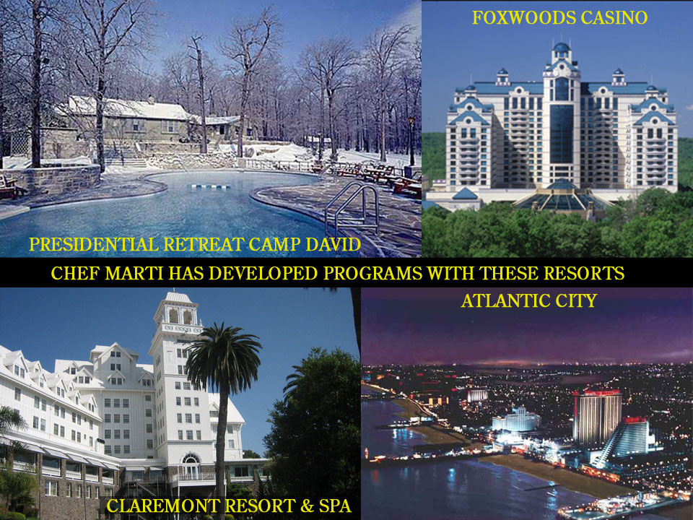

Slide 32


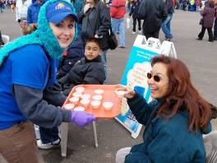
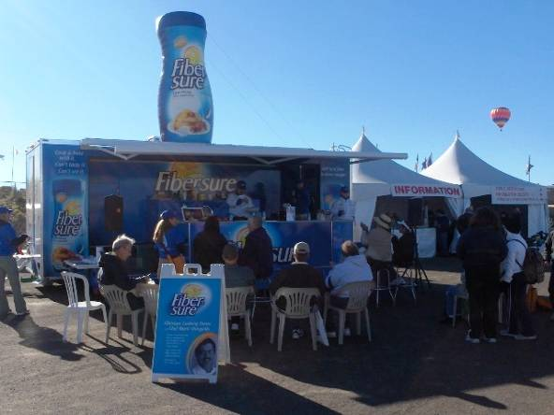
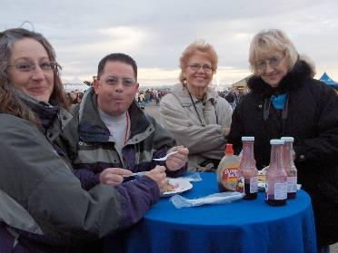
The Chefs and their Shows have appeared all over the world at shows like this:
The International Balloon Festival in Albuquerque, New Mexico

Slide 33
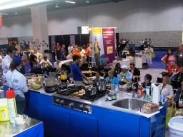
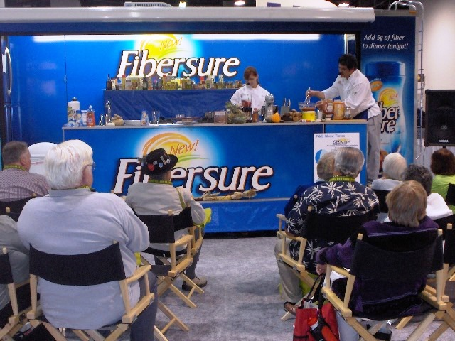
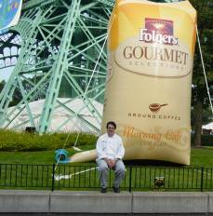

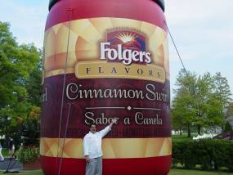

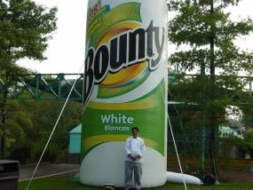
The AARP Annual Convention (Anaheim, CA) and Paramount’s Kings Island Amusement Park (Columbus, OH) and Concert Stadium

Slide 34


Slide 35
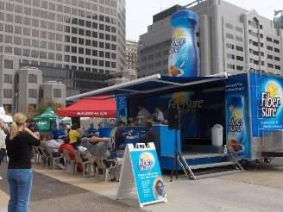
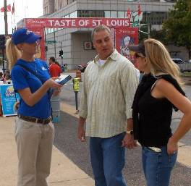

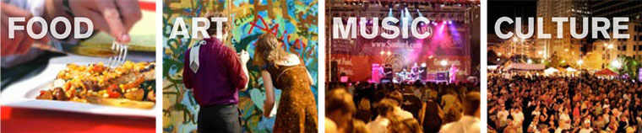
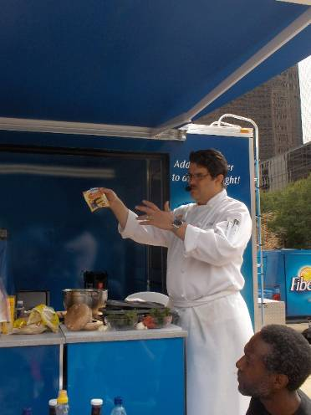
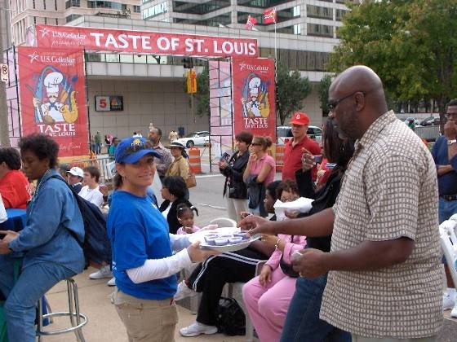

Slide 36
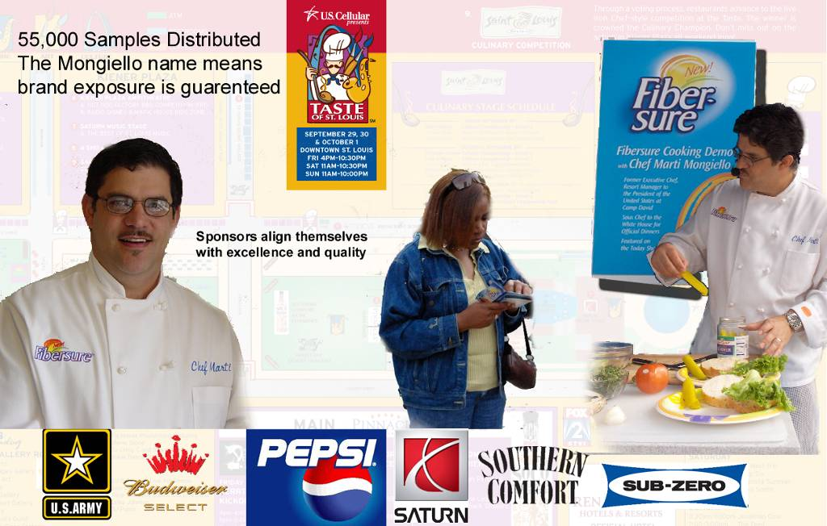
A quarter million samples distributed per day under the guidance of Chefs Marti and Stormy at mega-shows and festivals across the world

Slide 37

Arts, Beats & Eats Festival, Michigan – 250,000 samples distributed while managing a temporary hired - 20 person team

Slide 38


INFORMATION
Writers Guild of America East Registration Number: I237867, Library of Congress registered,
Mongiello Associates Strategic Marketing, 704-490-3947, www.mongielloassociates.com
The Inn of the Patriots – a top 30 world ranked B & B, Rated #1, worldwide, for HISTORY
Rated “Best of the South,” Zagat rated 26 of 30
3 Dogwood Blossom Award – highest green travel award in NC
301 Cleveland Avenue, Grover, NC 28073
Home of the “Presidential Culinary Museum®” and Presidential Service Center™

