Slide 1




PLANNING TOOLS FOR BROWNFIELD REDEVELOPMENT
Lesley Zlatev, Revitalization Specialist, Office of Community Planning, Development, and Community Infrastructure,
New York Department of State (DOS)
John Steimetz, Principal Planner & Regional Discipline Leader for Planning & Design,
Colliers Engineering & Design, Inc.
Schenine Mitchell, Section Chief, Brownfields Program, US Environmental Protection Agency (EPA)
Brownfield Developers Summit - Herkimer College - April 2026

Slide 2


Planning Tools for Brownfield Redevelopment
Presented by the US Environmental Protection Agency, Region 2
Mohawk Valley Brownfields Redevelopment Summit
April 21, 2026

Slide 3

Core Planning Activities Eligible for Funding
Site Reuse Planning: Developing reuse plans and market studies to determine the best future use for a property.
Inventory and Prioritization: Creating a database of potential brownfield sites and ranking them for future assessment and cleanup.
Site-Specific Cleanup Plans: Preparing the technical blueprints required to safely remediate contamination.
Community Involvement: Developing Community Involvement Plans and conducting outreach to ensure resident needs are met.
Infrastructure Analysis: Evaluating future utility needs, stormwater management, and flood resiliency during the assessment phase.
Planning is considered the "glue" that ensures a site's eventual reuse is feasible and aligns with community goals. Eligible activities include:

Slide 4
Brownfield Reuse Planning Elements
Site Inventorying & Prioritization
Market Analysis/Market Potential
Area-wide Analysis & Planning
Site Planning & Layout of Site Amenities
Conceptual Architectural Adaptive Reuse
Level of Magnitude Costs & Project Packaging
Identify Funding & Financing Opportunities
Analysis of Brownfield Cleanup Alternatives
Integrating Engineering Controls

Slide 5
The US Environmental Protection Agency Brownfields Program
ASSESSMENT GRANTS
Definition: Funding to inventory, characterize, and assess properties while engaging the community.
Grant Categories:
Community-Wide: for multiple sites across a region.
Site-Specific: for one identified property.
Coalitions: for partnerships between 3+ jurisdictions.
Note: These funds cannot be used for actual cleanup—only for assessment and planning.
Assessment grants provide the initial funding to move from "vacant lot" to "vibrant reuse".
Core Goals:
Inventory and prioritize brownfield sites.
Assess environmental conditions (Phase I and II ESAs).
Plan for sustainable redevelopment.

Slide 6
The US Environmental Protection Agency Brownfields Program
CLEANUP GRANTS
Grant Highlights:
Grant types: Cleanup, Multipurpose, and Revolving Loan Fund
​Depending on grant type, activities may include:​
Scope and plan process for site cleanup and reuse​
Remediation at one or more sites owned by the recipient​
Provide loans and subgrants for cleanup​
Community involvement to inform and engage stakeholders
Note: Sites must be owned by the applicant to be eligible for funding.
Definition: Cleanup Grants provide funding to carry out cleanup activities at brownfield sites owned by the applicant.
Core Goals:
Funds may be used to address sites contaminated by petroleum and/or hazardous substances, pollutants, or contaminants (including hazardous substances comingled with petroleum).
Stakeholder engagement throughout the project.

Slide 7
Brownfields Program: Technical Assistance
TARGETED BROWNFIELD ASSESSMENT PROGRAM
A TBA may encompass one or more of the following activities:​
An ASTM Phase I environmental site assessment (ESA), which includes a background and historical document review, site inspection, and interviews​
A full site assessment (Phase II ESA), including sampling activities to identify types and concentrations of contaminants and the areas of contamination that must be cleaned up; and​
The determination of how much more investigation is needed and/or the establishment of cleanup options and cost estimates based on future uses and redevelopment plans.
TBAs are considered a grant of services and are typically conducted by environmental consultants under contract with EPA.
The TBA program does not help conduct site cleanup or building demolition activities.
The EPA Targeted Brownfields Assessment (TBA) program helps municipalities and non-profits partnered with municipalities to redevelop contaminated parcels in their communities. ​
The purpose of a TBA is to minimize the uncertainties surrounding the actual or perceived contamination associated with these sites.

Slide 8

Who Is Eligible to Apply for TBA?
EPA offers TBA assistance to public entities (e.g., municipalities, regional planning commissions) or non-profits who partner with a public entity. ​
Applicants should have redevelopment plans for the contaminated property. ​
Applicants should apply on behalf of a specific site which it currently owns or can obtain ownership through some other means (e.g., tax foreclosure). If the site is currently not owned by the applicant, the site should be "abandoned". ​
An "abandoned" site for the purposes of the TBA program is a site where the current owner has shown no interest in the property, has not paid taxes on the property, and does not have the resources to conduct the required site assessment work. ​
Sites where the applicant could be considered a responsible party for the contamination on the site are not eligible for assistance under this program. ​
TBA program is not intended to assist private parties assess and cleanup their sites for redevelopment.

Slide 9
TYPICAL REUSE PLANNING PROCESS

Slide 10




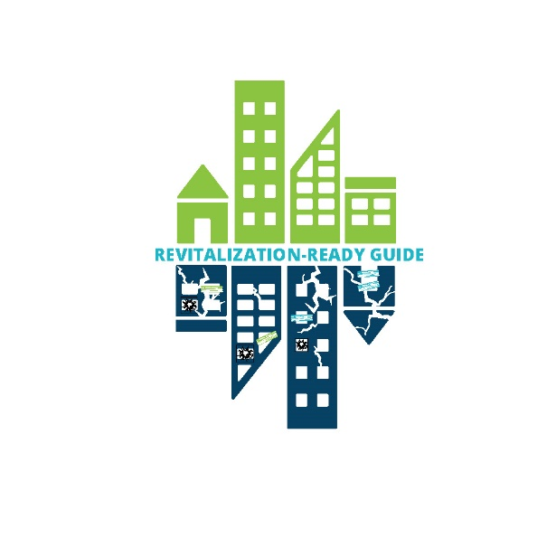

Brownfields Program Land Revitalization
Tools and technical assistance that help communities sustainably reuse properties
Develops guides, tools, trainings and best practices.
Provides technical assistance that helps communities cleanup and reuse contaminated land.
These and other LR resources are on EPA’s LR website

Slide 11
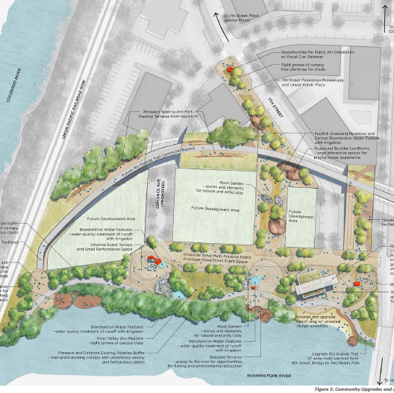
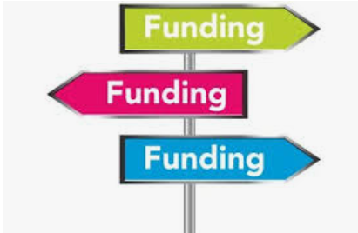
Land Revitalization: Technical Assistance
Site planning and research
Land revitalization technical assistance helps communities identify practical, safe reuse options and approaches that support local goals through access to site planning, design and finance experts.
Notes:
Activities that help to determine safe brownfield site reuse, decide cleanup, etc.
Site Reuse Assessment
Land Use Assessment
Market Study
Infrastructure Evaluation
Community Health Assessment
Site Disposition Strategy
Site Reuse Vision
Revitalization Plan
Resource Roadmap
Evaluation of Market Viability

Slide 12








Topic-specific Technical Assistance
Available to communities nationwide via these EPA Grant Recipients:
Support Nonprofits Seeking to Reuse Brownfields
Available: 2023 – 2028
Support for Brownfields Revolving Loan Funds
​Available: 2024-2029
Technical Assistance to Tribal Nations and Entities
Available: 2024 – 2029
Land Banking Strategies to Support Brownfields
​Available: 2023 – 2028
National Brownfields Training Conference
​Available: 2023 – 2030
Brownfields Anti-Displacement Research
​Available: 2023 – 2028
State Program Implementation
​Available: 2017 – 2029

Slide 13

EPA Brownfield Planning Resources

Slide 14


Thank You !
THANK YOU!
Schenine Mitchell, PhD
Brownfields Section Chief
U.S. Environmental Protection Agency, Region 2
Mitchell.Schenine@epa.gov
(212) 637 - 3283

