Slide 1




Slide 2
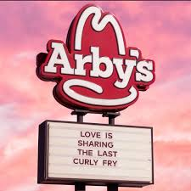
Shakedown!
Middle School 3pm Tuesday or Thursday
High School 6pm Thursday

Slide 3
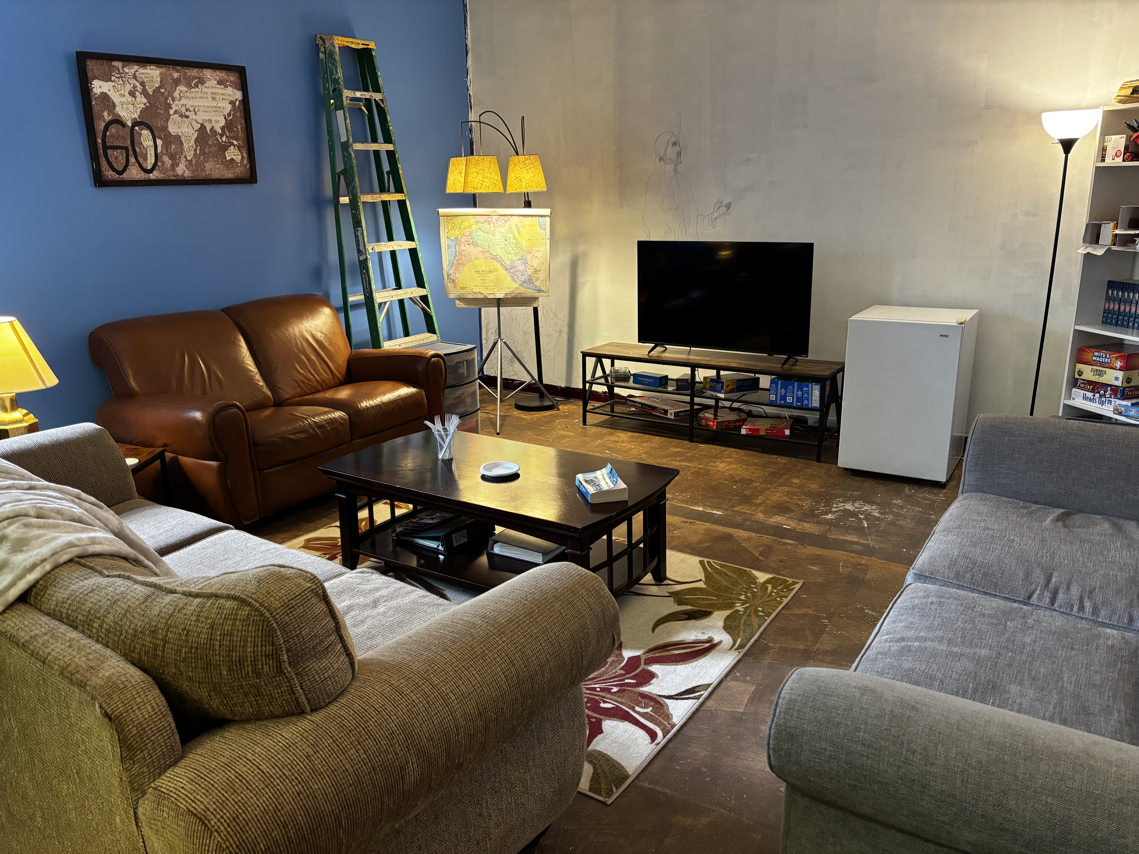
Sunday School and worship
Sunday school 9:30am with LARGE DEBRAS
Worship 10:30am – No Debras… Except that one lady

Slide 4
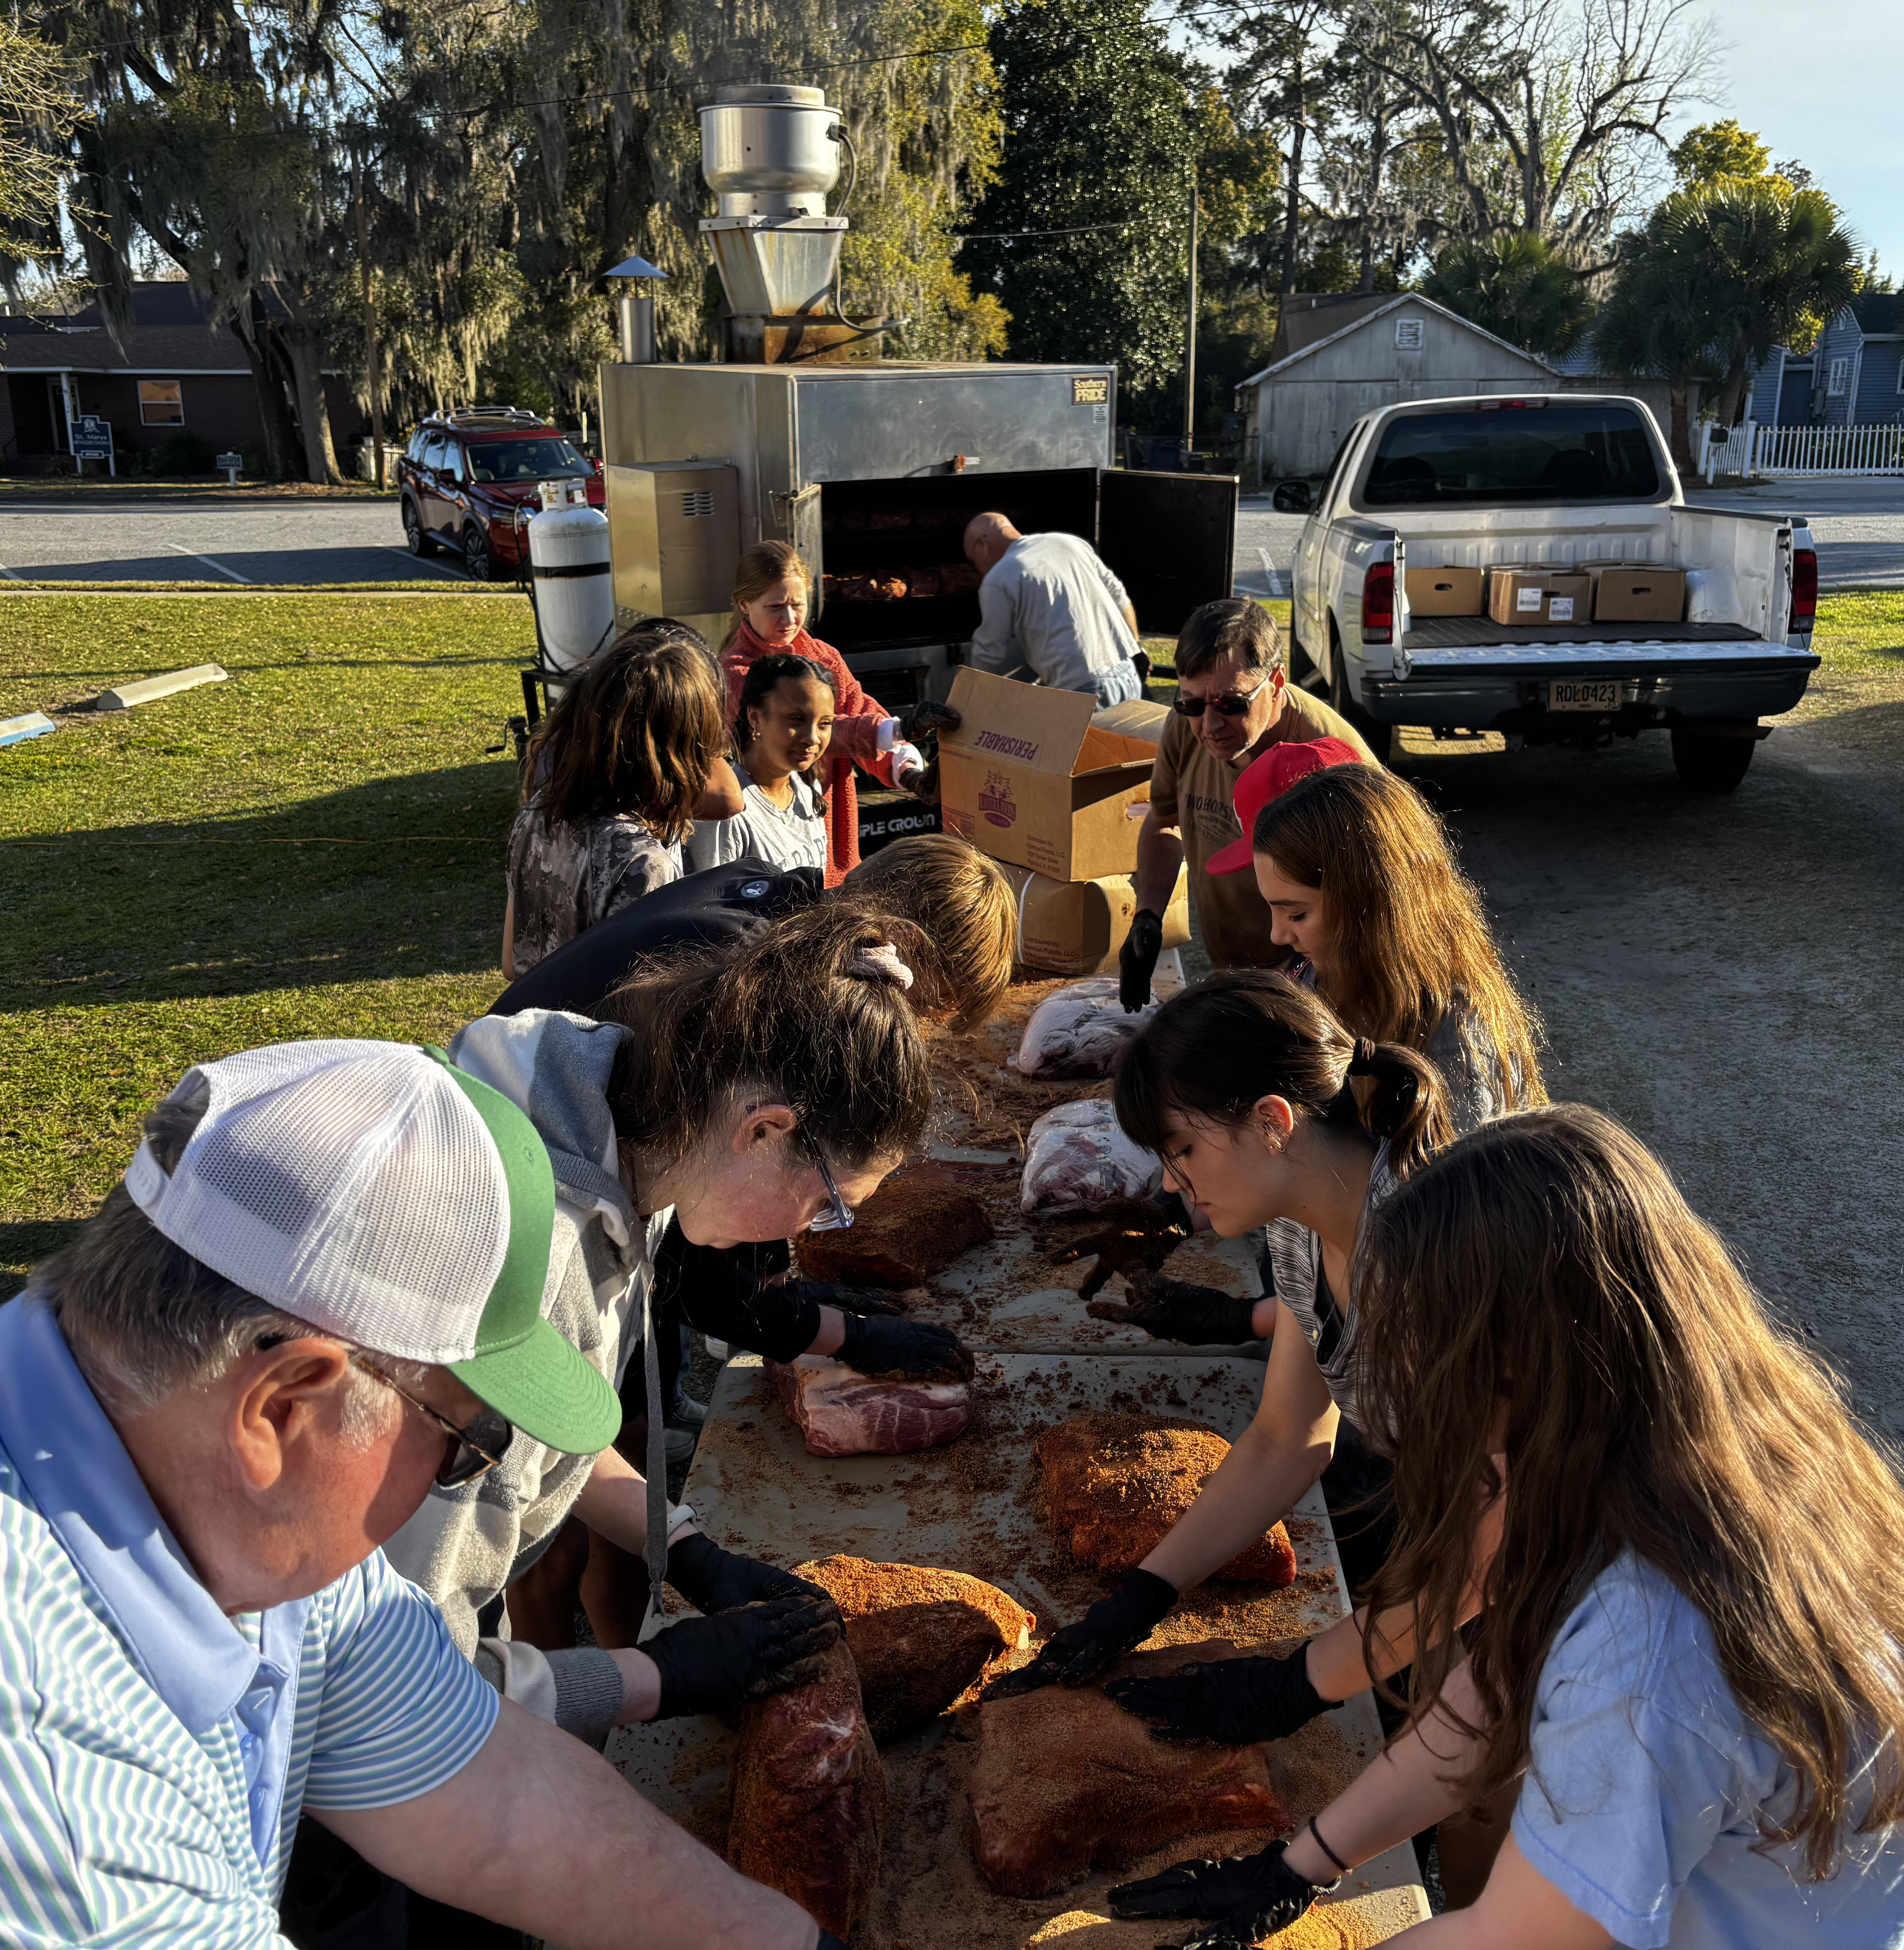
Boston Butt Fundraiser Help Needed Friday [THIS FRIDAY!!]
6PM FOR Approximately an Hour Right outside Bailey Hall
Help needed Saturday 10:30am – 1:30pm as well

Slide 5
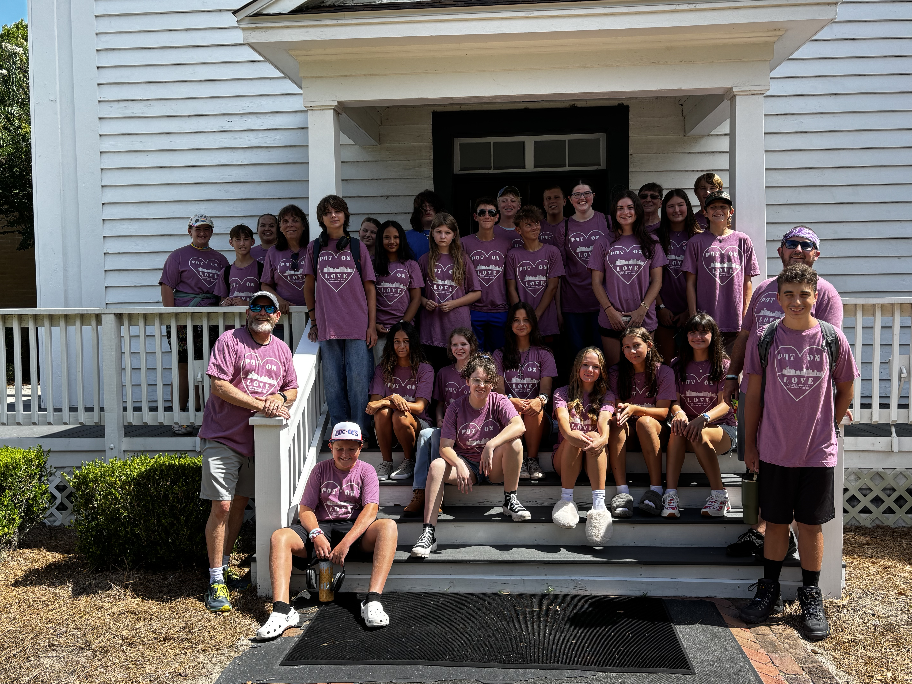
2026 Mission Trip Sign Ups
See the check-in/Food Table for a sign up form

Slide 6
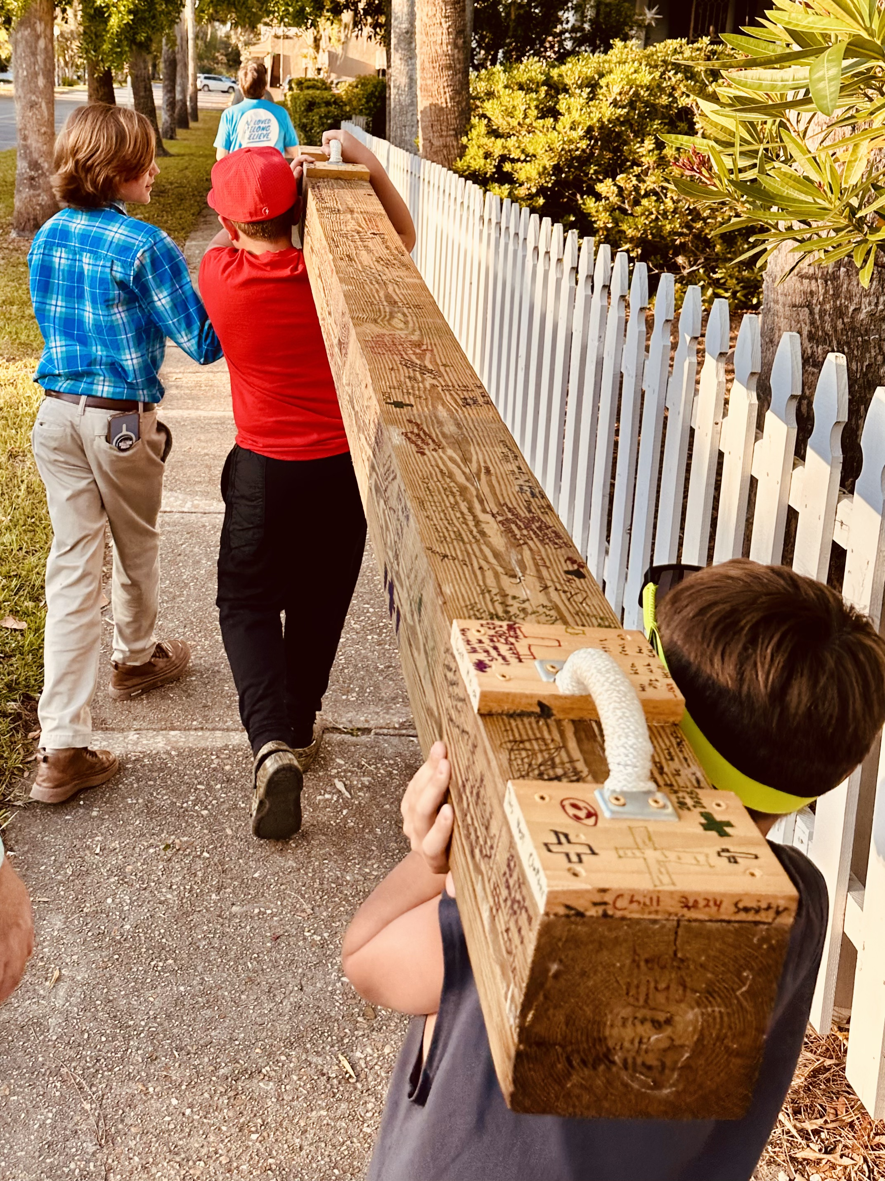
Carry the Cross Next week at 517

Slide 7
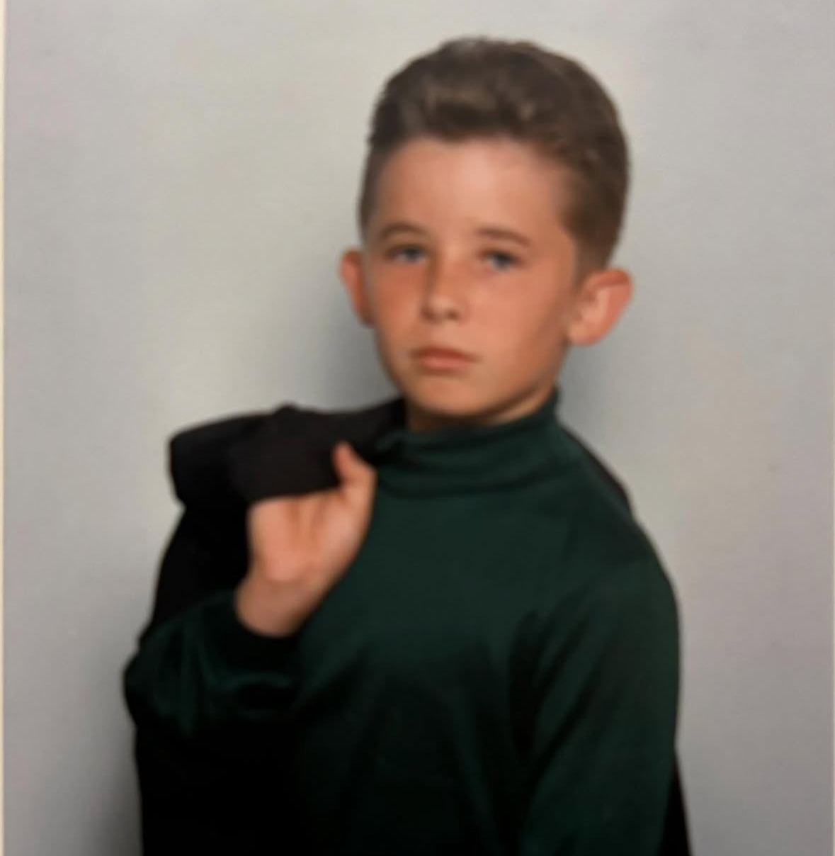
I LOVE YOU MANS
Give a loving shout out or a friendly roast (IN LOVE) to someone

Slide 8

What do you need prayed for?

Slide 9


