Slide 1
WATFORD WRITERS
WRITING A SHORT PLAY WORKSHOP 2
Chris McDermott (4.01.2021)
TWO – A consideration of Character and Dialogue.
(N.B. This follows on from the first session, which examined issues such as: Concept and Theme; Plot and Structure; Audience Impact).

Slide 2
RECAP OF SESSION ONE –delivered 16.11.2020. Some of the aspects discussed –overarching issues(1)
The writing process: creation, formulation, transcription and adaptation.
Concept and theme e.g. the relationship between a person’s parents as they were growing up.
Plot and structure: keeping a short play e.g. ten minutes within one time zone, with one set.
What impact do you want to have on your audience e.g. make them laugh; make them cry; pose questions; relay a serious message; hold them in suspense.

Slide 3
RECAP OF SESSION ONE –delivered 16.11.2020. Some of the aspects discussed – more detailed issues (2)
The employment of a narrator to help in the economical use of time.
Breaking the fourth wall by communicating directly with the audience e.g. Frankie Howerd, as Lurcio in Up Pompeii
Being clear about entrances and exits – which exit did a character use and where did she/he go?
Technical terms e.g. SFX (Sound) and LX (Lighting) – being clear.
Keeping the number of characters to a minimum in a short play.

Slide 4
INTERLUDE AND DISCUSSION TIME (1)
Are there any points you have for discussion, either from the recap of some of the points from the last session or from writing you have done since?

Slide 5
THINKING ABOUT CHARACTER
Jimmy McGovern (Brookside and Cracker) : It’s about character complexity and story simplicity.’ But how do we, as authors, know what the characters are really like?
The difference between character, which relates to issues such as honesty and kindliness and personality, which relates to issues such as extroversion and confidence.
Round characters and Flat characters. Round characters are relatively complex and can undergo development whereas Flat characters are uncomplicated, two dimensional and often stereotypical.
Is the character secondary to the theme, plot and genre of the play? Is your play plot-driven or character-driven?

Slide 6
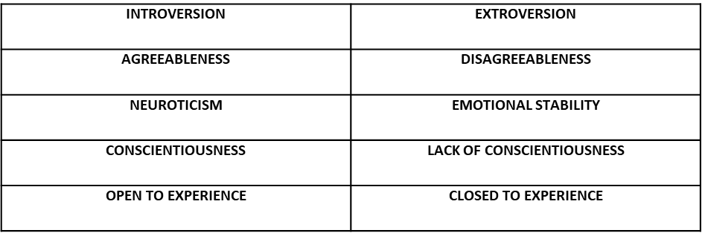
CHARACTERISTICS – FIVE CONTINUA.

Slide 7
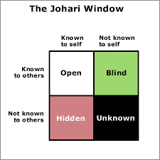
CHARACTER: THE JOHARI WINDOW.

Slide 8
THE JOHARI WINDOW - THE FOUR QUADRANTS.
The Open Quadrant – both the subject and others perceive this.
The Blind Quadrant – the subject does not perceive this, but others do.
The Hidden Quadrant – others are unaware of this, or it is untrue, but the subject keeps it hidden or it is untrue despite his/her claims.
The Unknown Quadrant – neither the subject nor others are aware of this, possibly because of a collective ignorance.

Slide 9
CHARACTER HONESTY AND TRANSPARENCY – HOW HONEST OR TRANSPARENT IS YOUR CHARACTER?
The character may try to keep secrets from:
The audience
Some of the other characters
All of the other characters
Themselves – if this is conscious this takes them into to the area of self-denial; if it is subconscious this takes them into the area of lack of self-awareness.

Slide 10
YOUR CHARACTER’S KNOWLEDGE AND SELF-AWARERNESS
Do other characters know things that this character does not know, either about themselves or in connection with the plot?
Does the audience know things about this character does not know about themselves or in connection with the plot?
Reflect on whether play and films you are familiar with are primarily plot-driven or character-driven. Three examples:
PLOT-DRIVEN:
The character may be ignorant of something which the audience knows; this can add suspense because the audience sees the character putting themselves in danger.
The character may know something the audience does not, and it is up to the audience or other characters in the play to discover this hidden truth e.g. the character is a murderer.
CHARACTER-DRIVEN:
The character is following a character arc and might experience an epiphany.

Slide 11
CHARACTERISATION AND CHARACTER ARC.
In the Murder Mystery plays I have written the characters tend to be Flat i.e. stereotypical because the plays are plot-driven and often humorous in intent.
In the other plays that I have written which are character-driven, the plays are serious and examine issues connected with human nature and society. For example, who holds the power in a relationship, how do they do this and why?
Character arc – this is the transforming of a character from one sort of person to another over the duration of the play. This is usually a positive transformation from selfish to selfless or unconfident to confident, but it can be a negative transformation, as in the case of Macbeth, who changes from hero to assassin.
It is difficult to achieve a character arc in a short play, but there is the opportunity for a revelation or an epiphany.

Slide 12
CHARACTER: SOME CONSIDERATIONS.
Where do we get our inspiration for characters from?
Are they Flat characters or Round Characters?
Are they the protagonist, the antagonist or the deuterogamist (ally)?
How have we named them? Is this significant?
What is their role in their relationships/family/workplace?
What is their role in the play?
Can they be trusted by the other characters? Can they be trusted by the audience? Can they be trusted by themselves? Do they know themselves?
A better understanding of individual characters by the author can mean that the characters drive the dialogue.

Slide 13
INTERLUDE AND DISCUSSION TIME 2: reflect on fictional characters you have met or created.
What is their name?
What is their role?
What is their function in the play?
Are they Round Characters or Flat Characters?
How do they relate to the other characters?
Are they believable?
Do they break the fourth wall?

Slide 14
DIALOGUE
The dialogue needs to be appropriate for the character in terms of age, social class, occupation etc.
What is the purpose of the conversation? Is it to tell us about an individual, the relationship between individuals or to progress the plot?
Generally, keep the dialogue brief. Do not overwrite – characters who, in real life, send us to sleep will probably have the same effect on the audience.
Omit unnecessary dialogue such as small talk.
Where possible, check the dialogue with people of the right age range.
Have you thought about: accent, dialect, vocabulary, body language? The concept of idiolect.
Read the dialogue aloud with friends.

Slide 15
SMALL EXCERPT FROM THE EPISODE I WROTE RECENTLY
Dave has just walked into a pub one lunchtime to discover that Karen is having a drink with her friend, Ruth. Karen has bought herself a new phone after her previous one had mysteriously ‘disappeared.’
DAVE: So, what’s going on then?
KAREN: What do you mean, Dave, going on? There’s nothing ‘going on’.
DAVE: Then why are you here with that Ruth having lunch, when you told me you were off out to get my Christmas present?
KAREN: Well, I am darling! It’s my top priority for the day.
DAVE: (NOTICING KAREN’S BAG) Oh yes! I see you’ve been out shopping. You don’t mind if I have a look do you?
KAREN: (REALISING DAVE MIGHT DISCOVER THE MOBILE PHONE) No, darling. No. Don’t look! Please don’t look! You know I wouldn’t want you to spoil your Christmas surprise!
DAVE: Just a little look in your bag. I’m sure it won’t do any harm.
KAREN: No Dave. Please don’t open my bag. What would Father Christmas say?
DAVE: He would say you don’t deserve the love I give you.

Slide 16
INTERLUDE AND DISCUSSION TIME (3):
REFLECTING ON THE DIALOGUE.
What is the purpose of the conversation from Dave’s point of view?
What is the purpose of the conversation from Karen’s point of view?
How do we know this?
What is the relationship between Dave and Karen? How do we know this?
Are both characters being honest with themselves and with each other? How do we know this?
What is the purpose of this conversation in terms of the information the writer is relaying to the audience?

Slide 17
Final thought.
Where do we go from here, if anywhere?

Slide 18
Thank you!

