Slide 1
Writing for Magazines
From my own experience
IAN WELLAND

Slide 2
Useful advice to me
“Write about what you know”
…Patrick Moore (Selsey, 1978)
“For every one question answered,
there should be three more questions to ask!”
…Christopher Lloyd (London, 2004)

Slide 3
Useful advice to me
The best part of writing is the research!
…Carl Sagan (London, 1980)
“You can be early,
but there is no excuse for lateness!”
…George Wheeler (London, 1978)

Slide 4
Workshop Content
Areas of Interest - Specialisms
Why write for magazines ?
First stages – how to decide what to write and for which media
Moving an idea forward – the “Angle”
Hot and Cold – Getting a script together
Submission. Publication and the aftermath
Record keeping

Slide 5
Areas of Interest and Specialisms
Astronomy
Amateur Astronomer (since 1974); Astronomical Historian (since 1979)
Art and Art History
Art Historian (since 1980)
History
Period 1900 – 1939 (since 1978)

Slide 6
My Experience (Summary)
Submitted over 100 articles between 1981 – 2015
Publication success average = 98%
Worked with a number of Editors and Sub-Editors
Have always delivered to deadline
Have also provided my own photos to many articles
Co-written 6 major features for ‘Astronomy Now’ including the ‘Uranus’ feature with Patrick Moore first published in 2006 and revised in 2010.

Slide 7
Why write for magazines?
Audience / readership
Share of knowledge
Relevance
Gets your work out there!

Slide 8
First Stages (How did I do it?)
Research!!!
Target publication(s)
Read the publication(s)
Look at the magazine’s profile
Understand the readership / target audience / circulation
Where the publication is located? UK or elsewhere?

Slide 9
Exercise 1 (10 mins)
Draw up a shortlist of magazines you like / have read
Choose one magazine that you could consider submitting to
Why have you selected that magazine?
What is the style and profile of the magazine?
What is your motivation for writing for / submitting to the magazine?

Slide 10
First Stages – Things to consider
What, when, where, why and how (relevance / “angle”)
Adding value
Look at past editions
Writing Guidelines
Additional media
Additional content

Slide 11
Moving an idea forward –the “Angle”
Ideas for an article(s)
Relevance / Topical / Unique ?
A “one-off” or a “series” ?
Is it an article, interview or review ?
Is your idea in line with the magazine’s culture or style?
Appeal ?

Slide 12
Moving an idea forward – the “Angle”
Be aware of deadlines
“Here and Now” ideas
Compliance
Submission
Assumptions

Slide 13
Exercise 2 (10 mins)
Having selected a magazine to write for (Exercise 1), plan out an idea for an article. Be sure to think about:
> Angle ?
> Audience – who is it aimed at ?
> Timescale – is it a “here and now” or an article in advance of an event, commemoration or anniversary ?
> Additional media – photos ?

Slide 14
Hot and cold – getting a script together
Working Title, Synopsis and Plan
Research – how much to use ?
Draft script
Final script
Final Title and word count
Format

Slide 15
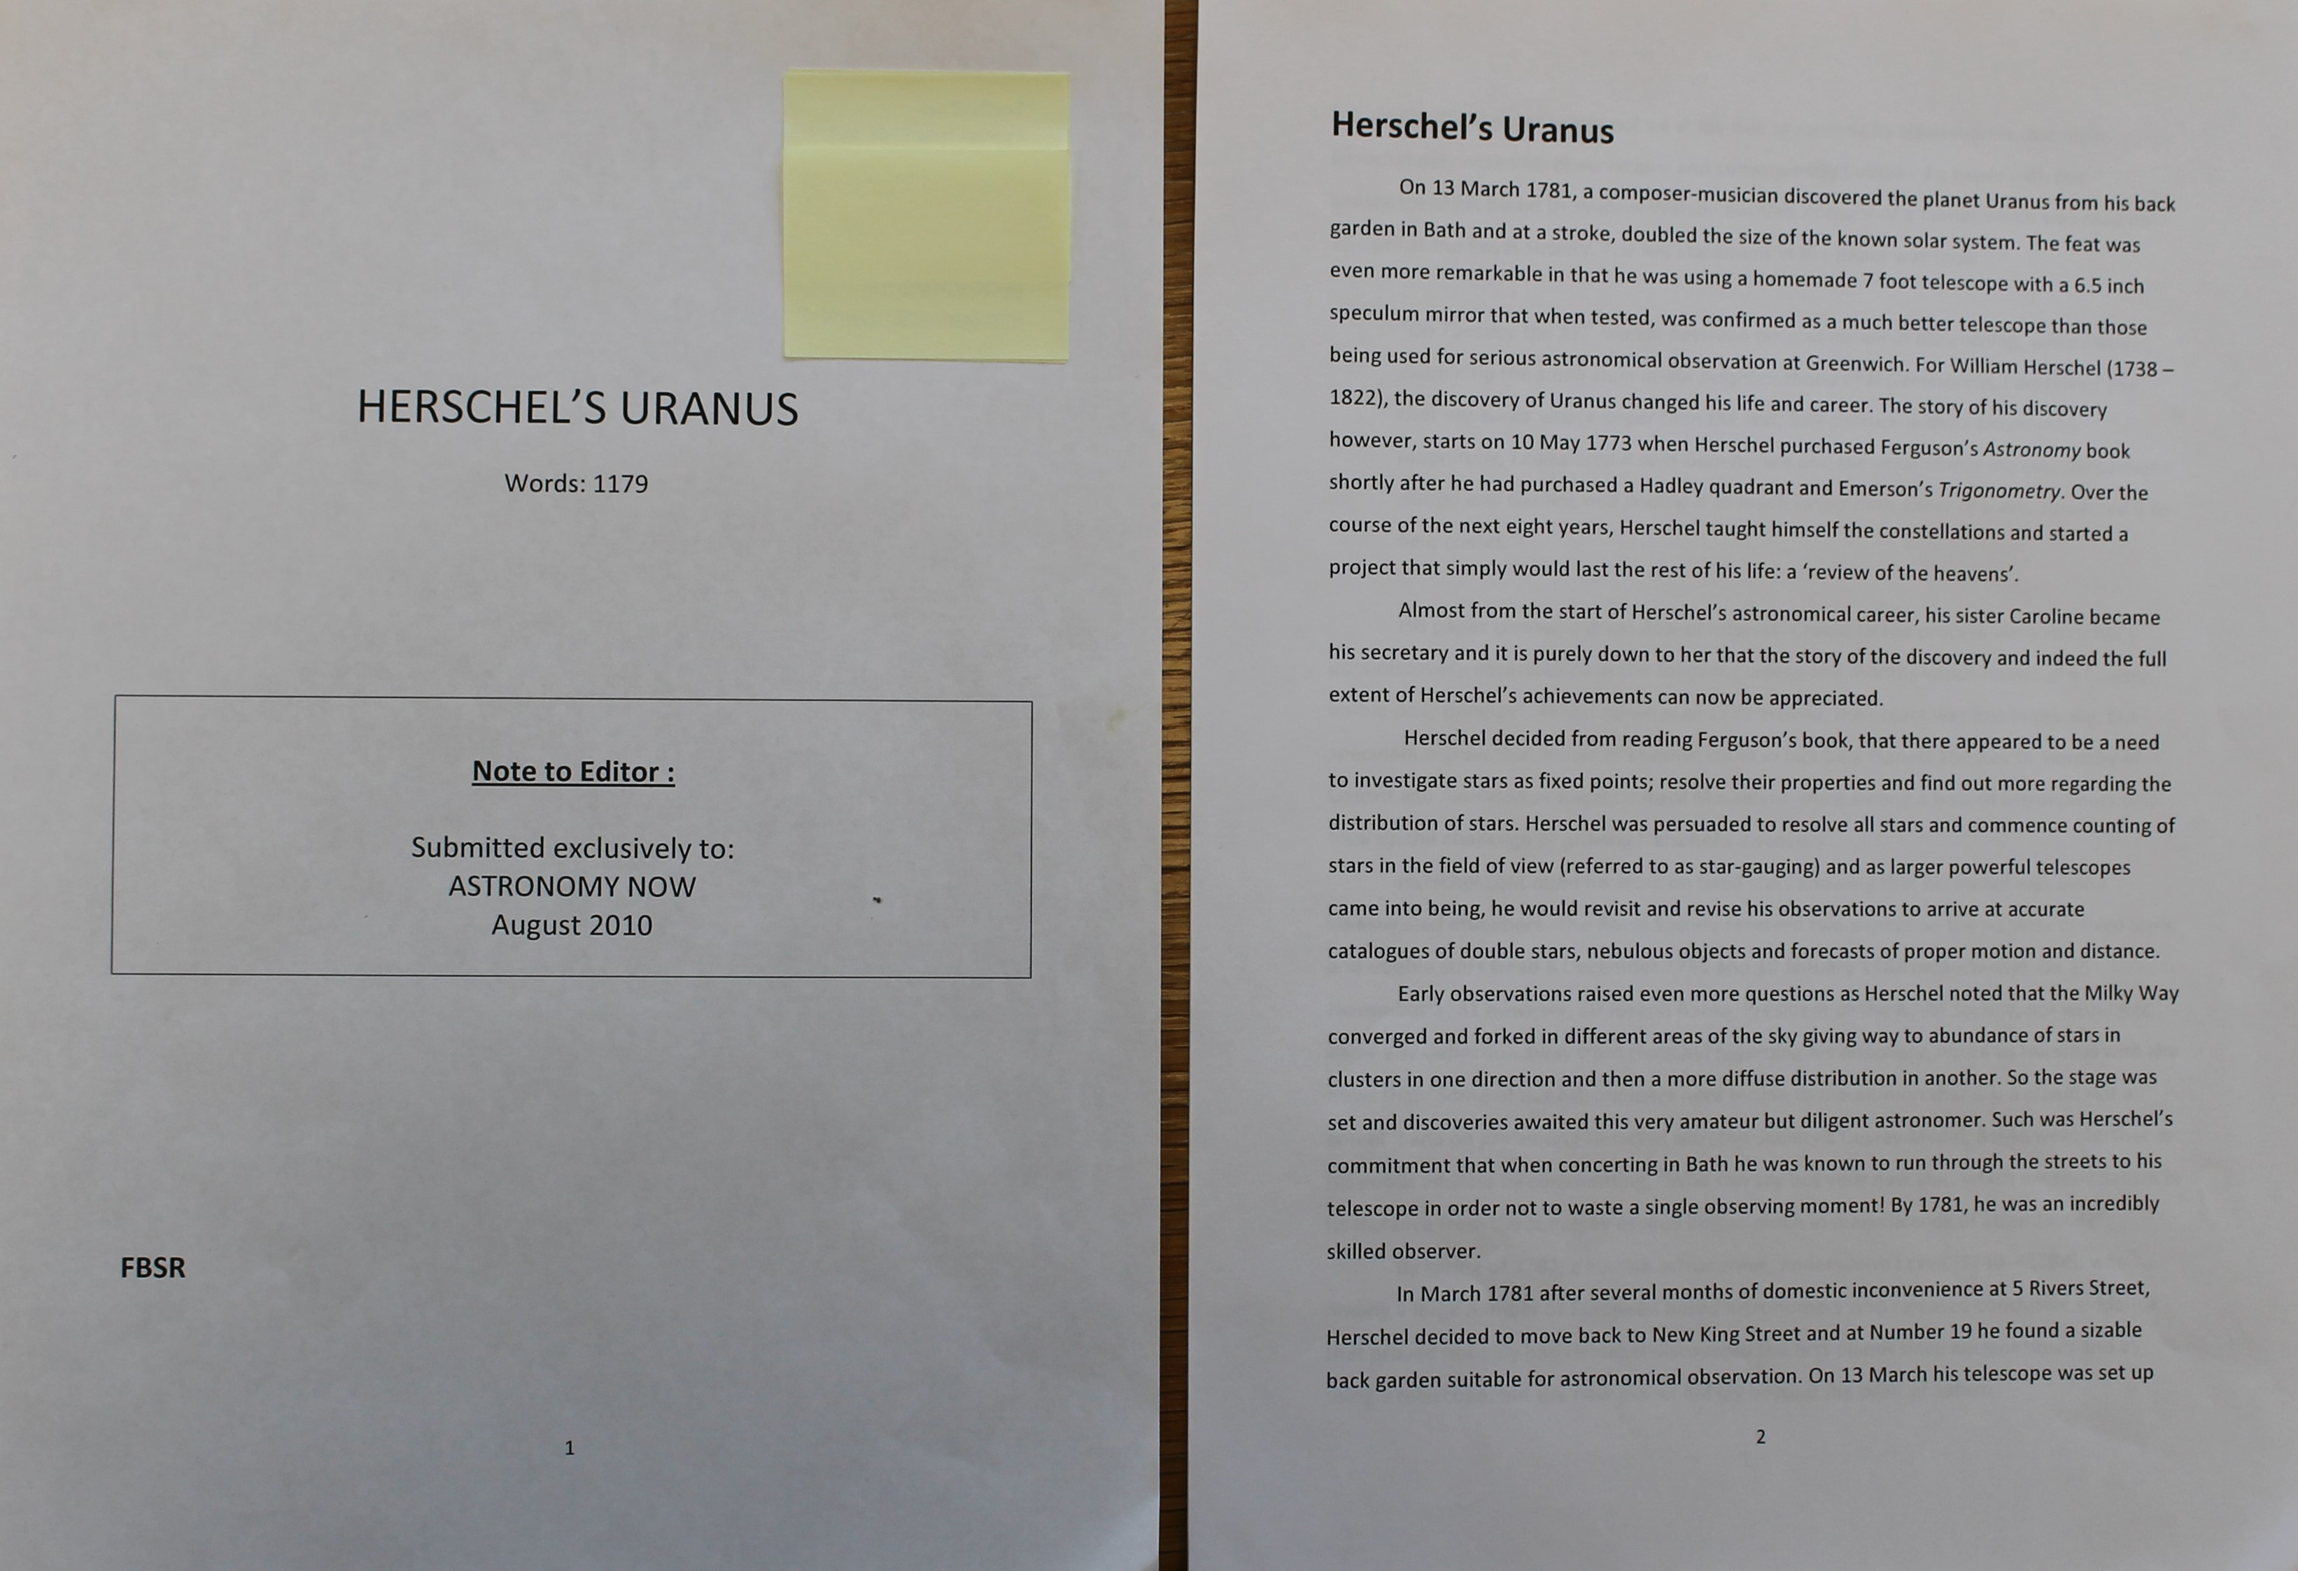

Slide 16
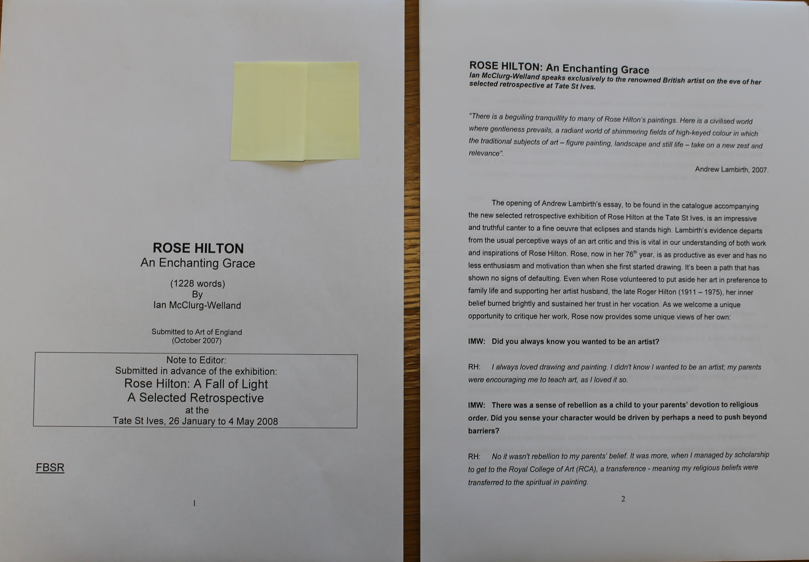

Slide 17
Submission, Publication & Aftermath
Title Page
Final Script
First British Serial Rights (FBSR)
Sending to the Editor
Publication and Invoicing
The Waiting Game

Slide 18
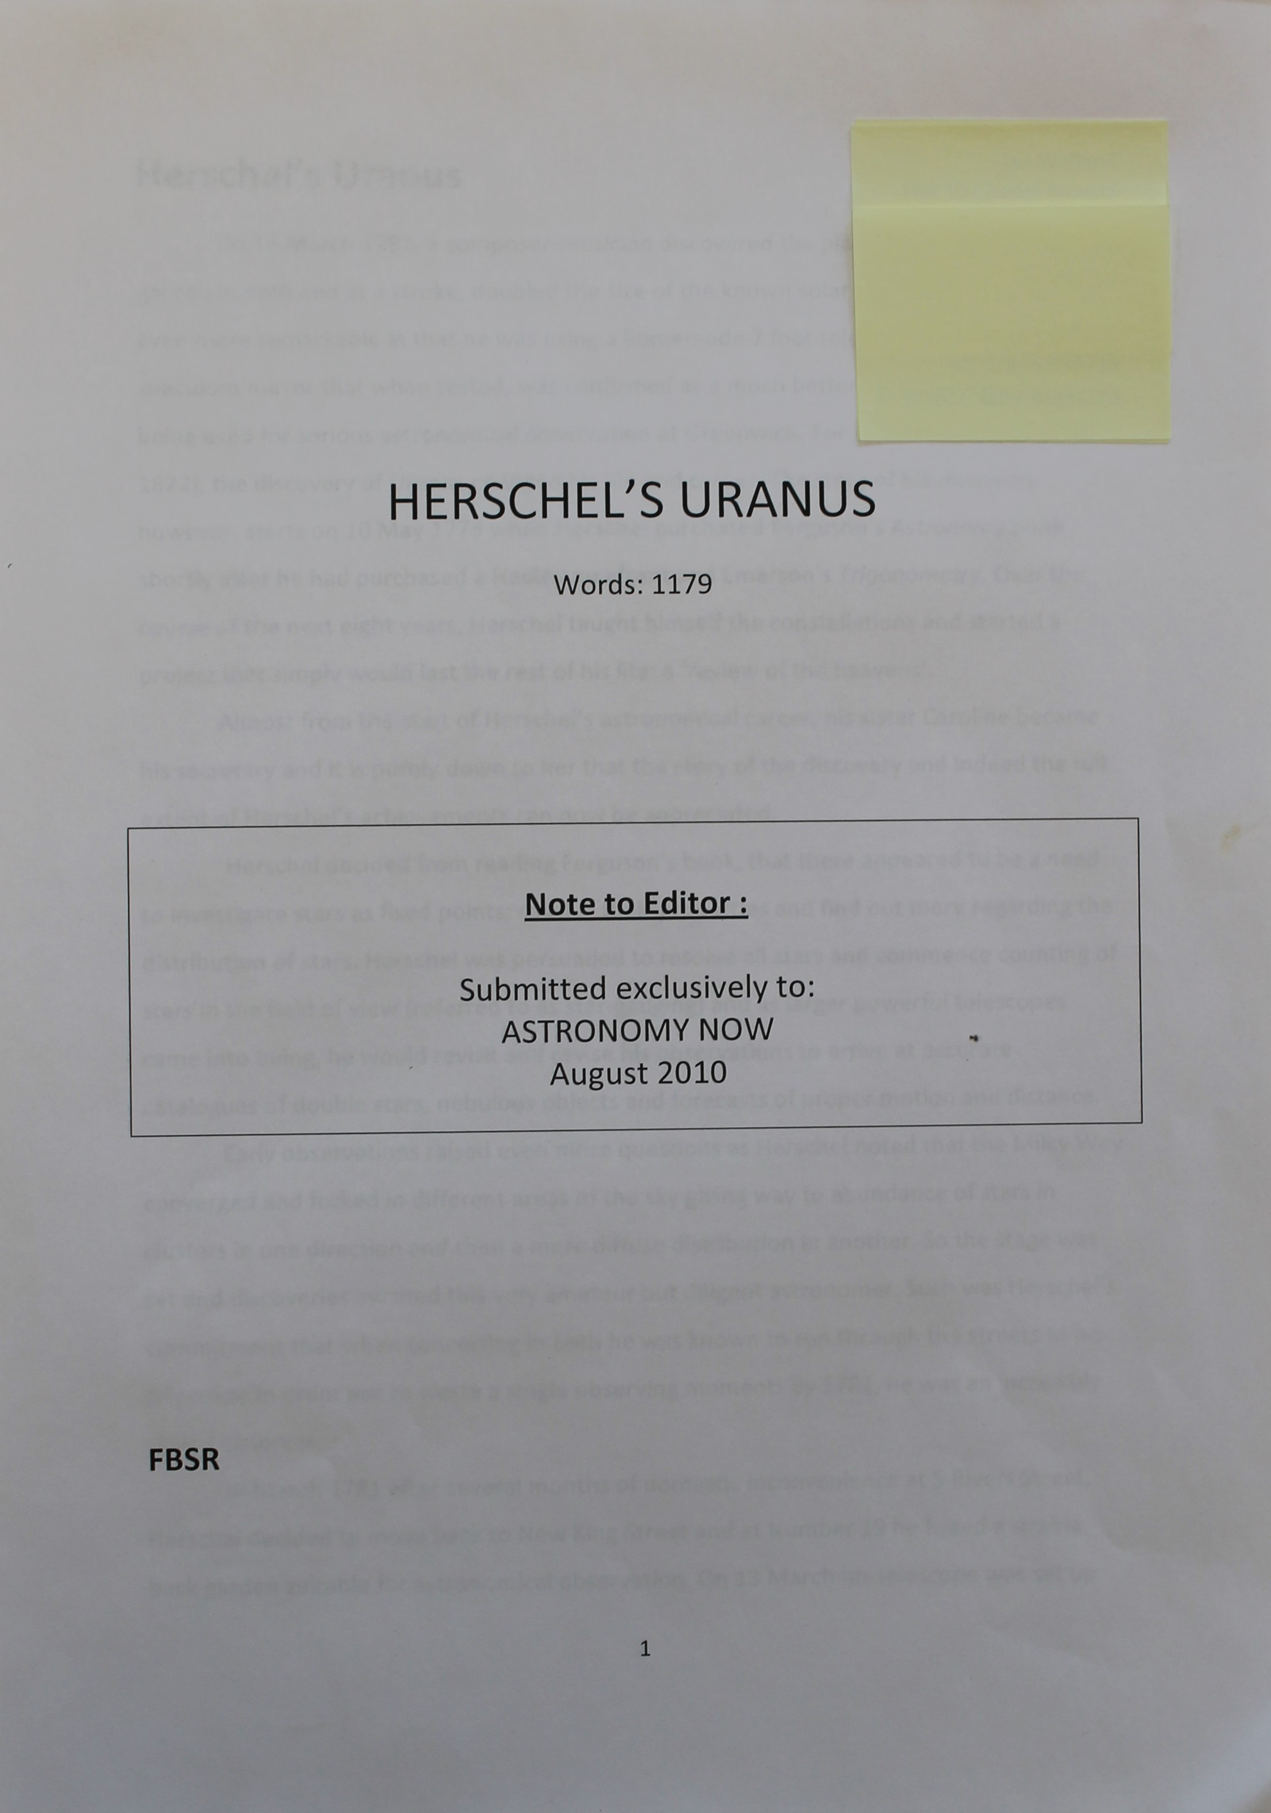
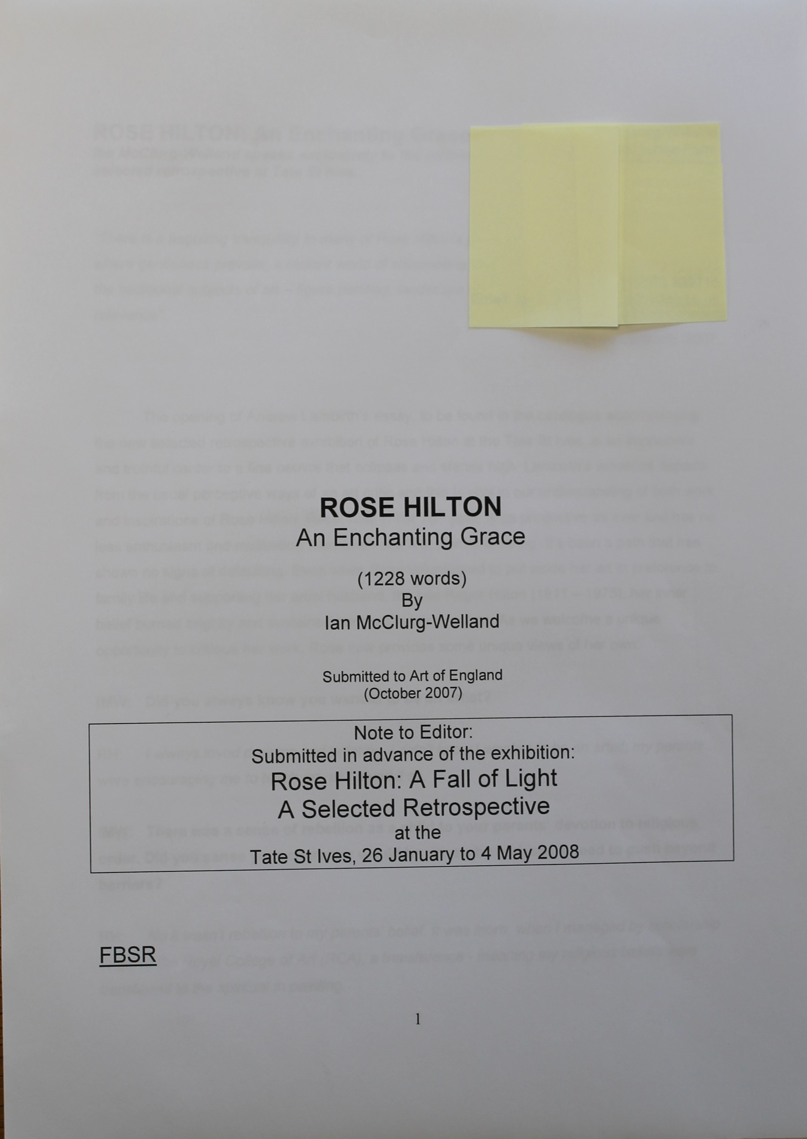

Slide 21
CHECKLIST
Are you sending your final completed article to the correct magazine and editor ?
Have you spelt their name correctly ? !
Have you attached your final version of your article (complete with front page) and attached any additional media (photos) ?
Have you submitted by deadline date ?

Slide 22
Newspapers
Freelance Journalism
Press Releases
“What, When, Where, Why and How”
Local Community News
Articles – anniversaries, commemorations, events
Reviews

Slide 23
Journals
Professional Associations and Societies
Book Reviews
News Items
Articles – these are normally commissioned, but you could pitch to the Editor

Slide 24
Record Keeping
Title
Date of Submission and FBSR offered?
Magazine submitted to
Editor
Publication Date
Invoiced amount (if any) and payment received
Comments – brief synopsis, reason for article, review date

Slide 25
…or you can read the first 98 pages of:

Slide 26
Your mission – should you care to accept it!
'FAMOUS INTERVIEWS’
You are a journalist and have been assigned to interview someone famous, or not-so famous. You have to prepare your questions and tease out what you believe your readers would like to know! Is your chosen person receptive or resistant?
Or; you may prefer to write an article on something you enjoy and could offer up to a magazine for the enjoyment of their readers
Maximum of 500 words to be presented to the group NEXT WEEK.

