Slide 1

Expanding Impact
An overview of growth, partnerships, and services
Prepared & presented by: Kim Koepf, Victim Services Senior Manager, MSCJ

Slide 2
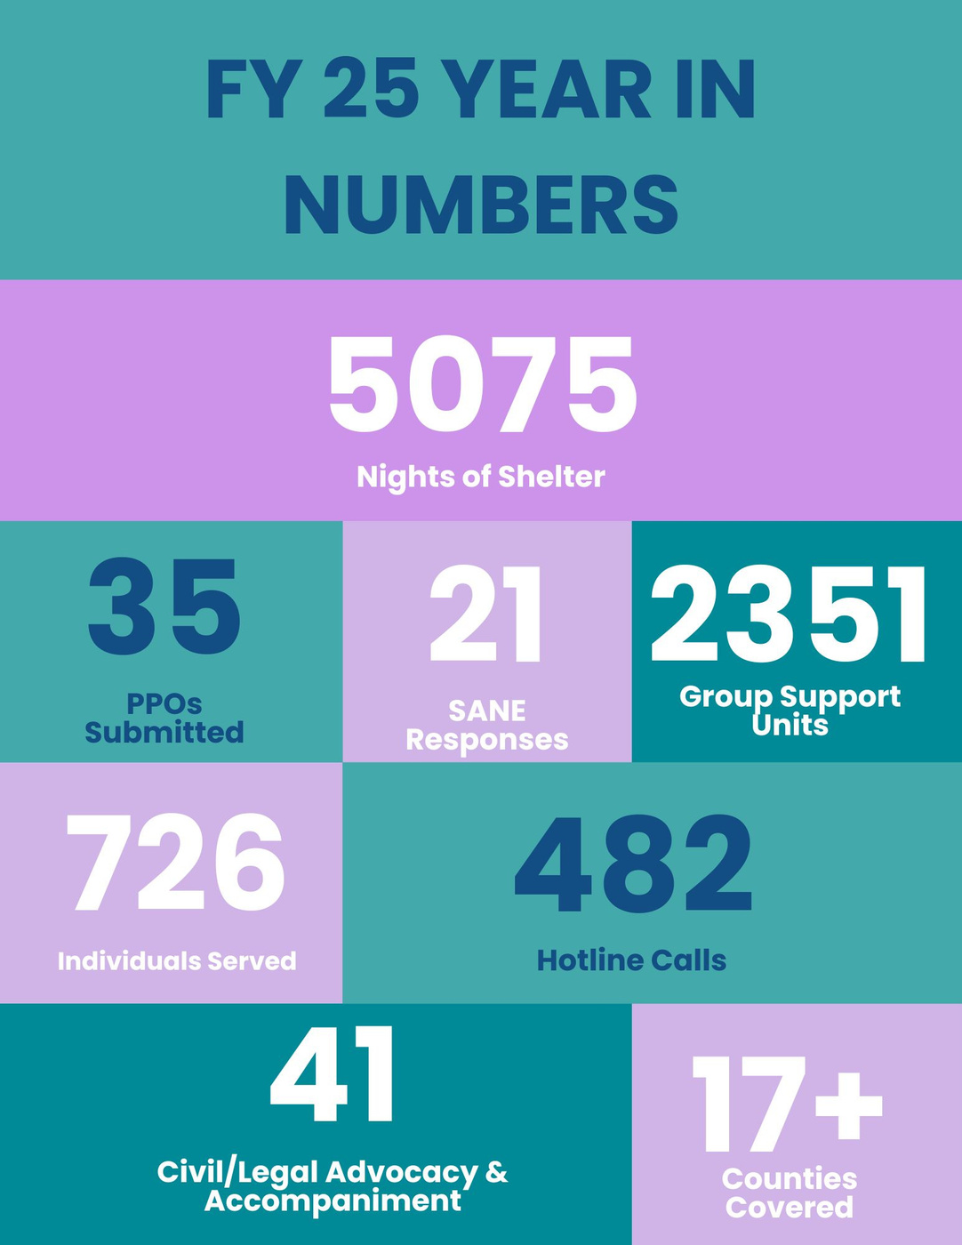
Services Overview
  ACC has provided emergency shelter for survivors of intimate partner violence since the 1980s. With the addition of the SACS grant in FY24, sexual assault survivors are now provided the same shelter access regardless of their relationship with the assailant.
  ACC staffing has increased to directly serve clients in Huron & Sanilac counties and to address survivor’s unique housing challenges needs.
  Community based advocates have helped navigate the unique procedures of civil/criminal justice systems, partnerships, and resources.
  Support groups are avaiable for survivors both during the day and in the evening to provide survivors with trauma informed activities and peer led conversations

Slide 3
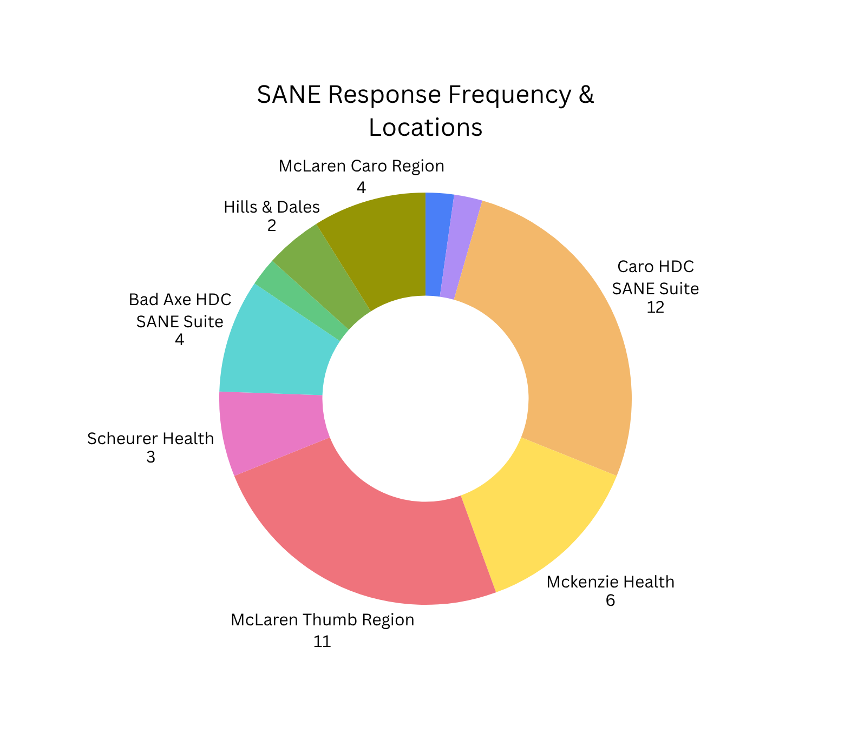
24/7 SANE Response
Throughout the Thumb
  4-person on call team provides response, typically within less than an hour
  46 responses since beginning comprehensive Sexual Assault Services in FY24
  Response provided for
survivors across the lifespan
(youngest: 2 years; eldest: 82 years)
  Survivors are provided with support during the exam, throughout the investigation, and with follow up based on their lead and comfort

Slide 4
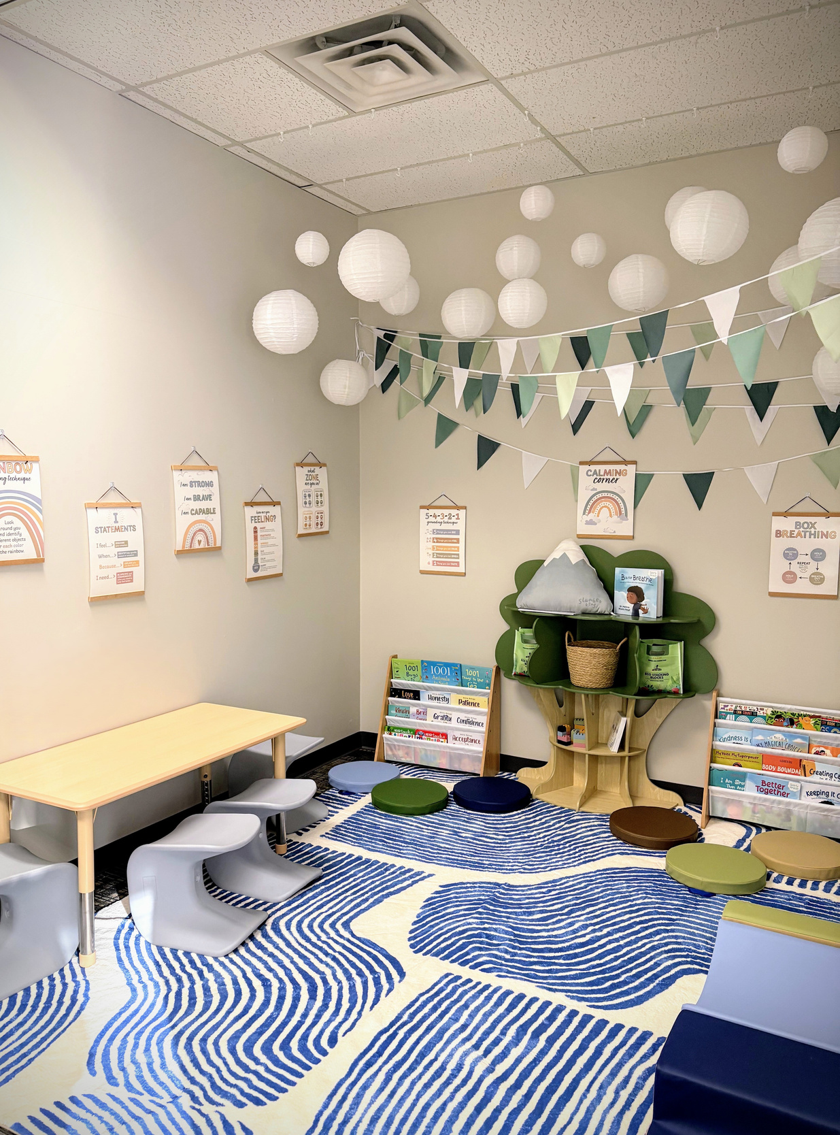
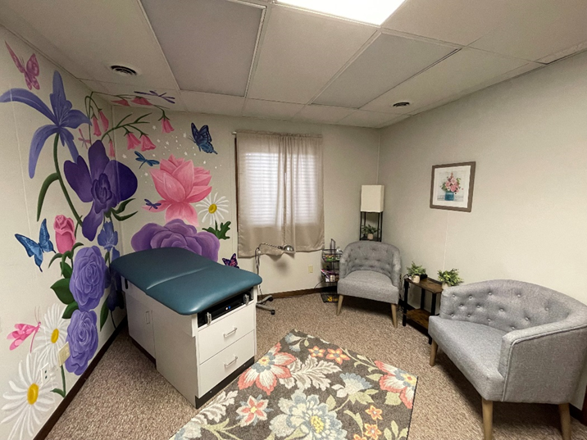
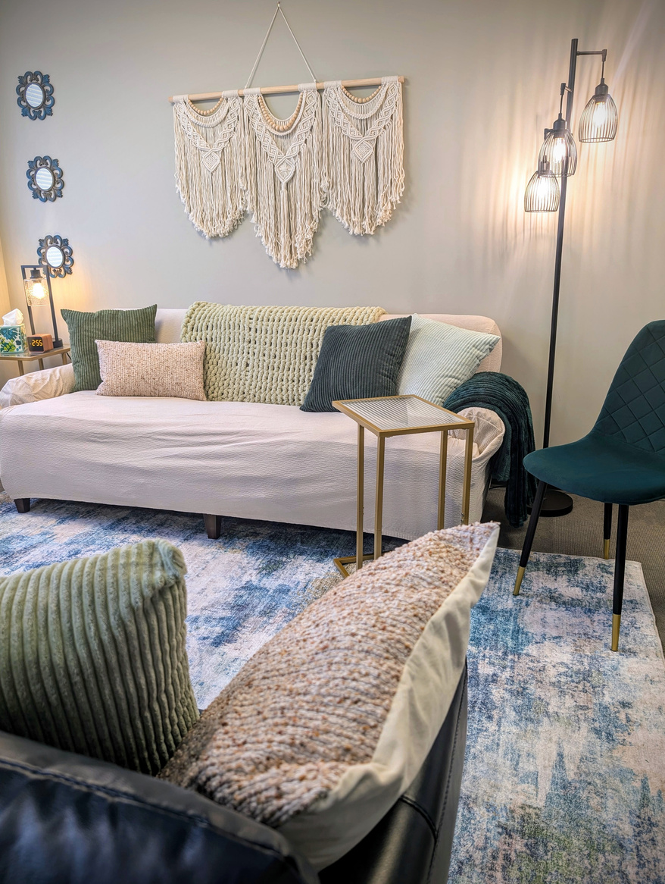
Community Sites
Bad Axe Children’s Area Caro SANE Suite Sandusky Group Space

Slide 5
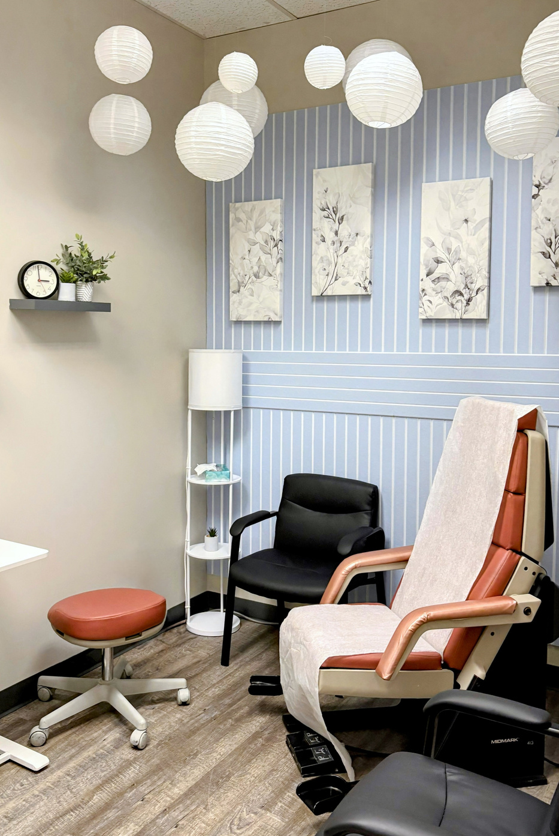
Purposeful Spaces Matter
Group Space | Bad Axe Survivor Group: 9-10:30AM Tuesdays Caro DV Group: 9-10:30AM Tuesdays & Thursdays Caro SA Group: 9-10:30AM Wednesdays Caro Survivor Group: 5:30-7PM Thursdays Sandusky Survivor Group: Starting in May - 5:30-7PM Weds
Soft InterviewRoom | The Bad Axe location features a dedicated, low-sensory 'soft' interview room—designed to be less clinical and punitive feeling—providing survivors a comfortable space to meet with service providers, legal representation, or law enforcement
SANE Suites | All three offices offer a dedicated space for Forensic Medical Exams. Survivors receive a head to toe exam assessing for injury and documenting evidence. Survivors can be provided with blankets, replacement sheets, clothing, and other needed resources.
Dedicated Children’s Spaces | Rapport building with children is often obtained by play, art, or comfort. Our spaces offer stuffies, age appropriate toys & activities for children while awaiting their services or those of their loved ones. Staff can provide childcare focusing on the 40 Developmental Assets framework.
Our goal was to help survivors feel serene, thought of, and welcomed while they navigate these traumatic experiences.

Slide 6
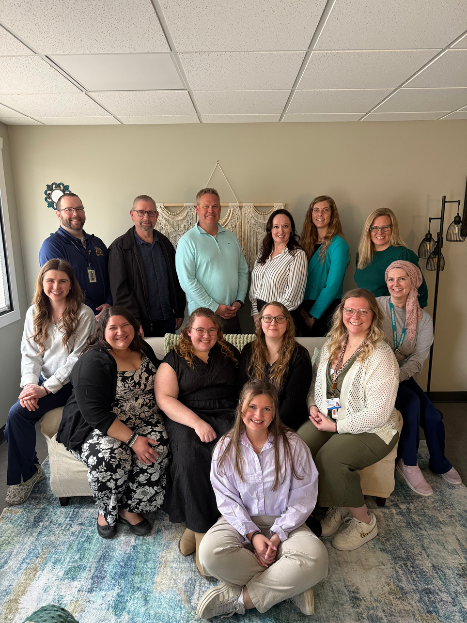
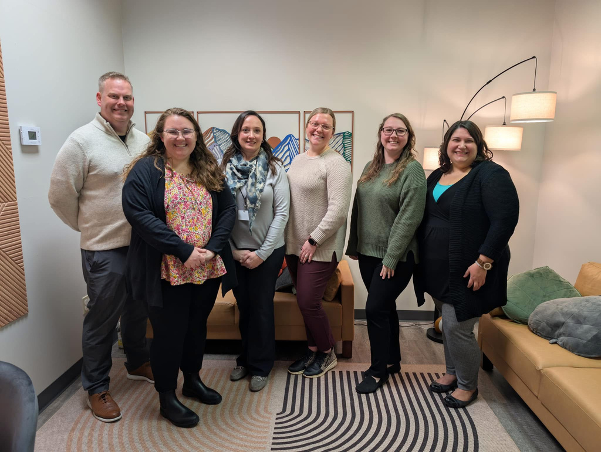
Sandusky Open House Attendees
  HDC board members & staff
  List Psychological Services Director
  Michigan Forensic Examiners Director & nurse
  Sanilac County Prosecutor
  Sanilac County Victim Advocate
  Sandusky Police Chief
  Sanilac County Sheriff & Undersheriff
  Sanilac Community Mental Health Nurses
  Families First Case Manager
  & more!
Open House Recap
Bad Axe Open House Attendees
  HDC board members & staff
  CAN Council board members & staff
  Michigan Forensic Examiners Director & nurses
  Huron County Victim Advocate
  Bad Axe Police Chief
  Huron County Sheriffs Deputy
  Huron Community Mental Health staff
  & more!

Slide 7

Empowerment Center:
Basement Remodel
Overview

Slide 8
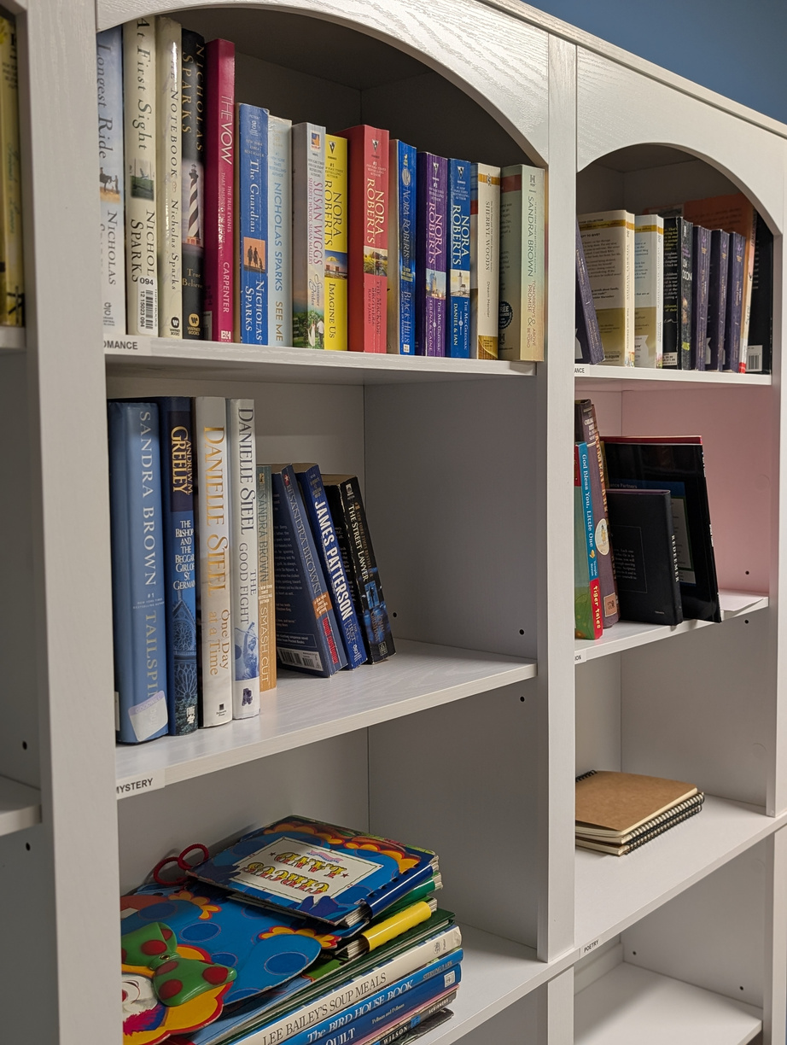
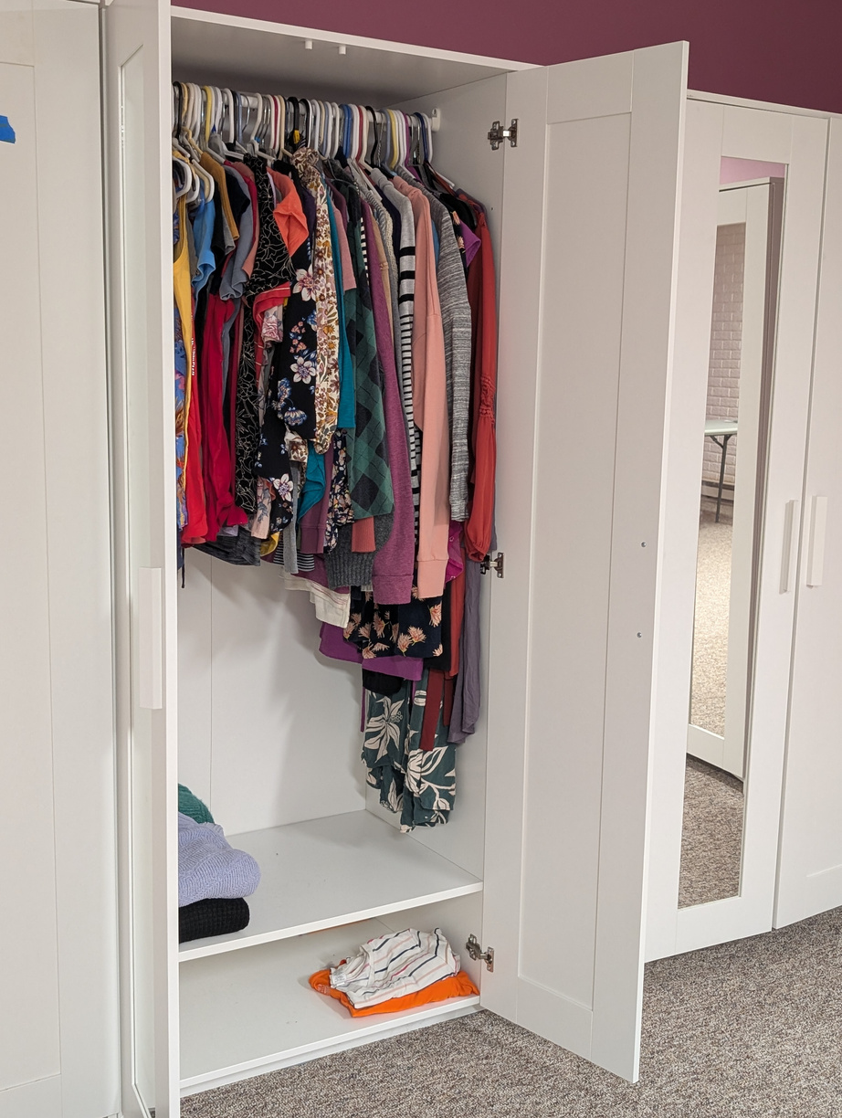
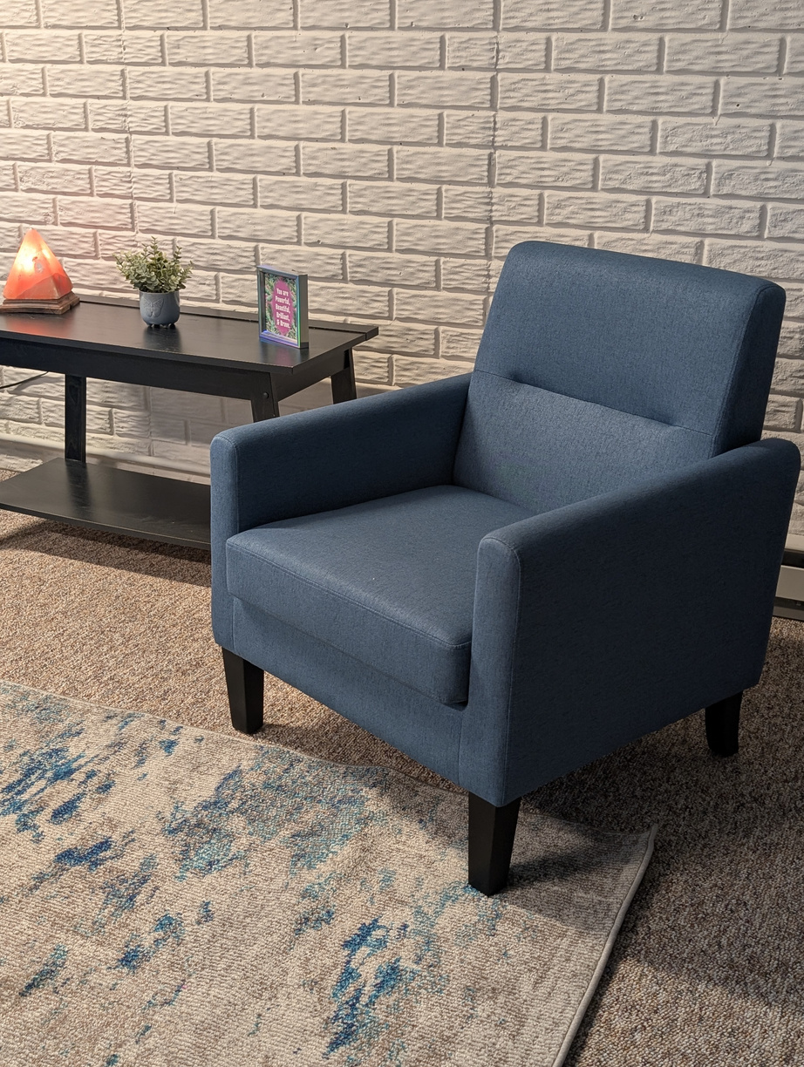
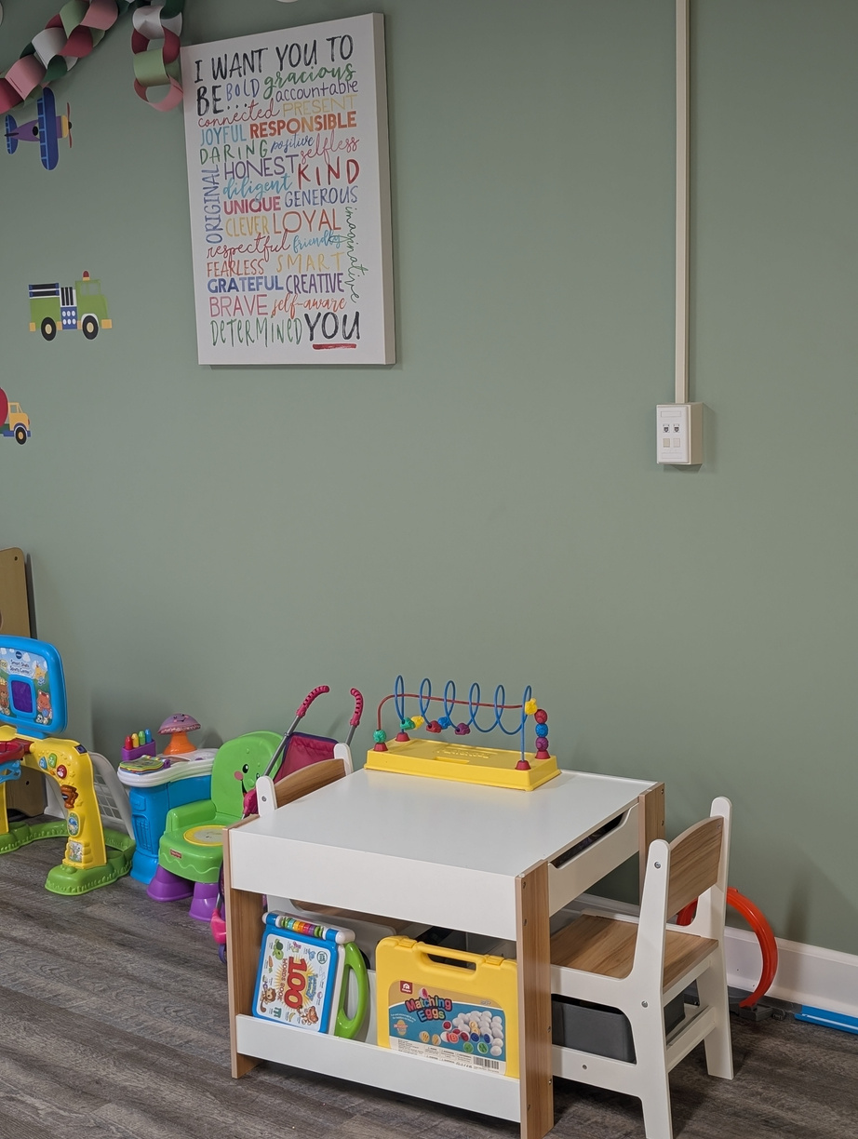
Empowerment starts with intention
Resource Room
Survivor Boutique
Connection space
Childrens spaces

Slide 9
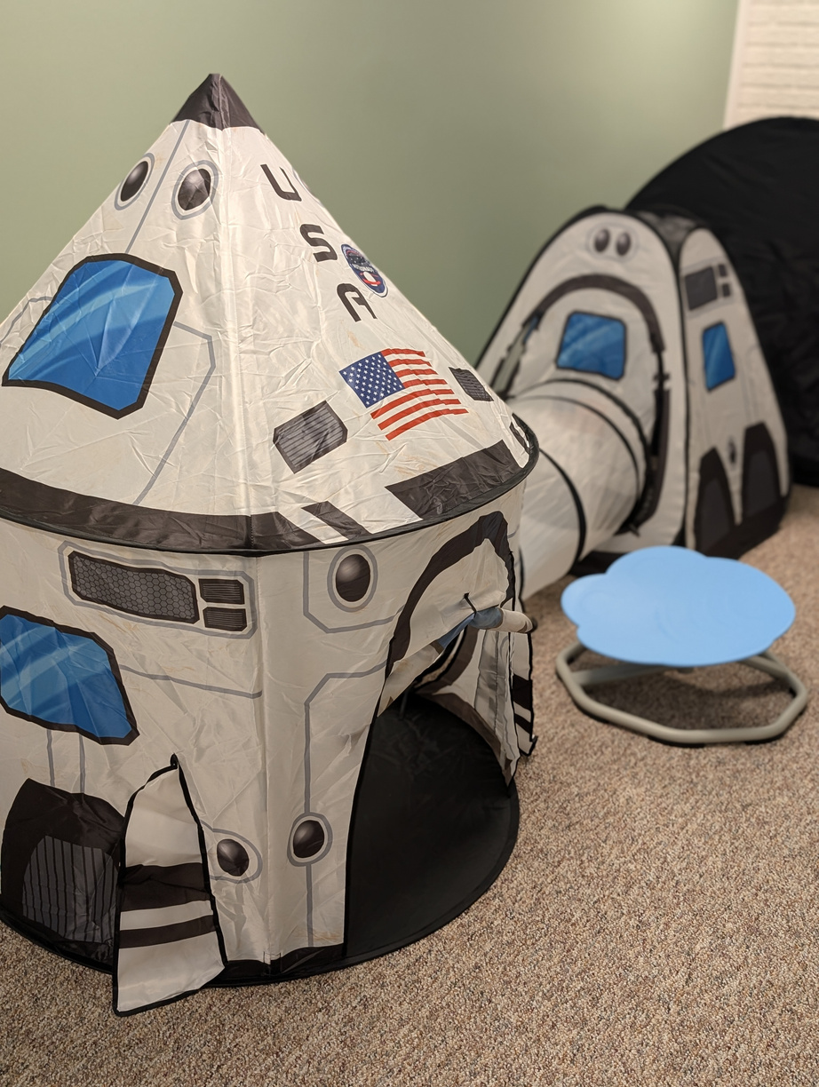
Library/Resource Room: This space offers comfort, distraction, and opportunities for rebuilding independence through resources like children’s and adult books, as well as computers for resume building, job searches, and accessing essential services.
Group Area: A connection space offers comfortable seating and a welcoming environment for group activities or quiet moments of reflection. It provides survivors a safe place to share their experiences, goals, and needs at their own pace and discretion.
Offices: Private offices ensure confidentiality and a secure space for phone calls and one-on-one client interactions.
Survivor Boutique: The survivor boutique celebrates choice, autonomy, and individuality by offering a shopping-style experience where survivors can select clothing that reflects their unique identity.
Teen Lounge: This space offers teens comfort, connection, and a sense of normalcy, with access to a TV, DVDs, and opportunities for gaming with non-violent video games in a safe and supportive environment.
Sensory Area: A sensory corner offers calming, supportive tools for survivors who are sensory-seeking or feeling dysregulated.
Create.
Hope.
Heal.

Slide 10
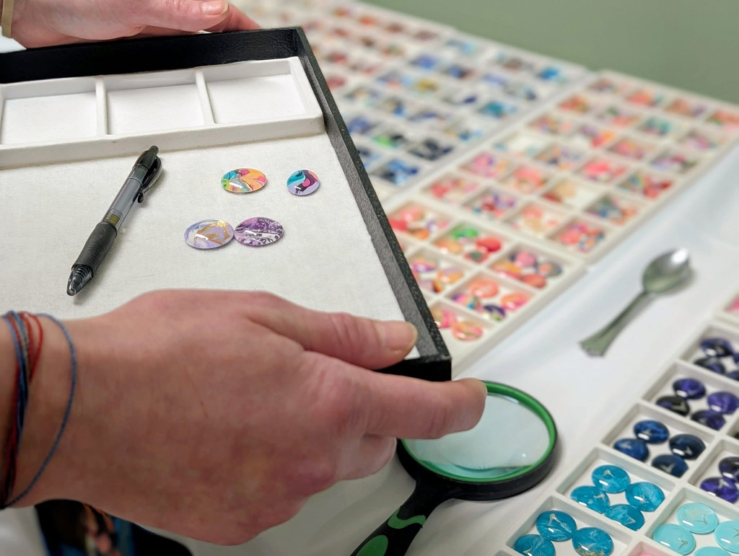
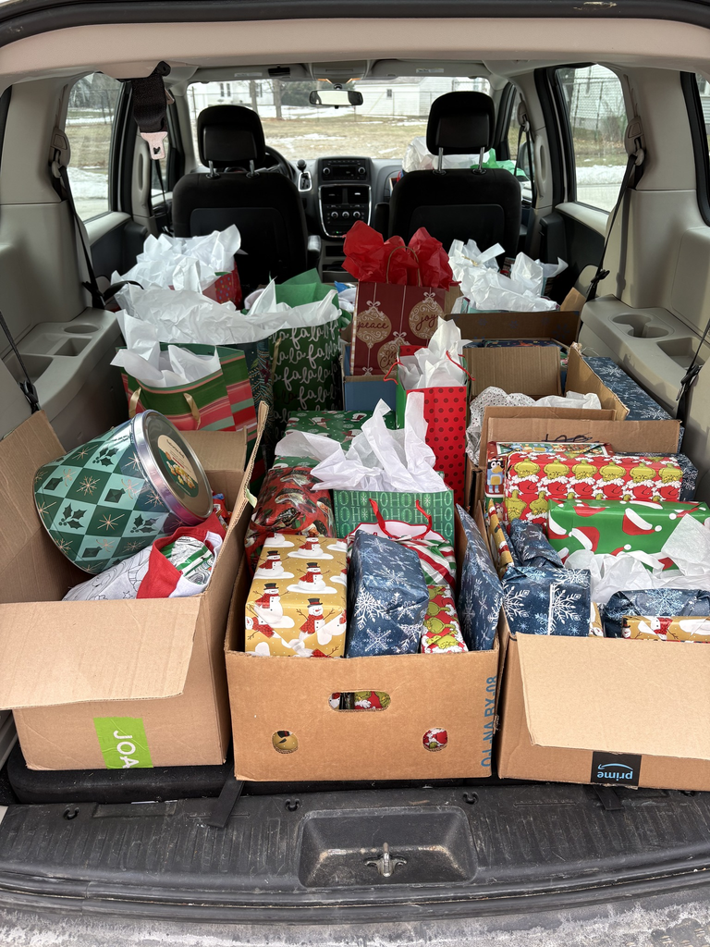
Celebrating Survivors
Pure Color Creations
Christmas Gift Collection
Through an Amazon wishlist & community donors, 74 survivors of DV/SA received gifts this holiday season! These items were direct requests from each receipent including doll houses, a sewing machine, and new shoes! 31 adults and 43 children!
Pure Color Creations supports survivors by hosting a free-of-charge jewelry event. Owners Jerry Doubler and Emily Doubler offer a personal, dignified experience that brings “a small joy during a very difficult time.”

Slide 11
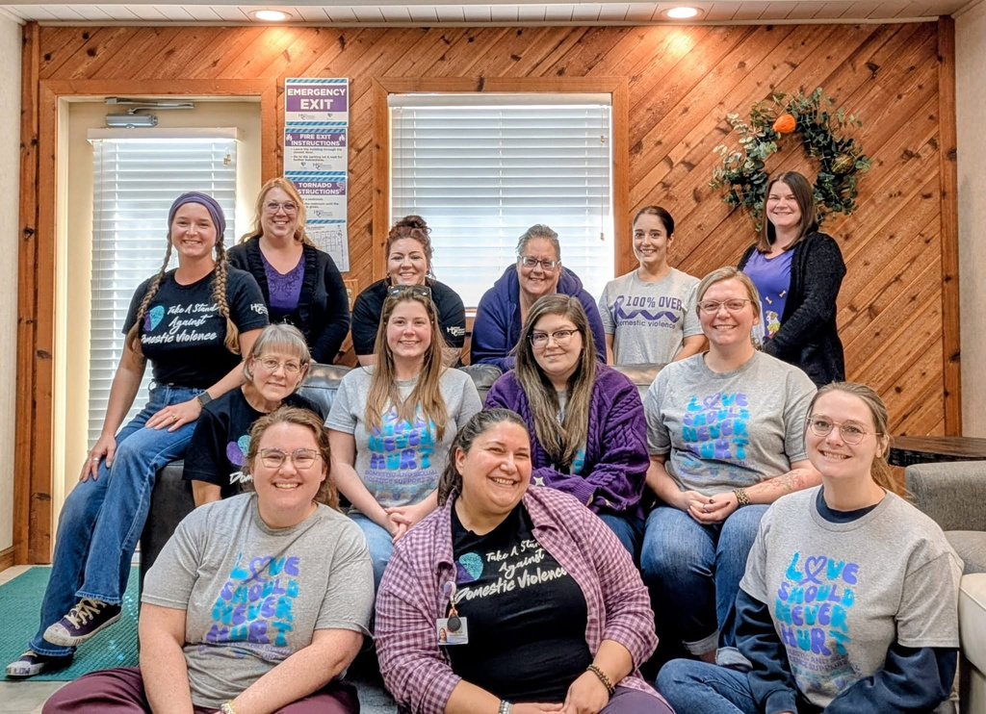
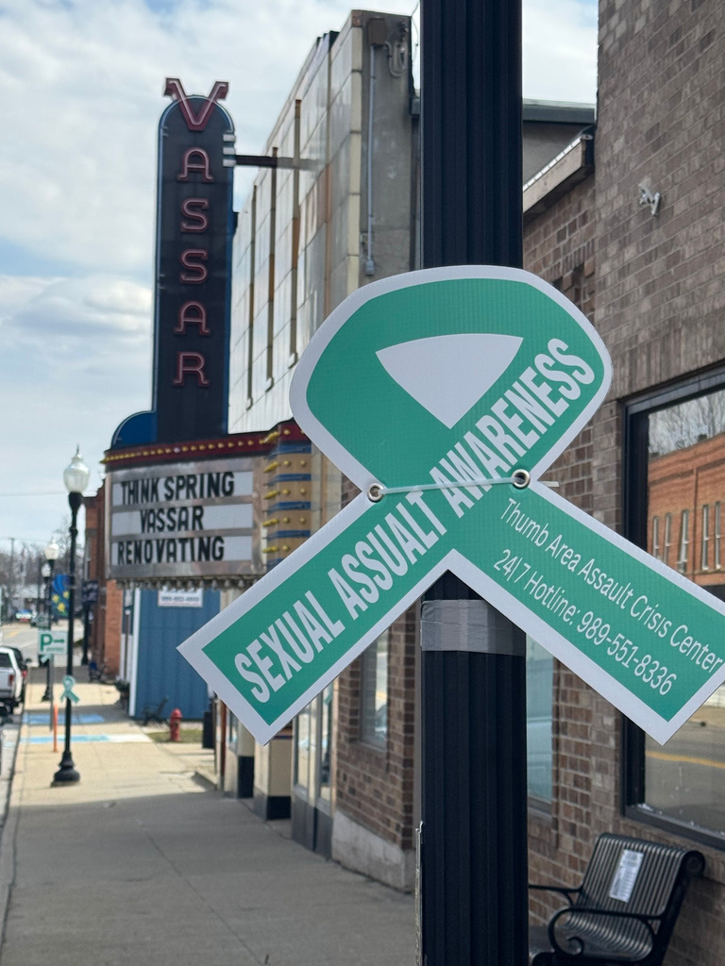
October: D.V. Awareness Month
  Paint the Town Purple: City of Vassar & City of Caro
  Purple Thursday
  Caro Library educational display
  Intentional Social Media Campaign
    Self Care Sunday
    Media Monday
    Lets Talk Tuesday
    Warning Sign Wednesday
    Throwback Thursday
    Fast Fact Friday
    Services Saturday
Awareness efforts help change culture, inform communities, and build relationships.
April: S.A. Awareness Month
  Sandsuky Open House
  Paint the Town Teal: Village of Pigeon & City of Vassar
  Gather for Good: items drive
  “What Were They Wearing” visual art display
  Denim Day April 29th
  Rotating courthouse educational display
  Month long educational display at Caro Library
  Intentional & trauma informed social media campaign

Slide 12
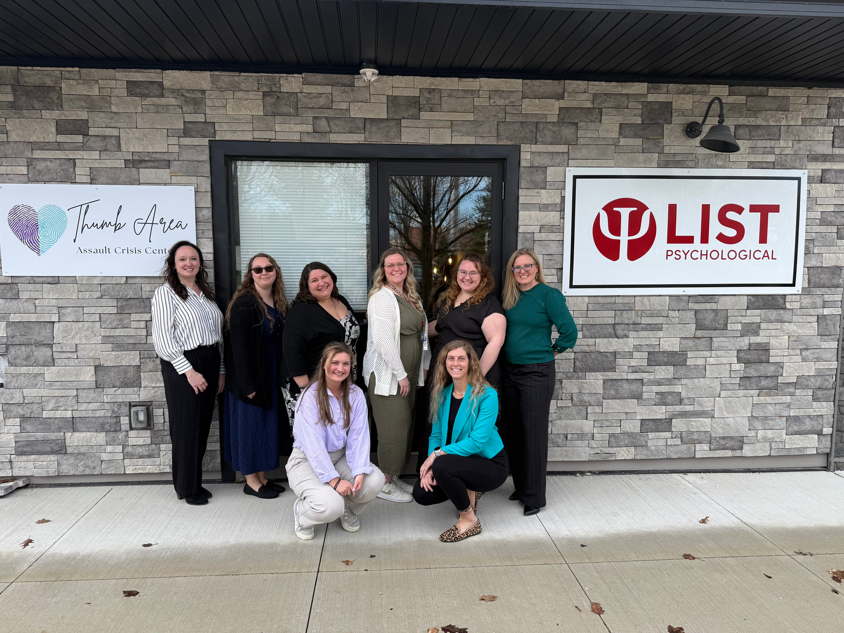
Contact Information
Crisis line: 989-551-4724
Direct Office Line: 989-672-1748
KimberlyK@HDC-Caro.org
Thank you
for your attention, time and support!
~ from my team to yours!

