Slide 1
Eastern Oregon Labor Force and Economic Activity
By Chris Rich - Eastern Oregon Regional Economist
July 26, 2022

Slide 4
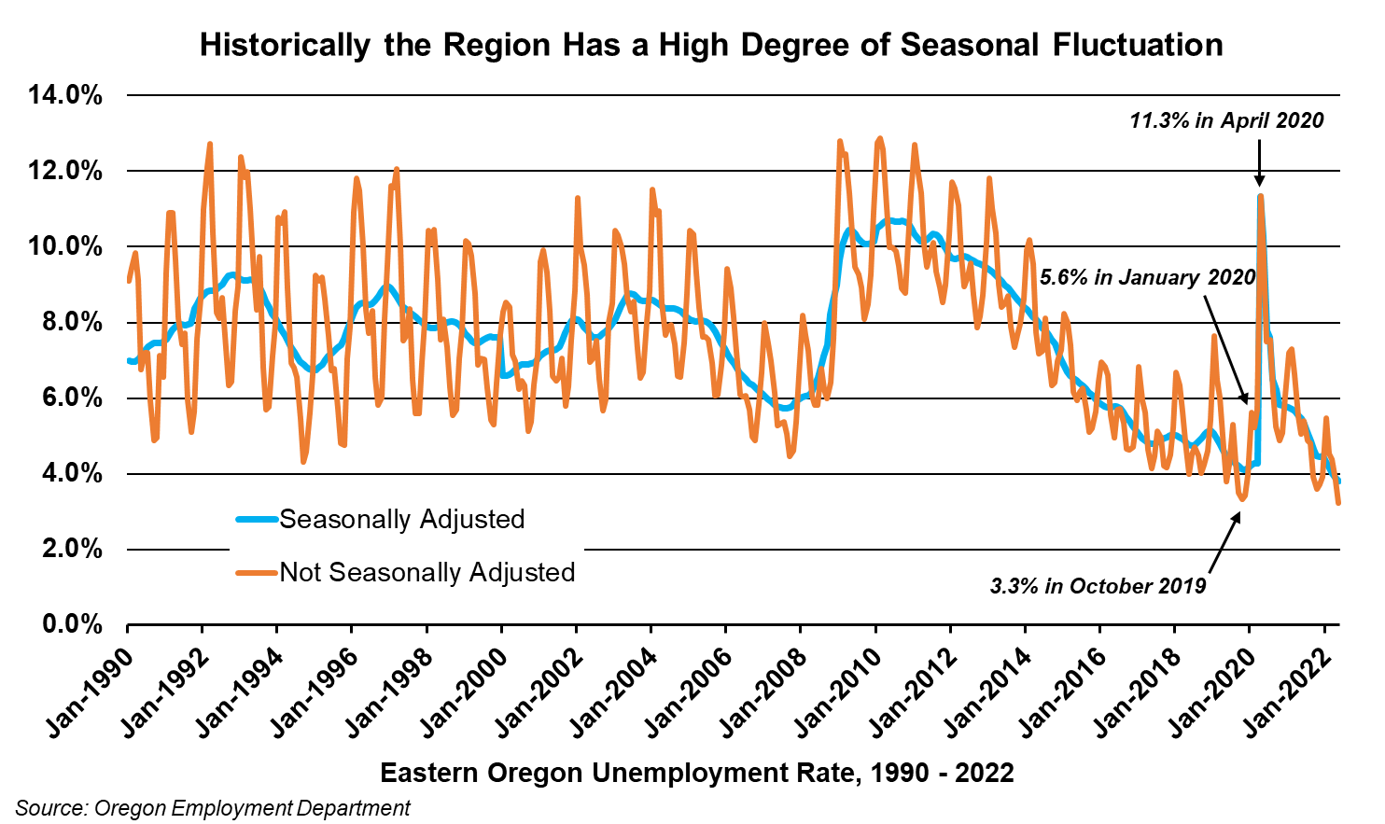

Slide 23
For More Information
Chris Rich, Eastern Oregon Regional Economist
Christopher.M.Rich@Oregon.gov
(541) 519-0315
www.Qualityinfo.org
Get the latest workforce and economic research delivered to your inbox!
Sign up at https://www.qualityinfo.org/p-sofrm/
Join the conversation:
OregonEmployment.Blogspot.com
Twitter: @OED_Research

