Slide 1


Notes:
The CITF is an organization separate from the UBC – they are focused entirely on training. They write and publish the books that apprenticeship training centers across North America use.
About 11 years ago, the CITF master instructors created this curriculum for high schools and other educational programs that wanted to develop the skills that are actually important in our industry and offer students a clear path into a career. Job Corps, prisons, community-based pre-apprenticeship programs use this material.
Career Connections has grown over the years from the first Project Books you’ll see in a minute to a collection of eight books and an online Learning Management System that rolled out last year.
The CITF developed all of the content and makes it available to schools regionally through their area’s Carpenters Apprenticeship Training Program – in Oregon, that’s the Pacific NW Carpenters Institute. With student books ranging from $11 to $30 and a yearly teacher Site License for $101, the materials are very affordable.
At the end I’ll give you contact information for Meg Kilmer, my colleague over at the Pacific NW Carpenters Institute.

Slide 2
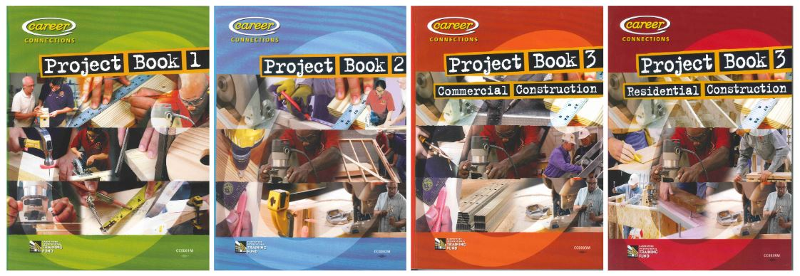
Project Books = Skill Development
Notes:
Project Books 1 introduces Safety concepts as well as Tools, Materials and Fasteners and provide drawings and pictures for 15 typical WoodShop class projects: coat rack, birdhouse, toolbox, stepstool, etc.
In Project Book 2, the drawings start to look like blueprints and the projects are more complex: sawhorses, Adirondack chairs, picnic tables and a shed.
Student develop a sequence of skills, from basic like reading a tape measure and using hand tools safely to more intermediate skills like using a framing square to layout angles and building trusses and rafters.
You can see there are two versions of Project Book 3. Schools typically choose the Residential Construction book and our pre-apprenticeship programs and Job Corps prefer the Commercial Construction book because it includes metal stud framing and other advanced skills.

Slide 3
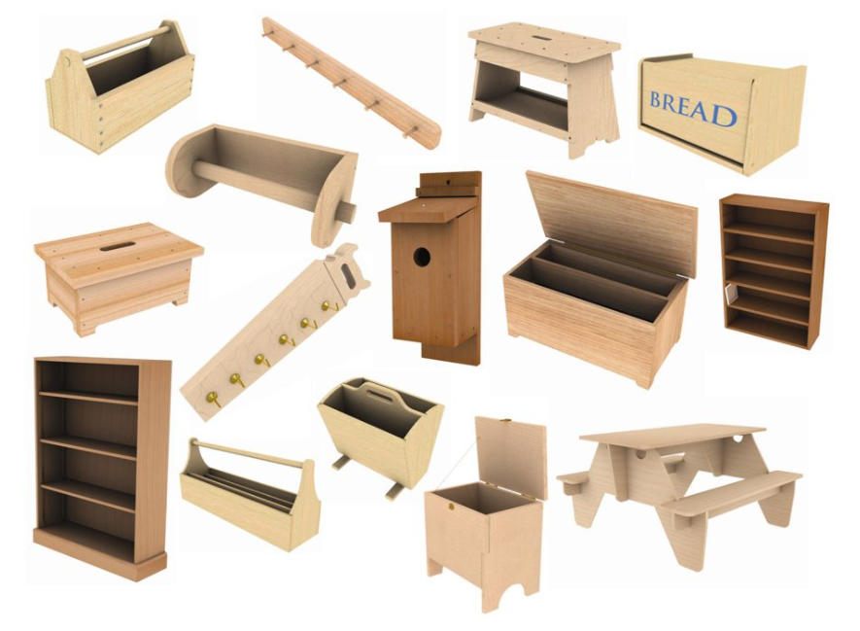
PB1 Projects
Notes:
Project Book 1 features lesson plans, drawings and resources for 15 total projects. Most schools can get through 5 key projects in a semester.

Slide 4
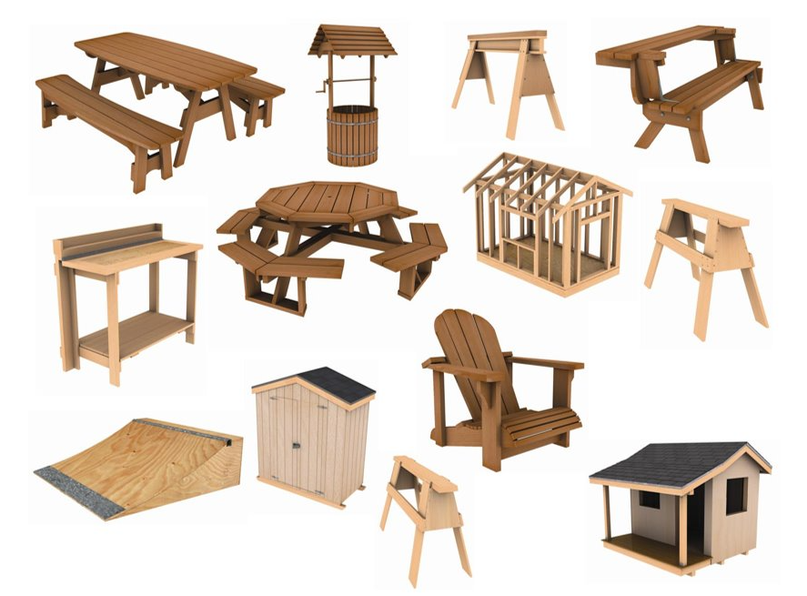
PB2 Projects
Notes:
You can see that things get bigger and more complex in Project Book 2.
3 kinds of Saw Horses
3 kinds of picnic tables
A Skateboard Ramp
Adirondack Chair
A cool Portable Folding Workbench
Shed with Gable Roof
Garden Shed
Wishing Well
Child’s Playhouse

Slide 5
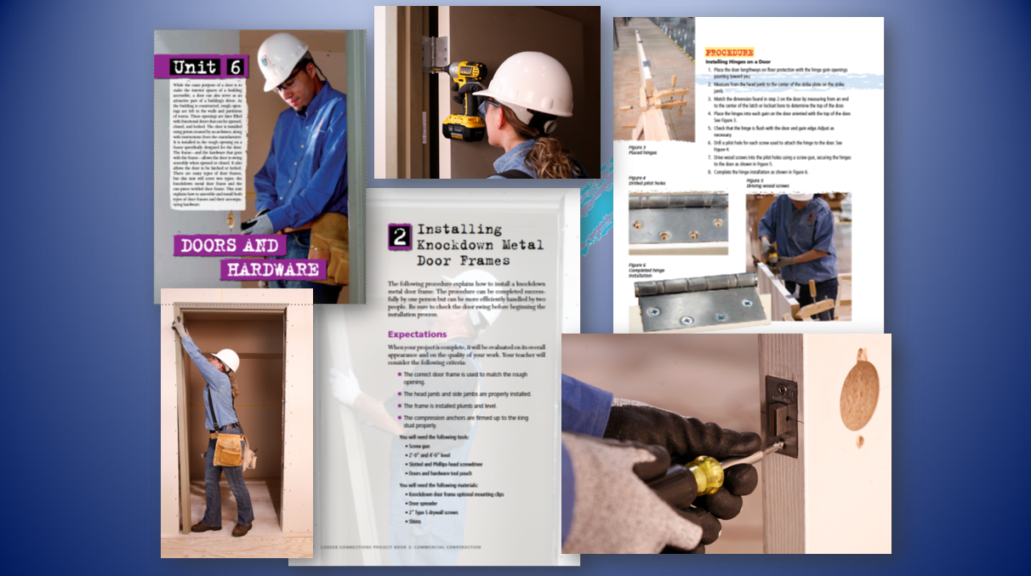
PB3 pages
Notes:
Here are a couple pages from the Commercial Construction Project Book 3.
Notice lots of pictures and a magazine style layout.
Teachers also get a powerpoint for every chapter and students will recognize the same pictures and how-to information to reinforce what they read.

Slide 6
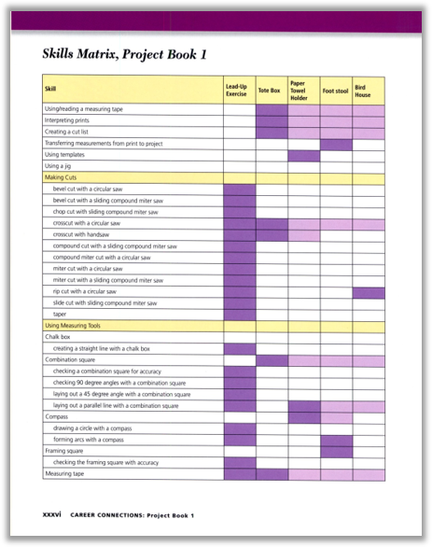
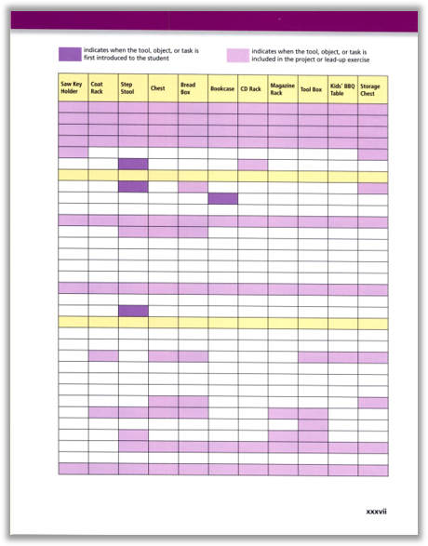
Notes:
These are pages from aTeacher’s Edition.
It shows the thinking behind the project books. It is a Skills Matrix, listing hundreds of skills students will learn. It shows the teacher which skills are associated with the sequence of projects students complete.
We’ve had shop teachers look at this and realize how many . . . Or how few . . . skills they have been teaching with the projects they’ve been doing.
Students like the Skills Matrix too – it shows them exactly what they are going to learn!

Slide 7
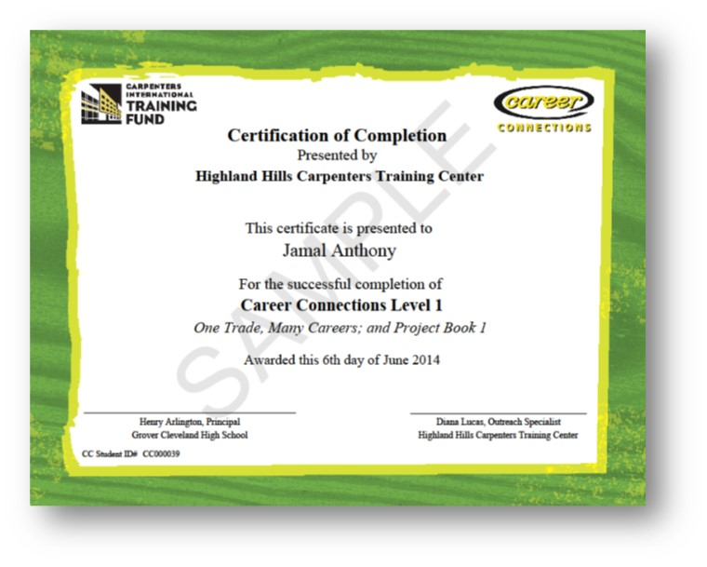
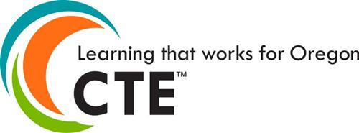
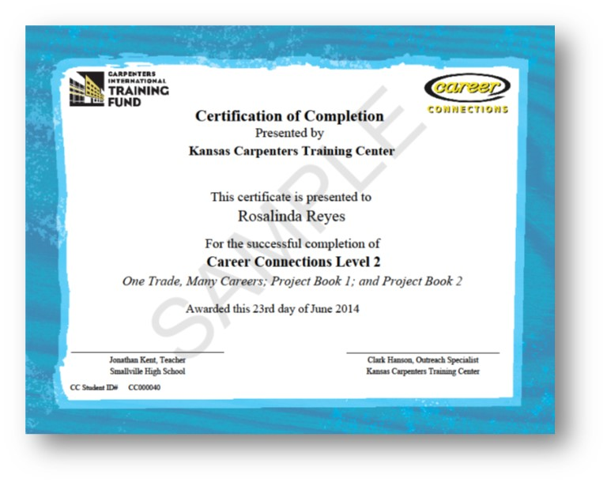
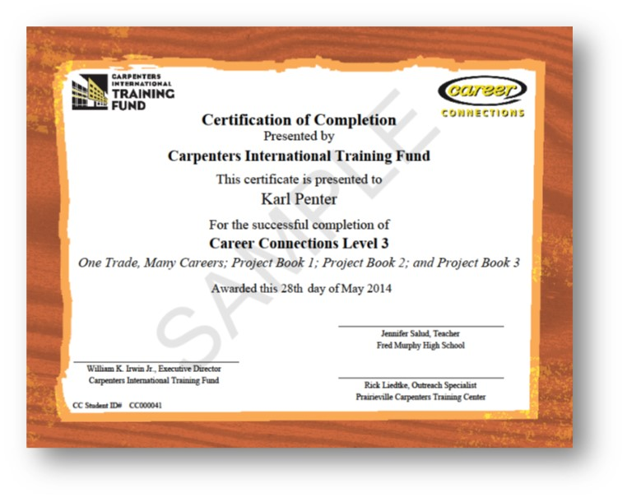
Industry Recognized Credentials
Notes:
Certificates are worth something to students should they EVER decide to pursue apprenticeship with the Union Carpenters. They’ll get points on their application for having certificates. These should go in a portfolio they bring to an interview. They can list on them a resume. Students should be proud of their achievements.
Teachers decide when their students can safely and consistently perform the skills they learn in Project Books 1 through 3. Teachers contact their regional Outreach Specialist to request a Certificate. We’ll come out and make a big fuss over the students and encourage them to keep taking their shop and construction classes.
For CTE programs, being able to offer their students what the Oregon Department of Education calls “INDUSTRY RECOGNIZED CREDENTIALS” is a big deal, a mark of a quality program. The good news for schools that have a more traditional woodshop type program is that ODE says that when a student earns a Career Connections Level 1 PLUS a Level 2 certificate, the school gets to claim an Industry Recognized Credential. Schools that have Construction Tech programs typically use Project Book 3 and the students learn a lot of skills – ODE recognizes a Level 3 certificate from us as an IRC too.
There’s no extra charge for certificates.

Slide 8

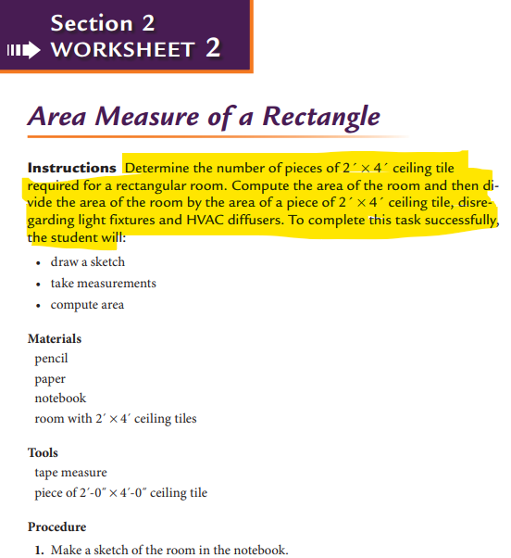
Integrate Academics into CTE Programs
Notes:
Math for the Trades includes arithmetic, fractions, decimals and a lot of geometry.
This book can help fill in the gaps for students who never fully grasped their fundamentals . . . And be more practice for others who will like seeing how their knowledge is valuable in construction.
It’s motivating when the story problems use a scenario from construction and often requires props so the math moves from theory to a real-world application.

Slide 9

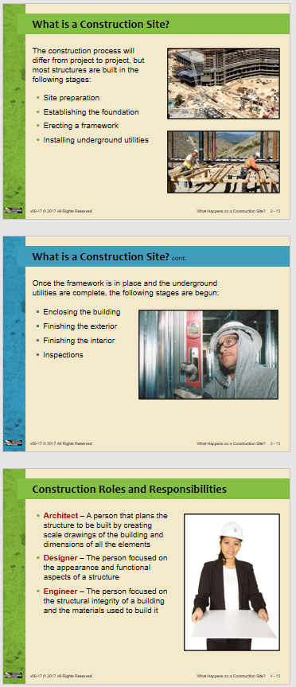
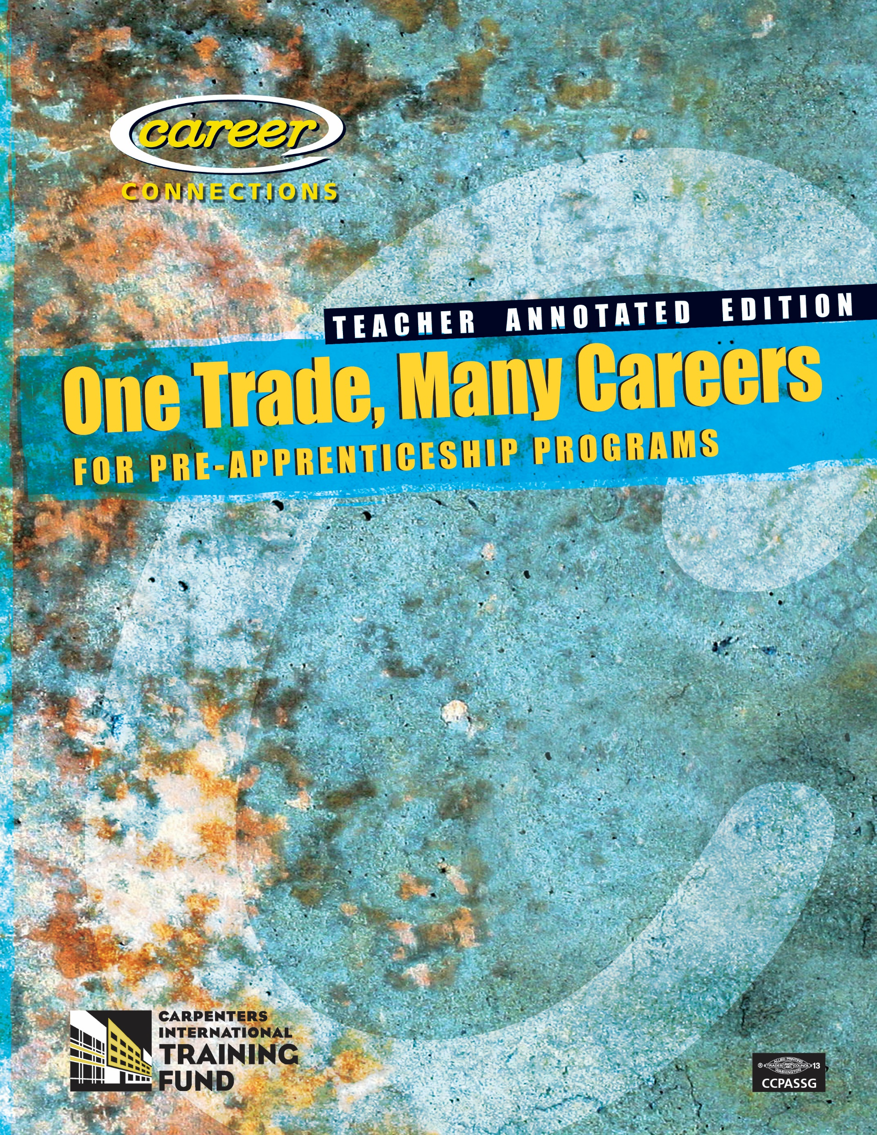

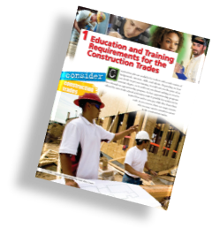
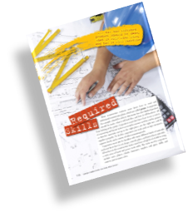
Integrate Academics into CTE Programs
Notes:
One Trades Many Careers is really a great career exploration guide. The first section is all about the student: who are you, what are you good at?
The second part is about the world of work and employer expectations. In the last part it focuses on construction careers.
Teachers have the books but also lesson plans, powerpoints, and chapter reviews to help them add reading, writing and thinking into their curriculum.

Slide 10
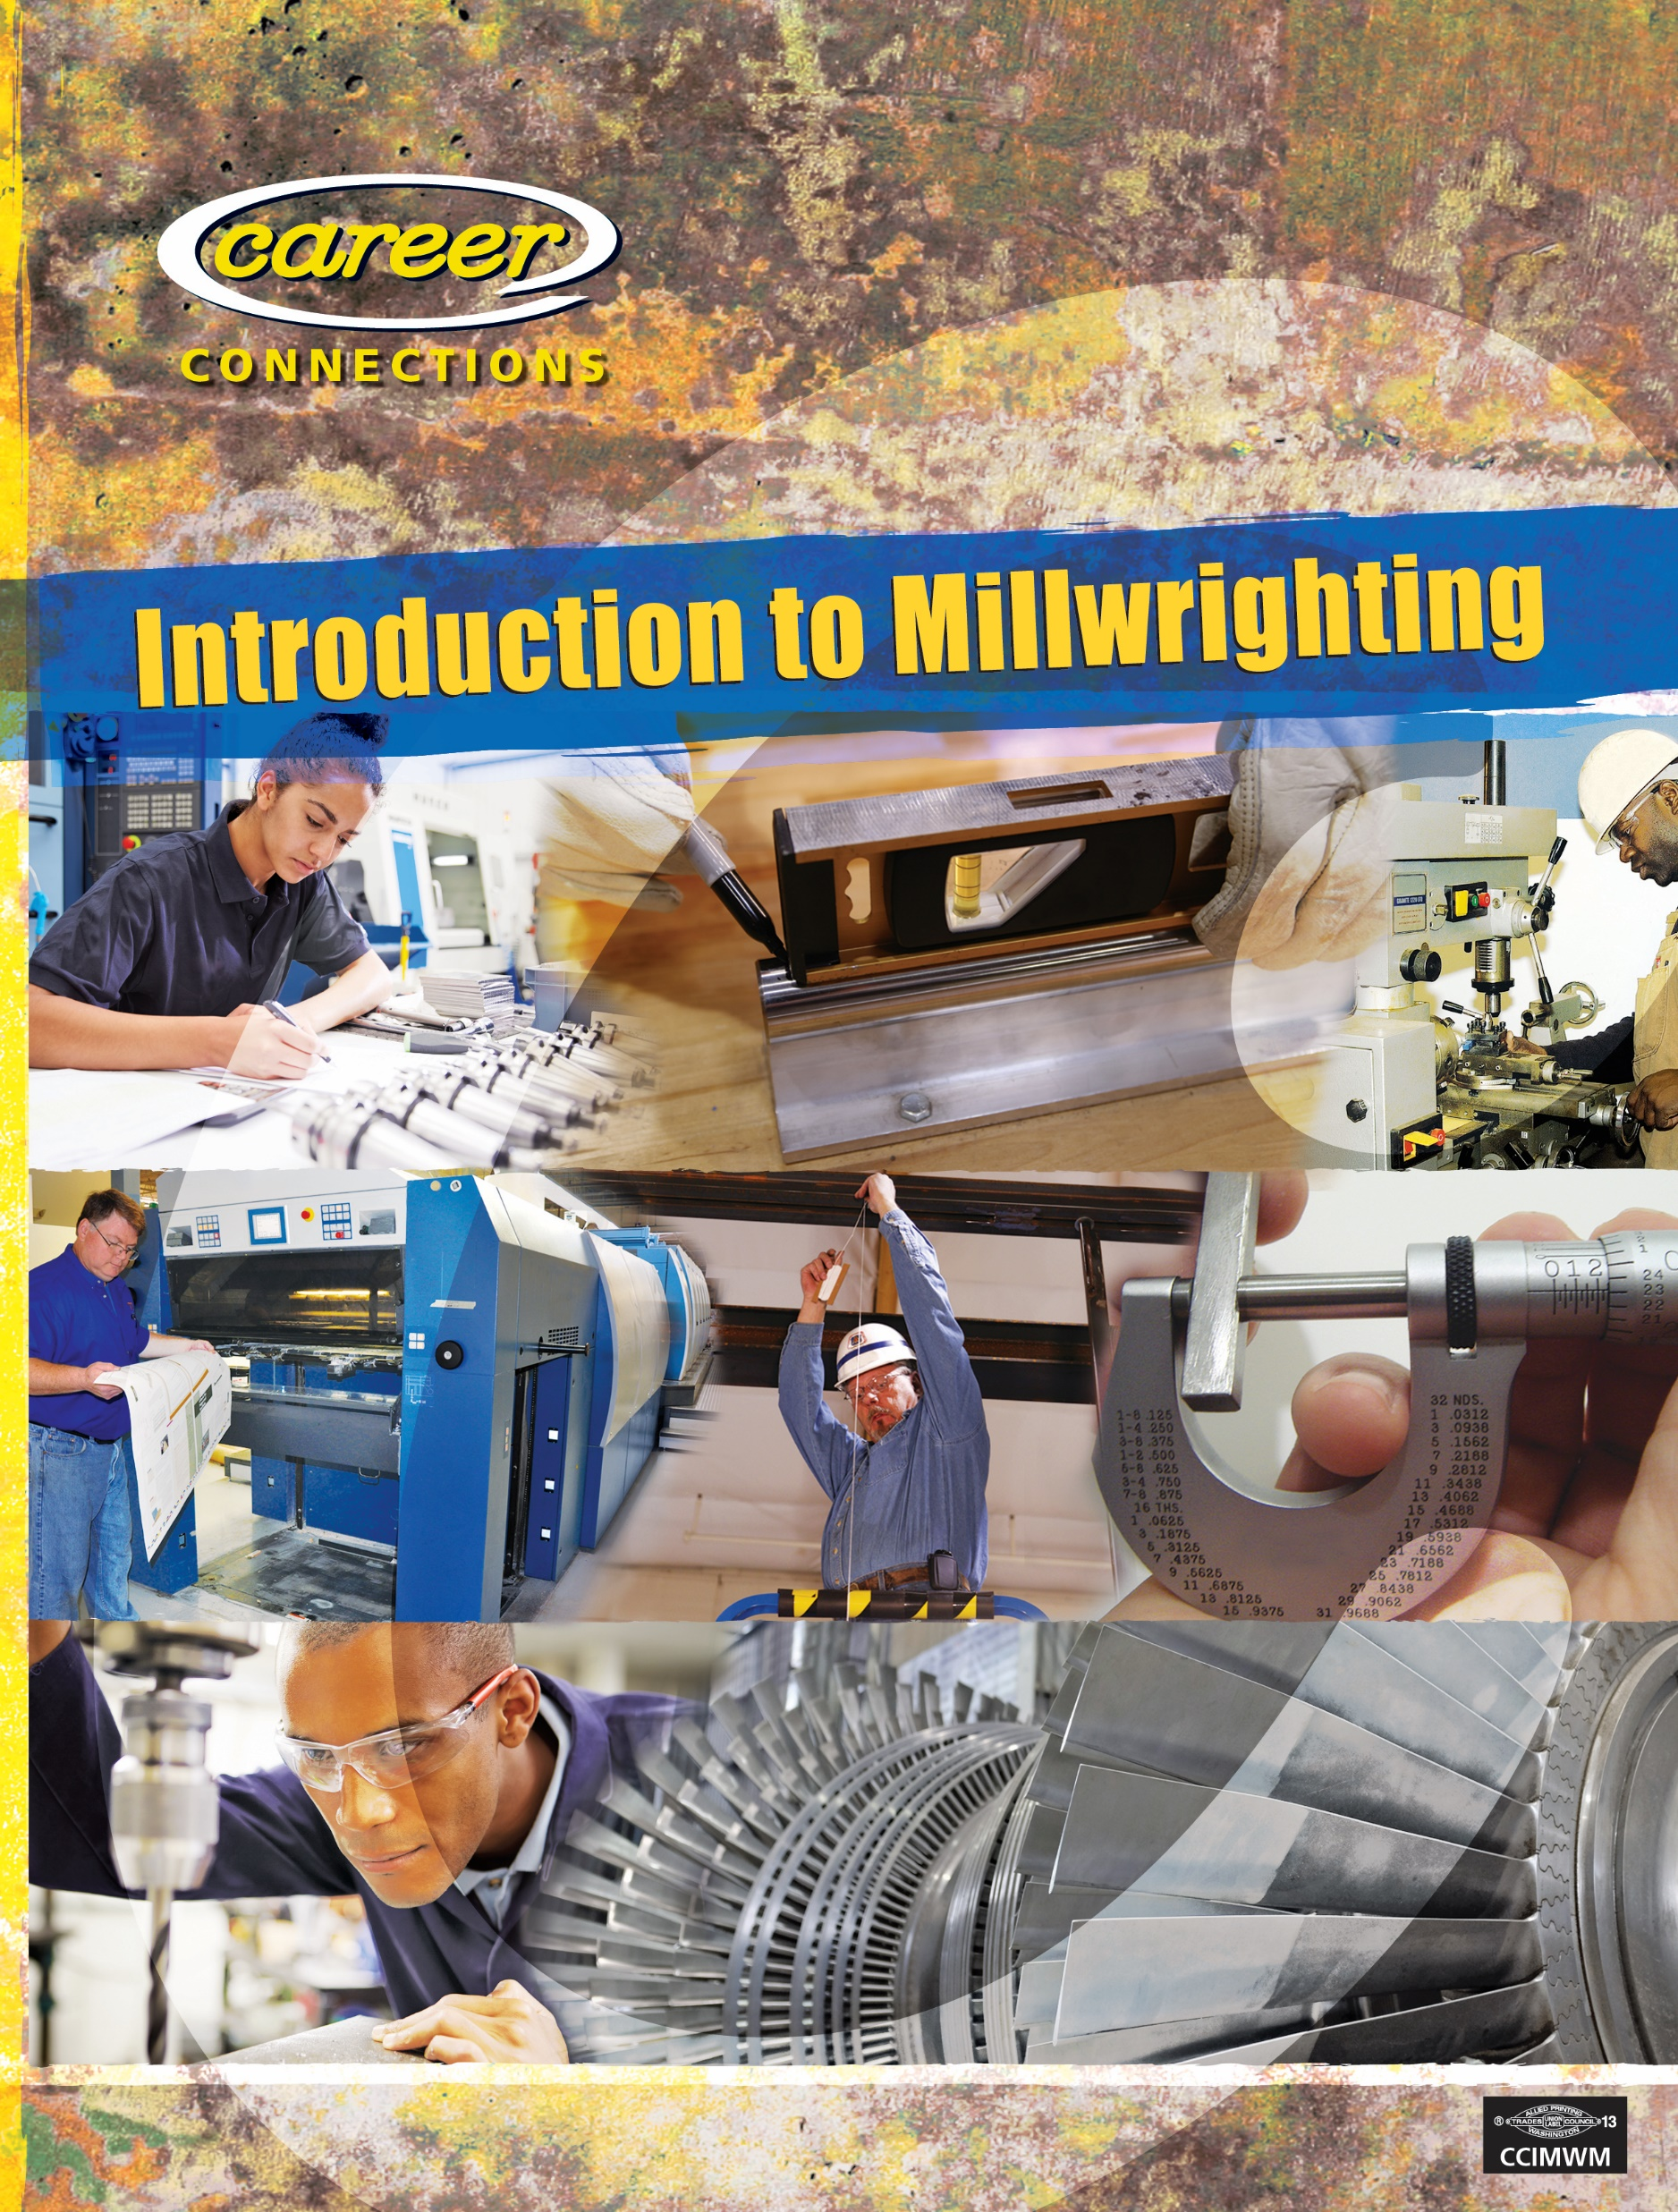
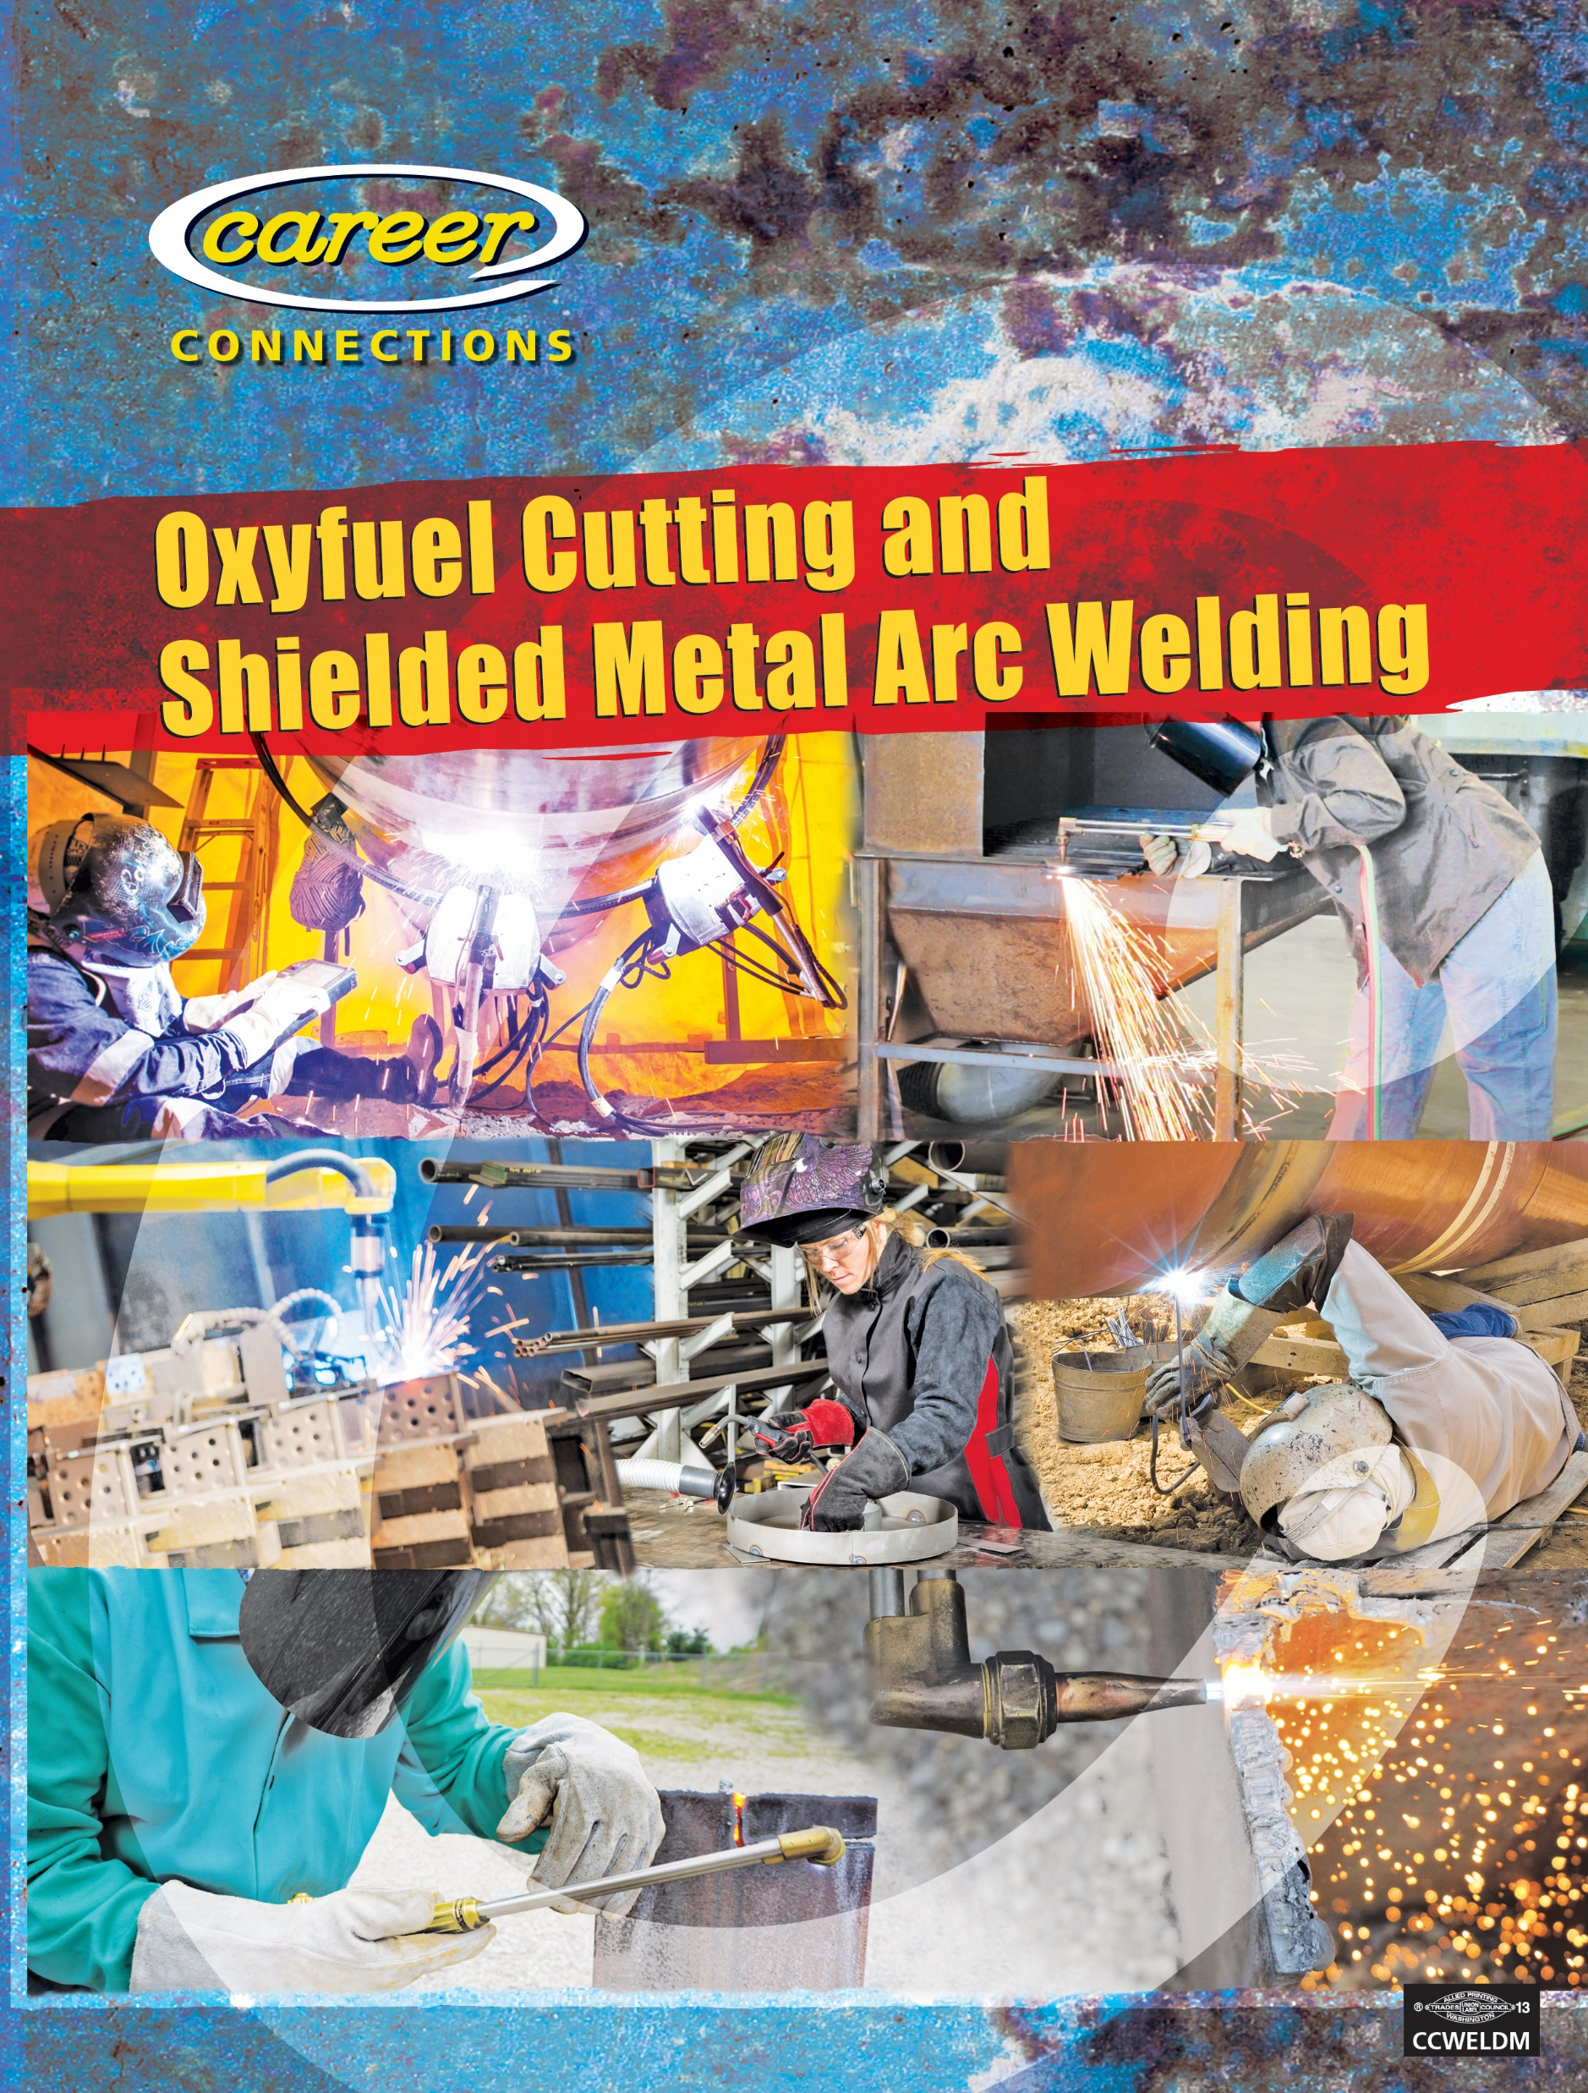
More Titles
Notes:
An Oregon Community College uses the Millwrighting book in a manufacturing program and the Welding book is popular with High School Ag teachers and metal shop programs too.
We don’t know of an Oregon HS that uses all of the books – they select the ones that relate to their programs.
The exception is . . . The schools that purchase the online version of Career Connections have access to all 8 books. As teachers build online classes they select the chapters from any of these books that they want to use.

Slide 11
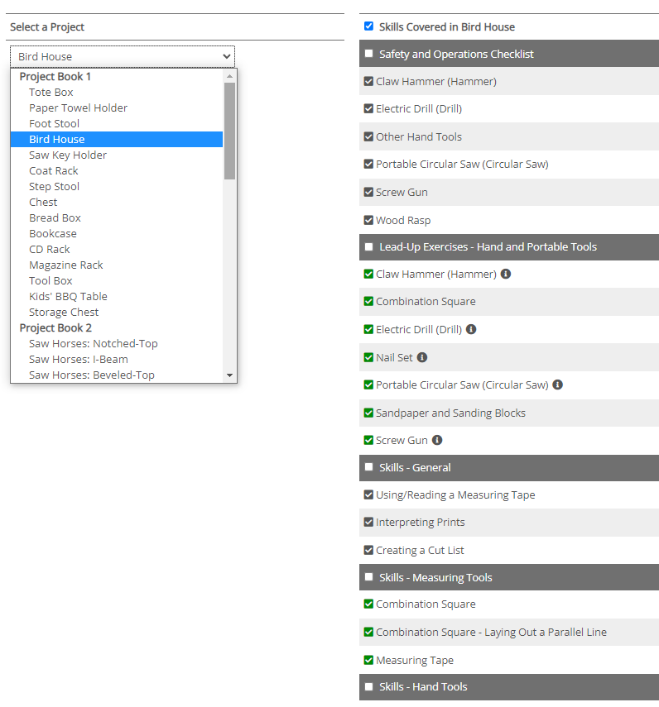
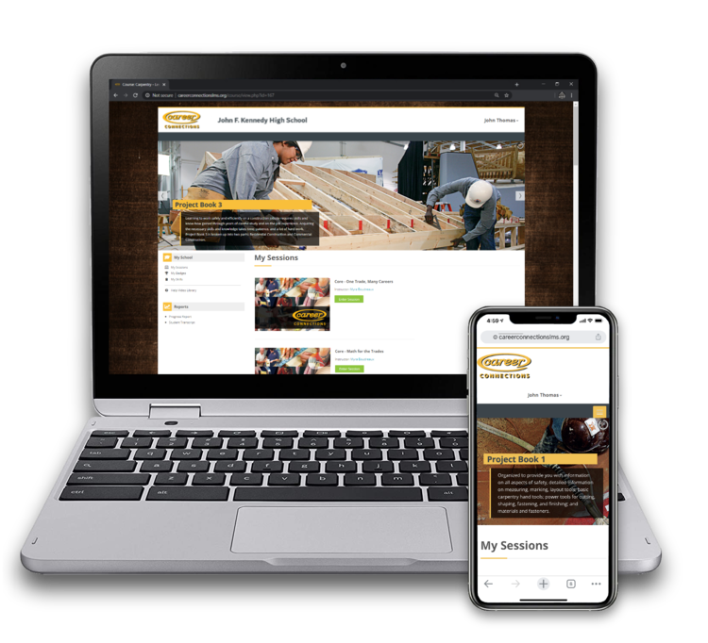
Online since 2020
Notes:
The Skills Matrix I showed you earlier is also behind the Learning Management System.
Here you can see how easily a teacher can track the skills a student mastered by building the birdhouse.

Slide 12
Affordable Textbooks Schools choose: One book per pupil or a classroom set
One Trade, Many Careers (Student) | $10.28
One Trade, Many Careers (Teacher's Annotated Edition) | $32.06
Project Book 1 (Student) | $12.53
Project Book 1 (TAE) | $47.57
Project Book 2 (Student) | $16.24
Project Book 2 (TAE) | $50.72
Project Book 3-Residential (Student) | $23.98
Project Book 3-Residential (TAE) | $83.19
Project Book 3-Commercial (Student) | $19.71
Project Book 3-Commercial (TAE) | $62.71
Math for the Trades (Student) | $19.15
Math for the Trades (TAE) | $50.72
Oxyfuel Cutting & Shielded Metal Arc Welding (S) | $17.91
Oxyfuel Cutting & Shielded Metal Arc Welding (TAE) | $30.79
Introduction to Millwrighting (Student) | $30.03
Introduction to Millwrighting (TAE) | $38.21
Career Connections Learning Management System (LMS)
Annual Teacher's Site License for Career Connections LMS | $101.00
Annual Student Site License for Career Connections LMS | $17.00
Notes:
The Carpenters International Training Fund is not in this to make a profit. They publish their own books and sell them at cost.
We are in this for the relationship. We want to support our local schools and show young people the path into a construction career. Apprenticeship is a solid choice for advanced training after high school.
Tomorrow’s Carpenters are in School Today!

Slide 13
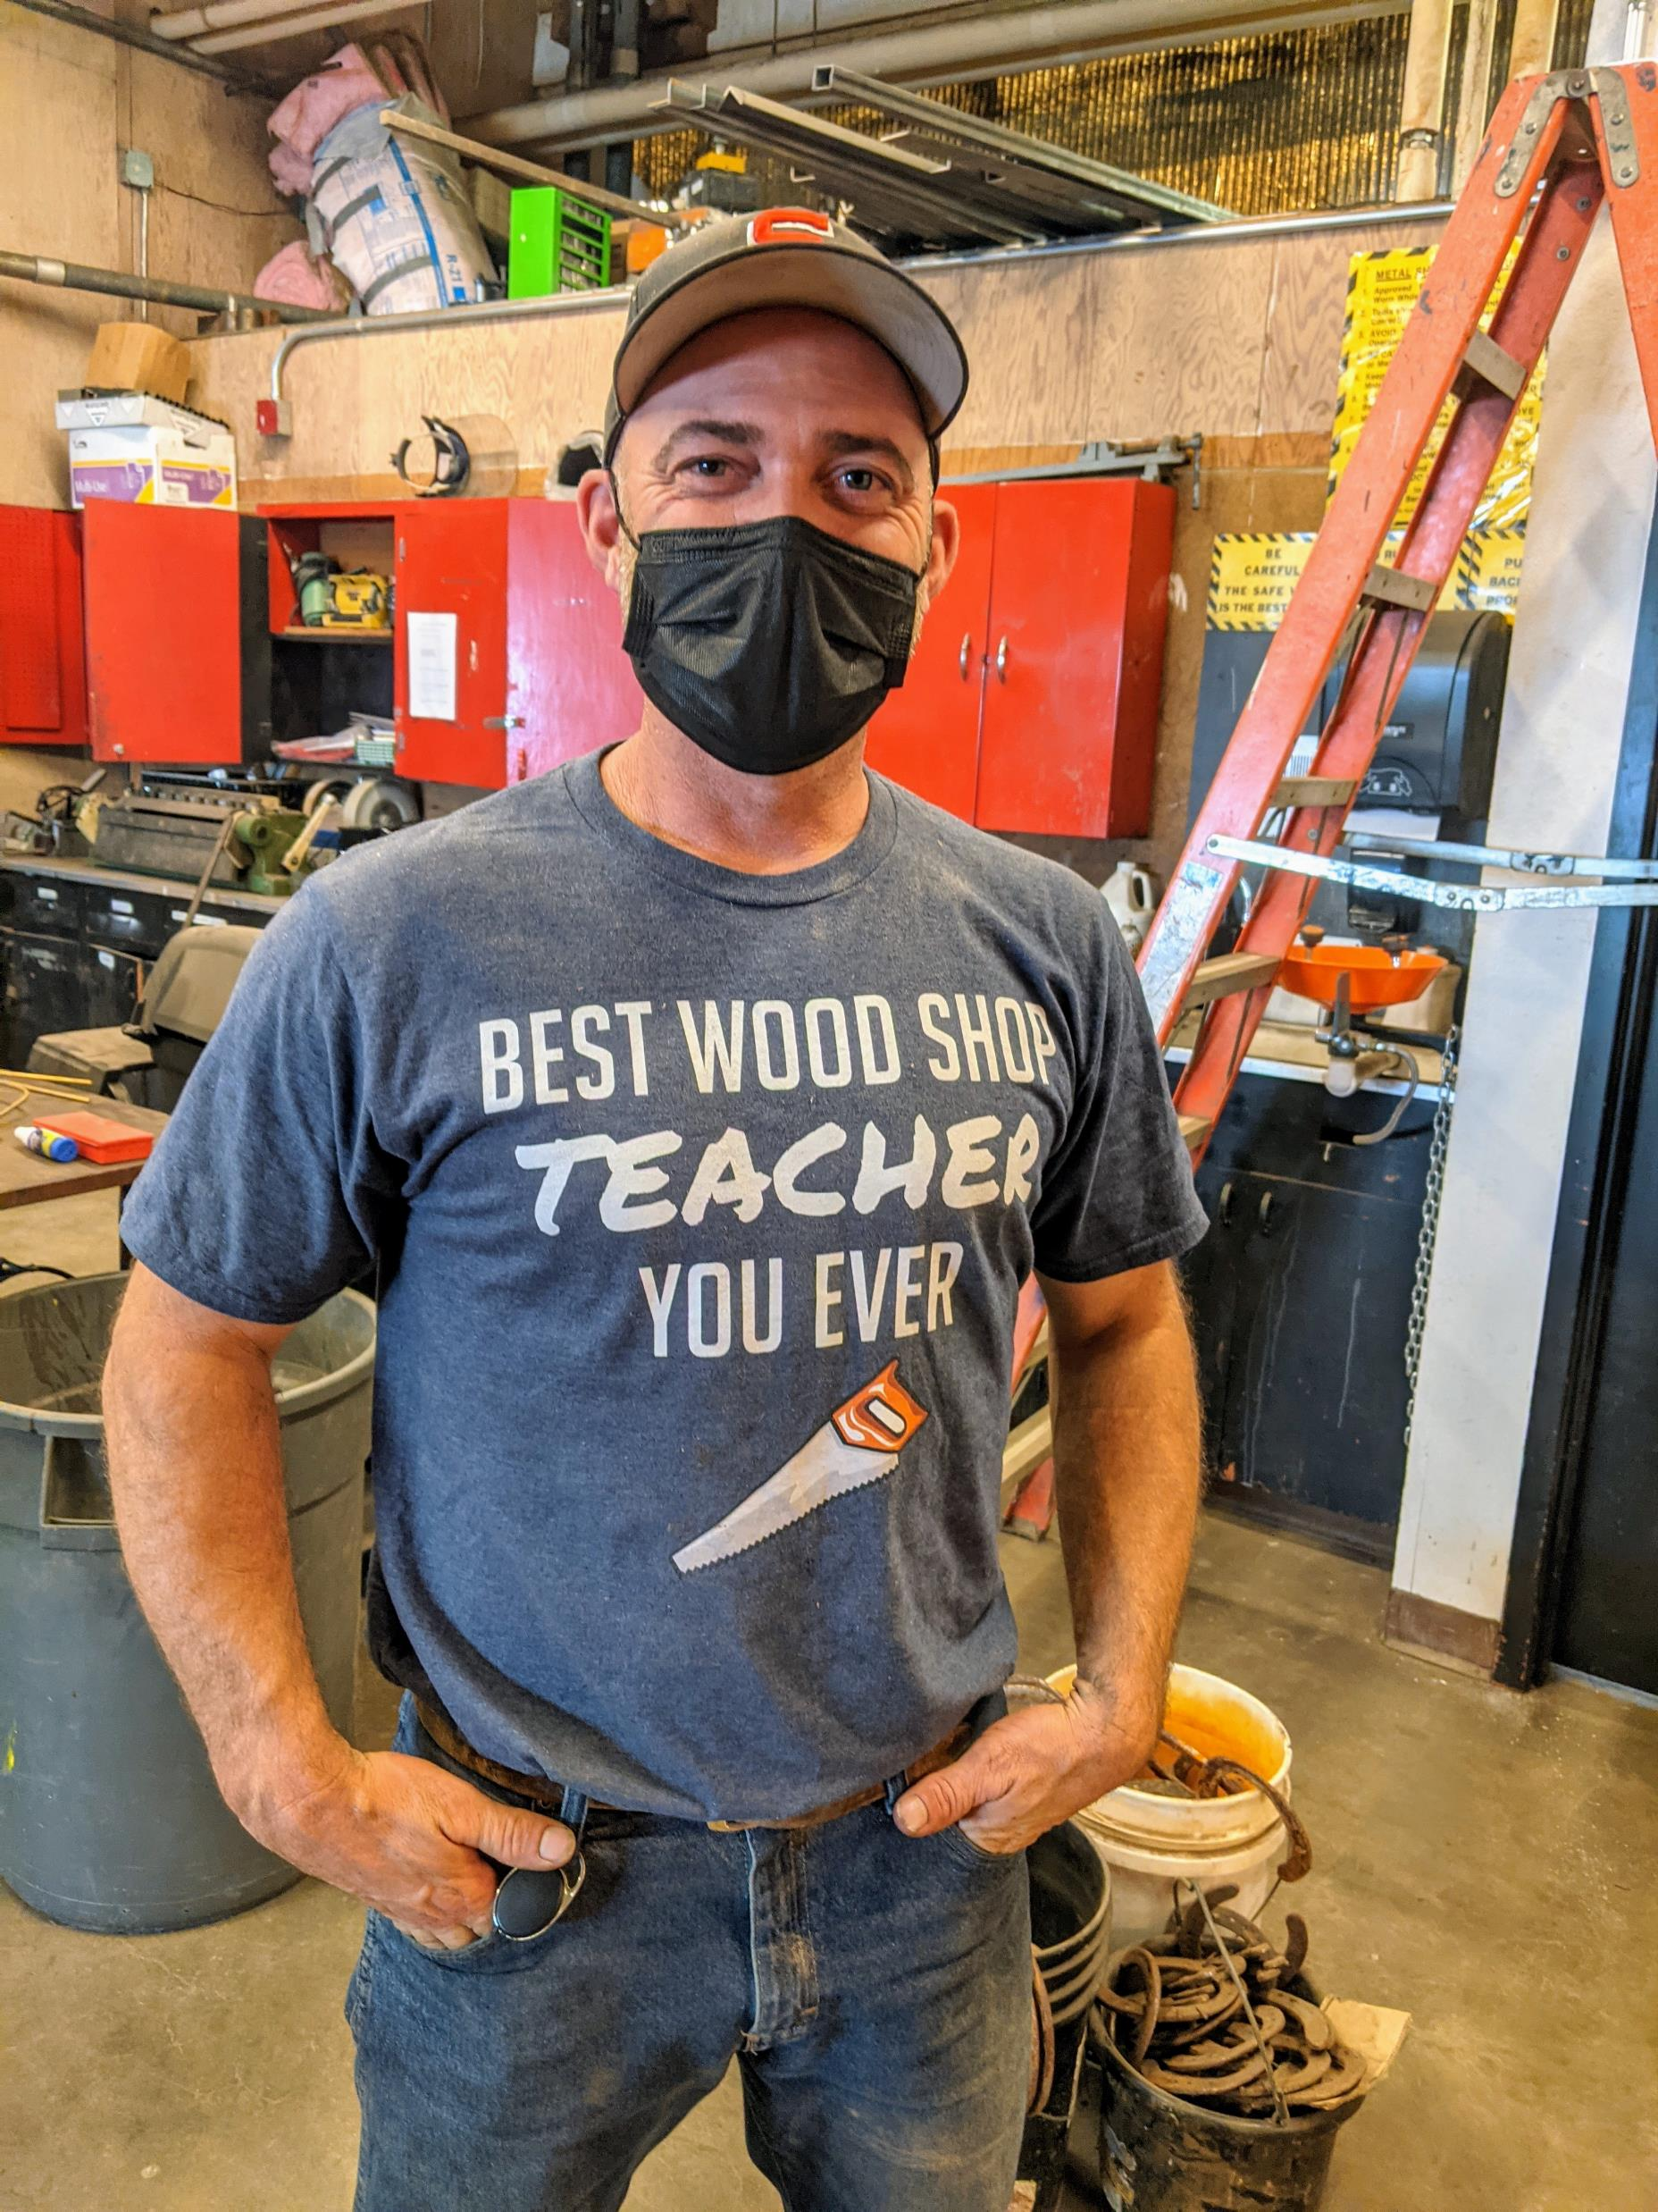
Teachers Like . . .
Lesson Plans
Safety Operations Checklists for tools
Question Bank/Assessment Generator
Timelines for Implementation
Material Lists
PowerPoints
Chapter Reviews
Virtual Shop:
How-To Videos
Blueprints
Rubrics
Evaluation Forms
Math Practice Sheets
Notes:
Career Connections teachers feel really supported by all the stuff that comes with their Teacher Editions.
The training center, Pacific NW Carpenters Institute, makes Career Connection teachers a priority too. They are welcome to take a class with apprentices in the summer and attend Curriculum classes.

Slide 14
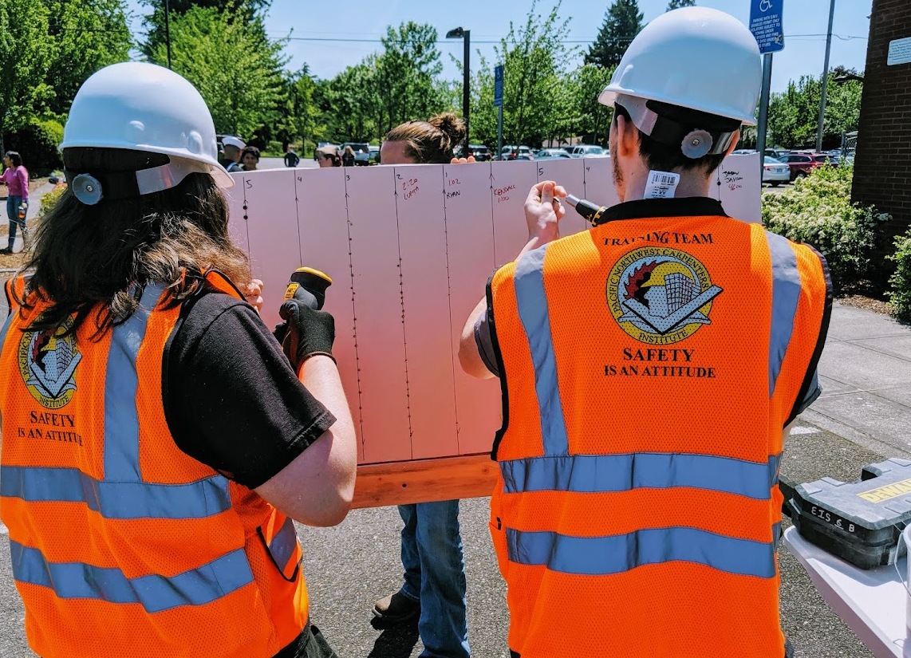
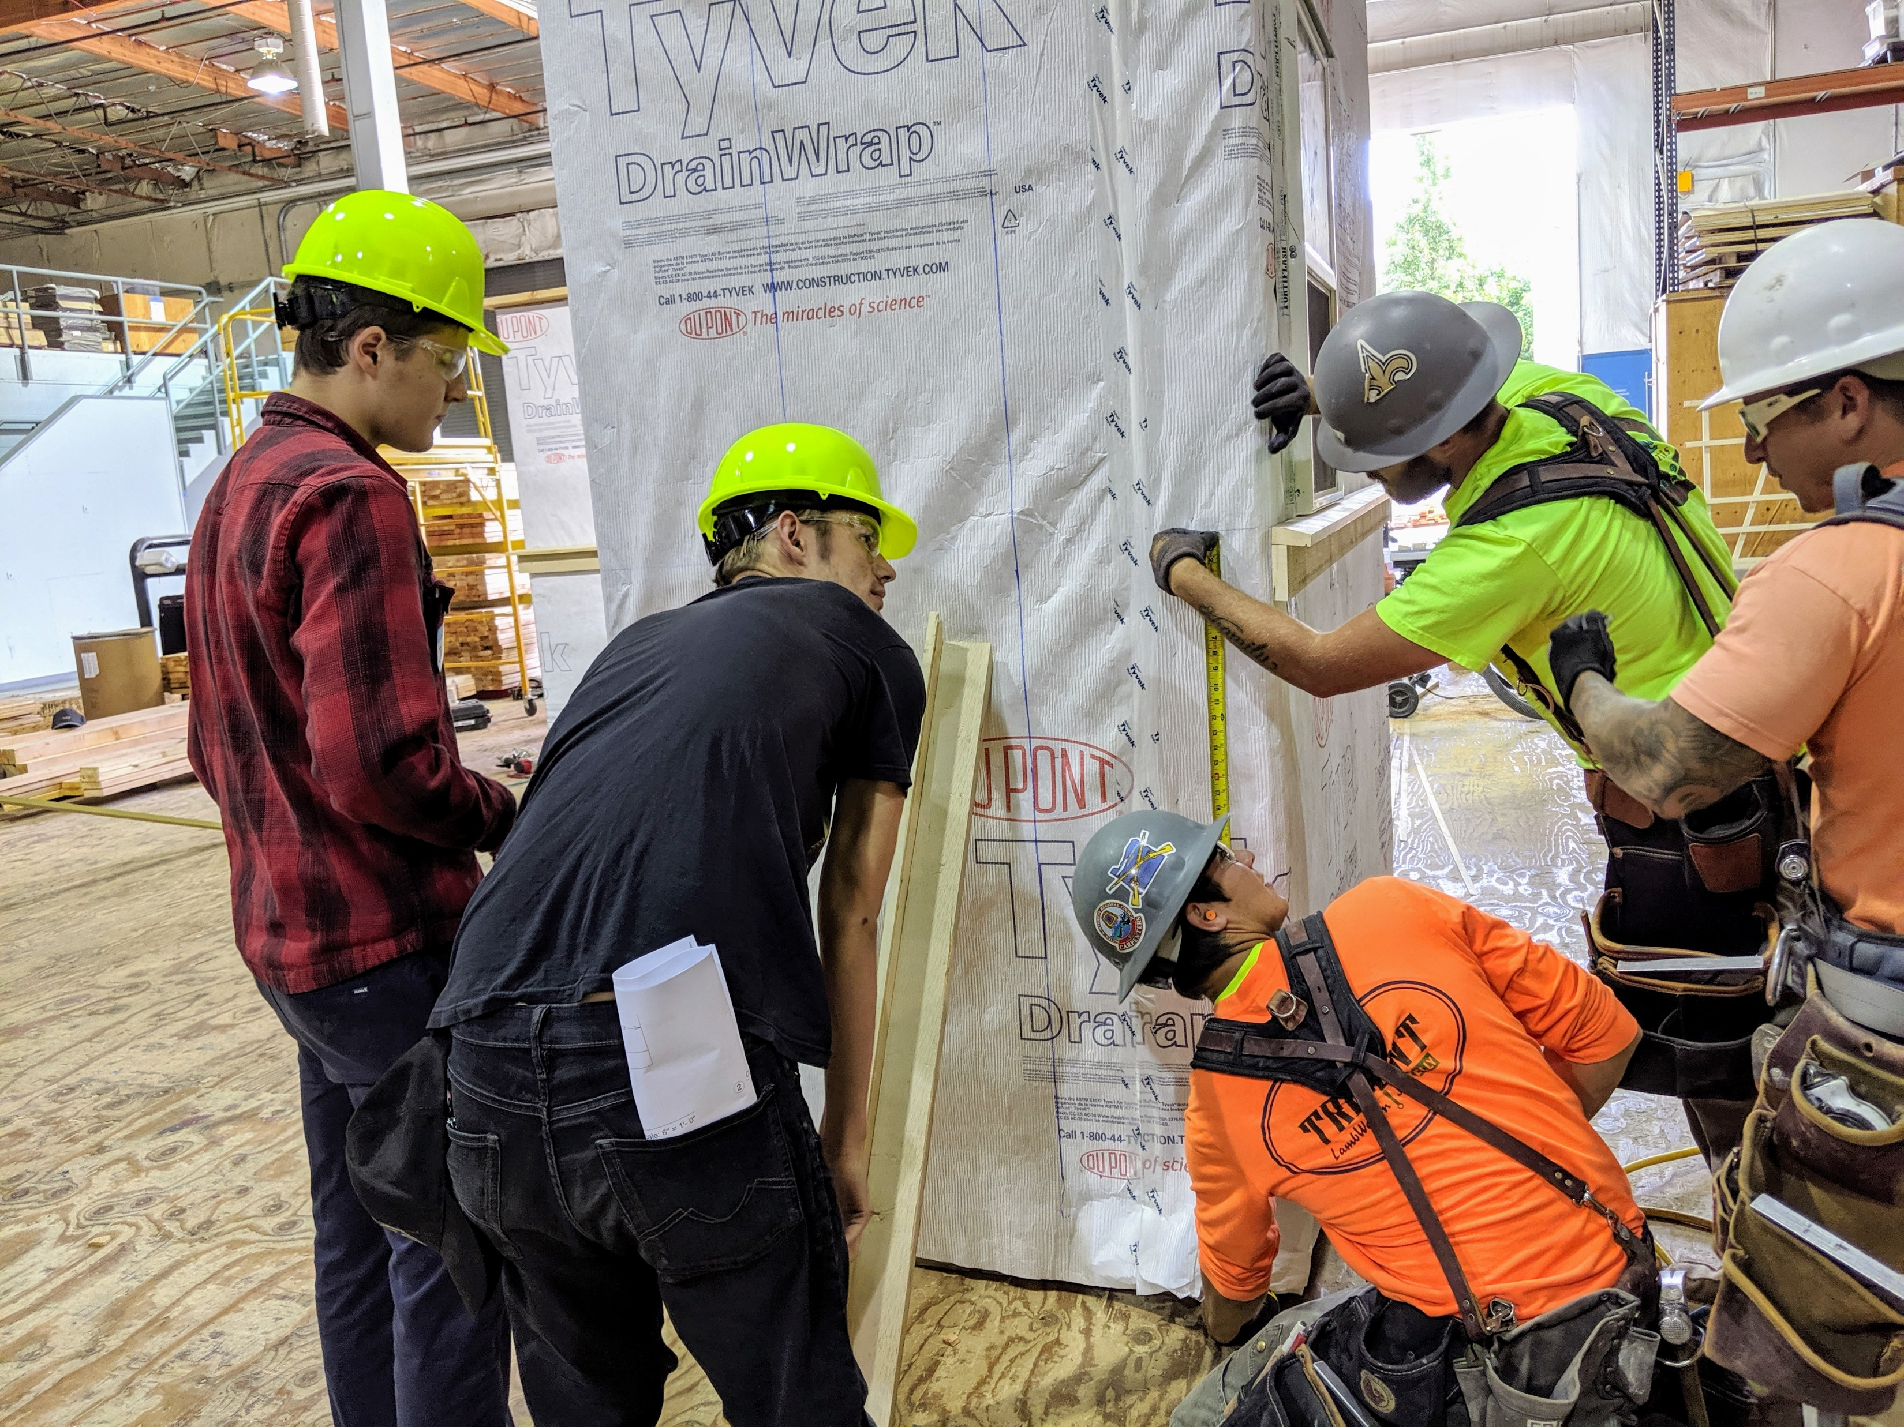
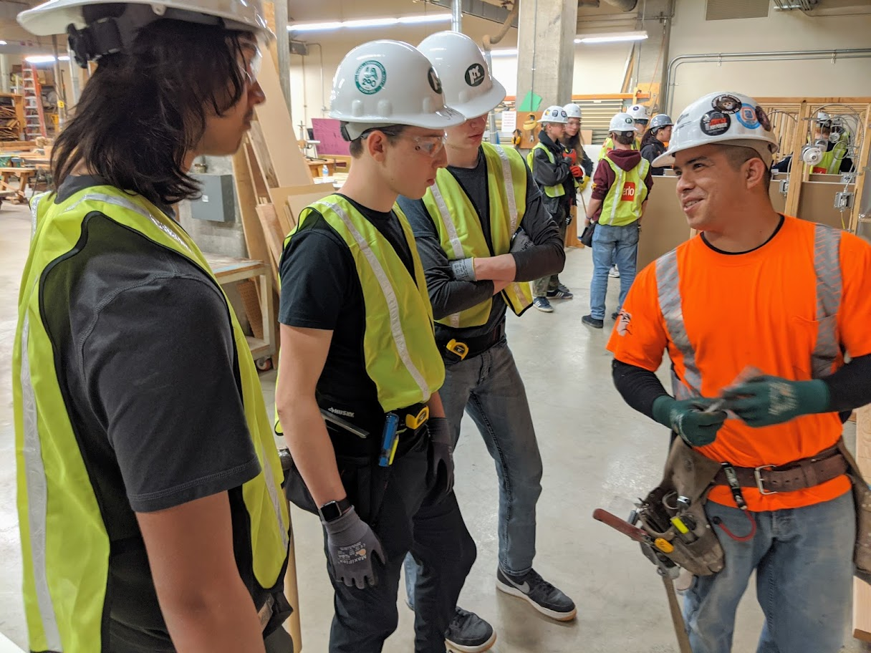
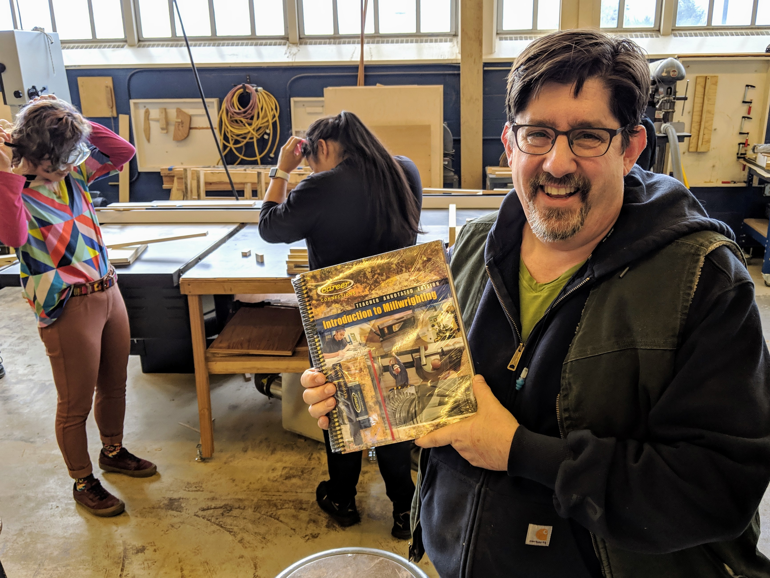

Career Connections Schools are PNCI’s Priority
Career Fairs
Classroom Visits
Job Shadows at PNCI
Teacher Workshops
HS Summer Internship
Notes:
PNCI gets a lot of requests for job fairs and job shadows. They can’t say yes to all of them, but Career Connection schools are welcome to ask for Career Related Learning Experiences.

Slide 15
Career Connections in OR/SW WA
Albany Options School
Battle Ground HS
Bend Senior HS
Bend Tech Academy at Marshall
Benson HS
Central HS
Cleveland HS
Crescent Valley HS
Creswell HS
David Douglas HS
Early College & Career Options (ECCO)
Elmira HS
Evergreen HS
Franklin HS
Gladstone HS
Grant HS
Harrisburg HS
Helensview HS
Hudson Bay HS
Jefferson HS La Grande HS
Lincoln County SD
Lowell Junior/Senior High
Madison HS
Mark Morris HS
Medford School District
Merlo Station
Mountain View HS
Obsidian MS
Redmond HS
Reynolds HS
Reynolds Learning Academy
Riverside Jr/Sr High
Roosevelt HS
Sabin Schellenberg Tech Ctr
Santiam HS
Silverton HS
St Helens HS
Stayton HS
Tigard HS
Toledo HS
Triangle Lake Charter School
Tualatin HS
Willamina HS
Wilson HS
Pre-Apprenticeship Programs
Oregon Job Corps Centers
Community Services Consortium Pre-Apprenticeship

Slide 16
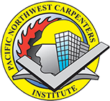
For More Information
Meg Kilmer
Career Connections Outreach Specialist
For Oregon, SW Washington and S. Idaho
Pacific NW Carpenters Institute
megkilmer@pnci.org
503 – 816 – 9047
community.pnci.org

