Slide 1
Better Documents with Microsoft Word
The basics of creating and formatting documents

Slide 2

Welcome and overview of class objectives
Introductions
Overview – what are we doing here?
Why do well formatted, professional documents matter?
We’ll cover licensing, basic formatting, including fonts, paragraphs, tabs, bullets and saving to different formats.

Slide 3
Licensing Microsoft Office
To license Microsoft Office, you can purchase a one-time license for Office 2024 or subscribe to Microsoft 365, which offers various plans based on your needs. For a one-time purchase, you pay upfront for the software, while a subscription provides ongoing access to updates and additional features.
Microsoft Office 365 costs range from $6/month to $22/month, depending on the plan chosen. Yearly options are available.
Microsoft Office 2024 is available for a one-time purchase price of $99.97. This license allows you to use the software on one PC or Mac without any recurring subscription fees.

Slide 4
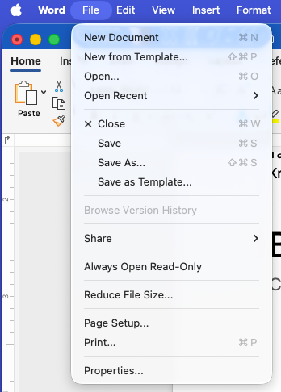
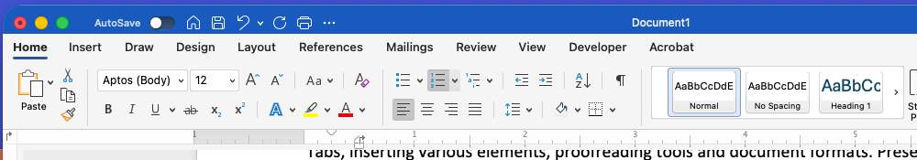
Getting Started with Word
Launching Word
Exploring the interface: Ribbon, menus, and toolbars

Slide 5
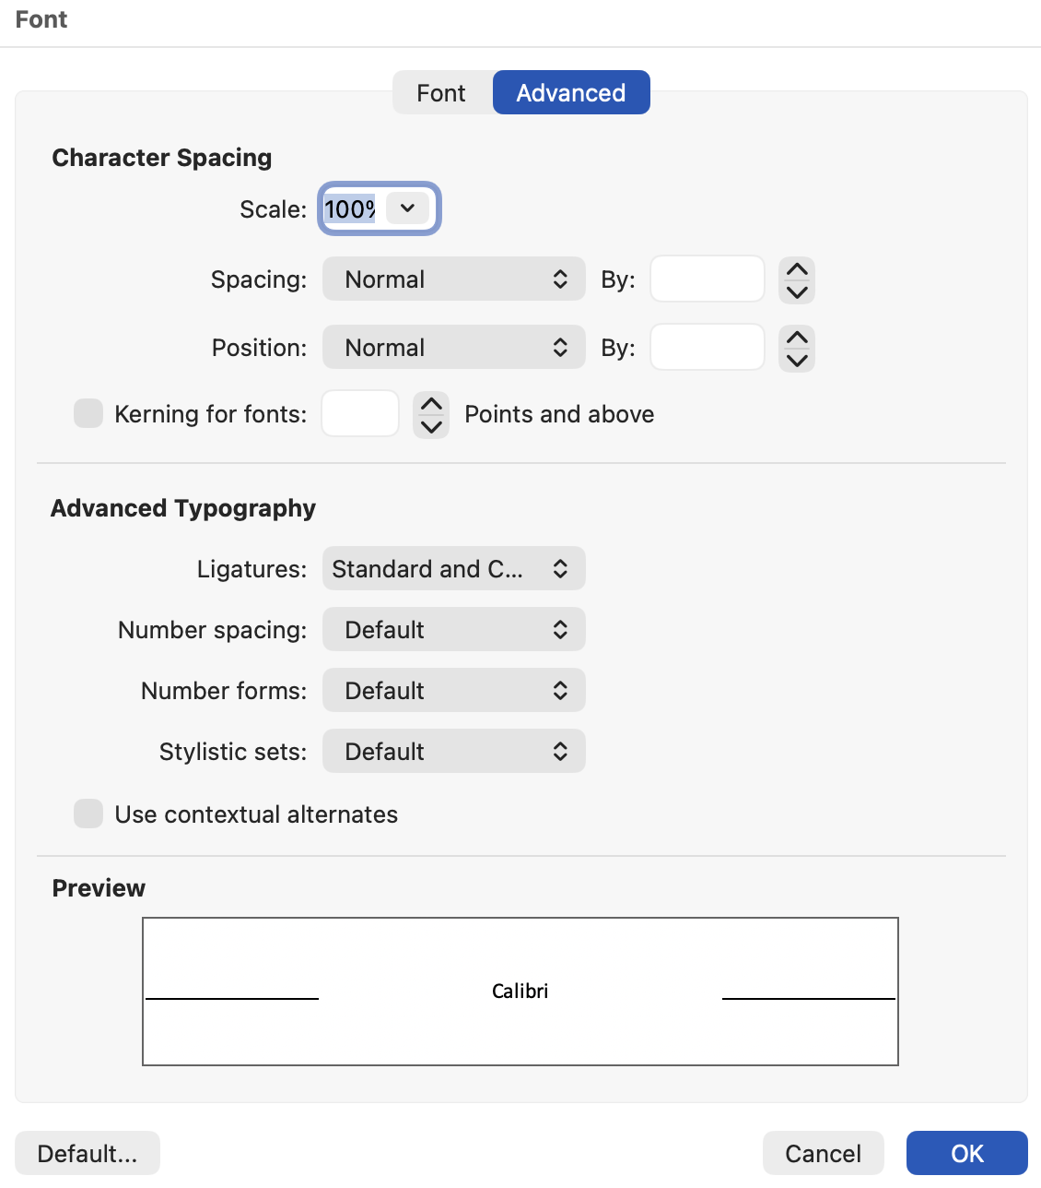
Basic document formatting - Fonts
Font styles, sizes, and colors
  Using the Ribbon vs Format/Font vs Keystroke commands
Selecting text – using the mouse or keyboard
Line Endings and Paragraph marks
Showing Non-Printing Characters (¶)
Advanced Font Formatting

Slide 6
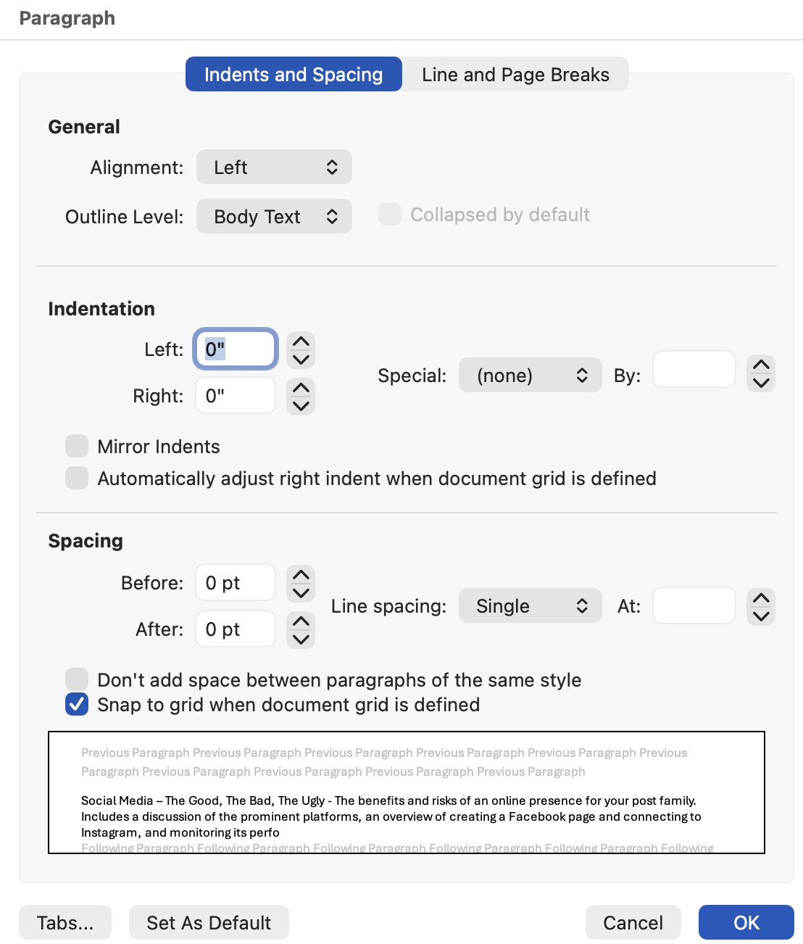
Basic document formatting - Paragraphs
Alignment
Indentation
Spacing
(Alignment and Indentation can also be changed using the Ribbon and ruler.)

Slide 7
Basic document formatting – Tabs
Using tabs in a document such as an agenda can help make the content easily readable.
To use tabs and leaders in Word, open the Tabs dialog from the Format menu or in the Paragraph settings dialog, set a tab stop position, and choose a leader character like dots or dashes. When you press the Tab key, the leader will appear between the text on the left and the tab stop on the right.
Remember, each paragraph has its own tab stops.

Slide 8
Basic document formatting – Tabs (cont.)
Understanding Tabs and Leaders in Word
What are Tabs and Leaders?
  Tabs: These are preset stops in a document where the cursor jumps when you press the Tab key. They help align text in a structured way. There are left, right, center and decimal tab types.
  Leaders: These are visual guides, often represented as dots, dashes, or other characters, that connect text on the left to text on the right. They are commonly used in tables of contents and indexes.

Slide 9
Basic document formatting – Tabs (cont.)
How to Add Leaders Using Tabs
Select the Text: Highlight the text where you want to add leaders.
Open the Tabs Dialog from the Format menu:
Set Tab Stops:
Enter a Tab Stop Position (e.g., 6 inches).
Choose an Alignment option (default is left).
Select a Leader character (e.g., dots, dashes).
Apply the Tab: After setting up, press the Tab key in your document. The leader will appear between the text on the left and the tab stop.

Slide 10
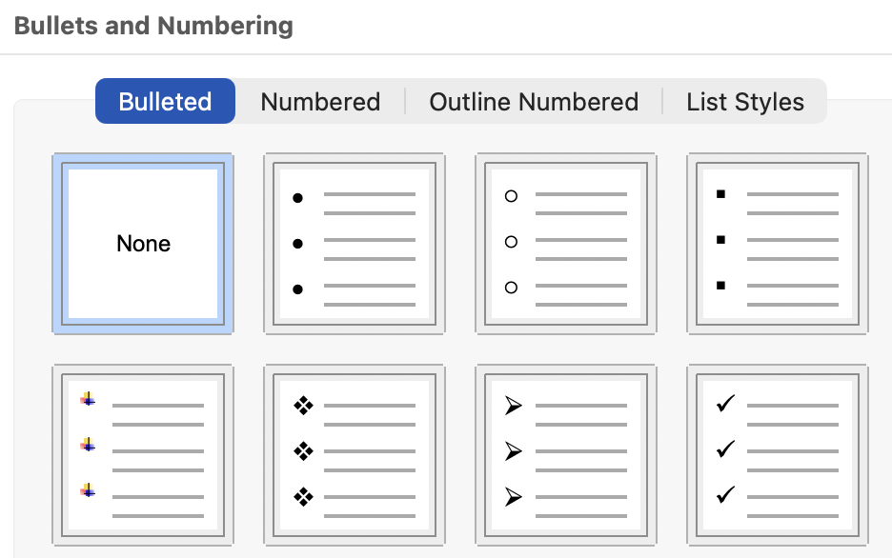
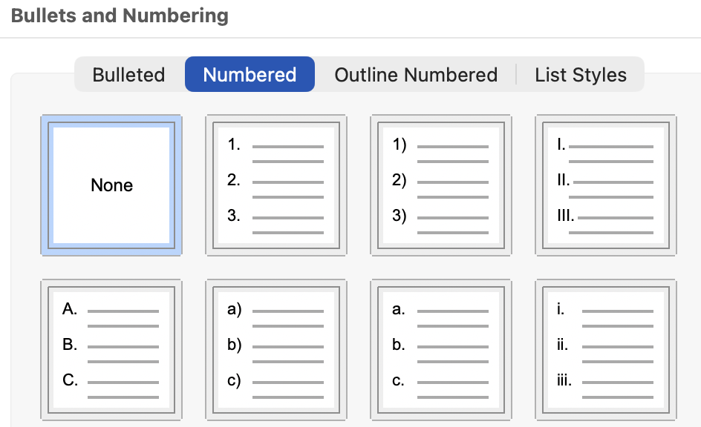
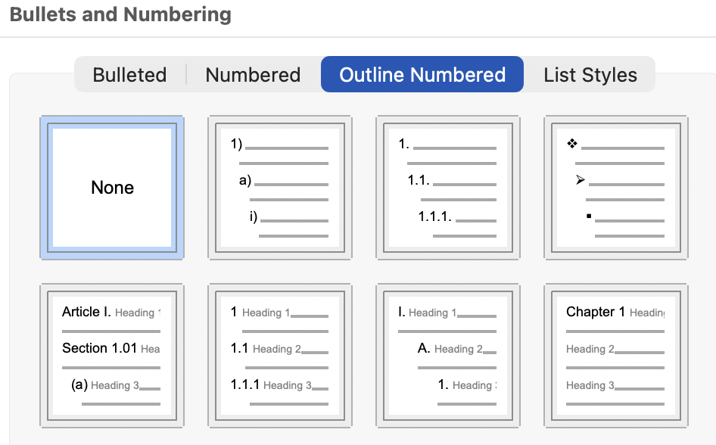
Basic document formatting – Bullets and numbering
Bullets
Numbering
Outline numbering
(Bullets and numbering can be inserted using the Ribbon.)

Slide 11
Saving to different formats
To save a document in different formats in Word, go to the "File" menu, select "Save As," and then choose the desired file type from the dropdown menu. You can save in formats like .docx, .pdf, or older Word formats for compatibility.
Common File Formats:
.docx | Default Word format for documents created in Word 2007 and later.
.doc | Older Word format for documents created in Word 97-2003.
.rtf | Rich Text Format, compatible with many word processors, like Open Office.
.pdf | Portable Document Format, ideal for sharing documents without editing.
.txt | Plain text format, removes all formatting.

Slide 12
Questions?

Slide 13
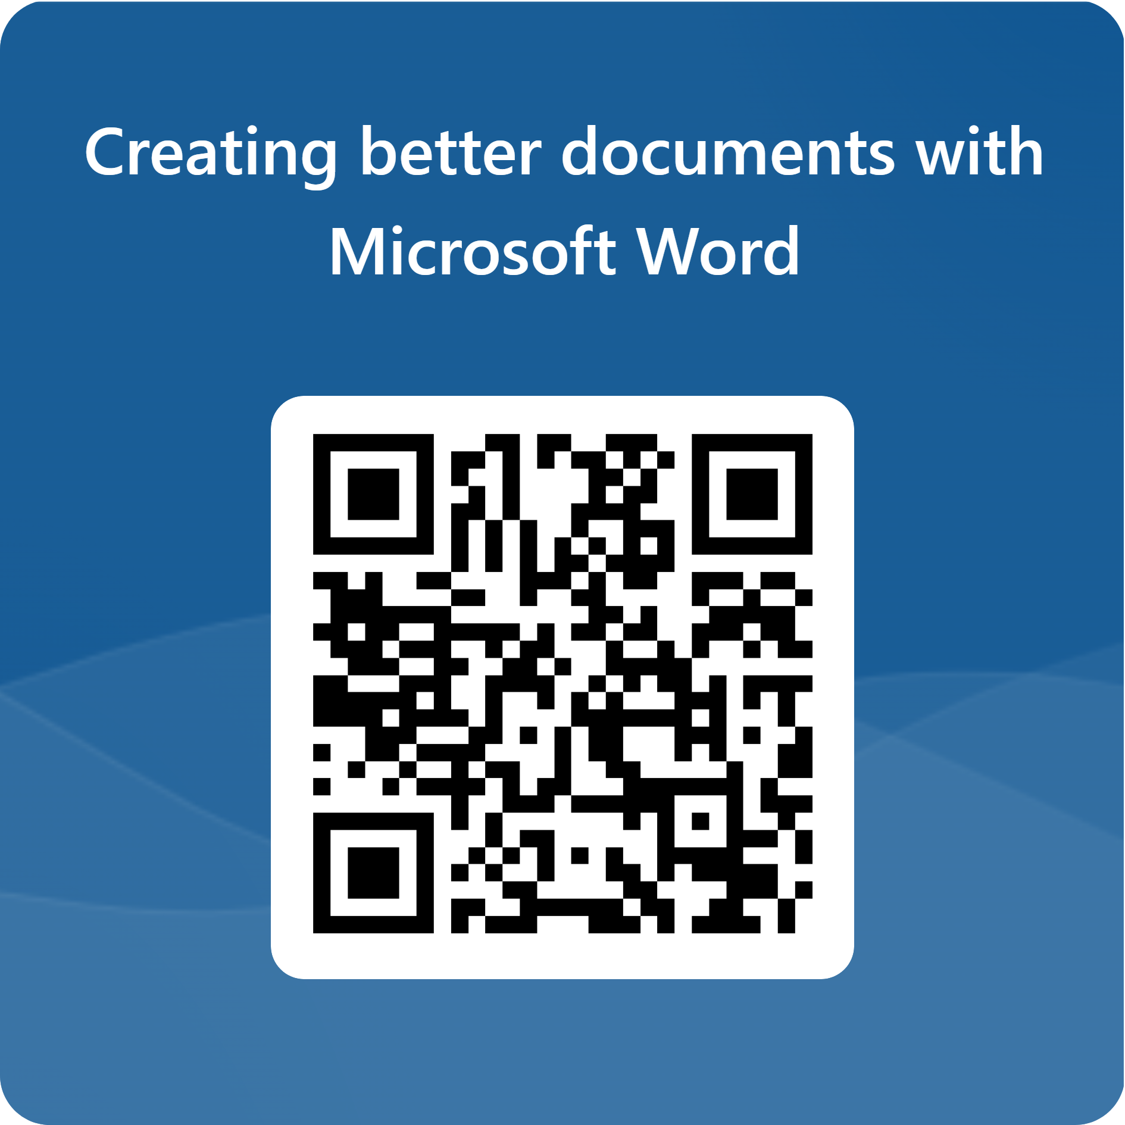
KALLC Class Survey

