Slide 1
Social Media – The good, the bad, the ugly
Guidelines for Social Media usage by American Legion Posts

Slide 2

Social Media and Engagement
Social media dominance is fleeting—MySpace was once on top before Facebook took over by prioritizing user engagement.
The main takeaway: communication should be user-friendly and open to interaction.
Since social media accounts are inexpensive, most businesses and American Legion posts have them. However, as misinformation and harsh feedback grow, organizations are rethinking their social media policies. Despite varying platform rules, control over messaging remains unclear. To ensure your American Legion post's voice is heard, establish a presence on one or two major social media sites.

Slide 3
Top Social Media Sites
There are too many social media sites for your American Legion post to be present on all of them.
As you build a following on the bigger sites, your message is likely to be seen by the audience that you are targeting. It’s not unusual for social media messages to be picked up by traditional media. Hopefully when this occurs it is for the right reason and not because of an inappropriate posting that contains political or controversial subjects.

Slide 4
Facebook
Owned by its parent company Meta, is the largest worldwide social media platform with 242 million North American users in 2025, is user-friendly and effective for brand promotion.
It helps American Legion posts inform the public, reach new audiences, and gain support.

Slide 5
Instagram
Also owned by Meta, it’s perfect for sharing photos and brief videos about what is happening at your American Legion post. As of January 2025, Instagram has over 172 million users in the US.
Also encourages hashtags, #RallyAroundtheFlag for example.
Facebook posts can be automatically posted to Instagram using Meta Business Suite, maximizing your social media reach. More on this later…

Slide 6
X (formerly known as Twitter)
A great site for brief messages, with over 600 million active users. X posts, or “Tweets,” are limited to 280 characters.
Through the use of hashtags, you can ensure your Tweets are categorized and targeted to specific Twitter users. For instance #LegacyRun2026.

Slide 7
YouTube
Owned by Alphabet/Google, this network allows users to upload, view, rate and share videos. Basic accounts allow for the posting of videos up to 15 minutes in length.
In 2019, approximately 1 billion hours of YouTube videos were watched every day.

Slide 8
#Hashtag Campaigns
Hashtag campaigns bring together posts on platforms like Facebook, X/Twitter, and Instagram.
The American Legion used #RallyAroundtheFlag to collect images and messages nationally, while hashtags like #ALBoysNation, and #LegacyRun2026 highlight specific events.
Broad hashtags such as #BeTheOne, #Veterans and #PoppyDay reach wider audiences.

Slide 9
Social media graphics can deliver, extend reach
Social media graphics are a powerful tool to educate, inform, and inspire audiences. They highlight military history dates, explain Memorial Day, encourage action, and honor the flag. When designing graphics, keep these rules in mind:
Plan ahead and keep a schedule of graphic treatments, such as Suicide Prevention Month, Veterans Day, American Legion Birthday or Flag Day.
Keep language brief and to the point.
Consider linking the graphic to a web page that offers further information.
If using The American Legion emblem or other trademarked logos of the organization, be sure to follow rules of use.
Encourage sharing of graphics among your followers.

Slide 10
Measuring social media performance
Social media traction is easily and publicly measured. The number of followers is reported prominently. Facebook also measures and reports trends, such as percentage increase in reach, engagements and page follower numbers. Some measurable terms to understand include:
Reach: Number of people who saw any of your posts at least once.
Reactions: Number of people who commented, liked, disliked, shared or reacted in some other way to a post.
Followers: Number of people who committed to follow your page.
These metrics can help you learn what interests your audience.

Slide 11
Tips on managing social media accounts
For social media accounts like Facebook, Twitter, or Instagram, have at least two administrators to ensure coverage and oversight.
Posts can use Facebook's access levels so multiple members can contribute.
• Allow comments on Instagram and Facebook to boost engagement, but monitor them. Scammers like to target these types of posts.
• Post new content often to retain followers.
• Share relevant National Headquarters posts with your own commentary.
• Only support official positions backed by resolutions; discuss issues, not politicians.
• Acknowledge important dates with posts, images, or videos—especially holidays and commemorative days like Veterans Day, Memorial Day, etc.

Slide 12
Getting started on Facebook
Go to facebook.com/pages/create. (I recommend using a computer vs a mobile device to get started. Once the page is up, you can use either to update and add content.
Enter a Page name, Page bio and category (Nonprofit Organization).
Click Create Page.
Customize your Page. You can add your bio, a profile picture and cover photo.

Slide 13
Set up Page Permissions
You can give trusted people partial access or full control of your Page to help manage it.
You can create multiple admin roles or assign task-based permissions individually for specific items such as advertising, content creation or insights.
Note that Meta’s Community Standards require that only authentic Facebook accounts have admin access for Pages.

Slide 14
Give, edit or remove Facebook Page access
You can give someone Facebook access with full control or partial control. People with Facebook access with full control or partial control can switch into the Page and manage it on Facebook. If you give someone Facebook access with full control, this means that person can give access to other people, remove anyone from the Page (including you) or delete the Page.
Log into Facebook, then click your profile photo in the top right.
Click See all profiles, then select the Page you want to switch into.
Click your Page's profile picture in the top right to go to your Page.
Click Settings & privacy.
Click Page setup, then click Page access.

Slide 15
Give, edit or remove Facebook Page access (Cont.)
Next to People with Facebook access, click Add New.
Click Next, type the name or email address of the person you want to give Facebook access, then click their name.
From here, you can choose to give the person Facebook access with full control or partial control:
To give Facebook access with partial control: Scroll down, then click Give Access.
To give Facebook access with full control: Scroll down, select the person to allow them to have full control, then click Give Access.
Type your Facebook password, then click Confirm.
The person will receive an email to accept your invitation to access your Page.

Slide 16
Creating an Instagram Account
Download the App: Install the Instagram app from the Apple App Store or Google Play.
Sign Up: Open the app and tap "Sign Up." You can register using an email address or a phone number.
Set Up Your Profile: Enter your name, create a username, and set a password. You can also add a profile picture.
Switch to Professional Account: After creating your account, go to your profile, tap the three lines in the top right, select "Settings," then "Account," and choose "Switch to Professional Account." Follow the prompts to select a business or creator account.

Slide 17
Connecting an Instagram Account to Facebook
From the Instagram App:
Go to your profile and tap "Edit Profile."
Under "Public Business Information," tap "Page."
Choose to connect to an existing Facebook Page or create a new one.
Log in to Facebook when prompted and confirm the connection.
From Facebook:
Log into Facebook and navigate to your Page.
Click on "Settings" and then "Instagram."
Click "Connect Account" and log into your Instagram account to complete the linking.

Slide 18
Connecting an Instagram Account to Facebook (cont)
Using Meta Business Suite:
Log into Meta Business Suite and select your Business Portfolio.
Click on "Accounts" and then "Instagram Account."
Follow the prompts to add your Instagram account.
Connecting an Instagram account to Facebook allows for seamless cross-posting of content, which can increase visibility and engagement across both platforms. It also simplifies account management and can enhance marketing efforts by reaching a larger audience and improving ad targeting.

Slide 19
Connecting an Instagram Account to Facebook (cont)
Important Notes
Ensure your Instagram account is set to professional (business or creator).
You must have admin access to the Facebook Page you want to connect.
Only one Instagram account can be linked to one Facebook Page and vice versa.

Slide 20
Using Meta Business Suite
Meta Business Suite is an all-in-one platform that helps you manage your Facebook and Instagram accounts from a single dashboard, allowing you to create, schedule, and analyze posts easily.
It streamlines social media management by integrating messaging and performance tracking, making it ideal for businesses looking to enhance their online presence.
It’s available via a mobile app on both Apple and Android, and on web browsers.

Slide 21
Social Media – Content to avoid
Avoid posting pictures showing alcohol – this casts a negative light on the American Legion and contributes to an unwanted stereotype.
Avoid posting political content of any kind. Remember that the American Legion is a non-partisan organization. Of course, advocating for legislation that The American Legion supports is encouraged.
If an individual is desiring to move up in the American Legion, Auxiliary, SAL, Riders, or Cruisers, it would be wise to avoid posting political content to social media personally.

Slide 22
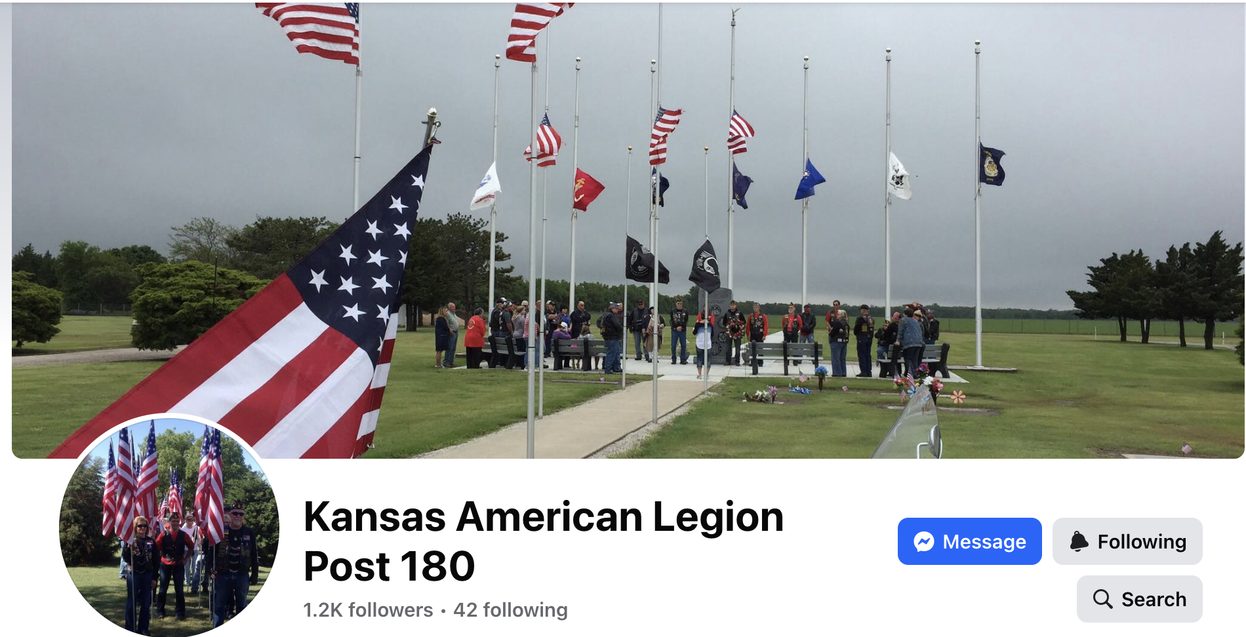
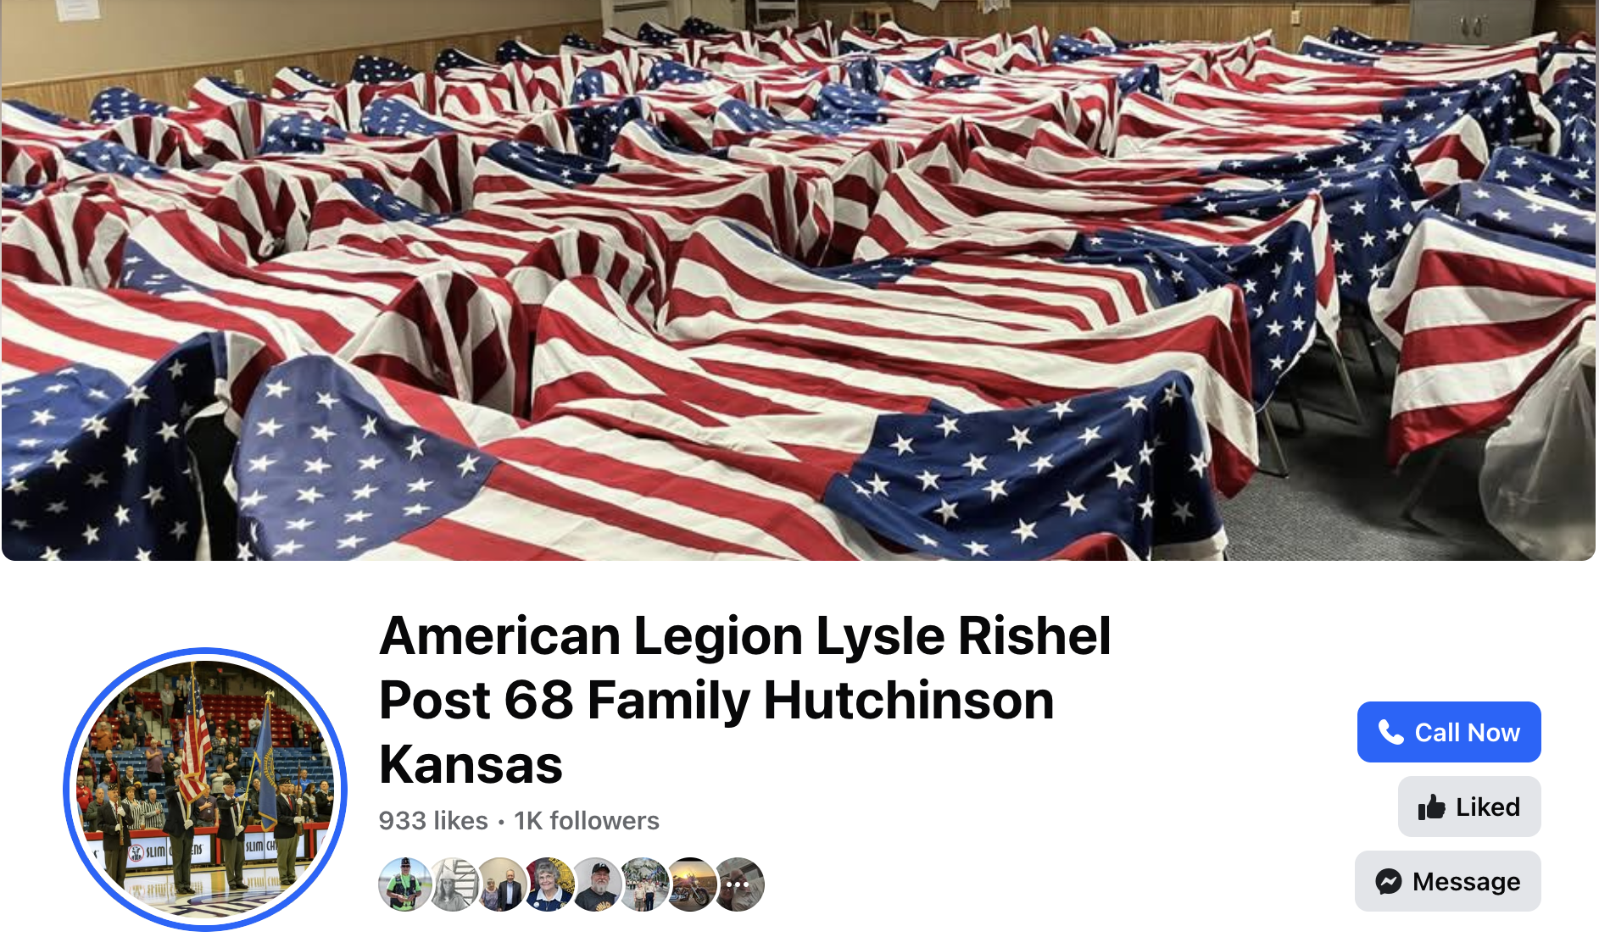
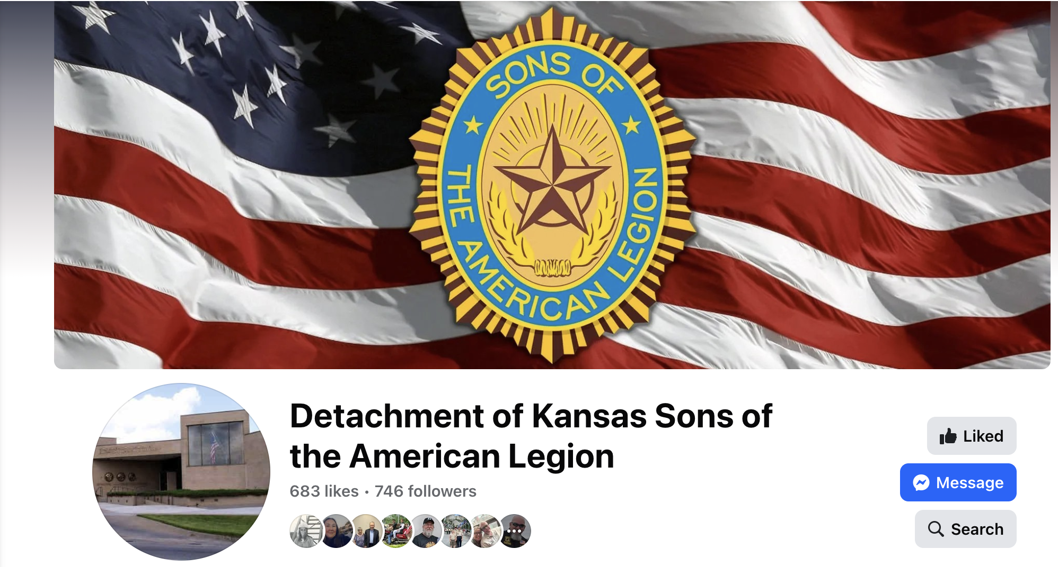
Examples of Facebook pages

Slide 23
Using American Legion emblems, brandmarks or wordmarks
All emblems, brandmarks and wordmarks of the American Legion are copyrighted.
The brandmark and emblem are legally protected property of The American Legion. Any use outside of the organization – such as merchandising, marketing by groups unaffiliated with The American Legion or at political events – is legally restricted and requires authorization.
Search legion.org for “Branding Guidelines” or go to https://issuu.com/theath1296/docs/american_legion_emblem_branding_guidelines

Slide 24
Getting permission to reproduce American Legion emblems, brandmarks or wordmarks
If you would like to request to use the American Legion name or emblem on merchandise, (such as challenge coins, clothing, other other manufactured items) please complete an Emblem Use Request Form, found at https://www.legion.org/about/organization/the-emblem/emblem-and-brand-mark-download.
This form should be sent to the Department Adjutant, at the Topeka Headquarters. If approved the Adjutant will forward the request to the National Adjutant for approval. The process usually takes a few days.
Approval will be sent by mail to the requester.

Slide 25
Questions?

Slide 26
KALLC Class Survey

