Slide 1
Leveraging Online Presence & Emblem/Brandmark Usage
Guidelines for Social Media, Websites, and proper usage of American Legion Emblems and Brandmarks

Slide 2

Resources for creating Post websites:
Legionsites.com – a comprehensive service for creating websites. Easy to use and create, but constrained to a common design.
Website creation sites like GoDaddy, Wix, Squarespace, Canva – these allow more freedom while not having to learn web site coding.

Slide 3
Domain names and hosting
Domain name – your site’s “name” on the internet, ie legion.org, hutchpost68.org, salkansas.org, etc.
Hosting service – this is the entity that stores, or “hosts” your website.
Whois information – part of creating your website, this is publicly available information about the site and hosting. Hosting providers will have an extra cost option to hide your private details, which is highly encouraged.

Slide 4
Websites – points to consider
Consider the content you want to show.
Keep maintenance in mind.
Think about succession planning – making sure more than one person knows how to update the site, passwords, etc.

Slide 5
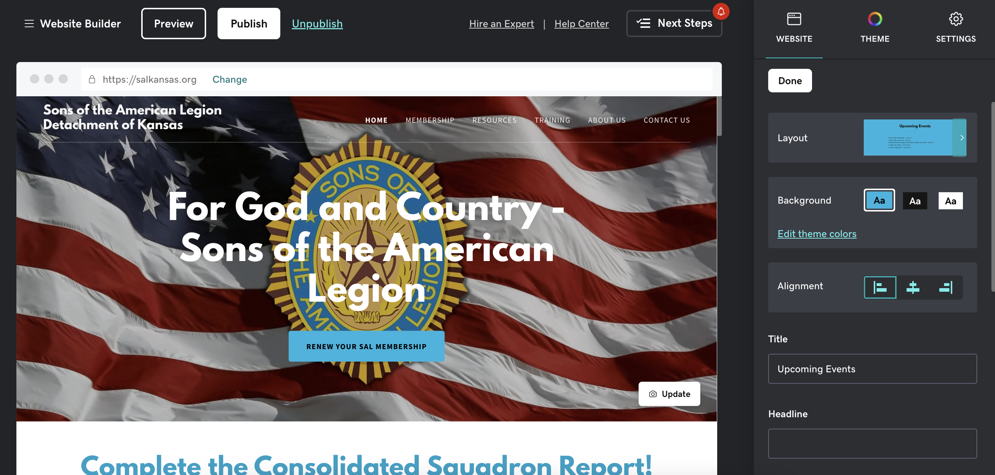
SAL Detachment website

Slide 6
Social Media
Facebook
  Meta Business Suite (makes administrating pages easier. Can schedule posts up to 30 days in advance
Instagram
  Can be connected to Facebook so posts appear in both places
X (formerly Twitter)

Slide 7
Facebook – points to consider
Who can post content?
  Several levels of rights are available:
    Admin – full access
    Editor – high level access
    Moderator
Types of content:
  Posts – Drive traffic
  Events – Publicize and boost visability
  Reels – Reach new users
  Stories - Engage current followers
Groups

Slide 8
Social Media – What to post?
Show what’s happening at your post:
  Post events
    Flag etiquette presentations
    Honoring Veterans
    Veterans Day, Memorial Day, etc
  Community Service
  Legislative issues
    Encourage use of VoterVoice

Slide 9
Social Media – Content to avoid
Avoid posting pictures showing alcohol – this casts a negative light on the American Legion and contributes to an unwanted stereotype.
Avoid posting political content of any kind. Remember that the American Legion is a non-partisan organization.
If an individual is desiring to move up in the American Legion, Auxiliary, SAL, Riders, or Cruisers, it would be wise to avoid posting political content to social media personally.

Slide 10
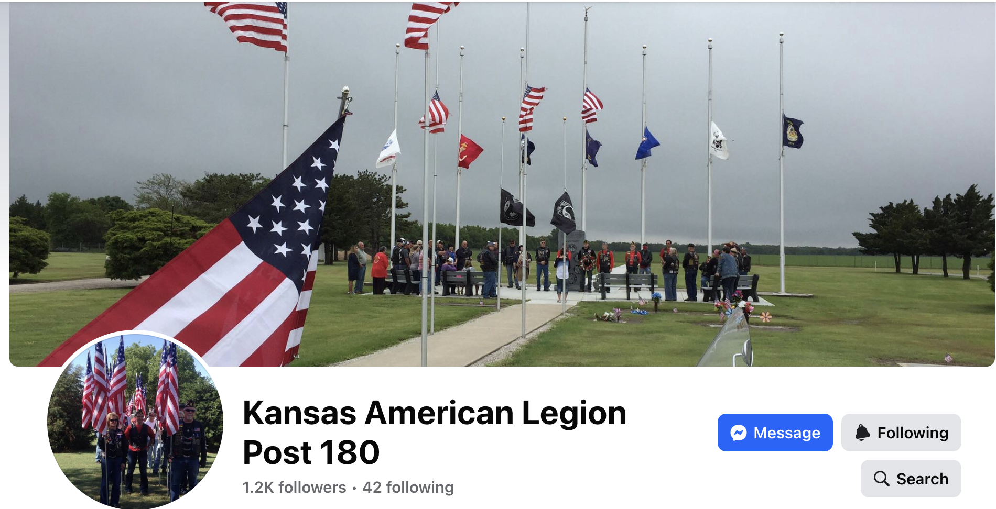
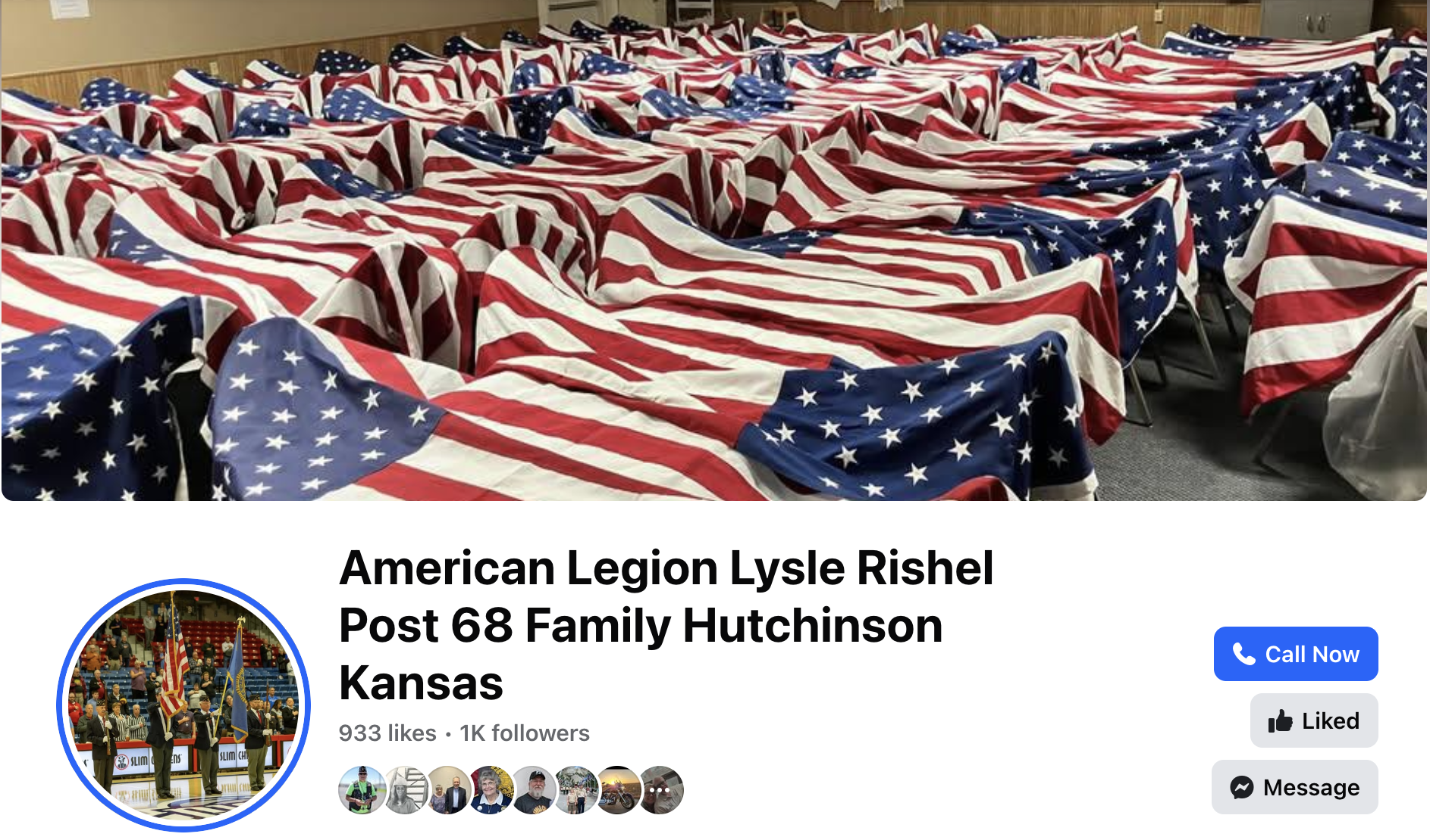
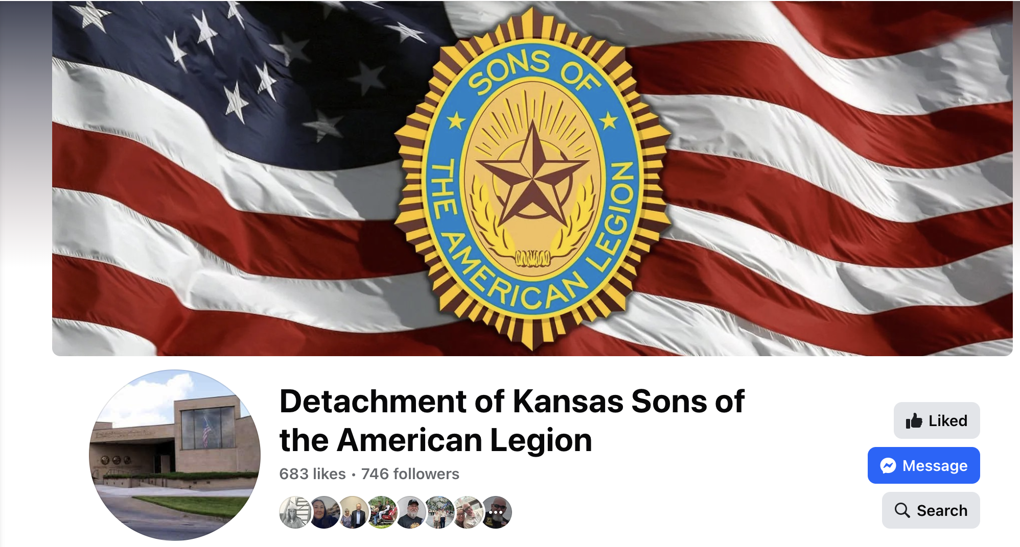
Examples of Facebook pages

Slide 11
Using American Legion emblems, brandmarks or wordmarks
All emblems, brandmarks and wordmarks of the American Legion are copyrighted.
The brandmark and emblem are legally protected property of The American Legion. Any use outside of the organization – such as merchandising, marketing by groups unaffiliated with The American Legion or at political events – is legally restricted and requires authorization.

Slide 12
Getting permission to reproduce American Legion emblems, brandmarks or wordmarks
If you would like to request to use the American Legion name or emblem on merchandise, (such as challenge coins, clothing, other other manufactured items) please complete an Emblem Use Request Form, found at https://www.legion.org/about/organization/the-emblem/emblem-and-brand-mark-download.
This form should be sent to the Department Adjutant, at the Topeka Headquarters. If approved the Adjutant will forward the request to the National Adjutant for approval. The process usually takes a few days.
Approval will be sent by mail to the requester.

Slide 13
Questions?

Slide 14
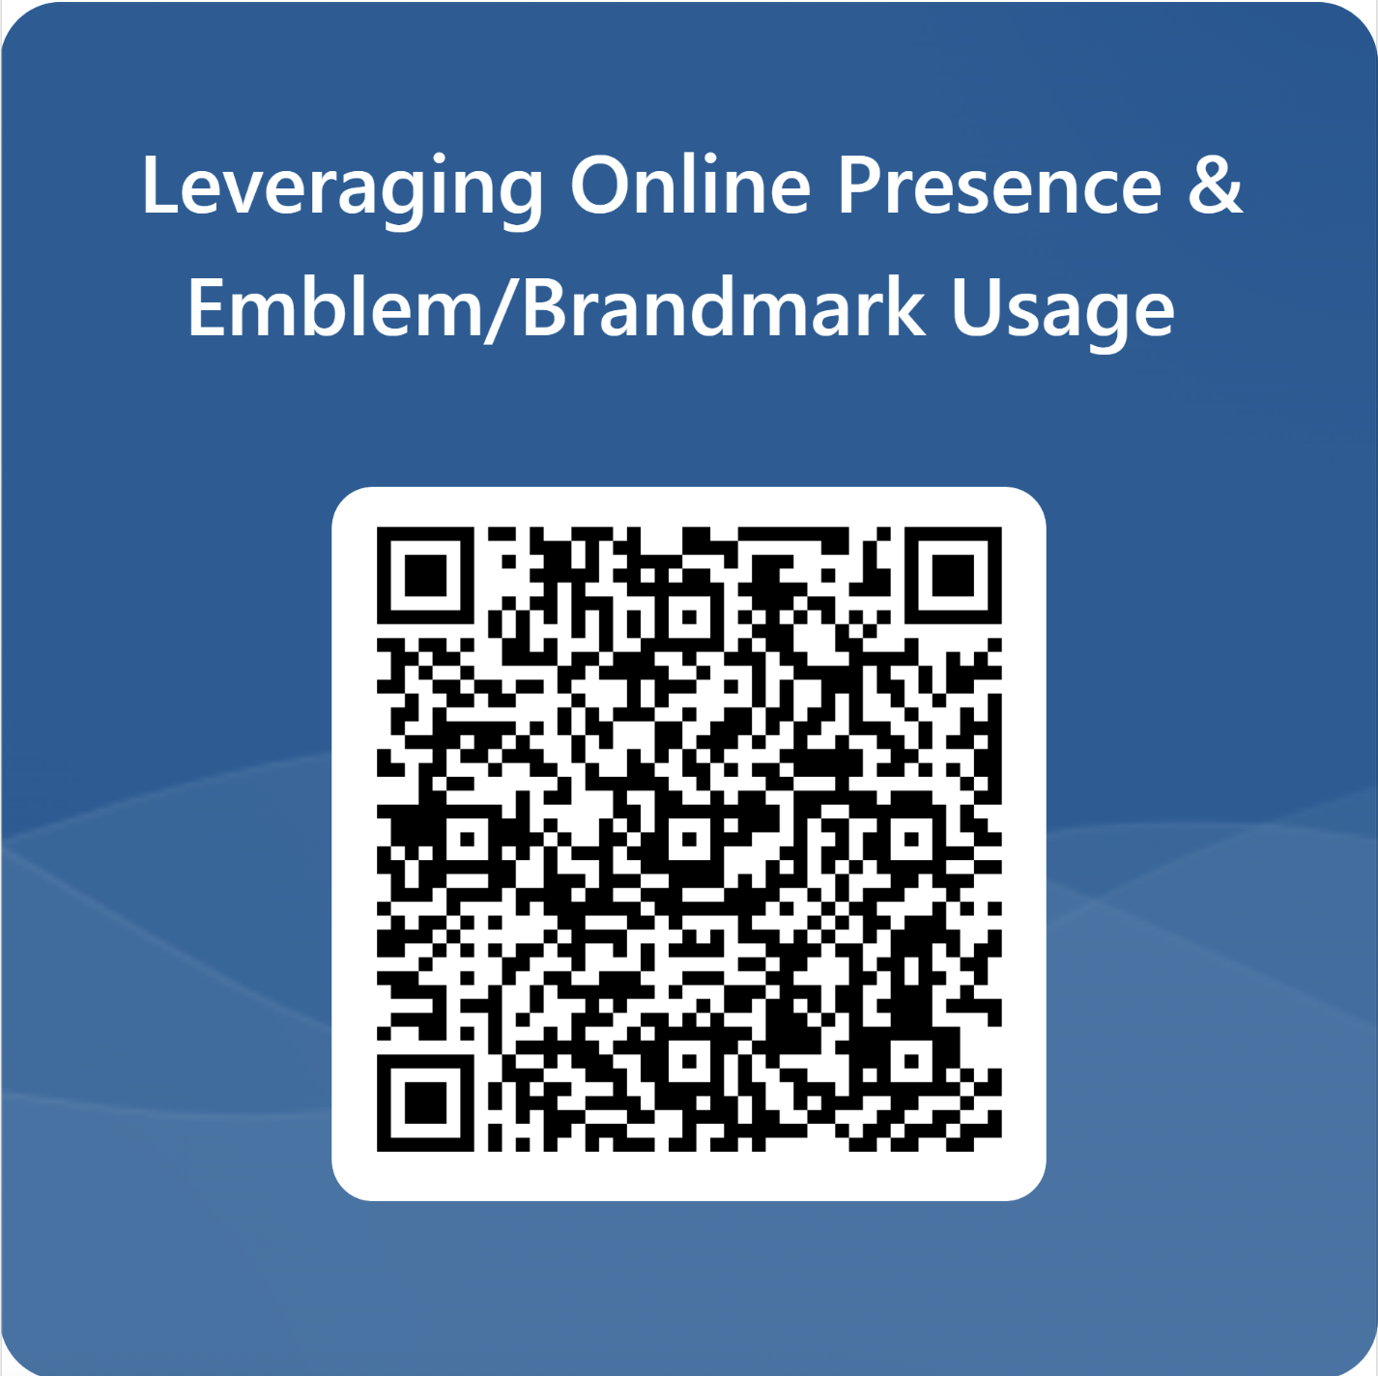
KALLC Class Survey

