Slide 1
MyLegion.org
Registration
Training Guide
Released April 1, 2021

Slide 2
MyLegion.org Registration
Go to MyLegion.org and select “register”
Enter email in the register window. Click “next”
Enter your name, check required consents and click “next” A one-time password (OTP) will be sent to your email address
Welcome window, enter password and OTP, click “finish registration”
Click “MY ACCOUNT” to view account information

Slide 3
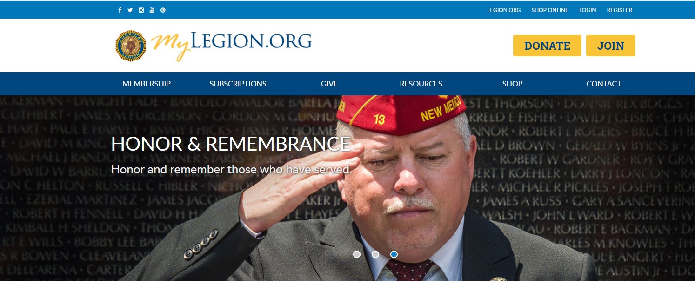
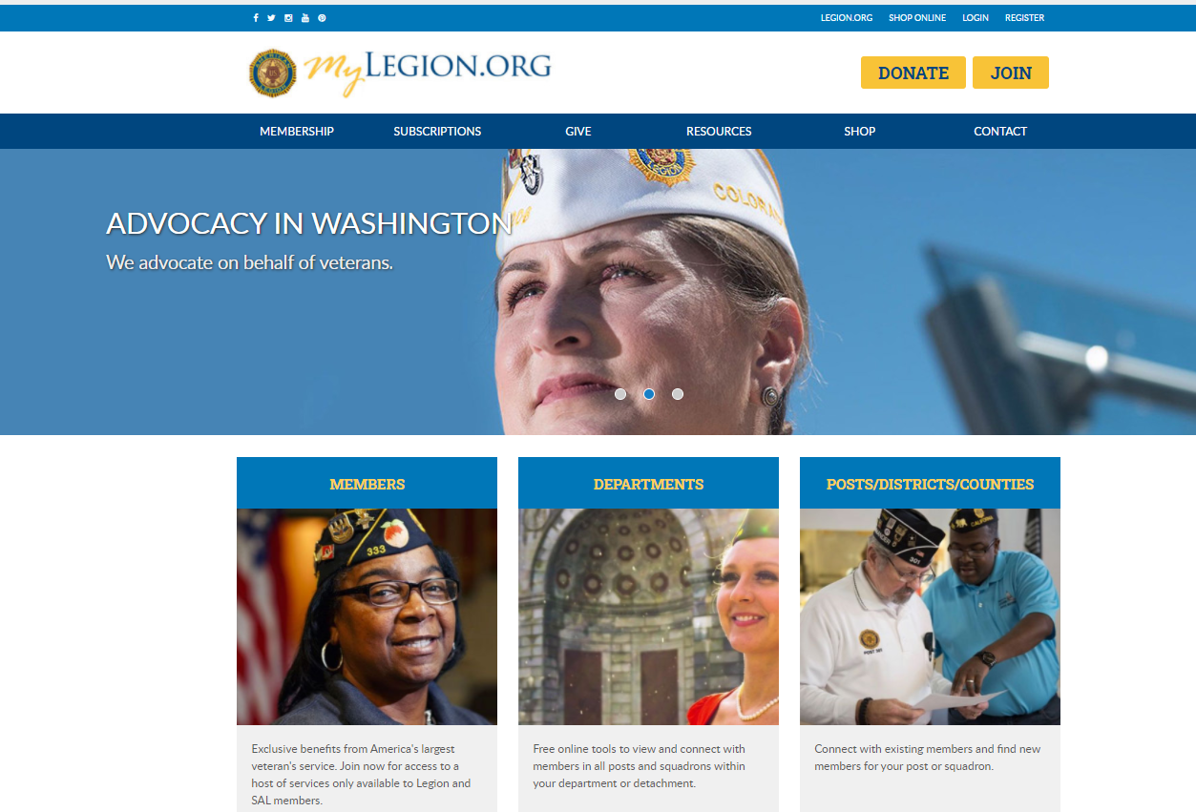
Register a MyLegion Account

Slide 4
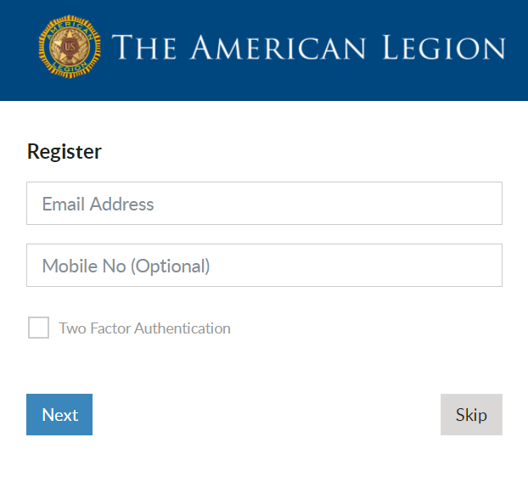
Register a MyLegion Account

Slide 5
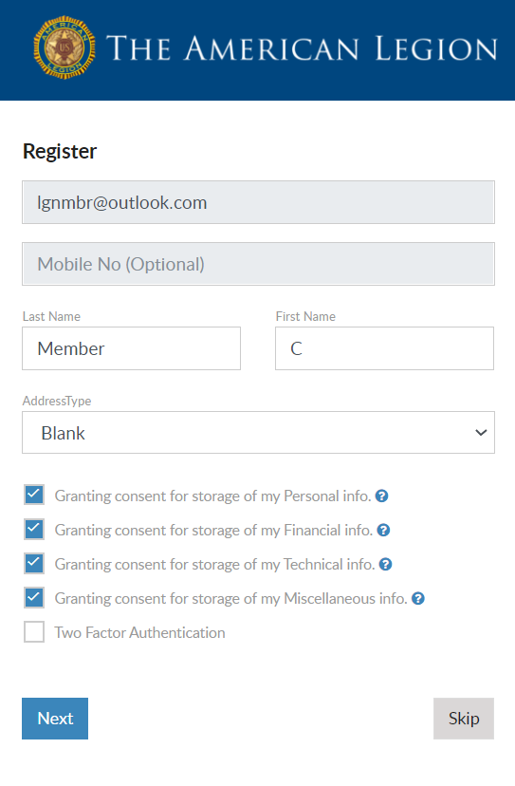
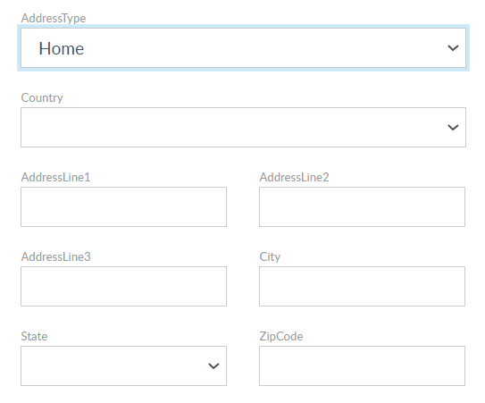

Slide 6
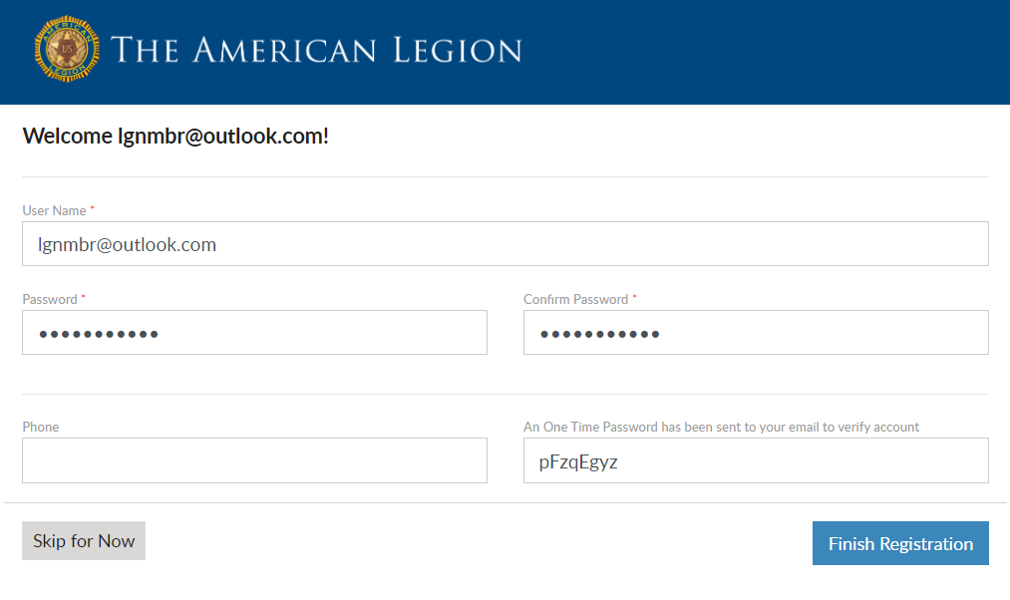

Slide 7
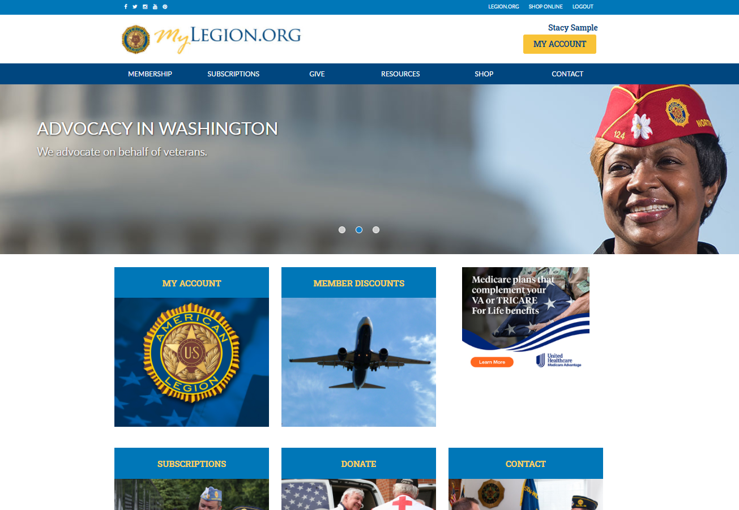

Slide 8
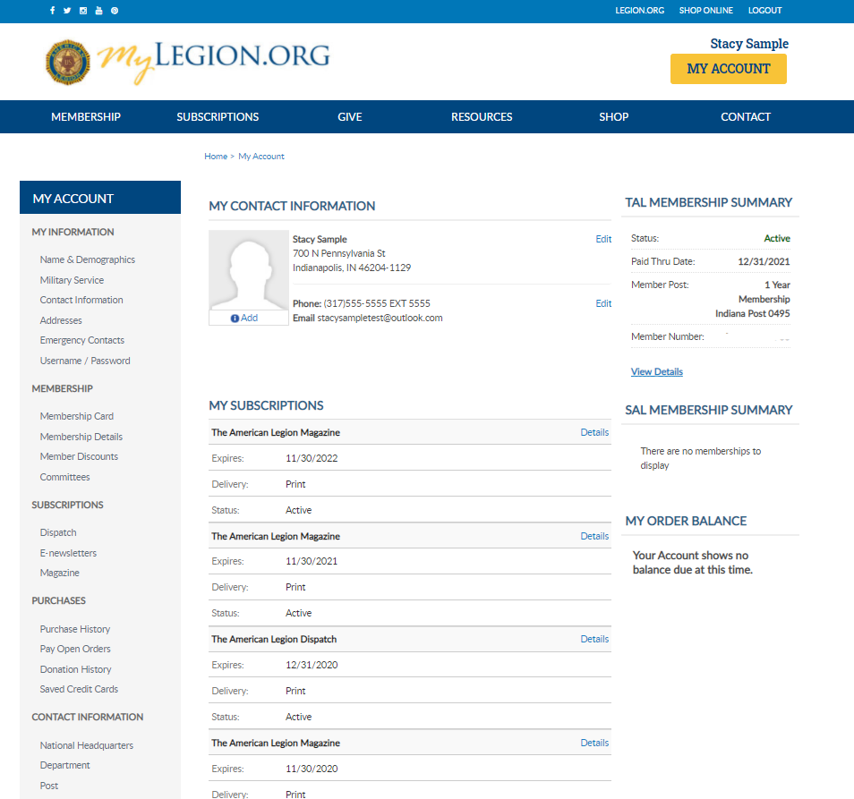
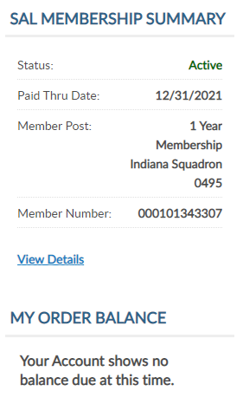
My Account

